Slide 1
Model-driven Test Generation
Oleg Sokolsky
September 22, 2004

Slide 2
Outline and scope
Classification of model-driven testing
Conformance testing for communication protocols
Coverage-based testing
  Coverage criteria
  Coverage-based test generation
Can we do more? (open questions)

Slide 3
Testing classification
By component level
  Unit testing
  Integration testing
  System testing
By abstraction level
  Black box
  White box
  Grey box ???

Slide 4
Testing classification
By purpose
  Functional testing
  Performance testing
  Robustness testing
  Stress testing
Who performs testing?
  Developers
  In-house QA
  Third-party

Slide 5
Functional testing
An implementation can exhibit a variety of behaviors
For each behavior, we can tell whether it is correct or not
A test can be applied to the implementation and accept or reject one or more behaviors
  The test fails if a behavior is rejected
A test suite is a finite collection of tests
  Testing fails if any test in the suite fails

Slide 6
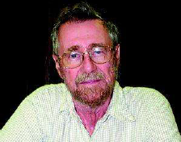
Formal methods in testing
“Testing can never demonstrate the absence of errors, only their presence.”
Edsger W. Dijkstra
How can formal methods help?
Add rigor!
  Reliably identify what should to be tested
  Provide basis for test generation
  Provide basis for test execution

Slide 7
Model-driven testing
Rely on a model of the system
  Different interpretations of a model
Model is a requirement
  Black-box conformance testing
  QA or third party
Model is a design artifact
  Grey-box unit/system testing
  QA or developers

Slide 8
Conformance testing
A specification prescribes legal behaviors
Does the implementation conform to the specification?
  Need the notion of conformance
Not interested in:
  How the system is implemented?
  What went wrong if an error is found?
  What else the system can do?

Slide 9
Test hypothesis
How do we relate beasts of different species?
  Implementation is a physical object
  Specification is a formal object
Assume there is a formal model that is faithful to implementation
  We do not know it!
Define conformance between the model and the specification
  Generate tests to demonstrate conformance

Slide 10
Conformance testing with LTS
Requirement is specified as a labeled transition system
Implementation is modeled as an input-output transition system
Conformance relation is given by ioco
  [Tretmans96]
  Built upon earlier work on testing preorders

Slide 11
Historical reference
Process equivalences:
  Trace equivalence/preorder is too coarse
  Bisimulation/simulation is too fine
Middle ground:
  Failures equivalence in CSP
  may- and must-testing by Hennessy
  Testing preorder by de Nicola
  They are all the same!
Right notion but hard to compute

Slide 12
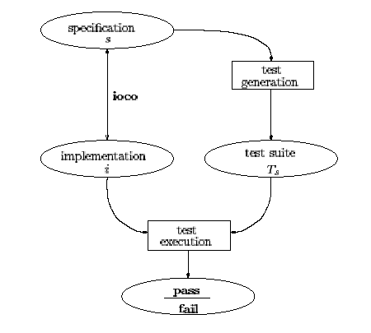
Testing architecture
Implementation relation
Test generation algorithm
Test execution engine

Slide 13
Input-Output Transition Systems
dime, nickel coffee, tea
from user to machine from machine to user
initiative with user initiative with machine
machine cannot refuse user cannot refuse
input output
L_{I} L_{U}
L_{I} ∩ L_{U} = ∅ L_{I} ∪ L_{U} = L
S0
dime
?
?
nickel
S1
S2
coffee
!
tea
!
S3
S4
L_{I} = { ?dime, ?nickel }
L_{U} = { !coffee, !tea }

Slide 14
Input-Output Transition Systems
Input-Output Transition Systems
IOTS (L_{I} ,L_{U} ) ⊆ LTS (L_{I} ∪ L_{U} )
IOTS is LTS with Input-Output
and always enabled inputs:
for all states s,
for all inputs ?a ∈ L_{I} :
?dime
?nickel
?dime
?nickel
?dime
?nickel
!coffee
!tea
?dime
?nickel
?dime
?nickel
?a
L_{I} = { ?dime, ?nickel }
L_{U} = { !coffee, !tea }
S

Slide 15
Preorders on IOTS
implementation
i
imp
specification
s
environment
e
environment
e
i ∈ IOTS(L_{I},L_{U})
s ∈ LTS(L_{I}∪L_{U})
imp ⊆ IOTS (L_{I},L_{U}) x LTS (L_{I}∪L_{U})
Observing IOTS where system inputs
interact with environment outputs, and vice versa

Slide 16
Preorders on IOTS
implementation
i
imp
specification
s
environment
e
environment
e
i ∈ IOTS(L_{I},L_{U})
s ∈ LTS(L_{I}∪L_{U})
i imp s ⇔ ∀ e ∈ E . obs ( e, i ) ⊆ obs (e, s )
↓ IOTS(L_{U},L_{I})

Slide 17
Input-Output Testing Relation
implementation
i
≤_{iot}
specification
s
environment
e
environment
e
i ∈ IOTS(L_{I},L_{U})
s ∈ LTS(L_{I}∪L_{U})
i ≤_{iot} s ⇔ ∀ e ∈ IOTS(L_{U},L_{I}) .obs ( e, i ) ⊆ obs (e, s )
obs ( e, p ) = ( traces (e||p ), qtraces (e||p ) )
qtraces(p) = σ ∈ L*. p after σ refuses L_{U}

Slide 18
Testing preorders – a side note
One of the reasons for using IOTS over LTS is that ≤_{iot} is computationally simpler than conventional testing preorder
  Testing preorder requires us to compare sets of pairs (trace, refusal set)
  At the same time ≤_{iot} allows us to use inclusion of weakly quiescent traces:
    inputs can never be refused by i, and
    outputs can never be refused by e
    i after σ refuses A ⇒ A = ∅ or A = L_{U}

Slide 19
Representing quiescence
Extend IOTS with quiescent transitions
  deterministic δ-trace automata
Δp:
p:
δ
?dime
?nickel
?dime
?nickel
?dime
?nickel
?dime
?nickel
?dime
?nickel
?dime
?nickel
!coffee
!tea
!coffee
!tea
?dime
?nickel
δ
?dime
?nickel
?dime
?nickel
?dime
?nickel
δ

Slide 20
Conformance relation ioconf
Finally…
  i ≤_{iot} s ⇔ ∀ σ∈L*.out( Δi after σ ) ⊆ out( Δs after σ )
Allow underspecification
  restrict to traces of s
  i ioconf s =_{def}
  ∀σ∈traces(Δs)∩L*.out(Δi after σ) ⊆ out(Δs after σ)
ioconf_{F}: use arbitrary F instead of traces of s
Conformance relation ioco accounts for repetitive quiescence

Slide 21
Test cases
A test case is a deterministic IOTS(L_{U},L_{I}) with finite behaviors
  Note reversed inputs and outputs
  Do not allow choice between outputs or between input and output
Verdict function ν: S → {fail,pass}
Test run: i passes t =_{def}
  (i||t) after σ deadlocks ⇒
  ν(t after σ)=pass
pass
?dime
fail
!coffee
!tea
pass
fail

Slide 22
Test generation
Test suite T_{s} for a specification s is complete:
i ioconf s iff ∀t∈Ts . i passes t
Test suite T_{s} is sound if
i ioconf s ⇒ ∀t∈Ts . i passes t
Complete test suites are usually infinite
  Aim at generating sound test suites

Slide 23
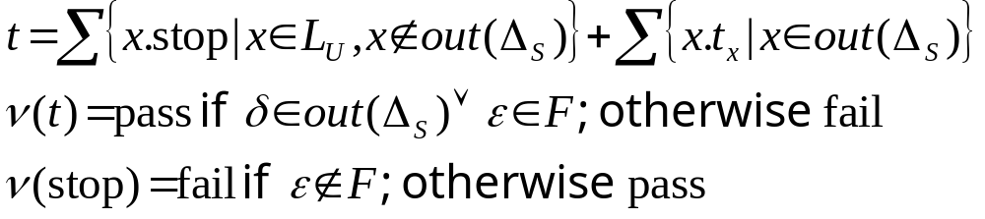
Test generation algorithm
Gen( Δ_{s}, F )
  Choose non-deterministically:
  t = stop and ν (t) = pass
  t = a . Gen(Δ’_{s}, F after a), with Δ_{s} → Δ’_{s}
    ν (t) = pass
a

Slide 24
Example
F = dime.coffee
Δp:
δ
quiescent
?dime
?nickel
pass
?dime
?nickel
output-enabled
?dime
?dime
?nickel
!coffee
!tea
fail
ε not in
F after dime
and not quiescent
δ
?dime
?nickel
!coffee
?dime
?nickel
δ
!tea
pass
fail
Wrong output
Right output

Slide 25
Test purposes
Where does F come from?
Test purposes:
  Requirements, use cases
  Automata, message sequence charts
Test purposes represent “interesting” or “significant” behaviors
  Define “interesting” or “significant”…
Can we come up with test purposes automatically?

Slide 26
Summary: conformance testing
Advantages:
  Very rigorous formal foundation
  Size of the test suite is controlled by use cases
Disadvantages:
  How much have we learned about the system that passed the test suite?
  Does not guarantee coverage

Slide 27
Coverage-based testing
Traditional:
  Tests are derived from the implementation structure (code)
Model-driven:
  Cover the model instead of code
  Model should be much closer to the implementation in structure
Relies on coverage criteria

Slide 28
Coverage criteria and tests
[HongLeeSokolskyUral02]
Control flow:
  all-states
  all-transitions
Data flow:
  all-defs
  all-uses
  all-inputs
  all-outputs
Test is a linear sequence of inputs and outputs

Slide 29
Specifications: EFSM
Transition systems equipped with variables
Transitions have guards and update blocks
t1: insert[m+x<=5]
/m:=m+x
t2: coffee[m>1]
/m:=m-1
IDLE
BUSY
t3: done
t4: display/y:=m
t5: display/y:=m

Slide 30
Coverage criteria
Each coverage criterion is represented by a set of temporal logic formulas
  WCTL: a subset of CTL
    Atomic propositions p₁,…,p_{n}
    Temporal operators EX, EU, EF
    Conjunctions: at most one non-atomic conjunct
    Negations is applied only to atomic propositions
    Unrestricted disjunctions
    E.g.: EF(p₁ & EFp₂)
  WCTL formulas have linear witnesses

Slide 31
All-states coverage criterion
Requires every state be covered at least once
With every state s, associate EF(s & EFexit)
t1: insert[m+x<=5]
/m:=m+x
EF(idle & EFexit)
EF(busy & EFexit)
t2: coffee[m>1]
/m:=m-1
IDLE
IDLE
BUSY
BUSY
t3: done
t4: display/y:=m
t5: display/y:=m

Slide 32
All-transitions coverage criterion
Requires every transition be covered at least once
With every transition t, associate EF(t & EFexit)
t1: insert[m+x<=5]
/m:=m+x
EF(t1 & EFexit)
EF(t2 & EFexit)
EF(t3 & EFexit)
EF(t4 & EFexit)
EF(t5 & EFexit)
t1: insert[m+x<=5]
/m:=m+x
t2: coffee[m>1]
/m:=m-1
t2: coffee[m>1]
/m:=m-1
IDLE
BUSY
t3: done
t3: done
t5: display/y:=m
t4: display/y:=m
t5: display/y:=m
t4: display/y:=m

Slide 33
Data flow: definitions and uses
Definition: a value is assigned to a variable
Use: a value of a variable is used in an expression
Variables are defined and used in transitions
Definition-use pair: (v,t,t’)
  v is defined by t
  v is used by t’
  There is a path from t to t’ free from other definitions of v

Slide 34
Covering a du-pair
With a du-pair (v, t, t’), associate
  EF(t & EXE[!def(v) U (t’ & EFexit)])
  def(v) : disjunction of all transitions that define v
t1: insert[m+x<=5]
/m:=m+x
t1: insert[m+x<=5]
/m:=m+x
EF(t1 & EXE[!(t1 | t2) U (t2 & EFexit)])
t2: coffee[m>1]
/m:=m-1
t2: coffee[m>1]
/m:=m-1
IDLE
BUSY
t3: done
t4: display/y:=m
t5: display/y:=m

Slide 35
Data-flow coverage criteria
All-defs coverage criterion: a definition-clear path
  from every definition to some use
All-uses coverage criterion: a definition-clear path
  from every definition to every use
t1: insert[m+x<=5]
/m:=m+x
All-uses coverage criterion
EF(t1 & EXE[!(t1 | t2) U (t1 & EFexit)])
EF(t1 & EXE[!(t1 | t2) U (t2 & EFexit)])
EF(t1 & EXE[!(t1 | t2) U (t4 & EFexit)])
EF(t1 & EXE[!(t1 | t2) U (t5 & EFexit)])
EF(t2 & EXE[!(t1 | t2) U (t1 & EFexit)])
EF(t2 & EXE[!(t1 | t2) U (t2 & EFexit)])
EF(t2 & EXE[!(t1 | t2) U (t4 & EFexit)])
EF(t2 & EXE[!(t1 | t2) U (t5 & EFexit)])
t2: coffee[m>1]
/m:=m-1
IDLE
BUSY
t3: done
t4: display/y:=m
t5: display/y:=m

Slide 36
Data flow chains
Affect pair (v, t, v’, t’): the value of v used by t affects the value of v’ defined at t’
  Either t=t’ ((v,t) directly affects (v’,t’)) or
  there is a du-pair (v’’,t,t’’) s.t. (v,t) directly affects (v’’,t) and (v’’,t’’) affects (v’,t’)
t1: insert[m+x<=5]
/m:=m+x
t1: insert[m+x<=5]
/m:=m+x
t1: insert[m+x<=5]
/m:=m+x
(x, t1) directly affects (m, t1)
t2: coffee[m>1]
/m:=m-1
(x, t1) affects (y, t5)
IDLE
BUSY
t3: done
t5: display/y:=m
t4: display/y:=m
t5: display/y:=m

Slide 37
Data flow chain coverage
Affect pair (v, t, v’, t’)
  May consist of an arbitrary number of definition-use pairs
  We extend CTL with least fixpoint operators
    Alternatively, we can use (alternation-free) mu-calculus
All-inputs coverage criterion
  Requires a path from every input to some output be covered at least once
All-outputs coverage criterion
  Requires a path from every input to every output be covered at least once

Slide 38
Test Generation
System
model
True or
false
Model
checker
Logic
formula
Witness or
counterexample
System
model
Model
checker
Coverage
criterion
A set of
logic
formulas
A set of
witnesses

Slide 39
Test Generation
Generating a witness for a formula
  Cost: the length of a witness
  A minimal-cost witness for a formula
    Existing model checkers generate a minimal-cost witness by breadth-first search of state space
E[ U ]

Slide 40
Test Generation
Costs
  The total length of witnesses or
  The number of witnesses
Both optimization problems are NP-hard
E[ U ]
E[ U ]
E[ U ]
E[ U ]

Slide 41
Coverage for distributed systems
What if our system is a collection of components?
Possible solutions:
  Generate tests for each components
    Clearly unsatisfactory; does not test integration
  Generate tests from the product of component models
    Too many redundant tests
Non-determinism is another problem

Slide 42
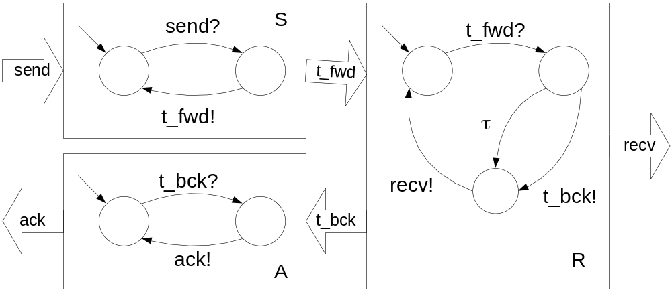
Example
Producer-consumer with acknowledgements

Slide 43
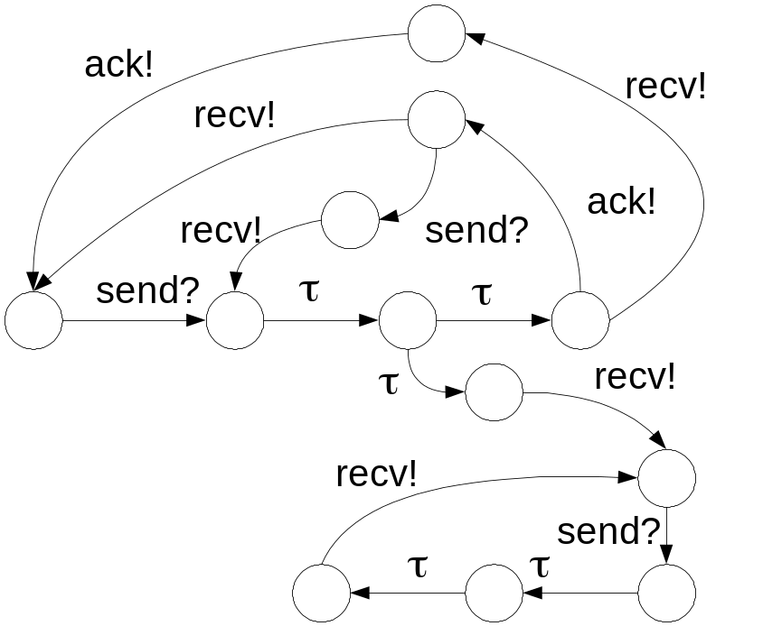
Covering product transition system
Linear tests bring trouble:
  send?.ack!.recv!
  May fail if the system chooses a different path
Tests differ in interleavings
of independent events
  No need to test
  send?.ack!.recv!
  send?.recv!.ack!
  separately
State explosion in test suite!

Slide 44
Partial orders for test generation
Use event structures instead of transition systems [Heninger97]
Test generation covers the event structure
Allows natural generation of distributed testers

Slide 45



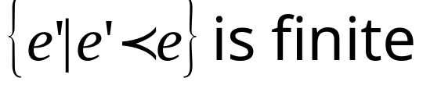

Prime event structures (PES)
Set of events E
  Events are occurrences of actions
Causality relation
  Partial order
Conflict relation
  irreflexive and symmetric
Labeling function
Finite causality
Conflict inheritance

Slide 46
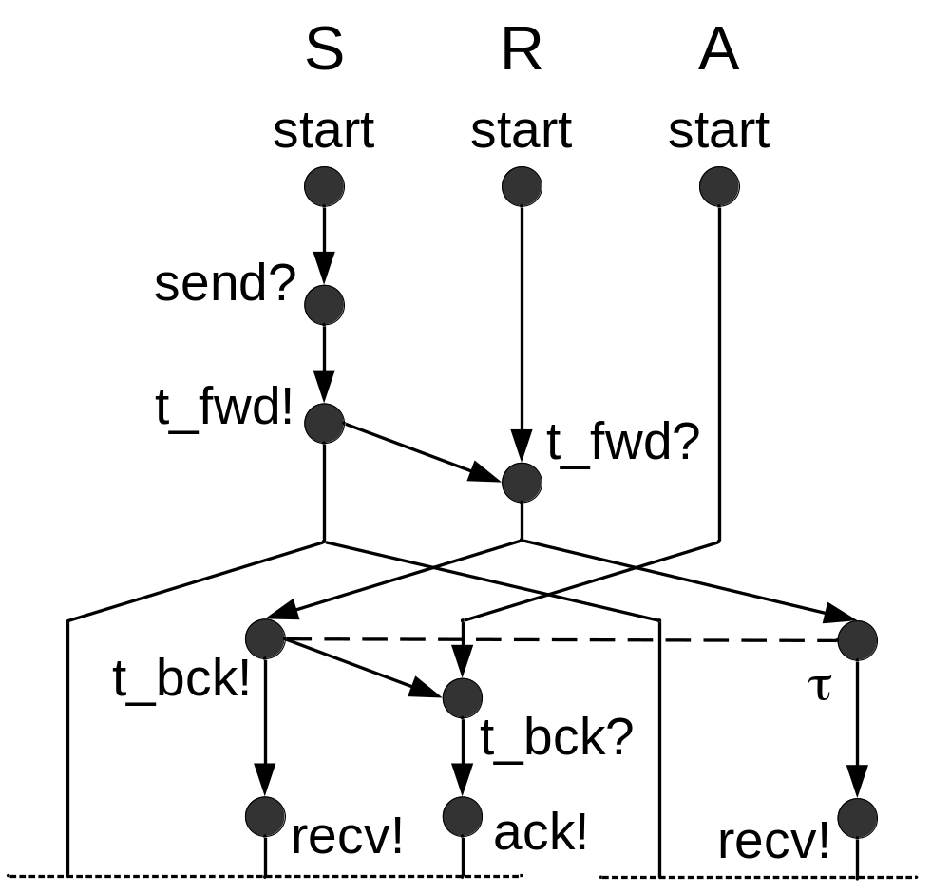
Producer-consumer PES
Structure is infinite
  Initial part is shown
Causally unrelated and
non-conflicting events
can occur together
Behaviors will start
repeating
  Can stop with
  finite structure

Slide 47
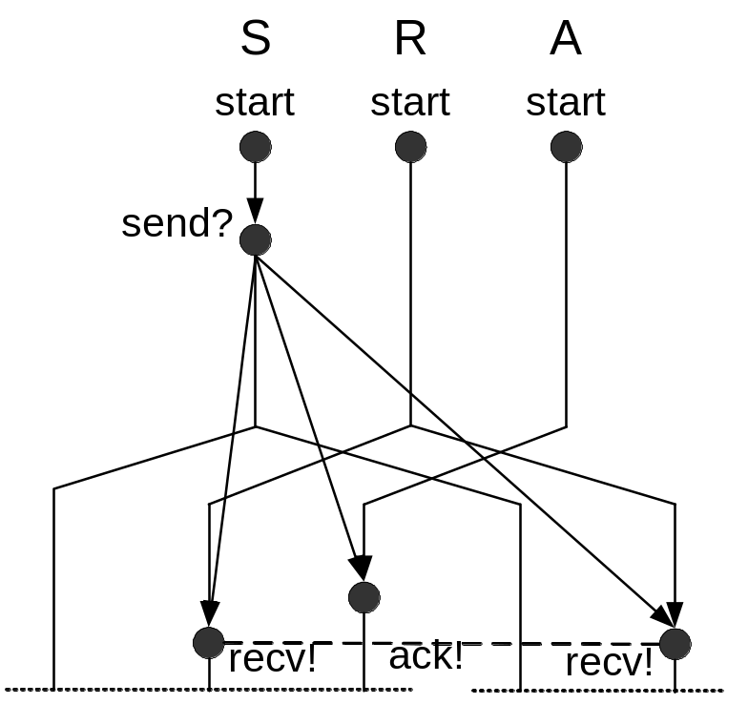
Test generation with PES
Project PES on observable actions, propagating conflicts
Every path in the PES should be covered
Tests consist of distributed
testers with coordination
messages between tests
  Coordination messages are
  inserted when there is a
  causal edge between
  locations

Slide 48
Summary: coverage-based testing
Advantages:
  Exercise the specification to the desired degree
  Does not rely on test purpose selection
Disadvantages:
  Large and unstructured test suites
  If the specification is an overapproximation, tests may be infeasible

Slide 49
Generation of test purposes
Recent work: [HenningerLuUral-03]
Construct PES
Generate MSC (message sequence charts) to cover PES
Use MSC as test purposes in ioco-based test generation

Slide 50
Controllability of testing
Conformance testing may not provide enough guarantees
  With branching tests, test purpose behavior may be avoided
  What if I never
  see ack?
Problem: inherent uncertainty in the system

Slide 51
How to contain uncertainty?
Avoidance (no need to increase control)
  During testing, compute confidence measure
    E. g., accumulate coverage
  Stop at the desired confidence level
Prevention (add more control)
  Use instrumentation to resolve uncertainty
  What to instrument?
    Use model for guidance
Anyone needs a project to work on?

Slide 52
Test generation tools
TorX
  Based on ioco
  On-the-fly test generation and execution
  Symbolic testing (data parameterization)
  LOTOS, Promela, …
  http://fmt.cs.utwente.nl/tools/torx/
TGV
  Based on symbolic ioconf
  LOTOS, SDL, UML
  http://www.irisa.fr/pampa/VALIDATION/TGV/TGV.html

