Slide 1
Model-based Testing

Slide 2
Model-based Testing
Finite state machines
Statecharts
Grammars
Markov chains
Stochastic Automata Networks

Slide 3
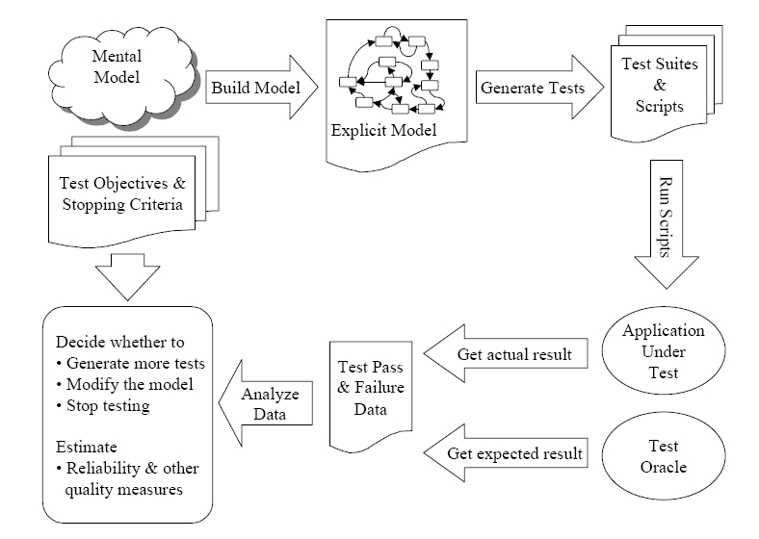
Model-based Testing

Slide 4
Finite State Machine
Finite state machines have the state changed according to the input.
They are different from event flow graphs.

Slide 5
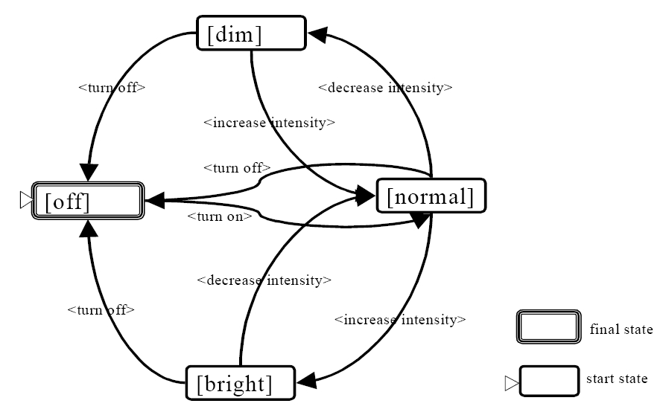
Finite State Machine
Test case: {<turn on>,
<decrease intensity>,
<increase intensity>,
<turn off>}
 | off | dim | normal | bright
off |  |  | <turn on>
dim | <turn off> |  | <incr. int.>
normal | <turn off> | <decr. Int.> |  | <incr. int.>
bright | <turn off> |  | <decr. int.>

Slide 6
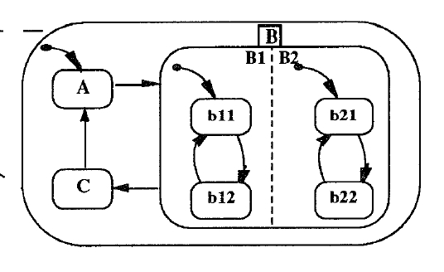
Statecharts
Statecharts specify state machines in a hierarchy.
states: AND, OR, basic states
AND: {B1, B2}
OR: {b11, b12}
basic state: {A}

Slide 7
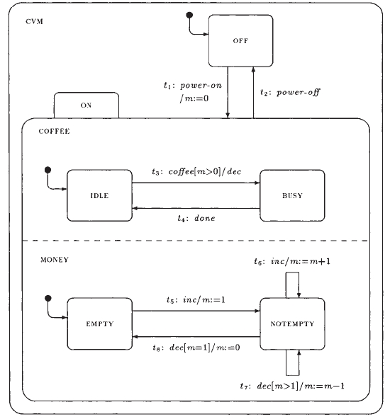
Statecharts
configuration: set of states in which a system can be simultaneously.
C1={CVM, OFF}
C2={CVM, ON, COFFEE, IDLE, MONEY, EMPTY}
C3={CVM, ON, COFFEE, BUSY, MONEY, EMPTY}

Slide 8
Statecharts
transition: tuple (s, l, s’)
s: source, s’: target, l: label defined as e[g]/a
e: trigger
g: guard
a: action
t3: coffee[m>0]/dec

Slide 9
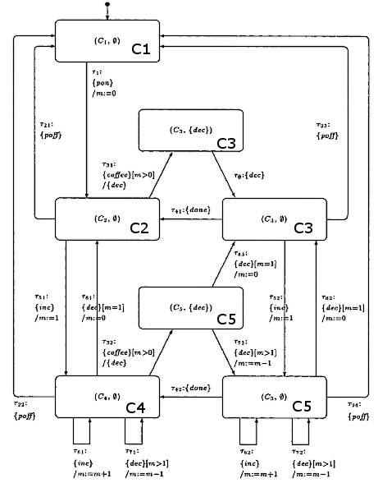
Statecharts
Normal form specification:
C1: {CVM, OFF}
C2: {CVM, ON, COFFEE, IDLE, MONEY, EMPTY}
C3: {CVM, ON, COFFEE, BUSY, MONEY, EMPTY}
C4: {CVM, ON, COFFEE, IDLE, MONEY, NOTEMPTY}
C5: {CVM, ON, COFFEE, BUSY, MONEY, NOTEMPTY}

Slide 10
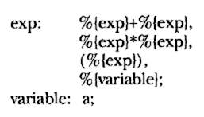
Grammars
Context-free grammars to generate test cases.
Example of TC:
1 + 2 * 3
Problem:
The test cases may be infinitely long. Weights must be inserted in the rules.

Slide 11
Markov Chains
Markov chains are structurally similar to finite state machine, but can be seen as probabilistic automata.
arcs: labeled with elements from the input domain.
transition probabilities: uniform if no usage information is available.

Slide 12
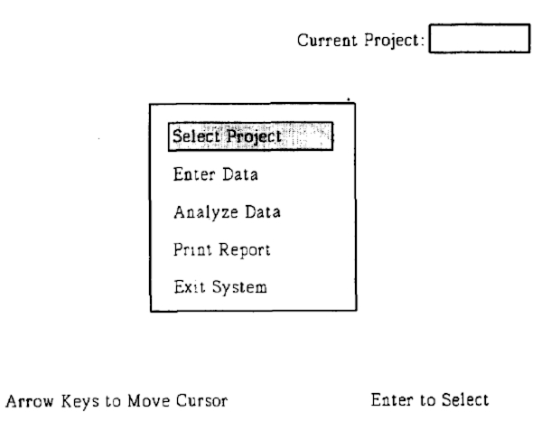
Markov Chains
input domain: {Enter, up-arrow, down-arrow}
variables:
cursor location = {“Sel”, “Ent”, “Anl”, “Prt”, “Ext”}
project selected = {“yes”, “no”}
states:
{(CL = “Sel”, PD = “No”), (CL = “Sel”, PD = “Yes”), ...}

Slide 13
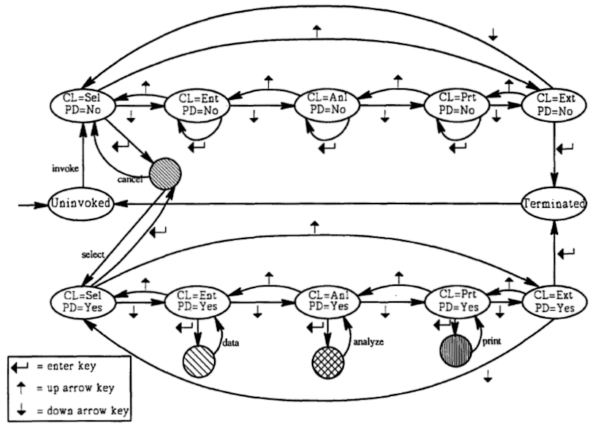
Markov Chains
test case:
invoke
Enter
select
down-arrow
down-arrow
Enter
analyze
down-arrow
down-arrow
Enter

Slide 14
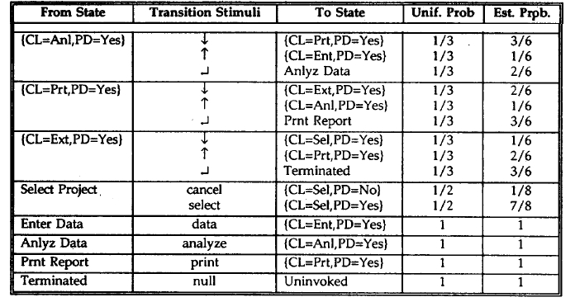
Markov Chains

Slide 15
Markov Chains
Analysis of the chain:
Example 1: Expected length and standard deviation of the input sequences.
length: 20.1
standard deviation: 15.8

Slide 16
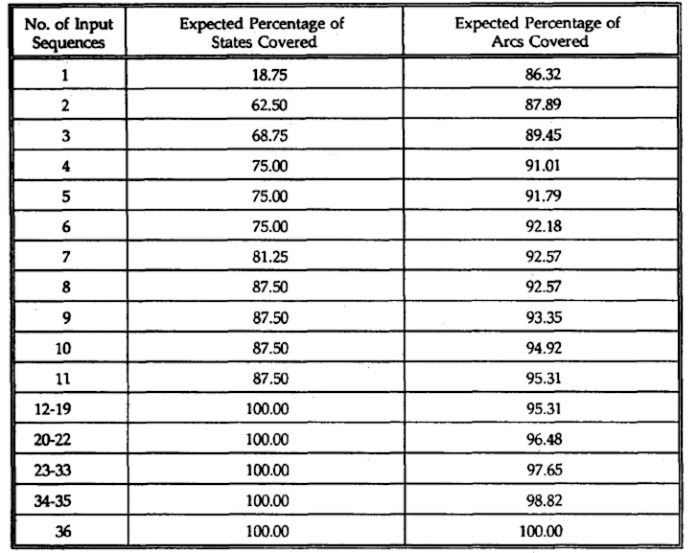
Markov Chains
Example 2:
Estimate the coverage of the chain states and arcs.
81.25% of states appear in the test after 7 input sequences.

Slide 17
Markov Chains
Problems with Markov Chains:
Transition matrix may become very large.
The growth of the number of states and transitions impacts in the readability.
Maintainability – it is hard to find all transitions that should be included to keep the model consistent when a new state is added.

Slide 18
Stochastic Automata Networks
SAN represents the system by a collection of subsystems.
subsystems: individual behavior (local transitions) and interdependencies (synchronizing events and functional rates).
SAN may reduce the state space explosion by its modular way of modeling.

Slide 19
Stochastic Automata Networks
Definition of SAN: tuple (G, E, R, P, I)
G = {G₁, ..., G_{m}} global states, composed by A₁ x A₂ x ... x A_{n} (A_{i} is an automaton).
E = {E₁, ..., E_{k}} set of events.
R = {R₁, ..., R_{k}} set of event rate functions (rate of occurrence of the event).
P = {P₁, ..., P_{k}} transition probability functions, one for each pair (event, global state).
I: set on initial states.

Slide 20
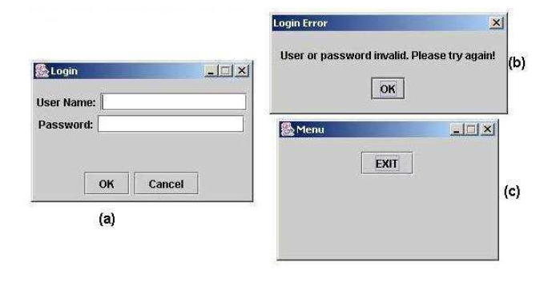
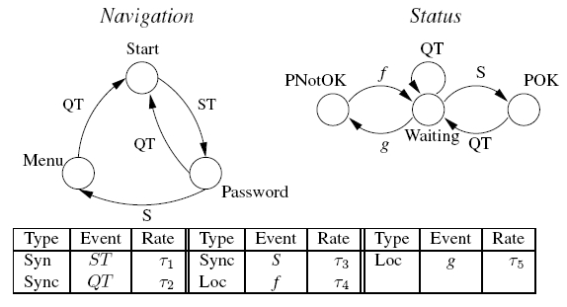
Stochastic Automata Networks
Example:
Automata: {Navigation, Status}
Navigation = {Start, Password, Menu}
Status = {Waiting, POK, PNotOK}
Events
E = {ST, QT, S, g, f}
ST = {(Start, Wait) → (Pass, Wait)}
S = {(Pass, Wait) → (Menu, POK)}

Slide 21
Stochastic Automata Networks
QT = {(Pass, Wait) → (Start, Wait), (Menu, Wait) → (Start, Wait), (Menu, POK) → (Start, Wait)}
g = {(pass, wait) → (pass, PNotOk)}
f = {(pass, PNotOk) → (pass, wait)}
Initial State
I={(Start, Waiting)}

Slide 22
Markov Chain vs SAN
Test case samples generated using Markov chain and stochastic automat networks.
Experiments:
Generation time analysis
Quality of test suite

Slide 23
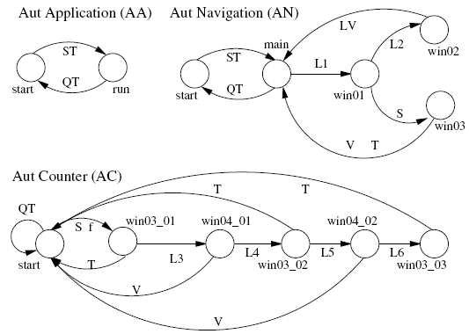
Markov Chain vs SAN
Simple counter navigation
MC: 9 states and 24 transitions
SAN: 3 automata (2 x 5 x 6) total of 60 states, 9 global reachable states.

Slide 24
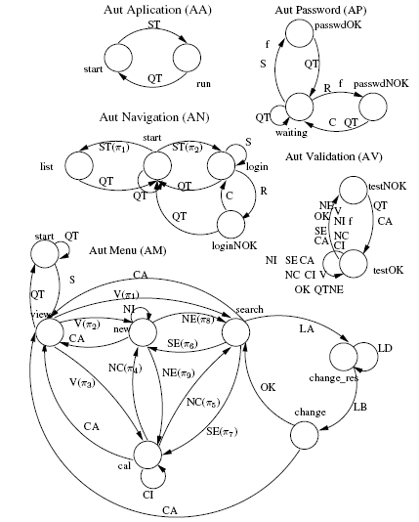
Markov Chain vs SAN
Calendar Manager
MC: 16 states and 67 transitions
SAN: 5 automata (2 x 3 x 4 x 2 x 7) total of 336 states, 16 global reachable states.

Slide 25
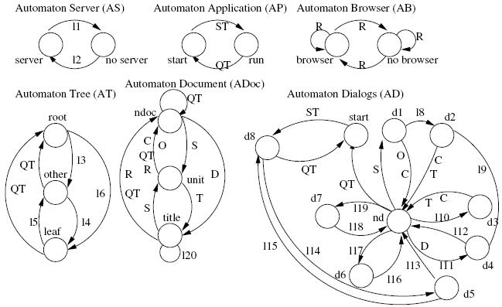
Markov Chain vs SAN
Form-based Documents Editor
MC: 417 states and 2593 transitions
SAN: 3 automata (2 x 2 x 2 x 3 x 3 x 10) total of 417 states, 720 global reachable states.

Slide 26
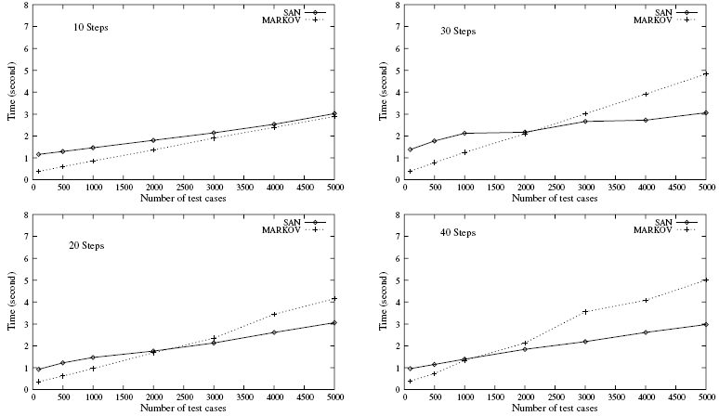
Markov Chain vs SAN
Generation time (simple counter navigation)

Slide 27
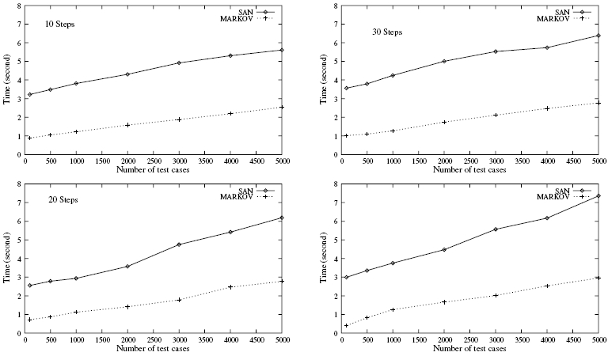
Markov Chain vs SAN
Generation time (calendar manager)

Slide 28
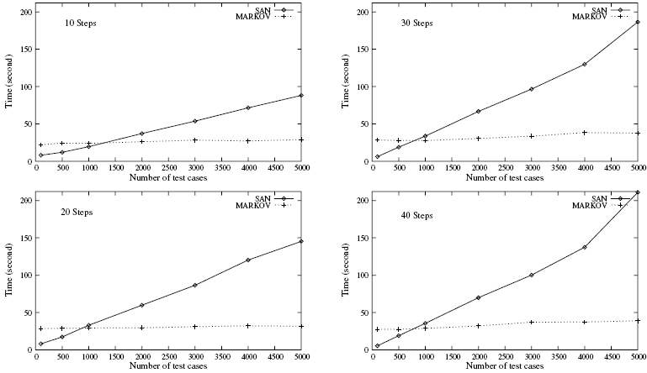
Markov Chain vs SAN
Generation time (docs editor)

Slide 29
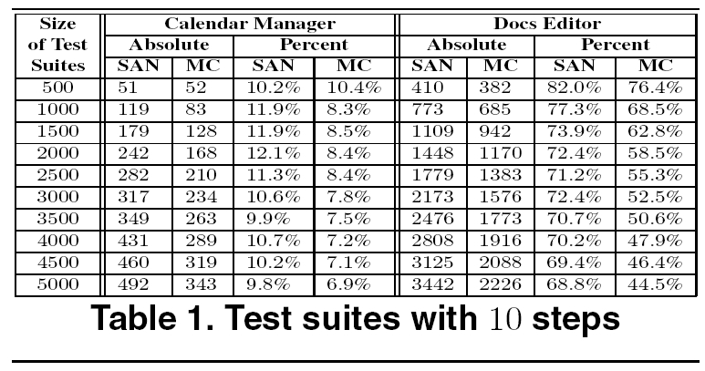
Markov Chain vs SAN
Quality of test suite

Slide 30
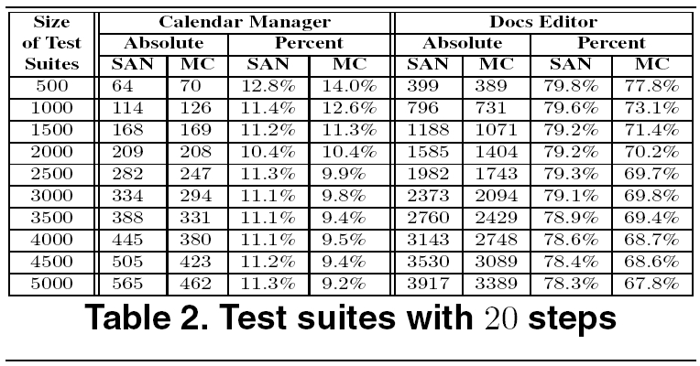
Markov Chain vs SAN
Quality of test suite

Slide 31
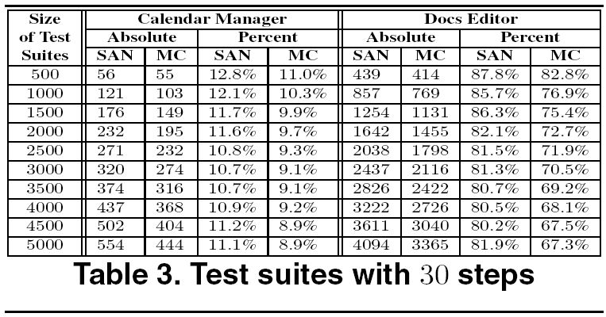
Markov Chain vs SAN
Quality of test suite

Slide 32
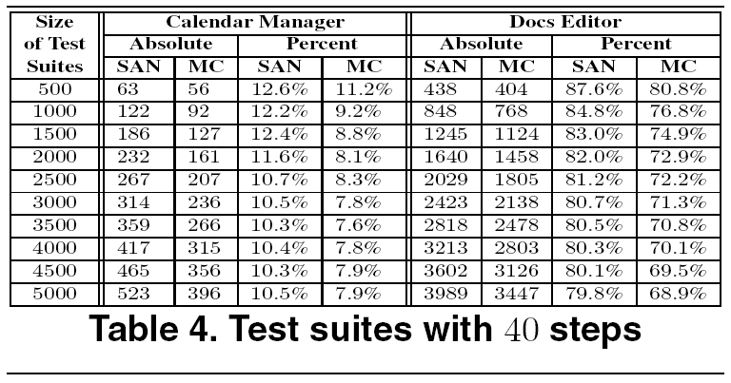
Markov Chain vs SAN
Quality of test suite

Slide 33
Markov-based GUI Testing
Event flow graph
Have an usage model
Retrieve sequences of events
Given a start and final state, one could use the properties of markov chains to generate tests.

