Slide 1
Model Based Testing
Property Checking for Real

Slide 2
Overview
Introduction
  Testing
  Formal methods and Testing
Formal Testing
  Framework
  Pre/post-condition program testing
Transition system testing
  ioco test theory
  a test tool
  an application: "Rekeningrijden"
Conclusions

Slide 3
Overview
Introduction
  Testing
  Formal methods and Testing
Formal Testing
  Framework
  Pre/post-condition program testing
Transition system testing
  ioco test theory
  a test tool
  an application: "Rekeningrijden"
Conclusions

Slide 4
Testing
Testing:
to check the quality of an object
by performing experiments
in a controlled way
w.r.t. a specification
n
m
IUT
n+m
tester
Software Testing :
testing the quality of a software product

Slide 5
Paradox of Software Testing
Testing is:
important
much practiced
30% - 50% of project effort
expensive
time critical
not constructive
(but sadistic?)
But also:
ad-hoc, manual, error-prone
hardly theory / research
no attention in curricula
not cool :
“if you’re a bad programmer
you might be a tester”
?
Attitude is changing:
more awareness
more professional
Improvements possible
with formal methods !

Slide 6
Types of Testing
Level of detail
system
integration
module
unit
stress
Accessibility
robustness
white box
black box
performance
usability
reliability
functional behaviour
Characteristics

Slide 7
Testing
specification
property
test cases
scenarios
IUT
correct w.r.t.
specification
IUT
tester
pass fail

Slide 8
Overview
Introduction
  Testing
  Formal methods and Testing
Formal Testing
  Framework
  Pre/post-condition program testing
Transition system testing
  ioco test theory
  a test tool
  an application: "Rekeningrijden"
Conclusions

Slide 9
Testing & Formal Methods
A Perfect Couple ?
Formal methods:
proving properties
research
sound theories
“clean”
Testing :
trial & error
practice
heuristics
“dirty hands”
“Testing is not necessary after formal verification”
“Testing can only detect the presence of errors, not their absence”
“Formal methods are toys for boys”
“Formal methods are only for toy problems"

Slide 10
Formal Testing
Why testing with a formal specification:
improves the testing process
precise and unambiguous basis for testing
allows automatic generation of tests
Why no formal verification (theorem proving, model checking, …) :
code/structure of system not accessible (black-box)
system too complex
verification only on model of implementation
prove evidence to customer/user
no formalization possible

Slide 11
Development Process
informal
requirements
specification
formalizable
design
code
realization

Slide 12
Specification Based
Functional Testing with Formal Methods
specification
Goal:
Testing functional behaviour
of black-box implementation
with respect to specification
in formal language
based on formal definition
of conformance
s
formal testing
implementation
under test
Model assumed to be correct

Slide 13
Overview
Introduction
  Testing
  Formal methods and Testing
Formal Testing
  Framework
  Pre/post-condition program testing
Transition system testing
  ioco test theory
  a test tool
  an application: "Rekeningrijden"
Conclusions

Slide 14
Formal Testing
i ioco s
specification
⇑ ⇓
S
⇔
exhaustive
sound
test
generation
i passes T_{s}
correctness criterion
implementation
relation
test suite T_{S}
implementation
i
test
execution
pass / fail

Slide 15
Formal Testing : Conformance
specification
s ∈ SPECS Specification
IUT Implementation under Test
IUT is concrete, physical object
Model the physical world
But IUT is black box ! ?
Assume that model i_{IUT} exists
S
IUT correct wrt s
correctness criterion
implementation
IUT

Slide 16
Formal Testing : Test Hypothesis
Test hypothesis :
∀ IUT ∈ IMPS . ∃ i_{IUT} ∈ MODS .
∀ t ∈ TESTS . obs ( t, IUT ) = obs ( t, i_{IUT} )
IUT
i_{IUT}
test t
test t

Slide 17
Formal Testing : Conformance
s ∈ SPECS Specification
i_{IUT} ∈ MODS model of IUT
Test hypothesis :
each concrete IUT can be modelled
by some i_{IUT} ∈ MODS
Correctness : i_{IUT} imp s
i_{IUT} is not known ;
testing to learn about i_{IUT}
specification
S
formal
correctness criterion
i_{IUT} imp s
implementation
i_{IUT}

Slide 18
Completeness
Completeness of test suite T_{s} on models:
∀ i ∈ MODS .
∀ t ∈ T_{s} . obs ( t, i ) = pass i imp s
exhaustive
⇒
⇐
sound
⇔

Slide 19
Testing for Conformance
?
IUT passes T_{s} ⇔ IUT correct wrt s
IUT passes T_{s}
⇔
∀ t ∈ T_{s} . IUT passes t
⇔
IUT passes T_{s} ⇔_{def} ∀ t ∈ T_{s} . IUT passes t
IUT passes t ⇔_{def} obs ( t, IUT ) = pass
∀ t ∈ T_{s} . obs ( t, IUT ) = pass
⇔
∀ t ∈ T_{s} . obs ( t, i_{IUT} ) = pass
⇔
Test hypothesis :
∀ t ∈ TESTS . obs ( t, IUT ) = obs ( t, i_{IUT} )
i_{IUT} imp s
⇔
Proof obligation :
∀ i ∈ MODS .
( ∀ t ∈ T_{s} . obs ( t, i ) = pass ) ⇔ i imp s
IUT correct wrt s
Definition : IUT correct wrt s

Slide 20
Formal Testing
s ∈SPECS
Test hypothesis :
∀IUT∈IMPS . ∃i_{IUT} ∈MODS .
∀t∈TESTS . obs(t,IUT) = obs(t,i_{IUT})
der : SPECS → ℘(TESTS)
Proof soundness and exhaustivess:
∀i∈MODS .
∀t∈T_{s} . obs(t,i) = pass ⇔ i imp s
imp
Then:
IUT is correct
iff it passes the test
T_{s} ⊆ TESTS
IUT ∈IMPS
i_{IUT} ∈MODS
obs : TESTS × MODS → ℘(OBS)
exec : TESTS × IMPS → ℘(OBS)
pass / fail

Slide 21
Approaches to Formal Testing
Instantiations of Formal Framework
Programs as functions (pre/post-conditions)
Finite State Machine / methods with state
Labelled Transition Systems
Abstract Data Type testing

Slide 22
Overview
Introduction
  Testing
  Formal methods and Testing
Formal Testing
  Framework
  Pre/post-condition program testing
Transition system testing
  ioco test theory
  a test tool
  an application: "Rekeningrijden"
Conclusions

Slide 23
Simple Input/Output Programs
x: X
y: Y
IUT
Specification: s ⊆ X × Y
Test hypothesis: implementation i :: X → Y
Tests: T ⊆ X
Passing a test t ∈ T : ( t, i(t) ) ∈ s
Tools: QuickCheck, G∀ST
Problem/challenge: select "good" subset T ⊆ X:
classical techniques: equivalence partitioning, boundary analysis, ……

Slide 24
Input/Output Program: Example
IUT
i(x) = √x
x: real
pre: x ≥ 0
y: real
post: |y × y - x| ≤ 0.00001
Specification:
propSqrt(x,y) = x ≥ 0 ⇒ |y × y - x| ≤ 0.00001
Possible test set: T = { 0, 0.00232, 1, 1.87392, 2738894 }
Tools like QuickCheck, G∀ST easily generate thousands
of test cases
But still: what is a "good" set ?

Slide 25
Overview
Introduction
  Testing
  Formal methods and Testing
Formal Testing
  Framework
  Pre/post-condition program testing
Transition system testing
  ioco test theory
  a test tool
  an application: "Rekeningrijden"
Conclusions

Slide 26
Formal Testing with Transition Systems
s ∈ LTS
Test hypothesis :
∀IUT∈IMPS . ∃i_{IUT} ∈IOTS .
∀t∈TTS . exec(t,IUT) = obs(t,i_{IUT})
der : LTS → ℘(TTS)
Proof soundness and exhaustivess:
∀i∈IOTS .
( ∀t∈der(s) . ν_{t}(obs(t,i)) = pass )
⇔ i ioco s
ioco
T_{s} ⊆ TTS
IUT ∈IMPS
i_{IUT} ∈IOTS
obs : TTS × IOTS → ℘(traces)
exec : TESTS × IMPS → ℘(OBS)
pass / fail

Slide 27
Labelled Transition Systems
Labelled Transition System ⟨ S, L, T, s₀ ⟩
states
initial state
s₀ ∈ S
actions
transitions
T ⊆ S × (L∪{τ}) × S
!coffee
?coin
!alarm
?button
?button

Slide 28
Implementation Relation ioco
Correctness expressed by implementation relation ioco:
i ioco s =_{def} ∀σ ∈ Straces (s) : out (i after σ) ⊆ out (s after σ)
p ^{δ} p = ∀ !x ∈ L_{U} ∪{τ} . p ^{!x}
Straces ( s ) = { σ ∈ (L∪{δ})* | s ^{σ} }
p after σ = { p’ | p ^{σ} p’ }
out ( P ) = { !x ∈ L_{U} | p ^{!x} , p∈P } ∪ { δ | p ^{δ} p, p∈P }

Slide 29
Implementation Relation ioco
Correctness expressed by implementation relation ioco:
i ioco s =_{def} ∀σ ∈ Straces (s) : out (i after σ) ⊆ out (s after σ)
Intuition:
i ioco-conforms to s, iff
if i produces output x after trace σ,
then s can produce x after σ
if i cannot produce any output after trace σ,
then s cannot produce any output after σ ( quiescence δ )

Slide 30
Implementation Relation ioco
?dub
ioco
ioco
?kwart
?dub
!coffee
!tea
?dub
?dub
?kwart
s
!choc
!coffee
!tea
?dub
?kwart
ioco
?dub
?kwart
!tea
!choc

Slide 31
Test Generation Algorithm
Algorithm
To generate a test case from transition system specification s₀
compute T(S), with S a set of states, and initially S = s₀ after ε ;
For T(S), apply the following recursively, non-deterministically:
1 end test case
3 observe output
pass
forbidden outputs
allowed outputs
?y
?x
2 supply input
θ
fail
fail
!a
T ( S after !x )
T( S after ?a ≠ ∅ )
allowed outputs or δ: !x ∈ out ( S )
forbidden outputs or δ: !y ∉ out ( S )

Slide 32
Completeness of Test Generation
For every test t generated with algorithm we have:
Soundness :
t will never fail with correct implementation
i ioco s implies i passes t
Exhaustiveness :
each incorrect implementation can be detected
with a generated test t
i ioco s implies ∃ t : i fails t

Slide 33
Overview
Introduction
  Testing
  Formal methods and Testing
Formal Testing
  Framework
  Pre/post-condition program testing
Transition system testing
  ioco test theory
  a test tool
  an application: "Rekeningrijden"
Conclusions

Slide 34
A Test Tool : TorX
On-the-fly test generation and test execution
Implementation relation: ioco
Specification languages: LOTOS, Promela, FSP, Automata
user:
manual
automatic
next
input
offer
input
specification
TorX
IUT
check
output
observe
output
pass
fail
inconclusive

Slide 35
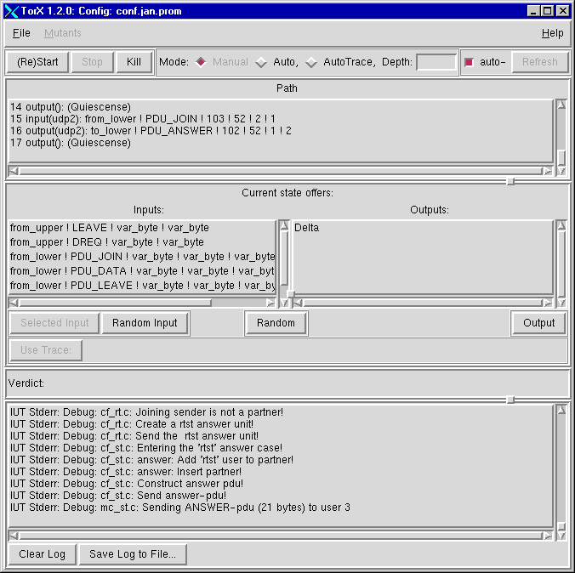
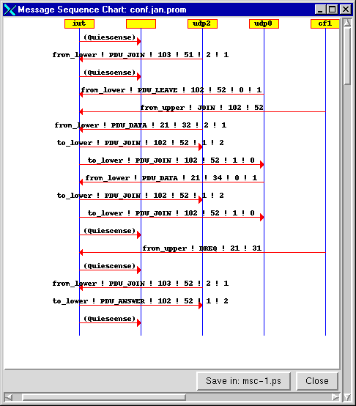
TorX

Slide 36
Overview
Introduction
  Testing
  Formal methods and Testing
Formal Testing
  Framework
  Pre/post-condition program testing
Transition system testing
  ioco test theory
  a test tool
  an application: "Rekeningrijden"
Conclusions

Slide 37
TorX Case Studies
Conference Protocol
EasyLink TV-VCR protocol
Cell Broadcast Centre component
‘’Rekeningrijden’’ Payment Box protocol
V5.1 Access Network protocol
Easy Mail Melder
FTP Client
“Oosterschelde” storm surge barrier-control
academic
Philips
CMG
Interpay
Lucent
CMG
academic
CMG

Slide 38
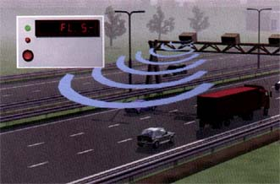
Interpay ‘’Rekeningrijden’’
Payment Box Protocol

Slide 39

“Rekeningrijden”
Characteristics :
Simple protocol
Parallellism :
  many cars at the same time
Encryption
Real-time issues
System passed traditional testing phase

Slide 40
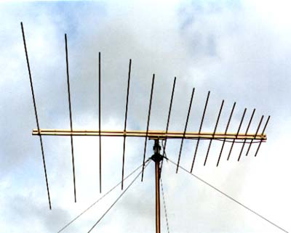
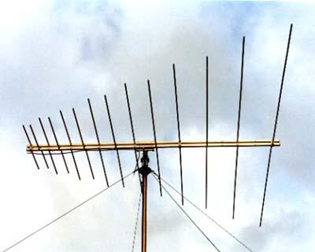
‘’Rekeningrijden’’
Highway Tolling System
Payment
Box
(PB)
Onboard
Unit
Road Side
Equipment
Wireless
UDP/IP

Slide 41
‘’Rekeningrijden’’: Test Architecture
TorX
Payment
Box
spec
PCO
PB

Slide 42
‘’Rekeningrijden’’: Test Architecture
spec
TorX
Test Context
Payment
Box
ObuSim
PB
+
ObuSim
+
TCP/IP
+
UDP/IP
TCP/IP
UDP/IP
PCO
IAP
SUT

Slide 43
‘’Rekeningrijden’’: Issues
Parallellism :
  very easy
Encryption :
  Not all events can be synthesized :
  Leads to reduced testing power
Real-time :
  How to cope with real time constraints ?
  Efficient computation for on-the-fly testing ?
  Lack of theory: quiescence vs. time-out

Slide 44
‘’Rekeningrijden” : Results
Test results :
  1 error during validation (design error)
  1 error during testing (coding error)
Automated testing :
  beneficial: high volume and reliability
  many and long tests executed ( > 50,000 test events )
  very flexible: adaptation and many configurations

Slide 45
Overview
Introduction
  Testing
  Formal methods and Testing
Formal Testing
  Framework
  Pre/post-condition program testing
Transition system testing
  ioco test theory
  a test tool
  an application: "Rekeningrijden"
Conclusions

Slide 46
Concluding ……
Testing can be formal, too (M.-C. Gaudel, TACAS'95)
  Testing shall be formal, too
But testing can never be complete
  it increases confidence in correctness
Testing can be the first step:
  counter-example finding before expensive formal verification
Or the last:
  to show that not only the model is correct
  but also the real system

Slide 47
Thanks to ...
University of Twente:
Ed Brinksma, Lex Heerink, Axel Belinfante,
Jan Feenstra, René de Vries, Machiel van der Bijl, ……
Eindhoven University of Technology:
Nicolae Goga, Loe Feijs, Sjouke Mauw
University of Nijmegen: Pieter Koopman
Philips Research Labs Eindhoven: Lex Heerink, Ron Koymans
KPN Research: Erik Kwast, Henri Dol
Lucent Technologies - R&D Centre Twente: Arjan de Heer
Project Pampa, IRISA, Rennes
(Logica)CMG Information Technology:
Peter Christian, Robert Spee, Wouter Geurts, ……
Interpay B.V.: Cornel van Mastrigt, Rommert Jorritsma
Ordina Utopics: Pim Kars
………

