Slide 1
測試市場市場報告
R08921087王文樺

Slide 2
1. 一年軟體測試全球總預算？ 包含外包、內部的預算
About USD 12.6 billion in 2019

Slide 3
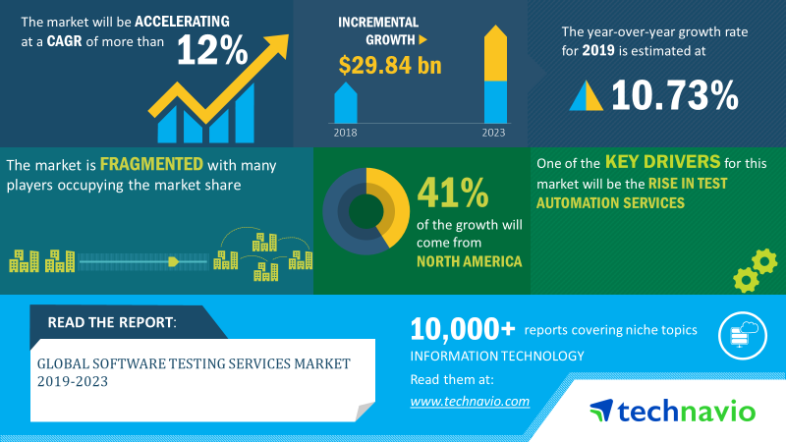
2. 軟體測試產業成長趨勢與動能？
The global software testing services market size will grow by USD 29.84 billion during 2019-2023.

Slide 4
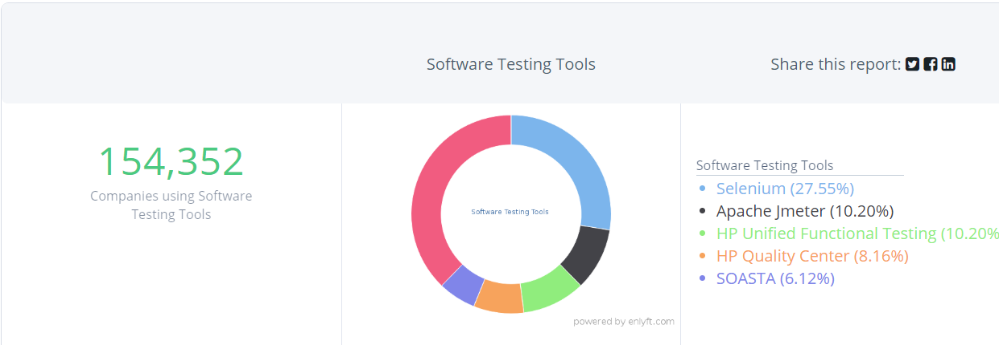
3. 一年軟體測試工具（含web、android、ios）市場規模多少？

Slide 5
4. 一年各測試服務（testing services）公司的市場規模？
#1) ScienceSoft
Company size: 500+ employees
Company yearly revenue: $22M
Headquarters: McKinney, Texas, US
#2) Mindful QA
No. of Employees: 50-200

Slide 6
#3) Cybage
Company size: 5700 employees
Headquarter: Pune, India
Company yearly revenue: $4M
#4) Infosys
Company size: 200,364 employees
Company yearly revenue: $10.9 billion in revenue
Headquarter: Bengaluru, India
#5) Microexcel
Company size: 1500 employees Headquarter: Secaucus, New Jersey 07094, USA Company yearly revenue: $20M

Slide 7
#6) Tech Mahindra
Company size: 113,550 employees Company yearly revenue: US$4.77 billion Headquarter: India
#7) JadeGlobal
Company size: 900+ employees. Headquarter: San Jose, California Company yearly revenue: $39.0 M
#8) NTT DATA Services
Company size: 15,228 employees Headquarter: Tokyo Company yearly revenue: $14 billion.

Slide 8
#9) Powertest
Company size: 53 employees Headquarter: San Francisco Company yearly revenue: $11.6M
#10) Thinksys
Company size: 150 employees Headquarter: USA Company yearly revenue: $3.5 M
#11) ZenQ
Company size: 400 employees Headquarter: Hyderabad (India) Company yearly revenue: $2.5
#12) A1QA
Company size: 60 Headquarter: Lakewood, CO Company yearly revenue: $2M

Slide 9
5. 市場上web、android、ios測試工具的功能？

Slide 10

1. Selenium
Selenium offers flexibility that is unseen in many other test automation tools and frameworks.
Users can write test scripts in many differents languages (such as Java, Groovy, Python, C#, PHP, Ruby, and Perl) that run on multiple system environments (Windows, Mac, Linux) and browsers (Chrome, Firefox, IE, and Headless browsers).

Slide 11

2. Katalon Studio
Leveraging Selenium and Appium engines, Katalon Studio provides a uniquely integrated environment for testers who find difficulties in integrating and deploying different frameworks and libraries to use Selenium and Appium, as well as those who are already familiar with these engines.

Slide 12

3.UFT
Several highlights of the tool that support API testing:
Intuitive user interface for creating, executing, and reporting API tests
Support generating API tests from WADL documents
Tests’ actions, activities, and parameters can be visualized in diagrams

Slide 13
參考資料
Q1:https://www.researchandmarkets.com/reports/4841326/automation-testing-market-by-component-testing
Q2:https://www.technavio.com/report/software-testing-services-market-industry-analysis
Q3:https://enlyft.com/tech/software-testing-tools/
Q4:https://www.softwaretestinghelp.com/performance-testing-service-providers/
Q5:https://medium.com/@briananderson2209/best-automation-testing-tools-for-2018-top-10-reviews-8a4a19f664d2

