Slide 1
Compiler Technology of Programming Languages
Chapter 9
Semantic Analysis
Prof. Farn Wang
Department of Electrical Engineering

Slide 2

Outlines of Chapter 9
Semantic analysis for control structures
  Reachability and Termination Analysis
  If statements
  Switch and Case
  While, Do and Repeat Loops
  For loops
  Break, Continue, Return and GoTo
  Exception Handling
Semantic analysis of Calls
Select statements
Iterative statements
Departure from normal path
Prof. Farn Wang, Department of Electrical Engineering
Notes:
Syntactic differences do not matter. AST hides such differences.

Slide 3

Semantic Analysis for Control Structures
Three aspects of semantic analysis
  Type Correctness
    Chapter 8 covered this type of analysis
  Reachability and termination
    determines if a construct will ever be executed and will terminate normally
    required by Java and C#
  Exception Handling
    Constructs may throw exceptions rather than terminate normally.
Prof. Farn Wang, Department of Electrical Engineering

Slide 4
Semantic Analysis for Control Structures
Static semantics
  Semantics visitor
  checks type rules
  Reachability visitor
    Analyzes control structures for reachability and proper termination
  Throw visitor
    Computes the ThrowsSet field, which records exceptions that may be thrown
Required by Java and C#
Optional for C and C++
Prof. Farn Wang, Department of Electrical Engineering

Slide 5
Exceptions
Anomalous or exceptional conditions during execution that require special processing.
Hardware exception handling/traps
  Traps are internal interrupts, if no registered exception handler, traps will cause core dump – program termination.
  Example: misaligned access, segmentation faults, floating point underflow.
  OS provides signal supports:
    E.g. SIGSEGV, SIGILL, SIGBUS, SIGFPE
Software exception handling
  Offer programmers a chance to handle it gracefully.
  Many modern PLs (C++,C#, Java, ML, Objective-C, Python, Ruby, Scala, .NET languages) support exception handling.
Prof. Farn Wang, Department of Electrical Engineering
Notes:
Exception handling is expensive, unpleasant.
Pipelined process. Vector computer, GPGPU, …. Any high performance computers hate exceptions/interrupts
Yet without exception handling, the processor is incomplete.
=========================
=========================
UNALIGNED MEMORY ACCESSES
=========================
:Author: Daniel Drake <dsd@gentoo.org>,
:Author: Johannes Berg <johannes@sipsolutions.net>
:With help from: Alan Cox, Avuton Olrich, Heikki Orsila, Jan Engelhardt,
Kyle McMartin, Kyle Moffett, Randy Dunlap, Robert Hancock, Uli Kunitz,
Vadim Lobanov
Linux runs on a wide variety of architectures which have varying behaviour
when it comes to memory access. This document presents some details about
unaligned accesses, why you need to write code that doesn't cause them,
and how to write such code!
The definition of an unaligned access
=====================================
Unaligned memory accesses occur when you try to read N bytes of data starting
from an address that is not evenly divisible by N (i.e. addr % N != 0).
For example, reading 4 bytes of data from address 0x10004 is fine, but
reading 4 bytes of data from address 0x10005 would be an unaligned memory
access.
The above may seem a little vague, as memory access can happen in different
ways. The context here is at the machine code level: certain instructions read
or write a number of bytes to or from memory (e.g. movb, movw, movl in x86
assembly). As will become clear, it is relatively easy to spot C statements
which will compile to multiple-byte memory access instructions, namely when
dealing with types such as u16, u32 and u64.
Natural alignment
=================
The rule mentioned above forms what we refer to as natural alignment:
When accessing N bytes of memory, the base memory address must be evenly
divisible by N, i.e. addr % N == 0.
When writing code, assume the target architecture has natural alignment
requirements.
In reality, only a few architectures require natural alignment on all sizes
of memory access. However, we must consider ALL supported architectures;
writing code that satisfies natural alignment requirements is the easiest way
to achieve full portability.
Why unaligned access is bad
===========================
The effects of performing an unaligned memory access vary from architecture
to architecture. It would be easy to write a whole document on the differences
here; a summary of the common scenarios is presented below:
- Some architectures are able to perform unaligned memory accesses
transparently, but there is usually a significant performance cost.
- Some architectures raise processor exceptions when unaligned accesses
happen. The exception handler is able to correct the unaligned access,
at significant cost to performance.
- Some architectures raise processor exceptions when unaligned accesses
happen, but the exceptions do not contain enough information for the
unaligned access to be corrected.
- Some architectures are not capable of unaligned memory access, but will
silently perform a different memory access to the one that was requested,
resulting in a subtle code bug that is hard to detect!
It should be obvious from the above that if your code causes unaligned
memory accesses to happen, your code will not work correctly on certain
platforms and will cause performance problems on others.
Code that does not cause unaligned access
=========================================
At first, the concepts above may seem a little hard to relate to actual
coding practice. After all, you don't have a great deal of control over
memory addresses of certain variables, etc.
Fortunately things are not too complex, as in most cases, the compiler
ensures that things will work for you. For example, take the following
structure::
struct foo {
u16 field1;
u32 field2;
u8 field3;
};
Let us assume that an instance of the above structure resides in memory
starting at address 0x10000. With a basic level of understanding, it would
not be unreasonable to expect that accessing field2 would cause an unaligned
access. You'd be expecting field2 to be located at offset 2 bytes into the
structure, i.e. address 0x10002, but that address is not evenly divisible
by 4 (remember, we're reading a 4 byte value here).
Fortunately, the compiler understands the alignment constraints, so in the
above case it would insert 2 bytes of padding in between field1 and field2.
Therefore, for standard structure types you can always rely on the compiler
to pad structures so that accesses to fields are suitably aligned (assuming
you do not cast the field to a type of different length).
Similarly, you can also rely on the compiler to align variables and function
parameters to a naturally aligned scheme, based on the size of the type of
the variable.
At this point, it should be clear that accessing a single byte (u8 or char)
will never cause an unaligned access, because all memory addresses are evenly
divisible by one.
On a related topic, with the above considerations in mind you may observe
that you could reorder the fields in the structure in order to place fields
where padding would otherwise be inserted, and hence reduce the overall
resident memory size of structure instances. The optimal layout of the
above example is::
struct foo {
u32 field2;
u16 field1;
u8 field3;
};
For a natural alignment scheme, the compiler would only have to add a single
byte of padding at the end of the structure. This padding is added in order
to satisfy alignment constraints for arrays of these structures.
Another point worth mentioning is the use of __attribute__((packed)) on a
structure type. This GCC-specific attribute tells the compiler never to
insert any padding within structures, useful when you want to use a C struct
to represent some data that comes in a fixed arrangement 'off the wire'.
You might be inclined to believe that usage of this attribute can easily
lead to unaligned accesses when accessing fields that do not satisfy
architectural alignment requirements. However, again, the compiler is aware
of the alignment constraints and will generate extra instructions to perform
the memory access in a way that does not cause unaligned access. Of course,
the extra instructions obviously cause a loss in performance compared to the
non-packed case, so the packed attribute should only be used when avoiding
structure padding is of importance.
Code that causes unaligned access
=================================
With the above in mind, let's move onto a real life example of a function
that can cause an unaligned memory access. The following function taken
from include/linux/etherdevice.h is an optimized routine to compare two
ethernet MAC addresses for equality::
bool ether_addr_equal(const u8 *addr1, const u8 *addr2)
{
#ifdef CONFIG_HAVE_EFFICIENT_UNALIGNED_ACCESS
u32 fold = ((*(const u32 *)addr1) ^ (*(const u32 *)addr2)) |
((*(const u16 *)(addr1 + 4)) ^ (*(const u16 *)(addr2 + 4)));
return fold == 0;
#else
const u16 *a = (const u16 *)addr1;
const u16 *b = (const u16 *)addr2;
return ((a[0] ^ b[0]) | (a[1] ^ b[1]) | (a[2] ^ b[2])) == 0;
#endif
}
In the above function, when the hardware has efficient unaligned access
capability, there is no issue with this code. But when the hardware isn't
able to access memory on arbitrary boundaries, the reference to a[0] causes
2 bytes (16 bits) to be read from memory starting at address addr1.
Think about what would happen if addr1 was an odd address such as 0x10003.
(Hint: it'd be an unaligned access.)
Despite the potential unaligned access problems with the above function, it
is included in the kernel anyway but is understood to only work normally on
16-bit-aligned addresses. It is up to the caller to ensure this alignment or
not use this function at all. This alignment-unsafe function is still useful
as it is a decent optimization for the cases when you can ensure alignment,
which is true almost all of the time in ethernet networking context.
Here is another example of some code that could cause unaligned accesses::
void myfunc(u8 *data, u32 value)
{
[...]
*((u32 *) data) = cpu_to_le32(value);
[...]
}
This code will cause unaligned accesses every time the data parameter points
to an address that is not evenly divisible by 4.
In summary, the 2 main scenarios where you may run into unaligned access
problems involve:
1. Casting variables to types of different lengths
2. Pointer arithmetic followed by access to at least 2 bytes of data
Avoiding unaligned accesses
===========================
The easiest way to avoid unaligned access is to use the get_unaligned() and
put_unaligned() macros provided by the <asm/unaligned.h> header file.
Going back to an earlier example of code that potentially causes unaligned
access::
void myfunc(u8 *data, u32 value)
{
[...]
*((u32 *) data) = cpu_to_le32(value);
[...]
}
To avoid the unaligned memory access, you would rewrite it as follows::
void myfunc(u8 *data, u32 value)
{
[...]
value = cpu_to_le32(value);
put_unaligned(value, (u32 *) data);
[...]
}
The get_unaligned() macro works similarly. Assuming 'data' is a pointer to
memory and you wish to avoid unaligned access, its usage is as follows::
u32 value = get_unaligned((u32 *) data);
These macros work for memory accesses of any length (not just 32 bits as
in the examples above). Be aware that when compared to standard access of
aligned memory, using these macros to access unaligned memory can be costly in
terms of performance.
If use of such macros is not convenient, another option is to use memcpy(),
where the source or destination (or both) are of type u8* or unsigned char*.
Due to the byte-wise nature of this operation, unaligned accesses are avoided.
Alignment vs. Networking
========================
On architectures that require aligned loads, networking requires that the IP
header is aligned on a four-byte boundary to optimise the IP stack. For
regular ethernet hardware, the constant NET_IP_ALIGN is used. On most
architectures this constant has the value 2 because the normal ethernet
header is 14 bytes long, so in order to get proper alignment one needs to
DMA to an address which can be expressed as 4*n + 2. One notable exception
here is powerpc which defines NET_IP_ALIGN to 0 because DMA to unaligned
addresses can be very expensive and dwarf the cost of unaligned loads.
For some ethernet hardware that cannot DMA to unaligned addresses like
4*n+2 or non-ethernet hardware, this can be a problem, and it is then
required to copy the incoming frame into an aligned buffer. Because this is
unnecessary on architectures that can do unaligned accesses, the code can be
made dependent on CONFIG_HAVE_EFFICIENT_UNALIGNED_ACCESS like so::
#ifdef CONFIG_HAVE_EFFICIENT_UNALIGNED_ACCESS
skb = original skb
#else
skb = copy skb
#endif

Slide 6
Rules for Java Exceptions
Catch or Declare Rule
  All checked exceptions that may occur in a procedure must be caught by that procedure or are listed in that procedure’s throws clause
  All checked exceptions that may be propagated to a caller from a procedure must be listed in that procedure’s throws clause.
  All checked exceptions that are listed in a procedure’s throws clause must be propagated to a caller from that procedure in some situations.
Prof. Farn Wang, Department of Electrical Engineering

Slide 7
Checked vs. Unchecked Exceptions
Checked exceptions:
  if you know how to deal with using some alternative code.
  must be dealt with in a try/catch block or by declaring a “throws” clause in a method.
Unchecked exceptions:
  you don’t know how to deal with, and they should never happen
  if they do, it is a bug.
  If they happen, let them come up to the surface and displayed to the user.
  normally runtime exceptions like NullPointerException.
Programmers usually tend to ignore that responsibility.
Prof. Farn Wang, Department of Electrical Engineering

Slide 8
Basic Try-Throw-Catch
try { if (num==0)
throw new exception(“error! …”);
….}
catch (exception e)
{
String message = e.getMessage();
System.out.println(message);
System.exit(0);
}
Exception handler
Prof. Farn Wang, Department of Electrical Engineering

Slide 9
Throwing Exceptions in a Method
Public void safedivide(int top, into bottom)
throws divbyzeroException
{
if (bottom == 0)
throw new divbyzeroException();
return top/bottom;
}
Public class divbyzeroException extends Exception
{
constructor…
access methods …
}
Prof. Farn Wang, Department of Electrical Engineering

Slide 10
Catching Exceptions in the Caller
Public void calldivide() {
try {
int result = safedivide(2,0);
….}
catch (divbyzeroException, e);
// do something with the exception
Prof. Farn Wang, Department of Electrical Engineering

Slide 11
Propagate Exceptions
Public void calldivide()
throws divbyzeroException
{
int result = safedivide(2,0);
….
}
Uncaught exceptions must propagate up the call stack
Prof. Farn Wang, Department of Electrical Engineering

Slide 12
Reachability and Termination Analysis
Java requires unreachable statements be identified.
In the general case, to tell whether a statement is unreachable is undecidable.
So the reachability analysis is usually conservative.
answering unreachable or don’t know
…;
return;
a=a+1;
…
Unreachable
conservative here means “err on one side”
Prof. Farn Wang, Department of Electrical Engineering

Slide 13
Example
1) for (i=0; c < n; i++) { c = f(i); }
Will this loop ever terminate?
2) If (a > b) {…}
else if (a > c) { S1 }
Will S1 be reachable?
What if when a <= b then a is always <= c ?
Prof. Farn Wang, Department of Electrical Engineering

Slide 14
Example
1) for (i=0; c < n; i++) { c = f(i); }
Will this loop ever terminate?
2) If (a > b) {…}
else if (a > c) { S1 }
Will S1 be reachable?
What if when a <= b then a is always <= c ?
Conservative: TerminateNormally
Conservative: isReachable
Prof. Farn Wang, Department of Electrical Engineering

Slide 15
Conservative Analysis in Compilers
Example 1
isReachable ➔ may be reachable
Example 2:
terminateNormally ➔ may terminate normally
Example 3:
variable a is initialized ➔ may be initialized
Example 4: alias/heap/pointer analysis
*p may alias with *q
*p may alias with variable a,b[3],*(*(c+2)+5)
Prof. Farn Wang, Department of Electrical Engineering

Slide 16
Termination analysis
A statement terminates normally if execution continues to the next statement.
According to this criterion,
statements such as break, continue, return, etc. do not terminate normally.
An infinite loop, such as for (;;) {}, does not terminate normally, either.
Prof. Farn Wang, Department of Electrical Engineering

Slide 17
Rules for isReachable and TerminateNormally
Each STMT and STMT_list (nonterminals) AST nodes will include two attributes:
isReachable and TerminateNormally
If a statement list is reachable, it is also true for its first statement
If TerminateNormally is false for the last statement in a statement list, it is also false for the whole list.
The statement list that comprises the body of a method, constructor or a static initializer is always considered reachable.
Prof. Farn Wang, Department of Electrical Engineering

Slide 18
Rules for isReachable and TerminateNormally
A local variable declaration or an expression statement always have TerminateNormally true.
A null statement never generates an error message if it is not reachable. The isReachable value is propagated to the successor.
A statement is reachable if and only if its predecessor terminate normally.
True meaning:
isReachable → is possibly reachable
TerminateNormally → may terminate normally
Prof. Farn Wang, Department of Electrical Engineering

Slide 19
Example
Void example ()
{ int v;
v++; return; ; v=10; v=20; }
the method body is reachable
the declaration is reachable
the declaration and the increment terminate normally
The return is reachable, but does not terminate normally
the null statement is not reachable
V=10 is not reachable, and generate an error msg
Prof. Farn Wang, Department of Electrical Engineering

Slide 20
Function
If the STMT list of a function body is terminate abnormally,
  that means it does not execute a return.
  So the needs to issue an error message.
Prof. Farn Wang, Department of Electrical Engineering

Slide 21
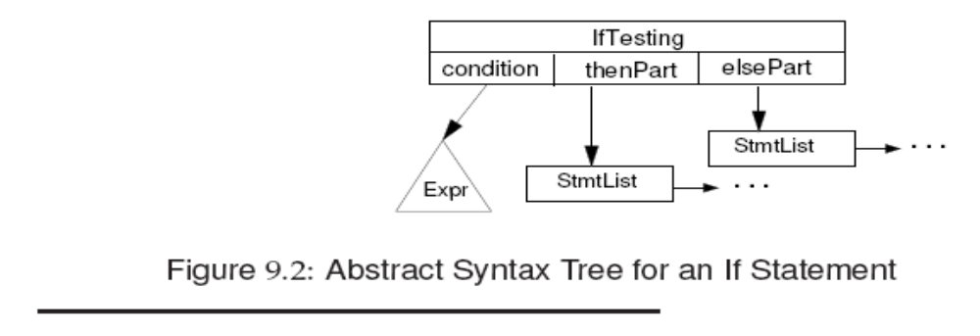
IF statements
Check whether the predicate (Expr) has the
boolean or errorType type.
Type check for children (then and else)
Reachability check and collect exceptions from each child.
What if the predicate is known (T or F)?
Prof. Farn Wang, Department of Electrical Engineering

Slide 22
Example of Checking an IF statement
If (b) a = 1;
else a = 2;
Check that the predicate b produces a boolean value
Two children (then and else) are type checked.
Since the two statements terminate normally, so does the whole IF statement.
Prof. Farn Wang, Department of Electrical Engineering

Slide 23
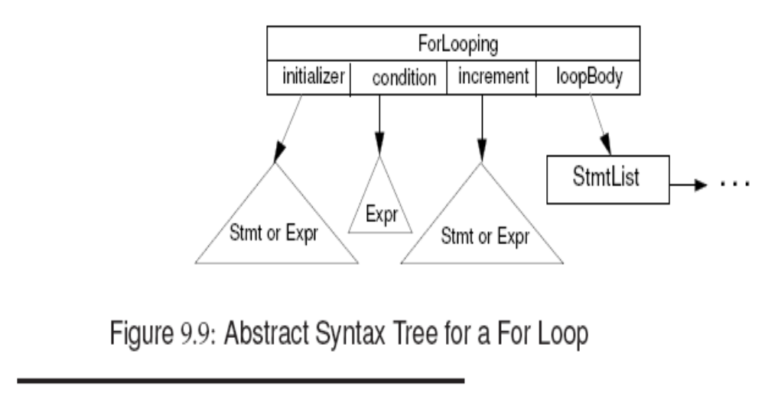
For Loops
Prof. Farn Wang, Department of Electrical Engineering

Slide 24
Semantic Checking of For
In C++, C# and Java, a new index variable local to the for loop may be declared.
e.g. for (int n = 1; n < 10; n++)
A null condition and a constant-true predicate make the loop non-terminating
Gather all the ThrowsSet from all children
Prof. Farn Wang, Department of Electrical Engineering

Slide 25
Exception Checks
Exceptions may be thrown explicitly or implicitly
Thrown exceptions may be propagated several times and then finally get caught by a handler.
Java exceptions are typed: all exceptions are subclasses of the Throwable class.
Two kinds of exceptions: checked and unchecked.
  A checked exception must be caught by an enclosing try statement or is listed in the throws clause of the enclosing method.
  exceptions that are exempt from the Catch or Declare rule are called unchecked exceptions.
Prof. Farn Wang, Department of Electrical Engineering

Slide 26
Exception Checks
class ExitComputation extends Exception { . . . }
try { . . .
if (a > b) throw new ExitComputation();
if (v < 0.0) throw new ArithemticException();
else a =Math.sqrt(v)
}
catch (ExitComputation e) { print(e); return(0); }
catch (ABCException e) { print(e); return(5); }
finally { a := b + c; }
Prof. Farn Wang, Department of Electrical Engineering

Slide 27
Exception Checks
An unchecked exception (i.e. a RuntimeException or an Error) may optionally be handled in a try statement.
  If not caught by the program, it will be passed to the Java runtime system, and the program will terminate.
  For example, the ArithemeticException, a subclass of RuntimeException, is an unchecked exception.
For the catch clause, we must check
  if indeed an exception is thrown
  if the exception subsumes (i.e. hide) a later exception in the list. (the compiler may either warn, or reverse the order)
For the throw statement
  Check if indeed the parameter is an exception object
Prof. Farn Wang, Department of Electrical Engineering

Slide 28
Exception Checks
Error Case 1
int mm() throws A, B {
try { throw new E;
} catch (C e) { ... }
catch (D e) { ... }
}
Error Case 2
int mm() throws A, B {
  try {
  ... throw new A;
  ... throw new B;
  ... throw new C;
  // never throw new D;
  } catch (C e) { ... }
  catch (D e) { ... } // this D handler is redundant
  }
Prof. Farn Wang, Department of Electrical Engineering

