Slide 1
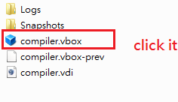
Open prepared VirtualBox image
Please install VirtualBox first.
*If the Internet is disable, please reconnect the Internet or reboot the OS.

Slide 2
If internet is disable.
Please reboot or reconnect.

Slide 3
How to run our output.s

Slide 4
Tools
arm-linux-gnueabihf-gcc
(Ubuntu/Linaro 4.8.2-16ubuntu4) 4.8.2
arm-linux-gnueabihf-objdump
GNU objdump (GNU Binutils for Ubuntu) 2.24

Slide 5
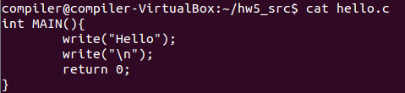
Don’t modify main.S .
hello.c is the input file( what we want to cpmpile).
Run ./parser hello.c. The output.s is the output.

Slide 6
Linking: arm-linux-gnueabihf-gcc –static –mcpu=cortex-a15 main.S output.s
a.out is the arm executable. We run a.out through qemu-arm

Slide 7
You can also use run.sh
We also provide a script: run.sh to do all these instructions.
Usage:
./run.sh [your parser] [ the C-- file]
The output is a a.out executable.
Ex: ./run.sh .parser ./patern/hello.c

Slide 8
How to debug?

Slide 9
Using GDB and QEMU
We can run command: arm-linux-gnueabihf-objdump -d a.out >tmp.s to dump assembly to tmp.s
Run: qemu-arm-static -g 1234 ./a.out
create another terminal and type the following command
gdb-multiarch
(enter gdb)
set architecture arm
target remote localhost:1234

Slide 10
Some useful command for gdb
b *address
layout asm
layout regs
c
nexti
Can get more information by typing help or google gdb.

Slide 11
