Slide 1
Introduction to Compilers 編譯器介紹
Farn Wang 王凡
farn@ntu.edu.tw
Thanks to Prof. Wei Chung Hsu for sharing the presentation matierials.

Slide 2
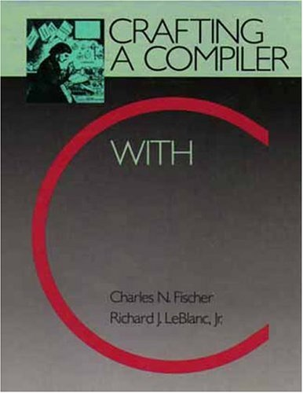
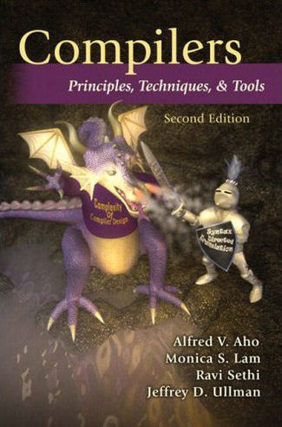
Textbooks
C.N. Fischer, R.K. Cytron,
and R.J. LeBlanc, Jr.
Crafting a Compiler with C
Pearson
開發圖書公司
23585 新北市中和區中山路二段327巷1號6樓,
(02) 8242-3988
Reference book:
A.V. Aho, M. Lam, R. Sethi, and J.D. Ullman
Compilers: Principles, Techniques and Tools
the Dragon book, 2nd edition, 2007 (1st edition in 1986)

Slide 3

Textbooks
Instructor: 王凡教授
Office Hours: Monday 13-14, BL 616
farn@ntu.edu.tw
TA：王冠鈞 (jeff1jeffo@gmail.com)

Slide 4
Software complexities (1/2)
Year | Operating System | SLOC (Million)
1993 | Windows NT 3.1 | 4-5
1994 | Windows NT 3.5 | 7-8
1996 | Windows NT 4.0 | 11-12
2000 | Windows 2000 | >29
2001 | Windows XP | 40
2003 | Windows Server 2003 | 50
Vincent Maraia
Build Master, The:Microsoft's Software Configuration Management Best Practices
Addison-Wesley
October 2005
ISBN13: 9780321332059, ISBN10: 0-321-33205-9

Slide 5
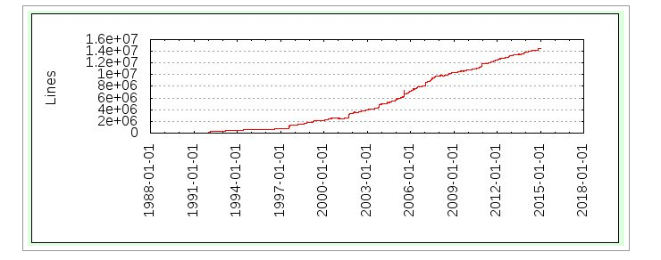
GCC (4.9) Soars Past 14.5 M Lines Of Code
System Software Dragons
Linux kernel (4.1) is over 22M Lines Of Code
Notes:
If you lack of SW development experience, you need to get help – open source SW community, senior students, …

Slide 6
Software complexities (2/2)
Operating System | SLOC (Million)
Debian 2.2 | 55-59
Debian 3.0 | 104
Debian 3.1 | 215
Debian 4.0 | 283
OpenSolaris | 9.7
FreeBSD | 8.8
Mac OS X 10.4 | 86
Linux kernel 2.6.0 | 5.2
Linux kernel 2.6.29 | 11.0
Linux kernel 2.6.32 | 12.6
source lines of code
http://en.wikipedia.org/wiki/Source_lines_of_code

Slide 7
Software Crisis Productivity of SEers did not scale!
Software | Estimates (LOC/P-month)
Real-time embedded systems | 40-160
Systems programs | 150-400 LOC/P-month
Commercial applications | 200-800 LOC/P-month
* including all necessary activities in software development.
Ian Sommerville
Software cost estimation, chapter 29
Software Engineering, 5th edition, Addison-Wesley
modified by Spiros Mancoridis 1998

Slide 8

Software Crisis toward the solutions
I double every 18 month!
AI
Oh, oh!
I produce <1000 LOC a month!
Automated programming
Theory
Program proof!
Automated verification!
Algorithm templates!
PL
OS
Abstraction
Optimization
OO
libraries
SE
System services!
Abstract API!
OO
CI
Testing
Disciplene

Slide 9
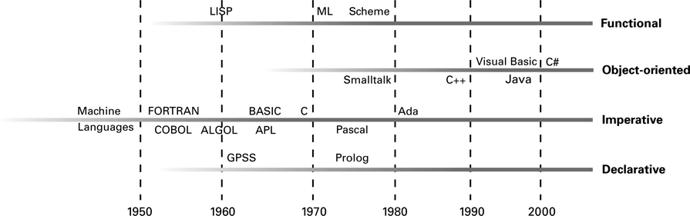
The evolution of programming paradigms

Slide 10
Grading:
Homework and Compiler Implementation: 45%
Midterm Exam: 20% (in-class)
Final Exam: 20% (in-class)
Peer evaluation (10%)
Quizzes and Class Participation (5%)
Compiler Implementation Project
Team of two
In C or C++
Details: visit the class website (Ceiba)
Notes:
Exams are open books/open notes/open google

Slide 11
Introduction to Compilers 課綱
Week 1 | 9/14 | 1) Course Organization, 2) Chapter 1: Introduction
Week 2 | 9/21 | 1) Chapter 2: A Simple Compiler (Homework: A Simple Compiler)
Week 3 | 9/28 | Chapter 3: Scanner
Week 4 | 10/5 | Quiz1 (Chapter 1-3) (Project: A C– Compiler CheckPoint#1: A Scanner) Chapter 4: Grammar and Parsing
Week 5 | 10/12 | Chapter 5: Top-Down Parsing
Week 6 | 10/19 | Chapter 6: Bottom-up Parsing (CheckPoint#2: A Parser) Quiz2 (Chapter 4-6)
Week 7 | 10/26 | Midterm Exam
Week 8 | 11/2 | Chapter 7: Syntax Directed Translation (CheckPoint#3: A Type Checker)
Week 9 | 11/09 | Chapter 12: Runtime Support
Week 10 | 11/16 | Chapter 8: Declaration Processing and Symbol Table
Week 11 | 11/23 | Chapter 9: Semantic Analysis
Week 12 | 11/30 | Code Generation for ARMV8 (CheckPoint#4: Code Generation I)
Week 13 | 12/7 | Code Generation for Data Accesses and Simple Register Allocation
Week 14 | 12/14 | Code Generation for Control Structures (CheckPoint#5: Code Generation II)
Week 15 | 12/21 | Code Generation for Arrays, Procedure Calls
Week 16 | 12/28 | Basic Code Optimizations: CSE, Register Allocation, and Code Scheduling
Week 17 | 1/4 | Advanced Optimization: Parallelization, GPGPU optimization, Vectorization, Memory Hierarchy related optimization, …

Slide 12
Introduction to Compilers課綱
Introduction and Overview of a Simple compiler
Week 1 | 9/14 | Introduction
Week 2 | 9/21
Week 3 | 9/28 | Chapter 3: Scanner
Week 4 | 10/5 | Quiz1 (Chapter 1-3) (Project: A C– Compiler CheckPoint#1: A Scanner) Chapter 4: Grammar and Parsing
Week 5 | 10/12 | Chapter 5: Top-Down Parsing
Week 6 | 10/19 | Chapter 6: Bottom-up Parsing (CheckPoint#2: A Parser) Quiz2 (Chapter 4-6)
Week 7 | 10/26 | Midterm Exam
Week 8 | 11/2 | Chapter 7: Syntax Directed Translation (CheckPoint#3: A Type Checker)
Week 9 | 11/09 | Chapter 12: Runtime Support
Week 10 | 11/16 | Chapter 8: Declaration Processing and Symbol Table
Week 11 | 11/23 | Chapter 9: Semantic Analysis
Week 12 | 11/30 | Code Generation for ARMV8 (CheckPoint#4: Code Generation I)
Week 13 | 12/7 | Code Generation for Data Accesses and Simple Register Allocation
Week 14 | 12/14 | Code Generation for Control Structures (CheckPoint#5: Code Generation II)
Week 15 | 12/21 | Basic Code Optimizations: CSE, Register Allocation, and Code Scheduling
Week 16 | 12/28 | Advanced Optimization: Parallelization, GPGPU optimization
Week 17 | 1/4 | Advanced Optimization: Vectorization, Memory Hierarchy related optimization, …
Scanner
Parser
Exam
Type Checker (Semantic Analyzer)
Code Generation
Compiler Optimizations
Notes:
If you only like to know the rough concept of a compiler, you may quit after two weeks

Slide 13
Compiler Technology of Programming Languages
Chapter 1
Introduction
Prof. Farn Wang

Slide 14
What is a compiler? (original meaning)
reads a program written in the source language and
translate it into an equivalent program in machine language.
Source
Program
(in high level lang.)
Compiler
Machine code (or object code)
Automatic translation +
Optimization
Error messages

Slide 15
Fallacy and Facts
Code in assembly language to obtain the highest performance
Compilers register allocation, code scheduling, and many very sophisticated code optimization techniques.
Such optimizations by hand are error prone.
Compilers usually have the better knowledge of the processor architecture.
Software crisis: High-level languages for productivity, maintainability, portability, ease of debugging, code reusability.

Slide 16
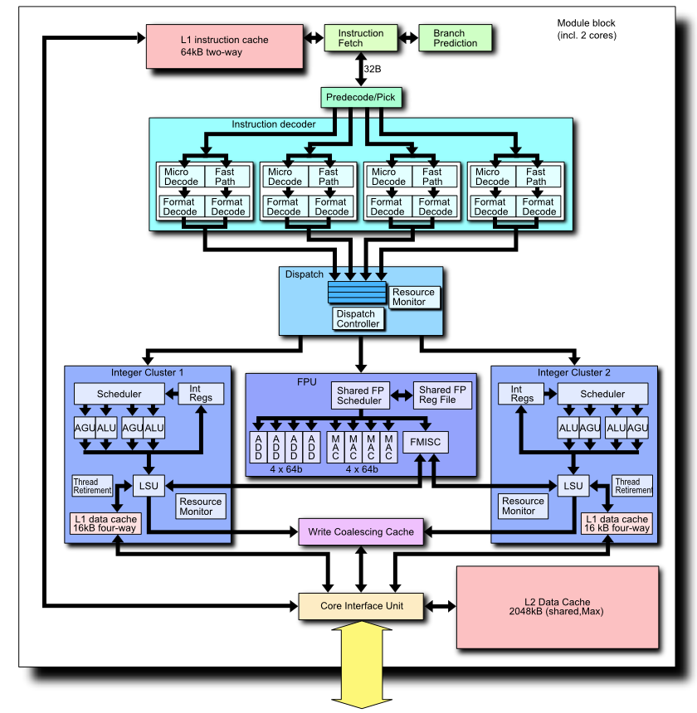
Micro-architectures are getting increasingly more complex, writing assembly code to obtain high performance is no longer a manageable task.
Micro-architectures are company IP, for example, Intel would not give out all details of x86 micro-architectures.
For dynamic, OOO processors, it is hard for a programmer to know how to write a high performance code. Should leave this job to experts.

Slide 17
What is a compiler? (broader meaning)
reads a program written in a source language and
translate it into an equivalent program in target language.
Compiler
Source
program
Target
Program
Error messages

Slide 18
What Do Compilers Do?
Source language:
High-level programming languages,
Text-formatting languages, (e.g. LaTex)
Logic-level specification languages (e.g. HDL)
Application binaries in one ISA (e.g. x86/ARM)
DataBase Query Languages
Target language:
Machine languages,
Other high-level PL,
Typesetting commands,
VLSI layout
Other ISAs
DataBase Access Methods
Compiler technology can be broadly applied

Slide 19
Target machine code
Pure machine code (i.e. ISA)
Assembly language format
Relocatable binary format
Augmented machine code (augment with system calls, I/O, memory allocation, math functions, …) (i.e. ABI)
Virtual machine code (e.g. P-code or byte code)
Good for transportable compilers
Generated code need to be interpreted
Whatever target codes are, compilers do the same job: Translation/Compilation.
VISA
Notes:
Relocation is related to linking and loading. Read Levine's book Linkers & Loaders for details. Long time ago (at the beginning of Unix, 1970s) the kernel loaded and started an executable by simply copying blocks -memory segments- from disk to RAM, but today, with virtual memory & paging enabling shared libraries, things are much more complex.
(I'm taking mostly a Linux perspective below; but I guess you can adapt my answer to your OS.)
Usually object files (or libraries) -sometimes called relocatable binaries- contain not only some binary sections (containing machine code and/or data) but also some relocation sections containing a sequence of relocation directives to modify the segment containing the section at link or load time. Even some executables (notably those dynamically linked) may contain relocation directives ... A relocation directive might be: in memory at address A loaded by offset B in file, replace the three following bytes by the 24 lowest bits of difference between A and the value of the linker symbol (e.g. the address of function named) printf
Read more about ELF, and read the ABI specification relevant to your system (e.g. this one for Linux/x86_64 ABI), for details about the particular relocation directives possible on your computer. The actual relocation directives depend upon the processor's instruction set & addressing modes and the flexibility of the linker or operating system kernel.
Read also about position-independent code, self-relocation, dynamic linker, ASLR. See also ld-linux(8) & elf(5). Use and play with readelf(1), objdump(1), ldd(1) to explore and understand some particular ELF binary (e.g. /bin/ls), and execute it with strace(1) to understand the system calls (listed in syscalls(2)...) involved when running it. See also execve(2) & read Advanced Linux Programming to get a broader picture.
In some systems, the relocation directives (actually some bytecode for the linker) may be complex enough to make them Turing complete (iirc, some versions of HPUX for some HPPA RISC processors had very complex relocations, with conditionals; arithmetic; loops).
And you might consider that link time optimization could be seen as some very complex relocation; but most people view it as some weird compiler optimization happening at link time (In fact, the border between compilation & linking & running is unclear, see also just-in-time compilation).
********************************
ABI: an application binary interface (ABI) is an interface between two binary program modules; often, one of these modules is a library or operating system facility, and the other is a program that is being run by a user.
**************************************
In computer programming, a p-code machine, or portable code machine[citation needed] is a virtual machine designed to execute p-code (the assembly language of a hypothetical CPU). This term is applied both generically to all such machines (such as the Java Virtual Machine and MATLAB precompiled code), and to specific implementations, the most famous being the p-Machine of the Pascal-P system, particularly the UCSD Pascal implementation (among whose developers the "p" in "p-code" was construed to mean "pseudo" more often than "portable", "pseudo-code" thus meaning instructions for a pseudo-machine) .
Although the concept was first implemented circa 1966 (as O-code for BCPL and P – a code for the Euler Language),[1] the term p-code first appeared in the early 1970s. Two early compilers generating p-code were the Pascal-P compiler in 1973, by Nori, Ammann, Jensen, Hageli, and Jacobi,[2] and the Pascal-S compiler in 1975, by Niklaus Wirth.
Programs that have been translated to p-code can either be interpreted by a software program that emulates the behavior of the hypothetical CPU, or translated into the machine code of the CPU on which the program is to run and then executed. If there is sufficient commercial interest, a hardware implementation of the CPU specification may be built (e.g., the Pascal MicroEngine or a version of the Java processor).
***************************************
Intel(R) C++ Compiler 15.0 Beta Update 2 provides a feature which enables offloading general purpose compute kernels to processor graphics. This feature enables the processor graphics silicon area for general purpose computing. Unlike the discrete graphics cards, processor graphics can directly access system RAM. Each processor graphics (depending on the processor generation and SKU) host certain number of execution units and each execution has certain number of hardware threads (each thread can run in SIMD mode). The key idea is to utilize the compute power of both CPU cores and GPU execution units in tandem for better utilization of available compute power. Intel(R) C++ Compiler enables the compute offload using Intel(R) Cilk(TM) Plus programming model which gives a seamless porting experience for C/C++ developers. Refer to https://01.org/linuxgraphics/documentation for more information on the hardware specifications of different processor graphics SKUs.
Code generation options:
Virtual Instruction Set Architecture (vISA) - This is a standard approach for general purpose computing. Here the compiler, during the target offload compilation phase, will not generate the native instruction for the target rather generates a virtual instruction (similar to bytecodes in Java). This is an intermediate representation which is feed as a input to the jitter at runtime. The Jitter queries the SKU of the processor graphics on board the target machine and jits the native instructions corresponding to each virtual ISA. The Jitter comes as a part of Intel(R) HD Graphics Driver. For more information of how to get the driver, please refer to "Getting Started with compute offload to Intel(R) Graphics Technology".

Slide 20
Analysis and Synthesis
Two parts to translation/compilation
Analysis: breaking up the source program into pieces for syntax and semantic analysis, e.g. parsing.
widely used in many tools.
Synthesis: constructing the desired target program, e.g. code generation.
can be very complex, such as the optimizer.

Slide 21
Interpreter and Compiler
Interpreter: executes programs without explicitly performing target code generation.
Interpretation often involves large overhead
Interpretation avoids the synthesis part.
Interpreter
Output
Source
program
Data

Slide 22
Why Interpretation
A higher degree of machine independence: high portability.
Dynamic execution: modification or addition to user programs are allowed (e.g. for interactive debugging).
Dynamic data types: type of objects may change at runtime (e.g. Javascript)
Easier to write an interpreter – no synthesis part.
Better diagnostics: more source text information available

Slide 23
Hybrid Translation
Source program
JIT
Translator
Virtual
Machine
Intermediate
Code (bytecode)
Output
Input
Compilation
(javac)
Interpretation
(JVM)
Compilation
(JIT)
Example: A Java Virtual Machine with a JIT
Notes:
just-in-time (JIT) compilation (also dynamic translation or run-time compilations)[1] is a way of executing computer code that involves compilation during execution of a program – at run time – rather than prior to execution.[2] Most often, this consists of source code or more commonly bytecode translation to machine code, which is then executed directly. A system implementing a JIT compiler typically continuously analyses the code being executed and identifies parts of the code where the speedup gained from compilation or recompilation would outweigh the overhead of compiling that code.

Slide 24
Fallacy Compilation is always static.
Runtime compilation:
increasingly more popular, considering Java JIT, MS .net, Graphics rendering, GPGPU code generation, …
allowing for more portable applications. (compile then distribute vs. distribute then compile)
enableing more machine dependent code optimizations.
enabling adaptive systems (e.g. dispatching OpenCL kernels to a more suitable device)
Notes:
OpenCL™ (Open Computing Language) is a low-level API for heterogeneous computing that runs on CUDA-powered GPUs. Using the OpenCL API, developers can launch compute kernels written using a limited subset of the C programming language on a GPU.
OpenCL support is included in the latest NVIDIA GPU drivers, available at www.nvidia.com/drivers

Slide 25
Structure of a Compiler
Analysis
Lexical analysis (Linear Analysis) : stream of characters are grouped into tokens
Syntax analysis (Hierarchical Analysis): tokens are grouped hierarchically with collective meaning
Semantic Analysis: ensuring the components of a program fit together (type, scope, ..)
Synthesis
Code Generation and Optimization

Slide 26
Structure of a Syntax-Directed Compiler
Source
Program
Scanner
Tokens
Parser
Syntactic
Semantic
Routines
(Character
Stream)
Structure
Intermediate
Representation
Symbol and
Attribute
Tables
Optimizer
(Used by all
Phases of the Compiler)
Code
Generator
Target Machine
Code
Department of Computer Science and Engineering
26

Slide 27
Syntax-Directed Translation
Translation actions attached to each rule of grammar.
Parsing is the driver of compilation
Once a construct is recognized by a grammar rule, a sequence of actions are taken to perform semantic checks, code generation.

Slide 28
Lexical Analysis Example
Pay := Base + Rate* 160
Lexical analysis:
characters are grouped into seven tokens:
Pay, Base, Rate are identifiers
:= is assignment symbol
+ and * are operators
160 is a number
Error example:
pay := base + rat@e*160
pay := base + rat^^e*160
→ this error (^^) will be propagated to syntax analysis and reported as a syntax error

Slide 29
Syntax Analysis Example
Pay := Base + Rate* 160
The seven tokens are grouped into a parse tree
Assignment stmt
identifier
expression
:=
pay
expression
expression
+
identifier
*
base
Rate
160

Slide 30
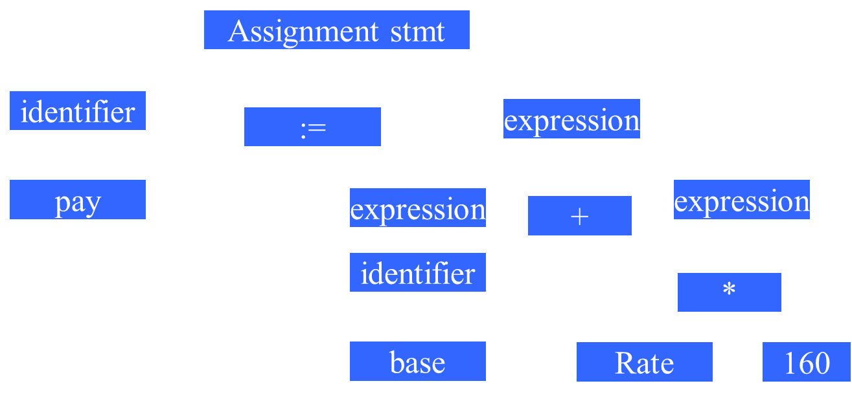
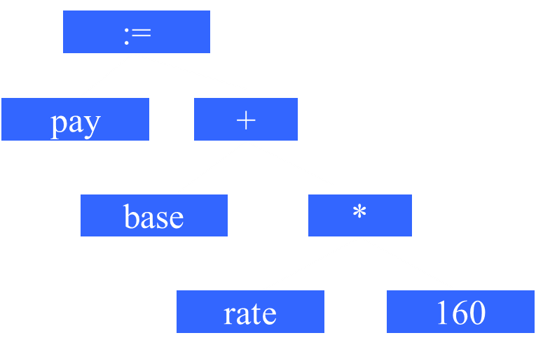
Transforming a Parse Tree to a Syntax Tree
Syntax Tree
(also called
Abstract Syntax Tree
AST)
Parse Tree

Slide 31
Semantic Analysis Example
Pay := Base + Rate* 160
Checks for semantic errors and gathers type information for code generation.
:=
:=
pay
+
pay
+
base
*
base
*
rate
Int-to-real
rate
160
160

Slide 32
The Phases of a Compiler
Source Program
Analysis
Lexical
Syntax
Semantic
IR code gen
Optimizer
Synthesis
Target code gen
Target Program
Notes:
IR: code generation is the process by which a compiler's code generator converts some intermediate representation of source code into a form (e.g., machine code) that can be readily executed by a machine.

Slide 33
The Phases of a Compiler
Source Program
Lexical
Symbol
Table
manager
Syntax
Error
handler
and
recovery
Semantic
IR code gen
Optimizer
資料庫
Target code gen
監察院?
Target Program

Slide 34
The Phases of a Compiler
Source Program
Lexical
Symbol
Table
manager
Syntax
Error
handler
and
recovery
Semantic
IR code gen
Optimizer
Target code gen
Is increasingly more important
Target code Optimizer

Slide 35
Source Program
Pay := base + rate * 60
Id1 := Id2 + Id3 * 60
lexical
:=
+
syntax
id1
*
id2
:=
id3
60
semantic
+
id1
*
id2
id3
inttoreal
IR code gen
temp1 = inttoreal(60) temp2 = id3* temp1 temp3 = id2+ temp2 id1 = temp3
60
temp1 = id3* 60.0
id1 = id2+temp1
optimizer
target code gen
movf id3, fr2; movf id2, fr1
mulf #60.0, fr2
addf fr2,fr1
movf fr1, id1
Target Program

Slide 36
Grouping of Compiler Phases
Front end
those phases depending on the source language but largely independent of the target machine.
Back end
those phases that are usually target machine dependent such as optimization and code generation.

Slide 37
Pop quiz
Which of the following components are part of front-end, which are part of back-end ?
Target code optimizer
Parser
Scanner
IR code generator
Type checker
Back-end
front-end
front-end
front/middle end
front-end

Slide 38
Common Back-end Compiling System
Fortran
C/C++
Pascal
Cobol
Common IR
(e.g. LLVM bc, GCC GENERIC/GIMPLE)
Optimizer
Target Machine Code Gen

Slide 39
Retargetable Compiler
C compiler Front-End
IR Code Generation
Machine Independent Optimization
Code gen for
MIPS
Code gen for
IA32
Code gen for
SPARC
Code gen for
PowerPC

Slide 40
Pop quiz
The HP PA-RISC compiler/optimizer is
a) a common back-end compiling system
b) a retargetable compiler
The ICC compiler (Intel’s C Compiler) is
a) a common back-end compiling system
b) a retargetable compiler
The GCC (GNU C Compiler) is
a) a common back-end compiling system
b) a retargetable compiler
a
a (C and C++)
b (x86 and IA64)
b
Notes:
PA-RISC is an instruction set architecture (ISA) developed by Hewlett-Packard. As the name implies, it is a reduced instruction set computer (RISC) architecture, where the PA stands for Precision Architecture. The design is also referred to as HP/PA for Hewlett Packard Precision Architecture.
The architecture was introduced on 26 February 1986, when the HP 3000 Series 930 and HP 9000 Model 840 computers were launched featuring the first implementation, the TS1.[1][2]
PA-RISC has been succeeded by the Itanium (originally IA-64) ISA, jointly developed by HP and Intel.[3] HP stopped selling PA-RISC-based HP 9000 systems at the end of 2008 but supported servers running PA-RISC chips until 2013.[4]

Slide 41
Quick Overview
What are the two main functions of translation?
Analysis and Synthesis
What are major work involved in analysis?
Lexical, Syntax and Semantics analysis
What are the typical phases in a compilation?
lexical,syntax,semantics,IR-CG,optimization,TargetCG
What phases belong to FE (Front-End)
Analysis + IR
What phases belong to BE (Back-End)
Target Code Gen + Machine dependent optimization
How is a JVM/JIT different from an ordinary compiler
JIT compiles ByteCode (VISA) into native code at runtime

Slide 42
Without IR
C front-end
X86 backend
Fortran
front-end
ARM backend
Basic
front-end
PPC backend
Pascal
front-end
SPARC backend
Notes:
The output language: PowerPC assembly language
The target language for our compiler is PPC, an abstract syntax for a subset of the PowerPC assembly language, comprising 82 of the 200+ instructions of this processor, plus 7 macro-instructions.

Slide 43
With IR
C front-end
X86 backend
Fortran
front-end
ARM backend
IR
Basic
front-end
PPC backend
Pascal
front-end
SPARC backend
Notes:
The output language: PowerPC assembly language
The target language for our compiler is PPC, an abstract syntax for a subset of the PowerPC assembly language, comprising 82 of the 200+ instructions of this processor, plus 7 macro-instructions.

Slide 44
LLVM Compiler Infrastructure
Clang
(C/C++/Objective-C)
X86 backend
dragonegg
(GCC tool chain)
(Fortran/Ada/OpenMP/…)
ARM backend
LLVM IR
Others
(Java, C#, Haskell, Ruby, Python, Rust,…)
PPC backend
SPARC backend
LLBT
( Arm, x86, …)
Notes:
DragonEgg is a gcc plugin that replaces GCC's optimizers and code generators with those from the LLVM project. It works with gcc-4.5 or newer, can target the x86-32/x86-64 and ARM processor families, and has been successfully used on the Darwin, FreeBSD, KFreeBSD, Linux and OpenBSD platforms. It fully supports Ada, C, C++ and Fortran. It has partial support for Go, Java, Obj-C and Obj-C++.
********************************
LLBT: an LLVM-based static binary translator
Bor-Yeh Shen, Jiunn-Yeu Chen, +1 author Wuu YangPublished 2012 in CASES
DOI:10.1145/2380403.2380419
Lack of applications has always been a serious concern for designing machines with a new but incompatible ISA. To address this concern, binary translation is one common technique to migrate applications from one legacy ISA to new ones. In the past, dynamic binary translation (DBT) has been more widely adopted for migrating applications since it avoids some challenging problems for binary translation such as code discovery for variable length ISA and code location issues for handling indirect branches. Static binary translation (SBT) is usually regarded as a less general solution and has not been actively researched on. However, SBT has advantages of performing more aggressive optimizations, which could yield more compact code and greater code quality. In general, SBT translated applications are likely to consume less memory, processor cycles and power, and can be started more quickly. All the above advantages are more critical for embedded systems than for general systems. Therefore, we believe that even though SBT is not as general as DBT, it has a unique role to play for migrating applications in embedded systems.
In this paper, we designed and implemented a new portable SBT tool, called LLBT, which translates source binary into LLVM IR and then retargets the LLVM IR to various ISAs by using the LLVM compiler infrastructure. Using the LLVM compiler infrastructure, LLBT successfully leverages two important functionalities from LLVM: the comprehensive optimizations and the retargetability. For example, most DBTs map guest architecture states into the host registers to minimize accessing guest architecture states with memory operations, but must deal with guest architecture state saving/reloading at trace/block entry/exit points. LLBT can treat the complete application binary as a single function and uses the global register allocation optimization in LLVM to consistently map guest architecture states in host registers so as to avoid the costly state saving and reloading at trace/block exits.
In this paper, we have shown our ARM-based LLBT can effectively migrate EEMBC benchmark Suite from ARMv5 to Intel IA32, Intel x64, MIPS, and other ARMs such as ARMv7. On the Intel i7 based host systems, the LLBT generated code can run 3 to 64 times faster than emulating with QEMU, which uses the DBT technique.
*****************************

Slide 45
LLVM Compiler Infrastructure
Clang
(C/C++/Objective-C)
X86 backend
dragonegg
(GCC tool chain)
(Fortran/Ada/OpenMP/…)
ARM backend
LLVM
IR
Ind
Opt
Others
(Java, C#, Haskell, Ruby, Python, Rust,…)
PPC backend
SPARC backend
LLBT
( Arm, x86, …)

Slide 46
Syntax and Semantics
A complete definition of a PL includes specification of its syntax (structure) and semantics (meaning)
Syntax
Syntax is usually defined by CFG (context free grammar)
e.g. A := B+C; is legal, A:=B+; is not.
CFG example:
<exp> → <exp> + identifier
B+C, A+D, A+B+C, … are valid expressions
Semantics
Many important language features such as type
compatibility and scoping rules are context-sensitive.
e.g. A:=B+C; is legal when all variables are declared, are not boolean or structure type, and are type compatible

Slide 47
Static Semantics
Static semantics provide a set of rules which syntactically legal programs are actually valid, such as type rules.
e.g.
all identifiers are declared
operator and operands are type compatible
procedures are called with the proper parameters
Attribute grammars are a popular method of formally specifying static semantics. e.g.
Exp1→Exp2+Term (Exp2.type == numeric && Term.type==numeric).

Slide 48
Imprecise Semantics Challenges
Example:
In Pascal, a logical expression
(I <> 0) and (K div I > 10)
is not well-defined – because it is not defined whether the and operator should be treated as ordinary binary operator (both expressions {I<>0} and {K div I} should be evaluated first) or like a short-circuit operator (i.e. expression {K div I} should not be evaluated if I==0).
Why short-circuit is not always a preferred
implementation here ?

Slide 49
Imprecise Semantics Challenges
Another Example:
In Java, all functions must return via a return expr statement.
The following function is illegal:
public static int subr(int b) {
if (b!=0) return b+100; }
How about the following?
public static int subr(int b) {
if (b!=0) return b+100;
else if (10*b == 0) return 1; }

Slide 50
Why Study Compilers?
Influences on programming language design (see section 1.6)
Influences on computer design (see section 1.7)
Compiling techniques are useful for software development
Parsing techniques are often used
Learn practical data structures and algorithms
Basis for many tools such as text formatters, structure editors, silicon compilers, design verification tools,…
So you may write more efficient code
Writing a compiler requires an understanding of almost many important CS subfields

Slide 51
Why Study Compilers?
Influences on programming language design (see section 1.6)
Influences on computer design (see section 1.7)
Compiling techniques are useful for software development
Parsing techniques are often used
Learn practical data structures and algorithms
Basis for many tools such as text formatters, structure editors, silicon compilers, design verification tools,…
So you may write more efficient code
Writing a compiler requires an understanding of almost many important CS subfields
Requirements for a successful language
Easy to compile
Has a quality compiler on a wide variety of machines
Better code will be generated
Fewer compiler bugs
Compiler is smaller, faster, reliable
Good diagnostic messages and development tools

Slide 52
Why Study Compilers?
Influences on programming language design (see section 1.6)
Influences on computer design (see section 1.7)
Compiling techniques are useful for software development
Parsing techniques are often used
Learn practical data structures and algorithms
Basis for many tools such as text formatters, structure editors, silicon compilers, design verification tools,…
So you may write more efficient code
Writing a compiler requires an understanding of almost many important CS subfields
Many machines failed because they are hard to compile/optimize for:
Intel 860
IBM cell
Cray-2

Slide 53
Why Study Compilers?
Influences on programming language design (see section 1.6)
Influences on computer design (see section 1.7)
Compiling techniques are useful for software development
Parsing techniques are often used
Learn practical data structures and algorithms
Basis for many tools such as text formatters, structure editors, silicon compilers, design verification tools,…
So you may write more efficient code
Writing a compiler requires an understanding of almost many important CS subfields
programming, data structures and algorithms, automata and formal language, system programming, computer organization.

Slide 54
Compiler and AI
Compiler is AI, it has high intelligence:
It can correct your syntax errors, ensure correct semantics
It is an expert in generating highly efficient machine code
Compiler is the key to “SDE” – Software Defined Everything. Retargeting a software for different devices enables SDE.
Machine Learning (ML and DL) need domain specific compilers (such as XLA from Google) to increase performance
Compilers need AI/ML to be more intelligent
Deep learning to discover most suitable optimizations
Efficient and effective retargeting to various devices
Resource allocation and management for heterogeneous systems
Automate the compiler generation

Slide 55
A Short History of Compiler Construction
1945—1960 Code Generation
How to generate code for a given machine
The goal was to match the efficiency of assembly coding.
1960—1975 Parsing
Many new languages came out. Automatic parsing became more important.
1975—present Code Optimization
ILP: RISC and Post-RISC machines.
Vectorization: SIMD(SSE, GPGPU) Parallelization: Multiprocessors (SMP, MPP)
Heterogeneous Computing: Cuda, OpenCL, HSA
Notes:
Instruction-level parallelism (ILP) is a measure of how many of the instructions in a computer program can be executed simultaneously.
There are two approaches to instruction level parallelism:
Hardware
Software
Hardware level works upon dynamic parallelism, whereas the software level works on static parallelism. Dynamic parallelism means the processor decides at run time which instructions to execute in parallel, whereas static parallelism means the compiler decides which instructions to execute in parallel.[2][clarification needed] The Pentium processor works on the dynamic sequence of parallel execution, but the Itanium processor works on the static level parallelism.
Consider the following program:
e = a + b
f = c + d
m = e * f
Operation 3 depends on the results of operations 1 and 2, so it cannot be calculated until both of them are completed. However, operations 1 and 2 do not depend on any other operation, so they can be calculated simultaneously. If we assume that each operation can be completed in one unit of time then these three instructions can be completed in a total of two units of time, giving an ILP of 3/2. ********************************
A Non-Profit Foundation
Heterogeneous System Architecture (HSA) Foundation is a not-for-profit industry standards body focused on making it dramatically easier to program heterogeneous computing devices. The consortium comprises various semiconductor companies, tools providers, software vendors, IP providers, and academic institutions that develops royalty-free standards and open-source software.
Reducing Heterogeneous System Complexity
HSA Foundation members are building a heterogeneous compute software ecosystem that abstracts away the complexities of heterogeneous systems by specifying runtime and system architecture API’s that run on top of cache coherent shared virtual memory hardware. This architected system removes the need for time consuming operating system calls and runs at user level.
Exploiting Compute Capabilities
Nearly all modern SoC’s are heterogeneous systems with large amounts of compute capability. Historically each processor was programmed with its own tool chain. Obtaining access to the compute agents required expert programmers. HSA simplifies this process by using single source programming where both control and compute code reside in the same file or project.
Programming in Standard Languages
Rather than forcing developers to use unfamiliar programming languages, HSA has adapted its platform to conform to many different programming languages. Compilation tools are available from both proprietary and open-source projects (LLVM and GCC). HSA compilers are available for C/C++, OpenCL, OpenMP, C++AMP, Python and more.
High Performance
The goal of HSA has been to abstract the processor details in a heterogeneous system without loss of performance. Source languages are compiled to HSA’s virtual instruction set HSAIL. This virtual ISA resembles a RISC register-based load/store machine with SIMD operations. An important extension is that HSAIL retains the parallel information specified in the source language making it easier for a finalizer to generate native machine instructions without loss of performance.
Developer Productivity
HSAF is driving greater developer productivity in heterogeneous computing by removing many of the barriers of traditional heterogeneous programming, enabling developers to focus on their algorithms and not managing system resources. The HSA Foundation seeks to sponsor applications that seamlessly blend scalar processing with high performance compute on CPU’s, GPU’s, DSP’s, Image Signal Processors, VLIW’s, Neural Network Processors, FPGA’s, and more.

Slide 56
A Short History of Compiler Construction
1945—1960 Code Generation
How to generate code for a given machine
The goal was to match the efficiency of assembly coding.
1960—1975 Parsing
Many new languages came out. Automatic parsing
became more important.
1975—present Code Optimization
ILP: RISC and Post-RISC machines.
Vectorization: SIMD(SSE, GPGPU) Parallelization: Multiprocessors (SMP, MPP)
Heterogeneous Computing: Cuda, OpenCL,HSA
Present to 2050 AI and Compilers

Slide 57
Compiler Constructions Tools
First Fortran compiler took 18 person-years. Now with compiler construction tools, you may build a simple compiler in one semester.
Translator writing tools:
Scanner generator
Parser generator
Symbol table manager
Attribute grammar evaluator
Automatic code generator
Data flow analyzer generator
Compiler - Compiler

Slide 58
Quiz
In 2001, Intel introduced the new 64-bit architecture IA-64 or IPF (called Itanium Processor Family), and a few generations of processors, including Merced(01), McKinley (02), Madison (03), Montecito (06), and Tukwila (2010). IA-64 is not binary compatible to x86 (i.e. IA-32) machines.
Q: How to create the first C compiler on the Itanium machine?
Requirements:
1) the compiler must generates Itanium code
2) the compiler must run on Itanium machines

Slide 59
Quiz
Q: How to create the first C compiler on the Itanium machine?
a) Write a C compiler in C, compiled it on Itanium machines using GCC.
b) Write a C compiler in Itanium machine code
c) Develop a Cross-compiler on x86 PC and use it to compile itself into C/Itanium.
d) Leave it to Intel/MicroSoft (i.e. evil empire)

Slide 60
Cross-Compilation
A C Compiler
Written in C
Generates
Itanium code
Step 1
GCC compile on PC
A C Compiler
Gen Itanium code
Runs on x86
C Compiler
Gen Itanium code
Runs on Itanium
Step 2

Slide 61
Cross-Compilation and Bootstrapping
Quiz: How to create the first C compiler on the new Itanium if no cross-compilers to use?

Slide 62
Cross-Compilation and Bootstrapping
Answer: Bootstrapping.
A subset of C is selected (e.g. C--) and a simple compiler is written in assembly code, called this compiler C0.
Rewrite this subset compiler using the subset (C--), compile it with C0, get a new compiler called C1.
Write a more complete set of C in C--, compiled with C1, get a new compiler C2
Repeat the process until a complete C compiler is done

Slide 63
Summary
What is a compiler
Why is compiling technique important
Three phases of analysis
Phases of a compiler
Grouping of phases
Compiler construction tools

Slide 64
Runtime Semantics
Runtime (or execution time) semantics specifies what a program computes.
For example, a program state is defined, and program execution is described as in terms of changes to that state.
Natural semantics
Give assertions known to be true before a construct, we may infer assertions that will hold after the evaluation of the construct.
Axiomatic semantics
A set of formally specified relations or predicates that relate program variables.
Statements are defined by how they modify these relations
Denotational semantics
Above methods try to enable runtime checks to be generated automatically from language semantic specification
Notes:
denotational semantics (initially known as mathematical semantics or Scott–Strachey semantics) is an approach of formalizing the meanings of programming languages by constructing mathematical objects (called denotations) that describe the meanings of expressions from the languages. Other approaches provide formal semantics of programming languages including axiomatic semantics and operational semantics.
Broadly speaking, denotational semantics is concerned with finding mathematical objects called domains that represent what programs do. For example, programs (or program phrases) might be represented by partial functions or by games between the environment and the system.
An important tenet of denotational semantics is that semantics should be compositional: the denotation of a program phrase should be built out of the denotations of its subphrases.

