Slide 1
Compiler Optimizations
12/28/2017
Department of Computer Science and Information Engineering

Slide 2
Compiler Optimizations
In today’s world, up-to-the-minute information is the norm and patience is a thing of the past. Code generation needs optimizations.
Code optimizations are to minimize or maximize some attributes of an executable program
  Execution time
  Code size (e.g. IoT devices)
  Power (e.g. embedded sensors)
  Compile time may also be an optimization target
Department of Computer Science and Information Engineering

Slide 3
Why Different Optimizations
Q: Why small code does not necessary yield better runtime?
Q: Why faster execution does not always consume less power?
Q: Why compile time may be more important than code execution time?
Q: Why not leave performance job to Moore’s law?
Q: Why not let AI deep learning take over compiler optimizations?
Department of Computer Science and Information Engineering
Notes:
Intel had “disproved the death of Moore’s Law many times over”,
its next generation of microprocessors would take slightly longer to produce.
Only professionals can do both fast and good

Slide 4

Compiler Optimizations (cont.)
Optimization Basics
  Never compromise original program valid behavior
  Optimization is a misnomer
    Optimal runtime solutions are often un-decidable
    Many optimization problems are NP-hard
  Compile time and space are limited
    Especially for Runtime compilation such as JIT
  Some transformations may impede performance for some other cases
  Heuristic methods,
  Sub-optimal solutions,
  Often rely on compiler options/flags controlled by users
Department of Computer Science and Information Engineering
Notes:
Optimization is a misnomer
X86 reorder buffer does not like ambiguous memory operations too close to others
Polarity limitation
Unrolling – recursion at Rice
FE vs BE fight for credits
Ordering is important
Inlining
Cache prefeching

Slide 5
Compiler Optimizations (cont.)
Optimization Roadblocks
  Static translation
  Procedure calls
  Separate compilation
  Aliasing
  Debugging needs
  Parallel execution requirement
  Volatile memory
Department of Computer Science and Information Engineering
Notes:
Index/subscripts, branch directions, pointers, iteration counts/conditions

Slide 6
Optimizations Related Issues
Machine independent vs. Machine dependent optimizations
Compile time (Static) vs. Runtime (Dynamic) tradeoffs (as in JIT or adaptive optimization systems)
Domain specific vs. General purpose optimizations
Static vs. Profile driven vs. Runtime optimizations
Predictive Heuristics vs. Iterative Optimization
Locality vs. Parallelism
Department of Computer Science and Information Engineering
Notes:
My scheduler is like iterative optimization

Slide 7
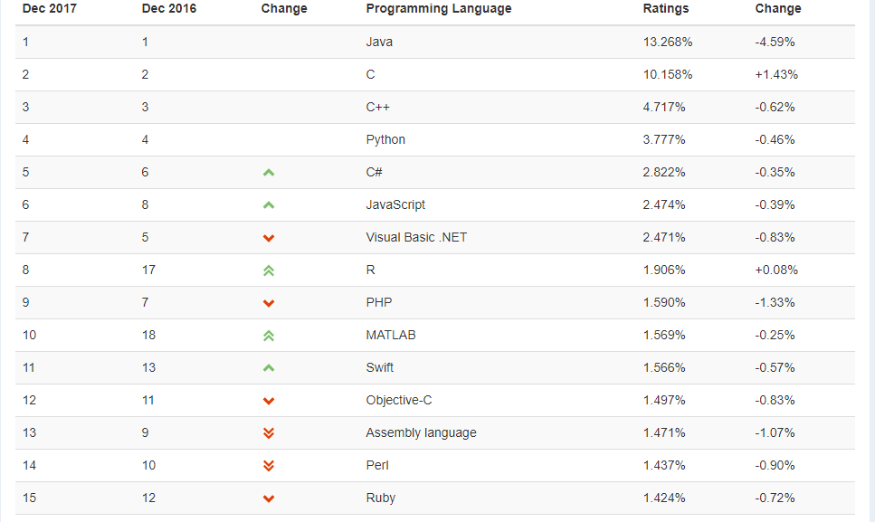
Popular PL and Impact on Opt.
Department of Computer Science and Information Engineering
Notes:
Objective-C has small-talk style messaging. It is used by Apple for iOS and OS X, and API like Cocoa touch

Slide 8
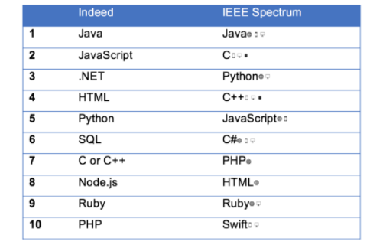
Most Popular PL. (2016-2017)
A job search site
Dice and CareerBuilder
Department of Computer Science and Information Engineering
Notes:
Objective-C has small-talk style messaging. It is used by Apple for iOS and OS X, and API like Cocoa touch

Slide 9
PL Trend Impact
More languages require runtime/adaptive translations:
Java, C#, PHP, Python, JavaScript, Perl, Ruby, AJAX
More scripting languages:
  Programmers favor languages with simple syntax and semantics
Optimizations
  Some traditional: constant folding, loop transformations, pointer analysis, …
  Some new: type inference, function caching,..
Department of Computer Science and Information Engineering
Notes:
Function caching is to add a cache object to a function. Memozition? Fibanacci function, SQRT? EXP? Server?

Slide 10
Some Basic Code
Generation Techniques
Department of Computer Science

Slide 11
Sethi-Ullman (or Ershov) Numbering
Value Numbering (CSE)
DAG Building
Automatic Instruction Selection
Register Allocation: Graph Coloring
Local Code Scheduling
Global Code Scheduling
Department of Computer Science

Slide 12
Translating Expression Trees
+
What is the minimum number
of registers used?
+
-
+
*
A
B
C
D
E
F
Department of Computer Science

Slide 13
Translating Expression Trees
R1
+
R2
+
R1
R2
R3
-
+
*
R2
R2
R3
R3
R4
R1
A
B
C
D
E
F
Department of Computer Science

Slide 14
Translating Expression Trees
R1
+
R1
+
R2
R1
R2
*
-
+
R2
R3
R1
R2
R2
R3
A
B
C
D
E
F
Department of Computer Science

Slide 15
Sethi-Ullman/Ershov Numbering
Determines the minimum number of registers needed to evaluate any expression trees
Procedure registerNeeds(T)
If T.kind == ID or T.kind == const)
{ T.regcount = 1}
else
{call registerNeeds(T.leftchild);
call registerNeeds(T.rightchild);
if (T.leftchild.regcount == T.rightchild.regcount)
{ T.regcount = T.rightchild.regcount +1; }
else
{T.regcount = MAX (T.leftchild.regcount, T.rightchild.regcount);}
end
Department of Computer Science

Slide 16
Sethi-Ullman/Ershov Numbering
3
+
3
+
2
2
2
-
+
*
1
1
1
1
1
1
A
B
C
D
E
F
Department of Computer Science

Slide 17
Sethi-Ullman Numbering Code Gen
TreeCG
We use regcount labeling to drive code gen
It generates code to evaluate the tree, leaving the result in the first register on the list.
If TreeCG is given too few registers, it spills a register to the frame (i.e. activation record)
If left child has a regcount > right child
it evaluates left child first, then the right child
otherwise, it evaluate the right child, then the left child.
Department of Computer Science

Slide 18
Other Considerations
Can the immediate value fit in inst ?
Some machines allow immediate values to be specified in instructions.
Some operators are associative, for example, (a+b) + c == a + (b+c)
Applying associative rule, registers could be reduced, for example:
(a+b)+(c+d) requires 3 registers
but a+b+c+d requires only 2 registers
However, this is not true for FP arithmetic due to rounding issues
Department of Computer Science

Slide 19
Insufficiently Supply of Registers
Assume we have r registers available
If a node N with a label k, k>r, we handle each side of the tree separately, and store the result of larger subtree (i.e. spill) to AR, and load back the result from AR before node N is evaluated.
Department of Computer Science

Slide 20
CSE (Common Sub-Expressions)
(A+B) + (A+B)*C
(A+B) here is called a common sub-expression
A CSE can be allocated to a register to avoid redundant computations.
An expression tree captures no CSEs, each operand has only one consumer. A CSE has more than one consumers.
A DAG (Directed Acyclic Graph) supports CSEs
Value numbering is an efficient algorithm to identify CSEs in building a DAG
Department of Computer Science

Slide 21
CSE (Common Sub-Expressions)
(A-B) + (A-B)*C
+
+
A TREE
A DAG
*
*
-
C
-
-
B
B
A
B
C
A
A
Department of Computer Science

Slide 22
Local Value Numbering
Each variable and expression is assigned a unique number
When the compiler sees a variable or expression, check if it is already assigned a number.
  If so, use the number for that value
  If not, assign a new number
Same number means same value (i.e. an index of an array).

Slide 23
Local Value Numbering
Example:
A = B + C
D = B + C
E = B
F = E + C
Numbers assigned
B → #1
C → #2
B+C → #1+#2 → #3
A → #3
D → #3
E → #1
E+C → #1+#2 → #3
F → #3

Slide 24
Value Numbering Implementation
Example:
i=i+j;
k=(i+j)*k;
…
x=(i+j)*k+2
index | type | left | right
1 | ID | i
2 | ID | j
3 | + | 1 | 2
4 | = | 1 | 3
5 | ID | k
6 | * | 3 | 5
Value number means the index of the array

Slide 25
Value Numbering Implementation
Example:
i=i+j;
k=(i+j)*k;
…
x=(i+j)*k+2
index | type | left | right
1 | ID | i
2 | ID | j
3 | + | 1 | 2
4 | = | 1 | 3
5 | ID | k
6 | * | 3 | 5
How to locate the expression (i+j) quickly in the
table? Hint: this is a sequential table
Hash – take (+, I, j) and generate a hash value

Slide 26

Automatic Instruction Selection
Instruction selection
  Relatively easy for RISC machines
  Complex for CISC machines
    Wide variety of addressing modes, operands do not need to be in registers, … etc
  A challenge to retargetable compilers
Idea:
  Generate source code into a low level IR code sequence (down to register level), represented as trees
  Each target machine instruction is also represented as an individual subtree
  Code generation turns into a tree matching problem like parsing

Slide 27
Automatic Instruction Selection
Example b[i] = a + 1
Low level
IR tree
=
+
+
*
b
load
1
load
4
+
i
$fp
a

Slide 28
IR Tree Patterns for MIPS Instructions
reg
reg1
load
load
address
+
lw $reg, address
reg2
offset
lw $reg1, offset($reg2)
reg1
reg1
*
*
reg2
4
reg2
const
sll $reg1, $reg2, 2
mul $reg1, $reg2, const

Slide 29
lw $reg, i
=
=
+
+
+
+
*
*
b
b
load
1
load
1
4
reg
4
load
+
+
i
a
$fp
a
$fp
Similar to bottom-up parsing

Slide 30
lw $reg, i
=
sll $reg1, $reg2, 2
=
+
+
+
+
*
b
reg
b
load
1
load
1
reg
4
+
+
a
$fp
a
$fp
Similar to bottom-up parsing

Slide 31
=
=
+
+
+
+
b
reg
b
reg
reg
1
load
1
lw $reg, i
+
sll $reg1, $reg2, 2
lw $reg1, offset($reg2)
$fp
a
Similar to bottom-up parsing

Slide 32
lw $reg, i
sll $reg1, $reg2, 2
lw $reg3, offset($reg4)
inc $reg1
=
=
+
+
+
reg
b
reg
reg
1
b
reg
Similar to bottom-up parsing

Slide 33
Search for Least-Cost Tree Pattern
More than one instruction sequence can implement the same construct. In terms of IR trees, different reductions of the same tree yielding different code sequences. So how do we obtain the least expensive code sequence?
Both BURS (Bottom-Up Rewriting System) and TWIG use dynamic programming to find the least cost cover for a subtree. (see textbook chapter 13.5)

