Slide 1
編譯器設計
Languages and Their Representations

Slide 2
Alphabets and Languages
Webster defines a language as
  “the body of words and methods of combining words used and understood by a considerable community”
The definition is not precise
  A formal language will be defined
An alphabet:
  any finite set of symbols, e.g.
    Latin alphabet {A, B, C, …, Z}
    Greek alphabet {α, β, γ, …, ω}
    binary alphabet {0, 1}

Slide 3
Alphabets and Languages
A sentence over an alphabet
  any string of finite length composed of symbols from the alphabet
  Synonyms for sentence are string and word
The empty sentence є
  the sentence consisting of no symbols
If V is an alphabet, then
  V * denotes the set of all sentences composed of symbols of V, including the empty sentence
  V ⁺=V *－{є}
  If V ={0,1}, then
  V * ={є, 0, 1, 00, 01, 10, 11, 000, …}

Slide 4
Alphabets and Languages
A language
  any set of sentences over an alphabet
  e.g. {0, 1} is a language
Three questions are raised
  How do we represent a language?
    It’s simple if the language is finite
    How to represent an infinite language with a finite representation
  Does there exist a finite representation for every language?
  What can be said about the structures of those languages for which there exist finite representation?

Slide 5
Representations of Languages
Two ways to represent a language
  To give an algorithm which determines if a sentence is in the language or not
    To give a procedure which halts with the answer “yes” for sentences in the language and either does not terminate or else halts with the answer “no” for sentences not in the language
  To give a grammar that generates sentences in the language

Slide 6
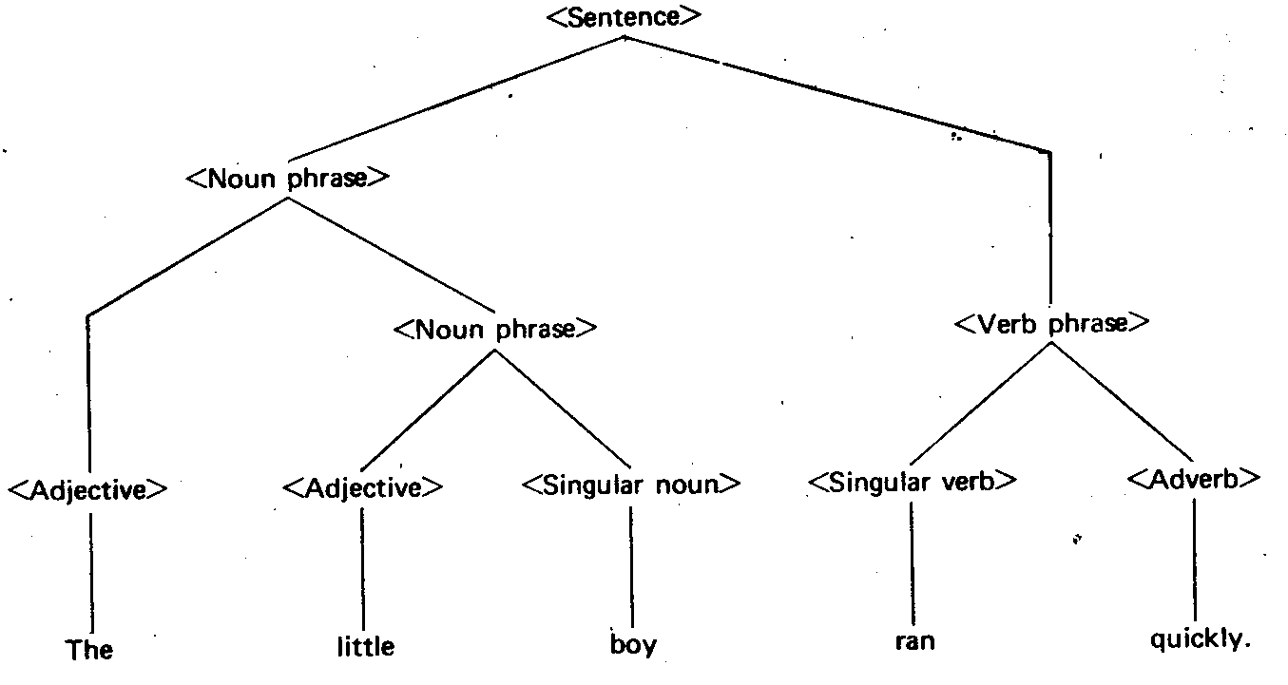
Grammars
Example: “The little boy ran quickly”
  <sentence> →<noun phrase><verb phrase>
  <noun phrase> →<adjective><noun phrase>
  <noun phrase> →<adjective><noun>
  <verb phrase> →<verb><adverb>
  <adjective> → The
  <adjective> → little
  <noun> → boy
  <verb> → ran
  <adverb> → quickly

Slide 7
Formal Notation of a Grammar
Four concepts
  Nonterminals (or Variables)
    e.g. <sentence>, <adjective>, <verb phrase>, etc.
  Terminals
    e.g. words such as The, little, boy, etc.
  Productions
  relationships between strings of variables and terminals
    e.g. <sentence>→<noun phrase><verb phrase>
  Start Symbol
  distinguished symbol that generates exactly those strings of terminals that are deemed in the language
    e.g. <sentence>

Slide 8
Formal Notation of a Grammar
A grammar G can be denoted by (V_{N}, V_{T}, P, S)
  V_{N} : nonterminals
  V_{T} : terminals (V_{N} ∩V_{T} =ψ, V_{N} ∪V_{T} = V)
  P : productions
    α → β ∈P
  S : start symbol

Slide 9
Derivation
Derivation by a production
  If α → β ∈P and γ, δ∈ V, then
  γαδ ⇒ γβδ
  i.e. γαδ directly derives γβδ
Derivation by productions
  If α₁, α₂,…, α_{m} are strings in V *, and
  α₁ ⇒ α₂ ⇒ … ⇒ α_{m}
  then we say
  α₁ ⇒ α_{m}

Slide 10


Derivation
The language generated by G is defined
  That is, a string is in L(G) if
    The string consists solely of terminals
    The string can be derived from S
  Grammars G₁ and G₂ are equivalent if
    L(G₁) = L(G₂)
  Example G = (V_{N} , V_{T} , P, S) V_{N} = {S}, V_{T} = {0, 1}, P = {S→0S1, S→01}
  ∴ L(G) = {0^{n}1^{n}}
  A string of terminals and nonterminals α is called a sentential form if

Slide 11
Types of Grammars
Let G = (V_{N} , V_{T} , P, S) be a grammar
  Type 0 grammar
  Type 1 grammar (context-sensitive grammar)
    For every production α→β in P, |α| ≦ |β|
    e.g. P = {S→aSBC, S→aBC, CB→BC, aB→ab, bB→bb, bC→bc, cC→cc}
  Type 2 grammar (context-free grammar)
    For every production α→β in P, |α| =1 and β≠є
    e.g. P = {S→0S1, S→01}
  Type 3 grammar (regular grammar)
    Every production in P is of the form
    A →aB, or
    A →a

