Slide 1
編譯器設計
Chapter 3:
Lexical Analysis

Slide 2
Lexical Analysis
The role of the lexical analyzer
  To read the input characters
  To produce a sequence of tokens
source program
lexical
analyzer
tokens
parser
parse tree
symbol
table
Reasons to separate lexical analysis
  Simpler design is the most import consideration
  Compiler efficiency is improved
  Compiler portability is enhanced

Slide 3
Tokens, Patterns, and Lexemes
Tokens
  The terminal symbols in the grammar
Patterns
  Rule describing the set of strings that correspond to the same token
Lexeme
  A sequence of characters matched by a pattern
Token | Sample Lexemes | Informal Description of Pattern
const | const | const
if | if | if
relop | <, <=, =, <>, >, >= | < or <= or = or <> or > or >=
id | pi, count, D2 | letter followed by letters and digits
num | 0, 3,14, 6.02E23 | any number constant

Slide 4
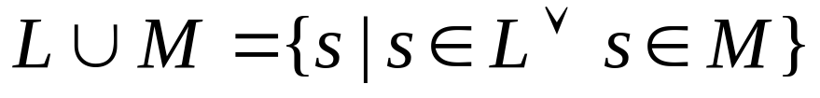
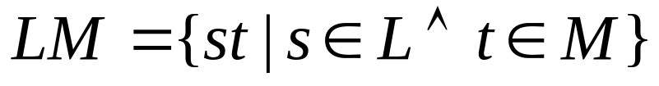
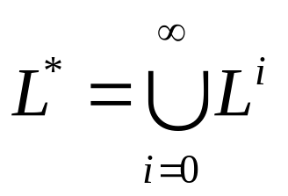
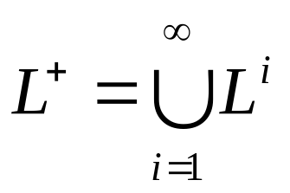
Operations on Languages
Union of L and M, written as L∪M
Concatenation of L and M, written as LM
Kleene closure of L, written as L*
  denotes “zero or more concatenations of L
Positive closure of L, written as L⁺

Slide 5
Operations on Languages
Example
  Let L={A, B, …, Z, a, b, …z} and D={0, 1, 2, … 9}
  L ∪D
    the set of letters and digits
  LD
    the set of strings consists of a letter followed by a digit
  L ⁴
    the set of all four-letter strings
  L*
    the set of all strings of letters, including ε
  L(L ∪D )*
    the set of all strings of letters and digits beginning with a letter

Slide 6
Regular Expressions
Each regular expression r denotes a language L(r)
Rules to define the regular expressions overΣ
  є is regular expression that denotes {є}
  If a is a symbol inΣ, then a is a regular expression that denote {a}
  Suppose r and s are regular expressions, then
    (r )|(s) is a regular expression denoting L (r ) ∪L (s)
    (r )(s) is a regular expression denoting L (r )L(s)
    (r )* is a regular expression denoting (L (r ))*
    (r )⁺ is a regular expression denoting (L (r ))⁺
  If two regular expressions r and s denote the same language, we say r and s are equivalent and write r = s

Slide 7
Regular Expressions
Example: letΣ= {a, b}
  The regular expression a | b denotes {a, b}
  (a|b)(a|b) denotes {aa, ab, ba, bb}
    i.e. the set of all 2-letter strings of a’s and b’s
    Another form is aa | ab | ba | bb
  a * denotes the set of all strings of a’s
    i.e. {є, a, aa, aaa, …}
  (a | b )* denotes the set of all strings of a’s and b’s
    Another form is (a *b*)*
  a | a*b denotes the set containing the string a and all strings consisting of zero or more a’s and followed by b’s

Slide 8
Precedence
Unnecessary parentheses can be avoided in regular expressions if
  The unary operator * has the highest precedence and is left associative
  Concatenation has the second highest precedence and is left associative
  | has the lowest precedence and is left associate
  Example
    (a )|((b )*(c )) ≡ a |b*c

Slide 9
Algebraic Properties of Regular Expressions
Some algebraic laws that hold for regular expressions r, s, and t
Axiom | Description
r | s = s | r | | is commutative
r | (s | t) = (r | s ) | t | | is associative
(r s ) t = r (s t) | concatenation is associative
r(s | t) = r s | r t (s | t) r = s r | s t | concatenation distributes over |
є r = r r є = r | є is the identity element of concatenation
r* = (r | є)* | relationship between * and є
r** = r* | * is idempotent

Slide 10
Regular Definitions
For notational convenience, we may wish to give names to regular expressions
  To define regular expressions using these names as if they were symbols
  IfΣis an alphabet, then a regular definition is a sequence of definitions of the form
    d₁ → r₁
    d₂ → r₂
    …
    d_{n} → r_{n}
  where each r_{i} is a regular expression over the symbols inΣ∪ {r₁, r₂, …, r_{i-1}}

Slide 11
Regular Definitions
Notational Shorthands
  +: one or more instance
  ?: zero or one instance
  [abc]: character classes, i.e. ≡ a|b|c
Example
    digit → 0 | 1 | … | 9
    letter → [A-Za-z]
    id → letter (letter | digit)*
    digits → digit+
    optional_fraction → (. digits)?
    optional_exp → ( E ( + | - )? digits)?
    num → digits optional_fraction optional_exp

Slide 12
Recognition of Tokens
Transition diagrams
  depicts the actions that take place when a lexical analyzer is called by the parser to get the next token
  States
    Positions in a transition diagram
      drawn as circles
    States are connected by arrows, call edges
    Start state
      the initial state of the transition diagram
<
=
0
1
2
other
3

Slide 13
Recognition of Tokens
Example: relop → < | <= | = | <> | > | >=
<
=
0
1
2
return(relop, LE)
>
=
3
return(relop, NE)
other
4
return(relop, LT)
>
5
return(relop, EQ)
=
6
7
return(relop, GE)
other
8
return(relop, GT)

Slide 14
Implementing a Transition Diagram
A transition diagram can be converted into a program
  Each state gets a segment of code
    If there are edges leaving a state, then its code reads a character and selects an edge to follow
      If there is an edge labeled by the character read, then control is transferred
      If there is no such edge, then fail
<
token nexttoken( ) {
switch(state) {
case 0: /* state 0 */
c = nextchar();
if (c == ‘<‘) state = 1;
else if (c == ‘=‘) state = 5;
else if (c == ‘>’) state = 6;
else state = fail;
break;
…
}
0
1
=
>
5
6

Slide 15
Implementing a Transition Diagram
Several tools have built for constructing lexical analyzer from regular expressions
  e.g. lex
lex source program
lex
compiler
lex.yy.c
lex.yy.c
C
compiler
a.out
input stream
a.out
sequence of tokens

Slide 16
Finite Automata
We compile a regular expression into a lexical analyzer by constructing a generalized transition diagram called a finite automaton
  M = {S, Σ, δ, s₀, F}
    S : a finite, nonempty set of states
    Σ : an alphabet
    δ : mapping S × Σ → S
    s₀: start state
    F : the set of accepting (or final) states
  A finite automaton is called a deterministic finite automaton (DFA) if
    No state has an є-transition, and
    For each state s and input symbol a, there is at most one edge labeled a leaving s

Slide 17
Simulating a DFA
Input
  An input string x terminated by an eof
  A DFA D = {S, Σ, δ, s₀, F}
Output
  “yes” if D accepts x; “no” otherwise
Method
s = s₀
c = nextchar();
while c ≠ eof do
s = moveto(s, c);
c = nextchar();
end
if s is in F then return “yes”
else return “no”

Slide 18
Nondeterministic Finite Automata (NFA)
M = {S, Σ, δ, s₀, F}
  S: a finite, nonempty set of states
  Σ : an alphabet
  δ : mapping S × Σ → 2^{S}
  s₀: start state
  F : the set of accepting (or final) states
a
δ(0 , a) = {0, 1}
δ(0 , b) = {0}
δ(1, b) = {2}
δ(2, b) = {3}
a
b
b
0
1
2
3
b

Slide 19
Simulating an NFA
Input
  An input string x terminated by an eof
  A NFA N
Output
  “yes” if N accepts x ; “no” otherwise
Method
S = є-closure(s₀)
c = nextchar;
while c ≠ eof do
S = є-closure(moveto(S, c));
c = nextchar();
end
if S ∩F≠ψ then return “yes”
else return “no”

Slide 20
Operations on NFA States
є-closure(s)
  Set of NFA states reachable from state s on є-transitions only
є-closure(T)
  Set of NFA states reachable from some state s in T on є-transitions only
push all states in T onto stack
initialize є-closure(T ) to T
while stack is not empty do
pop t, the top element, off the stack
for each state u with an edge from t to u labeled є do
if u is not in є-closure(T ) then
add u to є-closure(T )
push u onto stack
end if
end
end

Slide 21
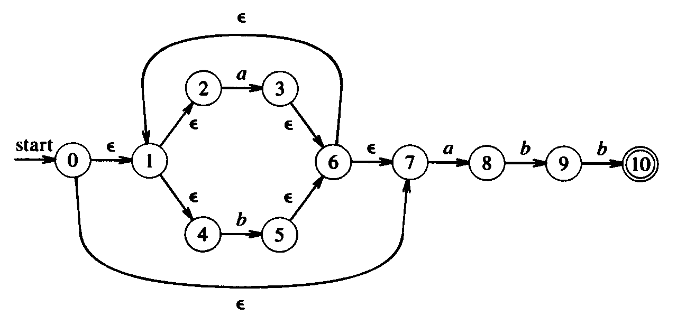
Operations on NFA States
moveto(T, a)
  Set of NFA states to which there is a transition on input symbol a from some NFA state s in T
Example: NFA for (a|b)*abb
  є-closure (0) = {0, 1, 2, 4, 7} ≡ A
  moveto (A, a) = є-closure ({3, 8}) = {1, 2, 3, 4, 6, 7, 8} ≡ B

Slide 22
Constructing a DFA from an NFA
Algorithm (Subset construction)
  Input. An NFA N
  Output. A DFA D accepting the same language
  Method. Constructs a transition table Dtran for D
initially, є-closure (s₀) is the only state in Dstates and unmarked
while there is an unmarked state T in Dstates do
mark T
for each input symbol a do
U = є-closure (moveto (T, a))
if U is not in Dstates then
add U to as an unmarked state to Dstates
Dtran [T, a] = U
end
end

Slide 23
Constructing a DFA from an NFA
Example: NFA for (a|b)*abb
  є-closure (0) = {0, 1, 2, 4, 7} ≡ A
  moveto (A, a) = є-closure ({3, 8}) = {1, 2, 3, 4, 6, 7, 8} ≡ B
  moveto (A, b) = є-closure ({5}) = {1, 2, 4, 5, 6, 7} ≡ C
  moveto (B, a) = є-closure ({3, 8}) = B
  moveto (B, b) = є-closure ({5, 9}) = {1, 2, 4, 5, 6, 7, 9} ≡ D
  moveto (C, a) = є-closure ({3, 8}) = B
  moveto (C, b) = є-closure ({5}) = C
  moveto (D, a) = є-closure ({3, 8}) = B
  moveto (D, b) = є-closure ({5, 10}) = {1, 2, 4, 5, 6, 7, 10} ≡ E
  moveto (E, a) = є-closure ({3, 8}) = B
  moveto (E, a) = є-closure ({5}) = C

Slide 24
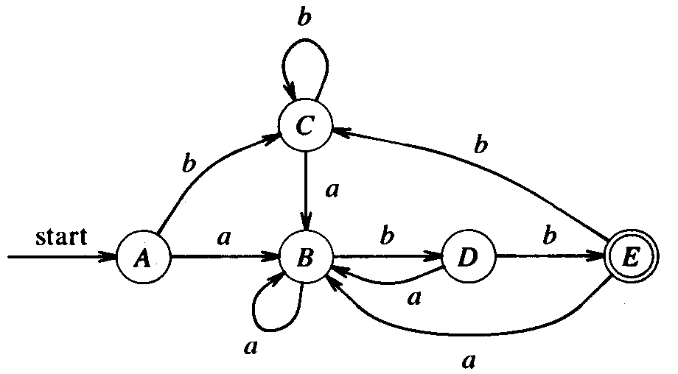
Constructing a DFA from an NFA
Example: NFA for (a|b)*abb
State | Input Symbol
 | a | b
A | B | C
B | B | D
C | B | C
D | B | E
E | B | C

Slide 25
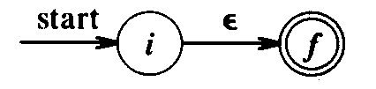
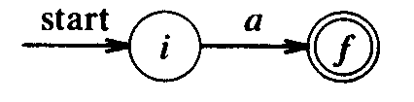
Constructing NFA from Regular Expression
Algorithm (Thompson’s construction)
  Input. A regular expression r over Σ
  Output. An NFA N accepting L(r )
  Method.
    For є, construct the NFA
      This NFA recognizes {є}
    For a in Σ, construct the NFA
      This NFA recognizes {a}

Slide 26
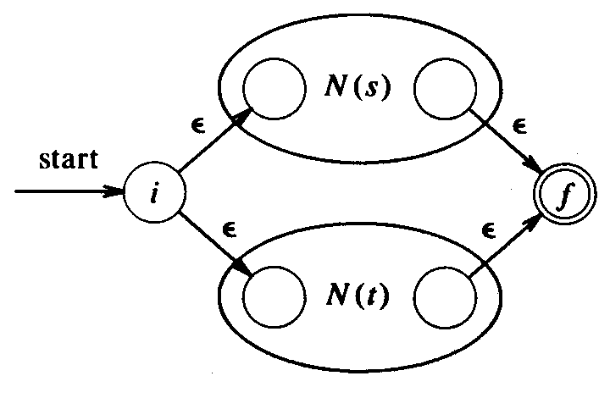
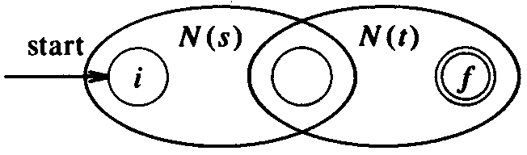
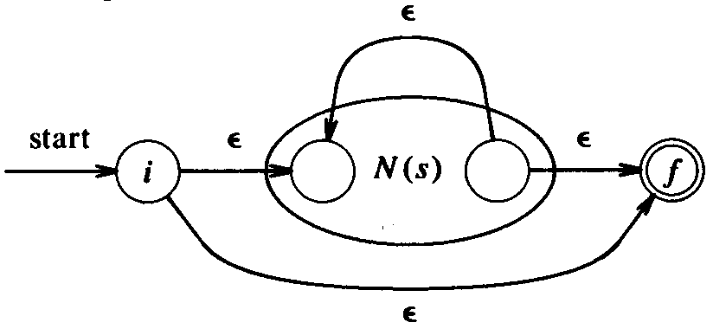
Constructing NFA from Regular Expression
    Suppose N(s) and N(t) are NFA’s for regular expressions s and t
      For the regular expression s | t
        This NFA recognizes L(s) ∪ L(t)
      For the regular expression st
        This NFA recognizes L(s)L(t)
      For the regular expression s*
        This NFA recognizes L(s)L(t)

Slide 27
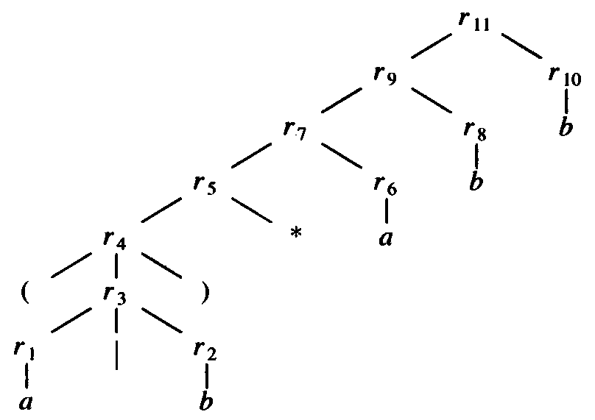
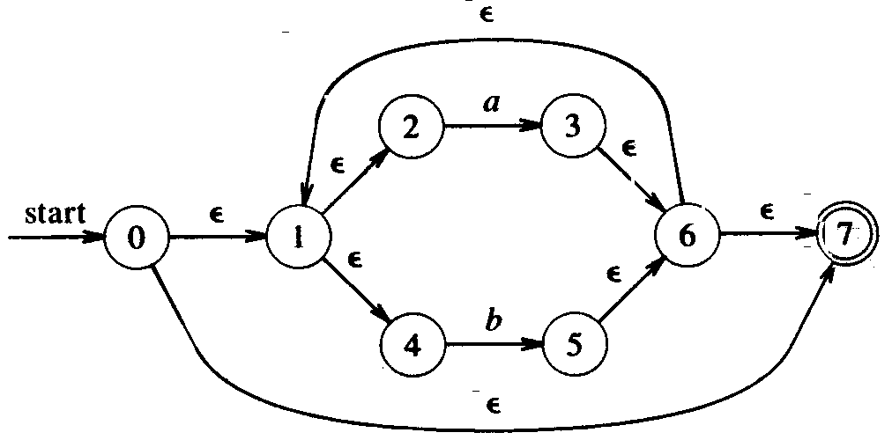


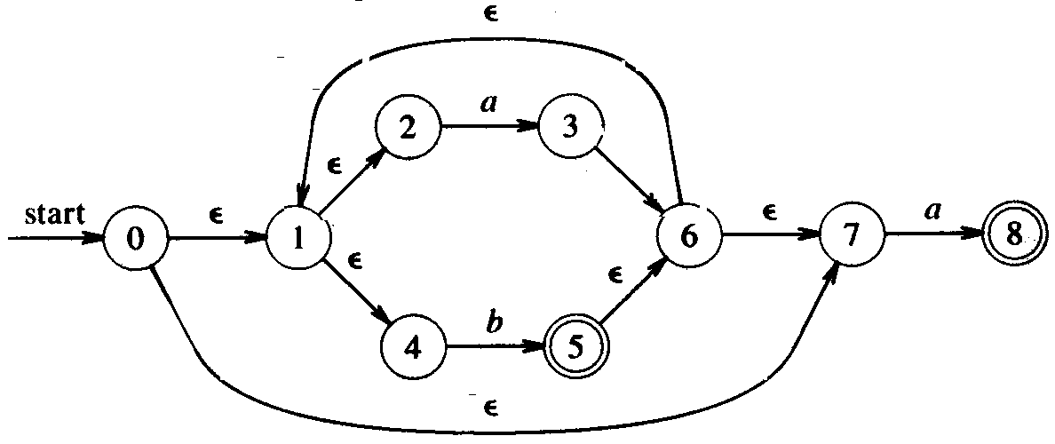

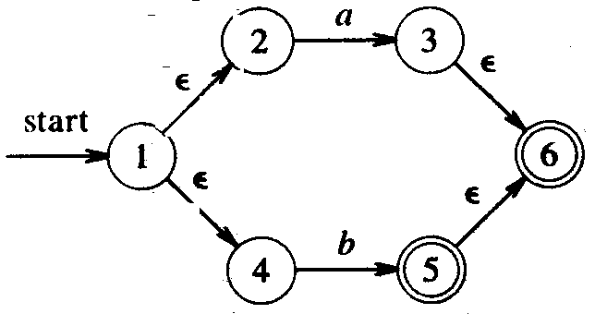
Constructing NFA from Regular Expression
Example: r = (a|b)*abb
  Parse r into its constituent subexpressions

Slide 28
Constructing NFA from Regular Expression
The construction produces an NFA N(r) with the following properties
  N (r ) has at most twice as many as states as the number of symbols and operators in r
    Each step creates at most two new states
  N (r ) has exactly one start state and one accepting state
    The accepting state has no outgoing transitions
  Each state of N (r ) has either one outgoing transition on a symbol inΣor at most two outgoing є-transitions

Slide 29
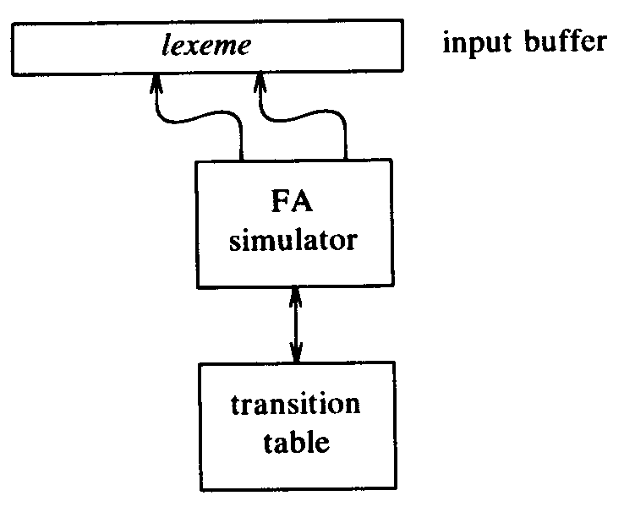

Design of a Lexical Analyzer Generator
Assuming a specification of a lexical analyzer
  p₁ { action₁ }
  p₂ { action₂ }
  …
  p _{n} { action_{n} }
A finite automaton is a natural model

Slide 30
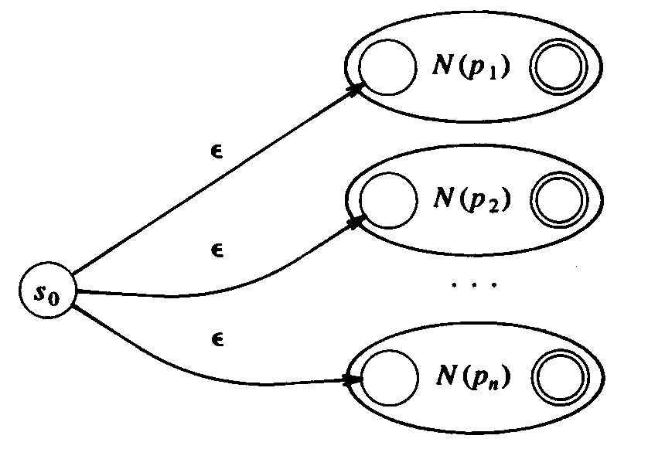
Design of a Lexical Analyzer Generator
Pattern matching based on NFA’s
  To construct the transition table of a NFA N for the pattern p₁ | p₂ | … | p₁

Slide 31
Minimizing the Number of States
An important theoretical result
  Every regular set is recognized by a minimum-state DFA that is unique up to state names
String w distinguishes state s from state t if
  By starting with the DFA M in state s and feeding it input w, we end up in an accepting state, but
  By starting in state t and feeding it input w, we end up in a nonaccepting state, or vice versa
  e.g. є distinguishes any accepting state from any nonaccepting state
DFA states can be minimized by finding all groups of states that can be distinguished by some input string
  Each group of states that cannot be distinguished by some input staring is then merged into single state

Slide 32
Minimizing the Number of States
Algorithm
  Construct an initial partition Π = {F, S−F }
  Construct a new partition:
for each group G ∈ Π do
partition G into subgroups such that
two states s and t ∈ G are in the same subgroup iff
for all input symbol a,
s and t have transitions on a to states in the same group in Π
replace G in Π_{new} by the set of subgroups formed
end
  If Π_{new} ≠ Π, then let Π = Π_{new.} Repeat.
  Choose one state in each group as the representative
    Update the transitions

Slide 33
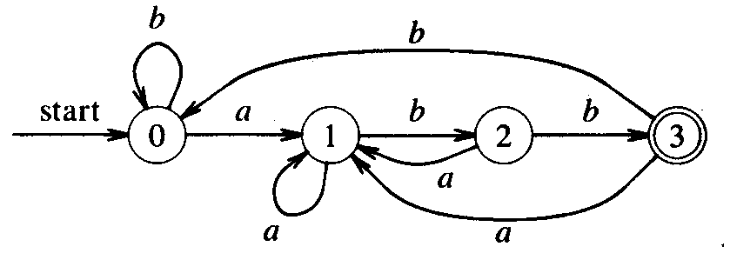
Minimizing the Number of States
Example
  Initially, Π = {(ABCD), (E)}
    (ABCD) ⇒ (ABC)(D)
  Π = {(ABC), (D), (E)}
    (ABC) ⇒ (AC)(B)
  Π = {(AC), (B), (D), (E)}
State | Input Symbol
 | a | b
A (0) | B | A
B (1) | B | D
D (2) | B | E
E (3) | B | A

Slide 34
Building Regular Grammar from NFA
Input. An NFA N
Output. A regular grammar r. N accepts L(r )
Method
  For each state i of N,
  create a nonterminal symbol A_{i}
  If state i goes to state j on symbol a,
  introduce the production A_{i} → aA_{j}
  If state i goes to state j on symbol є,
  introduce the production A_{i} → A_{j}
  If state i is a final state,
  introduce the production A_{i} → є
  If state i is the start state,
  make A_{i} be the start symbol

Slide 35
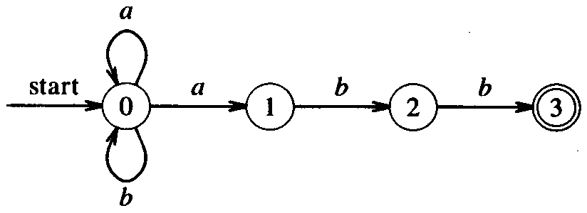
Building Regular Grammar from NFA
Example
  Nonterminal symbol:
  A₀ , A₁ , A₂ , A₃
  Productions
  A₀ → aA₀
  A₀ → bA₀
  A₀ → aA₁
  A₁ → bA₂
  A₂ → aA₃
  A₃ → є
  Start symbol: A₀

Slide 36
Building NFA from Regular Grammar
Input. A regular grammar G = (V_{N}, V_{T}, P, S)
Output. An NFA N = (K, V_{T}, δ, S, F) that accepts L(G)
Method
  K = V_{N} ∪ {A}
  If S → є ∈P, F = {S, A }
  Otherwise, F = {A }
  If B → a ∈P then
    A ∈ δ (B, a)
  If B → aC ∈P then
    C ∈ δ (B, a)
  For every a ∈V_{T}
    δ (A, a) = ∅

