Slide 1
編譯器設計
Chapter 5:
Syntax-Directed Translation

Slide 2
Syntax Analysis
To translate a programming language construct, a compiler may need to keep track of many quantities
  The type of the construct
  The location of the first instruction in the target code
  The number of instructions generated, etc.
Information is associated with a construct
  By attaching attributes to the grammar symbols representing the construct
Values for attributes are computed by
  Semantic rules associated with the grammar productions
Two notations for associating semantic rules
  Syntax-directed definitions
  Translation schemes

Slide 3
Syntax-Directed Definition
A generalization of a context-free grammar
  With each grammar symbol, it associates a set of attributes
    Synthesized attributes
      Each value of which is computed from the values of the attributes at the children in the parse tree
    Inherited attributes
      Each value is computed from the values of the siblings and the parent
  With each production, it associates a set of semantic rules for computing values of the attributes
Production | Semantic Rules
L → E n | print(E.val )
E → E₁ + T | E.val = E₁.val + T.val
E → T | E.val = T.val
T → T₁ * F | T.val = T₁.val * F.val
T → F | T.val = F.val
E → (E₁ ) | E.val = E₁.val
E → digit | E.val = digit.lexval

Slide 4
Form of a Syntax-Directed Definition
In a syntax-directed definition
  Each grammar production A → α has associated with it a set of semantic rules of the form b = f (c₁, c₂, …, c_{k})
    b is a synthesized attribute of A and c₁, c₂, …, c_{k} are attributes belonging to the grammar symbols on the right side of production,
  or
    b is an inherited attribute of one the grammar symbols on the right side of the production, and c₁, c₂, …, c_{k} are attributes belonging to A or any of the grammar symbols on the right side of production
  In either case, we say that attribute b depends on attributes c₁, c₂, …, c_{k}
Attribute grammar
  A syntax-directed definition in which the functions in semantic rules cannot have side effects

Slide 5
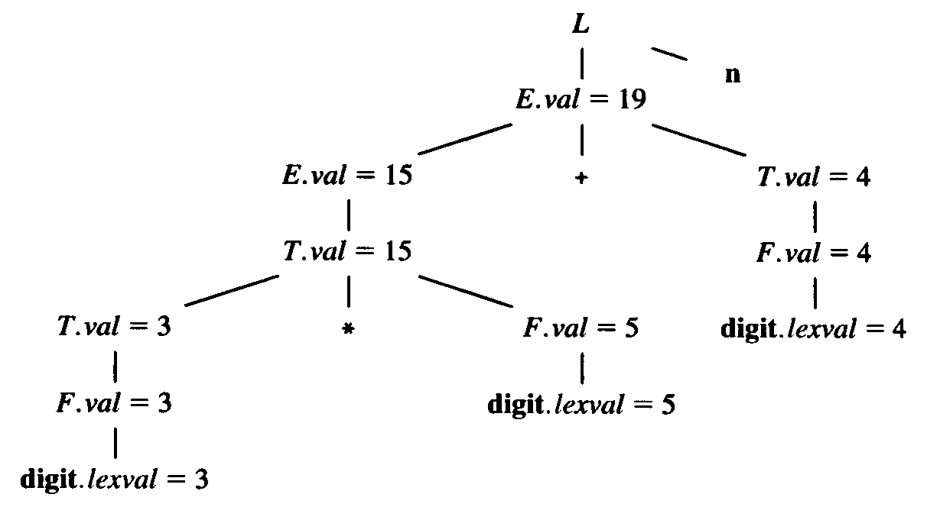
Synthesized Attributes
S-attributed definition
  A syntax-directed definition that uses synthesized attributes exclusively
    A parse tree for an S-attributed definition can always be annotated by evaluating the semantic rules for the attributes at each node bottom up

Slide 6
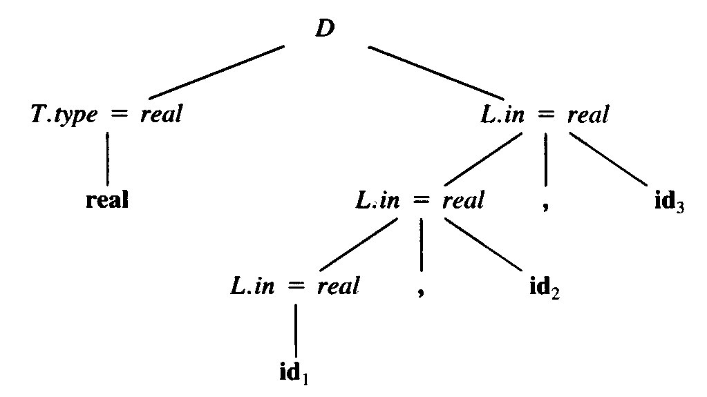
Inherited Attributes
An inherited attribute
  Its value at a node in a parse tree is defined in terms of attributes at the parent and/or siblings of the node
    It is always possible to rewrite a syntax-directed definition to use only synthesized attributes
    But it is often more natural to use syntax-directed definitions with inherited attributes
Production | Semantic Rules
D → T L | L.in = T.type
T → int | T.type = integer
T → real | T.type = real
L → L₁, id | L₁.in = L.in addtype (id.entry, L.in)
L → id | addtype (id.entry, L.in)

Slide 7
Dependence Graphs
Dependency
  If an attribute b depends on an attribute c, then the semantic rule for b must be evaluated after the semantic rule for c
  The interdependencies among inherited and synthesized attributes can be depicted by a directed graph called a dependency graph
  Algorithm to construct a dependency graph
for each node n in the parse tree do
for each attribute a of the grammar symbol at n do
construct a node in the dependency graph for a;
for each node n in the parse tree do
for each semantic rule b = f (c₁, c₂, …, c_{k})
associated with the production used at n do
for i = 1 to k do
construct an edge from the node for c_{i} to the node for b ;

Slide 8
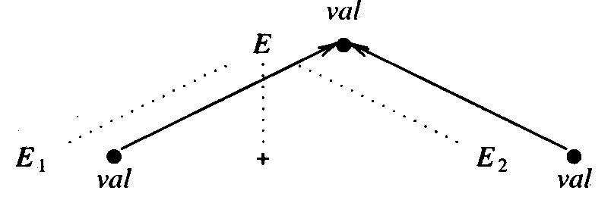
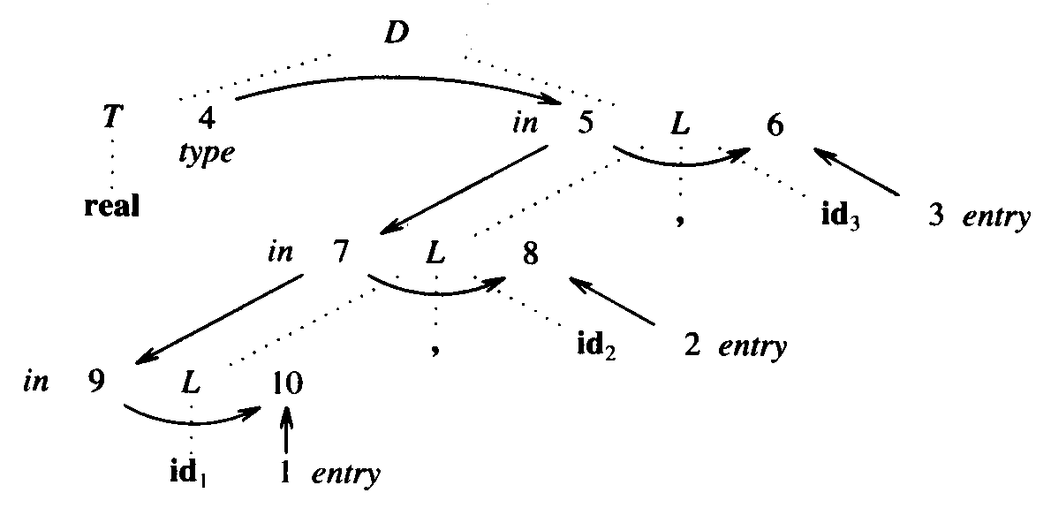
Dependence Graphs
Examples
Production | Semantic Rules
E → E₁ + E₂ | E.val = E₁.val + E₂.val
  Parse tree in Fig. 5.5

Slide 9
Evaluation Order
A topological sort of a directed graph
  Any ordering m₁, m₂, …, m_{k} of the nodes of the graph that edges go from nodes earlier in the ordering to the later nodes
    i.e. if m_{i} →m_{j} is an edge from m_{i} to m_{j}, then m_{i} appears before m_{j}
  Any topological sort of a dependency graph gives a valid order in which the semantic rules associated with the nodes in a parse tree can be evaluated
Methods for evaluating semantic rules
  Parse-tree methods
    An evaluation order is obtained from a topological sort of the dependency graph constructed from the parse tree
  Rule-based methods
    For each production, the order in which the attributes are evaluated is predetermined at compiler-construction time
  Oblivious methods
    An order is chosen without considering the semantic rules

Slide 10
Constructing Syntax Trees for Expressions
Syntax Trees
  A condensed form of parse trees
  The construction of a syntax tree for an expression
    Similar to the translation of the expression into postfix form
  Each node in a syntax tree can be implemented as a record
Functions to create the nodes
  mknode (op, left, right )
    Creates an operator node with label op and two fields containing pointers to left and right
  mkleaf (id, entry )
    Creates an identifier node with label id and a field containing entry, a pointer to the symbol-table entry for the identifier
  mkleaf (num, val )
    Creates a number node with label num and a field containing val, the value of the number

Slide 11
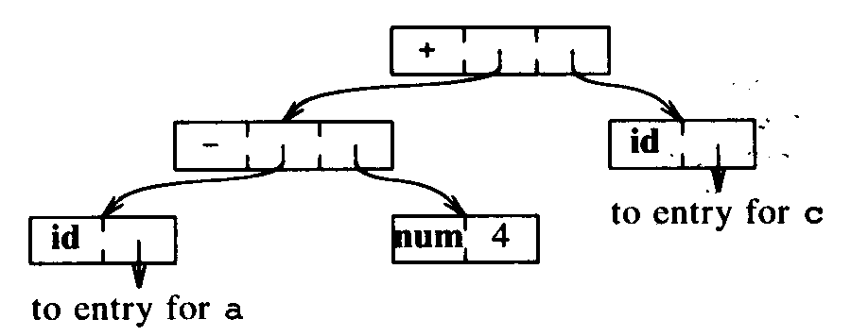
Constructing Syntax Trees for Expressions
Example
  a – 4 + c
  Steps to create the nodes
    p₁ = mkleaf (id, entrya )
    p₂ = mkleaf (num, 4)
    p₃ = mknode (‘-’, p₁, p₂)
    p₄ = mkleaf (id, entryc )
    p₅ = mknode (‘+’, p₃, p₄)

Slide 12
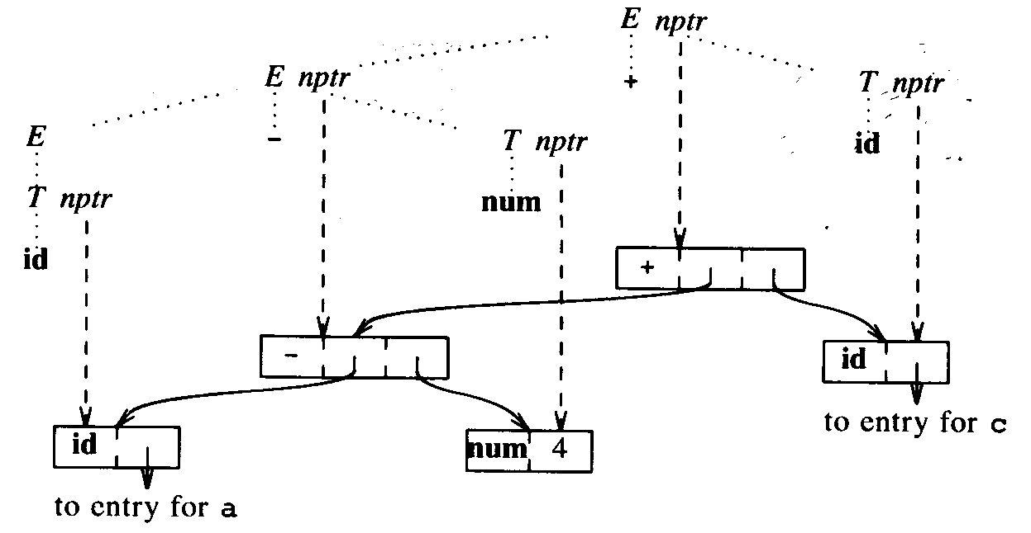
Constructing Syntax Trees for Expressions
A syntax-directed definition
Production | Semantic Rules
E → E₁ + T | E.nptr = mknode (‘+’, E₁.nptr, T.nptr)
E → E₁ − T | E.nptr = mknode (‘−’, E₁.nptr, T.nptr)
E → T | E.nptr = T.nptr
T → (E ) | T.nptr = E.nptr
T → id | T.nptr = mkleaf (id, id.entry)
T → num | T.nptr = mkleaf (num, num.val)

Slide 13
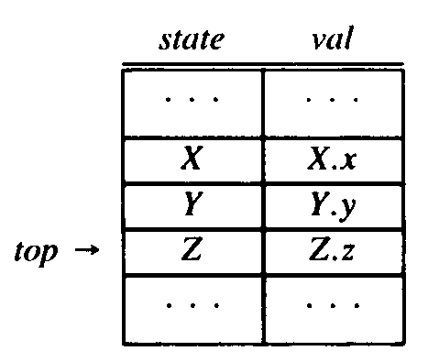
Bottom-Up Evaluation of S-Attributed Definitions
S-Attributed Definitions
  Syntax-directed definitions with synthesized attributes only
  Synthesized attributes can be evaluated by a bottom-up parser as the input is parsed
  The parser can keep the values of the synthesized attributes associated with grammar symbols on its stack
    e.g. A → XYZ A.a = f (X.x, Y.y, Z.z)
    When a reduction is made,
      t = f (val [top -2], val [top -1], val [top])
      val [top] = t

Slide 14
Bottom-Up Evaluation of S-Attributed Definitions
  Input state val Production
  3*5+4n – –
  *5+4n 3 3
  *5+4n F 3 F → digit
  *5+4n T 3 T → F
  5+4n T * 3 –
  +4n T * 5 3 – 5
  +4n T * F 3 – 5 F → digit
  +4n T 15 T → T * F
  +4n E 15 E → T
  4n E + 15 –
  n E + 4 15 – 4
  n E + F 15 – 4 F → digit
  n E + T 15 – 4 T → F
  n E 19 E → E + T
  E n 19 –
  L 19 L → E n
Example
Production | Semantic Rules
L → E n | print (val [top])
E → E₁ + T | val [ntop] = val [top-2] + val [top]
E → T
T → T₁ * F | val [ntop] = val [top-2] * val [top]
T → F
F → (E ) | val [ntop] = val [top-1]
F → digit

Slide 15
L-Attributed Definitions
A syntax-directed definition is L-attributed if
  Each attributed in each semantic rule for each production A → X₁X₂…X_{n} is a synthesized attributed, or an inherited attribute of X_{j}, 1 ≤ j ≤ n, depending only on
    The attribute of the symbols X₁, X₂, … , X_{j-1} to the left of X_{j}, and
    The inherited attribute of A
  Note that every S-attributed definition is L-attributed
  Example
Production | Semantic Rules
A → L M | L.i = l (A.i )
 | M.i = m (L.s )
 | A.s = f (M.s )
A → Q R | R.i = r (A.i )
 | Q.i = q (R.s )
 | A.s = f (Q.s )

Slide 16
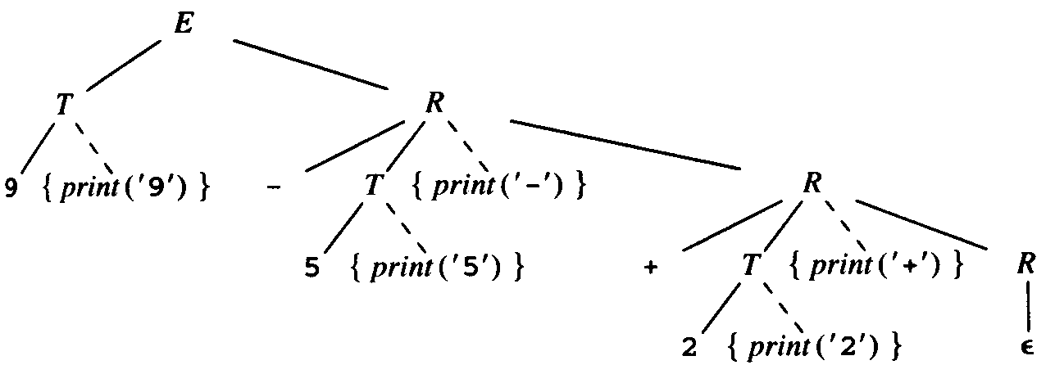
Translation Schemes
A translation scheme
  A context-free grammar in which attributes are associated with the grammar symbols and semantic actions enclosed between braces are inserted within the right sides of productions
  Example
    E → T R
    R → addop T {print (addop.lexeme)} R | є
    T → num {print (num.val )}
    9 – 5 + 2

Slide 17
Converting to Translation Schemes
Definitions with synthesized attributes only
  Create an action consisting of an assignment for each semantic rule
  Place this action at the end of the right side of each associated production
  Example
Production | Semantic Rules
T → T₁ * F | T.val = T₁.val * F.val
  can be transformed to
    T → T₁ * F {T.val = T₁.val * F.val }

Slide 18
Converting to Translation Schemes
Definitions with inherited and synthesized attributes
  An inherited attribute for a symbol on the right side of production must be computed in an action before the symbol
  An action must not refer to a synthesized attribute of a symbol to the right of the action
  A synthesized attribute for the nonterminal on the left can only be computed after all attributes it references have been computed
  Example
Production | Semantic Rules
S → A₁ A₂ | A₁.in = 1; A₂.in = 2
A → a | print (A.in)
    S → A₁ A₂ {A₁.in = 1; A₂.in = 2}
    A → a {print (A.in)}
    S → {A₁.in = 1} A₁ {A₂.in = 2} A₂
    A → {print (A.in)} a

Slide 19
Converting to Translation Schemes
Production | Semantic Rules
S → B | B.ps = 10; S.ht = B.ht
B → B₁ B₂ | B₁.ps = B.ps; B₂.ps = B.ps B.ht = max (B₁.ht, B₂.ht )
B → B₁ sub B₂ | B₁.ps = B.ps; B₂.ps = shrink (B.ps) B.ht = disp (B₁.ht, B₂.ht )
B → text | B.ht = text.h × B.ps
can be converted into the following translation scheme
  S → {B.ps = 10} B {S.ht = B.ht }
  B → {B₁.ps = B.ps} B₁ {B₂.ps = B.ps} B₂ {B.ht = max (B₁.ht, B₂.ht )}
  B → {B₁.ps = B.ps} B₁ sub {B₂.ps = shrink (B.ps)} B₂ {B.ht = max (B₁.ht, B₂.ht )}
  B → text {B.ht = text.h × B.ps}

Slide 20
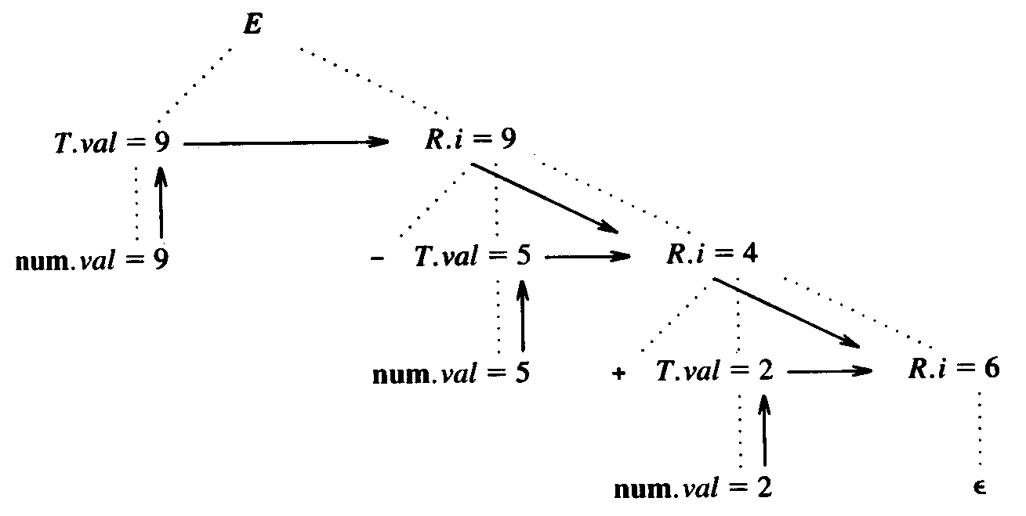
Top-Down Translation
Eliminating left recursion
  E → E₁ + T {E.val = E₁.val + T.val }
  E → E₁ − T {E.val = E₁.val − T.val }
  E → T {E.val = T.val }
  T → (E ) {T.val = E.val }
  T → num {T.val = num.val }
  E → T {R.i =T.val }
  R {E.val = R.s}
  R → + T {R₁.i = R.i + T.val }
  R₁ {R.s = R₁.s}
  R → − T {R₁.i = R.i − T.val }
  R₁ {R.s = R₁.s}
  R → є {R.s = R.i }
  T → (E ) {T.val = E.val }
  T → num {T.val = num.val }
  Example 9-5+2

Slide 21
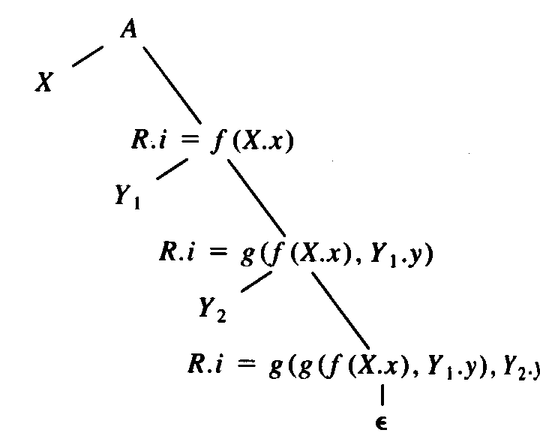
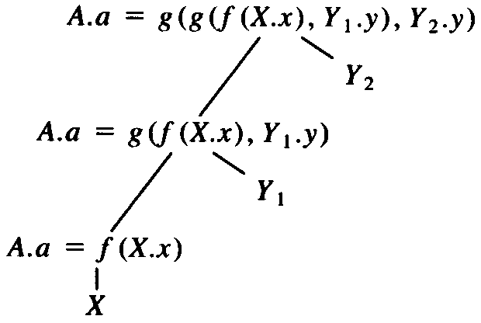
Eliminating Left Recursion
  Consider the following translation scheme
    A → A₁ Y {A.a = g (A₁.a, Y.y)}
    A → X {A.a = f (X.x)}
  Taking the semantic actions into account
    A → X {R.i = f (X.x)} R {A.a = R.s}
    R → Y {R₁.i = g (R.i, Y.y)} R {R.s = R₁.s}
    R → є {R.s = R₁.i }

Slide 22
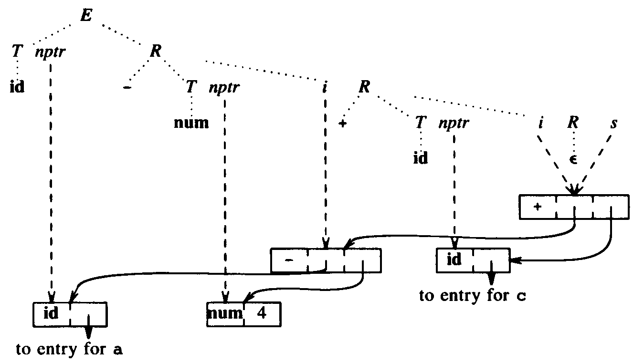
Eliminating Left Recursion
Production | Semantic Rules
E → E₁ + T | E.nptr = mknode (‘+’, E₁.nptr, T.nptr)
E → E₁ − T | E.nptr = mknode (‘−’, E₁.nptr, T.nptr)
E → T | E.nptr = T.nptr
T → (E ) | T.nptr = E.nptr
T → id | T.nptr = mkleaf (id, id.entry)
T → num | T.nptr = mkleaf (num, num.val)
  E → T {R.i = T.nptr} R {E.nptr = R.s}
  R → + T {R₁.i = mknode (‘+’, R.i, T.nptr)} R₁ {R.s = R₁.s}
  R → − T {R₁.i = mknode (‘−’, R.i, T.nptr)} R₁ {R.s = R₁.s}
  R → є {R.s = R.i }
  T → (E ) {T.nptr = E.nptr}
  T → id {T.nptr = mkleaf (id, id.entry)}
  T → num {T.nptr = mkleaf (num, num.val)}
  Example a-4+c

Slide 23
Design of a Predictive Translator
Algorithm
  Input. A syntax-directed translation scheme
  Output. Code for a syntax-directed translator
  Method.
    For each nonterminal A, construct a function that has a formal parameter for each inherited attribute of A and that returns the values of the synthesized attributes of A
    The code for nonterminal A decides what production to use based on the current input symbol
    The code associated with each production does the following.
      For token X with synthesize attribute x, save the value of x in the variable declared for X.x. Then match the input with token
      For nonterminal B, generate an assignment c = B (b₁, b₂, …,b_{k}) with a function call on the right side
        b₁, b₂, …,b_{k} are inherited attributes of B, and c is synthesized
      For an action, copy the code into the parser, replacing each reference to an attribute by the variable for that attribute

Slide 24
Design of a Predictive Translator
Example
  R → addop T {R₁.i = mknode (addop.lexeme, R.i, T.nptr)} R₁ {R.s = R₁.s}
  R → є {R.s = R.i }
Parsing procedure
procedure R;
begin
if lookahead = addop then
match(addop); T; R
else /* do nothing */
end;
Recursive-decent construction
function R (i: ↑syntax-tree-node): ↑syntax-tree-node;
var nptr, i1, s1, s: ↑syntax-tree-node;
addoplexeme : char;
begin
if lookahead = addop then /* production R → addop T R */
addoplexeme : = lexval ;
match (addop);
nptr := T;
i1 := mknode(addoplexeme, i, nptr);
s1 := R(i1);
s := sJ
else s := i; /* production R → є */
return s
end;

Slide 25
Bottom-Up Evaluation of Inherited Attributes
Removing embedding actions from translation schemes
  All translation actions must be at the end of the production
  We replace each embedded action by a marker nonterminal M and attach the action to the end of the production M → є
  Example
    E → T R
    R → + T {print (‘+’)} R | − T {print (‘−’)} R | є
    T → num {print (num.val )}
  will be transformed to
    E → T R
    R → + T M R | − T N R | є
    T → num {print (num.val )}
    M → є {print (‘+’)}
    N → є {print (‘−’)}

Slide 26
Bottom-Up Evaluation of Inherited Attributes
Inheriting attributes on the parser stack
  Consider the production A → XY
    If inherited attribute Y.i is defined the copy rule Y.i = X.s, then the value of X.s can be used where Y.i is called for
  Example
    D → T {L.in = T.type} L
    T → int {T.type = integer}
    T → real {T.type = real}
    L → {L₁.in = L.in} L₁ , id {addtype(id.entry. L.in)}
    L → id {addtype(id.entry. L.in)}
  Input state Production
  int p,q,r –
  p,q,r int
  p,q,r T T → int
  ,q,r T p
  ,q,r T L L → id
  q,r T L ,
  ,r T L , q
  ,r T L L → L, id
  r T L ,
  T L , r
  T L L → L, id
  D D → TL
    When reduced to L, T is just below the right side
Production | Semantic Rules
D → T L
T → int | val [ntop] = integer
T → real | val [ntop] = real
L → L₁, id | addtype(val [top], val [ntop-3])
L → id | addtype(val [top], val [ntop-1])

Slide 27
Bottom-Up Evaluation of Inherited Attributes
Simulating the evaluation of inheriting attributes
  The position of the attribute values must be predicted
    Example
      Production Semantic Rules
      S → aAC C.i = A.s
      S → aABC C.i = A.s
      C → c C.s = g(C.i )
    when C → c is reduced, the value of C.i is either in val [top -1] or in val [top -2]
  To make the positions predicted
    Marker nonterminals will be inserted
      Production Semantic Rules
      S → aAC C.i = A.s
      S → aABMC M.i = A.s; C.i = M.s
      C → c C.s = g(C.i )
      M → є M.s = M.i

Slide 28
Bottom-Up Evaluation of Inherited Attributes
  What if semantic rules are not copy rules
    Example
      Production Semantic Rules
      S → aAC C.i = f (A.s)
    the value of C.i can’t be stored in val [top -1]
    Marker nonterminals will be inserted
      Production Semantic Rules
      S → aAMC M.i = A.s; C.i = M.s
      M → є M.s = f (M.i)

Slide 29
Bottom-Up Evaluation of Inherited Attributes
  Example
Production | Semantic Rules
S → L B | B.ps = L.s ; S.ht = B.ht
L → є | L.s = 10
B → B₁ M B₂ | B₁.ps = B.ps; M.i = B.ps ; B₂.ps = M.s B.ht = max(B₁.ht, B₂.ht )
M → є | M.s = M.i
B → B₁ sub N B₂ | B₁.ps = B.ps; N.i = B.ps ; B₂.ps = N.s B.ht = disp(B₁.ht, B₂.ht )
N → є | N.s = shrink(N.i )
B → text | B.ht = text.h × B.ps
Production | Code Fragment
S → L B | val [ntop] = val [top]
L → є | val [ntop] = 10
B → B₁ M B₂ | val [ntop] = max(val [top-2], val [top] )
M → є | val [ntop] = val [top-1]
B → B₁ sub N B₂ | val [ntop] = disp(val [top-3], val [top] )
N → є | val [ntop] = shrink(val [top-2])
B → text | val [ntop] = val [top] × val [top-1]

Slide 30
Bottom-Up Evaluation of Inherited Attributes
algorithm
  Input. An L-attributed definition
  Output. A parser
  Method.
    For every production A → X₁ X₂ …X_{n}
    insert n new marker nonterminals M₁ ,M₂ ,…, and M_{n}, and
    replace the production by A → M₁ X₁ M₂ X₂ … M_{n} X_{n}
      The synthesized attribute X _{i}.s will be associated with X _{i}
      The inherited attribute X _{i}.i will be associated with M _{I}
    Reduce M _{i} → є
      Positions of attributes of A, M₁, X₁, M₂, X₂, … M_{i-1} X_{i-1} are known
    Reduce A → M₁ X₁ M₂ X₂ … M_{n} X_{n}
      A.i was already computed, at the position on the stack just below the position for A

Slide 31
Replacing Inherited by Synthesize Attributes
Sometimes it’s possible to avoid the use of inherited attributes by changing the grammar
  Example
    D → L : T
    T → int | real
    L → L₁ , id | id
  can be restructured
    D → id L
    L → , id L₁ | : T
    T → int | real

