Slide 1
編譯器設計
Chapter 8:
Intermediate Code Generation

Slide 2
Intermediate Code Generation
Recall the analysis-synthesis mode
  The front end translates a source program into an intermediate representation (IR)
  The back end generate the target code from IR
parser
static
checker
intermediate
code generator
IR
code
generator
Benefits of using machine-independent IR
  Retargeting is facilitated
    A compiler for a different machine can be created by attaching a backend end for the new machine to an existing front end
  A machine-independent code optimizer can be applied to IR

Slide 3
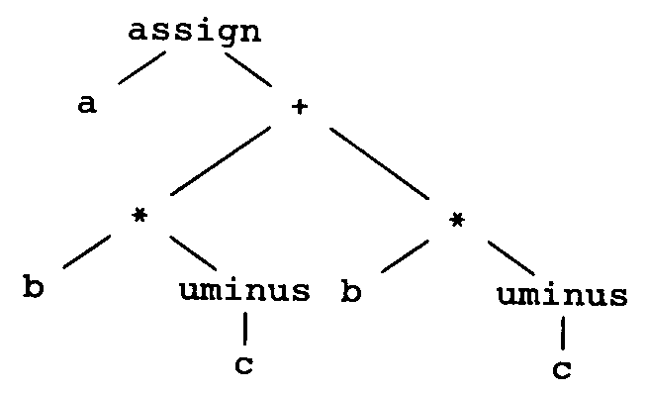
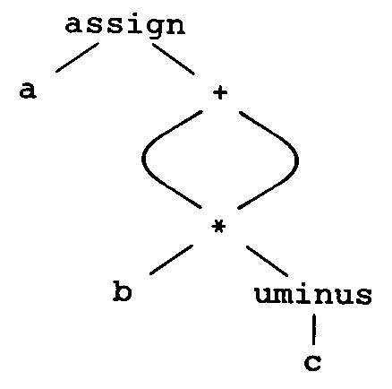
Intermediate Languages
Graphical representations
  Syntax trees
    Depict the natural hierarchical structures of source programs
  DAG (directed acyclic graphs)
    Give the same information but in a more compact way because common subexpressions are identified
Postfix Notation
  A linearized representation of a syntax tree
    e.g. a b c uminus * b c uminus * + assign

Slide 4
Intermediate Languages
Three-address code
  A sequence of statements of the general form
  x = y op z
  e.g.
t1 = −c
t2 = t * t1
t3 = −c
t4 = b * t3
t5 = t2 + t4
a = t5
t1 = - c
t2 = t * t1
t5 = t2 + t2
a = t5

Slide 5
Types of Three-Address Statements
Common three-address statements
  Assignment statements
    x = y op z or x = op z
  Copy statements
    x = y
  Unconditional jump
    goto L
  Conditional jumps
    if x relop y goto L
  Parameters and calls
    param x₁
    …
    param x_{n}
    call p, n
  Indexed assignments
    x = y[i] or x[i] = y
  Pointer assignments
    x = &y, x = *y, and *x = y

Slide 6
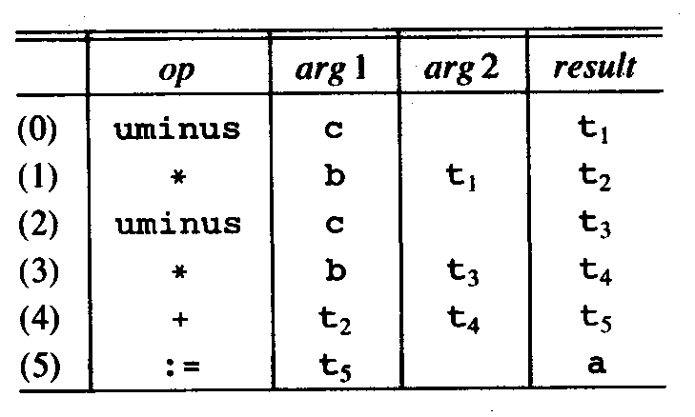
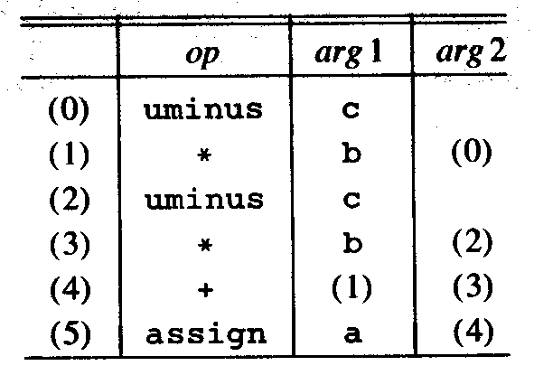
Implementation of Three-Address Statements
Quadruples
  A record structure with four fields
    op, arg1, arg2, result
Triples
  To avoid entering temporary names into the symbol table
  Refer to a temporary value by the position of the statement that computes it

Slide 7
Syntax-Directed Translation into 3-Address code
The nontermainal E has two attributes
  E.place. The name that will hold the value of E
  E.code. The sequence of 3-address statements evaluating E
Production | Semantic Rules
S → id := E | S.code = E.code‖gen (id.place ‘:=‘ E.place)
E → E₁ + E₂ | E.place = newtemp E.code = E₁.code‖E₂.code‖gen (E.place ‘:=‘E₁.place ‘+’ E₂.place)
E → E₁ * E₂ | E.place = newtemp E.code = E₁.code‖E₂.code‖gen (E.place ‘:=‘E₁.place ‘*’ E₂.place)
E → − E₁ | E.place = newtemp E.code = E₁.code‖gen (E.place ‘:= uminus’ E₁.place)
E → (E₁ ) | E.place = E₁.place
 | E.code = E₁.code
E → id | E.place = id.place E.code = ‘’

Slide 8
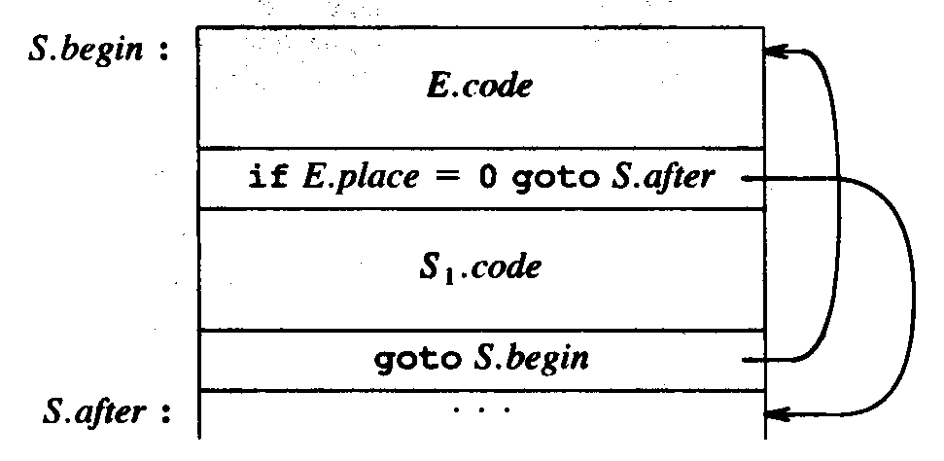
Syntax-Directed Translation into 3-Address code
while statement
Production | Semantic Rules
S → while E do S₁ | S.begin = newlabel S.after = newlabel S.code = gen (S.begin ‘:’)‖ E.code‖ gen (‘if’ E.place ‘= 0 goto‘ S.after )‖ S₁.code‖ gen (‘goto’ S.begin )‖ gen (S.after ‘:’ )

Slide 9
Declarations
Functions for symbol-table management
  enter (name, type, offset )
    Creates a symbol-table entry for name, gives it type type and relative address offset in its data area
Translation scheme for Pascal declarations
  P → {offset = 0} D
  D → D ;D
  D → id : T {enter (id.name, T.type, offset ); offset = offset + T.width}
  T → integer {T.type = integer ; T.width = 4}
  T → real {T.type = real ; T.width = 8}
  T → array[num] of T₁ {T.type = array (num.val, T₁.type ); T.width = num.val, T₁.width}
  T → ↑T₁ {T.type = pointer (T₁.type); T.width = 4}

Slide 10
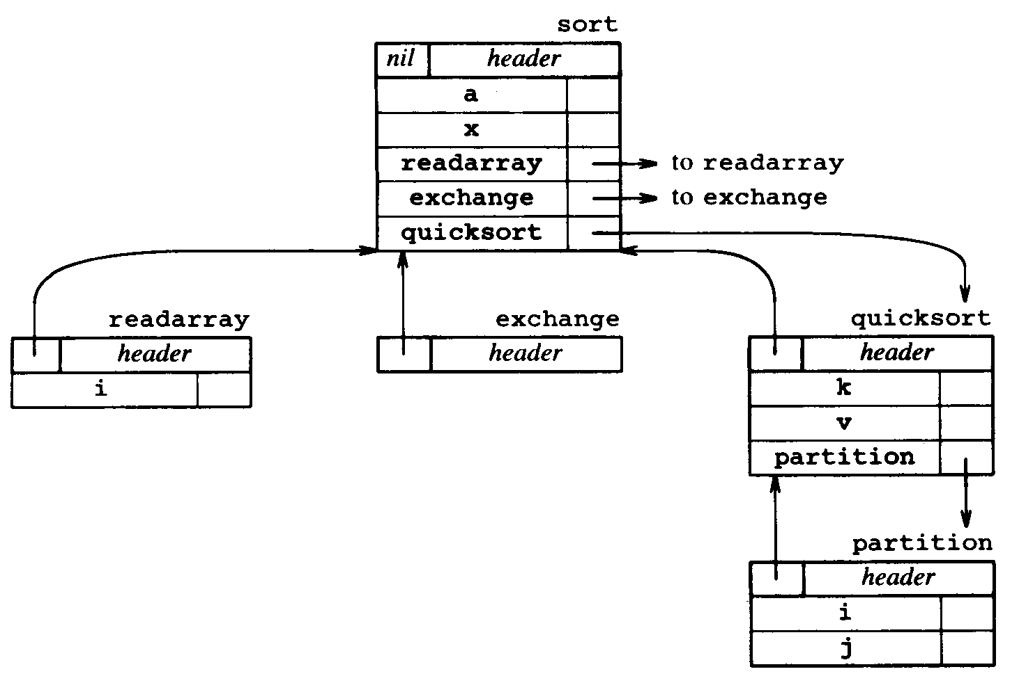
Keeping Track of Scope Information
Consider the grammar
  P → D
  D → D ; D | id : T | proc id ; D ; S
  and the example in Fig. 7.22 (p. 416)

Slide 11
Keeping Track of Scope Information
The semantics rules are defined in terms of
  mktable (previous)
    Creates a new symbol table and returns a pointer to the new table
      The pointer previous is placed in a header for the new symbol table
  enter (table, name, type, offset )
    Creates a new entry for name name in the symbol table pointed to by table
    Places type type and relative address offset in fields
  addwidth (table, width )
    Records the cumulative width of all the entries in table in the header associated with this symbol table
  enterproc (table, name, newtable )
    Creates a new entry for procedure name in the symbol table pointed to by table
    The argument newtable points to symbol table for name

Slide 12
Keeping Track of Scope Information
Processing declarations in nested procedures
  P → M D {addwidth (top (tblptr), top (offset ));
  pop (tblptr); pop (offset )}
  M → є {t = mktable (nil ); push (t, tblptr); pop (0, offset )}
  D → D ;D
  D → proc id; N D₁; S {t = top (tblptr); addwidth (t, top (offset )); pop (tblptr); pop (offset ); enterproc (top (tblptr), id.name, t );}
  D → id : T {enter (top (tblptr), id.name, T.type, top (offset )); top (offset ) = top (offset ) + T.width}
  N→ є {t = mktable (top (tblptr )); push (t, tblptr ); pop(0, offset )}

Slide 13
Field Names in Records
In addition to basic types, pointers, and arrays, records can be generated
  T → record D end
Processing record declarations
  T → record L D end {T.type = record (top (tblptr ));
  T.wideth = top (offset );
  pop (tblptr ); pop (offset )}
  L → є {t = mktable (nil ); push (t, tblptr ); pop (0, offset )}
  D → D ;D

Slide 14
Assignment Statements
Another approach
  Translation can be done by emitting to an output file
    if the code attribute of the nonterminal on the left side of every production is formed by concatenating the code attributes of nonterminals on the right
Translations schemes for assignments
  E → id := E {p = lookup (id.name);
  if p ≠ nil then emit (p ‘=‘ E.place) else error }
  E → E₁ + E₂ {E.place = newtemp ;
  emit (E.place ‘=‘ E₁.place ‘+‘ E₂.place )}
  E → E₁ − E₂ {E.place = newtemp ;
  emit (E.place ‘=‘ E₁.place ‘−‘ E₂.place )}
  E → − E₁ {E.place = newtemp ;
  emit (E.place ‘= −‘ E₁.place )}
  E → (E₁) {E.place = E₁.place )}
  E → id {p = lookup (id.name);
  if p ≠ nil then E.place = p else error }

Slide 15

Boolean Expressions
Methods to represent the value of a boolean expression
  To encode true and false numerically
    To evaluate a boolean expression analogously to an arithmetic expression
    e.g. 1 denotes true and 0 denotes false
  To implement by flow of control
    Represent the value of a boolean expression by a position reached in a program

Slide 16
Numerical Representation
Translation scheme using a numerical representation
  E → E₁ or E₂ {E.place = newtemp; emit (E.place ‘:=‘E₁.place ‘or‘ E₂.place)}
  E → E₁ and E₂ {E.place = newtemp; emit (E.place ‘:=‘E₁.place ‘and‘ E₂.place)}
  E → not E₁ {E.place = newtemp; emit (E.place ‘:= not‘ E₁.place)}
  E → (E₁) {E.place = E₁.place}
  E → true {E.place = newtemp; emit (E.place ‘:= 1‘)}
  E → false {E.place = newtemp; emit (E.place ‘:= 0‘)}
  E → id₁ relop id₂ {E.place = newtemp; emit (‘if’ id₁.place relop.op id₂.place ‘goto’ nextstat+3) emit (E.place ‘:= 0‘) emit (‘goto’ nextstat+2)
  emit (E.place ‘:= 1‘)}

Slide 17
Numerical Representation
example
  a < b or c < d and e < f
100: if a < b goto 103
101: t1 := 0
102: goto 104
103: t1 := 1
104: if c < d goto 107
105: t2 := 0
106: goto 108
107: t2 := 1
108: if e < f goto 111
109: t3 := 0
110: goto 112
111: t3 := 1
112: t4 := t2 and t3
113: t5 := t1 or t4

Slide 18
Flow-of-Control Statements
With a boolean expression E, two labels are associated
  E.true
    The label to which control flows if E is true
  E.false
    The label to which control flows if E is false
With a statement S, two attributes are associated
  S.code
    The sequence of 3-address code to compute S
  S.next
    The label attached to the first instruction to be executed after the code for S

Slide 19
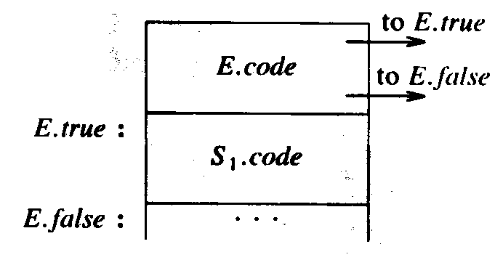
Flow-of-Control Statements
if-then statement
Production | Semantic Rules
S → if E do S₁ | E.true = newlabel E.false = S.next S₁.next = S.next S.code = E.code‖ gen (E.true ‘:‘)‖ S₁.code

Slide 20
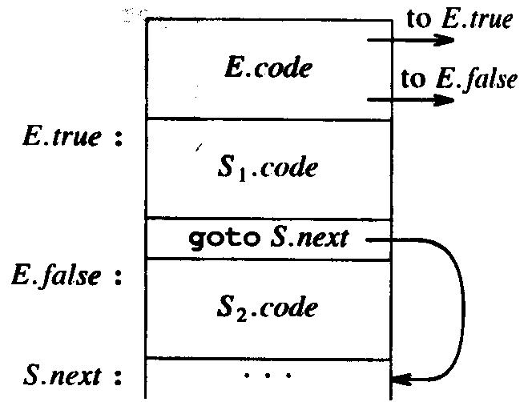
Flow-of-Control Statements
if-then-else statement
Production | Semantic Rules
S → if E do S₁ else S₂ | E.true = newlabel E.false = newlabel S₁.next = S.next S₂.next = S.next S.code = E.code‖ gen (E.true ‘:‘)‖ S₁.code ‖ gen (E.false ‘:‘)‖ S₂.code

Slide 21
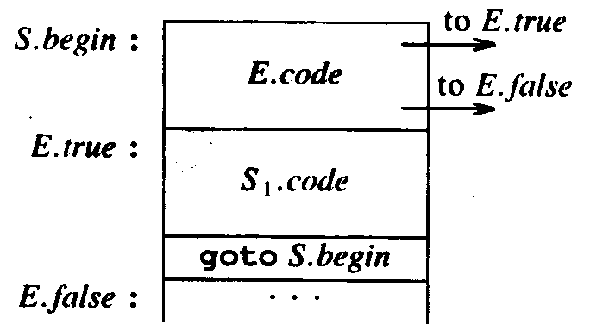
Flow-of-Control Statements
while-do statement
Production | Semantic Rules
S → while E do S₁ | S.begin = newlabel E.true = newlabel E.false = S.next S₁.next = S.begin S.code = gen (S.begin ‘:‘)‖ E.code‖ gen (E.true ‘:‘)‖ S₁.code ‖ gen (‘goto’ S.begin)

Slide 22
Control-Flow Translation of Boolean Expressions
Production | Semantic Rules
E → E₁ or E₂ | E₁.true = E.true; E₁.false = newlabel E₂.true = E.true; E₂.false = E.false E.code = E₁.code ‖gen (E₁.false ‘:’ ) ‖E₂.code
E → E₁ and E₂ | E₁.true = newlabel ; E₁.false = E.false E₂.true = E.true; E₂.false = E.false E.code = E₁.code ‖gen (E₁.true ‘:’ ) ‖E₂.code
E → not E₁ | E₁.true = E.false; E₁.false = E.true E.code = E₁.code
E → (E₁ ) | E₁.true = E.true; E₁.false = E.false E.code = E₁.code
E → id₁ relop id₂ | E.code = gen (‘if’ id₁.place relop.op id₂.place ‘goto’ E.true ) ‖ gen (‘goto’ E.false )
E → true | E.code = gen (‘goto’ E.true )
E → false | E.code = gen (‘goto’ E.false )

Slide 23
Control-Flow Translation of Boolean Expressions
Example
  a < b or c < d and e < f
  while a < b do
  if c < d then
  x := y + z
  else
  x := y − z
if a < b goto Ltrue
goto L1
L1: if c < d goto L2
goto Lfalse
L2: if e < f goto Ltrue
goto Lfalse
L1: if a < b goto L2
goto Lnext
L2: if c < d goto L3
goto L4
L3: t1 := y + z
x := t1
goto L1
L4: t2 := y − z
x := t2
goto L1
Lnext:

Slide 24
Case Statements
The “switch” or “case” statement is available in a variety of languages
  switch E
  begin
  case V₁: S₁
  case V₂: S₂
  …
  case V_{n}: S_{n-1}
  default: S_{n}
  end
code to evaluate E into t
if t ≠ V₁ goto L1
code for S₁
goto next
L1: if t ≠ V₂ goto L2
code for S₁
goto next
L2: …
Ln-2: if t ≠ V_{n-1} goto Ln-1
code for S_{n-1}
goto next
Ln-1: code for S_{n}
next:
code to evaluate E into t
goto test
L1: code for S₁
goto next
L2: code for S₁
goto next
…
Ln-1: code for S_{n-1}
goto next
Ln: code for S_{n}
goto next
test: if t = V₁ goto L1
if t = V₂ goto L2
…
if t = V_{n-1} goto Ln-1
goto Ln
next:

Slide 25
Procedure Calls
Calling sequences
  Space must be allocated for the activation record
  The arguments must be evaluated and made available to the callee in a known place
  S → call id (Elist ) {for each item p on queue do emit (‘param‘ p) emit (‘call‘ id.place)}
  Elist → Elist, E {append E.place to the end of queue}
  Elist → E {initialize queue to contain only E.place}

Slide 26
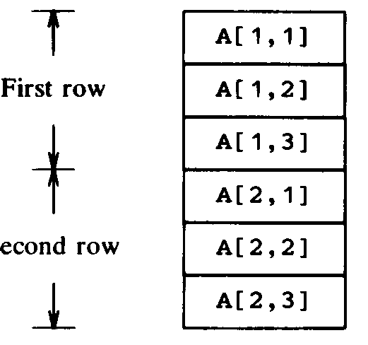
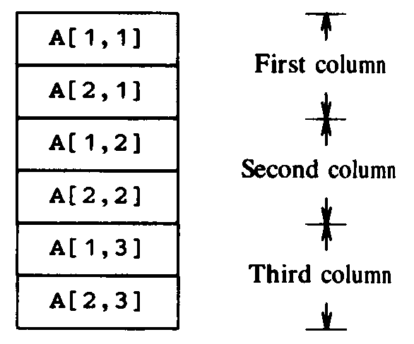
Arrays
A[i ] begins in location
  base + (i − low) × w
  where base is the address of A[low ] and w is the width of each element of array A
  The expression can be rewritten as
  i × w + (base − low × w)
    The subexpression base − low × w can be evaluated by compiler
Multidimensional arrays
  Two forms of layout
    Row-major
    Column-major

Slide 27
Arrays
A[i ₁, i ₂] begins in location (row-major)
  base + ((i₁ − low₁) × n₂ + i₂ − low₂) × w
  where n₂ = high₂ − low₂
  The expression can be rewritten as
  (i ₁ × n ₂ + i ₂) × w + (base − ((low ₁ × n ₂ ) + low ₂) × w)
    base − ((low₁ × n₂ ) + low₂) × w can be evaluated by compiler
A[i ₁, i ₂, …, i _{k}] begins in location (row-major)
  ((…(i ₁n ₂ + i ₂)n ₃ + i ₃)… )n _{k} + i _{k}) × w +
  base − (…((low ₁n ₂ + low ₂) n ₃ + low ₃ )… ) n _{k} + low _{k}) × w
  Recurrent can be used to simply the computation
  e ₁ = i ₁
  e ₂ = e ₁n ₂ + i ₂
  …
  e _{m} = e _{m-1}n _{m} + i _{m}

Slide 28
Arrays
Production for array references
  L → id [Elist ] | id
  Elist → Elist, E | E
  The dimensional limits n_{j} must be available when Elist is reduced
  They are stored in the symbol table and can be retrieved when id[Elist] is reduced
The grammar can be rewritten as
  L → Elist ] | id
  Elist → Elist, E | id [ E
  The dimensional limits can be passed from id to Elist
  Elist.ndim: the number of dimensions in the Elist
  Function limit (array, j ) returns dimensional limits n_{j}

Slide 29
Arrays
Translation schemes for array references
  Elist → id [E {Elist.place = E.place
  Elist.ndim = 1
  Elist.array = id.place)}
  Elist → Elist₁, E {t = newtemp; Elist.ndim = Elist.ndim + 1
  emit (t ‘:=‘ Elist₁.place ‘*’ limit (Elist₁.array, Elist.ndim)
  emit (t ‘:=‘ t ‘+’ E.place)
  Elist.array = Elist₁.array
  Elist.place = t }
  L → Elist ] {L.place = newtemp
  L.offset = newtemp
  emit (L.place ‘:=‘ Elist.array ‘+’ const (Elist.array))
  emit (L.offset ‘:=‘ Elist.place ‘*’ width (Elist.array)) }
  L → id {L.place = id.place ; L.offset = null }
  E → L {if L.offset = null then E.place ‘:=‘ L.place)
  else E.place = newtemp
  emit (E.place ‘ :=‘ L.place ‘[‘ L.offset ‘] ‘)
  S → L := E {if L.offset = null then emit (L.place ‘:=‘ E.place)
  else emit (L.place ‘[‘ L.offset ‘] :=‘ E.place ) }

Slide 30
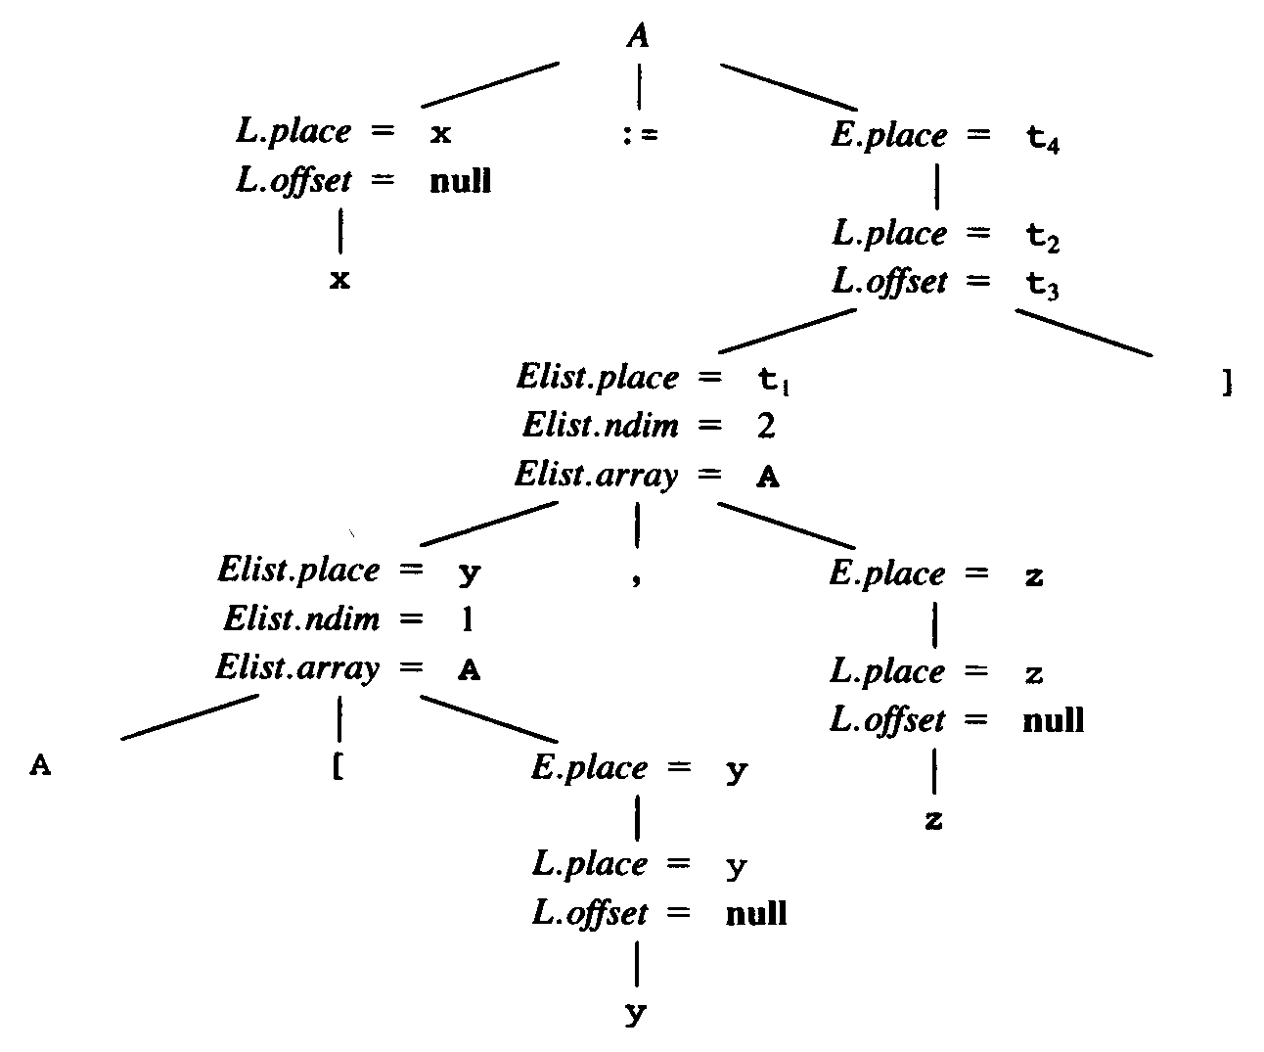
Arrays
Example
  var A: array[10, 20] of integer;
  …
  x := A[y, z];
t1 = y * 20
t1 = t1 + z
t2 = A – 84
t3 = t1 * 4
t4 = t2[t3]
x = t4

Slide 31
Type Conversions within Assignments
There are different types of variables and constants
  The compiler must either reject mixed-type operations or generate appropriate coercion (type conversion) instructions
  Suppose there are two types, real and integer
    Integers are converted to reals when necessary
  Another attribute E.type is introduced
    Its value is either integer or real
  The semantic rule for E.type associated with
  E → E₁ + E₂ {E.type =
  if E₁.type = integer and E₂.type = integer then integer else real }

Slide 32
Type Conversions within Assignments
Complete semantic action for E → E₁ + E₂
  E.place = newtemp;
  if E₁.type = integer and E₂.type = integer then
  emit (E.place ‘:=‘E₁.place ‘int +‘ E₂.place);
  E.type = integer ;
  else if E₁.type = real and E₂.type = real then
  emit (E.place ‘:=‘E₁.place ‘real +‘ E₂.place);
  E.type = integer ;
  else if E₁.type = integer and E₂.type = real then
  u = newtemp;
  emit (u ‘:= int2real‘ E₁.place);
  emit (E.place ‘:=‘ u ‘real +‘ E₂.place);
  E.type = real;
  else if E₁.type = real and E₂.type = integer then
  u = newtemp;
  emit (u ‘:= int2real‘ E₂.place);
  emit (E.place ‘:=‘ E₁.place ‘real +‘ u);
  E.type = real;
  else
  E.type = type_error ;

Slide 33
Backpatching
The main problem with generating code for boolean expressions and flow-of-control statements in 1 pass
  Labels that control must go to may not be known at the time jump statements are generated
  It can be get around by backpatching
    A series of branching statements with the targets of the jumps temporarily left unspecified
    Each such statement will be put on a list of goto statements whose labels will be filled when the labels can be determined
  Functions
    makelist (i )
      Creates a new list containing only i
    merge (p₁, p₂)
      Concatenates the lists pointed to by p₁ and p₂
    backpatch (p, i )
      Inserts i as the target label for each statement on list p

Slide 34
Backtracking
Translation scheme
  E → true {E.truelist = makelist (nextquad )
  emit(‘goto _’) }
  E → false {E.falselist = makelist (nextquad )
  emit(‘goto _’) }
  E → id₁ relop id₂ {E.truelist = makelist (nextquad )
  E.falselist = makelist (nextquad +1)
  emit(‘if’ id₁.place relop.op id₂.place ‘goto _’)
  emit(‘goto _’)}
  E → (E₁) {E.truelist = E₁.truelist
  E.falselist = E₁.falselist ) }

Slide 35
Backtracking
Translation scheme
  E → E₁ or M E₂ {backpatch (E₁.falselist, M.nextquad )
  E.truelist = merge (E₁.truelist, E₂.truelist )
  E₁.falselist = E₂.falselist }
  M → є {M.nextquad = nextquad }
  E → E₁ and M E₂ {backpatch (E₁.truelist, M.nextquad )
  E.truelist = E₂.truelist
  E.falselist = merge (E₁.falselist, E₂.falselist )}
  E → not E₁ {E.truelist = E₁.falselist
  E.falselist = E₁.truelist}

Slide 36
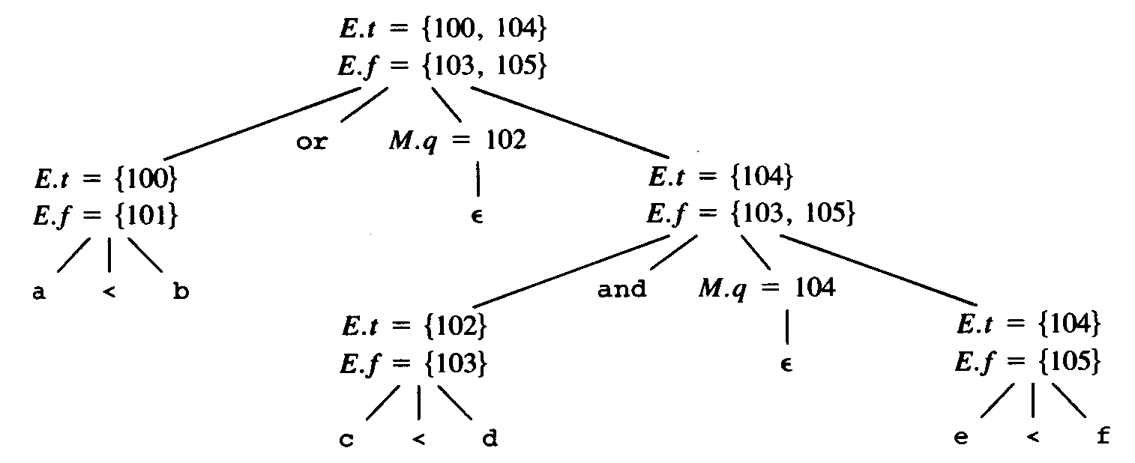
Backtracking
Example
  a < b or c < d and e < f
100: if a < b goto _
101: goto _
102: if c < d goto _
103: goto _
104: if e < f goto _
105: goto _

