Slide 1
Compiler Technology of Programming Languages syllabus
Farn Wang 王凡
farn@ntu.edu.tw
https://farnking.github.io/Farn-Wang-WWW/courses/Compiler/
Thanks to Prof. Wei Chung Hsu （徐慰中） for sharing the course matierials.

Slide 2


What are Compilers ?
Algorithms
coding
programs
compiler
Machine code
loading,
linking
system
support

Slide 3
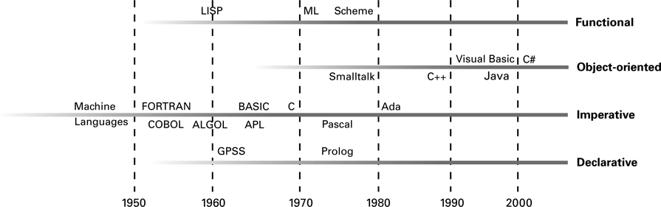
Evolution of Programming Paradigms
3

Slide 4
Why Compilers
Machine code is tedious!
Instructions, registers
CPU is very complex for app programmers to run efficiently.
Caches, hardware accelerators, GPU, OOO
Software crisis

Slide 5
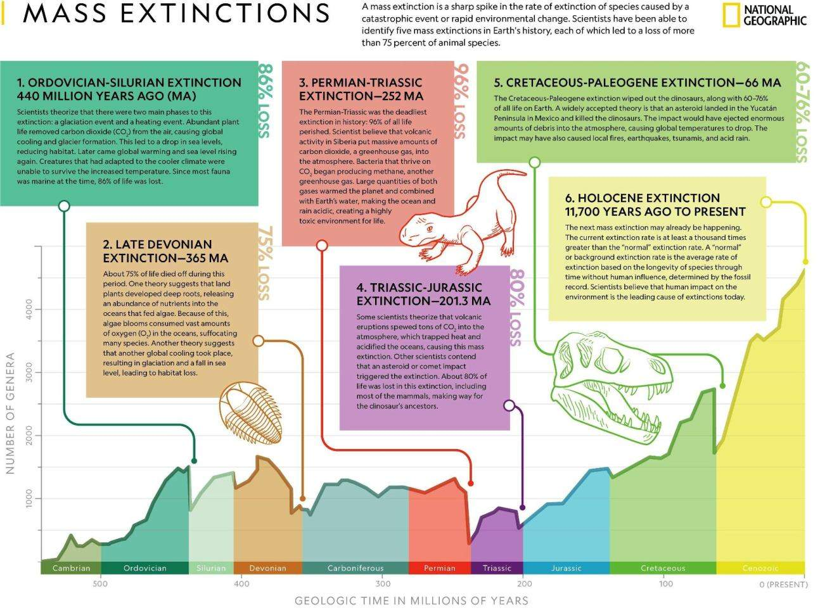
Why Learning Compilers?
LLM
Dramatic changes in programming paradigm!
Massive extinction of average programmers

Slide 6
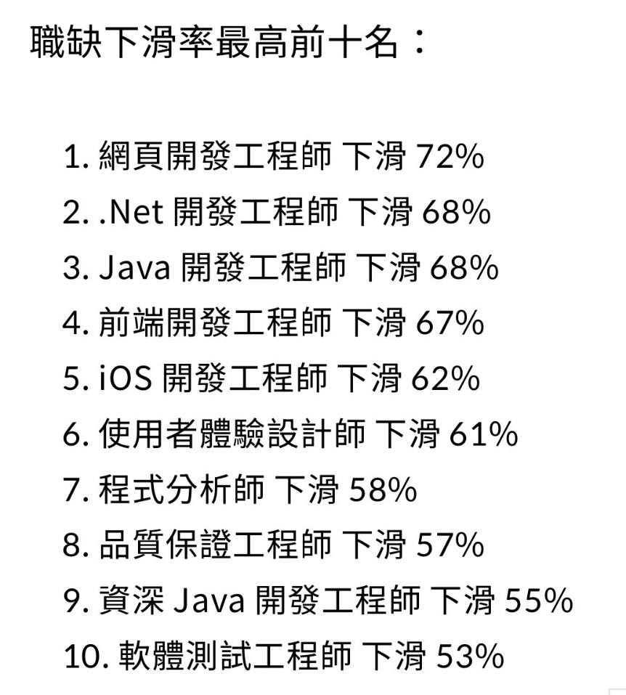
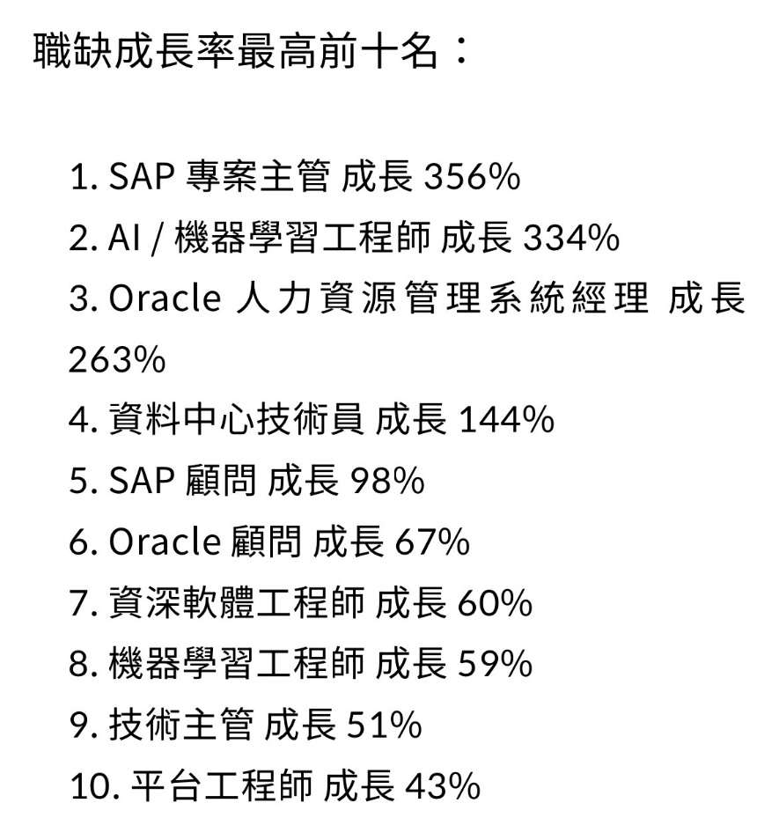
Why Learning Compilers in the LLM Era?
https://news.cnyes.com/news/id/6113572
Get ready for the drastic paradigm shift!
Prepare to survive with several deep techniques.

Slide 7
Software crisis the driving force of technical evolution
Software becomes complicated.
Modern software products need integrated design consideration in
CPU architecture,
compilation,
algorithms, and
user-experience
to achieve competitive performance.
7

Slide 8
Software Crisis
Year | Operating System | SLOC (Million)
1993 | Windows NT 3.1 | 4-5
1994 | Windows NT 3.5 | 7-8
1996 | Windows NT 4.0 | 11-12
2000 | Windows 2000 | >29
2001 | Windows XP | 40
2003 | Windows Server 2003 | 50
Vincent Maraia
Build Master, The:Microsoft's Software Configuration Management Best Practices
Addison-Wesley, October 2005
ISBN13: 9780321332059, ISBN10: 0-321-33205-9
8

Slide 9
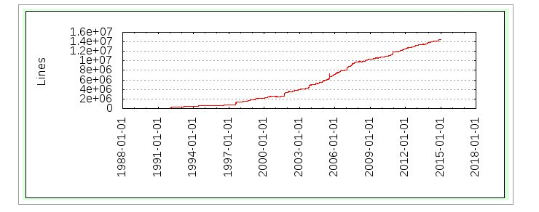
GCC (4.9) Soars Past 14.5 M Lines Of Code
Software Crisis
Linux kernel (4.1) is over 22M Lines Of Code
9
Notes:
If you lack of SW development experience, you need to get help – open source SW community, senior students, …

Slide 10
Software Crisis
Operating System | SLOC (Million)
Debian 2.2 | 55-59
Debian 3.0 | 104
Debian 3.1 | 215
Debian 4.0 | 283
OpenSolaris | 9.7
FreeBSD | 8.8
Mac OS X 10.4 | 86
Linux kernel 2.6.0 | 5.2
Linux kernel 2.6.29 | 11.0
Linux kernel 2.6.32 | 12.6
source lines of code
http://en.wikipedia.org/wiki/Source_lines_of_code
10

Slide 11
Software Crisis Productivity of SEers did not scale!
Software | Estimates (LOC/P-month)
Real-time embedded systems | 40-160
Systems programs | 150-400 LOC/P-month
Commercial applications | 200-800 LOC/P-month
* including all necessary activities in software development.
Ian Sommerville
Software cost estimation, chapter 29
Software Engineering, 5th edition, Addison-Wesley
modified by Spiros Mancoridis 1998
11

Slide 12
Software Crisis
Software quality is the main deciding factor to the competitiveness of software products.
Software QA relies on software testing.
Software testing, direct and indirect, is the main cost in software development!
50% of development cost.
50% of human resources.
The cost rises faster than ever.
12

Slide 13
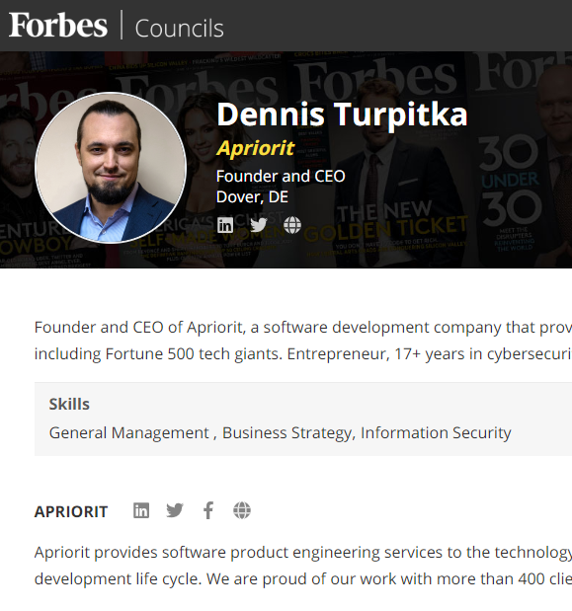
Software Crisis
Statistically speaking, testing occupies
20 percent of the overall development time for a single-component application,
20 to 30 percent for a two-component application
30 to 35 percent for an application with GUI.
35 to 50 percent for a distributed application with GUI.
13

Slide 14

Software Crisis - solutions
I double every 18 month!
AI
Automated programming
Oh, oh!
I produce <1000 LOC a month!
Theory
Program proof!
Automated verification!
Algorithm templates!
PL
OS
Abstraction
Optimization
User-friendliness
SE
System services!
Abstract API!
OO
CI
Testing
Disciplene
14

Slide 15
Software Crisis
Solutions from programming languages
Compilers
Abstraction
Subroutines
Libraries
OO
Optimization
Runtime, compile-time, OOO, caches
User-friendliness
15

Slide 16
What to learn in this course ?
Learning what it takes in making good apps.
Understanding the interaction among CPU, OS, and compilers.
Dealing with CPU, OS, and app people.
Learning language/document processing.
Your first-time nontrivial complete system.
It is simply interesting!

Slide 17
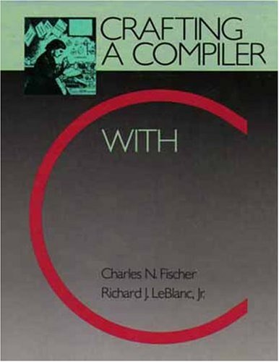
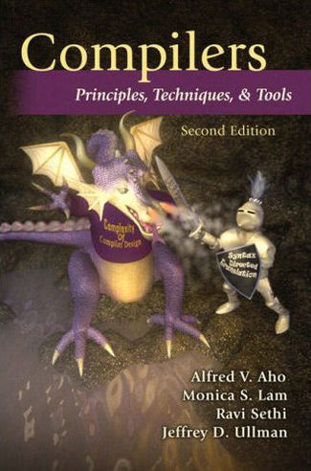
Textbooks
C.N. Fischer, R.K. Cytron, and R.J. LeBlanc, Jr.
Crafting a Compiler with C
Pearson/開發圖書公司
23585 新北市中和區中山路二段327巷1號6樓,
(02) 8242-3988
Reference book:
A.V. Aho, M. Lam, R. Sethi, and J.D. Ullman
Compilers: Principles, Techniques and Tools
the Dragon book, 2nd edition, 2007 (1st edition in 1986)
17

Slide 18
Contents
Fundamentals of compilers.
lexical analysis
parsing
semantics analysis
code generation
code optimization
survey assignments on cutting edge research topics.
Experiments with compilers via projects.
18

Slide 19
Grading Policy 1/4
4 Compiler implementation projects: 40%
Midterm presentation: 20%
Final Exam: 40% (in-class)
Closed book and internet
19
Notes:
Exams are open books/open notes/open google

Slide 20
Grading Policy 2/4
4 Compiler Implementation Projects: 40%
ACDC (10%),
deadline 2025/10/17
Lexical analysis and parsing (10%)
Deadline 2025/11/14
Semantics analysis (10%)
Deadline 2025/12/5
Code generation and optimization (10%)
Deadline 2025/12/26
Team of one! In C or C++!
Details: visit the class websites
20
Notes:
Exams are open books/open notes/open google

Slide 21
Grading Policy 3/4
Midterm presentation: 20%
One main paper from the main conference regular papers of ACM SOSP 2024-25, ACM ISCA 2023-24, IEEE ICPP 2023-24, ACM POPL 2023-24, or ACM PODC 2023-24.
Affiliated workshop papers are not allowed.
Tool and short papers are not allowed.
Main paper may not duplicate.
2 papers related to the main paper for comparison.
Submit and make a 10-min presentation in PP.
Team of one!
21
Notes:
Exams are open books/open notes/open google

Slide 22
Grading Policy 4/4
Final Exam: 40% (in-class)
80% of the points in Final exam are variation from the exercises in the textbook.
Closed book
No discussion in person and in network.
22
Notes:
Exams are open books/open notes/open google

Slide 23
Course Schedule
1. | 2025/9/5 | a) Curriculum Planning, b) Chapter 1: Introduction
2. | 9/12 | a) Chapter 2: A Simple Compiler
3. | 9/19 | Chapter 3: Scanner; Project 1 announcement: a simple compiler
4. | 9/26 | a) Chapter 4: Grammar and Parsing; b) Deadline of registration of midterm presentation papers!
5. | 10/3 | a) Chapter 5: Top-Down Parsing;
6. | 10/10 | National Holiday
7. | 10/17 | a) Project 1 deadline; b) Project 2 announcement: C-Compiler: A Scanner and a Parser
8. | 10/24 | National Holiday
9. | 10/31 | a) Chapter 6: Bottom-up Parsing
23

Slide 24
Course Schedule
10. | 11/7 | a) Chapter 7: Syntax Directed Translation; b) Deadline of midterm reports!
11. | 11/14 | a) Chapter 8: Declaration Processing and Symbol Table, b) project 2 deadline; c) project 3 announcement: A Type Checker.
12. | 11/21 | a) Chapter 9: Semantic Analysis
13. | 11/28 | a) Machine Code Generation b) Code Generation for Data Accesses and Simple Register Allocation;
14. | 12/5 | a) Code Generation for Control Structures b) Code Generation for Arrays, Procedure Calls c) project 3 deadline; d) project 4 announcement: Code Generation and optimization
15. | 12/12 | a) Optimization: Parallelization, CSE, Register Allocation, Code Scheduling, b) Vectorization, Memory Hierarchy related optimization, …;
16. | 12/19 | Final exam
17. | 12/26 | Project 4 submission deadline!
24

Slide 25

Instructor and TA
Instructor: 王 凡 教授
farn@ntu.edu.tw
https://farnking.github.io/Farn-Wang-WWW/
Teaching Assistant：楊冠彥
f11921091@ntu.edu.tw
Office Hours: Friday 12-13, BL 112
25

Slide 26
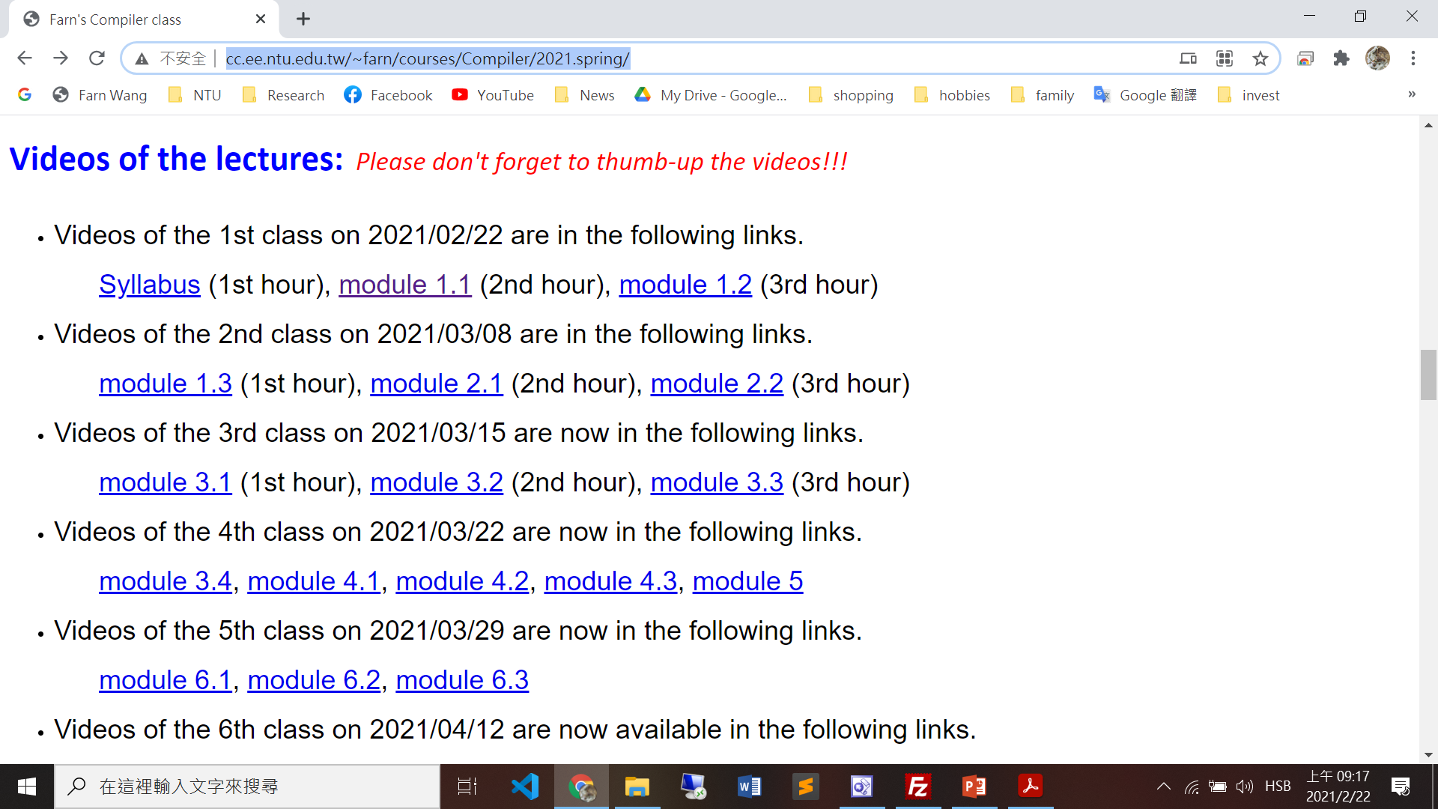
Video links in the course webpage

Slide 27
Resources
Teacher’s homepage
https://farnking.github.io/Farn-Wang-WWW/
https://farnking.github.io/Farn-Wang-WWW/courses/Compiler/
NTU COOL
CEIBA
Course videos uploaded before the each week’s class.
27

