Slide 1
Compiler Technology of Programming Languages syllabus
Farn Wang 王凡
farn@ntu.edu.tw

Slide 2
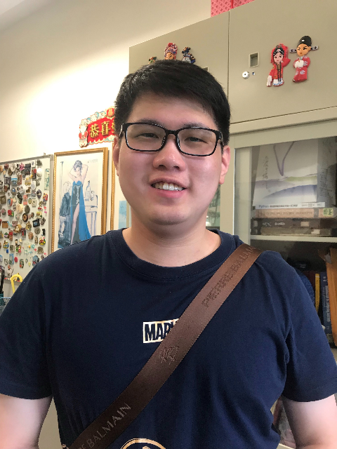
Instructor and TA
Instructor: 王 凡 教授
Office Hours: Tuesday 12-13, BL 616
farn@ntu.edu.tw
http://cc.ee.ntu.edu.tw/~farn/courses/Compiler
TA：陳煒凱
(d09921029@g.ntu.edu.tw)
2

Slide 3
Adding in the course
(2022/09/06)
Open to all students in the school course add/delete system.
Students do not need the signature or any procedure from the teacher to add in this course.

Slide 4
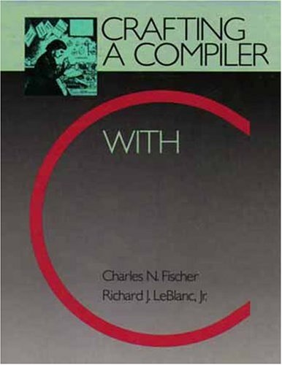
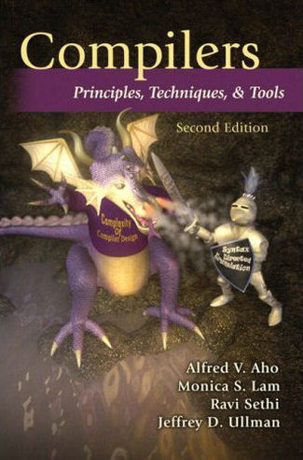
Textbooks
C.N. Fischer, R.K. Cytron,
and R.J. LeBlanc, Jr.
Crafting a Compiler with C
Pearson
開發圖書公司
23585 新北市中和區中山路二段327巷1號6樓,
(02) 8242-3988
Reference book:
A.V. Aho, M. Lam, R. Sethi, and J.D. Ullman
Compilers: Principles, Techniques and Tools
the Dragon book, 2nd edition, 2007 (1st edition in 1986)
4

Slide 5
Resources
Teacher’s homepage http://cc.ee.ntu.edu.tw/~farn
http://cc.ee.ntu.edu.tw/~farn/courses/Compiler/index.htm
NTU COOL
CEIBA
Course videos uploaded before the each week’s class.
Thanks to Prof. Wei Chung Hsu （徐慰中） for sharing the course matierials.
5

Slide 6
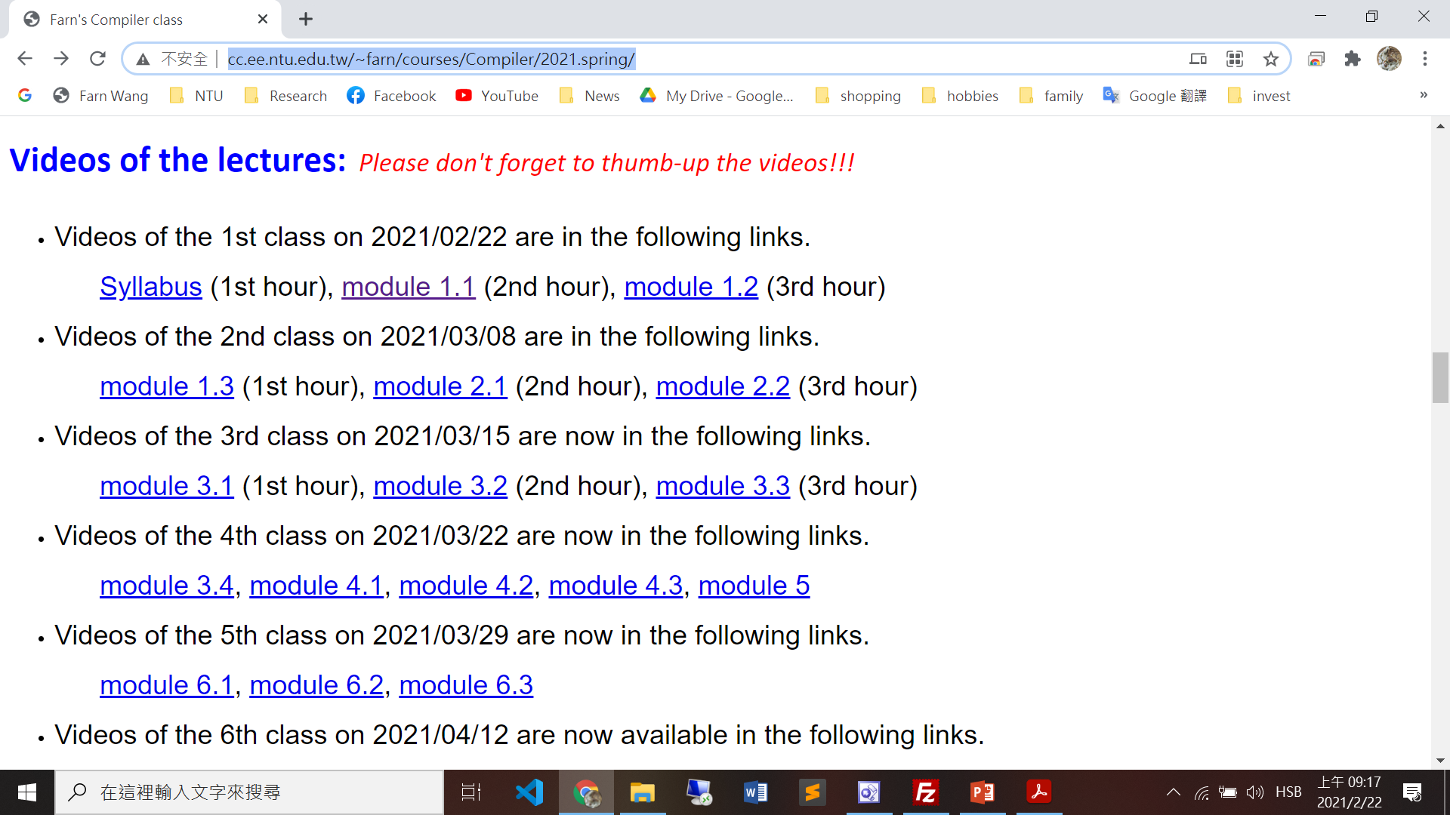
Video links in the course webpage

Slide 7

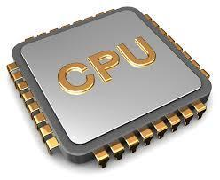

What are compilers ?
Algorithms
coding
programs
compiler
Machine code
loading,
linking
system
support

Slide 8
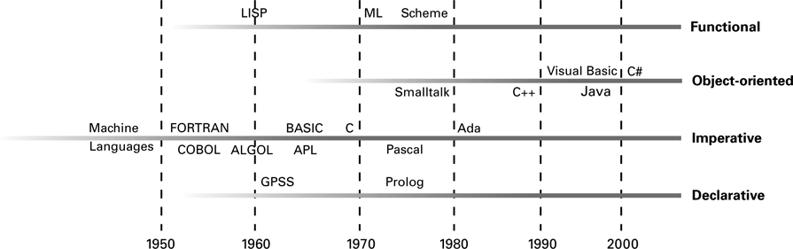
The evolution of programming paradigms
8

Slide 9
Why compilers
Machine code is tedious!
Instructions, registers
CPU is very complex for app programmers to run efficiently.
Caches, hardware accelerators, GPU, OOO
Software crisis

Slide 10
Software crisis the driving force of technical evolution
Software becomes complicated.
Modern software products need integrated design consideration in
CPU architecture,
compilation,
algorithms, and
user-experience
to achieve competitive performance.
10

Slide 11
Software Crisis
Year | Operating System | SLOC (Million)
1993 | Windows NT 3.1 | 4-5
1994 | Windows NT 3.5 | 7-8
1996 | Windows NT 4.0 | 11-12
2000 | Windows 2000 | >29
2001 | Windows XP | 40
2003 | Windows Server 2003 | 50
Vincent Maraia
Build Master, The:Microsoft's Software Configuration Management Best Practices
Addison-Wesley
October 2005
ISBN13: 9780321332059, ISBN10: 0-321-33205-9
11

Slide 12
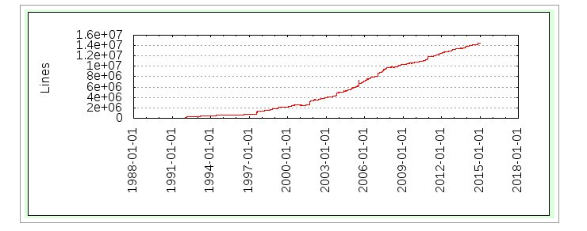
GCC (4.9) Soars Past 14.5 M Lines Of Code
Software Crisis
Linux kernel (4.1) is over 22M Lines Of Code
12
Notes:
If you lack of SW development experience, you need to get help – open source SW community, senior students, …

Slide 13
Software Crisis
Operating System | SLOC (Million)
Debian 2.2 | 55-59
Debian 3.0 | 104
Debian 3.1 | 215
Debian 4.0 | 283
OpenSolaris | 9.7
FreeBSD | 8.8
Mac OS X 10.4 | 86
Linux kernel 2.6.0 | 5.2
Linux kernel 2.6.29 | 11.0
Linux kernel 2.6.32 | 12.6
source lines of code
http://en.wikipedia.org/wiki/Source_lines_of_code
13

Slide 14
Software Crisis Productivity of SEers did not scale!
Software | Estimates (LOC/P-month)
Real-time embedded systems | 40-160
Systems programs | 150-400 LOC/P-month
Commercial applications | 200-800 LOC/P-month
* including all necessary activities in software development.
Ian Sommerville
Software cost estimation, chapter 29
Software Engineering, 5th edition, Addison-Wesley
modified by Spiros Mancoridis 1998
14

Slide 15
Software Crisis
Software quality is the main deciding factor to the competitiveness of software products.
Software QA relies on software testing.
Software testing, direct and indirect, is the main cost in software development!
50% of development cost.
50% of human resources.
The cost rises faster than ever.
15

Slide 16
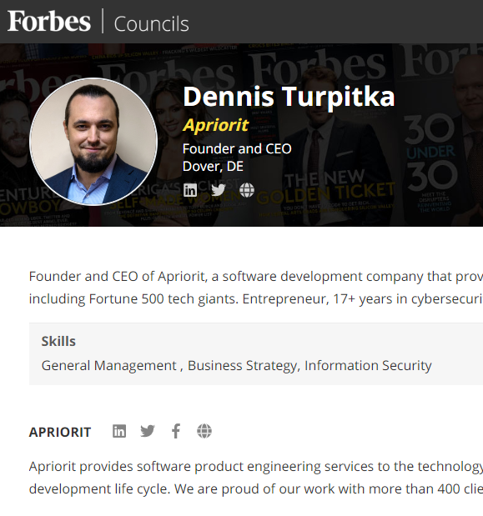
Software Crisis
Statistically speaking, testing occupies
20 percent of the overall development time for a single-component application,
20 to 30 percent for a two-component application
30 to 35 percent for an application with GUI.
35 to 50 percent for a distributed application with GUI.
16

Slide 17
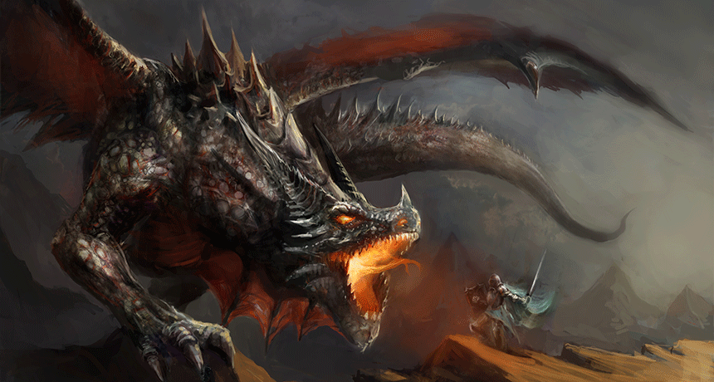
Software Crisis - solutions
I double every 18 month!
AI
Automated programming
Oh, oh!
I produce <1000 LOC a month!
Theory
Program proof!
Automated verification!
Algorithm templates!
PL
OS
Abstraction
Optimization
User-friendliness
SE
System services!
Abstract API!
OO
CI
Testing
Disciplene
17

Slide 18
Software Crisis
Solutions from programming languages
Compilers
Abstraction
Subroutines
Libraries
OO
Optimization
Runtime, compile-time, OOO, caches
User-friendliness
18

Slide 19
Why do you need this course ?
Learning what it takes in making good apps.
Understanding the interaction among CPU, OS, and compilers.
Dealing with CPU, OS, and app people.
Learning language/document processing.
Your first-time nontrivial complete system.
It is simply interesting!

Slide 20
Contents
Fundamentals of compilers.
lexical analysis
parsing
semantics analysis
code generation
code optimization
survey assignments on cutting edge research topics.
Experiments with compilers via projects.
20

Slide 21
Grading Policy 1/4
4 Compiler implementation projects: 40%
Midterm presentation: 20%
Final Exam: 40% (in-class)
Closed book and internet
21
Notes:
Exams are open books/open notes/open google

Slide 22
Grading Policy 2/4
4 Compiler Implementation Projects: 40%
ACDC (10%),
deadline 2022/10/11
Lexical analysis and parsing (10%)
Deadline 2022/11/1
Semantics analysis (10%)
Deadline 2022/11/29
Code generation and optimization (10%)
Deadline 2022/12/13
Team of one! In C or C++!
Details: visit the class websites
22
Notes:
Exams are open books/open notes/open google

Slide 23
Grading Policy 3/4
Midterm presentation: 20%
One main paper from the main conference regular papers of ACM SOSP 2018-19, ACM ISCA 2019-20, IEEE ICPP 2019-20, ACM POPL 2019-20, or ACM PODC 2019-20.
Affiliated workshop papers are not allowed.
Tool and short papers are not allowed.
Main paper may not duplicate.
2 papers related to the main paper for comparison.
Submit and make a 10-min presentation in PP.
Team of one!
23
Notes:
Exams are open books/open notes/open google

Slide 24
Grading Policy 4/4
Final Exam: 40% (in-class)
80% of the points in Final exam are variation from the exercises in the textbook.
Closed book
No discussion in person and in network.
24
Notes:
Exams are open books/open notes/open google

Slide 25
Course Schedule
1. | 9/6 | a) Course Organization, b) Chapter 1: Introduction
2. | 9/13 | a) Chapter 2: A Simple Compiler
3. | 9/20 | Chapter 3: Scanner; Project 1 announcement: a simple compiler
4. | 9/27 | a) Chapter 4: Grammar and Parsing; b) Deadline of registration of midterm presentation papers!
5. | 10/4 | a) Chapter 5: Top-Down Parsing;
6. | 10/11 | a) Project 1 deadline; b) Project 2 announcement: C-Compiler: A Scanner and a Parser
7. | 10/18 | a) Chapter 6: Bottom-up Parsing
8. | 10/25 | a) Chapter 7: Syntax Directed Translation; b) Midterm presentation 1. c) Deadline of the midterm presentation report in PPSX!
25

Slide 26
Course Schedule
9. | 11/1 | a) Chapter 12: Runtime Support; b) project 2 deadline; c) project 3 announcement: A Type Checker.
10. | 11/8 | a) Chapter 8: Declaration Processing and Symbol Table, b) Chapter 9: Semantic Analysis
11. | 11/15 | School celebration
12. | 11/22 | a) Code Generation for ARMv8; b) Midterm presentation 2.
13. | 11/29 | a) Code Generation for Data Accesses and Simple Register Allocation; b) project 3 deadline; c) project 4 announcement: Code Generation and optimization
14. | 12/6 | a) Code Generation for Control Structures b) Code Generation for Arrays, Procedure Calls
15. | 12/13 | a) Optimization: Parallelization, CSE, Register Allocation, Code Scheduling, b) Vectorization, Memory Hierarchy related optimization, …; c) Project 4 submission deadline!
16. | 12/20 | Final exam
26

