Slide 1




MYNTRA
WEEK 1 CASE STUDY
ANALYSIS OF MYNTRA APPAREL
PRESENTATION - 2025
www.myntra.com

Slide 2

ABOUT OUR COMPANY
Myntra is an Indian fashion e-commerce company headquartered in Bengaluru, Karnataka, India. The company was founded in 2007-2008 to sell personalized gift items. In May 2014, Myntra.com was acquired by Flipkart.

Slide 3


VISION AND MISSION
VISION
MISSION
To be India's most preferred destination for fashion and lifestyle products, offering a personalized and delightful shopping experience for every customer.
To democratize fashion in India by providing access to trendy, affordable, and high-quality apparel through a seamless digital shopping experience.

Slide 4
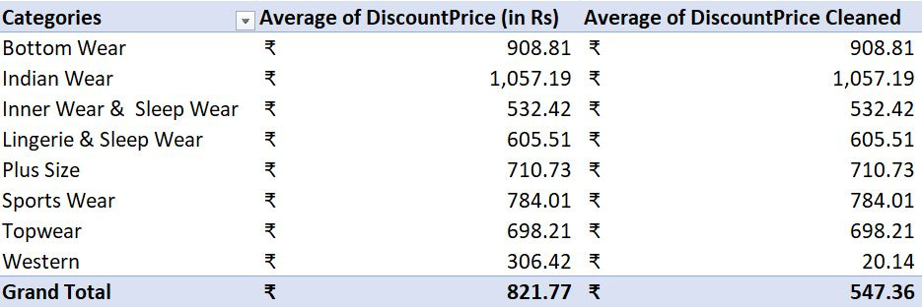
CATEGORY WISE AVERAGE

Slide 5
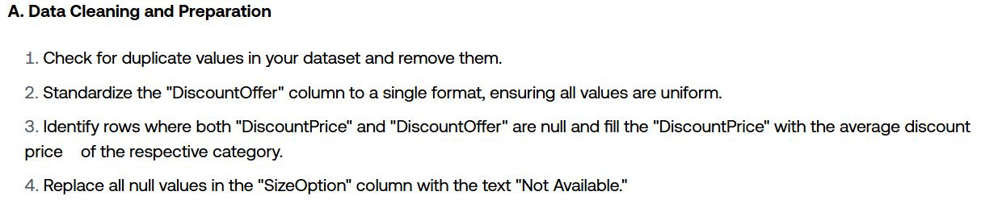
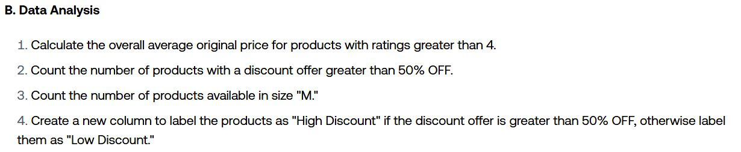
ANALYSIS OF MYNTRA APPAREL
PROJECT QUESTIONS

Slide 6
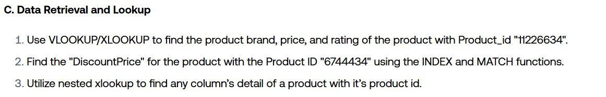
ANALYSIS OF MYNTRA APPAREL
PROJECT QUESTIONS

Slide 7
A. DATA CLEANING AND PREPARATION

Slide 8

A. DATA CLEANING AND PREPARATION
1. CHECK FOR DUPLICATE VALUES IN YOUR DATASET AND REMOVE THEM.
NO DUPLICATE data present here as per PRODUCT_ID is a unique column . It is a unique identifier for all products .

Slide 9
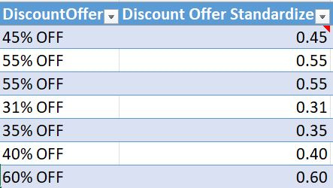
A. DATA CLEANING AND PREPARATION
2. STANDARDIZE THE "DISCOUNTOFFER" COLUMN TO A SINGLE FORMAT, ENSURING ALL VALUES ARE UNIFORM.
All values of DISCOUNTOFFER column has been standardize to decimal (0.45) format usign the below mention formula.Done some cleaning also , like removing Rs. , * Hurry.
=IF(ISBLANK(K2),0,IF(ISNUMBER(SEARCH("%",K2)),VALUE(TRIM(LEFT(K2,FIND("%",K2)-1))),IF(ISNUMBER(SEARCH("Rs. ",K2)),ROUND((VALUE(SUBSTITUTE(SUBSTITUTE(K2,"Rs. ","")," OFF",""))/J2)*100,2),0)))/100

Slide 10
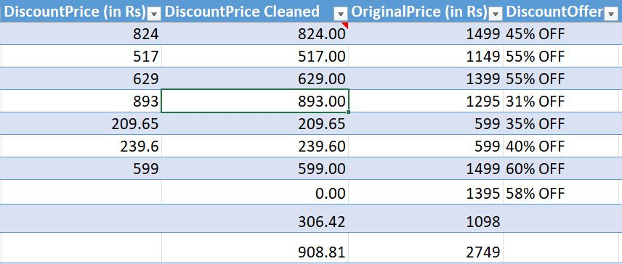
A. DATA CLEANING AND PREPARATION
3. IDENTIFY ROWS WHERE BOTH "DISCOUNTPRICE" AND "DISCOUNTOFFER" ARE NULL AND FILL THE "DISCOUNTPRICE" WITH THE AVERAGE DISCOUNT PRICE OF THE RESPECTIVE CATEGORY.
Average of respective category has been inserted into the column of “DISCOUNTPRICE” where “DISCOUTNPRICE” and “DISCOUTNOFFER” both have “BLANK” values .
=IF(ISBLANK([@[DiscountPrice (in Rs)]]),IF(ISBLANK([@DiscountOffer]),AVERAGEIFS(H:H,D:D,[@Category]),[@[DiscountPrice (in Rs)]]),[@[DiscountPrice (in Rs)]])

Slide 11
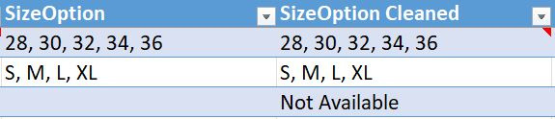
A. DATA CLEANING AND PREPARATION
4. REPLACE ALL NULL VALUES IN THE "SIZEOPTION" COLUMN WITH THE TEXT "NOT AVAILABLE."
All null values in the “SIZEOPTION” has been inserted with “NOT AVAILABLE” using the below excel formula .
=IF(ISBLANK(M2),"Not Available",M2)

Slide 12
B. DATA ANALYSIS

Slide 13

B. DATA ANALYSIS
1.CALCULATE THE OVERALL AVERAGE ORIGINAL PRICE FOR PRODUCTS WITH RATINGS GREATER THAN 4.
1797.65 is calculated Average for “Original Price” for products with rating more than 4 using below mention excel formula .
=AVERAGEIF(Table4[Ratings],4,Table4[OriginalPrice (in Rs)])

Slide 14
B. DATA ANALYSIS
2.COUNT THE NUMBER OF PRODUCTS WITH A DISCOUNT OFFER GREATER THAN 50% OFF.
5519 is the Count for products with Discount Offer Greater than 50% OFF , done using below mention formula.
=COUNTIF(Table4[Discount Offer Standardize],">0.50")

Slide 15

B. DATA ANALYSIS
3.COUNT THE NUMBER OF PRODUCTS AVAILABLE IN SIZE "M."
6582 is the Count for products with that have “M” Size option available right now , done using below mention formula.
=COUNTIF(Table4[SizeOption Cleaned],"*M*")
Note : Here I leannt new concept called WildCards in excel that helps in matching a specific text in cell with multiple values .

Slide 16
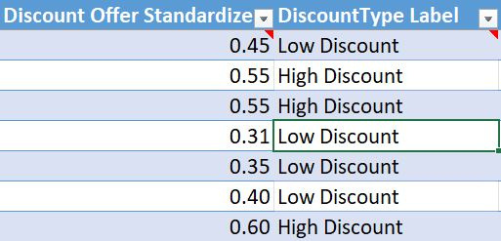
B. DATA ANALYSIS
4.CREATE A NEW COLUMN TO LABEL THE PRODUCTS AS "HIGH DISCOUNT" IF THE DISCOUNT OFFER IS GREATER THAN 50% OFF, OTHERWISE LABEL THEM AS "LOW DISCOUNT."
created new column labelled as “DISCOUNTTYPE LABEL” with values “HIGH DISCOUNT” if “DISOCUNT OFFER” have value more than 50% (0.50) “LOW DISCOUNT” have value less than 50% (0.50) , done usign the below mention formula .
=IF([@[Discount Offer Standardize]]>0.5,"High Discount","Low Discount")

Slide 17
C. DATA RETRIEVAL AND LOOKUP

Slide 18

C. DATA RETRIEVAL AND LOOKUP
1.USE VLOOKUP/XLOOKUP TO FIND THE PRODUCT BRAND, PRICE, AND RATING OF THE PRODUCT WITH PRODUCT_ID "11226634".
Used VLOOKUP function get Brand Name , Price and Ratign of Product_ID = “11226634” .
BrandName - =VLOOKUP(V10,Table4[[Product_id]:[Reviews]],2,FALSE)
Price - =VLOOKUP(V10,Table4[[Product_id]:[Reviews]],8,FALSE)
Rating - =VLOOKUP(V10,Table4[[Product_id]:[Reviews]],15,FALSE)

Slide 19

C. DATA RETRIEVAL AND LOOKUP
2.FIND THE "DISCOUNTPRICE" FOR THE PRODUCT WITH THE PRODUCT ID "6744434" USING THE INDEX AND MATCH FUNCTIONS.
Used INDEX and MATCH functions get Brand Name , Price and Ratign of Product_ID = “6744434” .
BrandName - =INDEX(C:C,MATCH(W10,B:B,0))
Price - ==INDEX(J:J,MATCH(W10,B:B,0))
Rating - =INDEX(P:P,MATCH(W10,B:B,0))

Slide 20
C. DATA RETRIEVAL AND LOOKUP
3.UTILIZE NESTED XLOOKUP TO FIND ANY COLUMN’S DETAIL OF A PRODUCT WITH IT’S PRODUCT ID.
=XLOOKUP(V10, Table4[Product_id], XLOOKUP(X13, Table4[#Headers], Table4))
Used INDEX and MATCH functions get Brand Name , Price and Rating of Product_ID = “6744434” .
V10 = ProductID
Table4[Product_id]= ProductIDs column
X13 = ColumnName
Table4[#Headers]= Table Headers as we want to search that
XLOOKUP(X13, Table4[#Headers], Table4) - returns all values of respective column of X13 (columnName) → Nested XLOOKUP()

Slide 21





OUR CONTACT
INFORMATION
You can contact Myntra customer support by email at communications@Myntra.com for general questions and comments. You can also email customergrievance@myntra.com for grievances.
+91-80-61561999
www.myntra.com
customergrievance@myntra.com

Slide 22


MYNTRA
THANK YOU
FOR YOUR ATTENTION
Presented by:
Farook Mohammad
farookmohammad27@gmail.com

