Slide 1
Customer Satisfaction Survey
Survey Results Report
Generated: 1/23/2026

Slide 2
Response Summary
Metric | Value
Total Responses | 3
Completed | 3
Partial | 0
Response Rate | 100.00%

Slide 3
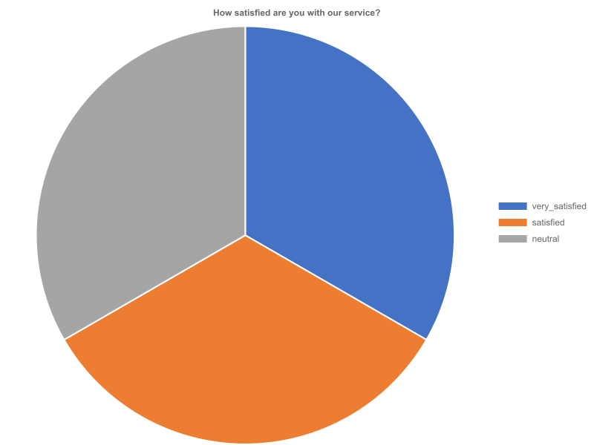
How satisfied are you with our service?
Response Rate: 100.00% (3 responses)

Slide 4
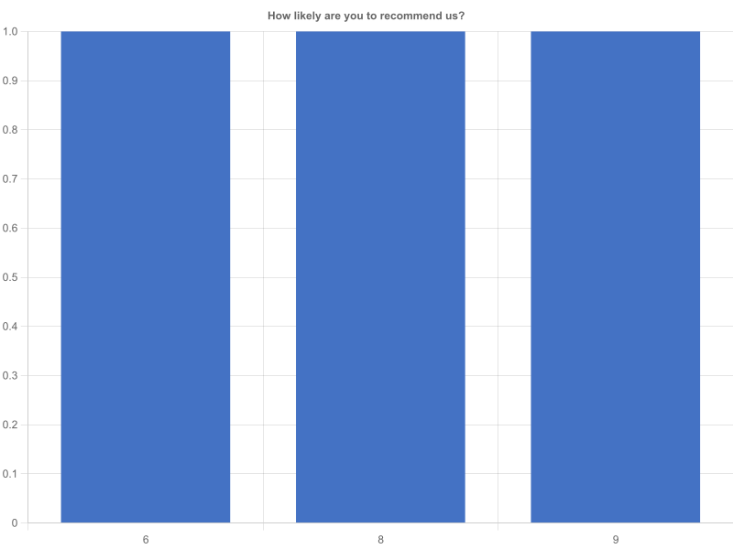
How likely are you to recommend us?
Response Rate: 100.00% (3 responses)

Slide 5
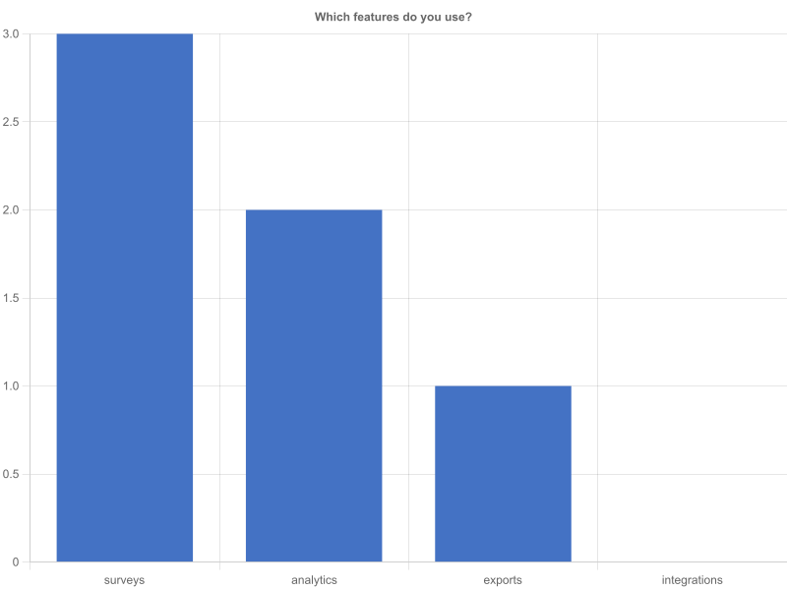
Which features do you use?
Response Rate: 100.00% (3 responses)

