Slide 1
GIT
26 November 2021

Slide 2
Agenda
Version Control System Types of Version Control Systems
Distributed Version Control System
Git Basics
Steps to get your project into Git
Three States
Recording changes to the repository
Checking the status of your Files
Viewing Staged and Unstages changes
Committing your Changes
Removing Files
Moving Files
Viewing the commit History
Changing your last commit
Unstaging and Unmodifying
Working with remotes
Branching
Merging
Rebasing

Slide 3
Version Control System
Version control is a system that records changes to a file or set of files.
The following are the types of version control systems:
Local Version Control System (Ex) RCS
Centralized Version Control System (Ex) CVS, Subversion, Perforce
Distributed Version Control System (Ex) Git , Mercurial, Bazaar or Darcs

Slide 4
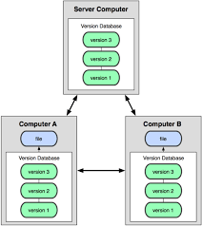
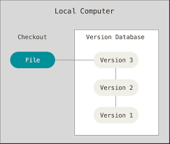

Types of Version Control Systems
Distributed VCS
Local VCS
Centralized VCS

Slide 5
Distributed Version Control System
Distributed version control system(DVCS) keeps track of software revisions and allows many developers to work on a given project without maintaining a connection to a common network.
Example: Git, Mercurial, Mercurial, Bazaar

Slide 6
GIT Basics
Git is a free and open source distributed version control system designed to handle everything from small to very large projects with speed and efficiency.
It was initially designed and developed by Linus Torvalds for linux kernel development.
Now it is maintained by Junio Hamano.
Every Git working directory contains a full-fledged repository with complete history and full revision tracking capabilities
It is not dependent on network access or a central server.

Slide 7
Steps to get your project into Git
There are two steps to get the project into the git.
Step 1 : Cloning the existing Git repository from the server to your local git repository.
Commands:
git clone git://github.com/schacon/grit.git(URL)
Step 2 : Import the existing project or directory into your local git repository and push into the remote git repository.
Commands:
git init //Create an empty Git repository or reinitialize an existing one
git add *.* // Add file contents to the index
git commit -m ‘ initial version’ // Record changes to the local repository
git push origin master // Push the code into remote repository

Slide 8
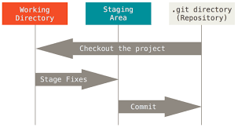
3 main stages of GIT
Git directory - Stores the metadata and object database for your project (while cloning the repository)
Working directory - Single checkout of one version of the project. The files in the directory are pulled out of the compressed database in the Git directory and placed on disk for you to edit and use.
Staging area - It is a simple file, generally present in your Git directory, that stores information about what will go into your next commit.

Slide 9
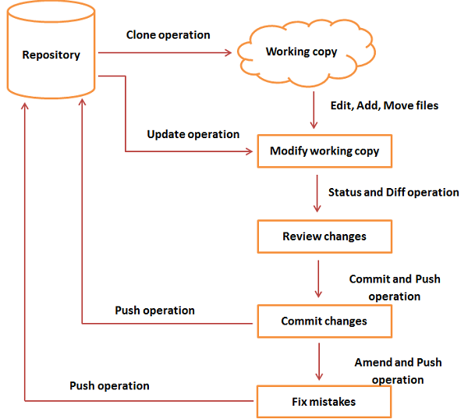
GIT Life Cycle

Slide 10
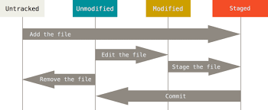
Recording Changes to the Repository
Each file in your working directory can be in one of the following two states: Tracked or Untracked
File status in Life Cycle :
Untracked
Unmodified
Modified
Staged

Slide 11
Checking the status of Your files
Command: git status
Untracked Files - Files in your working directory that are not present in your last snapshot and staging area.
Tracked Files - Files that are present in the last snapshot The following command is used to make the file status as trackable
Command: git add filename
Staging Modified Files – A File which is already tracked and has been modified in the working directory, but not yet staged.
Unstaging Modified Files - A File that is out of the staging area. The following command is used to make the file unstaged
Command : git reset HEAD filename

Slide 12
Viewing Your Staged and Unstaged Changes
To view the difference between staged and unstaged files
Command : git diff
To view the difference between staged and the last committed file
Command : git diff –cached
Note : git diff does not show the difference of staged and the last committed file

Slide 13
Commiting Your Changes
The simplest way to commit is to type
Command : git commit
To commit along with comments
Command : git commit –m “Comments”
Skipping the Staging Area:
To skip the staging area during commits
Command: git commit –a –m “Comments”

Slide 14
Removing Files
To remove the file
Command : git rm filename
To remove the file from staged area
Command : git rm -- cached filename

Slide 15
Moving Files
The metadata stored in Git does not tell you whether the file is renamed.
To rename a file in Git:
Command : git mv file_from file_to

Slide 16
Viewing the commit history
To view the commit history
Command : git log
To view the difference introduced in each commit
Command : git log p
To limit the output for last two entries
Command : git log p -2€

Slide 17
Changing Your Last Commit
To change the last commit (if we forgot to add any file)
Command : git commit –amend
This will take the file to the staging area and use it for commit
Example:
git commit –m ‘comments’ // Record changes to the repository
git add filename // Realize, you forgot to add the file
git commit –amend // Record changes to the repository with newlyadded file

Slide 18
Unstaging and Unmodifying
To make the Staged file to a Unstaged file
Command : git reset HEAD filename
To make the Modified file to an unmodified file
Command : git checkout filename

Slide 19
Working with remotes
To push our code to the remote server (actual git repository)
Command : git push origin branchname
To pull the code from the remote server (actual git repository)
Command : git pull
To get the newly created branches in our local repository
Command : git fetch

Slide 20
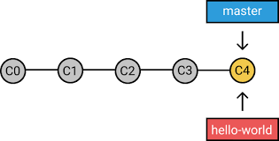
Branching
To create a branch in local repository
Command : git checkout –b branchname
To delete a branch in local repository
Command : git branch –d branchname

Slide 21
Merging the branch
Merging brings two lines of development together while preserving the ancestry of each commit history.
Command :
git merge branchname
git checkout devel // Switch to devel branch in local repository
git pull // Pull the latest code of devel from remote repository
git merge hotfix // Merge the hotfix branch into devel branch present in the local repository
git push origin devel // Merged devel branch is pushed to the remote repository

Slide 22
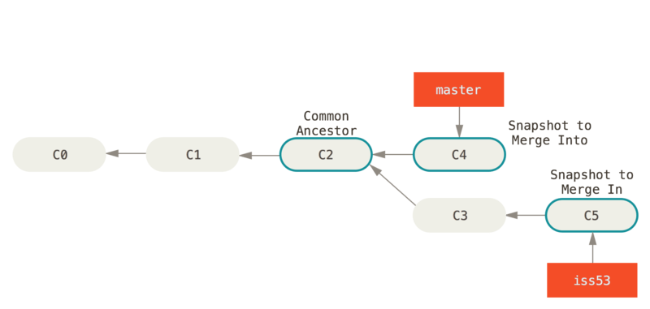
Example of merging the branch

Slide 23
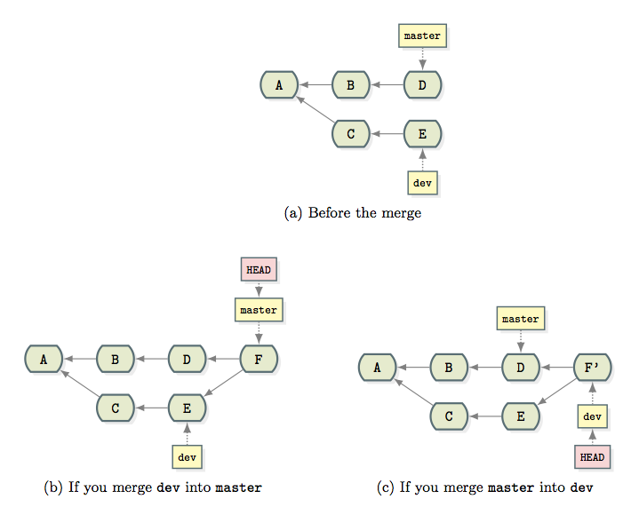
Example of merging the branch

Slide 24
Rebasing the branch
Rebasing unifies the lines of development by rewriting changes from the source branch so that they appear as children of the destination branch
Command :
git rebase branchname
git checkout devel // Switch to devel branch in local repository
git pull // Pull the latest code of devel from remote repository
git rebase hotfix // Get the hotfix branch changes to the devel branch present in the local repository
git push origin devel // Rebased devel branch is pushed to the remoter epository

Slide 25
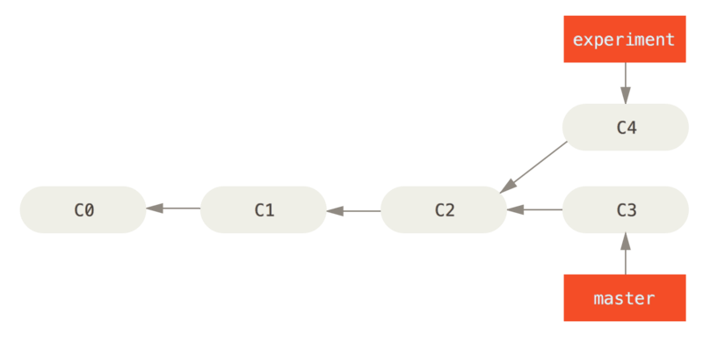
Example for Rebasing a branch
Simple Divergent History

Slide 26
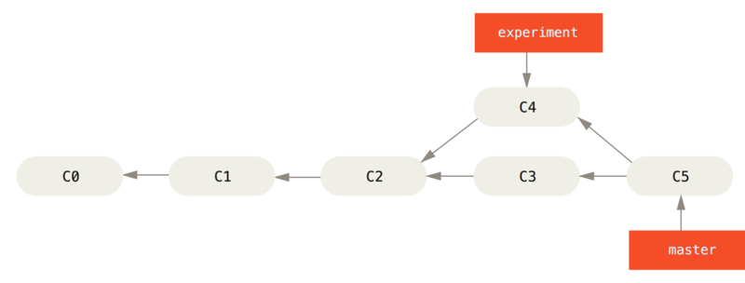
Example for Rebasing a branch
Merging to integrate diverged work history
For this example, you would check out the experiment branch, and then rebase it onto the master branch as follows:
$ git checkout experiment
$ git rebase master
First, rewinding head to replay your work on top of it...
Applying: added staged command

Slide 27
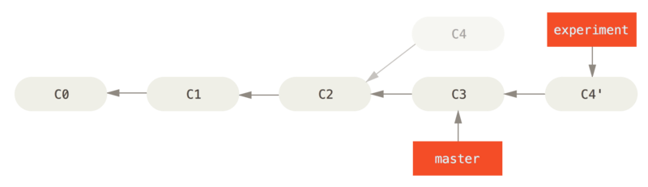
Example for Rebasing a branch
Rebasing the change introduced in C4 onto C3
At this point, you can go back to the master branch and do a fast-forward merge.
$ git checkout master
$ git merge experiment

Slide 28
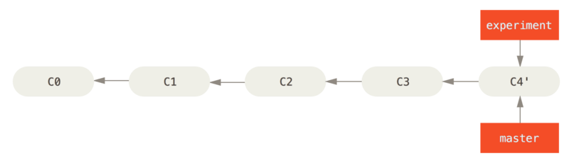
Example for Rebasing a branch
Fast-forwarding the master branch

Slide 29
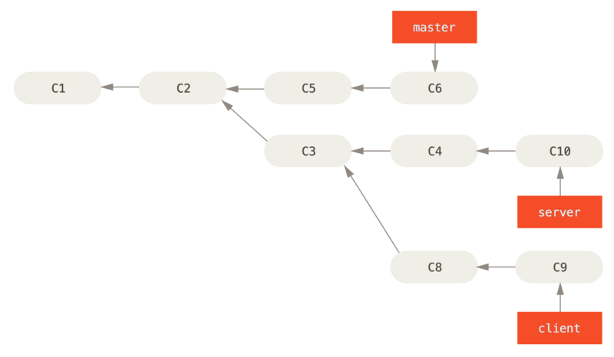
Example for Rebasing a branch
A history with a topic branch off another topic branch
$ git rebase --onto master server client

Slide 30
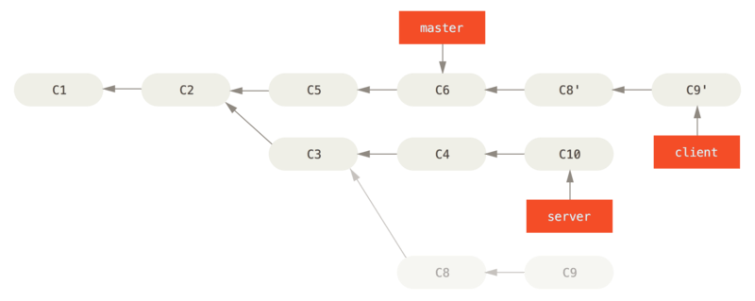
Example for Rebasing a branch
Rebasing a topic branch off another topic branch
$ git checkout master
$ git merge client

Slide 31



