Slide 1
Jenkins
22 July 2021

Slide 2
Agenda
About Jenkins
Possible steps performed using Jenkins
Salient Features Of Jenkins
Architecture of Jenkins
Jenkins Master-Agent Architecture
Installation & Configuration of Jenkins
Master & Agent(s) In Jenkins
Jenkins Pipeline
Advantages & Shortcomings Of Jenkins

Slide 3
About Jenkins
Jenkins, the Java-based open-source CI/CD tool
Jenkins is the oldest player in the CI/CD market, and it has more than 16,000 stars and 6,500 forks on GitHub
It also has huge community support with more than 1500 plugins to help professionals ship faster through their Jenkins Pipelines.

Slide 4
What Is Jenkins?
Jenkins is an open-source server that is written entirely in Java.
It lets you execute a series of actions to achieve the continuous integration process, that too in an automated fashion.
This CI server runs in servlet containers such as Apache Tomcat.
Jenkins facilitates continuous integration and continuous delivery in software projects by automating parts related to build, test, and deployment.
This makes it easy for developers to continuously work on the betterment of the product by integrating changes to the project.
Jenkins automates the software builds in a continuous manner and lets the developers know about the errors at an early stage.

Slide 5
Advantages & Shortcomings Of Jenkins
Advantages Of Jenkins
Jenkins is open-source and free to use. It is a preferred CI/CD tool by early-stage startups as well as large corporations since it has been under development since a long time.
It is a rich plugin ecosystem. At the time of this article, there were close to 1500+ plugins available for use.
Jenkins can be integrated with popular cloud platforms such as Amazon EC2, Google Cloud, VMWare vSphere, Digital Ocean, and more.
Jenkins Pipelines can be extremely useful for realizing CD requirements for large-scale projects.

Slide 6
Advantages & Shortcomings Of Jenkins
Shortcomings Of Jenkins
As a product, Jenkins is more ‘feature’ driven and ‘developer’ centric. Users who are obsessed with user interfaces may have to go through a learning curve to use Jenkins.
Setting changes (including plugin installations) might result in issues such as Jenkins not starting up, etc. In such scenarios, you have to search online for a solution and fortunately you would find one as Jenkins has a large user-base!

Slide 7
Possible steps performed using Jenkins
Software build using build systems such as Gradle, Maven, and more.
Automation testing using test frameworks such as Nose2, PyTest, Robot, Selenium, and more.
Execute test scripts (using Windows terminal, Linux shell, etc.
Achieve test results and perform post actions such as printing test reports, and more.
Execute test scenarios against different input combinations for obtaining improved test coverage.
Continuous Integration (CI) where the artifacts are automatically created and tested. This aids in identification of issues in the product at an early stage of development.

Slide 8
Salient Features Of Jenkins
Easy Installation & Configuration
Open-Source
Thriving Plugin Ecosystem
Easy Distribution

Slide 9
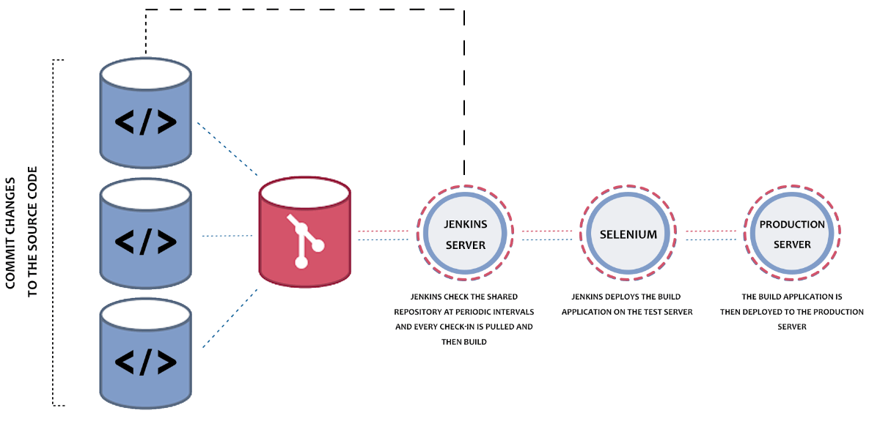
Architecture Of Jenkins
Notes:
These are the series of steps that outlines the interaction between different elements in Jenkins:
Developers do the necessary modifications in the source code and commit the changes to the repository. A new version of that file will be created in the version control system that is used for maintaining the repository of source code.
The repository is continuously checked by Jenkins CI server for any changes (either in the form of code or libraries) and changes are pulled by the server.
In the next step, we ensure that the build with the ‘pulled changes’ is going through or not. The Build server performs a build with the code and an executable is generated if the build process is successful. In case of a build failure, an automated email with a link to build logs and other build artifacts is sent to the developer.
In case of a successful build, the built application (or executable) is deployed to the test server. This step helps in realizing continuous testing where the newly built executable goes through a series of automated tests. Developers are alerted in case the changes have caused any breakage in functionality.
If there are no build, integration, and testing issues with the checked-in code, the changes and tested application are automatically deployed to the Prod/Production server.

Slide 10
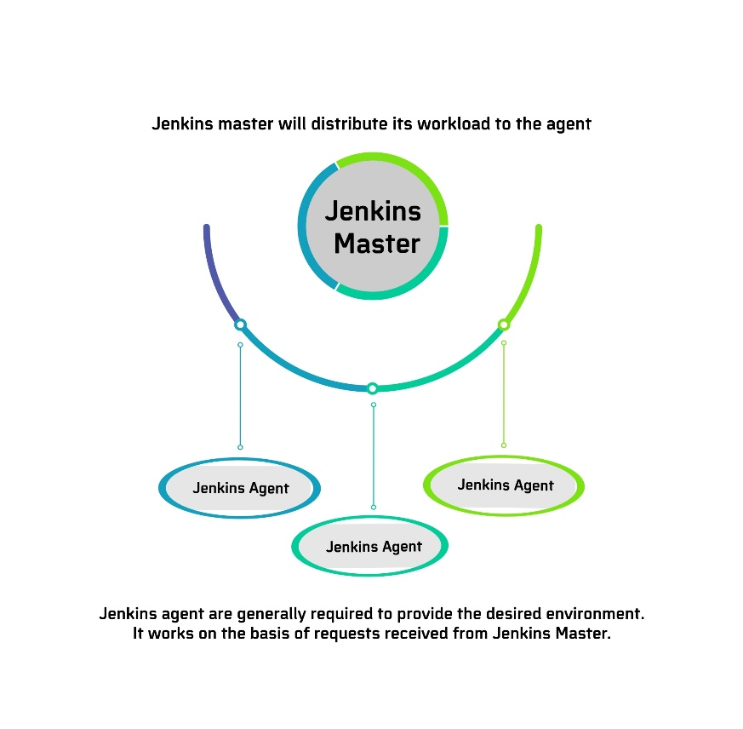
Jenkins Master-Agent Architecture
Jenkins Master
The main server in Jenkins is the Master.
Jobs handled Jenkins Master
Schedule build jobs
Choosing the appropriate agent in the master-agent ecosystem for dispatching the builds.
Monitor agents and take them online/offline as and when required.
Presenting the build results (and reports) to the developer.
Notes:
The master-agent (or distributed) architecture in Jenkins is used for managing distributed builds. The Master and Agent(s) communicate through the TCP/IP protocol.
These are the roles and responsibilities of the Jenkins Master and Agent(s):
Jenkins Master
The main server in Jenkins is the Master. Here are the jobs handled by Jenkins Master:
Schedule build jobs
Choosing the appropriate agent in the master-agent ecosystem for dispatching the builds.
Monitor agents and take them online/offline as and when required.
Presenting the build results (and reports) to the developer.
The Jenkins master can also execute the jobs directly but it is always recommended to select the appropriate agent(s) for build and execution-related tasks.

Slide 11
Jenkins Master-Agent Architecture
Jenkins Agent
A agent is a remote machine(‘N’ number of agents based on requirement) is connected to the Master.
Jobs handled by the Jenkins Agent(s)
Listen to commands from the Jenkins Master.
Execute build jobs that are dispatched by the Master.
Developers have the flexibility to run the build and execute tests on a particular agent or a particular type of Agent.
The default option is Jenkins Master selecting the best-suited Agent for the job.
Notes:
Jenkins Agent(s)
A agent is a remote machine that is connected to the Master. Depending on the project and build requirements, you could opt for ‘N’ number of agents. agents can run on different operating systems and depending on the ‘type of build request’, the appropriate Agent is chosen by the Master for build execution and testing.
Here are the jobs handled by the Jenkins Agent(s):
Listen to commands from the Jenkins Master.
Execute build jobs that are dispatched by the Master.
Developers have the flexibility to run the build and execute tests on a particular agent or a particular type of Agent. The default option is Jenkins Master selecting the best-suited Agent for the job.

Slide 12
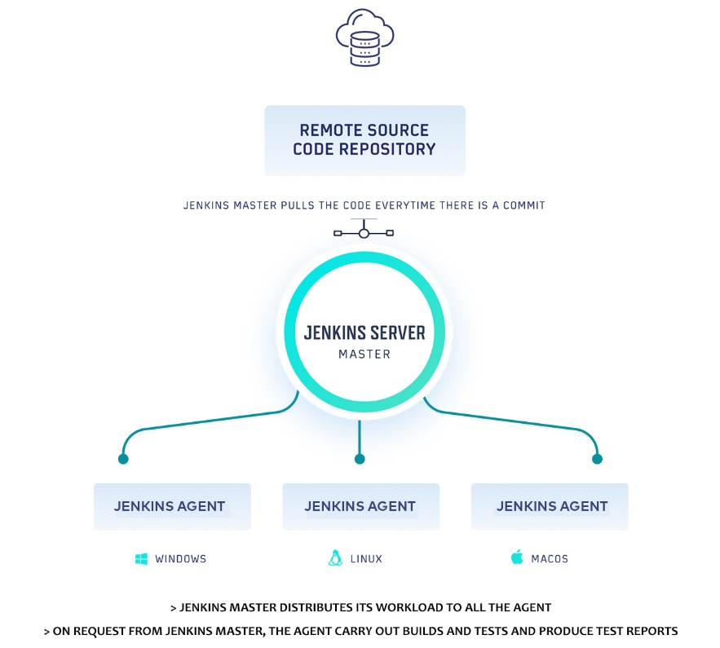
Jenkins Work In Master-Agent Architecture
Developers check-in their respective code changes in ‘The Remote Source Code Repository’
Only the Jenkins master is connected to the repository and it checks for code-changes (in the repository) at periodic intervals.
All the Jenkins Agents are connected to the Jenkins Master.
Jenkins master dispatches the request (for build and test) to the appropriate Jenkins Agent depending on the environment required for performing the build.
This lets you perform builds and execute tests in different environments across the entire architecture.
The Agent performs the testing, generates test reports, and sends the same to the Jenkins Master for monitoring.
Notes:
In the Jenkins Master-Agent architecture shown below, there are three Agents, each running on a different operating system (i.e. Windows 10, Linux, and Mac OS).
Developers check-in their respective code changes in ‘The Remote Source Code Repository’ that is depicted on the left-hand side.
Only the Jenkins master is connected to the repository and it checks for code-changes (in the repository) at periodic intervals. All the Jenkins Agents are connected to the Jenkins Master.
Jenkins master dispatches the request (for build and test) to the appropriate Jenkins Agent depending on the environment required for performing the build. This lets you perform builds and execute tests in different environments across the entire architecture.
The Agent performs the testing, generates test reports, and sends the same to the Jenkins Master for monitoring.
As developers keep pushing code, Jenkins Agents can run different builds versions of the code for different platforms. Jenkins Master (or Master Node) controls how the respective builds should operate.
In subsequent sections of the What is Jenkins blog, we would look at the steps for setting up Jenkins Master and Agents.

Slide 13
How To Install Jenkins?
Supported OS & versions
Jenkins is available for download for most of the operating systems like Windows, different flavours of Unix (e.g. UBuntu, Gentoo, FreeBSD, etc.), as well as Mac OS.
You can also put Jenkins in the Docker Container. Please Visit https://www.jenkins.io/download/ to download the required Jenkins installer.
Jenkins installer is also available as a generic Java Package (.war).

Slide 14
How To Install Jenkins?
Prerequisites For Jenkins Installation
If JDK (Java SE Development Kit) is not present on the machine, download latest JDK as per the configuration of your system (i.e. 32-bit or 64-bit).
Add the JDK installation path in the System Environment variable.
This also needs to be done for JRE (Java Runtime Environment).
Add environment variable JAVA_HOME pointing to the location where JDK 8 is installed.

Slide 15
How To Install Jenkins?
Steps To Install Jenkins (Using Jenkins Installer) On Windows 10
Download the stable version of Jenkins for Windows
Unzip the downloaded file and start the installation process.
Just follow the steps mentioned on the installer screen until the installation is complete.
Enter admin username and password wherever prompted
By default, Jenkins listens on port 8080. When the installation is complete, you would be required to enter the initialAdminPassword present in < installation-directory >\Jenkins\secrets\ initialAdminPassword
You would be prompted to create an Admin User. These credentials can be used for logging into Jenkins (instead of using initialAdminPassword).
Jenkins is ready for usage

Slide 16
How To Install Jenkins?
Steps To Install Jenkins (using .war) On Windows 10
Download Jenkins installer in the .war format
Jenkins can start directly from the command line (or terminal) by executing the following command:
Once the Jenkins service starts, you should visit localhost:9090 in the web browser to start using Jenkins.
1 | java -Dhudson.model.DirectoryBrowserSupport.CSP="sandbox allow-scripts allow-popups allow-popups-to-escape-sandbox; style-src 'unsafe-inline' *;" -Dsvnkit.http.sslProtocols=TLSv1 -jar Jenkins.war --httpPort=9090

Slide 17
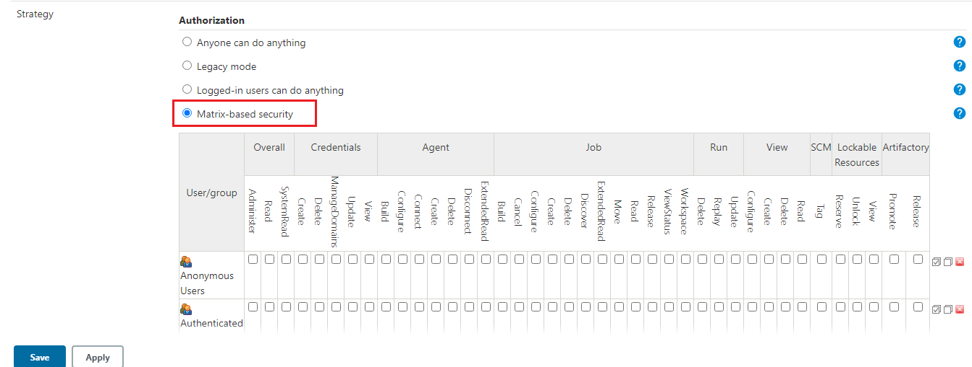
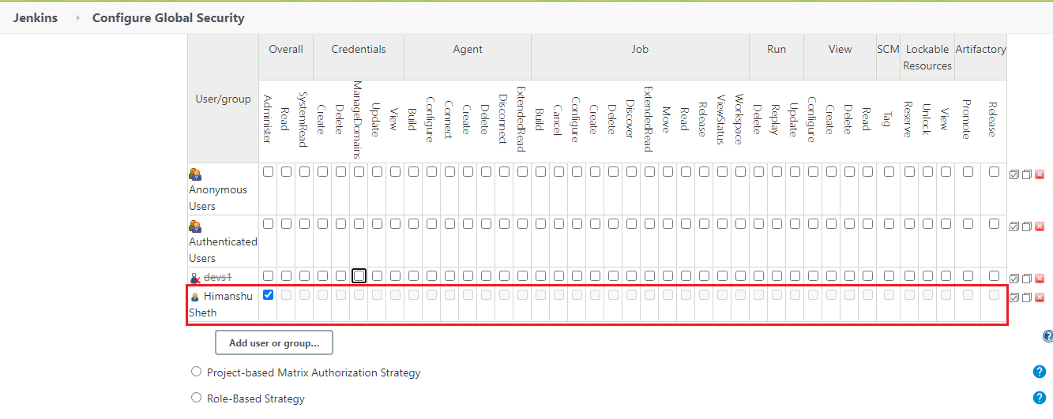
How To Configure Jenkins?
User Management In Jenkins
In the Authorization strategy, select ‘Matrix-based security Click on the ‘Add user or group’ button and enter the intended user/group name in the next box
On the login page, you should create an account for the newly created user that was just given access.

Slide 18
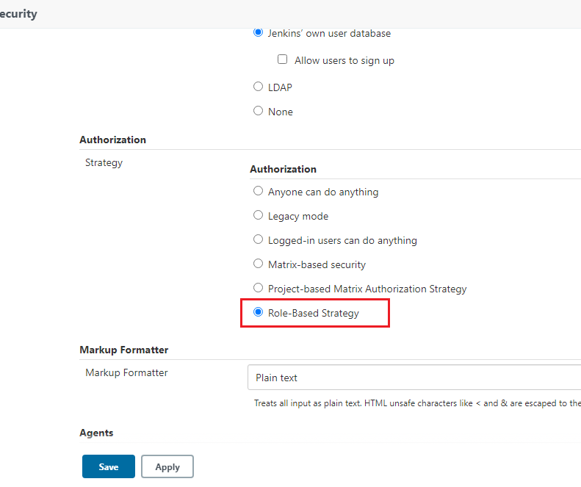
How To Configure Jenkins?
Assign Roles To Users In Jenkins
Go to Manage Jenkins ? Manage Plugins ? Enter ‘Role-based Authorization Strategy’ under Available tab. Click ‘Install’ to install the plugin.
Before assigning roles, it is important to change the Authorization strategy to Role-Based Strategy instead of Matrix-based security.

Slide 19
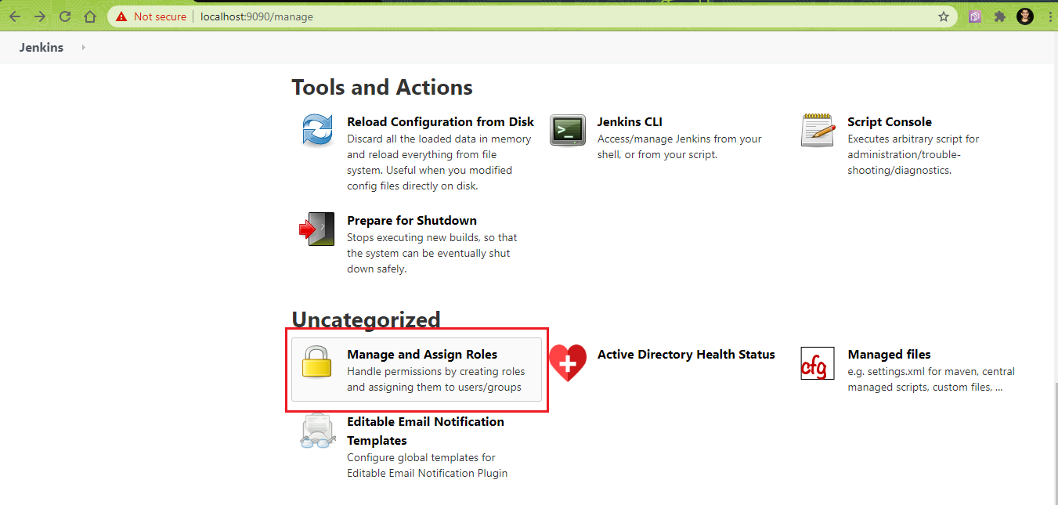
How To Configure Jenkins?
Assign Roles To Users In Jenkins (contd.,)
In ‘Manage Jenkins’, you would see ‘Manage and Assign Roles’ as shown below.

Slide 20
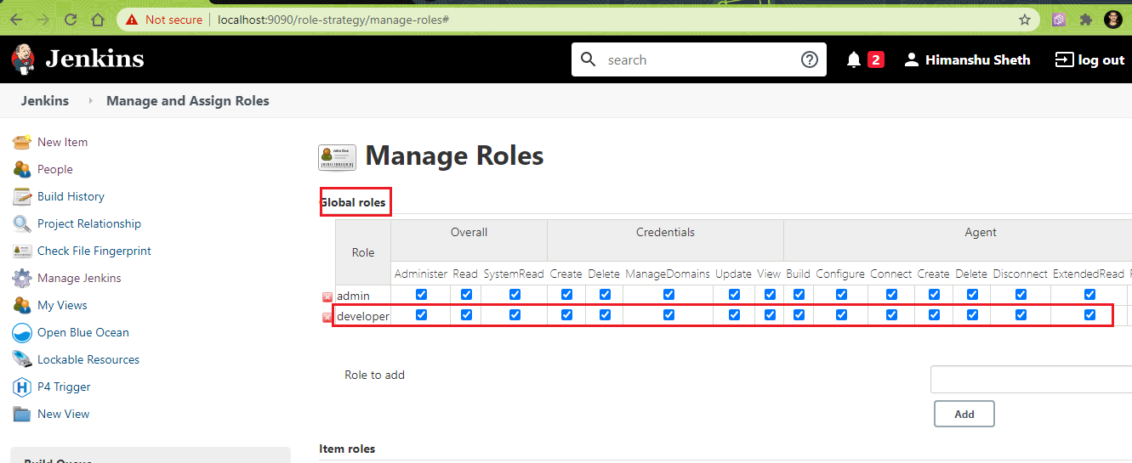
How To Configure Jenkins?
Assign Roles To Users In Jenkins (contd.,)
Create a new global role e.g. developer and select the permissions that you intend to assign to the role.

Slide 21
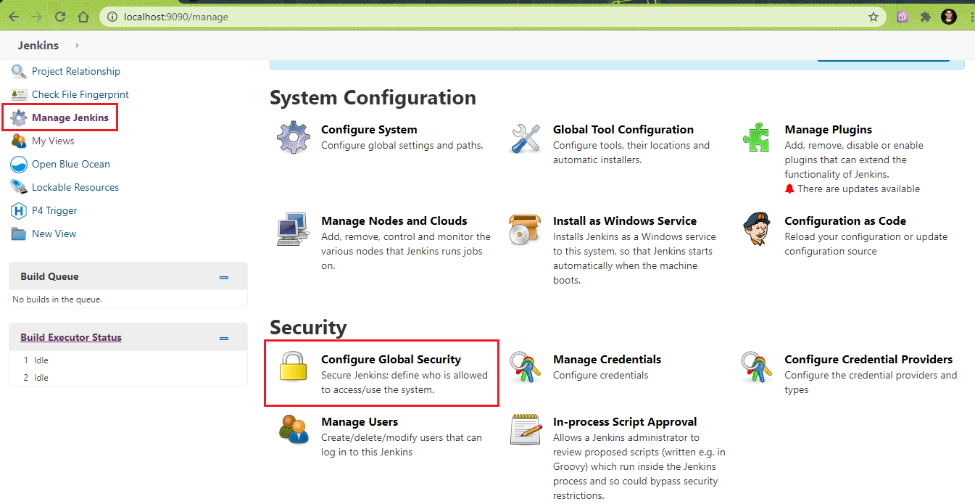
How To Setup Master & Agent(s) In Jenkins?
Prerequisites For Agent Creation
Before we go ahead with the creation of Agent Node, the following settings have to be changed in the ‘Global Security’ settings in Jenkins.
Go to ‘Manage Jenkins’ ? Configure Global Security and change the below settings

Slide 22
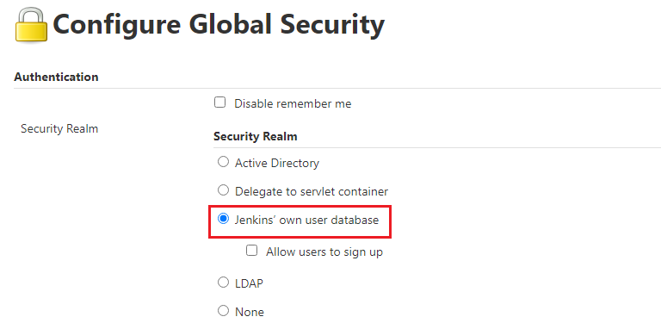
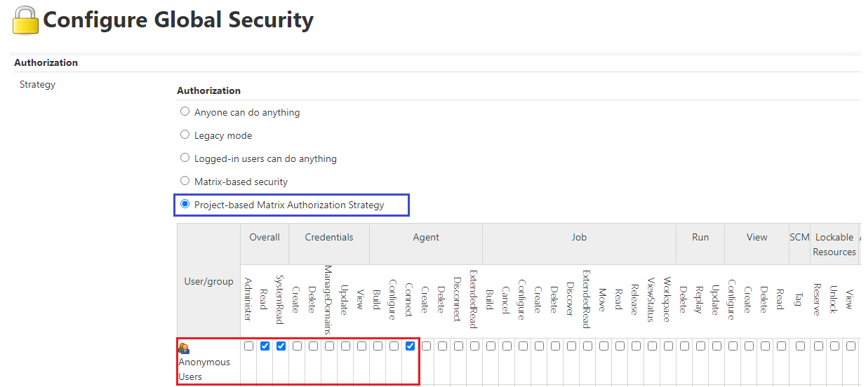
How To Setup Master & Agent(s) In Jenkins?
Prerequisites For Agent Creation (contd.,)
Go to ‘Authentication’ ? ‘Security Realm’ and change settings to ‘Jenkins’ own user database’
Go to ‘Authorization’ ? Strategy and change to ‘Project-based Matrix Authorization Strategy’. Enable ‘Read’ and ‘SystemRead’ properties for user ‘Anonymous users’. Enable ‘Connect’ in the ‘Agent section’ for user ‘Anonymous users’.

Slide 23
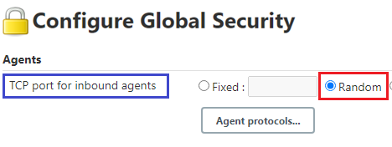
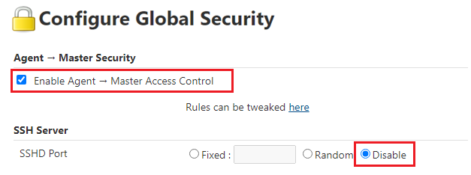
How To Setup Master & Agent(s) In Jenkins?
Prerequisites For Agent Creation (contd.,)
Go to ‘Agents’ ? ‘TCP port for inbound agents’ and change the setting to ‘Random’
Go to ‘Authorization’ ? Strategy and change to ‘Project-based Matrix Authorization Strategy’. Enable ‘Read’ and ‘SystemRead’ properties for user ‘Anonymous users’. Enable ‘Connect’ in the ‘Agent section’ for user ‘Anonymous users’.
Click on Apply and Save to save these settings.

Slide 24
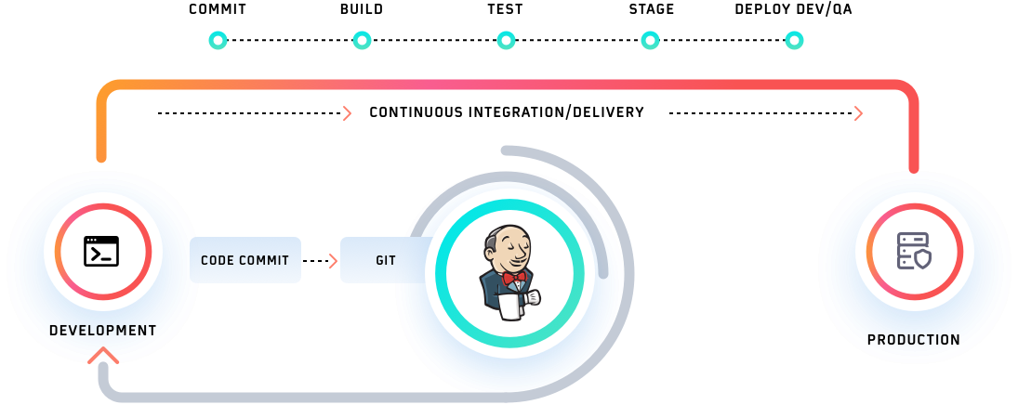
What Is Jenkins Pipeline?
Notes:
Inside Jenkins CI/CD, a pipeline is defined as a series of events or tasks which are interconnected in a particular order. In simple terms, Jenkins pipeline is a set of modules or plugins which enable the implementation and integration of Continuous Delivery pipelines within Jenkins.

Slide 25
What Is Jenkins Pipeline?
Pipeline in Jenkins is a group of jobs (or events) that are interlinked in a particular sequence. Jenkins Pipeline is a set or suite of plugins that provides support for implementation and integration of Continuous Delivery pipelines into Jenkins.
The Pipeline also provides a set of tools that are useful for modeling simple as well as complex delivery pipelines ‘as code’ through ‘Pipeline Domain-Specific Language (DSL)’ syntax.
Every job in the Jenkins pipeline has some dependency on one or more events. There are four states of Continuous Delivery in Jenkins pipeline-
Build
Deploy
Test
Release

Slide 26
Advantages Of Jenkins Pipeline
By using Groovy DSL (Domain Specific Language), it models easy to complex pipelines as code.
The code is stored in the form of a text file called ‘Jenkinsfile’ that can be scanned into Source Code Management.
It supports complex pipelines by adding conditional loops, forks, or joining operations and allowing parallel execution tasks.
It improves user experience by integrating user feedback into the pipeline.
It’s resilient in terms of Jenkins’ master unplanned restart.
It can resume from checkpoints saved.
It can incorporate multiple additional plugins and add-ins.

Slide 27
Important Concepts Of Jenkins Pipeline
Pipeline – Pipeline Consists of a set of instructions written as code. It defines the entire build process, which ideally consists of different stages for building, testing, and delivering the application.
Node - It is a machine that is a part of the Jenkins environment. The Jenkins Pipeline executes on a node block that is usually a part of the Scripted Pipeline syntax.
Stage - Stage in a Jenkins Pipeline consists of a unique subset of tasks such as Build, Test, Deploy, etc. The Stage block is used by many plugins for providing the visualization of Jenkins status (and progress).
Step - Step is a single task that tells Jenkins what exactly needs to be done. For example, setting an environment variable can be done in a step, executing a build command can also be a step. On the whole, a Jenkins Pipeline constitutes a series of steps.

Slide 28
Advantages Of Using Jenkins Pipeline
As the Jenkins Pipeline is implemented as code, it can be checked in the source control repository. Teams can view, edit, as well as iterate upon the delivery pipeline.
Jenkins Pipelines are robust. A Pipeline is automatically resumed in case the server witnesses an unplanned restart.
Pipeline process can pause and wait for input for any input from the user.
Pipelines are versatile as they can be used for realizing complex CD requirements, including performing work in parallel.
Jenkins Pipelines are extensible by plugin developers and users with Pipeline Shared Libraries.

Slide 29
Jenkinsfile
About Jenkinsfile
The entire definition of a Jenkins Pipeline is written into a text file called Jenkinsfile.
It contains the steps required for running a Jenkins Pipeline. ‘Pipeline as code’ can be implemented using Jenkinsfile and Domain Specific Language (DSL) is used for defining the same.
Jenkinsfile can also be committed to the source control repository of the project. With Jenkinsfile, the CD Pipeline is also treated as a part of the application that is versioned, committed, and reviewed like any other piece of code.

Slide 30
Jenkinsfile
Major benefits of Jenkinsfile
Single Jenkinsfile can be used for creating a Pipeline build process for all the branches and executing pull requests.
The implementation in a Pipeline can be reviewed like normal source code.
Audit trail of the Pipeline.
Singular source for the Pipeline can be viewed as well as edited by multiple members associated with the project.

Slide 31
Jenkinsfile
Syntax for Jenkinsfile
Jenkinsfile can be written using the following types of Syntax
Declarative
Declarative Pipeline is a recent feature of Jenkins Pipeline that makes reading and writing the Pipeline code a lot easier. Unlike Scripted Syntax with Pipelines, Declarative Syntax helps in controlling different aspects of the Pipeline in a simplistic manner.
Scripted
Scripted Pipeline is a more traditional way of writing a Jenkins Pipeline as code. It uses traditional Groovy-based syntax. The Web UI of Jenkins is normally used for writing the Scripted Pipeline in a Jenkinsfile.

Slide 32



