Slide 1
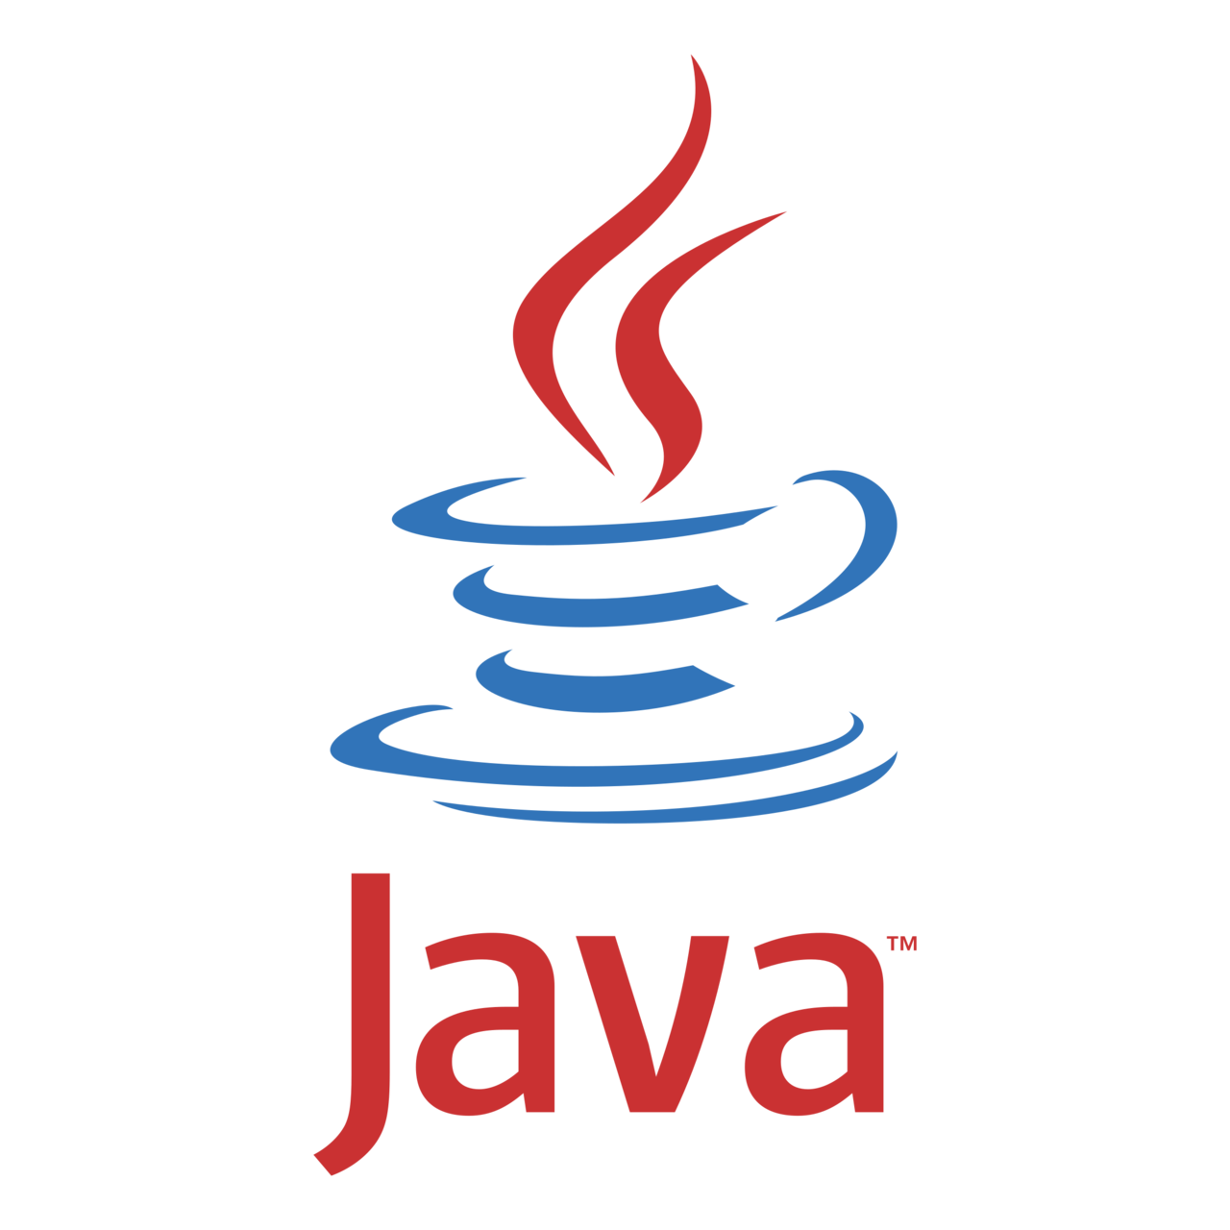
Module 1 Core Java
Java (version 11) with Maven (version 3.8), Junit (version 5)

Slide 2
Agenda
Introduction to Java
Java Naming conventions and Rules
Static Variables and Methods
Writing Your First Java Program

Slide 3
Introduction to Java

Slide 4
What is Java
Java is high-level programming language originally developed by Sun Microsystems and released in 1995.
Java runs on a variety of platforms, such as Windows, Mac OS/ and the various versions of UNIX. According to SUN, 3 billion devices run java.
There are many devices where java is currently used. Some of them are as follows: Desktop Applications such as acrobat reader, media player, antivirus etc.
Web Applications
Enterprise Applications such as banking applications.
Mobile & Embedded System Smart Card Robotics and Games etc.

Slide 5
History of Java
Currently, Java is used in internet programming, mobile devices, games, e- business solutions etc. There are given the major points that describes the history of java.
James Gosling, Mike Sheridan, and Patrick Naughton initiated the Java language project in June 1991. The small team of sun engineers called Green Team.
Originally designed for small, embedded systems in electronic appliances like set-top boxes.
Firstly, it was called "Greentalk" by James Gosling and file extension was .gt.
After that, it was called Oak and was developed as a part of the Green project.

Slide 6
Why Oak name for java language?
Oak is a symbol of strength and choose as a national tree of many countries like U.S.A., France, Germany, Romania et .
In 1995, Oak was renamed as "Java" because it was already a trademark by Oak Technologies.
Why Java name for java language? The team gathered to choose a new name.
The suggested words were “dynamic”, "revolutionary", "Silk", "jolt", 'DNA" etc. They wanted something that reflected the essence of the technology: revolutionary, dynamic, lively, cool, unique, and easy to spell and fun to say.
According to James Gosling "Java was one of the top choices along with Silk". Since java was so unique, most of the team members preferred java.

Slide 7
History of Java (contd…)
Notice that Java is just a name not an acronym.
Originally developed by James Gosling at Sun Microsystems (which is now a subsidiary of Oracle Corporation) and released in 1995.
In 1995, Time magazine called Java one of the Ten Best Products of 1995.
JDK 1.0 released in(January2 , 1996).

Slide 8
Philosophy of Java
The development of the Java language had five primary objectives:
The object-oriented approach should be employed.
It should allow multiple operating systems to run the same program.
It should have built-in computer network support.
It should be configured to execute code from distant sources safely.
By selecting which parts of the other object-oriented languages are considered acceptable. It should be simple to use.

Slide 9
Types of Java Applications
There are mainly 4 type of applications that can be created using java programming:
Standalone Application
Web Application
Enterprise Application
Mobile Application

Slide 10
List of Java Editions
Java Standard Edition
Java Enterprise Edition
Java Micro Edition
Java FX

Slide 11
Java Versions
J2SE 5.0
September 2004
Java SE 6
December 2006
Java se 7
July 2011
Java SE 8
March 2014
Java SE 12
March 2019
Java SE 11
September 2018
Java SE 10
March 2018
Java SE 9
September 2017
Java SE 13
September 2019
Java SE 14
March 2020
Java SE 15
September 2020
Java SE 16
March 2021
Java SE 17
September 2021

Slide 12
Programming paradigms
Procedural Programming
Logical Programming
Functional Programming
Object Oriented Programming
Encapsulation
Inheritance
Data Abstraction
Polymorphism

Slide 13
POP vs OOP
Procedure Oriented Programming
Object Oriented Programming
Global Data
Global Data
Data
Data
Functions
Functions
Function 1
Function 2
Function 3
Local
Data
Local
Data
Local
Data
Data
Functions

Slide 14
POP vs OOP (Contd…)
Procedural Programming | Object-Oriented Programming
Uses immutable data | Uses mutable data
Follows the declarative programming model | Follows the imperative programming model
Extends support to parallel programming | Not suitable for parallel programming
The execution order of statements is not the primary focus | The execution order of statements is very important
Flow control is performed using function calls | Flow control is performed through conditional statements and loops
Uses recursion concept to iterate collective data | Uses loop concept to iterate collection data
No such side-effects of its functions | The method can have certain side-effects
The focus in Procedural Programming is on ‘What You are Doing’ | The focus in Object-Oriented Programming is on ‘How You are Doing It’

Slide 15
Java Naming conventions and Rules

Slide 16
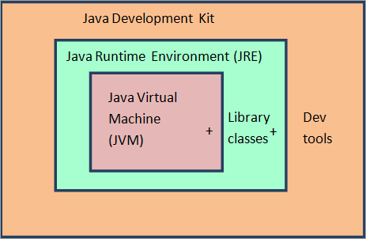
Components Of Java Programming Language

Slide 17
Objects
An object in Java is the physical as well as a logical entity.
An entity that has state and behavior is known as an object e.g., chair, bike, marker, pen, table, car, etc.
It can be physical or logical (tangible and intangible). The example of an intangible object is the banking system.
An object has three characteristics:
State
Behavior
Identity

Slide 18
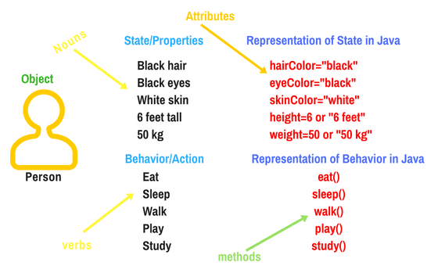
Real Time Example of Object

Slide 19
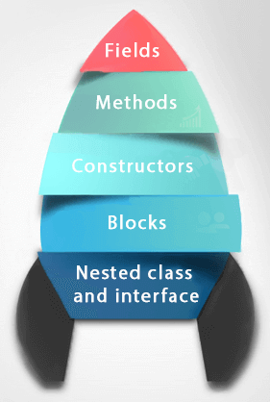
Classes
A class is a group of objects which have common properties. It is a template or blueprint from which objects are created. It is a logical entity. It can't be physical.
A class in Java can contain:
Fields
Methods
Constructors
Blocks
Nested class and interface
Syntax
class <class_name>{
field;
method;
}

Slide 20
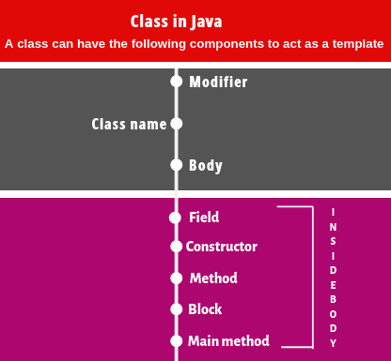
Components of Class in Java
class StudentDetails
{
// Class body starts here.
// Members of a class.
1. Field declarations;
2. Constructor declarations;
3. Method declarations;
4. Instance block declarations;
5. Static block declarations;
} Ends here.

Slide 21
A simple programming structure of Class and Objects
public class Student
{
// Declaration of state/Properties.
String name; // Instance variable.
int rollNo; // Instance variable.
int id;
static int age; // Static variable.
// Declaration of constructor.
Student()
{
// Constructor body.
}
// Declaration of Actions.
void display() // Instance method.
{
// method body.
}
// Declaration of instance block.
{
// block body.
}
public static void main(String[] args)
{
.......
}
}

Slide 22
Principles for creating the Class
Single Responsibility Principle (SRP
Open Closed Responsibility (OCP)
Liskov Substitution Responsibility (LSR)
Dependency Inversion Principle (DIP)
Interface Segregation Principle (ISP)

Slide 23
Classes and Objects in Java Example
// Class Declaration
public class Dog {
// Instance Variables
String breed;
String size;
int age;
String color;
// method 1
public String getInfo() {
return ("Breed is: "+breed+" Size is:"+size+" Age is:"+age+" color is: "+color);
}
public static void main(String[] args) {
Dog maltese = new Dog();
maltese.breed="Maltese";
maltese.size="Small";
maltese.age=2;
maltese.color="white";
System.out.println(maltese.getInfo());
}
}
Output:
Breed is: Maltese
Size is:Small
Age is:2
Color is: white

Slide 24
Instance Variable in Java
Cheat Sheet
Instance variables can use any of the four access levels
They can be marked final
They can be marked transient
They cannot be marked abstract
They cannot be marked synchronized
They cannot be marked strictfp
They cannot be marked, native
They cannot be marked static
class Page {
public String pageName;
// instance variable with public access
private int pageNumber;
// instance variable with private access
}

Slide 25
Constructors
A constructor is a member function of a class.
Types of Constructors:
Default (no-argument) constructor.
Parameterized constructor.
class MyClass{
MyClass(){
//constructor body.
}
public static void main(String args[]){
MyClass obj = new MyClass(); //instance created using new keyword.
}
}

Slide 26
Default Constructor
class Test{
int a;
int b;
//constructor creation.
Test(){
System.out.println("We are inside default constructor");
a= 10;
b = 20;
}
public void display(){
System.out.println("Value of a is: " +a);
System.out.println("Value of b is: " +b);
}
}
class ConstructorDemo{
public static void main(String args[]){
Test obj = new Test();
obj.display();
}
}
We are inside default constructor.
Value of a is: 10
Value of b is: 20

Slide 27
Parameterized Constructor
class Rectangle{
int length;
int width;
int result;
//parameterized constructor
Rectangle(int l, int w){ length = l; width = w; }
//calculate the area of rectangle.
public void rectArea(){
result = length*width;
System.out.println("Area of rectangle is: " +result);
}
}
class ConstructorDemo{
public static void main(String args[]){
//passing the values to constructor.
Rectangle obj = new Rectangle(10, 20);
obj.rectArea();
}
}
Area of rectangle is: 200

Slide 28
Constructor OverLoading
class Student{
int rollno; String name; int age;
//constructor with one argument.
Student(int r) { rollno = r; }
//constructor with two arguments.
Student(int r, String n) { rollno = r; name = n; }
//constructor with three arguments.
Student(int r, String n, int a){ rollno = r; name = n; age = a; }
//display rollno, name, and age.
public void display(){
System.out.println(rollno+ " " +name+" " +age);
}
}
class ConstructorDemo{
public static void main(String args[]){
//passing the value in the constructor.
Student obj1 = new Student(101);
Student obj2 = new Student(101, “Harry");
Student obj3 = new Student(101, “Harry", 21);
obj1.display(); obj2.display(); obj3.display();
}
}
101 null 0
101 Harry 0
101 Harry 21

Slide 29
Constructor Chaining
class Person{
public Person(){
System.out.println("This is person class constrcutor");
}
}
class Student extends Person{
public Student(){
this("Harry");
System.out.println("This is student class constrcutor");
}
public Student(String name){
System.out.println("Student name is Harry");
}
}
class ConstructorDemo{
public static void main(String args[]){
Student obj = new Student();
}
}
This is person class constrcutor
Student name is Harry
This is student class constrcutor

Slide 30
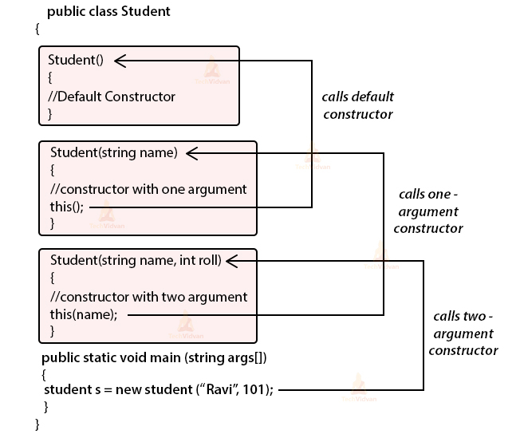
Working of Constructor Chaining

Slide 31
Copy Constructor
class Employee{
int id;
String name;
//constructor to initialize integer and string
Employee(int i, String n){ id = i; name = n; }
//constructor to initialize another object
Employee(Employee s){ id = s.id; name = s.name; }
void display(){
System.out.println(id + " " + name);
}
public static void main(String args[]){
Employee e1 = new Employee(101, "Harry");
Employee e2 = new Employee(e1);
e1.display();
e2.display();
}
}
101 Harry
101 Harry

Slide 32
Variables
A name which is associated with a value that can be changed
Syntax: data_type variable_name = value;
Example: char ch = 'A’; int number = 100;
There are three types of variables in Java.
Local variable
Static (or class) variable
Instance variable

Slide 33
Static (or class) Variable
public class StaticVarExample {
public static String myClassVar="class or static variable";
public static void main(String args[]){
StaticVarExample obj = new StaticVarExample();
StaticVarExample obj2 = new StaticVarExample();
//All three will display "class or static variable"
System.out.println(obj.myClassVar);
System.out.println(obj2.myClassVar);
//changing the value of static variable using obj2
obj2.myClassVar = "Changed Text";
//All three will display "Changed Text"
System.out.println(obj.myClassVar);
System.out.println(obj2.myClassVar);
}
}
class or static variable
class or static variable
Changed Text
Changed Text

Slide 34
Instance Variable
public class InstanceVarExample {
String myInstanceVar="instance variable";
public static void main(String args[]){
InstanceVarExample obj = new InstanceVarExample();
InstanceVarExample obj2 = new InstanceVarExample();
System.out.println(obj.myInstanceVar);
System.out.println(obj2.myInstanceVar);
obj2.myInstanceVar = "Changed Text";
System.out.println(obj.myInstanceVar);
System.out.println(obj2.myInstanceVar);
}
}
instance variable
instance variable
instance variable
Changed Text

Slide 35
Local Variable
public class VariableExample {
// instance variable
public String myVar="instance variable";
public void myMethod(){
// local variable
String myVar = "Inside Method";
System.out.println(myVar);
}
public static void main(String args[]){
// Creating object
VariableExample obj = new VariableExample();
/* We are calling the method, that changes the
* value of myVar. We are displaying myVar again after
* the method call, to demonstrate that the local
* variable scope is limited to the method itself.
*/
System.out.println("Calling Method");
obj.myMethod();
System.out.println(obj.myVar);
}
}
Calling Method
Inside Method
instance variable

Slide 36
Static Variables and Methods

Slide 37
Static Variables and Methods
class ClassName {
// static variable
public static type variableName;
// static method
public static returnType methodName(parameters) {
// implementation not shown
}
}
// To call a static method or variable, use the Class Name
System.out.println(ClassName.staticVariable);
ClassName.staticMethod();

Slide 38
Naming Conventions and Rules
All identifiers should begin with a letter (A to Z or a to z), currency character ($) or an underscore (_).
After the first character, identifiers can have any combination of characters.
A keyword cannot be used as an identifier.
Most importantly, identifiers are case sensitive.
Examples of legal identifiers: age, $salary, _value, __1_value.
Examples of illegal identifiers: 123abc, -salary.
A class name should start from a capital case letter and long names should use camel casing. For example: TaxationDepartment
Object name should start from lower case letter and long names should use camel casing. For example: taxationDepartment
https://www.oracle.com/java/technologies/javase/codeconventions-namingconventions.html

Slide 39
Writing Your First Java Program

Slide 40
Flow of a Java Program
Java Source Program
(abc.java)
Java Compiler
(Javac)
JVM
Executed by Machine
Library Code

Slide 41
Structure of a Java Program
Documentation Section
Suggested
Package Statement
Import Statement
Optional
Interface Statement
Class Definition
Package Statement
Essential

Slide 42
Useful Links
Download Java 11
https://www.oracle.com/in/java/technologies/javase-jdk11-downloads.html
Download Ideaj community edition
https://www.jetbrains.com/idea/download/#section=windows

Slide 43
Exercises
Write a complete program that calculates and prints the product of three integers.
Write a Java program that takes two numbers as input and display the product of two numbers.
Write a Java program to get a number from the user and print whether it is positive or negative.
Write a Java program that reads a floating-point number and prints "zero" if the number is zero. Otherwise, print "positive" or "negative". Add "small" if the absolute value of the number is less than 1, or "large" if it exceeds 1,000,000.
Write a Java program that keeps a number from the user and generates an integer between 1 and 7 and displays the name of the weekday.

Slide 44
ALTERNATIVE RESOURCES

Slide 45
RESOURCES
https://docs.oracle.com/en/java/javase/11/

Slide 46
THANKS!

