Slide 1

Module 1 Core Java
Day 2

Slide 2
Agenda
Inheritance
Method Overriding
Final keyword
Interface and Abstract Classes
Exercises

Slide 3
Inheritance

Slide 4
Inheritance
Inheritance means
Organizing classes in a hierarchy
Higher hierarchy inherits properties from lower hierarchy
Clubbing similar things into the same class
Classes go from general to specific as you go higher in hierarchy
Base Class
Derived Class

Slide 5
General format for Inheritance
class​ superclass
{
// superclass data variables
// superclass member functions
}
class​ subclass ​extends​ superclass
{
// subclass data variables
// subclass member functions
}

Slide 6
Types of Inheritance
Single Inheritance
Multiple Inheritance
Multi-Level Inheritance
Hierarchical Inheritance
Hybrid Inheritance

Slide 7
Single Inheritance
Creating subclasses from a single base class is called single inheritance.
Base Class
Derived Class

Slide 8
Multilevel Inheritance
Base Class
Derived Class 1
Derived Class 2

Slide 9
Hierarchical Inheritance
Base Class
Derived Class 1
Derived Class 2

Slide 10
Multiple Inheritance
Base Class 1
Base Class 2
Derived Class

Slide 11
Hybrid Inheritance
Base Class
Derived Class 1
Derived Class 2
Derived Class 3

Slide 12
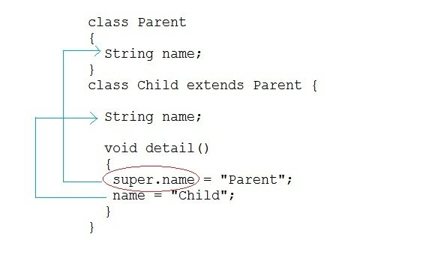
super keyword

Slide 13
Method Overriding

Slide 14
Method Overriding
Method Overriding is used to provide specific implementation of a particular method which was provided by the parents class.
Rules for Method overriding are:
Methods must share the same name in child and parent class.
It must have the same parameter as in the superclass.
There must be an IS-A type of Inheritance.

Slide 15
Exercise
Shape
draw()
Square
Class
Circle
Class
Hexagon
Class
draw()
draw()
draw()

Slide 16
Final Keyword

Slide 17
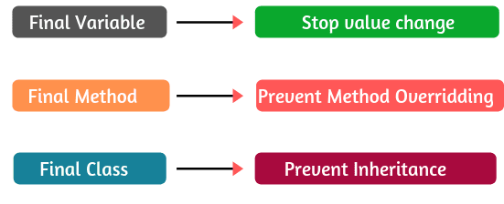
Final Keyword
Java Final keyword has three different uses:
To declare a constant.
To prevent inheritance.
To prevent method from being overridden.

Slide 18
final Variable
final int number = 10; //final variable final float value; //blank final variable static final double rate = 2.5; //final and static variable

Slide 19
final Method
A method that is declared with the final keyword is known as final method in Java.
A final method cannot be overridden in Java.

Slide 20
final Class
A class that is declared with a final keyword is known as final class in Java.
Final class means Restricting inheritance!.
It does not allow itself to be inherited by another class.
public final class Student
{
// class contents
}
public class Student
{
private Student(final int x)
{
. . . . . .
}
}

Slide 21
Interface and Abstract Classes

Slide 22
Interfaces
An interface can have methods and variables, but the methods declared in an interface are by default abstract (only method signature, no body).
interface <interface_name> {
// declare constant fields
// declare methods that abstract
// by default.
}
// A simple interface
interface Player
{
final int id = 10;
int move();
}

Slide 23
Class vs Interfaces
Class
Interface
Class can instantiate and create object
Interface can’t instantiate variable & create an object
Classes can contain concrete methods
The interface can’t contain concrete methods
The access specifiers used with classes are private, protected and public
In interface only one public specifiers used

Slide 24
Automatic Conversion of Java Interface
Interface printable{
int MIN = 5;
void print();
}
Interface printable{
public static int MIN = 5;
public abstract void print();
}
compiler

Slide 25
Extending interface
// Filename: Person.java
public interface Person
{
public void setName(String name);
public void setAge(int age);
}
// Filename: Student.java
public interface Student extends Person
{
public void marks(int marks);
public void getEnrollmentNumber(int roll);
public void yearOfPassing(int year);
}
// Filename: Teacher.java
public interface Teacher extends Person
{
public void teacherId(int id);
public void salary(int salary);
public void assignedClasses(int number);
public void subject(String subject);
}

Slide 26
Abstraction
An Abstraction is a process of exposing all the necessary details and hiding the rest.
In Java, Data Abstraction is defined as the process of reducing the object to its essence so that only the necessary characteristics are exposed to the users.
Types of Abstraction
Data Abstraction
Control Abstraction

Slide 27
Abstract Classes and Abstract Methods
An abstract class is a class that created using abstract keyword. In other words, a class prefixed with abstract keyword is known as an abstract class.
In java, an abstract class may contain abstract methods (methods without implementation) and also non-abstract methods (methods with implementation).
abstract class ClassName
{
//class body
}
abstract <return-type><method-name>(<parameters>);

Slide 28
8 Rules for method overriding
An abstract class must be created with abstract keyword.
An abstract class can be created without any abstract method.
An abstract class may contain abstract methods and non-abstract methods.
An abstract class may contain final methods that can not be overridden.
An abstract class may contain static methods, but the abstract method can not be static.
An abstract class may have a constructor that gets executed when the child class object created.
An abstract method must be overridden by the child class, otherwise, it must be defined as an abstract class.
An abstract class can not be instantiated but can be referenced.

Slide 29
Difference between Java Concrete Class and Abstract Class
Concrete classes cannot have abstract methods but abstract classes can have abstract methods.
Abstract classes cannot exist by themselves. They need a concrete class to inherit it and provide definition to its abstract methods. On the other hand, a concrete class can exist independently.
A concrete class can not have abstract methods but an abstract class may have only concrete methods.

Slide 30
abstract vs non abstract methods
The abstract methods cannot have implementations (like interface methods).
Ex: public void abstractMethod();
The non-abstract/concrete methods must have implementations (method body).
Ex:
public void nonAbstractMethod() {
System.out.println("Non-abstract method");
}

Slide 31
Marker interface
A marker interface is an interface that has no methods or constants inside it. It provides run-time type information about objects, so the compiler and JVM have additional information about the object.
Marker Interface Example
Serializable
Cloneable
Remote

Slide 32
Exercise 1
Create a class with a method that prints "This is parent class" and its subclass with another method that prints "This is child class". Now, create an object for each of the class and call 1 - method of parent class by object of parent class 2 - method of child class by object of child class 3 - method of parent class by object of child class

Slide 33
Exercise 2
Create a class named 'Member' having the following members:
Data members
Name, Age, Phone number, Address, Salary
It also has a method named 'printSalary' which prints the salary of the members.
Two classes 'Employee' and 'Manager' inherits the 'Member' class. The 'Employee' and 'Manager' classes have data members 'specialization' and 'department' respectively. Now, assign name, age, phone number, address and salary to an employee and a manager by making an object of both of these classes and print the same.

Slide 34
Exercise 3 - Abstract Classes & Interfaces
Create an abstract class pen with methods write () and refill () as abstract methods
Use the pen class from Q1 to create a concrete class fountain pen with additional method change Nib ()
Create a class monkey with jump ( ) and bite ( ) methods Create a class human whichinherits this monkey class and implements basicanimal interface with eat ( ) and sleep methods
Create a class telephone with ( ) , lift ( ) and disconnected ( ) methods as abstract methods create another class smart telephone and demonstrate polymorphism
Demonstrate polymorphism using using monkey class from Q3
Create an interface TVremote and use it to inherit another interface smart TVremote
Create a class TV which implements TVremote interface from Q6

Slide 35
ALTERNATIVE RESOURCES

Slide 36
RESOURCES
https://docs.oracle.com/javase/tutorial/java/IandI/index.html

Slide 37
THANKS!

