Slide 1

Module 1 Core Java
Day 3

Slide 2
Agenda
Strings
Arrays

Slide 3
Strings

Slide 4
String
String is basically an object that represents sequence of char values.
An array of characters works same as Java string.
For example:
char[] ch={'j','a','v','a','t','p','o','i','n','t'}; // by literal
String s=new String(ch); // by new keyword
is same as:
String s=“HelloWorld";

Slide 5
String and Memory management
Heap
S1
String constant Pool
Hello
Object
S2
The reference variables S1 and S2 are pointing to the same object.

Slide 6
Creating String Object by new Keyword
String s1 = new String (“Hello”);
String s2 = new String (“Hello”);
String s3 = “Hello”;
String s3 = “Hello”;
heap
S3
S1
Hello
String constant Pool
Hello
S4
S2
Hello
object
Total of 3 objects will be created, Out of 3, 2 objects will be created in heap area and one object in the String Constant Pool

Slide 7
Why are Strings final?
Heap
New String
String constant Pool
“Hello”
“HelloWorld”

Slide 8
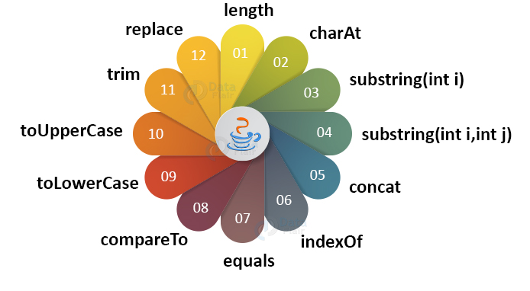

String Methods
String
Methods

Slide 9
String Compare
By equals() method
By = = operator (double equal operators)
By compareTo() method.

Slide 10
StringBuffer
StringBuffer Constructors
StringBuffer(): It creates an empty string buffer and reserves space for 16 characters.
StringBuffer(int size): It creates an empty string and takes an integer argument to set capacity of the buffer.
StringBuffer(String str): It creates a stringbuffer object from the specified string.
StringBuffer(charSequence []ch): It creates a stringbuffer object from the charsequence array.

Slide 11
methods of StringBuffer class
append()
insert()
reverse()
replace()
capacity()
ensureCapacity()

Slide 12
StringBuilder class
StringBuilder Constructors
StringBuilder ()
StringBuilder (int size)
StringBuilder (String str)
StringBuilder (CharSequence seq)
public final class StringBuilder extends Object implements Serializable, CharSequence

Slide 13
StringBuffer vs StringBuilder class
StringBuffer class | StringBuilder class
StringBuffer is synchronized. | StringBuilder is not synchronized.
Because of synchronisation, StringBuffer operation is slower than StringBuilder. | StringBuilder operates faster.
StringBuffer is thread-safe | StringBuilder is not thread-safe
StringBuffer is less efficient as compare to StringBuilder | StringBuilder is more efficient as compared to StringBuffer.
Its storage area is in the heap | Its storage area is the stack
It is mutable | It is mutable
Methods are synchronized | Methods are not synchronized
It is alternative of string class | It is more flexible as compared to the string class
Introduced in Java 1.0 | Introduced in Java 1.5
Its performance is moderate | Its performance is very high
It consumes more memory | It consumes less memory

Slide 14
Java Regex - Java Regular Expressions
Java regex is the official Java regular expression API.
The Java regex API consists of two core classes. These are:
Pattern (java.util.regex.Pattern)
Matcher (java.util.regex.Matcher)

Slide 15
Regex Methods
matches()
split()
replaceFirst()
replaceAll()

Slide 16
Exercise
Java program to demonstrate working of split() which splits with ":"
String: Quote: The Quick brown fox jumps over a lazy dog
Write a program to find the length of the string "refrigerator".
Write a String concatenation program
String : Java Programming
Concatenate with: Language
Write a java program to remove a particular character from a string ?
String: this is Java

Slide 17
Exercise
Create a class that contains int, long, float and double fields. Create a toString( ) method for this class that uses String.format( ), and demonstrate that your class works correctly.
Using the java.util.regex.Pattern, write a program to split the string "This!!unusual use!!of exclamation!!points".

Slide 18
Arrays

Slide 19
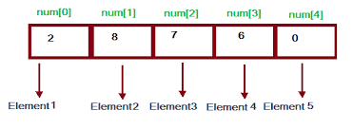
Array
A collection of variables of the same type that are referenced by a common name
Types
Single dimensional arrays
Multi-dimensional arrays

Slide 20
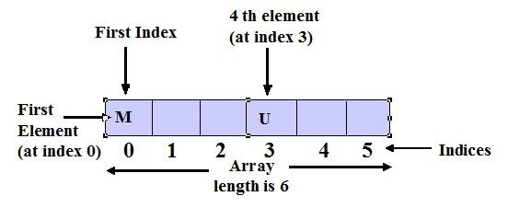
Single dimensional arrays
Declaring one-dimensional arrays
int daysInMonth [ ];
char [ ] lettersInSentence;
double salaryOfEmployees [ ];
String progLanguages[ ];
Initializing one-dimensional arrays
daysInMonth = new int [100];
lettersInSentence = new char[5];
salaryOfEmployees = new double[ ] {10000, 50000, 30000, 25000 };
progLanguages = { “C”, “Java”, “Ruby”, “Python”, “PHP” };

Slide 21
Passing an Array to a method or function
int[] num = new int[10]; //array declaration
methodName (int [] x) //passing an array to method
{
//method body
}
methodName (num); //calling the method

Slide 22
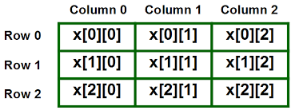
Multi-dimensional arrays
declaring two-dimensional arrays
int myArray [ ] [ ] = new int [5] [12] ;
or,
int[ ] [ ] myArray = new int[5] [12] ;

Slide 23
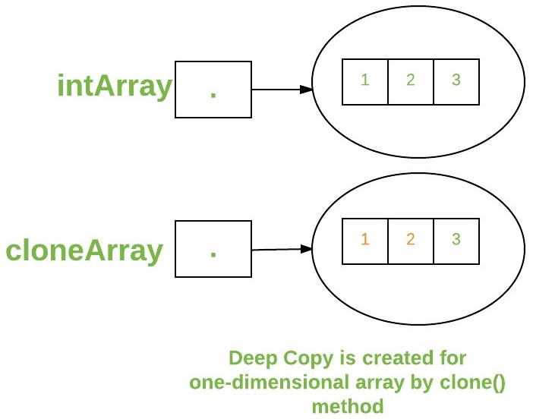
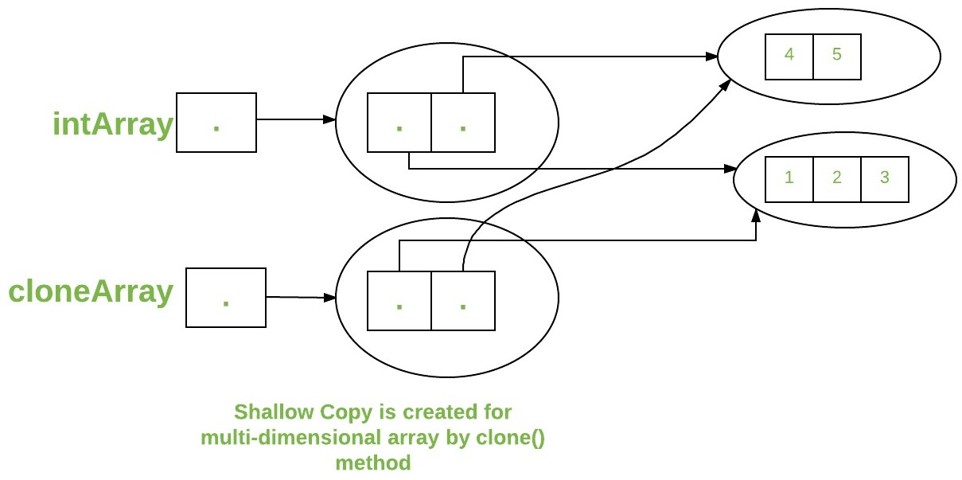
Cloning of arrays
There are 2 different types of cloning of arrays
Cloning single-dimensional arrays
Cloning of multi-dimensional arrays

Slide 24
Methods of Java Array Class
Boolean equals(arr1,arr2)
void fill(originalArray, value)
int binarySearch(array [], value)
copyOf(originalArray, newLength)

Slide 25
Exercise
Take 10 integer inputs from user and store them in an array and print them on screen.
Take 10 integer inputs from user and store them in an array. Now, copy all the elements in an another array but in reverse order.
Take 20 integer inputs from user and print the following:
number of positive numbers
number of negative numbers
number of odd numbers
number of even numbers
number of 0s.

Slide 26
Exercise
Take 10 integer inputs from user and store them in an array and Find largest and smallest elements of an array.
Write a program to check if elements of an array are same or not it read from front or back. E.g.-
2,3,15,15,3,2 -> evaluates to true
2,3,15,15,2,1 -> evaluates to false
Write a method that creates and initializes a twodimensional array of double. The size of the array is determined by the arguments of the method, and the initialization values are a range determined by beginning and ending values that are also arguments of the method. Create a second method that will print the array generated by the first method. In main( ) test the methods by creating and printing several different sizes of arrays.

Slide 27
ALTERNATIVE RESOURCES

Slide 28
RESOURCES
Strings : https://docs.oracle.com/javase/tutorial/java/data/strings.html
Arrays: https://docs.oracle.com/javase/tutorial/java/nutsandbolts/arrays.html

Slide 29
THANKS!

