Slide 1
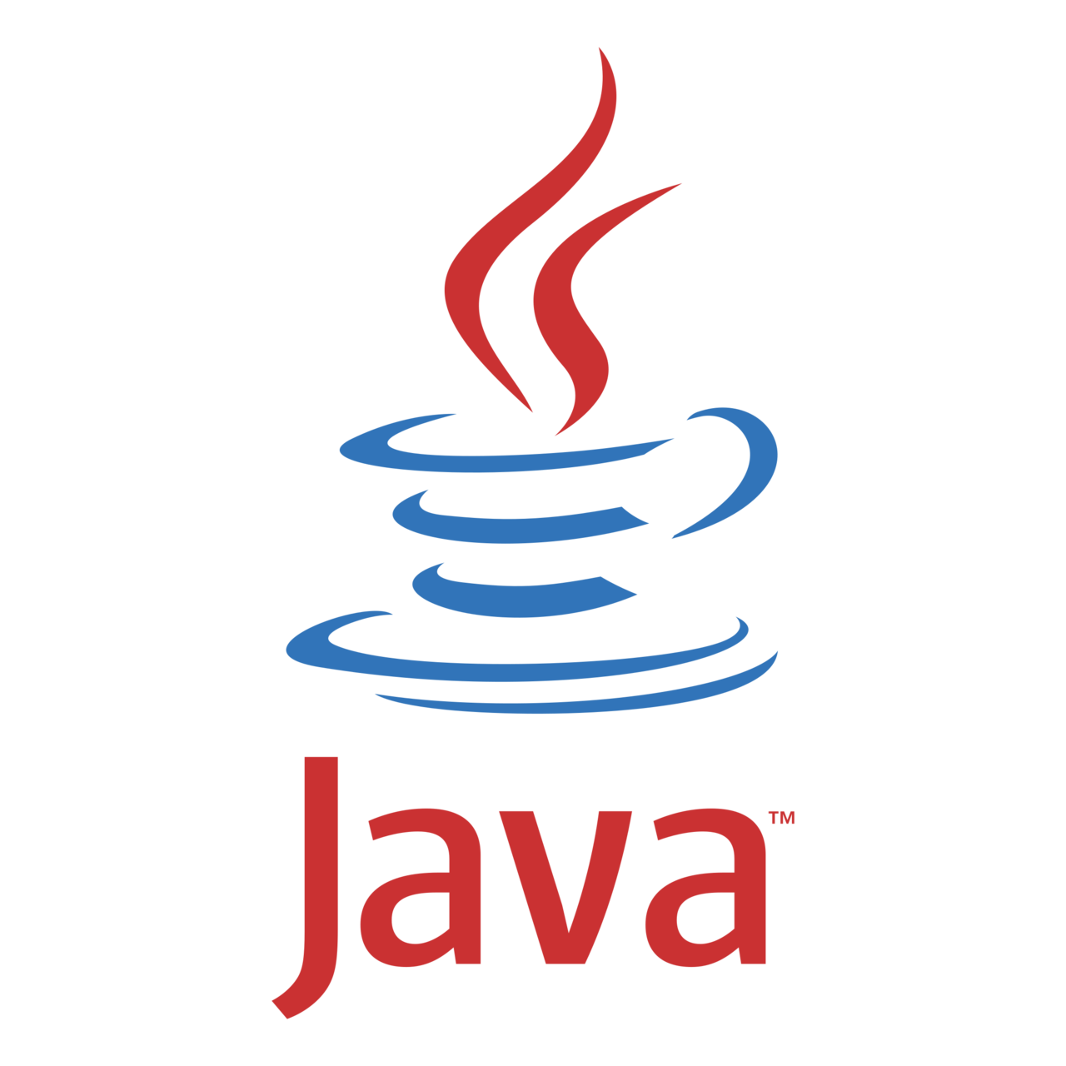
Module 1 Core Java
Day 9

Slide 2
Agenda
Java 11 Features
Junit 5

Slide 3
Java 11 Features

Slide 4
Java 11 Features
String class new Methods
Files class new Methods
var in Lambda Expression
Nest-Based Access Control
HTTP Client
Execute Java File without javac

Slide 5
String New Methods
isBlank()
lines()
strip()
stripLeading()
stripTrailing()
repeat()

Slide 6
Files New Methods
Java 11 added new methods in Files class for better file handling. These methods are:
readString(Path path)
writeString(Path path, CharSequence csq, OpenOption... options)
writeString(Path path, CharSequence csq, Charset cs, OpenOption... options)

Slide 7
Using var in Lambda Expression
While using var with lambda expression make sure you keep in mind the following scenario and rules.
(var s1, s2) -> s1 + s2 //no skipping allowed
(var s1, String y) -> s1 + y //no mixing allowed
var s1 -> s1 //not allowed. Need parentheses if you use var in lambda.
If one parameter use var then other parameters must use var rather than other types like int, float, etc.
Must use parenthesis () while using the var with the parameters.

Slide 8
Nest-Based Access Control
nest-based access control that allows classes to access each other's private members without the need for bridge methods created by the compiler.
These methods are called accessibility-broadening bridge methods and the compiler inserts these into the code during the program execution.

Slide 9
HTTP Client API
List of classes under Java.net.http package
HttpClient
HttpHeaders
HttpRequest.BodyPublishers
HttpResponse.BodyHandlers
HttpResponse.BodySubscribers

Slide 10
Execute Java File Without Compilation
To compile the code, we use javac java_file.java command. and
To run this file, we use java java_file command in the terminal (cmd in windows).
But if we are working with Java 11 then we don't need to follow these two steps. Just use single command java java_file.java

Slide 11
Junit 5

Slide 12
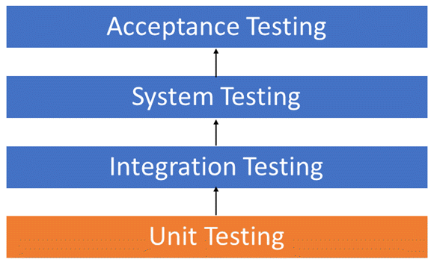
Unit Testing

Slide 13
Unit Testing Techniques
Code coverage techniques used in Unit Testing :
Statement Coverage
Decision Coverage
Branch Coverage
Condition Coverage
Finite State Machine Coverage

Slide 14
Unit Testing Tools
Several automated unit test software
Junit
Nunit
Jmockit
EMMA
PHPUnit

Slide 15
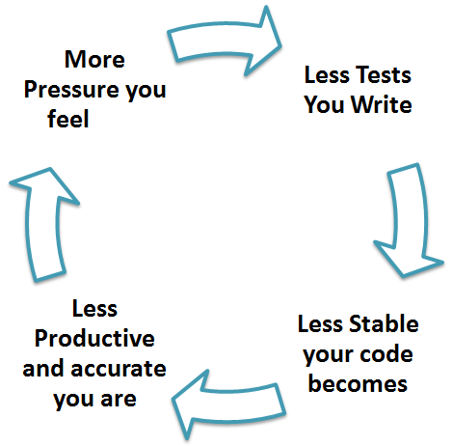
TDD & Unit Testing
what TDD brings to the world of unit testing?
Tests are written before the code
Rely heavily on testing frameworks
All classes in the applications are tested
Quick and easy integration is made possible

Slide 16
Unit Testing Best Practices
Unit Test cases should be independent.
Test only one code at a time.
Follow clear and consistent naming conventions.
Adopt a "test as your code" approach.

Slide 17
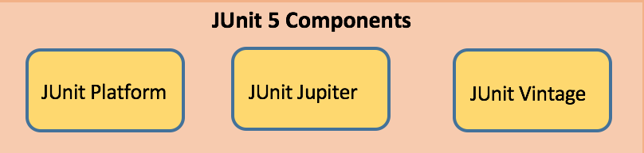
Unit Test Case
A Unit Test Case is a part of code, which ensures that another part of code (method) works as expected.

Slide 18
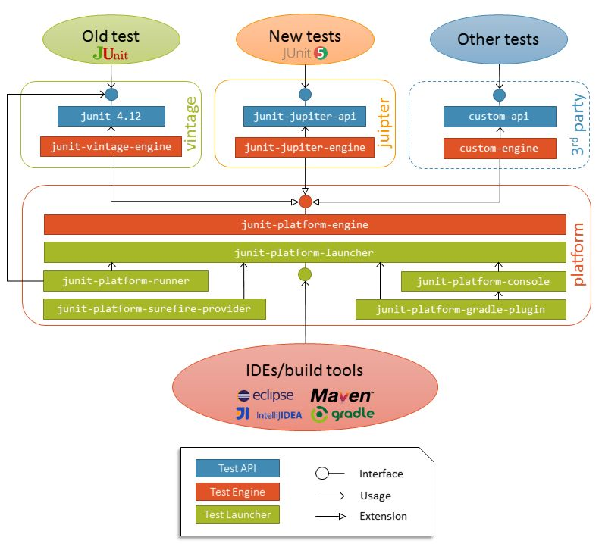
Junit 5 Architecture

Slide 19
JUnit Maven Dependencies
<dependency>
<groupId>org.junit.jupiter</groupId>
<artifactId>junit-jupiter-engine</artifactId>
<version>5.1.1</version>
<scope>test</scope>
</dependency>
<dependency>
<groupId>org.junit.platform</groupId>
<artifactId>junit-platform-runner</artifactId>
<version> 1.1.1</version>
<scope>test</scope>
</dependency>

Slide 20
JUnit5 maven surefire
<plugin>
<artifactId>maven-surefire-plugin</artifactId>
<version>2.19.1</version>
<dependencies>
<dependency>
<groupId>org.junit.platform</groupId>
<artifactId>junit-platform-surefire-provider</artifactId>
<version>1.0.2</version>
</dependency>
</dependencies>
</plugin>

Slide 21
JUnit Annotations
Annotation | Description
@Test | Denotes a test method
@DisplayName | Declares a custom display name for the test class or test method
@BeforeEach | Denotes that the annotated method should be executed before each test method
@AfterEach | Denotes that the annotated method should be executed after each test method
@BeforeAll | Denotes that the annotated method should be executed before all test methods
@AfterAll | Denotes that the annotated method should be executed after all test methods
@Disable | Used to disable a test class or test method
@Nested | Denotes that the annotated class is a nested, non-static test class
@Tag | Declare tags for filtering tests
@ExtendWith | Register custom extensions

Slide 22
JUnit Assertions
Assertion | Description
assertEquals(expected, actual) | Fails when expected does not equal actual
assertFalse(expression) | Fails when expression is not false
assertNull(actual) | Fails when actual is not null
assertNotNull(actual) | Fails when actual is null
assertAll() | Group many assertions and every assertion is executed even if one or more of them fails
assertTrue(expression) | Fails if expression is not true
assertThrows() | Class to be tested is expected to throw an exception

Slide 23
JUnit5 Assumptions
Assumptions are static methods in the org.junit.jupiter.api.Assumptions class. They will execute a test only when the specified condition met otherwise test will be aborted.
Assumptions | Description
assumeTrue | Execute the body of lamda when the positive condition hold else test will be skipped
assumeFalse | Execute the body of lamda when the negative condition hold else test will be skipped
assumingThat | Portion of the test method will execute if an assumption holds true and everything after the lambda will execute irrespective of the assumption in assumingThat() holds

Slide 24
Junit Test Exception
There are situations in which methods are expected to throw an exception under a specific condition.
assertThrows will fail the test if the given method does not throw the specified exception.
Throwable exception = assertThrows(IllegalArgumentException.class, () -> {
throw new IllegalArgumentException("Illegal Argument Exception occured");
});
assertEquals("Illegal Argument Exception occured", exception.getMessage());

Slide 25
JUnit Nested Test Classes
Nested tests allow to create nested classes and execute all of its test methods.
The inner classes must be non-static. Just annotate inner classes with @Nested and all test methods inside it will be executed.

Slide 26
JUnit Dynamic Tests
JUnit @TestFactory annotation coupled with DynamicTest can be used to create a test factory method.
JUnit @TestFactory methods must not be private or static.
These methods must return a Stream, Collection, Iterable, or Iterator of DynamicNode instances.

Slide 27
JUnit Repeated Tests
JUnit Jupiter provides @RepeatedTest annotation that lets us repeat a test specified number of times.
@RepeatedTest(5)
void test() {
System.out.println("@RepeatedTest Simple Example");
}

Slide 28
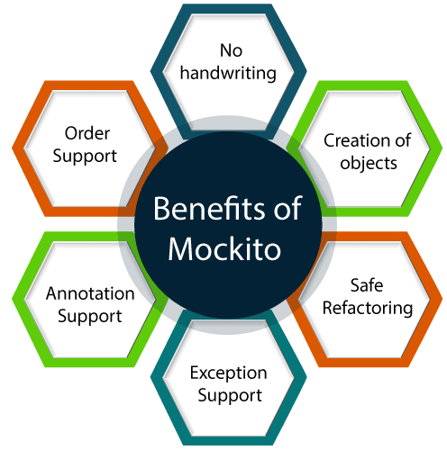
Mockito
Mockito facilitates creating mock objects seamlessly.
It uses Java Reflection in order to create mock objects for a given interface.
Mock objects are nothing but proxy for actual implementations.

Slide 29
Maven Dependency
<!-- Mockito Configuration-->
<dependency>
<groupId>org.mockito</groupId>
<artifactId>mockito-all</artifactId>
<version>1.10.19</version>
<scope>test</scope>
</dependency>
<dependency>
<groupId>org.mockito</groupId>
<artifactId>mockito-junit-jupiter</artifactId>
<version>2.23.0</version>
<scope>test</scope>
</dependency>
<dependency>
<groupId>org.hamcrest<groupId>
<artifactId>hamcrest-core</artifactId>
<version>1.2.1</version>
<scope>test</scope>
</dependency>
<!-- End Mockito Configuration -->

Slide 30
Ways to Create Mock Object
Mock Object by Annotation
Annotation | Description
@Mock | Create Mock of given Type
@Spy | Create Spy of given object
@Captor | Create argument of given object
@InjectMock | Create object of given type and inject mock and spies in existing test.

Slide 31
Varying Calls
Mockito provides the following additional methods to vary the expected call counts.
atLeast (int min) − expects min calls.
atLeastOnce () − expects at least one call.
atMost (int max) − expects max calls.

Slide 32
Behavior Driven Development
//Given
given(calcService.add(20.0,10.0)).willReturn(30.0);
//when
double result = calcService.add(20.0,10.0);
//then
Assert.assertEquals(result,30.0,0);

Slide 33
ALTERNATIVE RESOURCES

Slide 34
RESOURCES
https://junit.org/junit5/docs/current/user-guide/

Slide 35
THANKS!

