Slide 1

Module 1 Core Java
Day 4

Slide 2
Agenda
Packages
Wrapper classes and Boxing
Exception Handling

Slide 3
Packages

Slide 4
Packages
A package is a collection of similar types of Java entities such as classes, interfaces, subclasses, exceptions, errors, and enums.
Example: package com.company.demo
packages
User defined package
In build package

Slide 5
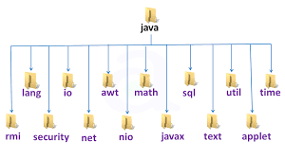
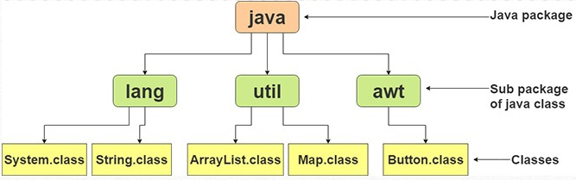
Java API packages or built-in packages

Slide 6
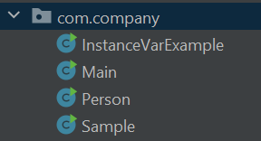
User-defined packages

Slide 7
Exercise 1
Create a Java package called packageDemo .
Inside the packageDemo package, create another package (subpackage) called employee
Create a Java class called Employee inside the java package.
Insert a main() method inside the Employee class.
Inside the main() method, insert this statement:
System.out.println("Employee Class executed");
Compile and run the main() method of the Employee class.

Slide 8
Exercise 2
Create a package called com.packageDemo and inside that a subpackage called java .
In the java package create a class called DataObject .
Inside the DataObject class create a public member variable called count of type int .
In the java package create a class called Main.
In the Main class insert a main() method.
Inside the main() method create an array of DataObject.
Create 3 DataObject instances and assign a reference to them to element 0,1 and 2 in the array.
Inside the main() method create a sum variable of type int .
Loop through the array and add all count member variable values of the DataObject instances to the sum variable.
Inside the main() method, insert a System.out.println() statement that prints out the value of the sum variable.

Slide 9
Wrapper classes and Boxing

Slide 10
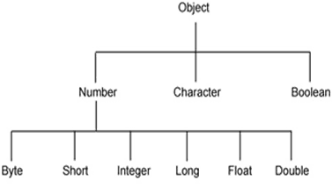
Wrapper Class
A Wrapper class in Java is the type of class that provides a mechanism to convert the primitive data types into the objects and vice-versa.
Primitive Data Type | Wrapper Class | Constructor Argument
boolean | Boolean | boolean or String
byte | Byte | byte or String
char | Character | char
int | Integer | int or String
float | Float | float, double or String
double | Double | double or String
long | Long | long or String
short | Short | short or String

Slide 11
Advantages of using Wrapper class
Serialization
Synchronization
java.util package
Collection Framework
Changing the value inside a Method
Polymorphism

Slide 12
Autoboxing and Unboxing
The process to automatically convert the primitive data types into corresponding wrapper class objects is called Autoboxing in Java
For example, char to Character, int to Integer, long to Long, double to Double, float to Float, boolean to Boolean, byte to Byte, and short to Short.
The process to convert the wrapper class object into its corresponding primitive data type is called Java Unboxing.

Slide 13
Implementing Wrapper class
// byte data type
byte byteVar = 5;
// wrapping around Byte object
Byte byteobj = new Byte(byteVar);
// int data type
int intVar = 33;
//wrapping around Integer object
Integer intobj = new Integer(intVar);
// float data type
float floatVar = 16.8f;
// wrapping around Float object
Float floatobj = new Float(floatVar);

Slide 14
Methods of Wrapper Class
typeValue()
compareTo()
equals()
valueOf()
toString()
parseInt()
abs()
ceil()
floor()
round()
min()
max()

Slide 15
Method Overloading
Method Overloading with Autoboxing
Method Overloading with Widening

Slide 16
Exception Handling

Slide 17
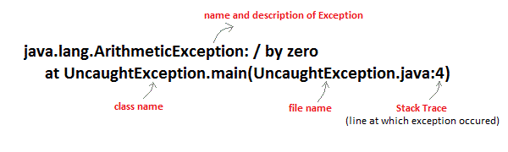
Uncaught Exceptions

Slide 18
Exception Handling
The unexpected errors or bugs during the runtime or normal execution of a program is a Java Exception.
A Java Exception is an object that describes the exception that occurs in a program.
When an exceptional events occurs in java, an exception is said to be thrown.
The code that's responsible for doing something about the exception is called an exception handler

Slide 19
How to Handle Exception
try
catch
finally
throw
throws

Slide 20
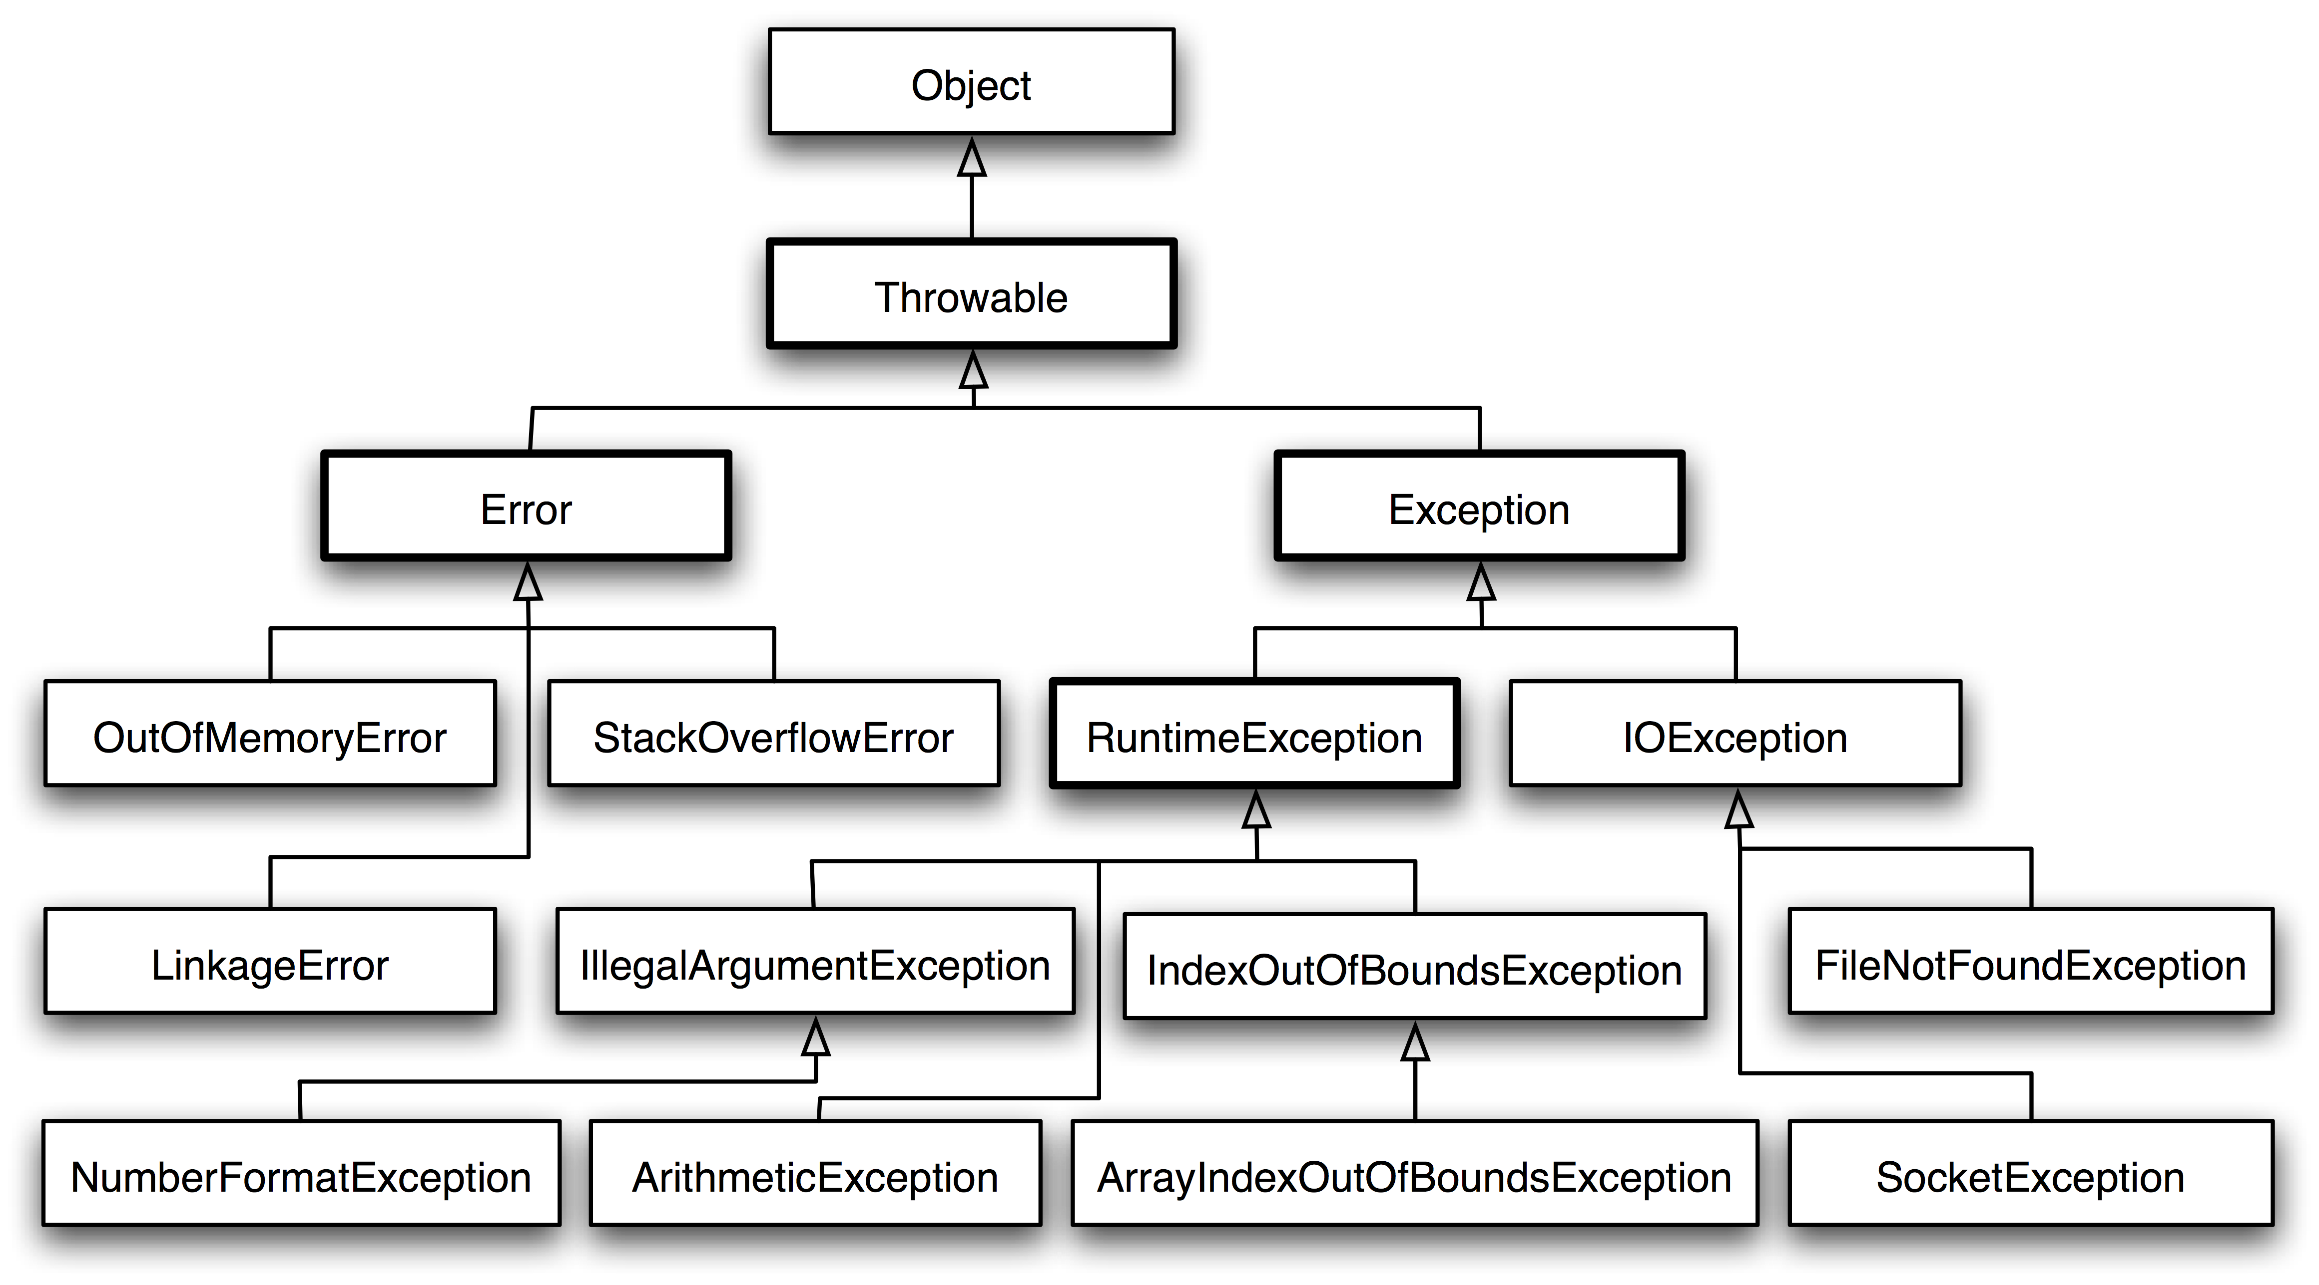
Types of Exceptions

Slide 21
try and catch
try
{
// suspected code
}
catch(Exception1 e)
{
// handler code
}
catch(Exception2 e)
{
// handler code
}
try{
// suspected code
}catch(ExceptionClass ec){}

Slide 22
try with Resource Statement
try(resource-specification(there can be more than one resource))
{
//use the resource
}
catch()
{
// handler code
}

Slide 23
Throw and throws
throw
Syntax: throw ThrowableInstance
Creating Instance of Throwable class: new NullPointerException("test");
throws
type method_name(parameter_list) throws exception_list
{
// definition of method
}

Slide 24
throw vs throws
throw | throws
throw keyword is used to throw an exception explicitly. | throws keyword is used to declare an exception possible during its execution.
throw keyword is followed by an instance of Throwable class or one of its sub-classes. | throws keyword is followed by one or more Exception class names separated by commas.
throw keyword is declared inside a method body. | throws keyword is used with method signature (method declaration).
We cannot throw multiple exceptions using throw keyword. | We can declare multiple exceptions (separated by commas) using throws keyword.

Slide 25
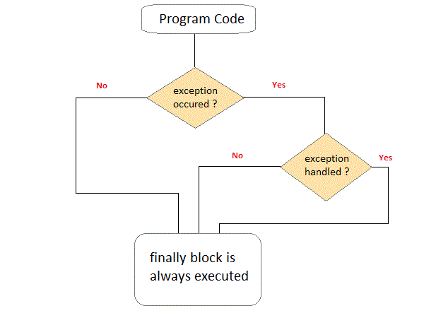
finally clause

Slide 26
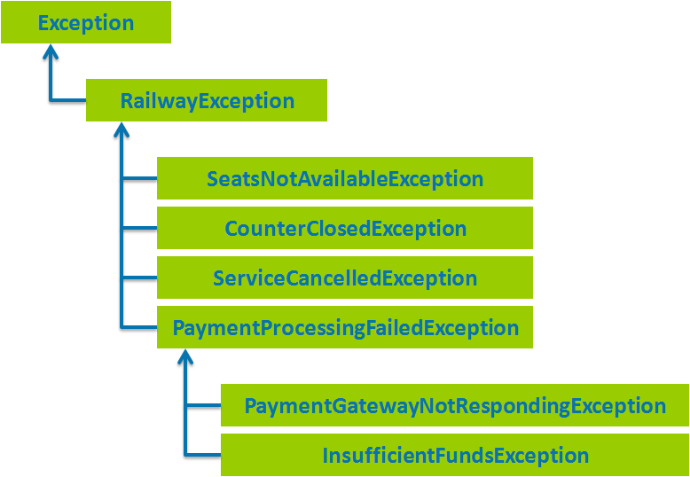
User defined Exception

Slide 27
Chained Exception
If you want to relate one exception with another exception, then it is Chained Exceptions
Constructors
Throwable(Throwable cause)
Throwable(String msg, Throwable cause)
Methods
getCause()
initCause(Throwable cause)

Slide 28
Exception Propagation
An exception is first thrown from the top of the stack and if it is not caught, it drops down the call stack to the previous method.
If not caught there, the exception again drops down to the previous method, and so on until they are caught or until they reach the very bottom of the call stack.
This is called exception propagation.

Slide 29
Exercises
Create a class with a main( ) that throws an object of class Exception inside a try block. Give the constructor for Exception a String argument. Catch the exception inside a catch clause and print the String argument. Add a finally clause and print a message to prove you were there.
Define an object reference and initialize it to null. Try to call a method through this reference. Now wrap the code in a try-catch clause to catch the exception.
Write code to generate and catch an ArraylndexOutOfBoundsException.

Slide 30
Exercise
Create your own exception class using the extends keyword. Write a constructor for this class that takes a String argument and stores it inside the object with a String reference. Write a method that displays the stored String. Create a try-catch clause to exercise your new exception.
Create three new types of exceptions. Write a class with a method that throws all three. In main( ), call the method but only use a single catch clause that will catch all three types of exceptions.

Slide 31
ALTERNATIVE RESOURCES

Slide 32
RESOURCES
Wrapper classes and boxing: https://docs.oracle.com/javase/tutorial/java/data/autoboxing.html
Packages: https://docs.oracle.com/javase/tutorial/java/concepts/package.html
Exception Handling: https://docs.oracle.com/javase/tutorial/essential/exceptions/index.html

Slide 33
THANKS!

