Slide 1

Module 1 Core Java
Day 6

Slide 2
Agenda
Generics
Maven & POM
Log4j

Slide 3
Generics

Slide 4
Java Generics
Generics is a way of implementing generic programming.
Generic programming provides the facility like for a set of related methods, declare a single method that support any valid types.
Generics are introduced in java 5.
In java, generics are added because of Compile time type safety.

Slide 5
Java Generic Classes
class MyGenClass<T>
{
T obj;
void add(T obj)
{
this.obj=obj;
}
T getObj()
{
return obj;
}
}

Slide 6
Type Parameters
The common type parameters are as follows:
T – Type
E – Element
K – Key
N – Number
V – Value

Slide 7
Generic Methods
The methods which can handle different types of arguments are known as generic methods. Types of the argument are specified on method call.
Syntax: generic method includes a type parameter, inside angle brackets and appears before the method’s return type.
public static <T> T identical(T obj){
return returnValue;
}

Slide 8
What is not allowed in Generics?
You can’t have a static field of type
You can not create an instance of T
public class GenericClass<T>
{
private static T member; //This is not allowed
}
public class GenericClass<T>
{
public GenericClass() //Constructor created
{
new T(); //Not Allowed
}
}

Slide 9
What is not allowed in Generics?
We can’t use primitive data types with Generics declaration
You can’t create Generic exception class
final HashMap<int> id = new HashMap<>(); //Not allowed
final HashMap<Integer> id = new HasMap<>(); //Allowed
// causes compiler error
public class GenericClass<T> extends Exception {}

Slide 10
Generics Constructor
class Dimension<T>
{
private T length;
private T width;
private T height;
//Generic constructor
public Dimension(T length, T width, T height)
{
super();
this.length = length;
this.width = width;
this.height = height;
}
}

Slide 11
Non-generic Vs Generic Collection
Basis | Non-generic Collection | Generic Collection
Syntax | ArrayList list = new ArrayList(); | ArrayList list = new ArrayList();
Type-safety | Can hold any type of data. Hence not type-safe. | Can hold only the defined type of data. Hence type safe.
Type casting | Individual type casting needs to be done at every retrieval. | No type casting is needed.
Compile-Time Checking | Checked for type safety at runtime. | Checked for type safety at Compile-time.

Slide 12
Exercise Demo
Create and test a SixTuple generic.

Slide 13
To be practiced
https://docs.oracle.com/javase/tutorial/java/generics/QandE/generics-answers.html

Slide 14
Maven & POM

Slide 15
What is a Build Tool?
Generating source code (if auto-generated code is used in the project).
Generating documentation from the source code.
Compiling source code.
Packaging compiled code into JAR files or ZIP files.
Installing the packaged code on a server, in a repository or somewhere else.

Slide 16

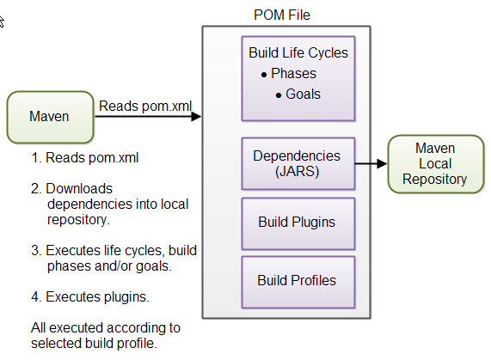
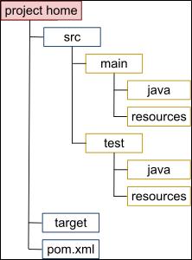
Maven
Maven is a project management and comprehension tool based on POM (project object model) that provides developers a complete build lifecycle framework.

Slide 17
Convention over Configuration
Item | Default
source code | ${basedir}/src/main/java
Resources | ${basedir}/src/main/resources
Tests | ${basedir}/src/test
Complied byte code | ${basedir}/target
distributable JAR | ${basedir}/target/classes

Slide 18
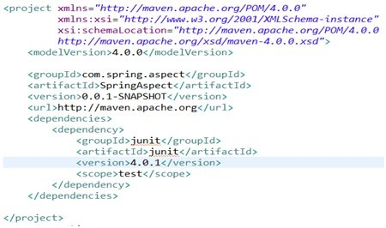
POM

Slide 19
Repositories in Maven
Local Repo
Remote Repo
<settings xmlns="http://maven.apache.org/SETTINGS/1.0.0"
xmlns:xsi="http://www.w3.org/2001/XMLSchema-instance"
xsi:schemaLocation="http://maven.apache.org/SETTINGS/1.0.0
http://maven.apache.org/xsd/settings-1.0.0.xsd">
<localRepository>D:/m2repo</localRepository>
</settings>
<repositories>
<repository>
<id>remote.repository</id>
<url>http://download.ogrname.com/maven2/</url>
</repository>
</repositories>

Slide 20
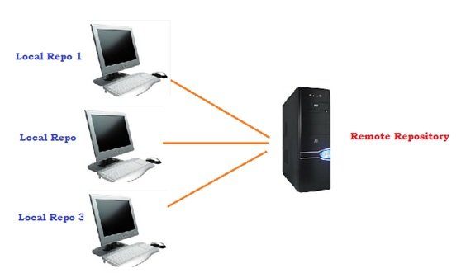
Repositories in Maven
Central Repo
Organization of Local and Remote/Central Repositories
<repositories>
<repository>
<id>central.repository</id>
<url>http://repo1.maven.org/maven2/</url>
</repository>
</repositories>

Slide 21
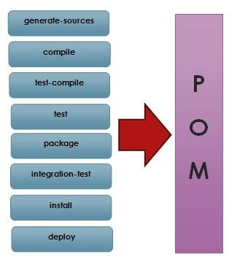
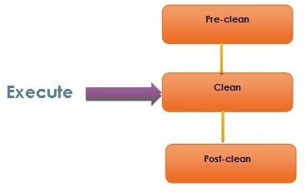
Build Life Cycle

Slide 22
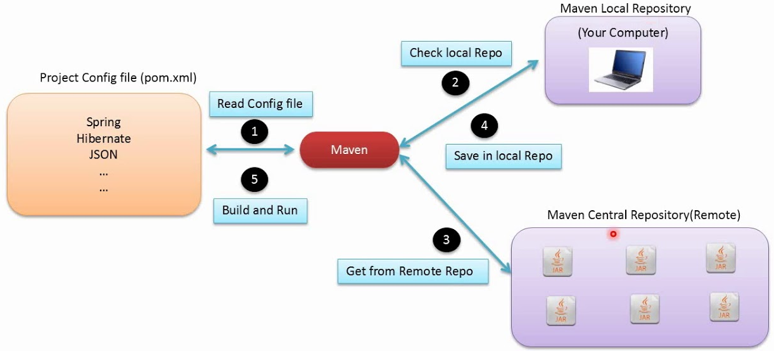
Objective

Slide 23
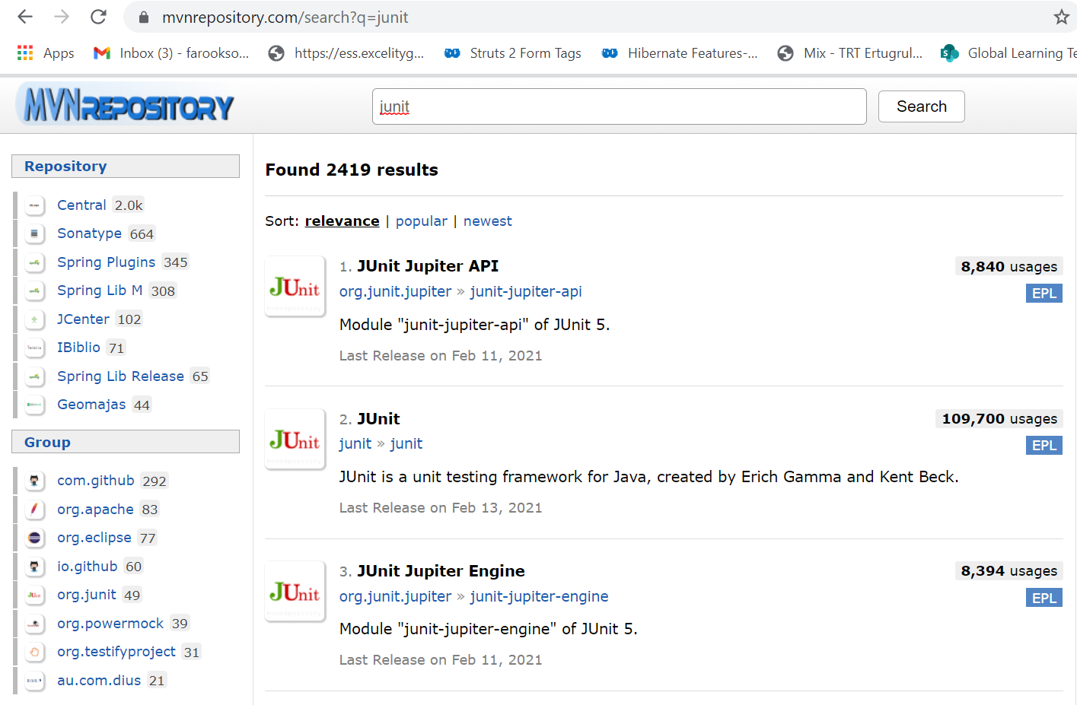

Slide 24
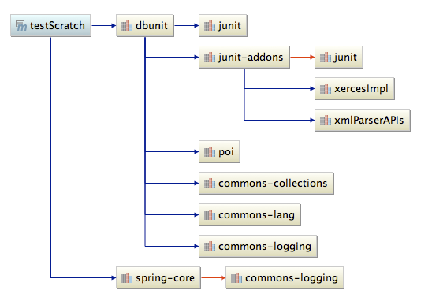
Dependencies

Slide 25
Log4j

Slide 26
Log4j
It is an open source.
With log4j, it is possible to store the flow details of our automation in a file or database.
Log4j is worked for large as well as small projects.
In log4j, we use log statements rather than SOPL statements in the code to know the condition of a project while it is executing.

Slide 27
Maven Dependency
<!-- https://mvnrepository.com/artifact/log4j/log4j -->
<dependency>
<groupId>log4j</groupId>
<artifactId>log4j</artifactId>
<version>1.2.17</version>
</dependency>

Slide 28
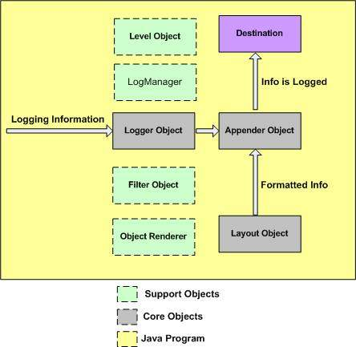
Log4j Architecture

Slide 29
ALTERNATIVE RESOURCES

Slide 30
RESOURCES
https://docs.oracle.com/javase/tutorial/java/generics/types.html
Maven: https://youtu.be/pt3uB0sd5kY

Slide 31
THANKS!

