Slide 1

Module 1 Core Java
Day 5

Slide 2
Agenda
Generics and Collections

Slide 3
Generics & Collections

Slide 4
Collection
Collection Framework in Java is one of the fundamental parts of the Java programming language.
Most of the programming languages majorly use the Collections.
Most of them support various types of Collections such as List, Set, Queue, Stack, etc.

Slide 5
Composition of Java Collection Frameworks
All collections frameworks in Java include the following:
Interfaces
Implementation or Classes
Algorithms

Slide 6
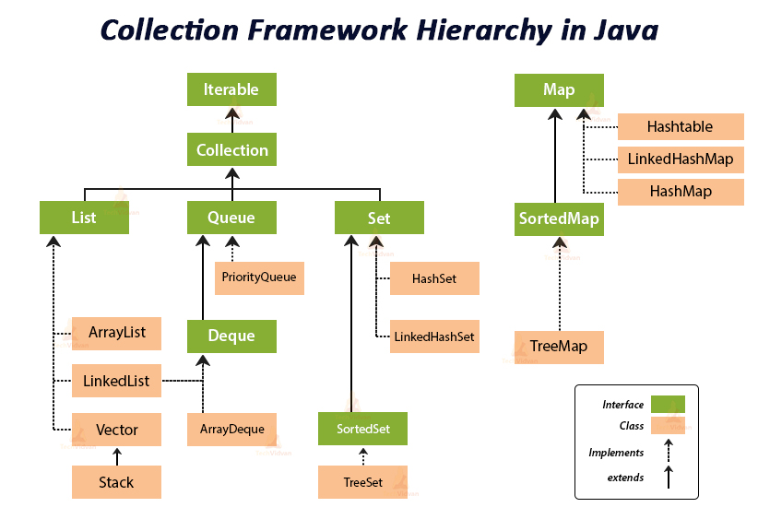

Slide 7
Advantages of Collection Framework
Consistent API
Reduces Programming Exertion
Increases Program Quality and Speed

Slide 8
Important Interfaces of Collection API
Collection
Dequeue
List
Queue
Set
SortedSet

Slide 9
Commonly Used Methods
public boolean add(E e)
public boolean addAll(Collection<? extends E> c)
public boolean remove(Object element)
public boolean removeAll(Collection<?> c)
default boolean removeIf(Predicate<? super E> filter)
public boolean retainAll(Collection<?> c)
public int size()
public void clear()
public boolean contains(Object element)
public boolean containsAll(Collection<?> c)

Slide 10
Exceptions in Collections Framework
UnSupportedOperationException
ClassCastException
NullPointerException
IllegalArgumentException
IllegalStateException

Slide 11
List Interface
A list in Java is a collection for storing elements in sequential order.
Sequential order means the first element, followed by the second element, followed by the third element, and so on.
Syntax: public interface List<E> extends Collection<E>
Creating a list:
List p = new ArrayList();
List q = new LinkedList();
List r = new Vector();
List s = new Stack();

Slide 12
Creating Generic List
List<data type> list = new ArrayList<data type>(); // General syntax.
For example:
List<String> list = new ArrayList<String>(); // Creating a list of objects of String type using ArrayList.
List<Integer> list = new LinkedList<Integer>(); Creating a list of objects of Integer type using LinkedList.
List<String> list1 = new LinkedList<String>();
List<obj> list = new ArrayList<obj>(); // obj is the type of object.

Slide 13
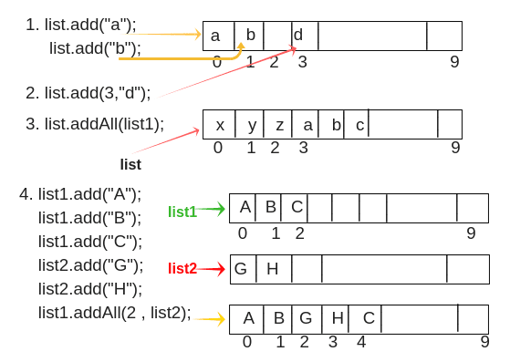
List Methods
boolean add(Object o)
void add(int index, Object o)
boolean addAll(Collection c)
boolean addAll(int index, Collection c)
object remove(int index)
object get(int index)
int indexOf(Object o)
int lastIndexOf(Object o)
object set(int index, Object o)
ListIterator listIterator()
ListIterator listIterator(int)

Slide 14
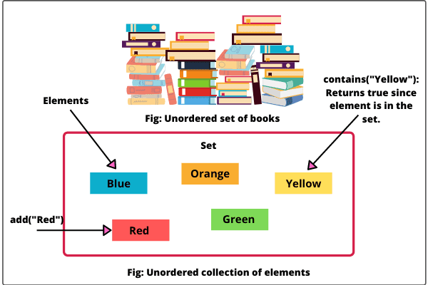
Set Interface
A set is an unordered collection of unique elements or objects.
Elements are simply added to the set without any control over where they go
Syntax: interface Set<E>

Slide 15
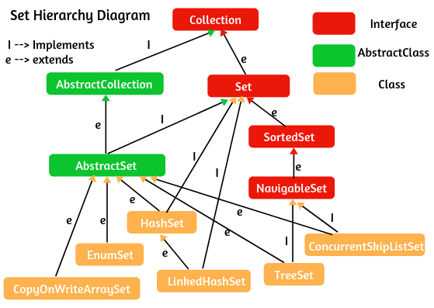
Set Hierarchy

Slide 16
Set Implementation
HashSet,
TreeSet,
LinkedHashSet.

Slide 17
Set Methods
boolean add(Object o)
boolean addAll(Collection c)
int size()
boolean isEmpty()
void clear()
boolean contains(Object o)
boolean containsAll(Collection c)
boolean remove(Object o)
boolean removeAll(Collection c)
Iterator iterate()
boolean equals(Object o)
int hashCode()

Slide 18
Create a Generic Set object
Set<T> set = new HashSet<T>(); where T is type of generic.
Set<T> set = new LinkedHashSet<T>();
Set<T> set = new TreeSet<T>();
For example:
Set<Integer> set = new HashSet<Integer>(); // Creates an empty set of Integer objects.
Set<String> set2 = new LinkedHashSet<String>(); // Creates an empty set of String objects.

Slide 19
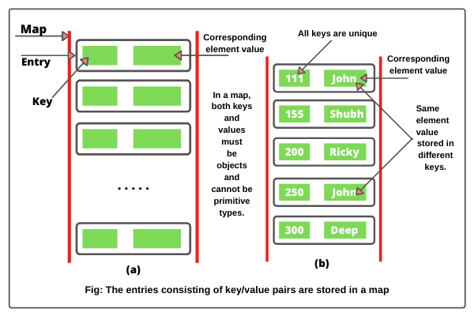
Map
A map is a container object that stores elements in the form of key and value pairs. Map interface in Java is defined in java.util.Map package
Syntax: public interface Map<K, V> // Map is a generic.

Slide 20
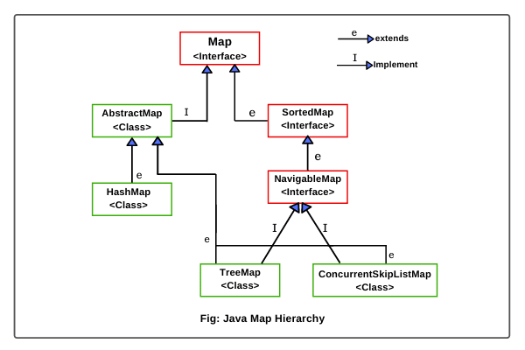
Map Hierarchy

Slide 21
Creating Map Object
Map<K, V> map = new HashMap<>(); // It create an empty map.
Map<K, V> map = new HashMap<>(Map m); // It creates a map with initializing elements of m.
Map<K, V> map = new HashMap<>(int initialCapacity); // It creates a map with initialization of initial capacity of HashMap.
Map<K, V> map = new HashMap<>(int initialCapacity, float fillRatio); // It creates a map object with initializing both initial capacity and fill ratio of HashMap.

Slide 22
Map Methods
void put(K key, V value)
void putAll(Map m)
void putIfAbsent(K key, V value)
void remove(Object key)
boolean remove(Object key, Object value)
Set<K> keySet()
void clear()
void get(Object key)
boolean equals(Object obj)
int hashCode()
boolean isEmpty()
int size()
void replace(K key, V value)
boolean replace(K key, V oldValue, V newValue)
Collection<V> values()
boolean containsKey(Object key)
boolean containsValue(Object value)

Slide 23

Queue Interface
A Queue in Java is a collection of elements that implements the “First-In-First-Out” order.
Declaring Queue: public interface Queue<E> extends Collection<E>

Slide 24
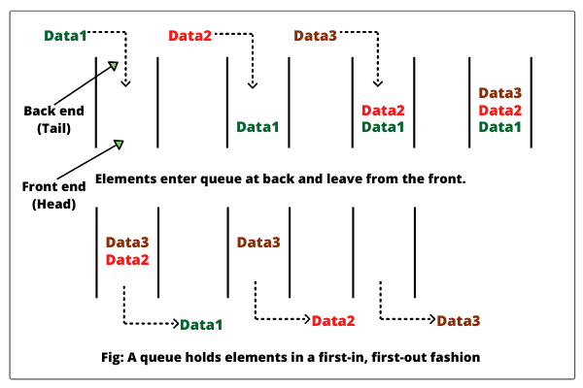
enqueue and dequeue.

Slide 25
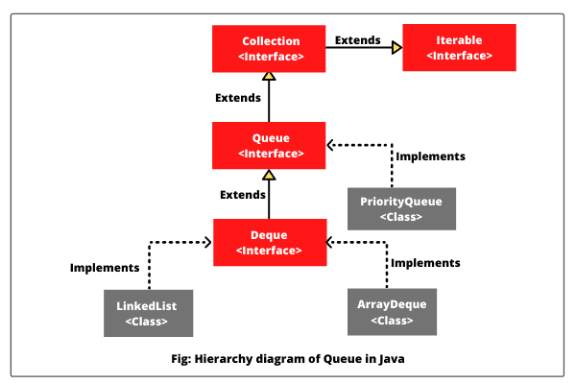
Hierarchy of Queue Interface

Slide 26
Creating a Queue
Queue<String> q = new LinkedList<>();
Queue<Integer> q = new ArrayDeque<>();

Slide 27
Methods of Queue Interface
boolean add(E e)
E element()
boolean offer(E e)
E peek()
E poll()
E remove()
Methods inherited from Collection interface:
addAll, remove, removeAll, isEmpty, clear, contains, containsAll, equals, hashCode, iterator, retainAll, size, toArray.

Slide 28
ArrayList Class
ArrayList supports dynamic array that can grow as needed.
It can contain Duplicate elements and it also maintains the insertion order.
Manipulation is slow because a lot of shifting needs to be occurred if any element is removed from the array list.
ArrayLists are not synchronized.
ArrayList allows random access because it works on the index basis.

Slide 29
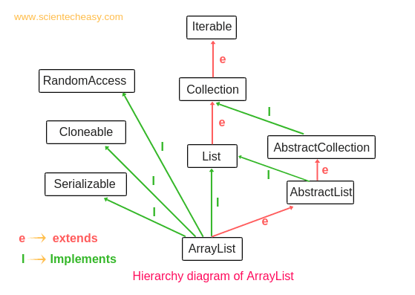
Hierarchy of ArrayList Class

Slide 30
Features of ArrayList
Resizable-array
Index-based structure
Duplicate elements
Null elements
Insertion order
Heterogeneous objects
Synchronized
Random Access
Performance

Slide 31
ArrayList Constructor
Java ArrayList class provides three constructors for creating an object of ArrayList.
ArrayList()
ArrayList(int initialCapacity)
ArrayList(Collection c)

Slide 32
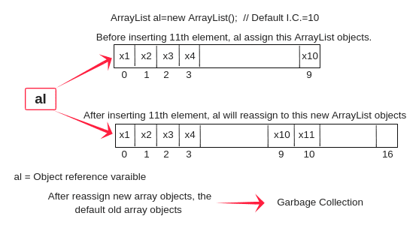
creating an instance of ArrayList class
Syntax:
ArrayList al = new ArrayList();
ArrayList al = new ArrayList(int initialCapacity);
ArrayList al = new ArrayList(Collection c);

Slide 33
ArrayList Initialization
Using Arrays.asList :
ArrayList<String> ar = new ArrayList<String>(Arrays.asList("A", "B", "C"))
Using normal way
Using Anonymous Inner class
ArrayList<Type> obj = new ArrayList<Type>();
obj.add("Obj o1");
obj.add("Obj o2");
and so on.
ArrayList<Type> arl = new Arraylist<Type>() {{
add(Object o1);
add(Object o2);
. . . . . . .
}};

Slide 34
ArrayList Methods
boolean add(Object o)
boolean addAll(Collection c)
boolean addAll(int index, Collection c)
void add(int index, Object o)
void addAll(int index, Object o)

Slide 35
increase or decrease current capacity
// Here, list can hold 10 elements.(Default initial capacity).
ArrayList<String> list = new ArrayList<String>();
list.ensureCapacity(20); // Now it can hold 20 elements.
list.trimTosize();

Slide 36

TreeSet Class
TreeSet class used to store unique elements in ascending order.
It is similar to HashSet except that it sorts the elements in the ascending order while HashSet doesn’t maintain any order.
Java TreeSet class implements the Set interface and use tree based data structure storage.
It extends AbstractSet class and implements the NavigableSet interface.
TreeSet class Declaration
public class TreeSet<E>extends AbstractSet<E>implements NavigableSet<E>, Cloneable, Serializable

Slide 37
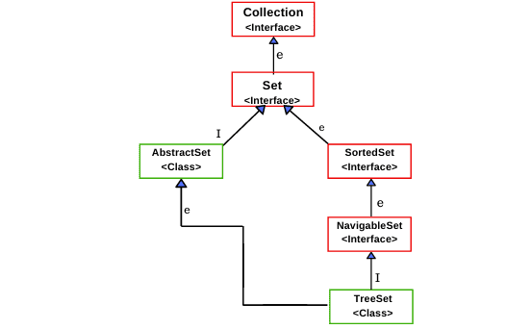
Hierarchy of TreeSet class

Slide 38
Creating TreeSet
TreeSet has 4 constructors.
TreeSet( )
TreeSet(Collection c)
TreeSet(Comparator comp)
TreeSet(SortedSet s)

Slide 39
TreeSet Methods
boolean add(Object o)
boolean addAll(Collection c)
void clear()
boolean isEmpty()
boolean remove(Object o)
boolean contains(Object o)
int size()
Iterator iterator()
Spliterator spliterator()
Object clone()
Iterator descendingIterator()

Slide 40
TreeMap Class
The TreeMap class is a implementation of Map interface based on red-black tree.
It provides an efficient way of storing key-value pairs in sorted order.
It is similar to HashMap class except it is sorted in the ascending order of its keys.
It is not suitable for thread-safe operations due to its unsynchronized nature.
It implements NavigableMap interface and extends AbstractMap class.
Declaration of this class is given below.
public class TreeMap<K,V>extends AbstractMap<K,V>implements NavigableMap<K,V>, Cloneable, Serializable

Slide 41
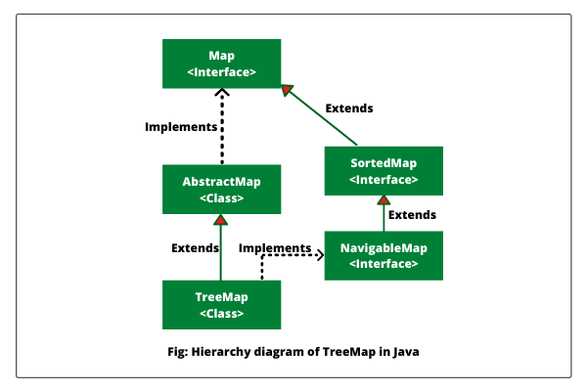
Hierarchy of TreeMap

Slide 42
Constructors of TreeMap class
TreeMap defines the following constructors
TreeMap()
TreeMap(Comparator<? super K> comparator)
TreeMap(Map<? extends K,? extends V> m)
TreeMap(SortedMap<K,? extends V> m)

Slide 43
Methods of TreeMap class
void clear()
V put(K key, V value)
void putAll(Map m)
V remove(Object key)
V get(Object key)
K firstKey()
K lastKey()
boolean containsKey(Object key)
boolean containsValue(Object value)
int size()
Set keySet()
Set entrySet()
Collection values()
Comparator comparator()
Object clone()
Map.Entry<K, V> ceilingEntry(K key)
K ceilingKey(K key)
NavigableSet<K> descendingKeySet()
NavigableMap<K,V> descendingMap()
Map.Entry firstEntry()

Slide 44
Sorting Collections and Arrays
java.util.Collections.sort() method is present in java.util.Collections class.
It is used to sort the elements present in the specified list of Collection in ascending order.
It works similar to java.util.Arrays.sort() method but it is better then as it can sort the elements of Array as well as linked list, queue and many more present in it.

Slide 45
Exercise 1
1. Write a Java program
To create a new array list, add some colors (string) and print out the collection.
To iterate through all elements in a array list.
To insert an element into the array list at the first position.
To retrieve an element (at a specified index) from a given array list.
To update specific array element by given element.
To remove the third element from a array list.
To search an element in a array list.
To sort a given array list.
To empty an array list.
To test an array list is empty or not.

Slide 46
Exercise 2
2. Write a Java program to create a new tree set, add some colors (string) and print out the tree set.
To iterate through all elements in a tree set.
To create a reverse order view of the elements contained in a given tree set.
To get the first and last elements in a tree set.
To get the number of elements in a tree set.
To remove a given element from a tree set.

Slide 47
ALTERNATIVE RESOURCES

Slide 48
RESOURCES
https://docs.oracle.com/javase/tutorial/collections/intro/index.html

Slide 49
THANKS!

