Slide 1
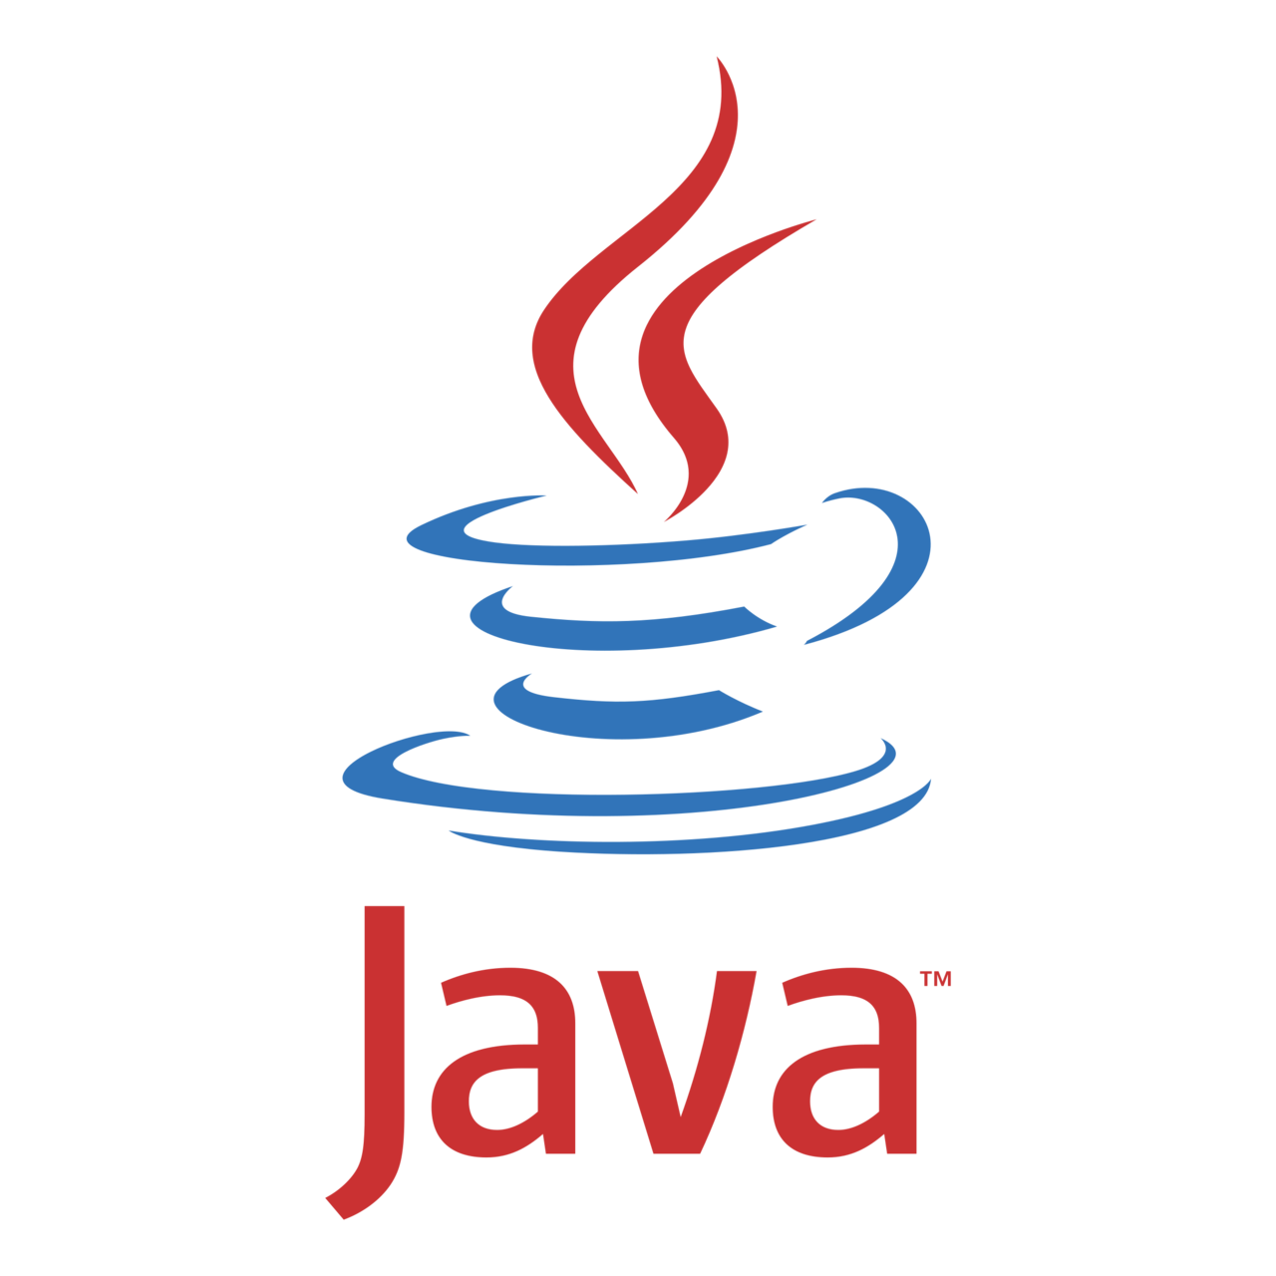
Module 1 Core Java
Day 8

Slide 2
Agenda
Date and Time API
Java I/O
JDBC

Slide 3
Date and Time API

Slide 4
The Date class
Java comes with the Date class that is located in the java.util package and provides many methods to perform operations with date and time.
The Date class of Java implements the Cloneable, Serializable, and Comparable interfaces of Java.
Constructors
Date()
Date(long millisec)

Slide 5
Methods of date Class
boolean after(Date date)
boolean before(Date date)
Object clone( )
int compareTo(Date date)
int compareTo(Object obj)
boolean equals(Object date)
long getTime( )
int hashCode( )
void setTime(long time)
String toString( )

Slide 6
Getting Current Date and time of the system
Using the Date class
Using the Calendar class

Slide 7
GregorianCalendar
It defines two fields: AD(After Death) and BC(Before Christ).
Constructors
GregorianCalendar()
GregorianCalendar(int year, int month, int dayOfMonth)
GregorianCalendar(int year, int month, int dayOfMonth, int hours, int minutes)
GregorianCalendar(int year, int month, int dayOfMonth, int hours, int minutes, int seconds)
GregorianCalendar(Locale locale)
GregorianCalendar(TimeZone timeZone)
GregorianCalendar(TimeZone timeZone, Locale locale)

Slide 8
Exercise
Write a Java program to create a Date object using the Calendar class.
Write a Java program to get current full date and time.
Write a Java program to get the number of days of a month.
Write a Java program to get a day of the week of a specific date.

Slide 9
Java I/O

Slide 10
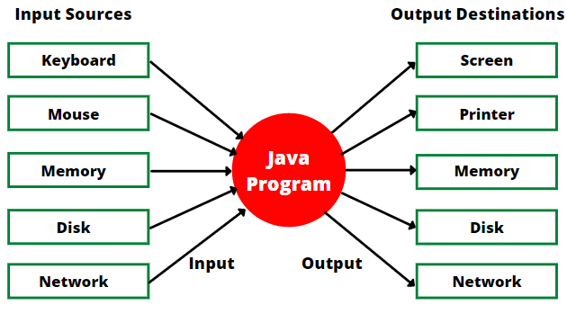
Java I/O

Slide 11
java.io.File class of Java
Creating a file in java is a very simple task. We can use any of the three methods to create a file in Java.
The different techniques of creating a file in Java are:
Using the java.io.File class
Using the java.io.FileOutputStream class
Using Java NIO Files.write() method

Slide 12
Opening a file
Different ways to open a file in Java are:
Desktop class in java
Java FileInputStream class
Java BufferedReader class
FileReader class in Java
Java Scanner class
Java nio package

Slide 13
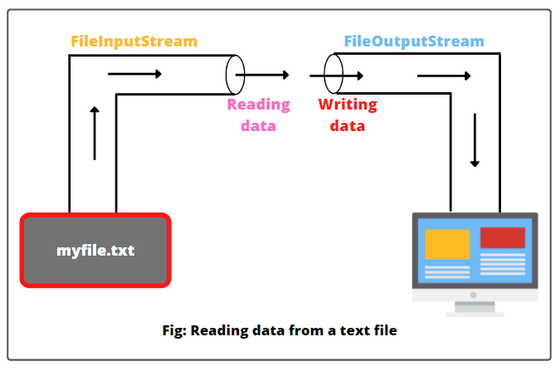
FileInputStream
Constructor
FileInputStream(File file)
FileInputStream(FileDescriptor fdObj)
FileInputStream(String filename)

Slide 14
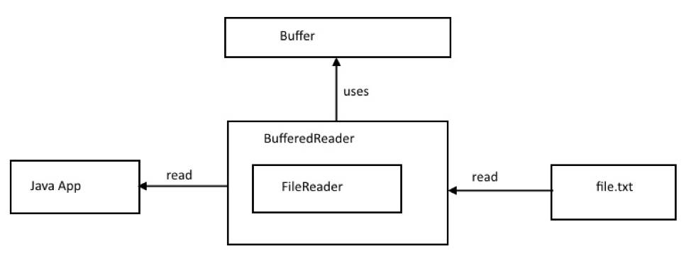
BufferedReader class
BufferedReader reads text from a character –input stream, buffering characters so as to provide for the efficient reading of characters, arrays, and lines.
BufferedReader in = new BufferedReader(Reader in, int size);
Constructors
BufferedReader(Reader in)
BufferedReader(Reader in, int sz)

Slide 15
Scanner Class
The Scanner class in Java is a predefined class that helps us to take input from the user. This class is present in the java.util package
creating the instance: Scanner scannerObject = new Scanner(System.in);

Slide 16
File NIO
The Java nio package has many classes and methods that use to read and open a file in Java.
The two important methods are:
readAllLines() method
Collections.emptyList()

Slide 17
Deleting a File
Different ways to delete a file in Java are:
Using File.delete() method : public boolean delete()
Using File.deleteOnExit() method: public void deleteOnExit()

Slide 18
Exercise
Write and read a plain text file using FileWriter and BufferedReader.

Slide 19
JDBC

Slide 20
Java Database Connectivity (JDBC)
JDBC is an API that helps Java program to communicate with databases and manipulates their data.
Purpose of JDBC API
To access tables and its data from relation database.
To send queries and update statement to database.
Obtain and modify the results to and from a JDBC application.
Find the metadata of the table.

Slide 21
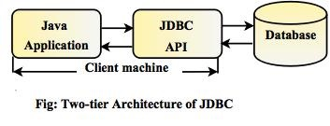
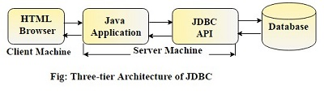
Architecture of JDBC
Two-tier Architecture
Three-tier Architecture

Slide 22
JDBC Components
JDBC API
DriverManager
Connection
JDBC Test Suite
JDBC - ODBC Bridge

Slide 23
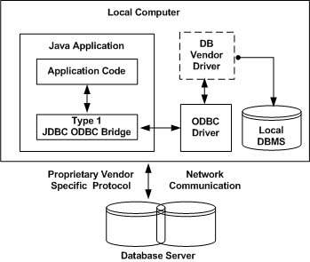
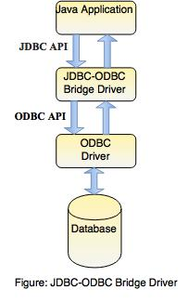
JDBC Driver - Type 1 : JDBC-ODBC bridge driver

Slide 24
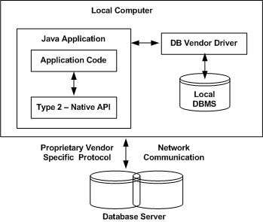
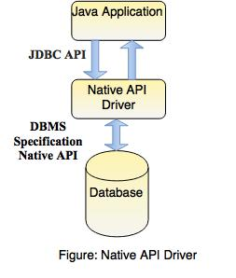
JDBC Driver - T2 : Native API Driver (Partial Java driver)

Slide 25
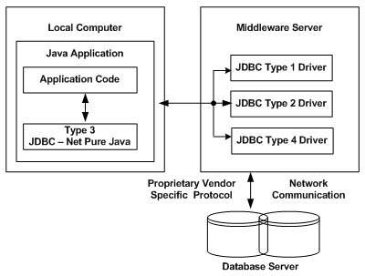
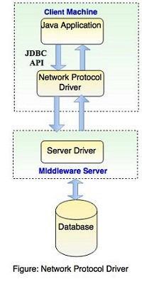
JDBC Driver - Type 3 : Network Protocol Driver

Slide 26
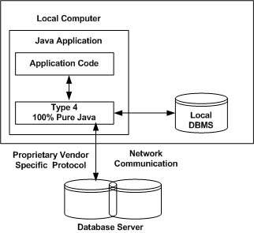
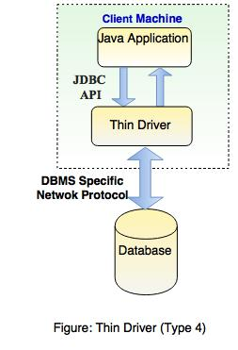
JDBC Driver - T4 : Thin driver (Pure Java driver)

Slide 27
Connect a Java Application to Database
5 steps to create the database connection with Java application:
Register the Driver
Create Connection
Create SQL Statement
Execute SQL Queries
Close the Connection

Slide 28
Exercise
Write a JDBC program to Create a database, Connect to database
Write a JDBC Program to create a table
Write a JDBC Program to insert, update, select & delete records
Write a JDBC program to drop the table and database.

Slide 29
ALTERNATIVE RESOURCES

Slide 30
RESOURCES
Date and Time: https://docs.oracle.com/en/java/javase/11/docs/api/java.base/java/time/package-summary.html
File I/O: https://docs.oracle.com/en/java/javase/11/docs/api/java.base/java/io/package-summary.html
JDBC: https://cr.openjdk.java.net/~iris/se/11/latestSpec/api/java.sql/java/sql/package-summary.html

Slide 31
THANKS!

