Slide 1

Module 1 Core Java
Day 7

Slide 2
Agenda
Threads

Slide 3
Threads

Slide 4
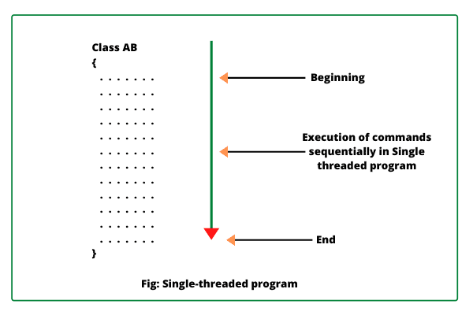
Thread
A thread is just a single lightweight and smallest part of a process. It is the smallest unit of a process that can run concurrently with the other parts (other threads) of the same process.
There can be multiple processes in an Application. Each process can have a single thread or multiple threads. Multithreading is the process of concurrent execution of multiple threads.

Slide 5
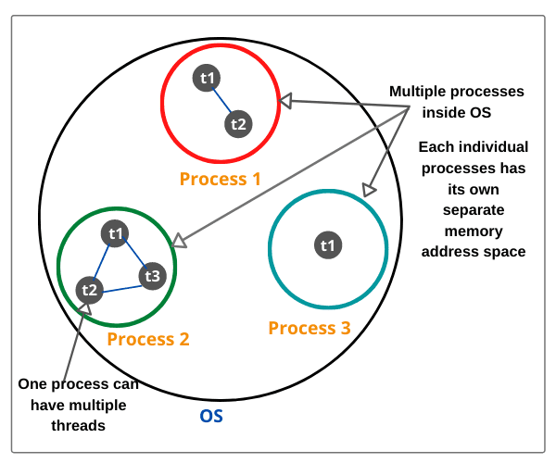
Process
Thread in Java is the smallest unit of executable code in a program.
A process is a program that executes as a single thread.

Slide 6
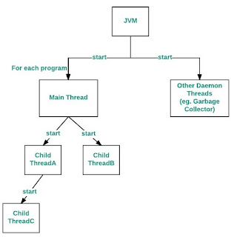
Main Thread
Main thread is the last thread to be executed in a program.
When main thread finishes the execution, the program terminates immediately.

Slide 7
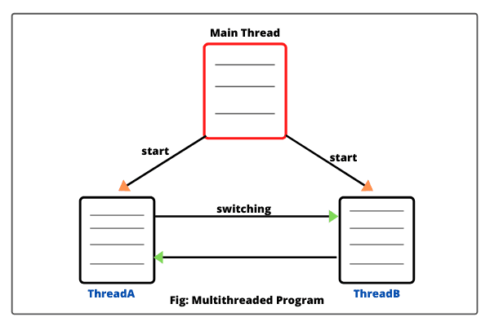
Multithread
Multithreading means multiple threads of execution concurrently.
The process of executing multiple threads simultaneously (concurrently) is called multithreading in Java.

Slide 8
Advantage of Multithreading
Different parts of the application are executed by different threads
Different threads are allotted to different processors
Reduce computation time.
Improves the performance of the application
Threads share the same memory address space
Multithreaded program makes maximum utilization of CPU

Slide 9
Drawbacks of Multithreading
Increased complexity.
Synchronization of shared resources.
In the multithreading programming concept, debugging is difficult. At times, result is unpredictable.
Potential deadlocks.
Programming complications may occur.

Slide 10
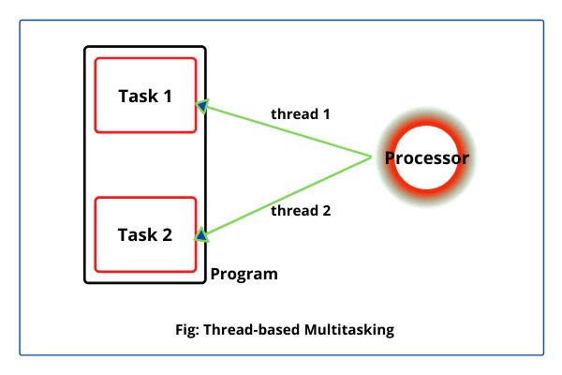
Multitasking
Multitasking can be implemented in two ways:
Process-based multitasking (Multiprocessing)
Thread-based multitasking (Multithreading)

Slide 11
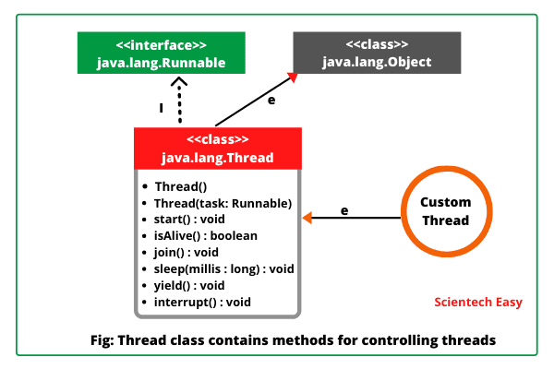
Thread Class & Methods
Thread class declaration
public class Thread extends Object implements Runnable

Slide 12
Thread Class Constructor
Thread()
Thread(String name)
Thread(Runnable r)
Thread(Runnable r, String name)

Slide 13
Methods of Thread Class
currentThread() : public static Thread currentThread()
sleep():
public static void sleep(long milliseconds) throws InterruptedException
public static void sleep(long milliseconds, int nanoseconds ) throw InterruptedException
yield(): public static void yield()
activeCount(): public static int activeCount()

Slide 14
instance methods of Thread class
start(): public void start( )
run(): public void run()
getName(): public final String getName()
setName(): public final void setName(String name)
getPriority(): public final int getPriority() // Return type is an integer.
setPriority(): public final void setPriority(int newPriority)
isAlive(): public final native boolean isAlive()
join(): public final void join() throw InterruptedException
stop(): public final void stop()
suspend(): public final void suspend()
resume(): public final void resume()
isDeamon(): public final boolean isDaemon()

Slide 15
Creating Threads
To create your own thread in Java
Class Myclass extends Thread
public void run(){ // statements to be executed. }
Myclass obj = new Myclass();
Thread t = new Thread(obj); (or) Thread t = new Thread(obj, "threadname");
t.start();
Creating a class using Runnable Intrerface
class Myclass implements Runnable

Slide 16
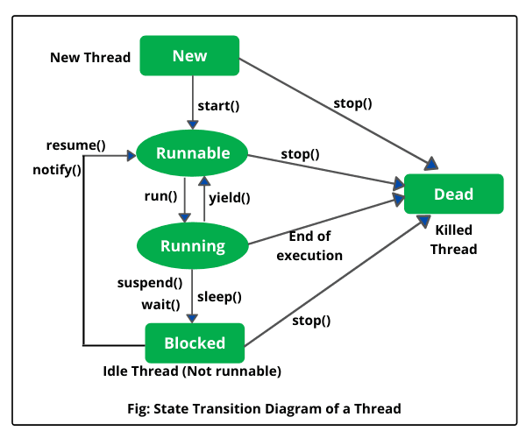
Life Cycle of Thread

Slide 17
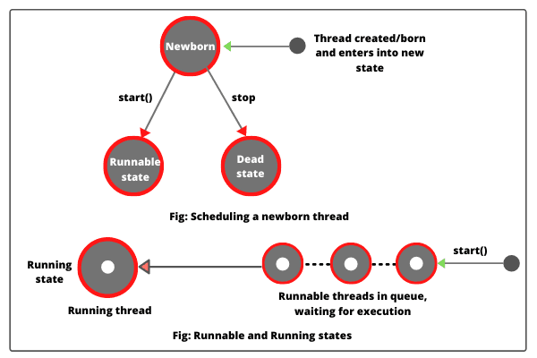
New (Newborn State)

Slide 18
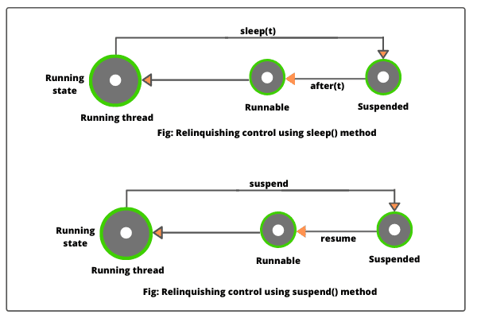
Running state

Slide 19
Creating Multiple Threads
Creating more than one thread to perform multiple tasks is called multithreading in Java.
In multiple threading programming, multiple threads are executing simultaneously that improves the performance of CPU because CPU is not idle if other threads are waiting to get some resources.

Slide 20
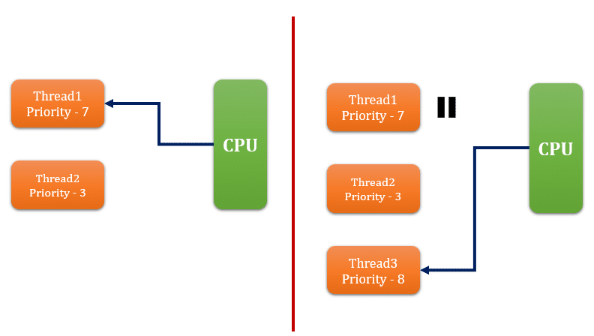
Thread Scheduler & Time Slicing
Thread scheduler in Java is the component of JVM that determines the execution order of multiple threads on a single processor (CPU).
Java runtime system mainly uses one of the following two strategies:
Preemptive scheduling
Time-sliced scheduling

Slide 21
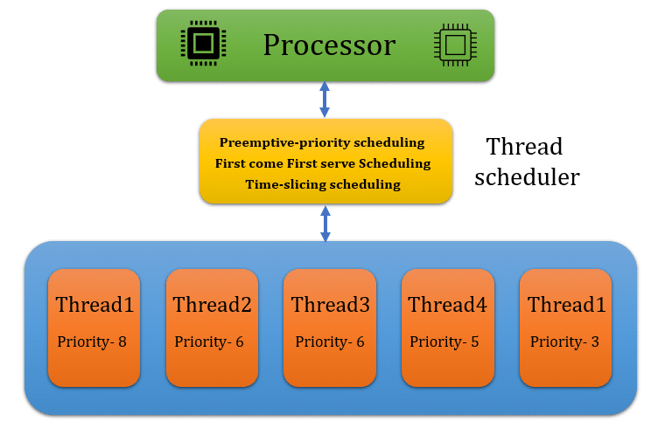
Working with the Thread Scheduler

Slide 22
Thread Priority
Each thread have a priority.
Priorities are represented by a number between 1 and 10.
In most cases, thread schedular schedules the threads according to their priority (known as preemptive scheduling).
3 constants defined in Thread class:
public static int MIN_PRIORITY
public static int NORM_PRIORITY
public static int MAX_PRIORITY

Slide 23
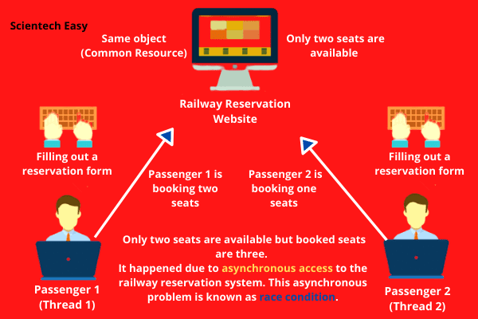
Thread Synchronization

Slide 24
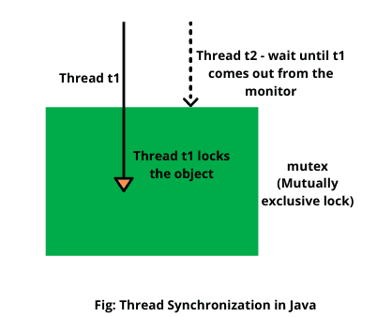
Object Lock

Slide 25
Rules for synchronizing shared resources
A thread must get an object lock associated with it before using a shared resource.
Only methods or blocks can be synchronized. Variables or classes cannot be synchronized.
Only one lock is associated with each object or shared resource.

Slide 26
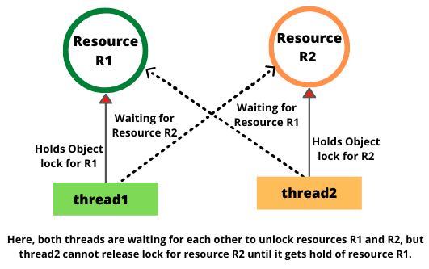
Deadlock

Slide 27
Conditions for deadlock
Mutual Exclusion
Hold and Wait
No Preemption
Circular Wait

Slide 28
How to avoid Deadlock
Mutual Exclusive Condition
Hold and Wait Condition
No Preemption Condition
Circular Wait Condition

Slide 29
Exercise
Program to implement thread using runnable interface
Program to creating multiple thread
Program to set priorities of thread
Program to display all running thread
Program for Synchronization block

Slide 30
Exercise
Write a program that creates 2 threads - each displaying a message (Pass the message as a parameter to the constructor). The threads should display the messages continuously till the user presses ctrl+c.
Write a Java program using Synchronized Threads, which demonstrates Producer Consumer concept.

Slide 31
ALTERNATIVE RESOURCES

Slide 32
RESOURCES
https://docs.oracle.com/javase/tutorial/essential/concurrency/runthread.html

Slide 33
THANKS!

