Slide 1

Module 2 Spring Framework
Day 9

Slide 2
Agenda
RESTful Web Services

Slide 3
RESTful API Design

Slide 4
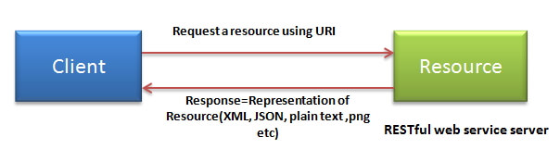
Features of RESTful web services
Client-Server
Stateless
Cache
Named Resources
Interconnected resource representations
Layered components
Self-descriptive messages

Slide 5
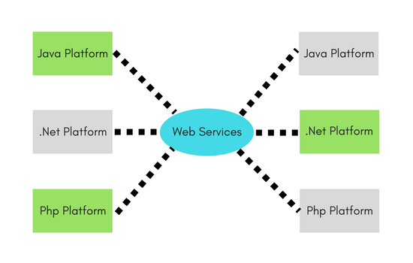
Webservices
Need for web services
Reuse already developed(old) functionality into new software
Usability
Interoperability
Loosely Coupled
Ease of Integration
Deployability

Slide 6
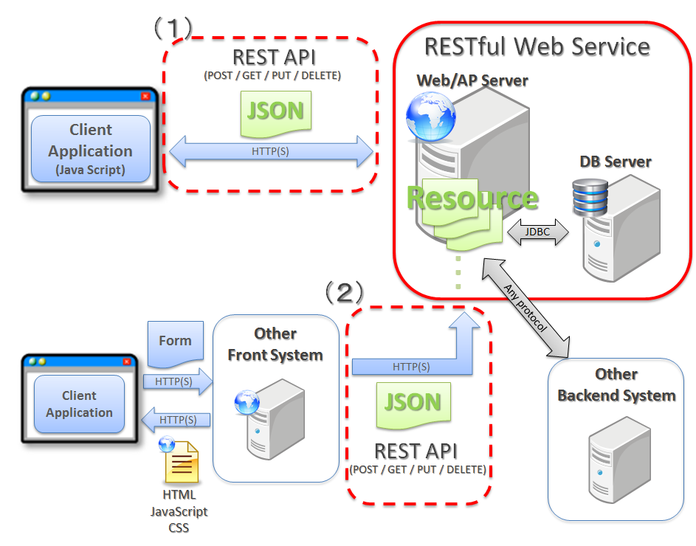
RESTful Web Service

Slide 7
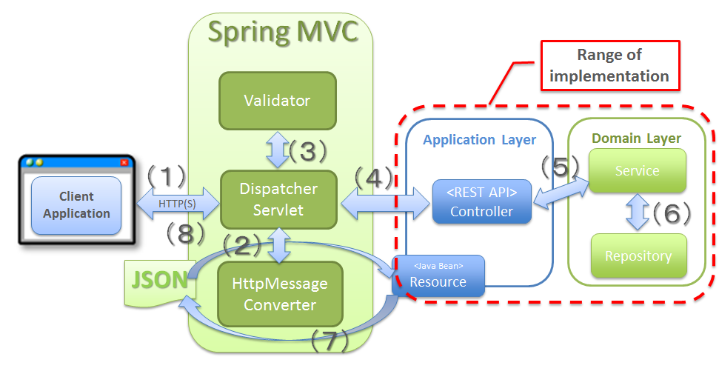
RESTful Web Service using Spring MVC

Slide 8
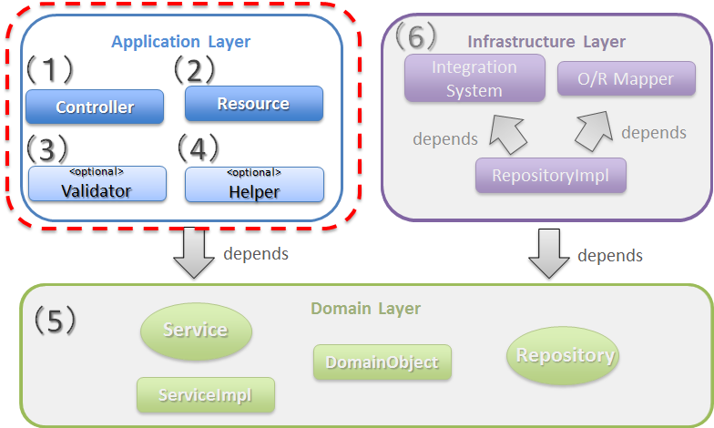
Configuration for RESTful Web Service module

Slide 9
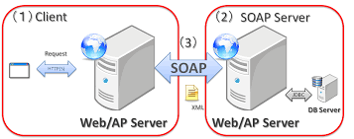
SOAP

Slide 10
REST vs SOAP
Message interchange format
Service Definitions
Transport
Ease of Implementation

Slide 11
URI in RESTful webservice
<protocol>://<service-name>/<ResourceType>/<ResourceID>
Constructing a Standard URI
Use Plural Noun
Avoid using spaces
Use lowercase letters
Maintain Backward Compatibility
Use HTTP Verb
Example
Following is an example of a poor URI to fetch a user.
http://localhost:8080/UserManagement/rest/UserService/getUser/1
Following is an example of a good URI to fetch a user.
http://localhost:8080/UserManagement/rest/UserService/users/1

Slide 12
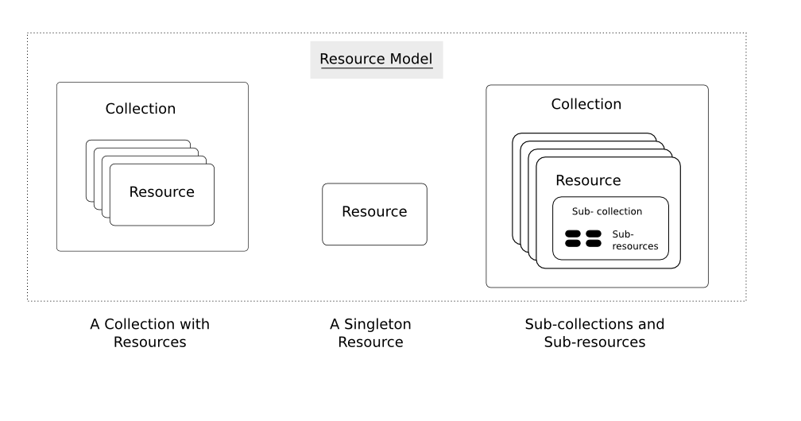
REST Resources

Slide 13
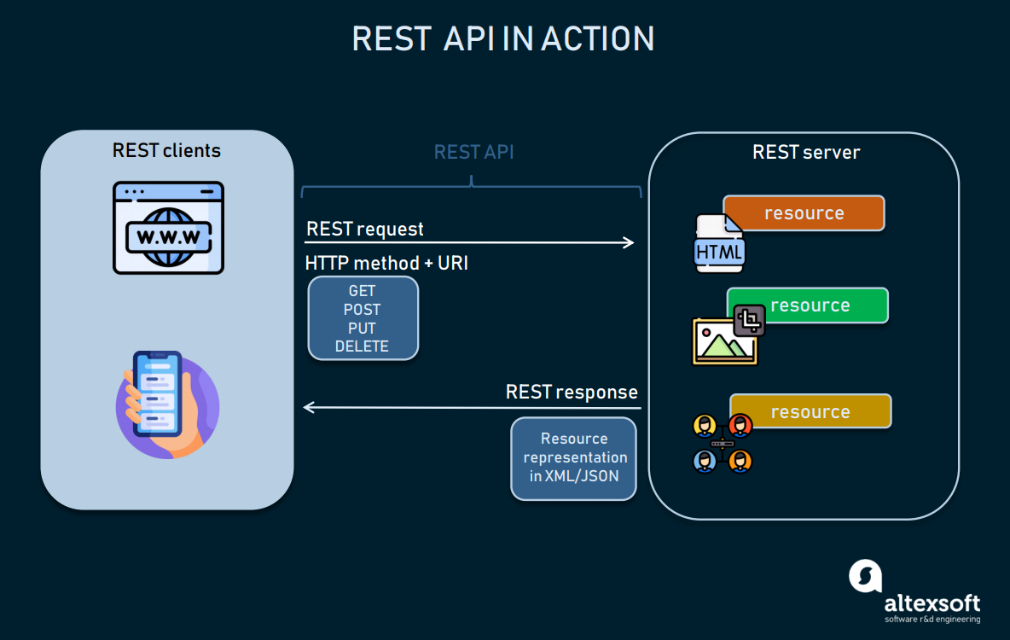
Resource Data

Slide 14
REST Metadata
Attribute | Type | Meaning
id | String | Identifies the unique ID of a resource.
href | String | Identifies the URL of the current resource.
link | Object | Identifies a relationship for a resource. This attribute is itself an object and has “rel” “href” attributes.

Slide 15
Representations
Type | Content-Type
JSON | application/x-resource+json application/x-collection+json
YAML | application/x-resource+yaml application/x-collection+yaml
XML | application/x-resource+xml application/x-collection+xml
HTML | text/html

Slide 16
JSON Format
{
"_type": "vm",
"name": "A virtual machine",
"memory": 1024,
"cpu": {
"cores": 4,
"speed": 3600
},
"boot": {
"devices": ["cdrom", "harddisk"]
}
}

Slide 17
YAML Format
!vm
name: A virtual machine
memory: 1024
cpu:
cores: 4
speed: 3600
boot:
devices:
- cdrom
- harddisk

Slide 18
XML Format
<vm xmlns:xs="http://www.w3.org/2001/XMLSchema">
<name type="xs:string">My VM</name>
<memory type="xs:int">1024</memory>
<cpu>
<cores type="xs:int">4</cores>
<speed type="xs:int">3600</speed>
</cpu>
<boot>
<devices type="xs:list">
<device type="xs:string">cdrom</device>
<device type="xs:string">harddisk</device>
</devices>
</boot>
</vm>

Slide 19
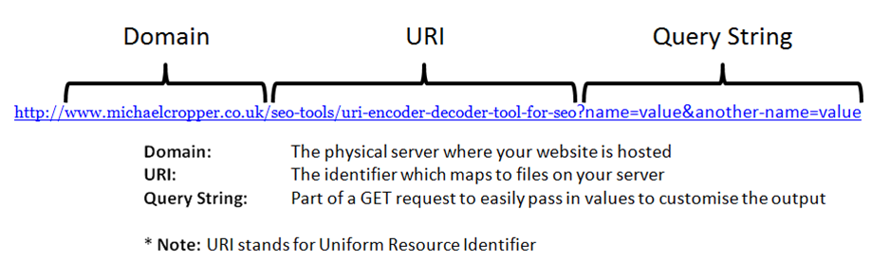
7 Rules for REST API URI Design
Rule #1: A trailing forward slash (/) should not be included in URIs
Rule #2: Forward slash separator (/) must be used to indicate a hierarchical relationship
Rule #3: Hyphens (-) should be used to improve the readability of URIs
Rule #4: Underscores (_) should not be used in URIs
Rule #5: Lowercase letters should be preferred in URI paths
Rule #6: File extensions should not be included in URIs
Rule #7: Should the endpoint name be singular or plural?

Slide 20
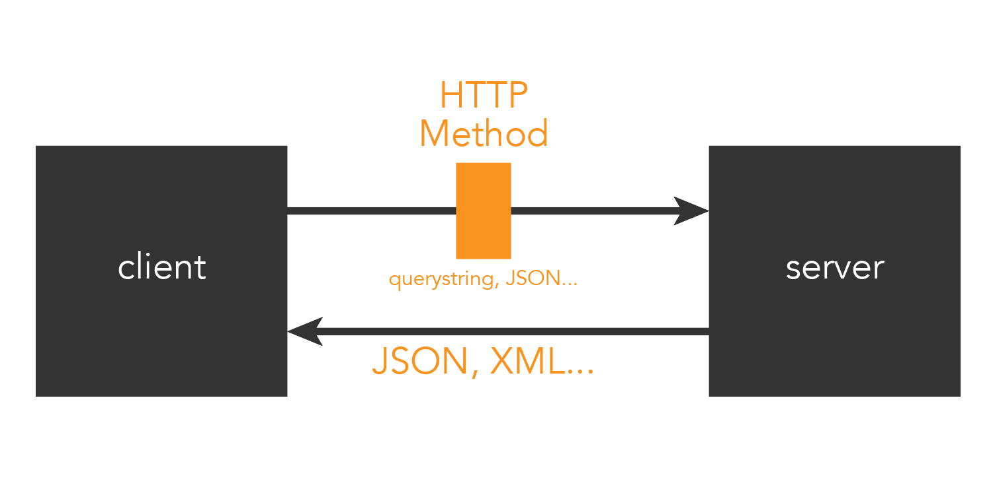
REST VS HTTP

Slide 21
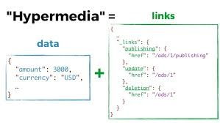
HATEOAS
6 REST principals:
Uniform access
Client-server
Layered system
Stateless
Cacheable
Code on demand(demand).

Slide 22
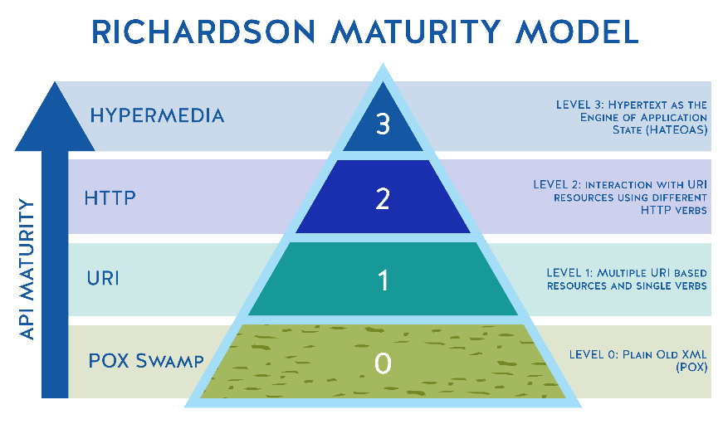
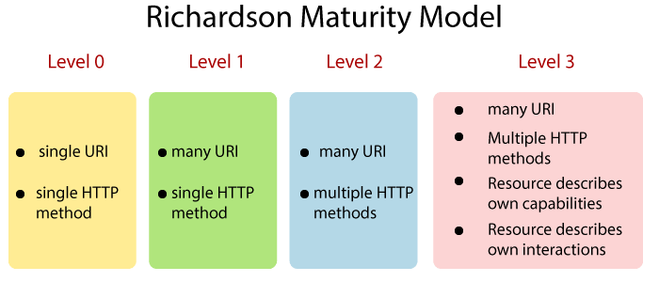
Richardson Maturity Model

Slide 23
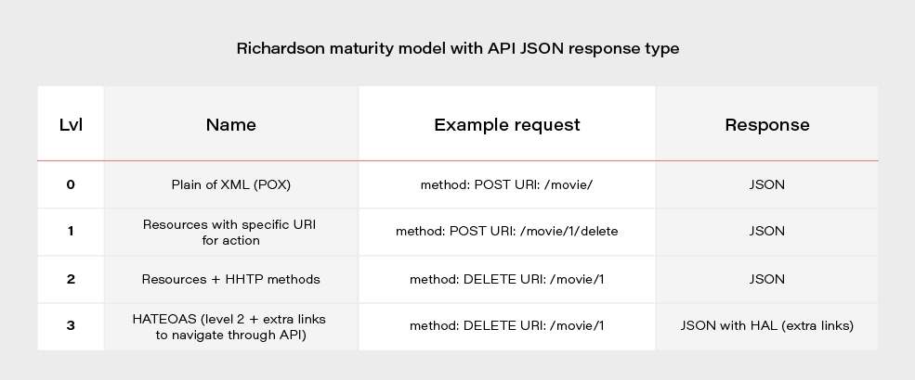
Richardson Maturity Model (contd…)

Slide 24
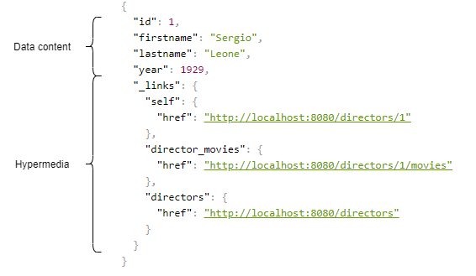
Hypermedia Controls

Slide 25
Changes in Spring HATEOAS 1.0
Old | New
ResourceSupport | RepresentationModel
Resource | EntityModel
Resources | CollectionModel
PagedResources | PagedModel
ResourceAssembler | RepresentationModelAssembler

Slide 26
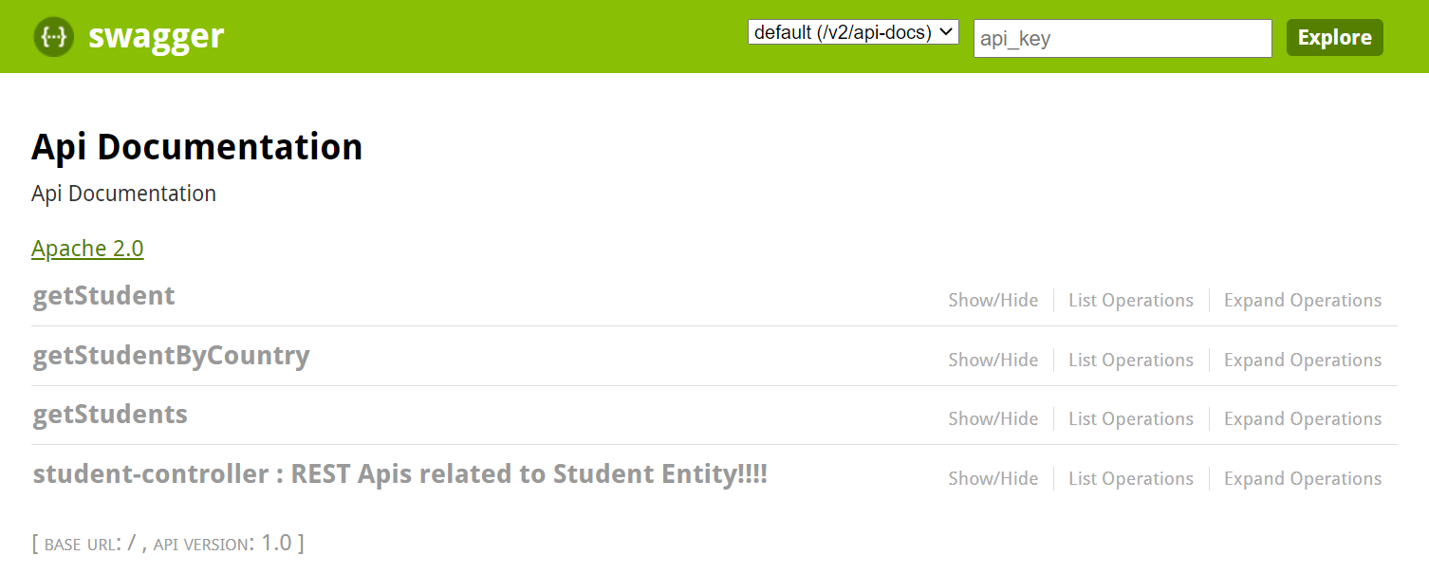
Swagger

Slide 27
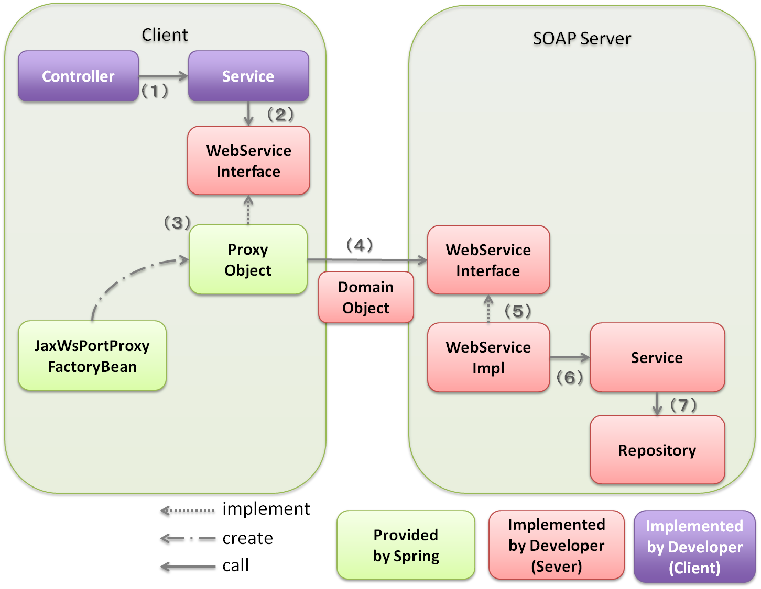
JAX-WS “Java API for XML-Based Web Services”

Slide 28
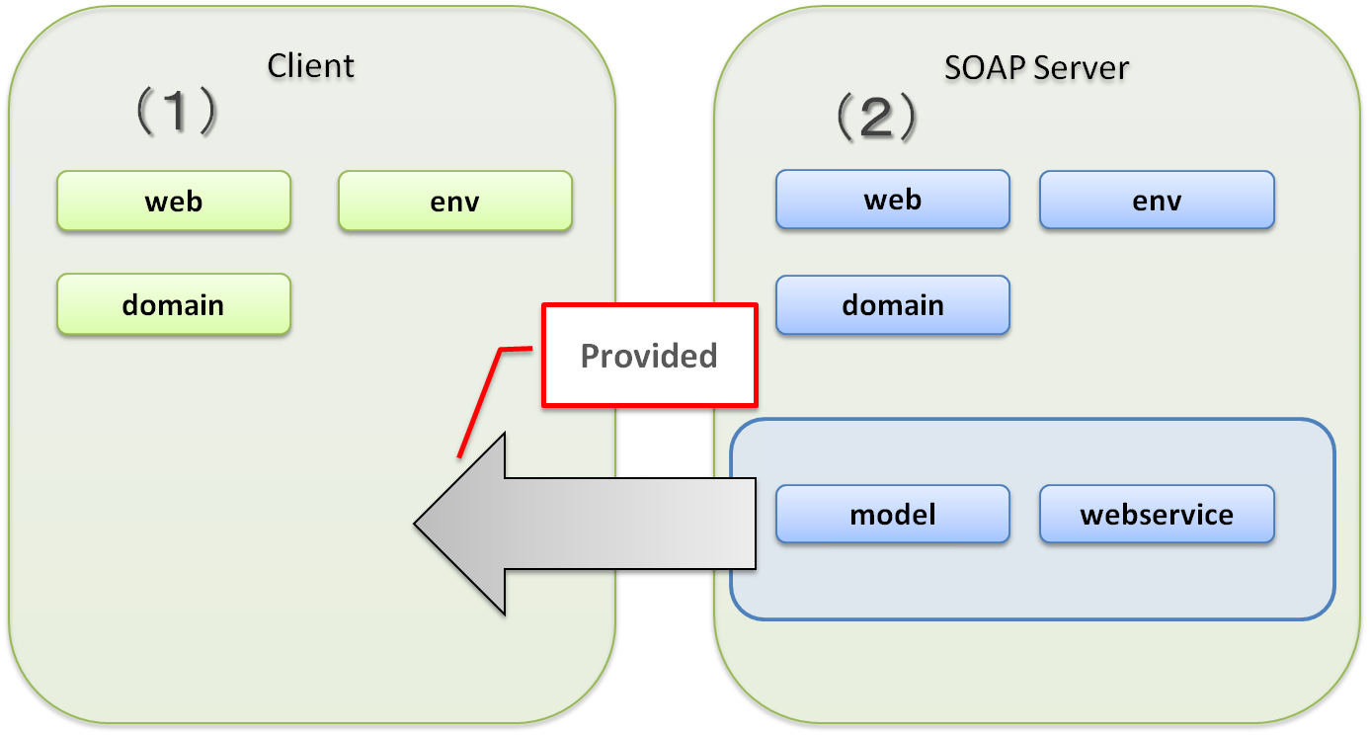
Configuration of Web service module which uses JAX-WS

Slide 29
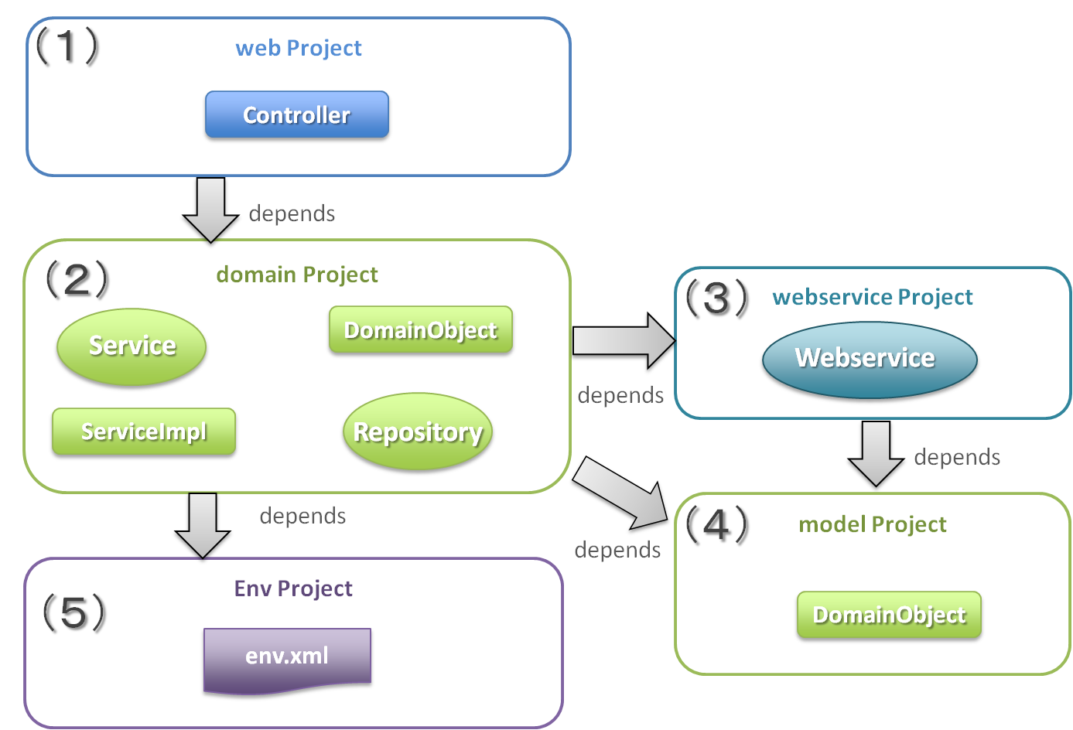
Creation of client

Slide 30
JAX-WS vs JAX-RS
JAX-WS | JAX-RS
JAX-WS uses SOAP as its main method of communication. | JAX-RS uses the Restful architectural structure to communicate between a client and a server.
JAX-WS follows the SOAP protocol and interacts in XML messages. In response to each message, another XML message is passed down from the server to the host. | On the other hand, JAX-RS, as it has no fixed structure to it, can communicate through XML, HTML, JSON, and HTTP. Normally it uses JSON as it is comparatively lighter and can pass quickly over the Internet. Each message does not create much of a difference but several million messages together make up for a significant time gain.
JAX-WS is used for mainly building up web-services on an enterprise-level where you have stringent data formats to abide by and a common mode of message exchange in XML. | JAX-RS is mostly used in smartphone apps and for purposes like Web Integration.

Slide 31
ALTERNATIVE RESOURCES

Slide 32
RESOURCES
https://spring.io/guides/tutorials/rest/
https://spring.io/guides/gs/rest-service/
https://spring.io/guides/gs/spring-boot/
https://spring.io/projects/spring-hateoas
https://docs.oracle.com/javaee/6/tutorial/doc/bnayk.html
https://www.udemy.com/share/101WNE/

Slide 33

THANKS!

