Slide 1

Module 2 Spring Framework

Slide 2
Agenda
Hibernate Validator
Spring Boot Logging
Spring Security
Spring MVC
Spring Data JPA
Spring Batch
Event-driven Microservices

Slide 3
Spring boot REST API requests using Hibernate validator

Slide 4
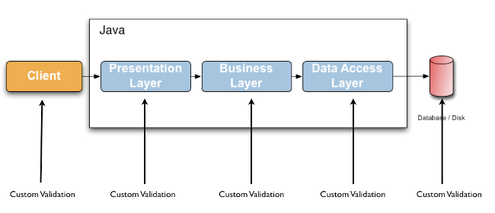
Hibernate validator
Hibernate Validator is the reference implementation of the validation API.

Slide 5
Important Java bean validations
@NotNull
@Size
@Min
@Max
@Email
@NotEmpty
@NotBlank

Slide 6
Spring Boot Logging

Slide 7
Spring Boot Logging
By default, Spring Boot redirects all logs sent from Apache Commons Logging (JCL), Log4J and Java Util Logging (JUL) APIs to SLF4J.
Logback is used as SLF4J implementation.
SLF4J is a simple facade API
Dependency:
<dependency>
<groupId>org.springframework.boot</groupId>
<artifactId>spring-boot-starter-logging</artifactId>
</dependency>

Slide 8
Dependencies included in spring-boot-starter-logging
<dependencies>
<dependency>
<groupId>ch.qos.logback</groupId>
<artifactId>logback-classic</artifactId>
</dependency>
<dependency>
<groupId>org.slf4j</groupId>
<artifactId>jcl-over-slf4j</artifactId>
</dependency>
<dependency>
<groupId>org.slf4j</groupId>
<artifactId>jul-to-slf4j</artifactId>
</dependency>
<dependency>
<groupId>org.slf4j</groupId>
<artifactId>log4j-over-slf4j</artifactId>
</dependency>
</dependencies>

Slide 9
Spring Security

Slide 10
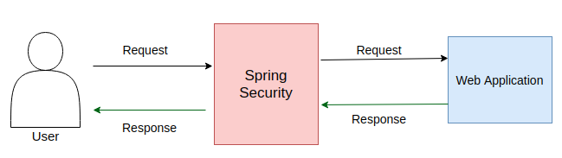
Introduction

Slide 11
Spring Security Modules
Core
Remoting
Aspect
Config
Crypto
Data
Messaging
OAuth2
OpenID
CAS
TagLib
Test
Web:

Slide 12
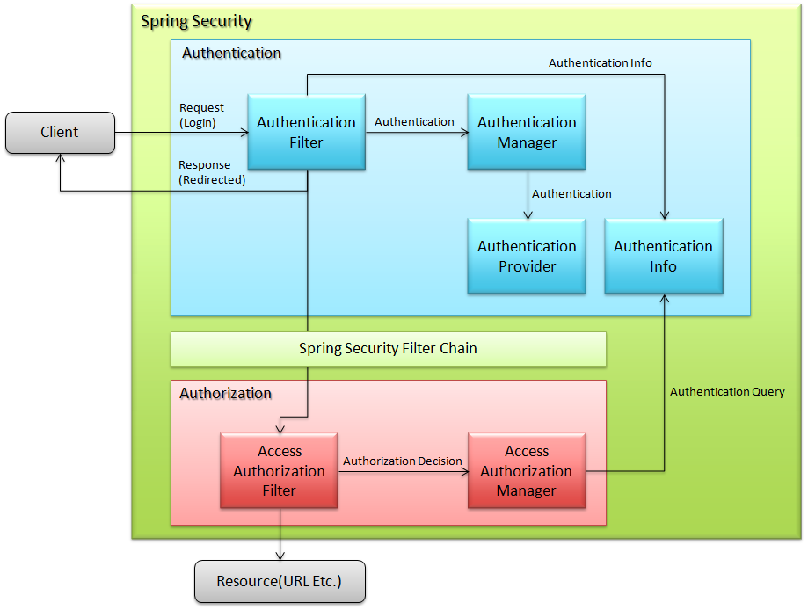
Spring Security overview

Slide 13
Spring Security Features
LDAP (Lightweight Directory Access Protocol)
Single sign-on
JAAS (Java Authentication and Authorization Service) LoginModule
Basic Access Authentication
Digest Access Authentication
Remember-me
Web Form Authentication
Authorization
Software Localization
HTTP Authorization
Features added in Spring Security 5.0
1. OAuth 2.0 Login
2. Reactive Support
3. Modernized Password Encoding

Slide 14
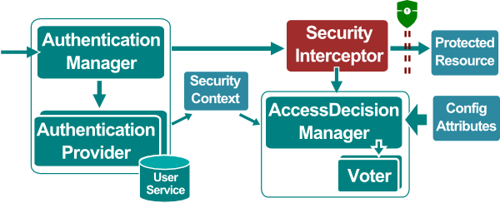
Spring Security Architecture

Slide 15
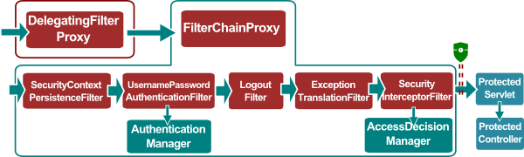
Spring Security Chain

Slide 16
Spring Security Configuration
Spring Security can be configured both with Java and XML.
Customization of Spring Security can be done by making the configuration class annotated with @EnableWebSecurity implement the interface WebSecurityConfigurer

Slide 17
Maven Dependencies For Spring Security
<!-- spring-security-core -->
<dependency>
<groupId>org.springframework.security</groupId>
<artifactId>spring-security-web</artifactId>
<version>5.4.2</version>
</dependency>
<!-- spring-security-config -->
<dependency>
<groupId>org.springframework.security</groupId>
<artifactId>spring-security-config</artifactId>
<version>5.4.2</version>
</dependency>

Slide 18
Spring Security annotations
Parameter | Description
@EnableWebSecurity | Enable Java-based configuration
@EnableGlobalMethodSecurity | Enable method-level security
@EnableGlobalAuthentication | Enable Java-based configuration of AuthenticationManager
@Secured | Define role-based access-control for method
@RolesAllowed | Define role-based access-control for method [JSR-250 annotation]
@PreAuthorize | Define role-based access-control for method with SPEL expression
@PostAuthorize | Define role-based access-control for method with SPEL [check done on return]

Slide 19
Spring MVC

Slide 20
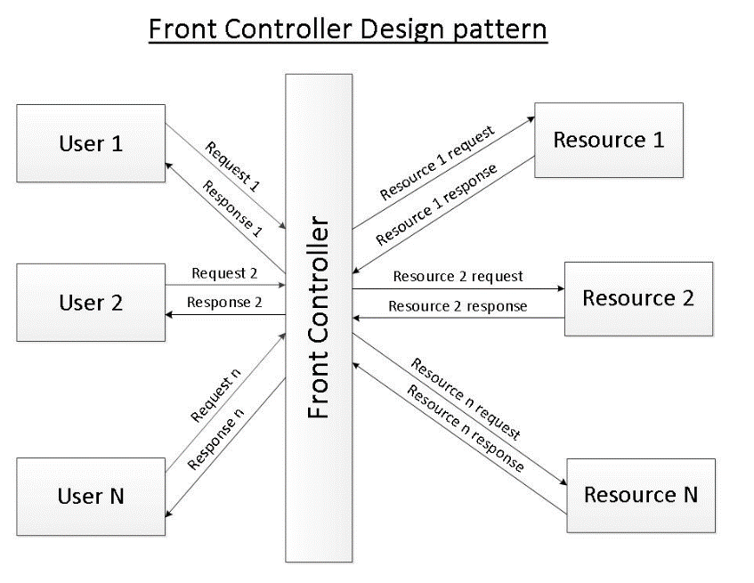
Front Controller design pattern

Slide 21
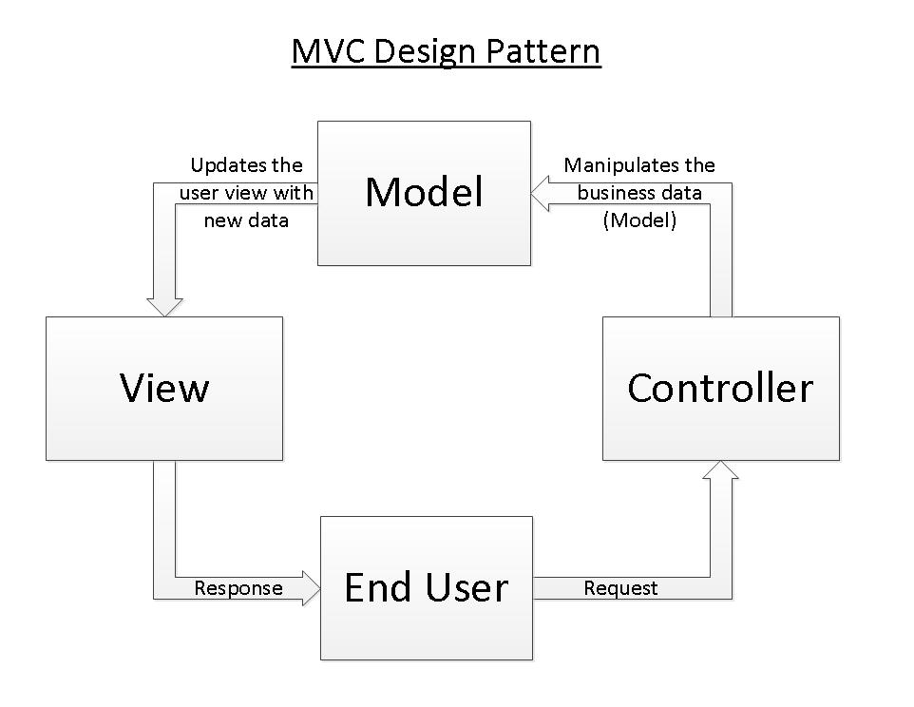
MVC design pattern

Slide 22
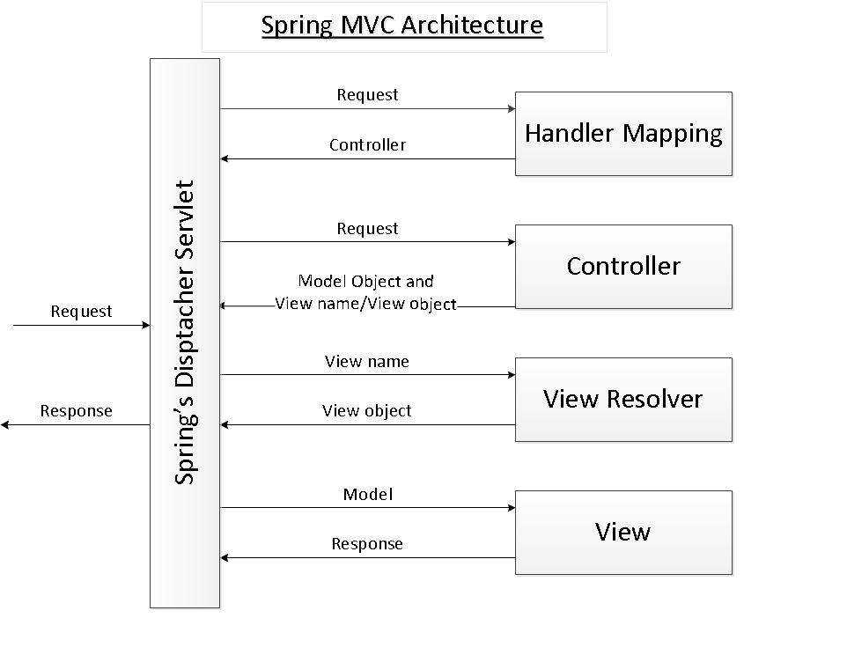
Spring’s MVC module

Slide 23
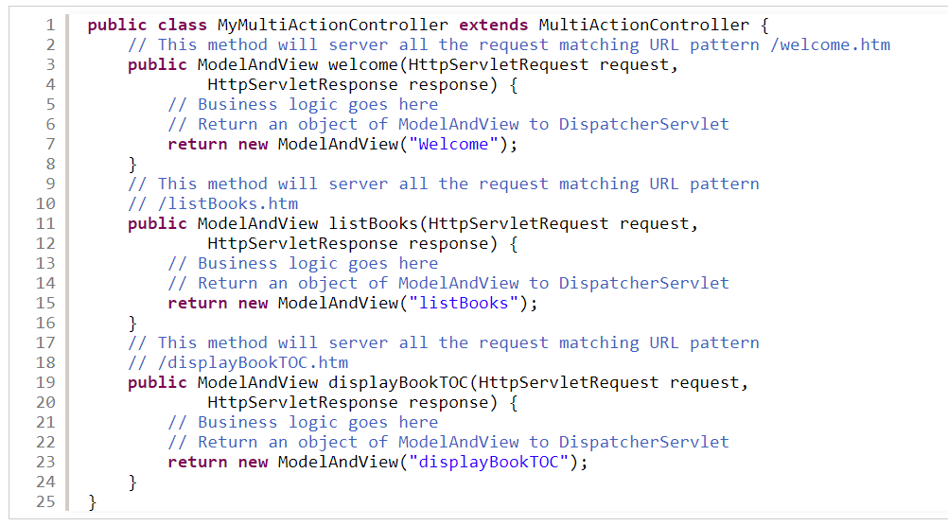
MultiActionController
Notes:
<!DOCTYPE html>
<html lang="en" xmlns="http://www.w3.org/1999/xhtml"
xmlns:th="http://www.thymeleaf.org">

Slide 24
Content Negotiation using Spring Boot
Two HTTP Headers related to Content Negotiation
Accept
Content-Type
$ curl -X GET "http://localhost:8080/item" -i
HTTP/1.1 200
Content-Type: application/json
Transfer-Encoding: chunked
Date: Wed, 16 Sep 2020 12:35:20 GMT
{
"id" : 1,
"name" : "Item 1",
"price" : 10.9
}

Slide 25
This content negotiation can be achieved
Using Path Extension
Using url parameter
Using Accept Headers
HttpHeaders headers = new HttpHeaders();
headers.setAccept(Arrays.asList(MediaType.APPLICATION_JSON));

Slide 26
Spring Data JPA

Slide 27
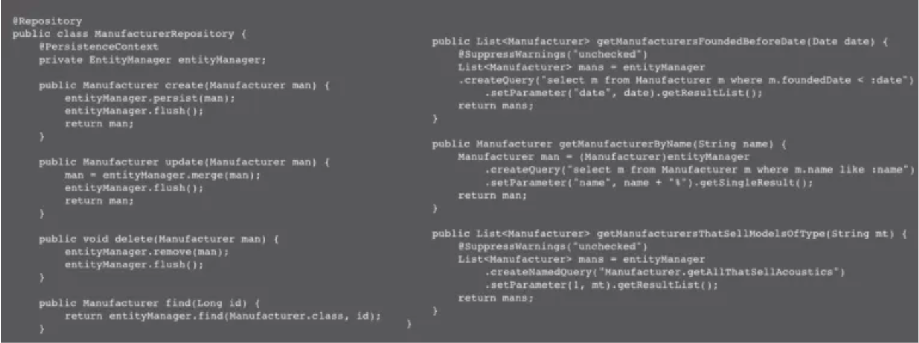
Spring Data JPA

Slide 28
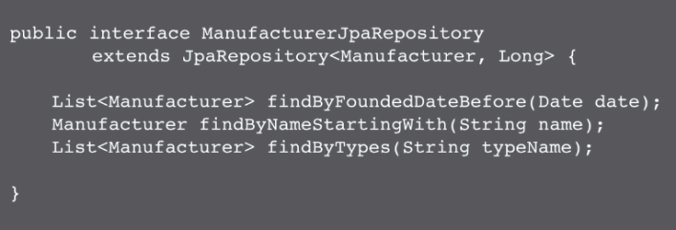

Slide 29
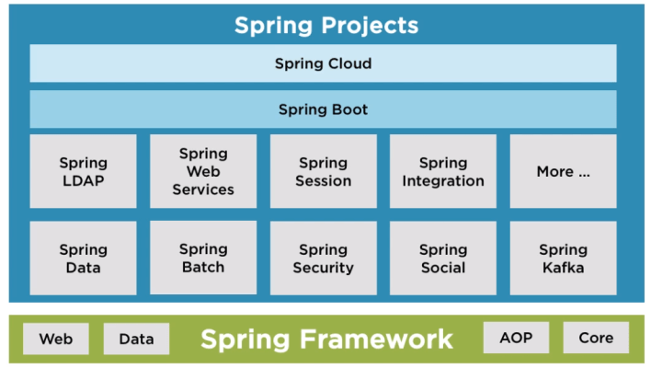

Slide 30
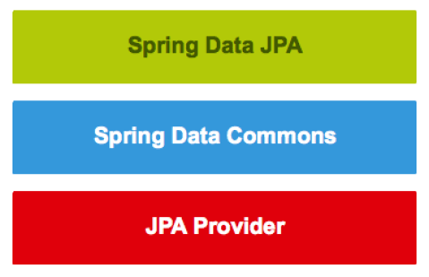

Slide 31
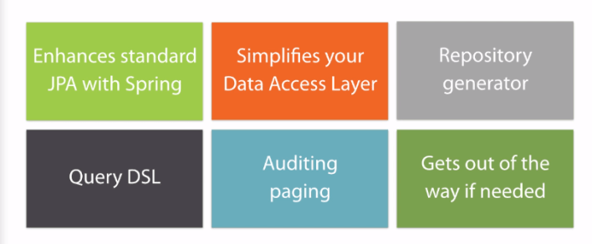
Spring Data JPA Features
Simplifies Data Access Layer
Intelligent Spring Repository Stereotyped Interfaces
Query DSL
Auditing, Paging, Handling Native SQL Queries
Gets Out of the Way, if Needed

Slide 32
Spring Batch

Slide 33
Spring Batch
Including logging and tracing
Transaction management
Job processing statistics
Job restart
Skip and Resource management

Slide 34
Features of Spring Batch
Flexibility
Maintainability
Scalability
Reliability
Support for multiple file formats
Multiple ways to launch a job

Slide 35
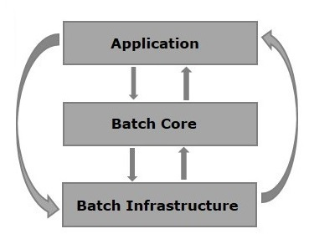
Spring batch Architecture

Slide 36
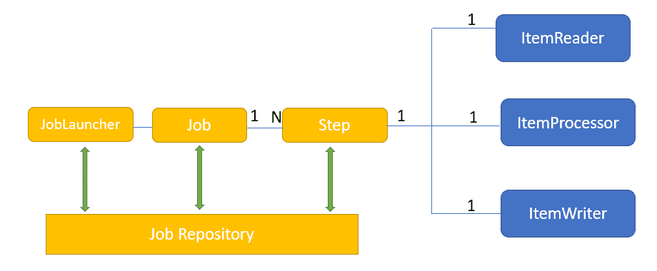
Components of Spring Batch

Slide 37
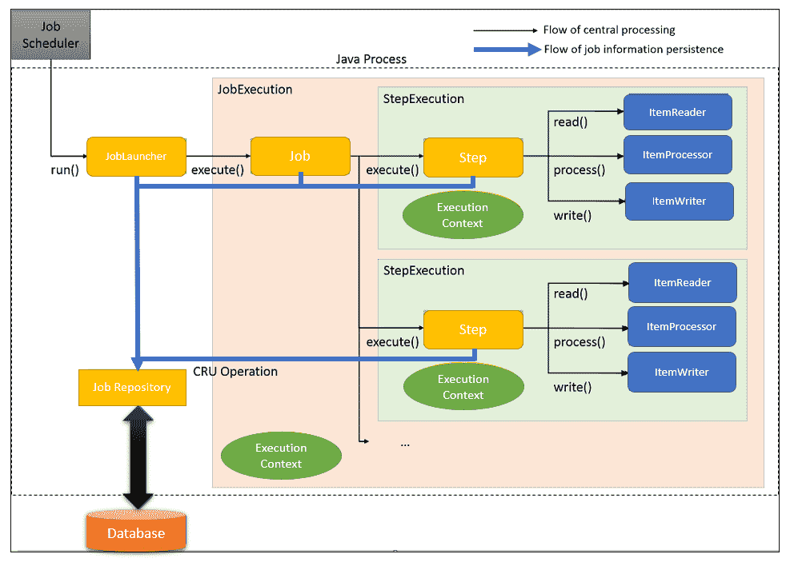

Slide 38
Event-driven Microservices

Slide 39
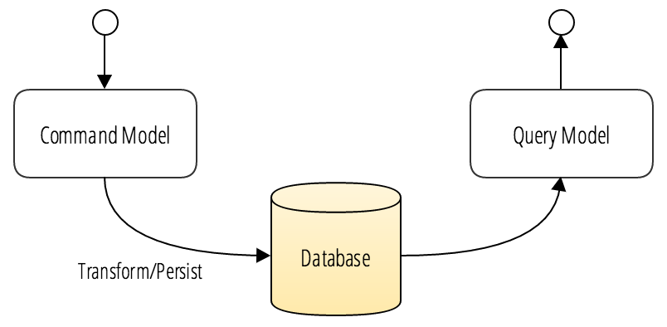
Command Query Responsibility Segregation (CQRS)

Slide 40
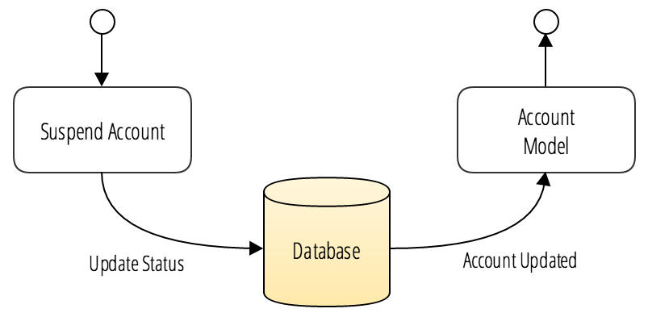
Example 1. Account aggregate
{
"createdAt": 1481351048967,
"lastModified": 1481351049385,
"userId": 1,
"accountNumber": "123456",
"defaultAccount": true,
"status": "ACCOUNT_ACTIVE"
}
Example 2. Account event
{
"createdAt": 1481353397395,
"lastModified": 1481353397395,
"type": "ACCOUNT_SUSPENDED",
"accountNumber": "123456"
}

Slide 41
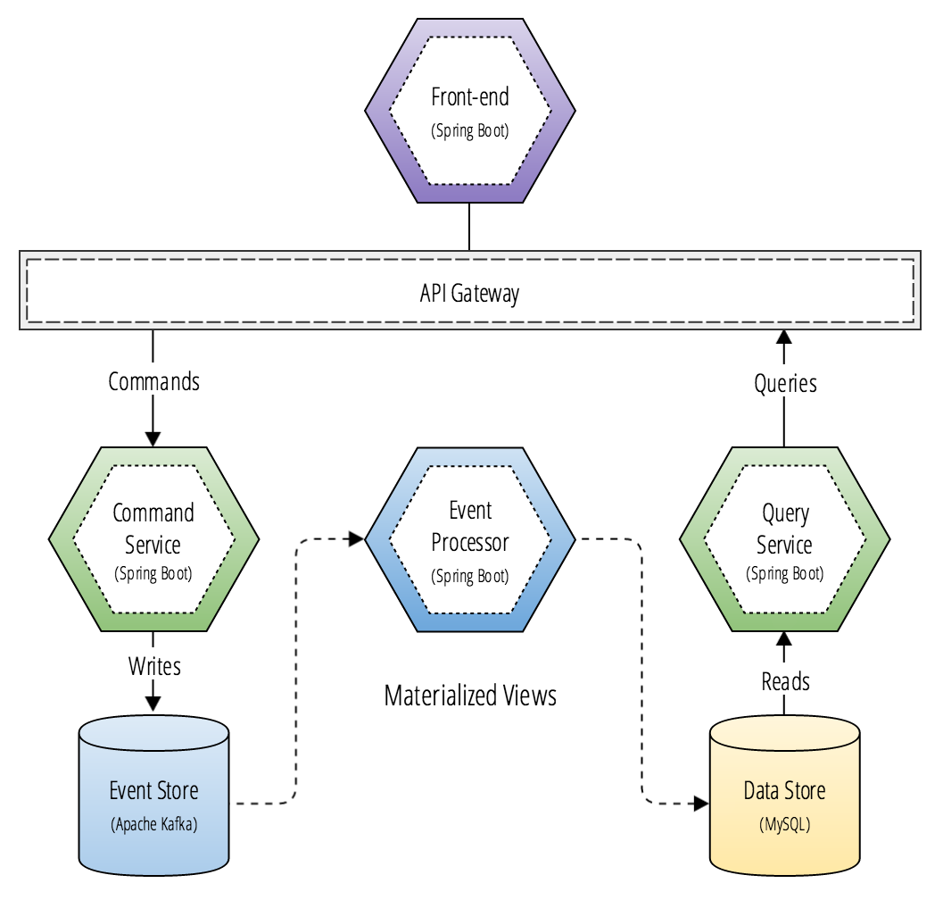
CQRS and Microservices

Slide 42
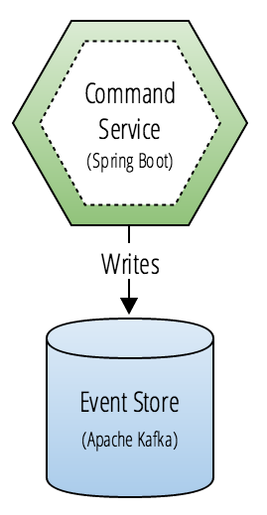
Command-side

Slide 43
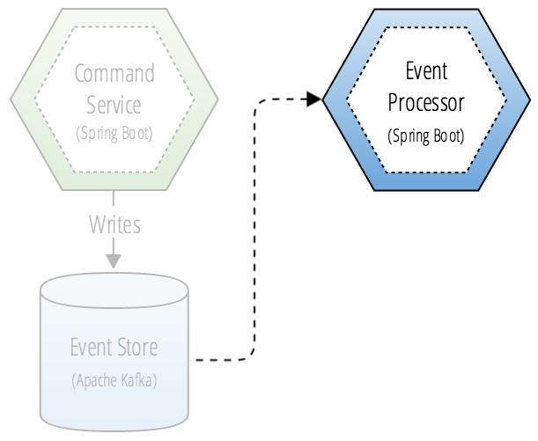
Event Processor

Slide 44
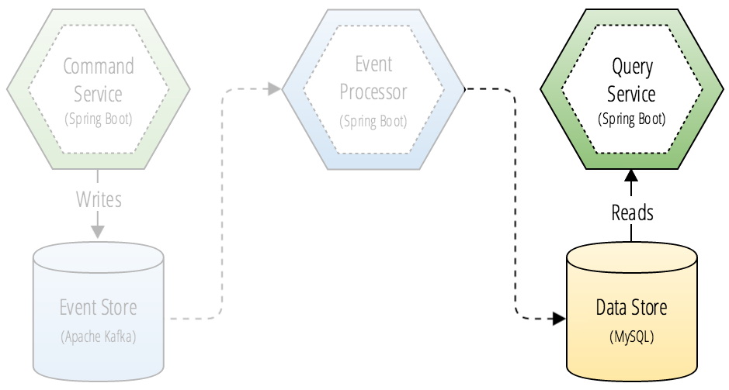
Query-side

Slide 45
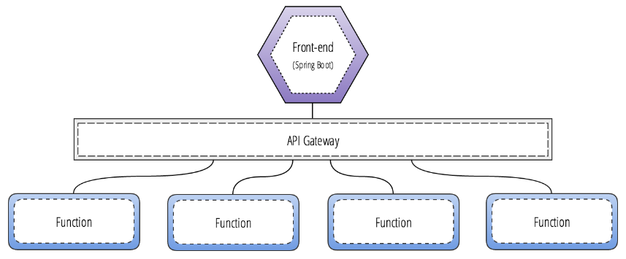
Microservices and Serverless

Slide 46
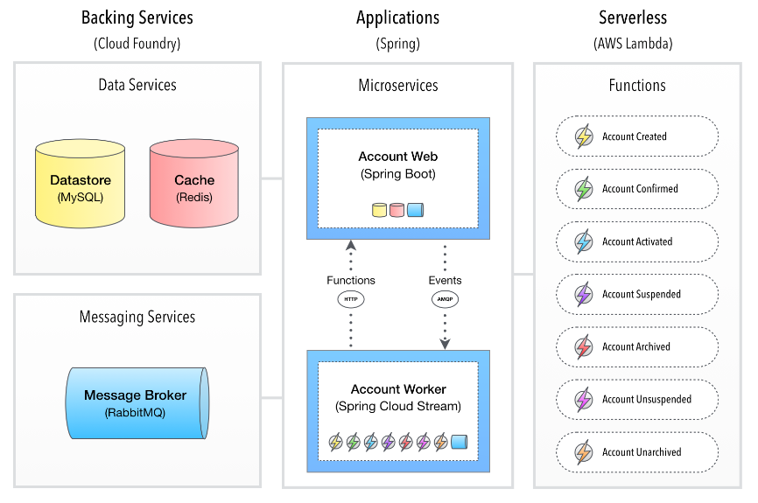
Cloud-native CQRS

Slide 47
ALTERNATIVE RESOURCES

Slide 48
RESOURCES
Hibernate Validator : https://hibernate.org/validator/documentation/getting-started/
Spring Boot Logging : https://docs.spring.io/spring-boot/docs/2.1.13.RELEASE/reference/html/boot-features-logging.html
Spring Security : https://spring.io/projects/spring-security
Spring MVC : https://docs.spring.io/spring-framework/docs/3.2.x/spring-framework-reference/html/mvc.html
Spring Data JPA : https://spring.io/projects/spring-data-jpa
Spring Batch : https://spring.io/projects/spring-batch
Event-driven Microservices : https://microservices.io/patterns/data/event-driven-architecture.html

Slide 49

THANKS!

