Slide 1

Module 2 Spring Framework
Day 2

Slide 2
Agenda
Dependencies and Dependency Injection (DI)

Slide 3
Dependency Injection(DI)

Slide 4
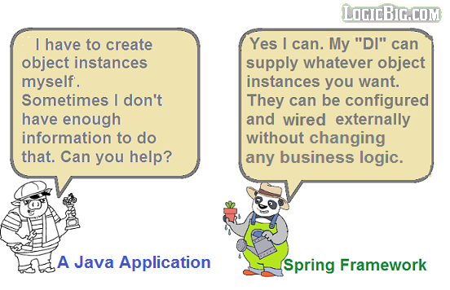

Slide 5
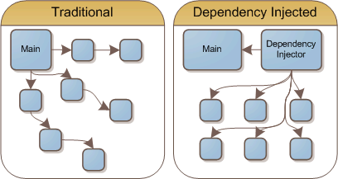

Slide 6
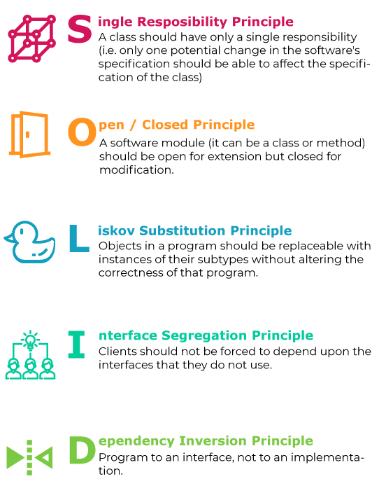
SOLID Design Principles
STUPID Code:
Singleton,
Tight Coupling,
Untestability,
Premature Optimization,
Indescriptive Naming,
Duplication

Slide 7
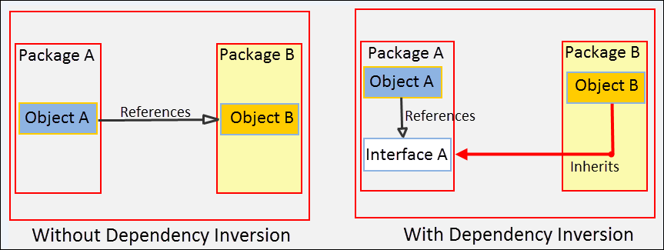
Dependency Inversion Principle

Slide 8
DIP BAD Example
public class ElectricPowerSwitch {
public LightBulb lightBulb;
public boolean on;
public ElectricPowerSwitch(LightBulb lightBulb) {
this.lightBulb = lightBulb;
this.on = false;
}
public boolean isOn() {
return this.on;
}
public void press(){
boolean checkOn = isOn();
if (checkOn) {
lightBulb.turnOff();
this.on = false;
} else {
lightBulb.turnOn();
this.on = true;
}
}
}
public class LightBulb {
public void turnOn() {
System.out.println("LightBulb: Bulb turned on...");
}
public void turnOff() {
System.out.println("LightBulb: Bulb turned off...");
}
}

Slide 9
DI XML Configuration
Spring XML Configuration, XML was the first available method and it is a better way to configure easily in Spring framework. Spring setup records contain bean definitions and other data. They are utilized to give context data to the Spring structure.
XML file by default consists a sequence of code and syntax as follows
<?xml version="1.0" encoding="UTF-8"?>
<beans xmlns="http://www.springframework.org/schema/beans"
xmlns:xsi="http://www.w3.org/2001/XMLSchema-instance" xmlns:context="http://www.springframework.org/schema/context"
xsi:schemaLocation="http://www.springframework.org/schema/beans http://www.springframework.org/schema/beans/spring-beans-4.0.xsd
http://www.springframework.org/schema/context http://www.springframework.org/schema/context/spring-context-4.0.xsd">
<bean id="activeMqMessaging" class="com.example.diXML.ActiveMQMessaging" />
<bean id="communication" class="com.example.diXML.Communication">
<property name="messaging">
<ref bean="activeMqMessaging" />
</property>
</bean>
</beans>

Slide 10
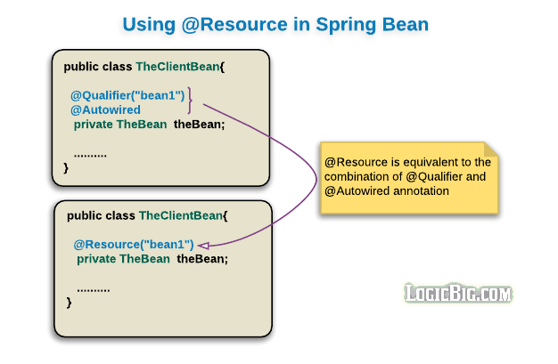
DI with @Resource

Slide 11
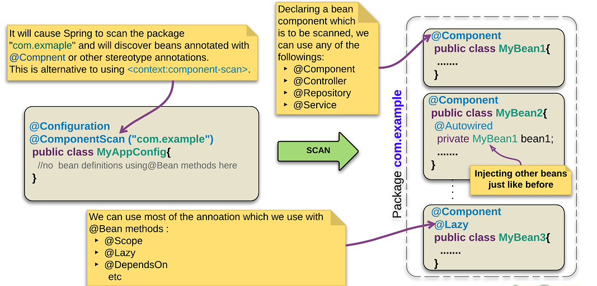
Stereotype component annotations

Slide 12
applicationContext.xml
<?xml version = "1.0" encoding = "UTF-8"?>
<beans xmlns="http://www.springframework.org/schema/beans"
xmlns:xsi="http://www.w3.org/2001/XMLSchema-instance"
xmlns:context="http://www.springframework.org/schema/context"
xsi:schemaLocation="http://www.springframework.org/schema/beans
http://www.springframework.org/schema/beans/spring-beans-3.0.xsd
http://www.springframework.org/schema/context
http://www.springframework.org/schema/context/spring-context-3.0.xsd">
<context:component-scan base-package="com.example.sterotypeAnnotation"/>
</beans>

Slide 13
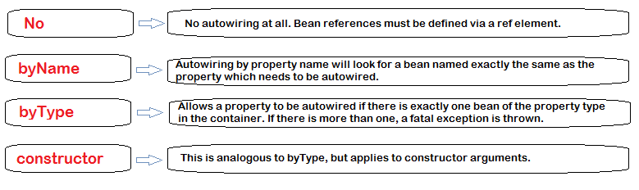
Bean Autowiring – @Autowired

Slide 14
@Autowired annotation on arbitrary methods
@Autowired
public void configure(GreetingService greetingService, LocalDateTime appStartTime) {
....
}

Slide 15
Resolving ambiguity by using @Resource

Slide 16
Spring Annotations
@Required annotation
@Autowired annotations
@Qualifier annotation
@JSR-250 based annotation
<?xml version="1.0" encoding="UTF-8"?>
<beans xmlns="http://www.springframework.org/schema/beans" xmlns:xsi="http://www.w3.org/2001/XMLSchema-instance" xmlns:context="http://www.springframework.org/schema/context" xsi:schemaLocation="http://www.springframework.org/schema/beans http://www.springframework.org/schema/beans/spring-beans-3.0.xsd http://www.springframework.org/schema/context http://www.springframework.org/schema/context/spring-context-3.0.xsd">
<context:annotation-config/>
<!-- bean definitions go here -->
</beans>

Slide 17
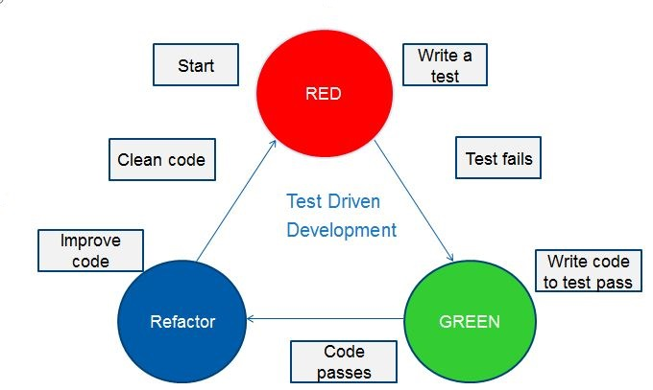
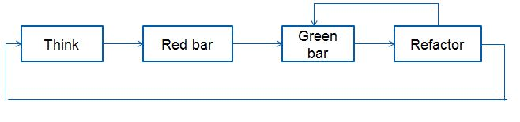
Test Driven Development - JUnit

Slide 18
ALTERNATIVE RESOURCES

Slide 19

THANKS!

