Slide 1

Module 2 Spring Framework
Day 4

Slide 2
Agenda
Transaction Management
Mockito

Slide 3
Transaction Management

Slide 4
Properties of Transaction
A
Atomicity
C
Consistency
I
Isolation
D
Durability

Slide 5
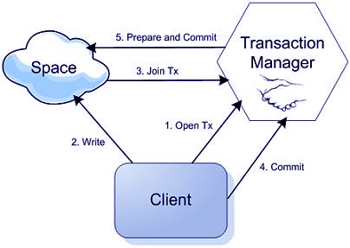
Spring Transaction Management

Slide 6
Types of Transaction Management
Programmatic Transaction Management in Spring
Declarative Transaction Management in Spring
Spring Transaction Abstractions
<?xml version="1.0" encoding="utf-8"?>
<beans xmlns="http://www.springframework.org/schema/beans"
xmlns:xsi="http://www.w3.org/2001/XMLSchema-instance"
xmlns:util="http://www.springframework.org/schema/util"
xmlns:tx="http://www.springframework.org/schema/tx"
xsi:schemaLocation="http://www.springframework.org/schema/beans
http://www.springframework.org/schema/beans/spring-beans.xsd
http://www.springframework.org/schema/tx
https://www.springframework.org/tx/spring-tx.xsd ">
</beans>

Slide 7
Transaction Definition
public interface TransactionDefinition {
int getPropagationBehavior();
int getIsolationLevel();
String getName();
int getTimeout();
boolean isReadOnly();
}

Slide 8
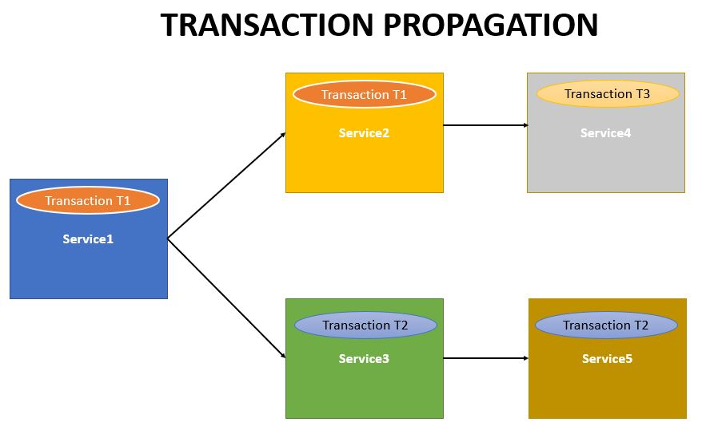

Slide 9
TX Propagation types
TransactionDefinition.PROPAGATION_MANDATORY
TransactionDefinition.PROPAGATION_NESTED
TransactionDefinition.PROPAGATION_NEVER
TransactionDefinition.PROPAGATION_NOT_SUPPORTED
TransactionDefinition.PROPAGATION_REQUIRED
TransactionDefinition.PROPAGATION_REQUIRES_NEW
TransactionDefinition.PROPAGATION_SUPPORTS

Slide 10
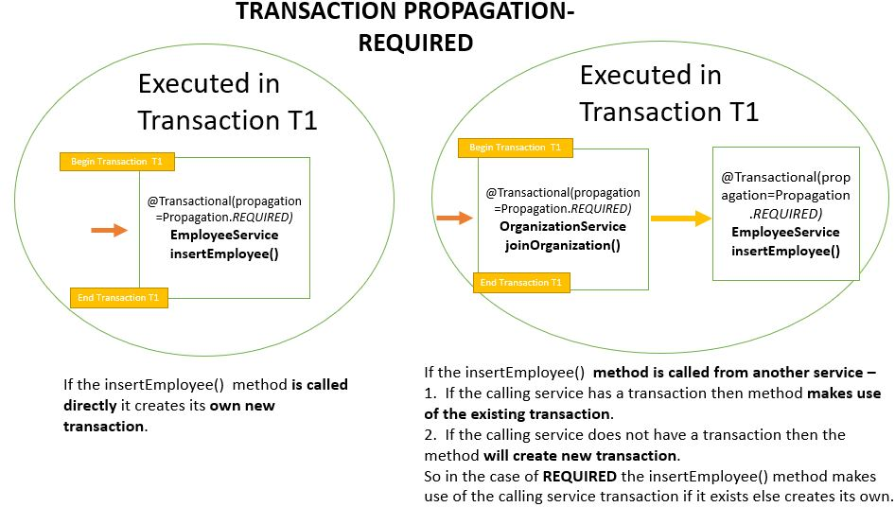

Slide 11
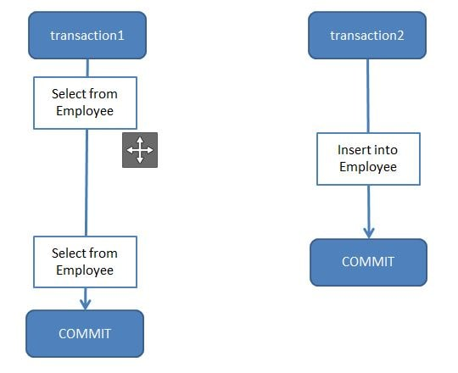
Isolation levels
TransactionDefinition.ISOLATION_DEFAULT
TransactionDefinition.ISOLATION_READ_COMMITTED
TransactionDefinition.ISOLATION_READ_UNCOMMITTED
TransactionDefinition.ISOLATION_REPEATABLE_READ
TransactionDefinition.ISOLATION_SERIALIZE
@Autowired
private TestDAO testDAO;
@Transactional(isolation=Isolation.READ_COMMITTED)
public void someTransactionalMethod(User user) {
// Interact with testDAO
}

Slide 12
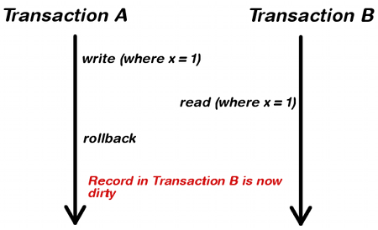
READ_UNCOMMITTED

Slide 13
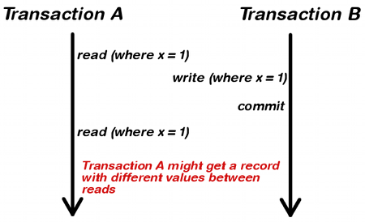
READ_COMMITTED

Slide 14
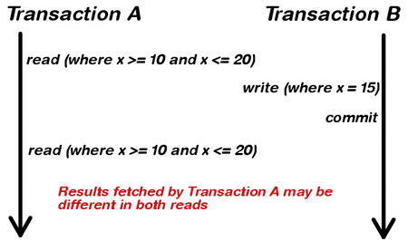
REPEATABLE_READ

Slide 15
Demo Example
<?xml version="1.0" encoding="UTF-8"?>
<beans xmlns="http://www.springframework.org/schema/beans"
xmlns:xsi="http://www.w3.org/2001/XMLSchema-instance"
xmlns:context="http://www.springframework.org/schema/context"
xmlns:tx="http://www.springframework.org/schema/tx"
xsi:schemaLocation="http://www.springframework.org/schema/beans
http://www.springframework.org/schema/beans/spring-beans.xsd
http://www.springframework.org/schema/context
http://www.springframework.org/schema/context/spring-context.xsd
http://www.springframework.org/schema/tx
http://www.springframework.org/schema/tx/spring-tx.xsd">
<bean id="dataSource" class="org.apache.commons.dbcp2.BasicDataSource">
<property name="driverClassName" value = "${db.driverClassName}" />
<property name="url" value = "${db.url}" />
<property name="username" value = "${db.username}" />
<property name="password" value = "${db.password}" />
<property name="initialSize" value = "${pool.initialSize}" />
</bean>
</beans>

Slide 16
Spring Transaction Abstractions
public interface PlatformTransactionManager {
TransactionStatus getTransaction(TransactionDefinition definition);
throws TransactionException;
void commit(TransactionStatus status) throws TransactionException;
void rollback(TransactionStatus status) throws TransactionException;
}

Slide 17
Mockito

Slide 18
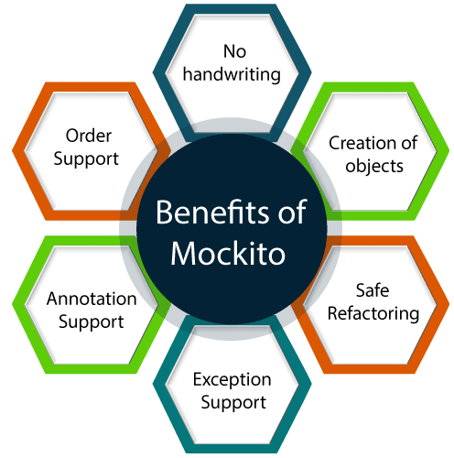

Mockito
Mockito facilitates creating mock objects seamlessly.
It uses Java Reflection in order to create mock objects for a given interface.
Mock objects are nothing but proxy for actual implementations.

Slide 19
Maven Dependency
<!-- Mockito Configuration-->
<dependency>
<groupId>org.mockito</groupId>
<artifactId>mockito-all</artifactId>
<version>1.10.19</version>
<scope>test</scope>
</dependency>
<dependency>
<groupId>org.mockito</groupId>
<artifactId>mockito-junit-jupiter</artifactId>
<version>2.23.0</version>
<scope>test</scope>
</dependency>
<dependency>
<groupId>org.hamcrest<groupId>
<artifactId>hamcrest-core</artifactId>
<version>1.2.1</version>
<scope>test</scope>
</dependency>
<!-- End Mockito Configuration -->

Slide 20
Ways to Create Mock Object
Mock Object by Annotation
Annotation | Description
@Mock | Create Mock of given Type
@Spy | Create Spy of given object
@Captor | Create argument of given object
@InjectMock | Create object of given type and inject mock and spies in existing test.

Slide 21
Varying Calls
Mockito provides the following additional methods to vary the expected call counts.
atLeast (int min) − expects min calls.
atLeastOnce () − expects at least one call.
atMost (int max) − expects max calls.

Slide 22
Behavior Driven Development
//Given
given(calcService.add(20.0,10.0)).willReturn(30.0);
//when
double result = calcService.add(20.0,10.0);
//then
Assert.assertEquals(result,30.0,0);

Slide 23
ALTERNATIVE RESOURCES

Slide 24
RESOURCES
Spring Transaction Management
https://docs.spring.io/spring-framework/docs/4.2.x/spring-framework-reference/html/transaction.html#:~:text=The%20Spring%20Framework%20provides%20a,Java%20Data%20Objects%20(JDO).
Mockito:
https://www.softwaretestinghelp.com/mockito-tutorial/

Slide 25
THANKS!

