Slide 1

Module 2 Spring Framework
Day 1

Slide 2
Agenda
Spring Introduction
IOC
Dependency Injection
Beans

Slide 3
Spring Introduction

Slide 4
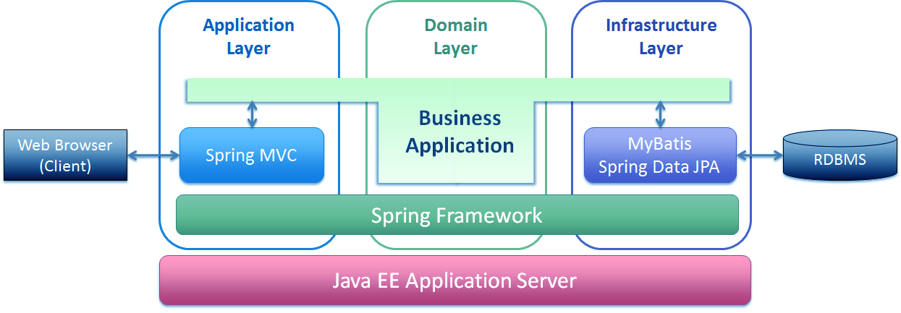

Slide 5
Advantages of Spring Framework
Modularity
Lightweight
Transaction Management
Ease of Testability
JDBC Abstraction Framework
MVC Framework
Loose Coupling

Slide 6
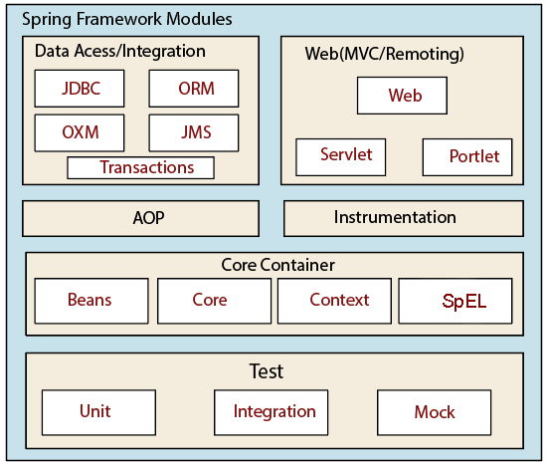
Spring Architecture

Slide 7
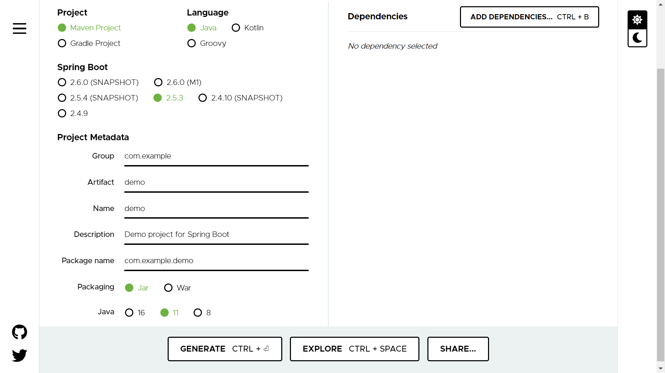
Spring Initializer https://start.spring.io/

Slide 8
Spring Framework Features
Lightweight
Aspect Oriented Programming(AOP)
Transaction Management
Container
Dependency Injection
Integration with other frameworks

Slide 9
Inversion of Control

Slide 10
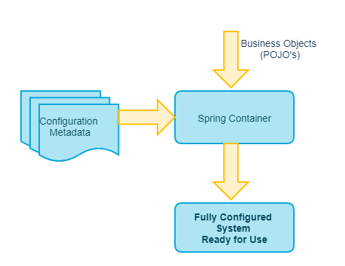
IOC

Slide 11
Types of IoC Containers
Spring BeanFactory Container
Spring ApplicationContext Container
FileSystemXmlApplicationContext
ClassPathXmlApplicationContext
WebXmlApplicationContext

Slide 12
Dependency Injection

Slide 13
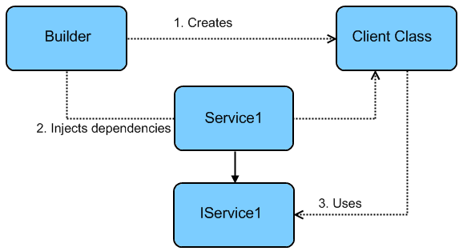

Slide 14
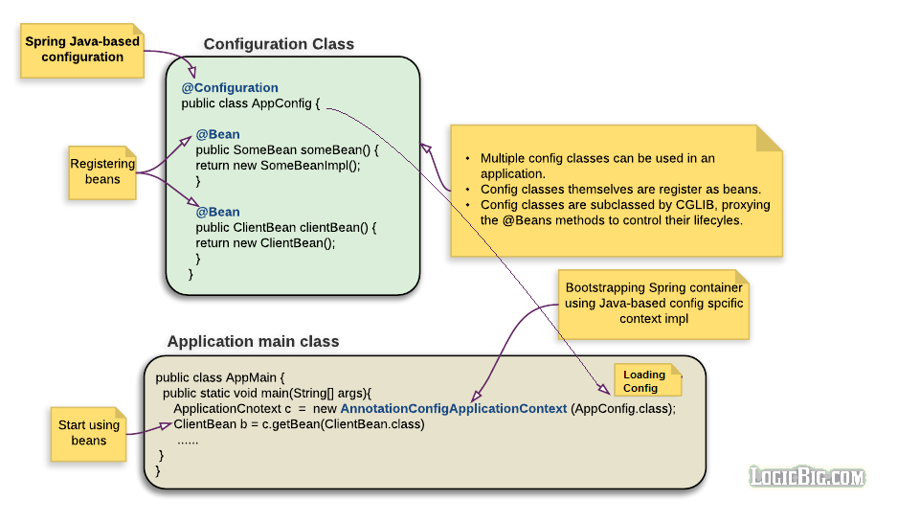
Java-based configuration: Using @Configuration

Slide 15
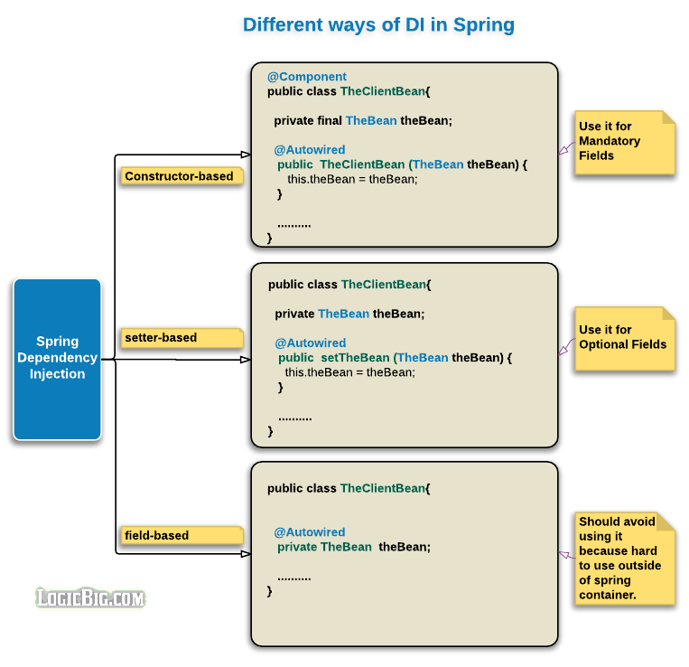
Dependency Injection

Slide 16
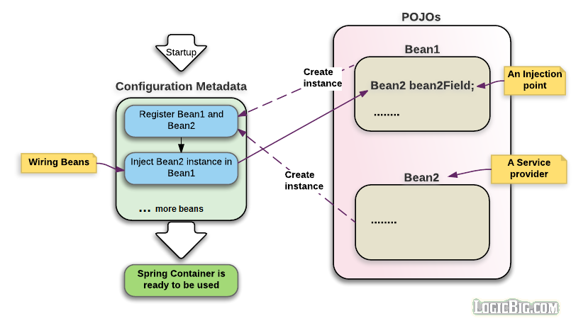
Spring - Configuration Metadata
XML-based Configuration
Annotation-based configuration
Java-based configuration (JavaConfig)

Slide 17
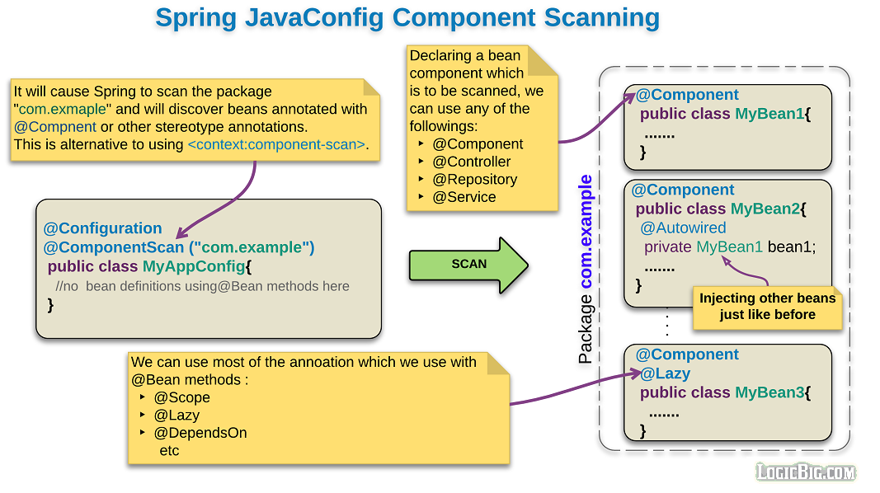

Slide 18
Beans

Slide 19
Beans
A bean is an object that is instantiated, assembled, and otherwise managed by a Spring IoC container.
Bean Properties
Class
Name
Scope
Constructor-args
Properties
Autowiring-mode
lazy-initialization mode
initialization method
destruction method

Slide 20
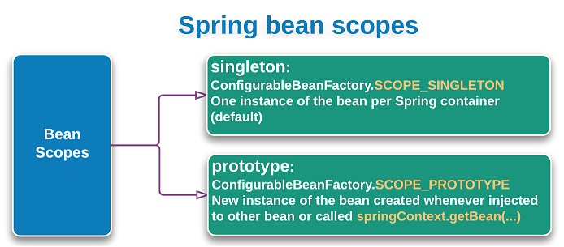
Bean Scopes

Slide 21
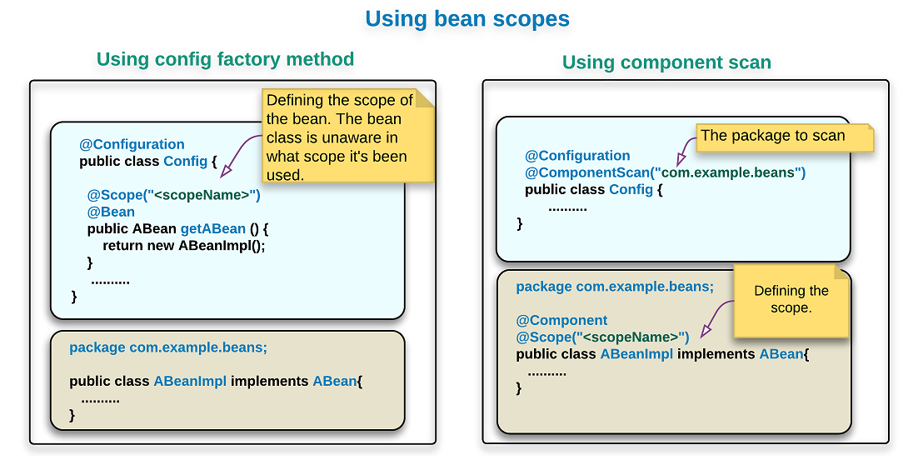
The @Scope annotation

Slide 22
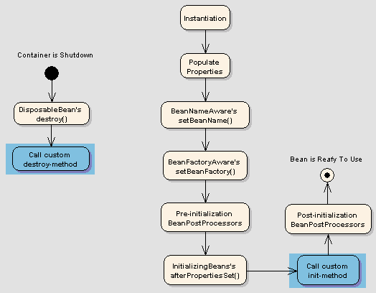
Bean Life Cycle

Slide 23
@PostConstruct and @PreDestroy annotations
The different ways to receive callbacks after bean has initialized and before bean is destroyed:
Using @PostConstruct and @PreDestroy
Using 'initMethod' and 'destroyMethod' of @Bean annotation.
By implementing InitializingBean and DisposableBean

Slide 24
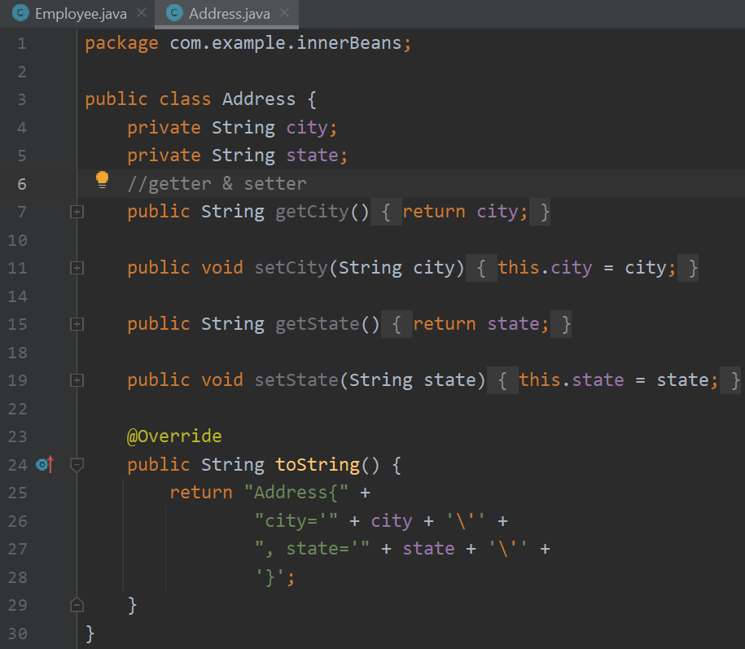
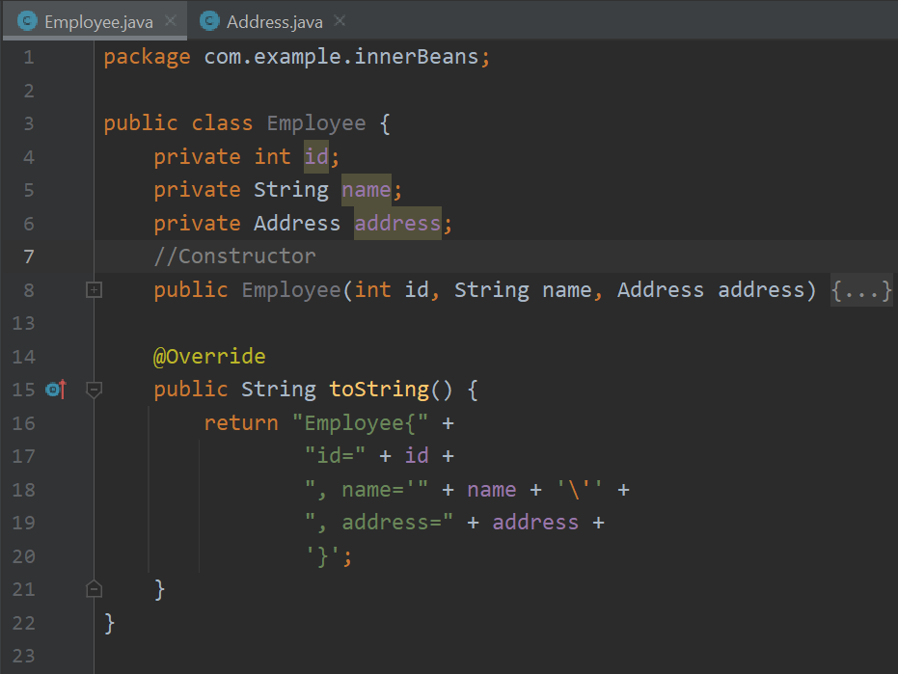
Inner Beans

Slide 25
XML vs Annotation Based Configuration
<?xml version="1.0" encoding="UTF-8"?>
<beans xmlns="http://www.springframework.org/schema/beans" ...>
<bean id="accountService" class="com.example.AccountServiceImpl">
<property name="accountDao" ref="accountDao"/>
</bean>
<bean id="accountDao" class="com.example.AccountDaoInMemoryImpl">
</bean>
</beans>
@Configuration
public class BeanConfiguration {
@Bean
public AccountService accountService() {
AccountServiceImpl bean = new AccountServiceImpl();
bean.setAccountDao(accountDao());
return bean; }
@Bean
public AccountDao accountDao() {
AccountDaoInMemoryImpl bean = new AccountDaoInMemoryImpl();
return bean; }
}

Slide 26
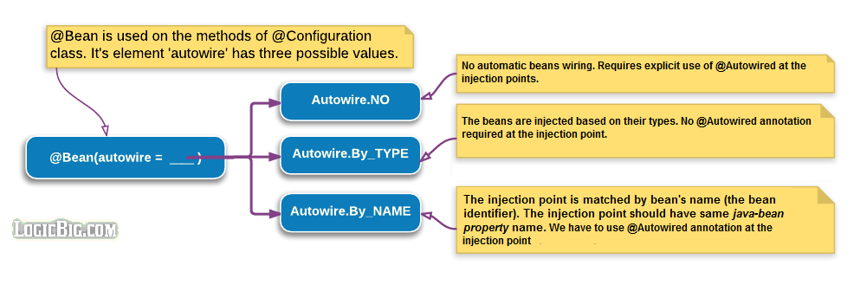
Beans Auto-Wiring
@Configuration
public class Config{
@Bean(autowire == <autowireMode>)
public ABean aBean(){
return new ABean();
}
.....
}

Slide 27
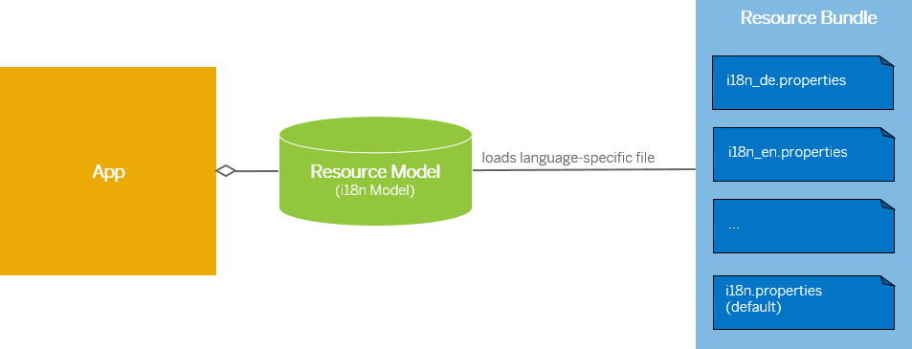
Resource Bundle

Slide 28
Internationalization Demo
package com.example.resourceBundleDemo;
import java.util.Locale;
import java.util.ResourceBundle;
public class InternationalizationTest {
public static void main(String[] args) {
ResourceBundle resourceBundle = ResourceBundle.getBundle("TestBundle");
displayValues(resourceBundle);
Locale defaultLocale = Locale.getDefault();
ResourceBundle bundle2 = ResourceBundle.getBundle("TestBundle", defaultLocale);
displayValues(bundle2);
Locale swedishLocale = new Locale("sv", "SE");
ResourceBundle bundle3 = ResourceBundle.getBundle("TestBundle", swedishLocale);
displayValues(bundle3);
Locale nonexistentLocale = new Locale("xx", "XX");
ResourceBundle bundle4 = ResourceBundle.getBundle("TestBundle", nonexistentLocale);
displayValues(bundle4); }
private static void displayValues(ResourceBundle resourceBundle) {
System.out.println("hello message:" + resourceBundle.getString("my.hello"));
System.out.println("goodbye message:" + resourceBundle.getString("my.goodbye"));
System.out.println("question message:" + resourceBundle.getString("my.question"));
System.out.println();
} }

Slide 29
Demo output
D:\Java Training\Demo\demo\demo\src\main\resources
TestBundle.properties
my.hello=Hello (default)
my.goodbye=Bye (default)
my.question=Do you speak English? (default)
hello message:Hello (default)
goodbye message:Bye (default)
question message:Do you speak English? (default)
hello message:Hello (default)
goodbye message:Bye (default)
question message:Do you speak English? (default)
hello message:Hejsan
goodbye message:Hejd?
question message:Pratar du engelska?
hello message:Hello (default)
goodbye message:Bye (default)
question message:Do you speak English? (default)
TestBundle_en_US.properties
my.hello=Hello
my.goodbye=Bye
my.question=Do you speak English?
TestBundle_sv_SE.properties
my.hello=Hejsan
my.goodbye=Hejd?
my.question=Pratar du engelska?

Slide 30
Event Handler
Spring Event Handling, The major part of Spring is the ApplicationContext, Application context gives a method for determining instant messages and give a non specific approach to load file assets and it can distribute events to beans that are registered as listeners.
The events of Spring
ContextRefreshedEvent
ContextStartedEvent
ContextStoppedEvent
ContextClosedEvent
RequestHandledEvent

Slide 31
Event Handler Demo
File 1:
package com.eventHandler;
public class HelloWorld {
private String message;
public void setMessage(String message){
this.message = message;
}
public void getMessage(){
System.out.println("Your Message : " + message);
}
}
File 2:
package com.eventHandler;
import org.springframework.context.ApplicationListener;
import org.springframework.context.event.ContextStartedEvent;
public class CStartEventHandler
implements ApplicationListener<ContextStartedEvent>{
public void onApplicationEvent(ContextStartedEvent event) {
System.out.println("ContextStartedEvent Received");
} }

Slide 32
Event Handler Demo
File 3:
package com.eventHandler;
import org.springframework.context.ApplicationListener;
import org.springframework.context.event.ContextStoppedEvent;
public class CStopEventHandler
implements ApplicationListener<ContextStoppedEvent>
public void onApplicationEvent(ContextStoppedEvent event) {
System.out.println("ContextStoppedEvent Received");
}
}

Slide 33
Event Handler Demo
File 4:
package com.eventHandler;
import org.springframework.context.ConfigurableApplicationContext;
import org.springframework.context.support.ClassPathXmlApplicationContext;
public class MainApp {
public static void main(String[] args) {
ConfigurableApplicationContext context =
new ClassPathXmlApplicationContext("Beans.xml");
// Let us raise a start event.
context.start();
HelloWorld obj = (HelloWorld) context.getBean("helloWorld");
obj.getMessage();
// Let us raise a stop event.
context.stop();
}
}

Slide 34
Event Handler Demo
File 5: bean.xml
<?xml version="1.0" encoding="UTF-8"?>
<beans xmlns="http://www.springframework.org/schema/beans" xmlns:xsi="http://www.w3.org/2001/XMLSchema-instance" xsi:schemaLocation="http://www.springframework.org/schema/beans http://www.springframework.org/schema/beans/spring-beans-3.0.xsd">
<bean id="helloWorld" class="splessons.HelloWorld">
<property name="message" value="Hello World!"/>
</bean>
<bean id="cStartEventHandler" class=" com.eventHandler.CStartEventHandler"/>
<bean id="cStopEventHandler" class=" com.eventHandler.CStopEventHandler"/>
</beans>

Slide 35
ALTERNATIVE RESOURCES

Slide 36
RESOURCES
Message Sources:
https://docs.spring.io/spring-framework/docs/current/javadoc-api/org/springframework/context/MessageSource.html
Spring
https://spring.io/guides/gs/spring-boot/
Spring Initializer
https://start.spring.io/

Slide 37

THANKS!

