Slide 1

Module 2 Spring Framework
Day 7 & 8

Slide 2
Agenda
Spring Boot
WebFlux
Spring 5 Features

Slide 3
Spring Boot

Slide 4
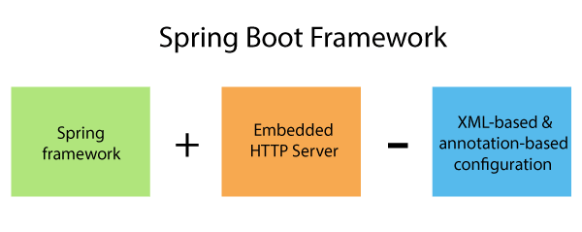
What is Spring Boot?

Slide 5
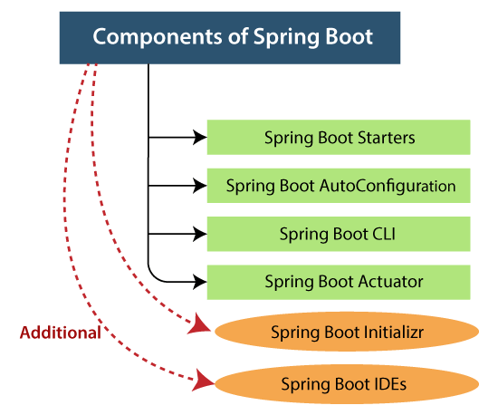
Key Components of Spring Boot Framework

Slide 6
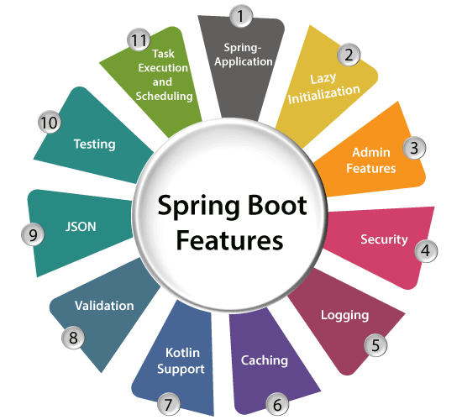
Spring Boot Features

Slide 7
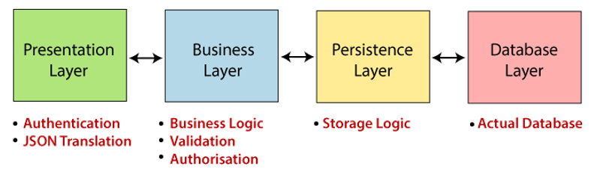
Spring Boot Architecture

Slide 8
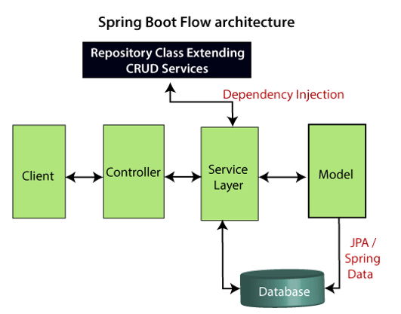
Spring Boot Work Flow

Slide 9
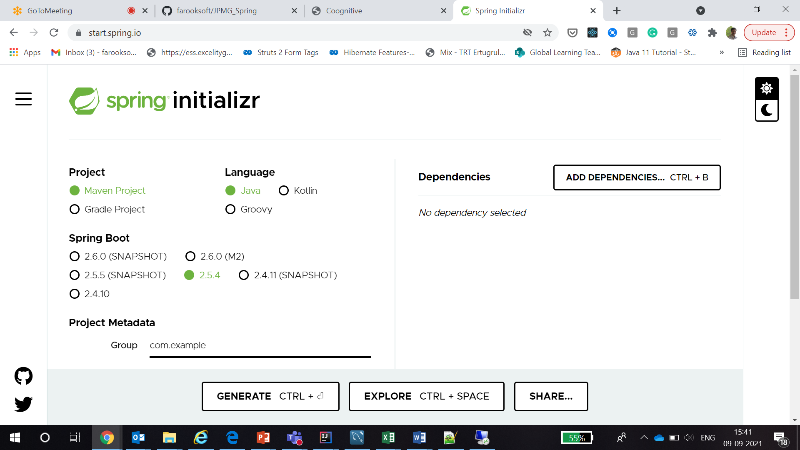
Spring Initializr

Slide 10
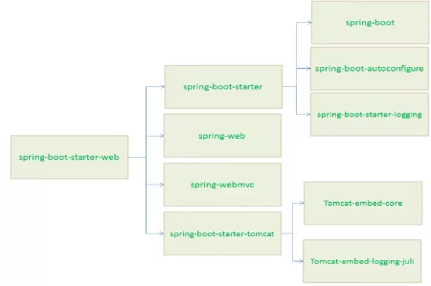
Spring Boot Starter

Slide 11
Spring Boot AutoConfigurator
@SpringBootApplication
@Configuration
@ComponentScan
@EnableAutoConfiguration
@Target(value=TYPE)
@Retention(value=RUNTIME)
@Documented
@Inherited
@Configuration
@EnableAutoConfiguration
@ComponentScan
public @interface SpringBootApplication

Slide 12
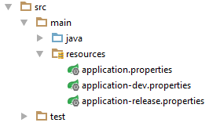
Spring Profile
Every enterprise application has many environments, like:
Dev | Test | Stage | Prod | UAT / Pre-Prod
Each environment requires a setting that is specific to them. For example, in DEV, we do not need to constantly check database consistency. Whereas in TEST and STAGE, we need to. These environments host specific configurations called Profiles.

Slide 13
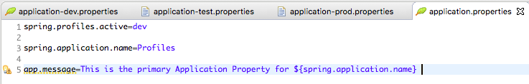
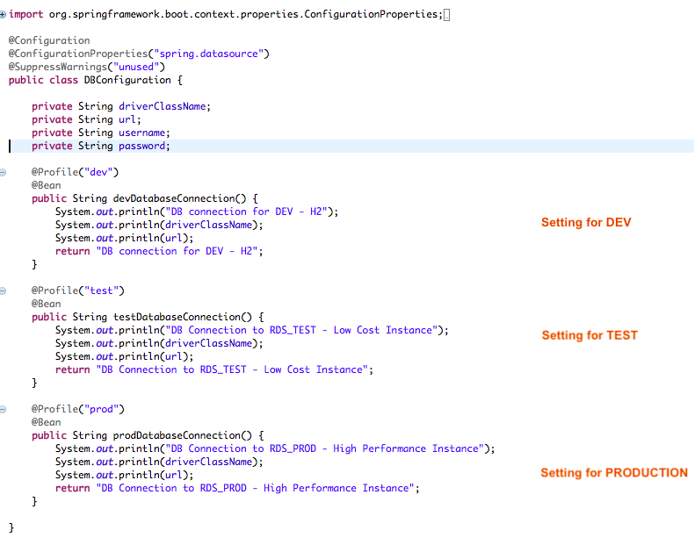
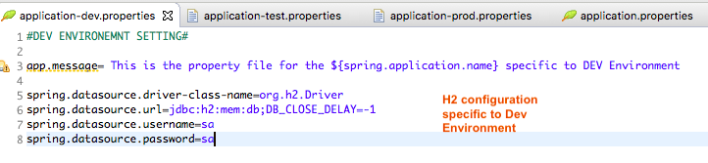
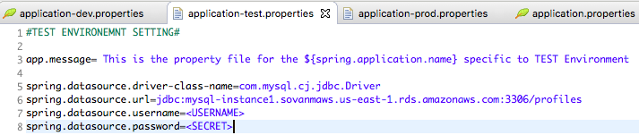
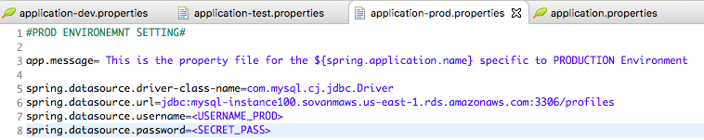

Slide 14
Spring Boot JPA Rest CRUD API
Methods | URLS | Actions
POST | /api/tutorials | create new Tutorial
GET | /api/tutorials | retrieve all Tutorials
GET | /api/tutorials/:id | retrieve a Tutorial by :id
PUT | /api/tutorials/:id | update a Tutorial by :id
DELETE | /api/tutorials/:id | delete a Tutorial by :id
DELETE | /api/tutorials | delete all Tutorials
GET | /api/tutorials/published | find all published Tutorials
GET | /api/tutorials?title=[keyword] | find all Tutorials which title contains keyword

Slide 15
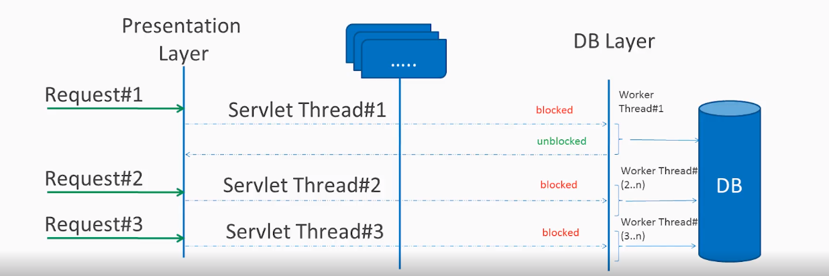
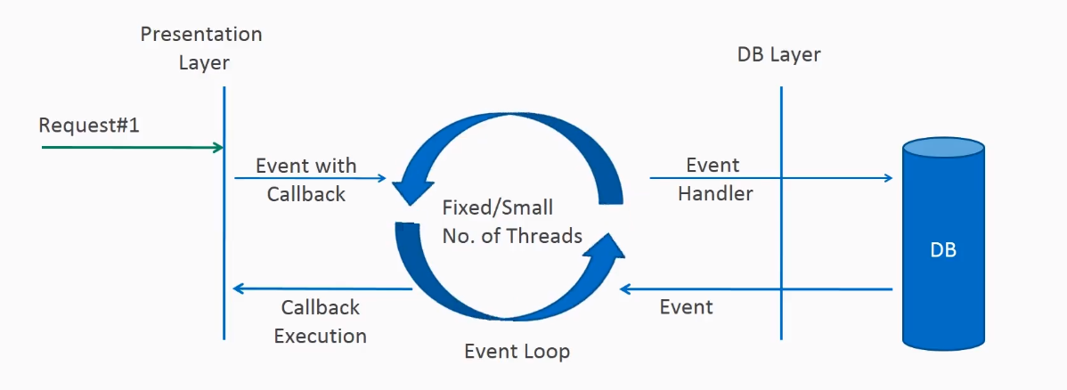
Spring WebFlux
Blocking request processing
Non-blocking request processing

Slide 16
Reactive Streams API
public interface Publisher<T>
{
public void subscribe(Subscriber<? super T> s);
}
public interface Subscription<T>
{
public void request(long n);
public void cancel();
}
public interface Subscriber<T>
{
public void onSubscribe(Subscription s);
public void onNext(T t);
public void onError(Throwable t);
public void onComplete();
}
public interface Processor<T, R> extends Subscriber<T>, Publisher<R>
{
}

Slide 17
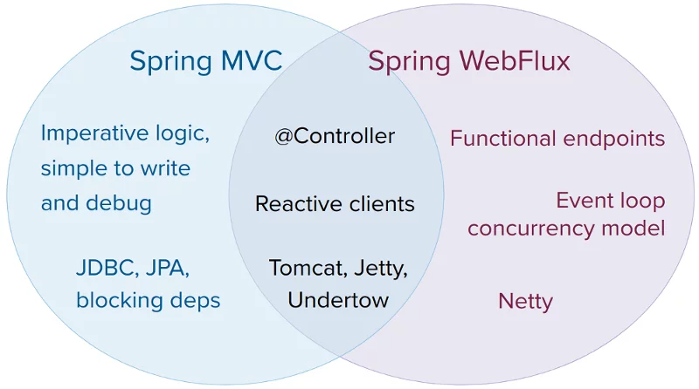
WebFlux vs MVC

Slide 18
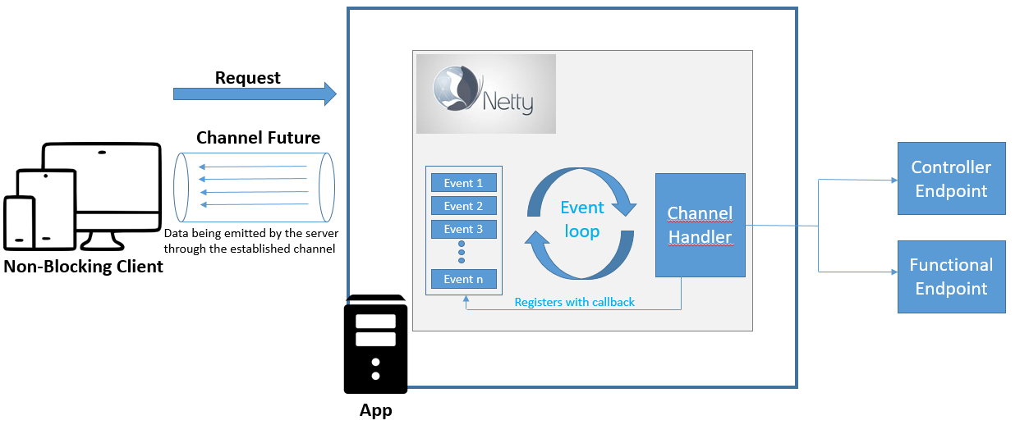
Spring WebFlux

Slide 19
Spring 5 Features
JDK baseline update.
Core framework revision.
Core container updates.
Functional programming with Kotlin.
Reactive Programming Model.
Testing improvements.
Library support.
Discontinued support.

Slide 20
ALTERNATIVE RESOURCES

Slide 21
RESOURCES
Spring Boot
https://spring.io/guides/gs/spring-boot/
https://spring.io/projects/spring-boot
Webflux
https://spring.io/guides/gs/reactive-rest-service/

Slide 22

THANKS!

