Slide 1

Module 2 Spring Framework
Day 3

Slide 2
Agenda
Aspect Oriented Programming
Spring JDBC

Slide 3
Aspect Oriented Programming (AOP)

Slide 4
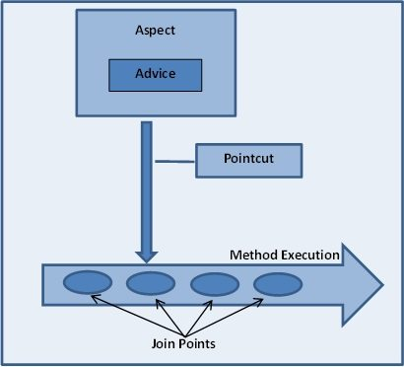
AOP
AOP is a programming technique based on the concept of aspect.
Aspect encapsulates cross-cutting concerns
Core Concepts
Aspect
Advice
Joint point
Pointcut
Proxy
Weaving

Slide 5
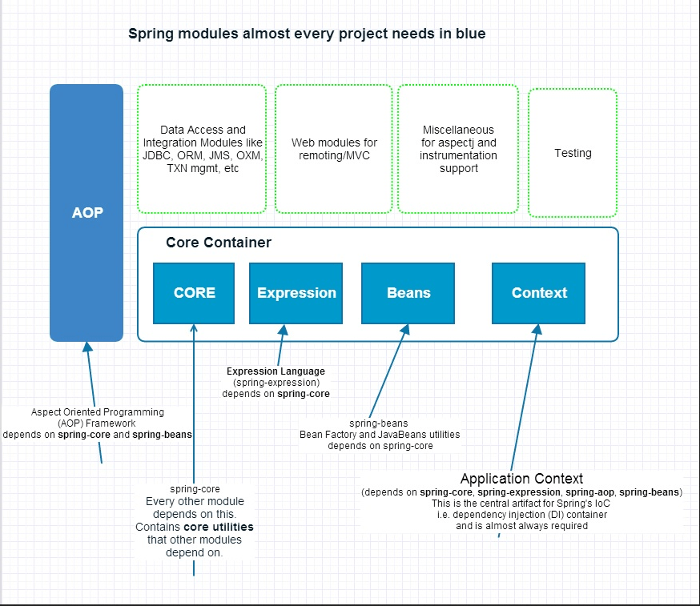

Slide 6
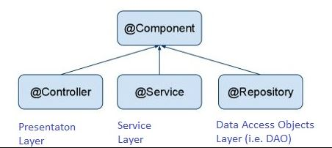
Example
<?xml version="1.0" encoding="UTF-8"?>
<beans xmlns="http://www.springframework.org/schema/beans"
xmlns:xsi="http://www.w3.org/2001/XMLSchema-instance"
xmlns:context="http://www.springframework.org/schema/context"
xmlns:aop="http://www.springframework.org/schema/aop"
xsi:schemaLocation="http://www.springframework.org/schema/beans
http://www.springframework.org/schema/beans/spring-beans-3.0.xsd
http://www.springframework.org/schema/aop
http://www.springframework.org/schema/aop/spring-aop-3.0.xsd
http://www.springframework.org/schema/context
http://www.springframework.org/schema/context/spring-context-3.1.xsd">
<aop:aspectj-autoproxy />
<context:component-scan base-package="com.aop.example" />
</beans>

Slide 7
Spring JDBC

Slide 8
Spring JDBC Abstraction Packages
org.springframework.jdbc.core
org.springframework.jdbc.datasource
org.springframework.jdbc.object
org.springframework.jdbc.support

Slide 9
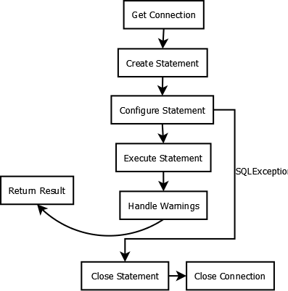
JDBC operation Flow

Slide 10
Data Source Bean Configuration
<?xml version="1.0" encoding="UTF-8"?>
<beans xmlns = "http://www.springframework.org/schema/beans"
xmlns:xsi = "http://www.w3.org/2001/XMLSchema-instance"
xsi:schemaLocation = "http://www.springframework.org/schema/beans
http://www.springframework.org/schema/beans/spring-beans-3.0.xsd">
<bean id="dataSource"
class="org.springframework.jdbc.datasource.DriverManagerDataSource">
<property name="driverClassName" value="com.mysql.cj.jdbc.Driver" />
<property name="url" value="jdbc:mysql://localhost:3306/employee" />
<property name="username" value="root" />
<property name="password" value="root" />
</bean>
<bean id="jdbcTemplate" class="org.springframework.jdbc.core.JdbcTemplate">
<property name="dataSource" ref="dataSource" />
</bean>
</beans>

Slide 11
Data Access
Service
Object
DAO
interface
DAO
Implementation

Slide 12
Data Access Template
DAO Template
DAO CallBack
Create Connections
Start Transaction
3. Access Database
5. Commit / Rollback
6. Close Connection
4. Return Result

Slide 13
Exercise
Create an Employee table with Id, Name, Age, Gender, Designation, Qualification, Salary, Years of Experience, Nationality, Contact Number.
Using Spring JDBC perform the CRUD operation.

Slide 14
ALTERNATIVE RESOURCES

Slide 15
RESOURCES
https://docs.spring.io/spring-framework/docs/2.5.x/reference/aop.html
https://spring.io/projects/spring-data-jdbc

Slide 16

THANKS!

