Slide 1

Module 2 Spring Framework
Day 13

Slide 2
Agenda
MicroService in detail
Demo

Slide 3
Introduction to Microservices

Slide 4
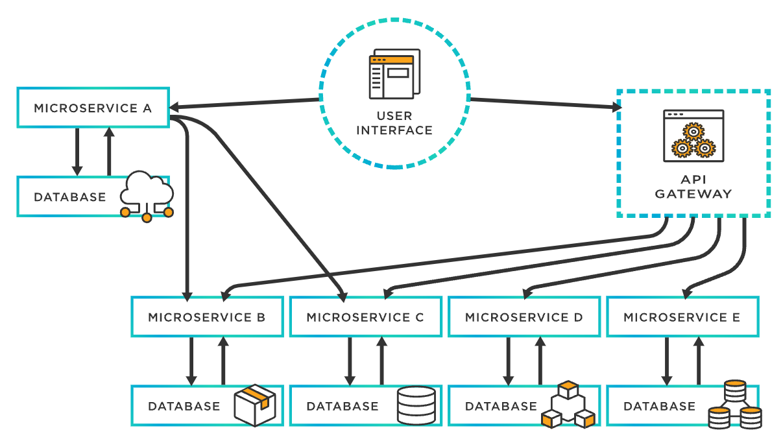

Slide 5
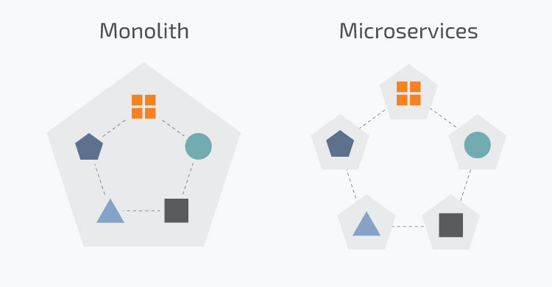
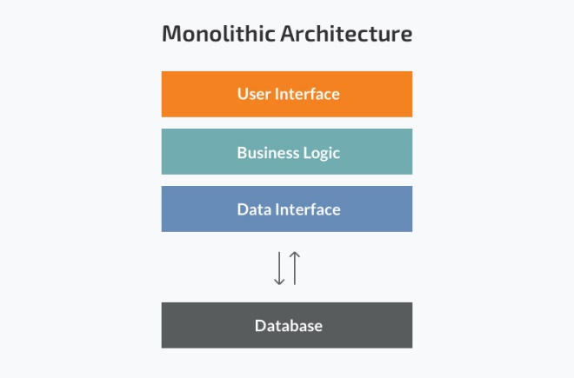
Monolithic Architecture

Slide 6
Monolithic Architecture
Strengths
Less cross-cutting concerns
Easier debugging and testing
Simple to deploy
Simple to develop
Weakness
Understanding
Making changes
Scalability
New Technology barriers

Slide 7
Benefits of Microservice
Developer independence
Isolation and resilience
Scalability
Lifecycle automation
Relationship to the business

Slide 8
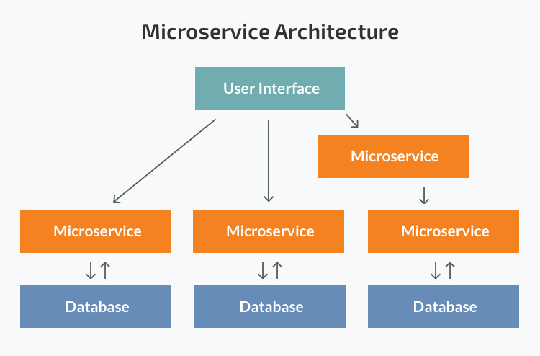
Microservices Architecture

Slide 9
Microservice Architecture
Strengths
Independent components
Easier understanding
Better scalability
Flexibility in choosing the technology
The higher level of agility
Weakness
Extra complexity
System distribution
Cross-cutting concerns
Testing

Slide 10
Monolithic vs MicroService Architecture
Monolithic Architecture
Small Team
Simple Application
No Microservice Expertise
Quick Launch
MicroService Architecture
Microservices expertise
A complex and scalable application
Enough engineering skills

Slide 11
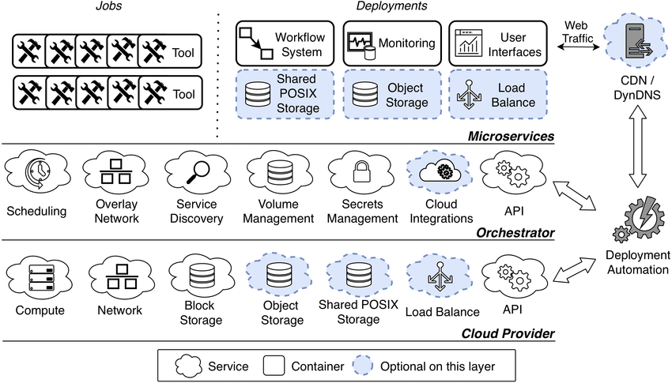
Microservice Orchestration

Slide 12
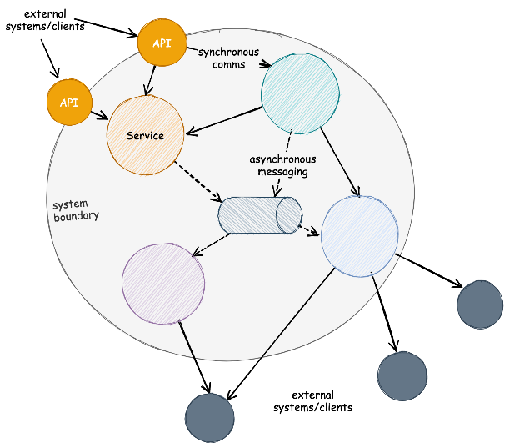
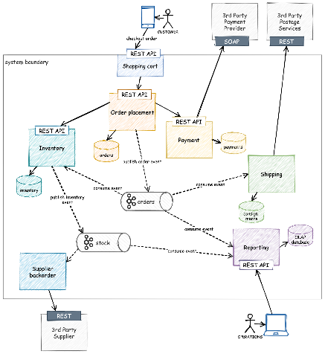
A Brief History

Slide 13
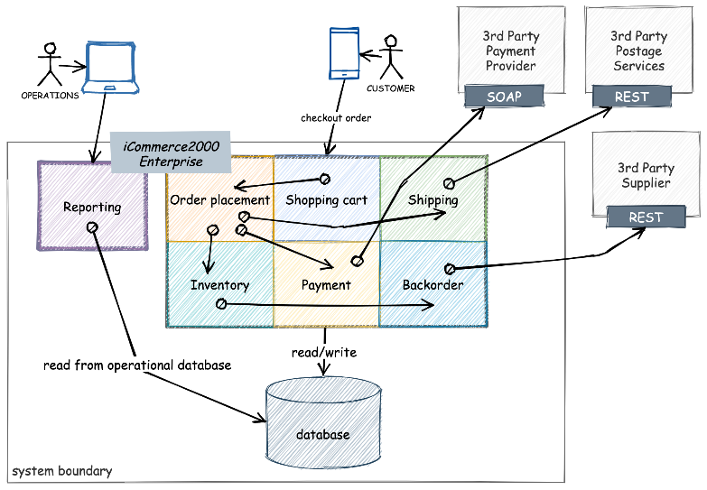

Slide 14
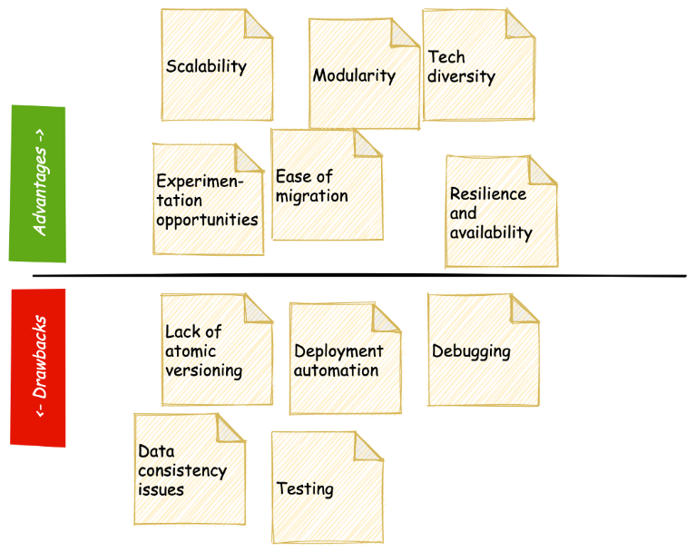
Limitations of Microservices
Atomic versioning
Deployment automation
Debugging
Data consistency
Testing

Slide 15
The 8 Principles of Microservices
Modeled around business domain
Adapt an automation approach
Hide internal implementation details
Highly Observable
Decentralization
Independent deployment
Customer-centric
Failure Isolation

Slide 16
8 key concepts in Microservices
Database per Service
Shared database
Saga
API Composition
CQRS
Domain event
Event sourcing
Domain-Driven-Design

Slide 17
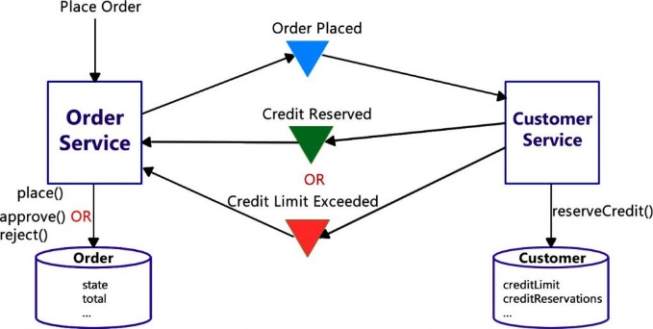
How Choreography-based Saga Works in Microservices

Slide 18
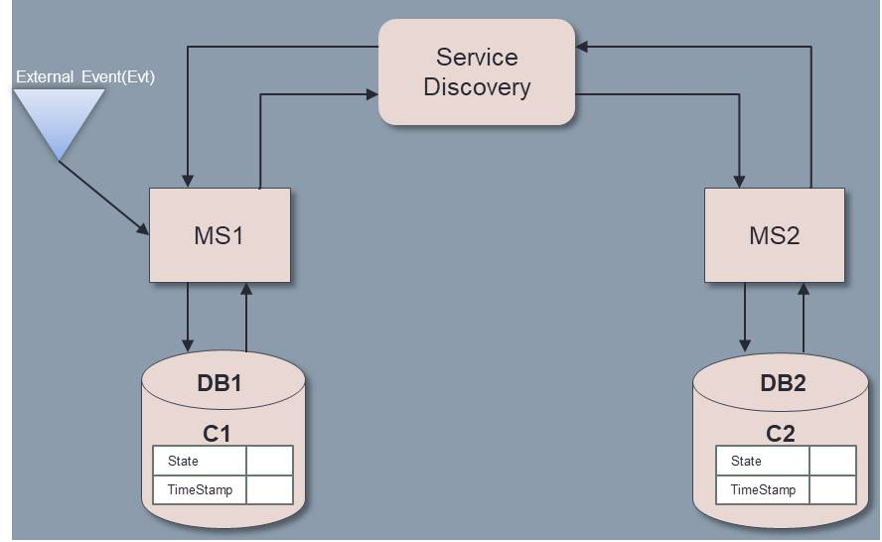
Choreography-based Saga Algorithm

Slide 19
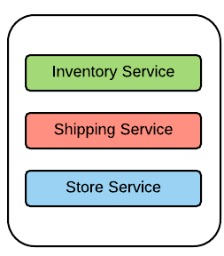
Pragmatic Microservices

Slide 20
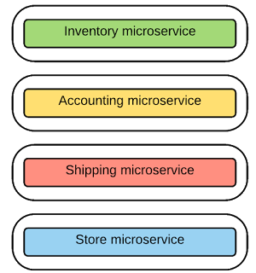
Microservices Architecture

Slide 21
Designing Microservices : Size, scope and capabilities
Lines of Code/Team size are lousy metrics
‘Micro’ is a bit misleading term
The SOA context

Slide 22
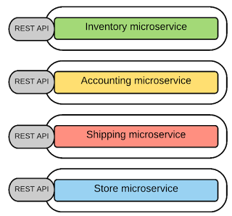
Messaging in Microservices
Synchronous Messaging
REST, Thrift
Asynchronous Messaging
AMQP, STOMP, MQTT
Message Formats
JSON, XML, Thrift, ProtoBuf, Avro

Slide 23
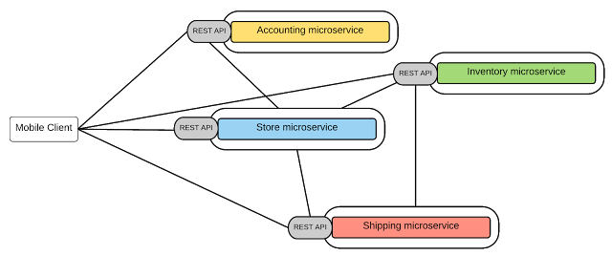
Integrating Microservices (Inter-service/process Communication)
Point-to-point style — Invoking services directly

Slide 24
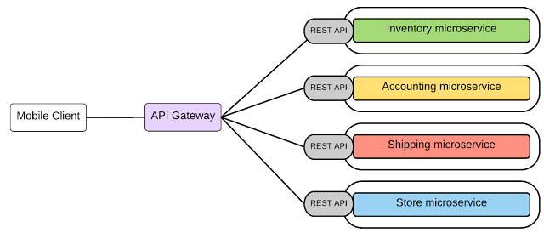
API-Gateway style

Slide 25
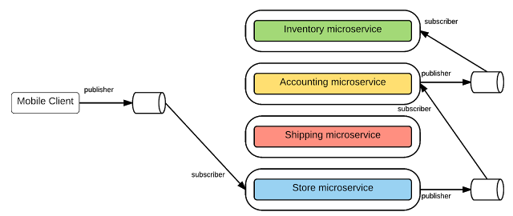
Message Broker style

Slide 26
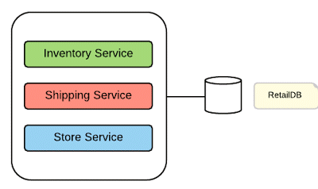
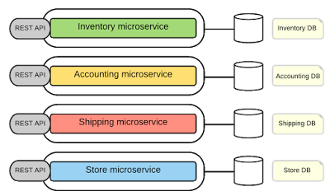
Decentralized Data Management

Slide 27
Decentralized Governance
Design-time governance — defining and controlling the service creations, design and implementation of service policies
Run-time governance — the ability to enforce service policies during execution

Slide 28
Service Registry and Service Discovery
Service Registry holds the microservices instances and their locations.
To find the available microservices and their location, we need to have a service discovery mechanism.
Client-side Discovery
Server-side Discovery

Slide 29
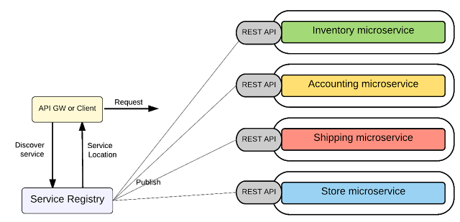
Client-side Discovery

Slide 30
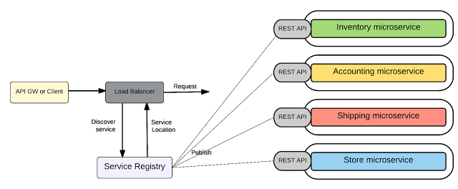
Server-side Discovery

Slide 31
Deployment
Ability to deploy/un-deploy independently of other microservices.
Must be able to scale at each microservices level (a given service may get more traffic than other services).
Building and deploying microservices quickly.
Failure in one microservice must not affect any of the other services.

Slide 32
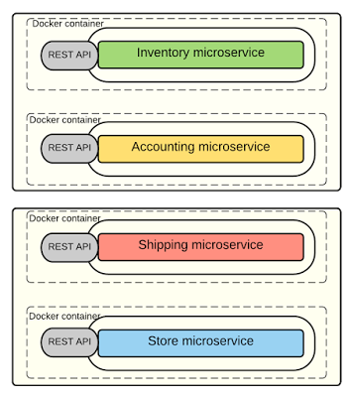
Docker

Slide 33
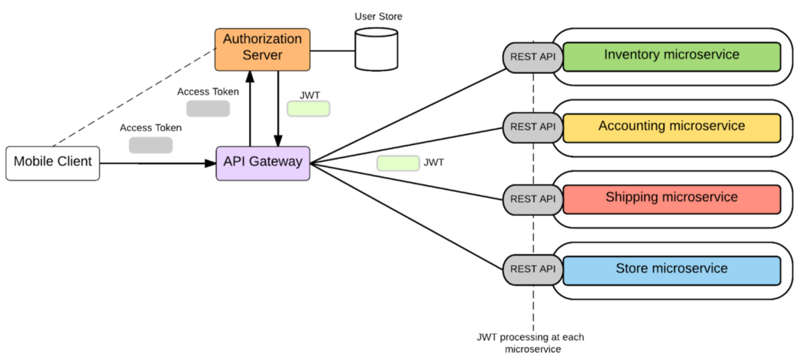
Security

Slide 34

Demo

Slide 35
ALTERNATIVE RESOURCES

Slide 36
RESOURCES
https://docs.microsoft.com/en-us/azure/architecture/guide/architecture-styles/microservices
https://microservices.io/
https://spring.io/blog/2015/07/14/microservices-with-spring

Slide 37

THANKS!

