Slide 1

Module 3 JavaScript
Day 4

Slide 2
Agenda
Intro to Java script
Functions, objects, arrays
Constructors, Variables and Scopes
This keyword, Date API
Classes
Higher Order Functions, Closures
IIFE
Async & Await, Promise

Slide 3
JavaScript

Slide 4
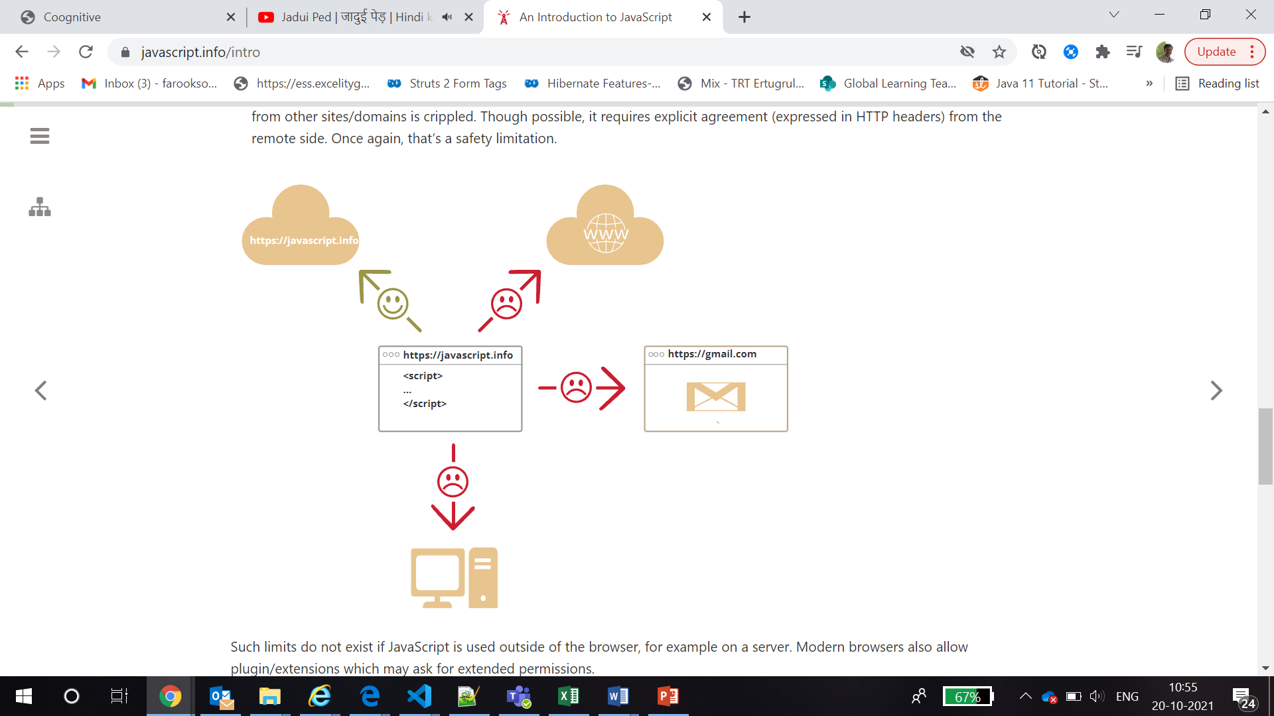

Slide 6
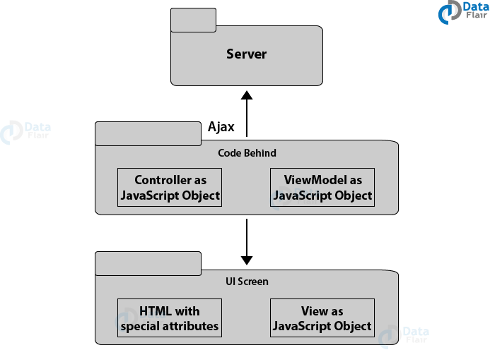
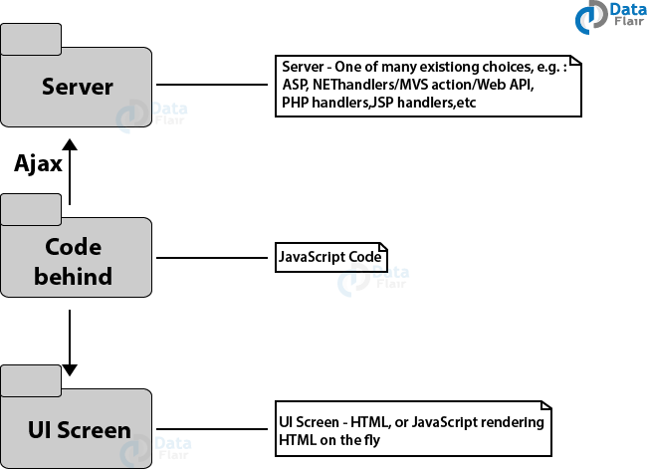
JavaScript Architecture
Typical JavaScript Application Architecture
Framework-based Typical JavaScript Architecture

Slide 7
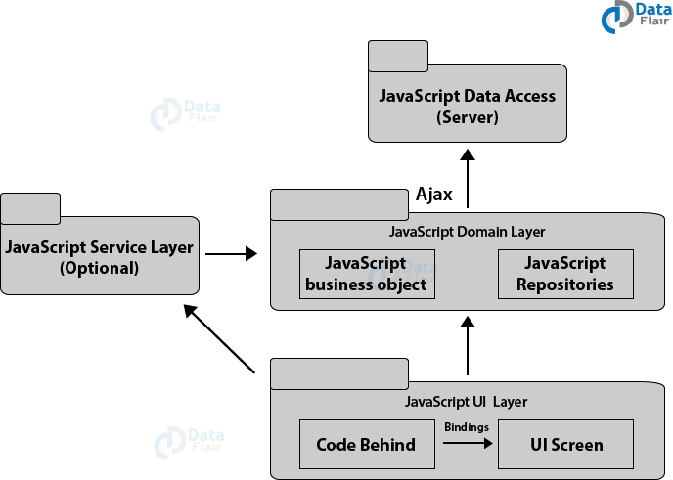
JavaScript Architecture
Advanced JavaScript Architecture

Slide 8
JavaScript Applications
Single Page Applications(SPAs)
Multi-page Applications
Isomorphic (Universal) Applications
Setup Development Environment for JavaScript:
In order to work with JavaScript, you need to install the following tools:
Browser
Editor

Slide 9
Languages “over” JavaScript
CoffeeScript
TypeScript
Flow
Dart
Brython
Kotlin

Slide 10
Client vs Server Side JavaScript

Slide 11
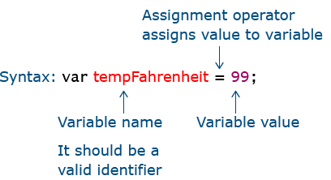
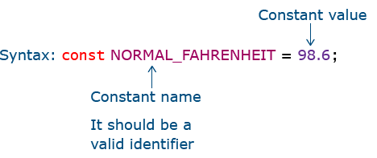
Identifiers Variables and Constants
Variables
Constants

Slide 12
Functions
Use the function keyword to declare a function.
Use the functionName() to call or invoke a function to execute it.
A function implicitly returns undefined, use the return statement to explicitly specify the return value for the function.
The arguments is an object that is accessible only inside the function body. It represents the arguments of the function.
The function hoisting allows you to place the call to the function before the function declaration.
function functionName(parameters) {
// function body
// ...
}

Slide 13
Types of Functions
Recursive Functions
Arrow Functions
Built-in Methods
alert(), prompt(), write(), getelementById(), getElementByClassName(), getDate(), includes()

Slide 14
Objects
An object is a collection of key-value pairs.
Use the dot notation ( .) or array-like notation ([]) to access a property of an object.
The delete operator removes a property from an object.
The in operator check if a property exists in an object.
The for...in iterates over properties of an object.
When functions are the properties of an object, they are called methods.
Use the this inside the method to access the object’s properties.

Slide 15
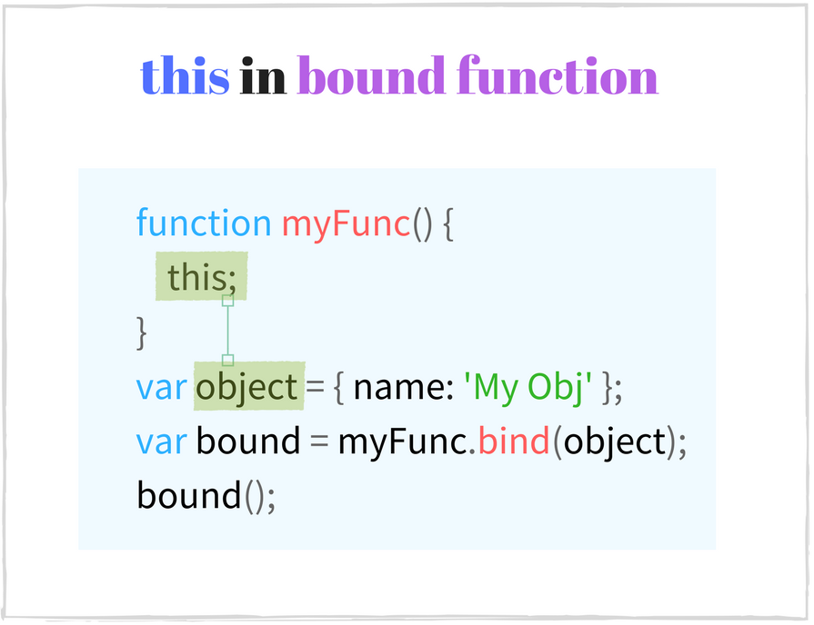
This Keyword
Default Binding
Implicit Binding
Explicit Binding
New Binding

Slide 16
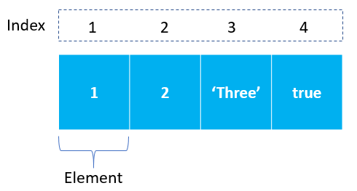
Arrays
An JavaScript array has the following characteristics:
First, an array can hold values of different types.
Second, the length of an array is dynamically sized and auto-growing.
In JavaScript, an array is an order list of values. Each value is called an element specified by an index.
An array can hold values of mixed types.
JavaScript arrays are dynamic. They grow or shrink as needed.

Slide 17
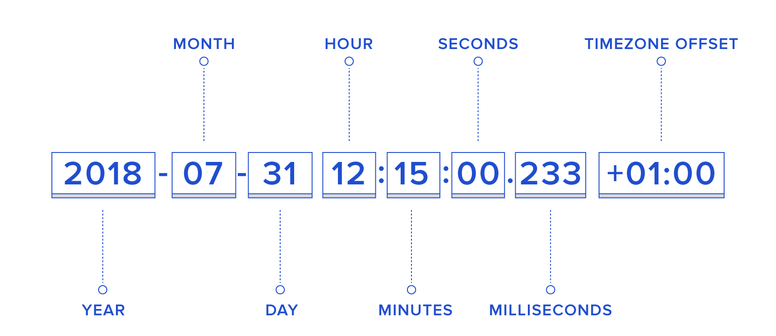
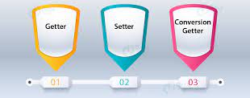
Date Time API

Slide 18
Date Time API
Method | Description
toDateString() | It returns a string, containing the “date” of the Date object in a human-readable format.
toTimeString() | It returns a string, containing the “time” of the Date object in a human-readable format.
toUTCString() | It returns a string, containing the Date using the UTC timezone.
valueOf() | This method returns the primitive value of the Date object.
toString() | This method returns a string representation of the specified Date object.

Slide 19
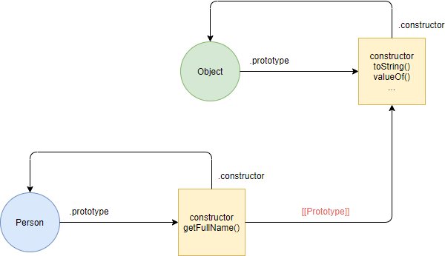
Constructors and Properties

Slide 20
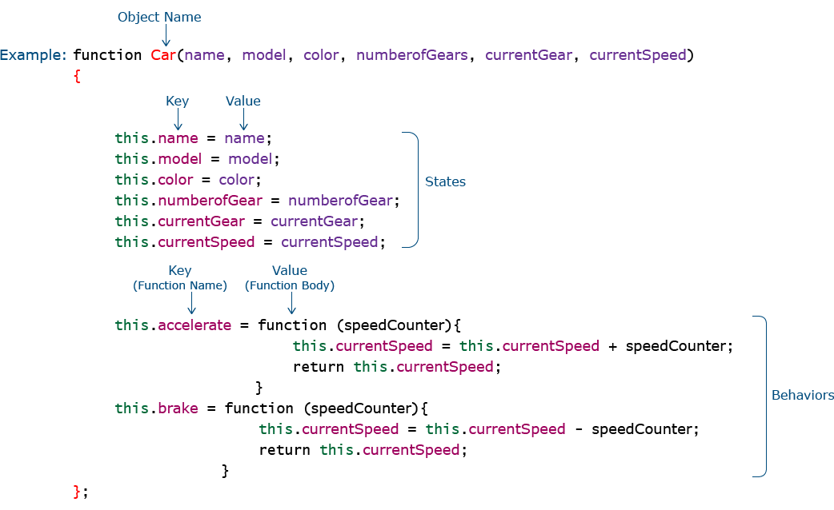
Creating Objects using Function Constructor

Slide 21
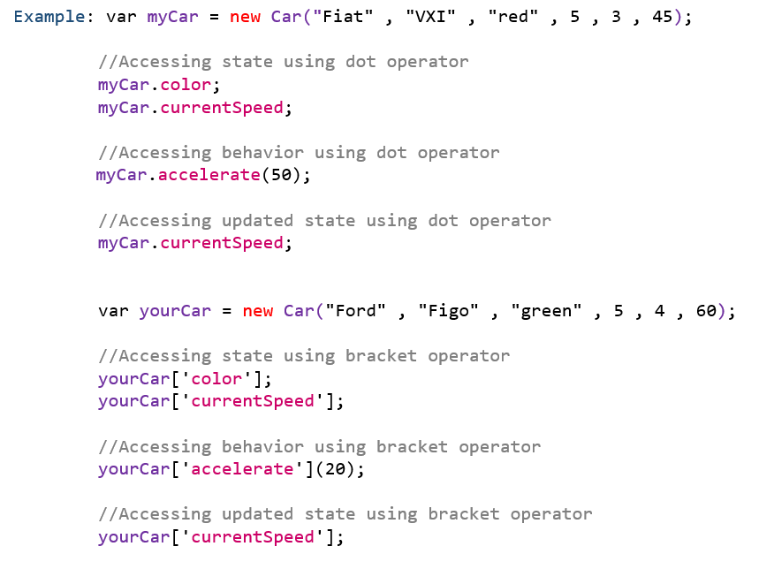
Invocation

Slide 22
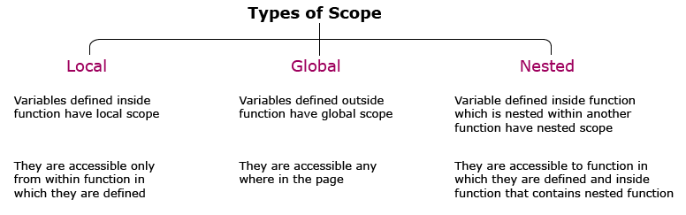
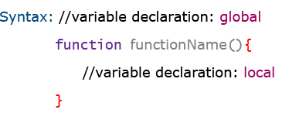
Variable Scopes

Slide 23
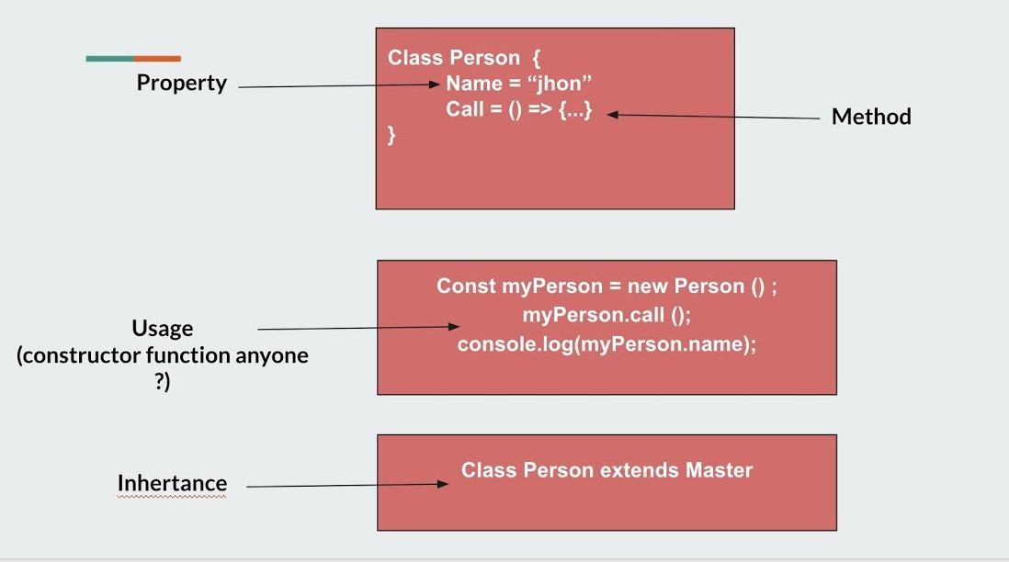
Classes in JavaScript

Slide 24
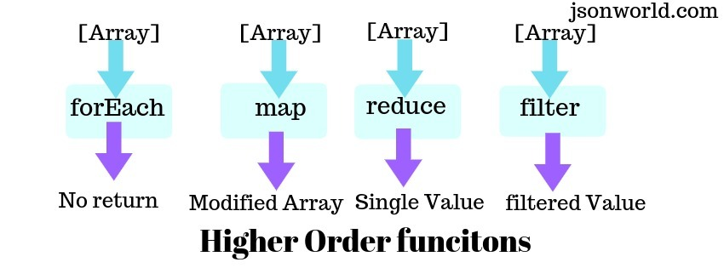
Higher Order Function

Slide 25
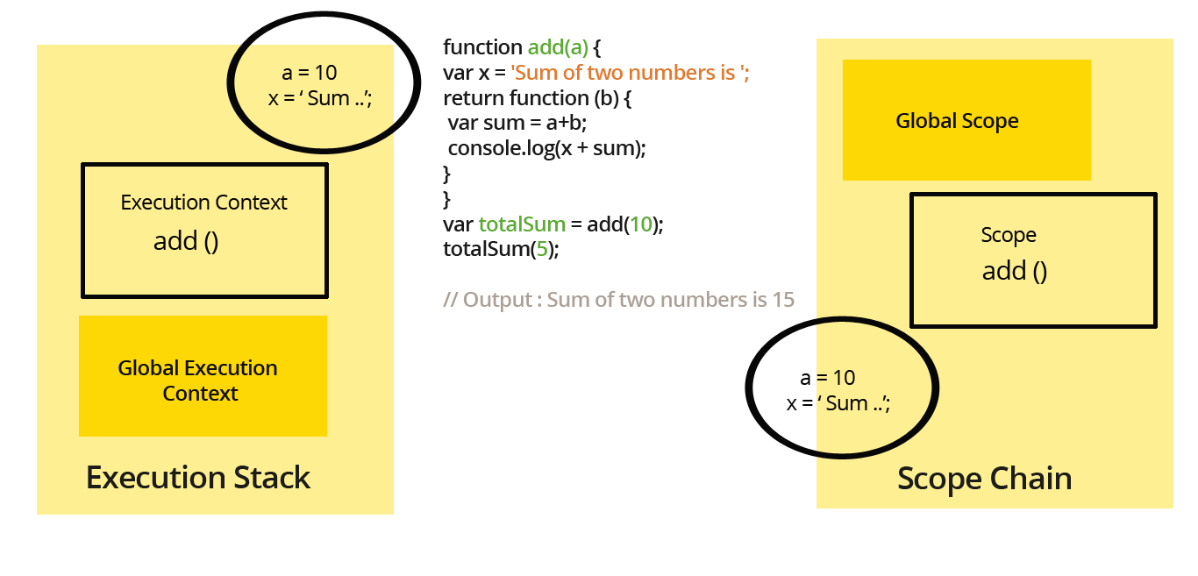
Closure

Slide 26
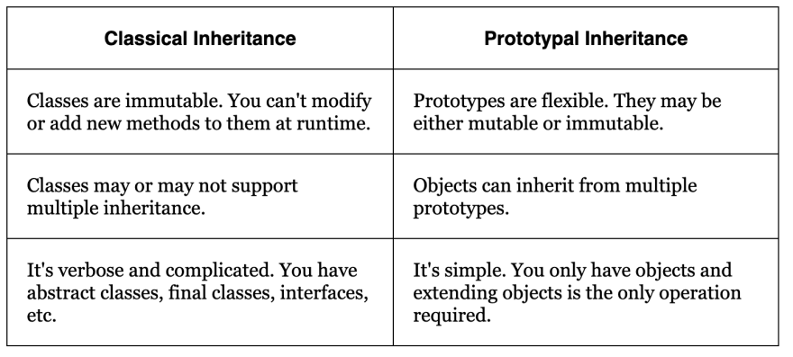
Prototypal vs. Classical Inheritance

Slide 27
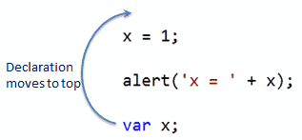
Hoisting
In JavaScript is a behavior in which a function or a variable can be used before declaration.
Types of Hoisting
Variable Hoisting : Only variable declared with var is hoisted (not let and const)
Function Hoisting : Only Simple functions is hoisted (not function expressions)

Slide 28
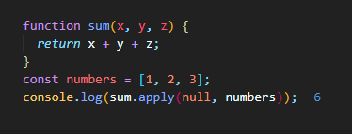
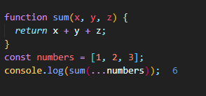
Spread Syntax
The spread operator is just 3 dots ...
It can be used on iterables like an array or a string.
It expands an iterable to its individual elements
It can provide a function call with an array (or any other iterable) where 0 or more arguments were expected.

Slide 29
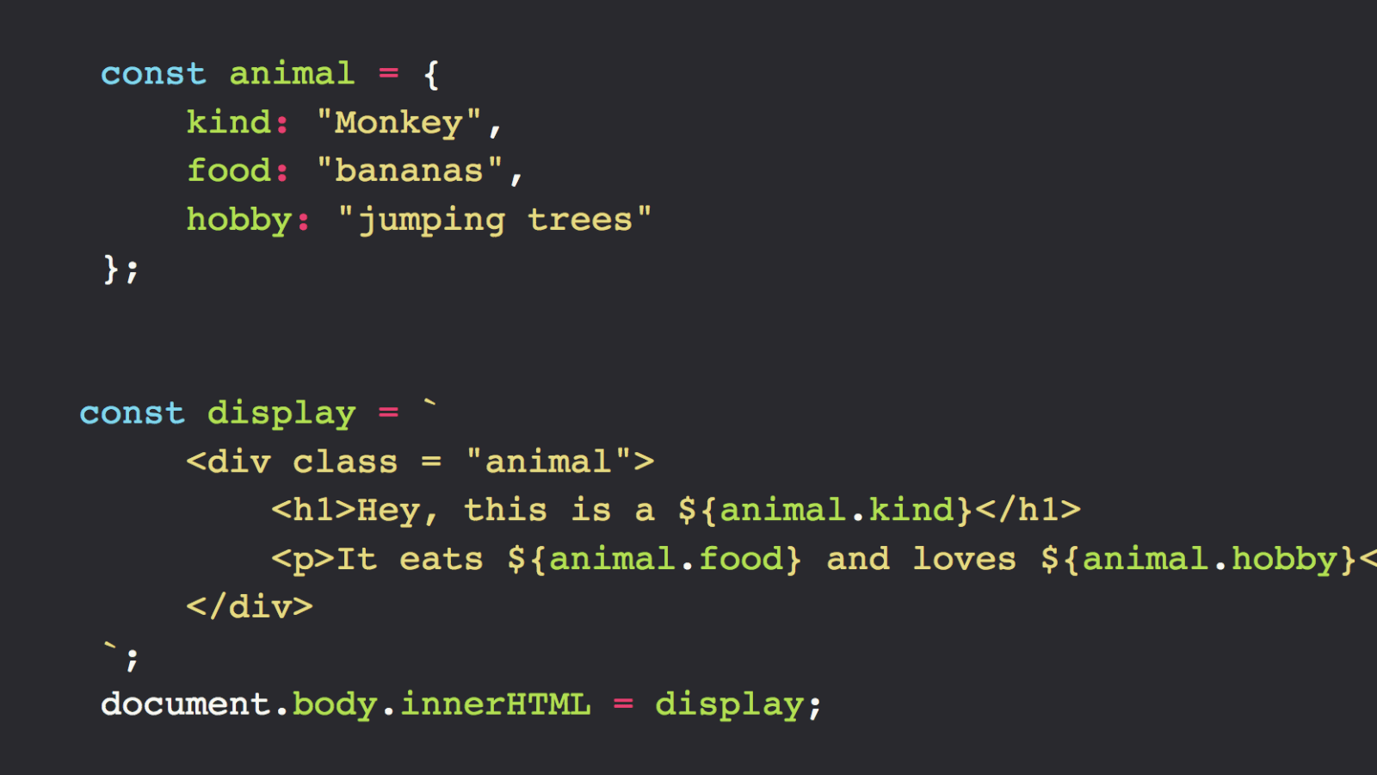
Template Literals

Slide 30
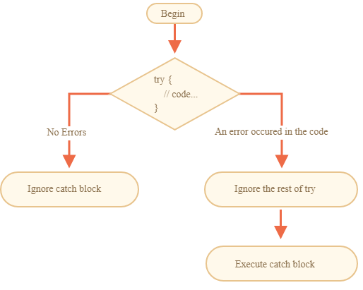
Error Handling

Slide 31
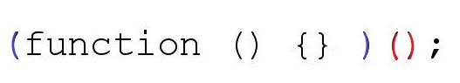
IIFE
The JavaScript Immediately Invoked Function Expression (IIFE) is a function which helps in providing a method that defines a sequence of a particular context.
Once a variable is defined inside a function it is not possible to access it outside the function where it is defined.
The functions which are created in JavaScript have named functions, anonymous functions and by making use of IIFE we can execute these as soon as they are mounted.
This functionality makes them IIFE.
Syntax:
(function () { // Function Logic Here. })();

Slide 32
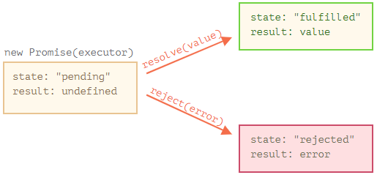
JavaScript promise
A promise in the JavaScript has 4 states:
Fulfilled
Rejected
Pending
Settled
Syntax #1
var promiseVariable= new Promise(function(resolve, reject){
//JavaScript logic
});

Slide 33
JavaScript promise
Syntax #2
.then(function(output){
//success message
}, function(errorMessage){
//error resolving logic
})
Syntax #3
.catch(function(errorMessage){
//error resolving logic
})
Syntax #4
Error message can also be shown by using Error function (Error()) from Promise()
var error=new Promise(function(resolve, reject) {
throw new Error(‘Error Message’)
})

Slide 34
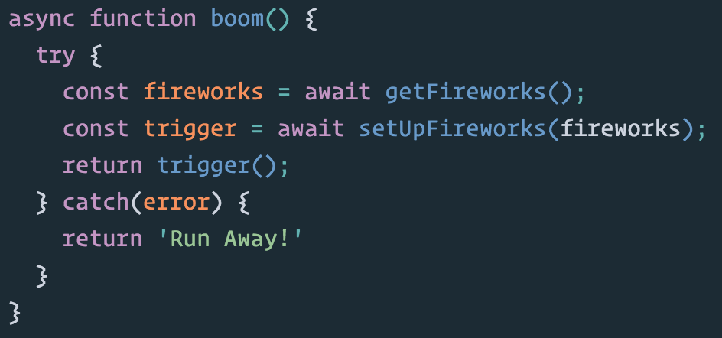
Async and Await

Slide 35
DOM

Slide 36
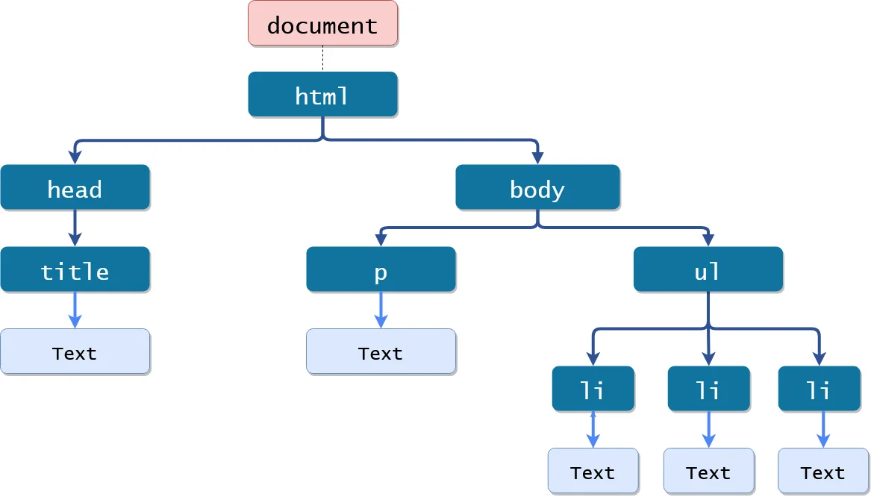

Slide 37
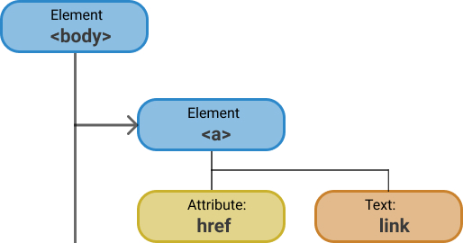
Nodes In HTML DOM
Javascript
can change and add nodes in the DOM
can add or change style (CSS) of the DOM element
can set new attributes to the DOM element and can remove and modify older attributes
can add new element in the DOM structure
can create and add events to the DOM element
can delete elements from the DOM tree

Slide 38
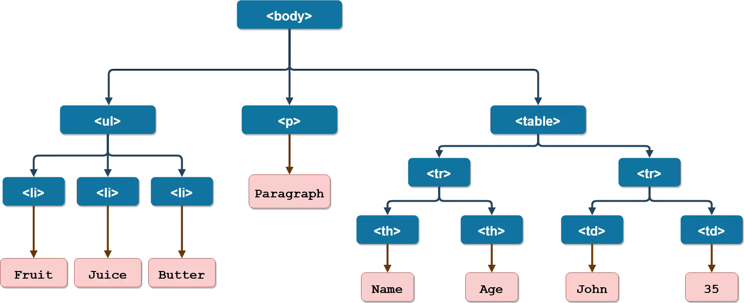
Visualising Elements in DOM Tree

Slide 39
Property | Description
Document.body | It represents the <body> node of the current document
Document.doctype | It returns Document Type Definition (DTD) of the current document
Document.doctypeURI | It returns location (URL) of the current document
Document.head | It returns <head> element of the current document
Document.title | Using it you can get/set document title
Document.links | It returns a list of all the hyperlinks in the current document
Document.images | It returns a list of all the images in the current document
Document.cookie | It returns semicolon-separated list of the cookies for the document
Document.activeElement | It returns element cursor is focusing to in document
Document.baseURI | It returns base URI of the document
Document.characterSet | It returns character encoding for the document

Slide 40
DOM Methods To Find Element
Methods | Description
document.getElementById() | Select the unique element with given id. In case there are 2 same ID then it selects the first element.
document.getElementsByClassName() | Select collection elements with given classname
document.getElementsByTagName() | Select collection elements with given tagname
document.querySelector() | Select element the first element on the basic of CSS string
document.querySelectorALL() | Select a list of elements on the basic of CSS string

Slide 41
Modifying DOM Elements
Properties/Methods | Description
element.innerHTML | This is an element property using which you can get or set the inner content of the element
element.innerText | It returns and sets the inner text of an element to the value given in string, without parsing to HTML
element.style. = value | Using these element properties you can set CSS to the element using javascript
element.getAttribute(attribute_name) | This method is used to get the value of the specified attribute
element.setAttribute(attribute_name, value) | It is the element method that is used to set a new attribute or modify the value of the attribute to the element
element.removeAttribute(attribute_name) | This element method removes the specified attribute from the element

Slide 42
DOM methods to create and remove elements
Methods | Description
document.createElement() | Creates an element specified by tag name
document.createTextNode() | Creates a new text node
document.appendChild() | It appends another element to an element in the DOM
document.insertBefore() | This method inserts a node before a specified node, if the node already exists in the DOM then it changes its position
document.replaceChild(new,old) | It replaces an element from DOM with another element
document.removeChild() | It removes an element from DOM
document.remove() | This method removes the node from the DOM it is applied upon
document.write() | It write something in the document

Slide 43
Javascript Dom Manipulation
Create new element
Attach new element to the DOM
Removing old element from the DOM
Replacing an element with another element
Changing the location of the element in the document
Making change in existing element by adding style or by adding content
Adding a new attribute to the element

Slide 44
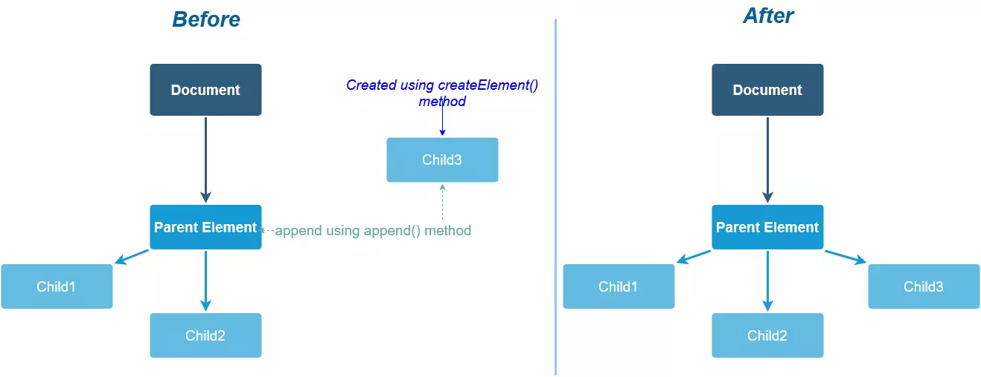
DOM manipulation methods
createElement()
append()
removeChild()
replaceChild()

Slide 45
Event
Event Listener
Event Handler
Adding Event Listener
Using HTML attribute
Using DOM Property
Using addEventListener Method

Slide 46
NodeJs

Slide 47
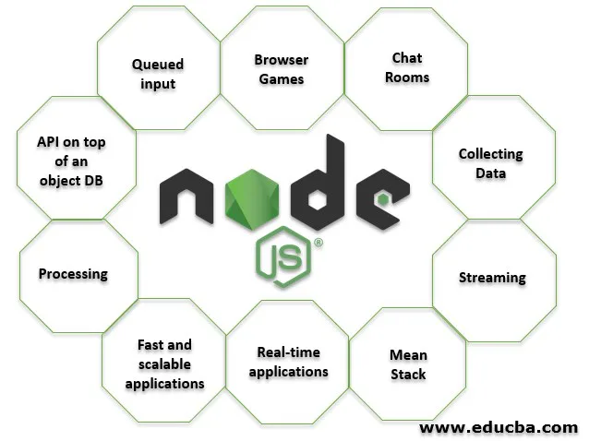

Slide 48
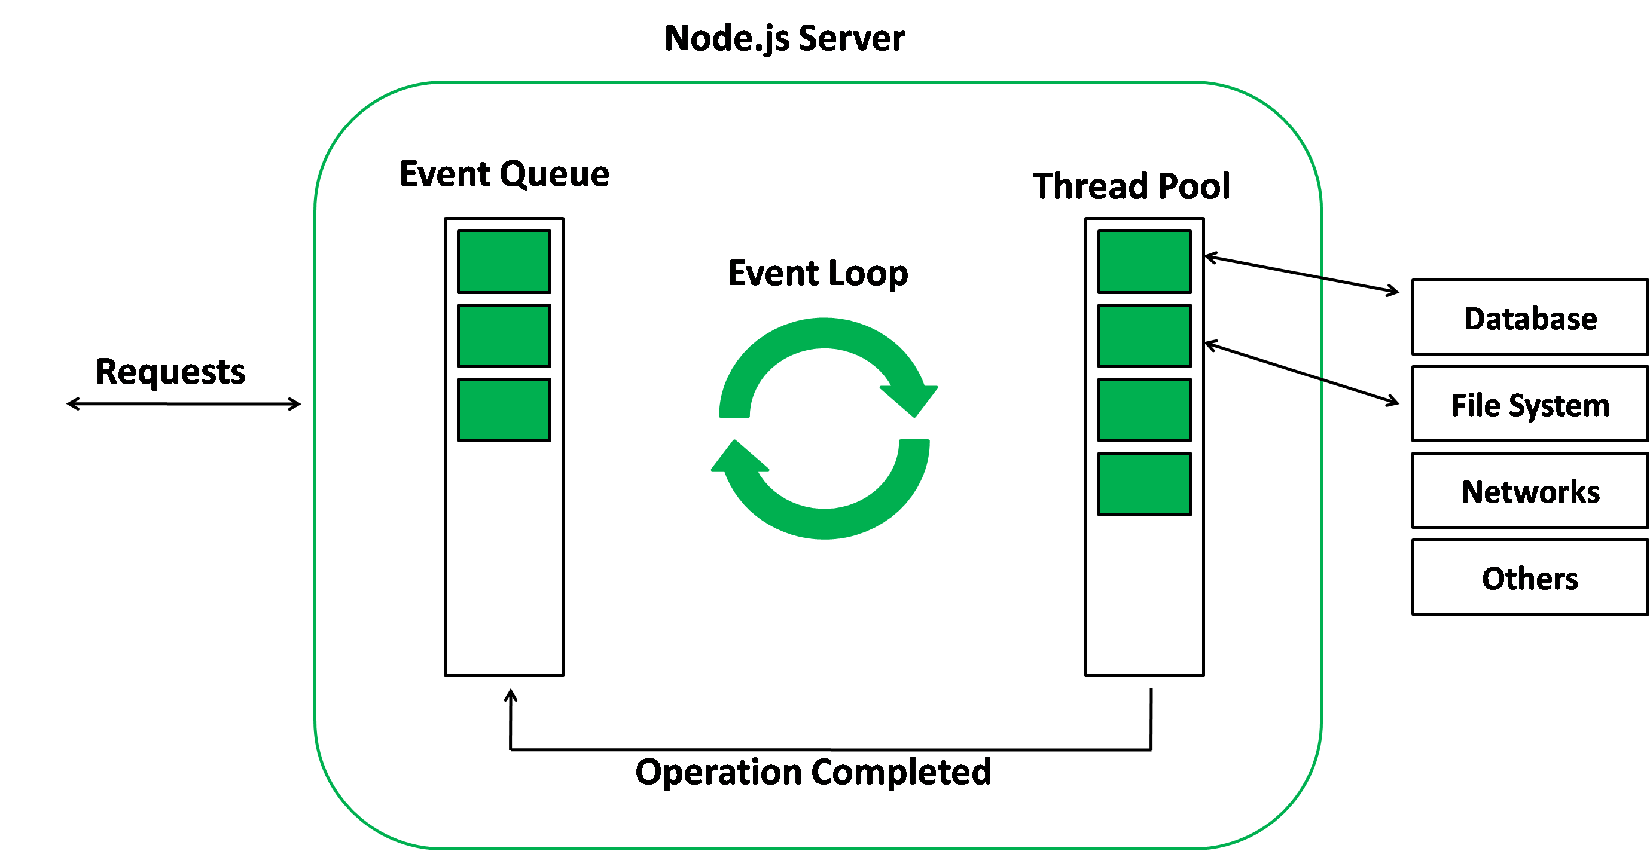
Events in Node.js

Slide 49
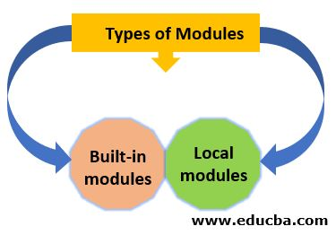
Modules

Slide 50
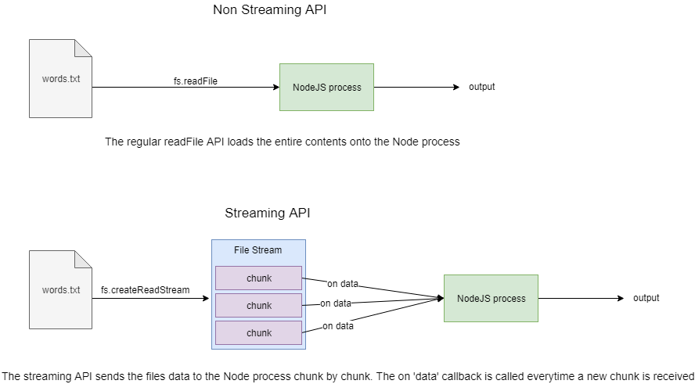
FileSystem in NodeJs

Slide 51
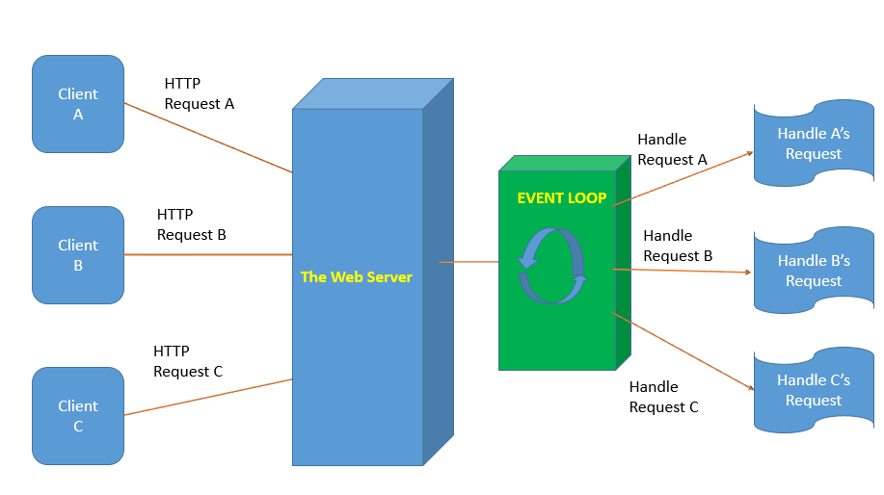

Slide 52
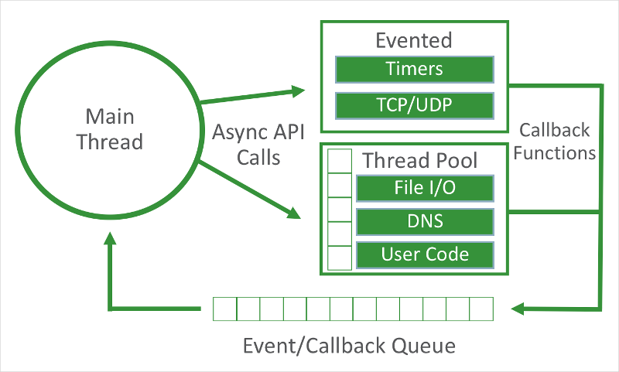
Asynchronous Code in Node JS

Slide 53
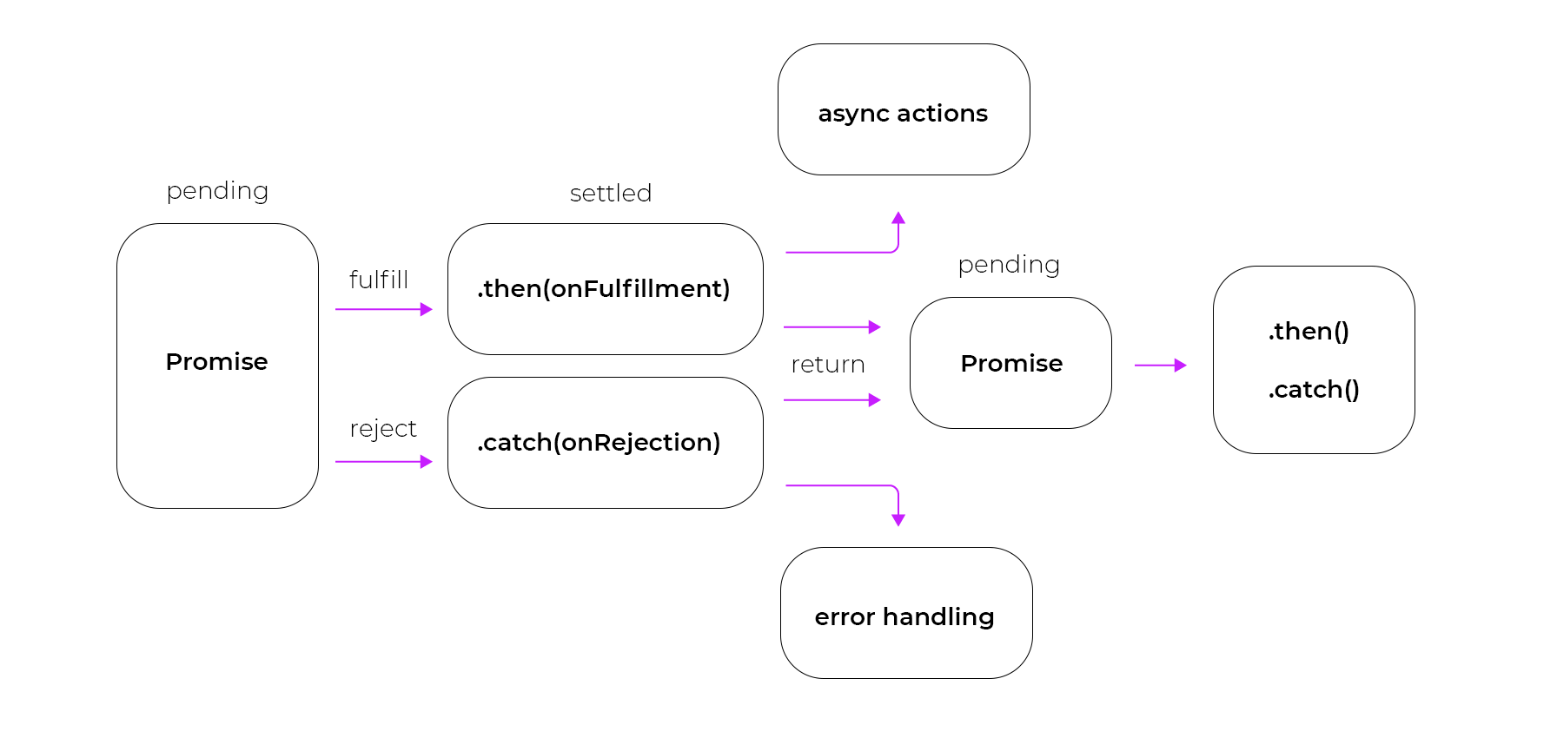

Slide 54
JSX

Slide 55
JSX
JSX stands for JavaScript XML.
JSX is a language that allows you to mix JavaScript and HTML-like tags to define user interface (UI) elements and their functionality.
JSX is an extension for JavaScript that allows for writing what looks like HTML and XML in our JavaScript.
JSX is a shorthand for calling React.createElement() to create elements and components.
JSX looks like HTML and offers a friendly syntax for creating DOM elements.
JSX accepts any valid JavaScript expression inside curly braces.

Slide 56
Using JavaScript Expressions in JSX
Variable and object values
Function calls and references
Expressions and operators
Loops and iteration

Slide 57
Reactive Programming

Slide 58
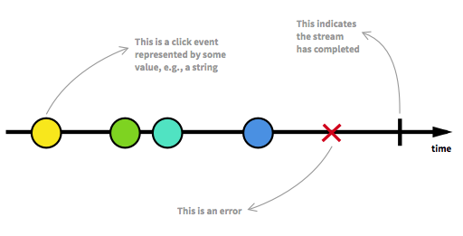
Streams
A stream is a sequence of ongoing events ordered in time.
It can emit three different things:
a value (of some type),
an error,
a "completed" signal.

Slide 59
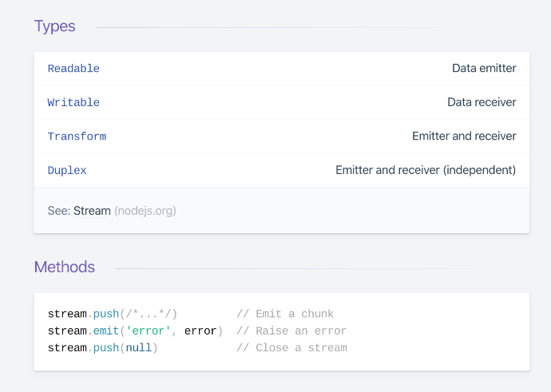

Slide 60
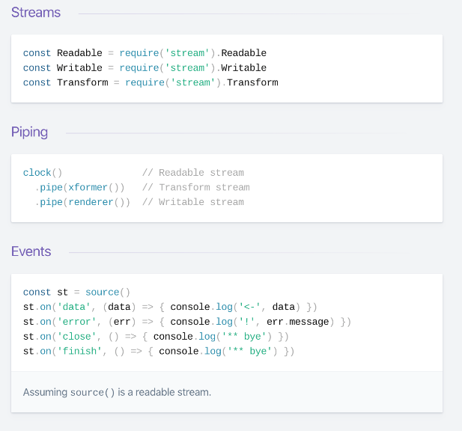

Slide 61
RxJS

Slide 62
RxJS
RxJS (Reactive Extensions Library for JavaScript) is a useful library for reactive programming.
State Management
Observable
Observer
Subscription
Subjects and Subscriptions
Essential operators in RxJS
Map
Filter
Reduce

Slide 63
JavaScript Unit Testing

Slide 64
Mocha Unit Testing
Writing a Node Module
Manually Testing the Code
Writing Your First Test with Mocha and Assert
Testing Asynchronous Code - Promise
Using Hooks to Improve Test Cases

Slide 65

Jest Unit Testing
Jest is a JavaScript testing framework and is widely used to test applications created with Vue.js, Babel, Angular, TypeScript, React, Node, and other JavaScript frameworks.
Jest is used by Facebook to test all JavaScript code including React applications.
install the jest dependency. npm install --save-dev jest

Slide 66
Jest over other testing tools
Simplicity at its peak
Lightening fast speed
Snapshot testing
Unit testing
Easy and Out-of-box Mocking
Code coverage
Rich context for failed tests

Slide 67
Jest expect API
test(‘asyncCode calls fetchPicture, fetchName and githubName’, () => {
expect.assertions(3);
function fetchPicture(data) {
expect(data).toBeTruthy();
}
function fetchName(data) {
expect(data).toBeTruthy();
}
function githubName(data) {
expect(data).toBeTruthy();
}
asyncCode(fetchPicture, fetchName, githubName );
});
Built-in Code Coverage Report :
npm install -g jest
Jest --coverage

Slide 68
JavaScript Tips & Tricks

Slide 69
1. Convert from everything to Boolean.
const foo = 'some data’
const toBool = !!foo
console.log(toBool) // true
2. Convert from everything to Number.
const foo = '21’
const toNumber = +foo
console.log(toNumber) // 21
const toNegativeNumber = -foo
console.log(toNegativeNumber) // -21
3. Empty Array
const arr = [1, 2, 3, 4, 5, 6]
arr.length = 0
console.log(arr) // []
// bonus for array truncate
arr.length = 3
console.log(arr) // [1, 2, 3]

Slide 70
4. Convert Array to Object
const arr = [ 'foo', 'bar', 1]
const obj = { ...arr }
console.log(obj) // {0: "foo", 1: "bar", 2: 1}
5. Copy Array/Object by value
// Array
const arr = [ 'foo', 'bar', 1] //solution const copyArr = [...arr]
// or
const copyArr = arr.slice()
arr.push('baz’)
console.log(arr) // ['foo', 'bar', 1, 'baz’]
console.log(copyArr) // ['foo', 'bar', 1]
// Object
const obj = { 'a': 1, 'b': 2, 'c': 3 } //solution const copyObj = {...obj}
//or
const copyObj = Object.assign({}, obj)
obj.d = 4
console.log(obj) // {a: 1, b: 2, c: 3, d: 4}
console.log(copyObj) // {a: 1, b: 2, c: 3}

Slide 71
6. Merge Array/Object
// Array
const arr1 = ['a', 'b', 'c’]
const arr2 = ['d', 'e', 'f’]
const margeArr = [...arr1, ...arr2]
console.log(margeArr) // ["a", "b", "c", "d", "e", "f"]
// Object
const obj1 = { 1: 'a', 2: 'b', 3: 'c’}
const obj2 = { 3: 'd', 4: 'e', 5: 'f’}
const mergeObj = {...obj1, ...obj2}
console.log(mergeObj) // {1: "a", 2: "b", 3: "d", 4: "e", 5: "f"}

Slide 72
7. Short Circuit and Default Value
const condition = true
const res = condition && doSomething()
// if condition is true, then call doSomething function
const res = condition || doSomething()
// if condition is false, then call doSomething function
const doSomething = input => (input || 18)
console.log(doSomething(15)) // return 15
console.log(doSomething()) // return 18 as a default value

Slide 73
8. Remove duplicate item in Array
const arr = ['a', 'b', 'c', 'b', 'd’]
const newArr = [... new Set(arr)]
console.log(newArr) // ["a", "b", "c", "d"]
9. Use Array splice instead of delete for remove an Array element
// delete array index
const arr1 = [1, 2, 3, 4, 5]
delete arr1[2]
console.log(arr1.length) // 5
console.log(arr1) // [1, 2, empty, 4, 5]
// array splice
const arr2 = [1, 2, 3, 4, 5]
arr2.splice(2, 1)
console.log(arr2.length // 4
console.log(arr2) // [1, 2, 4, 5]

Slide 74
10. Multi condition checking
// if input is 'string', 72, or 'hello', call doSomething function
if (input === 'string' || input === 72 || input === 'hello') {
doSomething()
}
// Shorthand
if (['string', 72, 'hello'].indexOf(input) !== -1) {
doSomething()
}

Slide 75
ALTERNATIVE RESOURCES

Slide 76
RESOURCES
https://eloquentjavascript.net/

Slide 77

THANKS!

