Slide 1

Module 3 UI
Day 2

Slide 2
Agenda
Animation Using canvas

Slide 3
Animation Using canvas

Slide 4
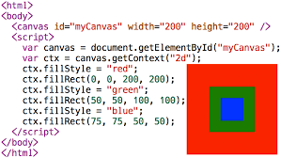
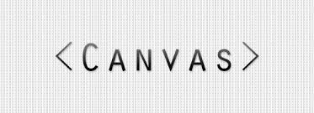

Slide 5
2D Transformation of Elements

Slide 6
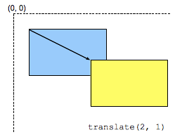
2D Transformation of Elements
The translate() Function
The rotate() Function
The scale() Function
The skew() Function
The matrix() Function

Slide 7
2D Transform Functions
Function | Description
translate(tx,ty) | Moves the element by the given amount along the X and Y-axis.
translateX(tx) | Moves the the element by the given amount along the X-axis.
translateY(ty) | Moves the the element by the given amount along the Y-axis.
rotate(a) | Rotates the element by the specified angle around the origin of the element, as defined by the transform-origin property.
scale(sx,sy) | Scale the width and height of the element up or down by the given amount. The function scale(1,1) has no effect.
scaleX(sx) | Scale the width of the element up or down by the given amount.
scaleY(sy) | Scale the height of the element up or down by the given amount.
skew(ax,ay) | Skews the element by the given angle along the X and Y-axis.
skewX(ax) | Skews the element by the given angle along the X-axis.
skewY(ay) | Skews the element by the given angle along the Y-axis.
matrix(n,n,n,n,n,n) | Specifies a 2D transformation in the form of a transformation matrix comprised of the six values.

Slide 8
3D Transformation of Elements

Slide 9
Using CSS Transform and Transform Functions
The translate3d() Function
The rotate3d() Function
The scale3d() Function
The matrix3d() Function

Slide 10
3D Transform Functions
Function | Description
translate3d(tx,ty,tz) | Moves the element by the given amount along the X, Y & Z-axis.
translateX(tx) | Moves the element by the given amount along the X-axis.
translateY(ty) | Moves the element by the given amount along the Y-axis.
translateZ(tz) | Moves the element by the given amount along the Z-axis.
rotate3d(x,y,z, a) | Rotates the element in 3D space by the angle specified in the last parameter, around the [x,y,z] direction vector.
rotateX(a) | Rotates the element by the given angle around the X-axis.
rotateY(a) | Rotates the element by the given angle around the Y-axis.
rotateZ(a) | Rotates the element by the given angle around the Z-axis.
scale3d(sx,sy,sz) | Scales the element by the given amount along the X, Y and Z-axis. The function scale3d(1,1,1) has no effect.
scaleX(sx) | Scales the element along the X-axis.
scaleY(sy) | Scales the element along the Y-axis.
scaleZ(sz) | Scales the element along the Z-axis.
matrix3d(n,n,n,n,n,n, n,n,n,n,n,n,n,n,n,n) | Specifies a 3D transformation in the form of a 4×4 transformation matrix of 16 values.
perspective(length) | Defines a perspective view for a 3D transformed element. In general, as the value of this function increases, the element will appear further away from the viewer.

Slide 11
CSS3 Transitions

Slide 12
CSS3 Transition Properties
Property | Description
transition | A shorthand property for setting all the four individual transition properties in a single declaration.
transition-delay | Specifies when the transition will start.
transition-duration | Specifies the number of seconds or milliseconds a transition animation should take to complete.
transition-property | Specifies the names of the CSS properties to which a transition effect should be applied.
transition-timing-function | Specifies how the intermediate values of the CSS properties being affected by a transition will be calculated.

Slide 13
CSS3 Animations

Slide 14
CSS3 Animation Properties
Property | Description
animation | A shorthand property for setting all the animation properties in single declaration.
animation-name | Specifies the name of @keyframes defined animations that should be applied to the selected element.
animation-duration | Specifies how many seconds or milliseconds that an animation takes to complete one cycle of the animation.
animation-timing-function | Specifies how the animation will progress over the duration of each cycle i.e. the easing functions.
animation-delay | Specifies when the animation will start.
animation-iteration-count | Specifies the number of times an animation cycle should be played before stopping.
animation-direction | Specifies whether or not the animation should play in reverse on alternate cycles.
animation-fill-mode | Specifies how a CSS animation should apply styles to its target before and after it is executing.
animation-play-state | Specifies whether the animation is running or paused.
@keyframes | Specifies the values for the animating properties at various points during the animation.

Slide 15
SASS

Slide 16
SASS
Sass stands for Syntactically Awesome Stylesheet
Sass is an extension to CSS
Sass is a CSS pre-processor
Sass is completely compatible with all versions of CSS
Sass reduces repetition of CSS and therefore saves time
Sass was designed by Hampton Catlin and developed by Natalie Weizenbaum in 2006
Sass is free to download and use

Slide 17
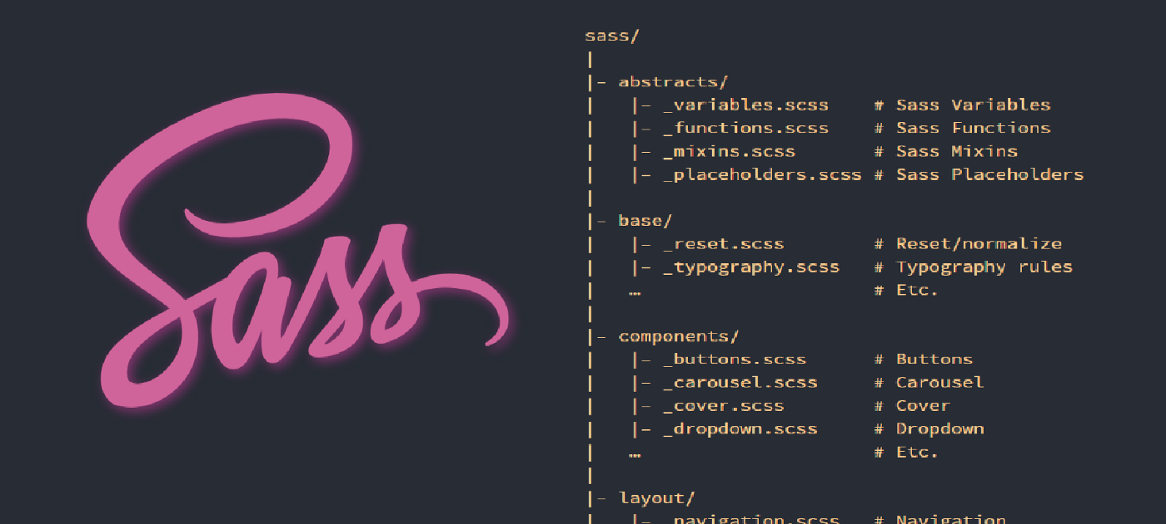

Slide 18
SASS @-Rules and Directives
@import
@media
@extend
@at-root
@debug
@warm
@error

Slide 19
Sass Importing Files
Example
@import "variables";
@import "colors";
@import "reset";

Slide 20
Creating Cross-Browser Compatible Websites
Step 1: Set a ‘Doctype’ for Your HTML Files
Step 2: Use the CSS Reset Rules
Step 3: Use Cross-Browser Compatible Libraries and Frameworks
<!DOCTYPE HTML PUBLIC “-//W3C//DTD HTML 4.01//EN”
“http://www.w3.org/TR/html4/strict.dtd">

Slide 21
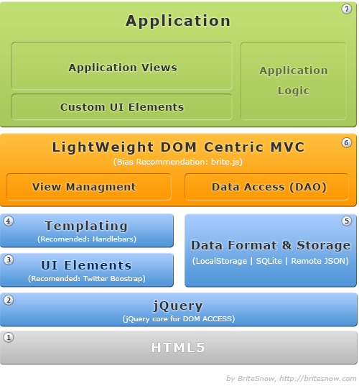

Slide 22
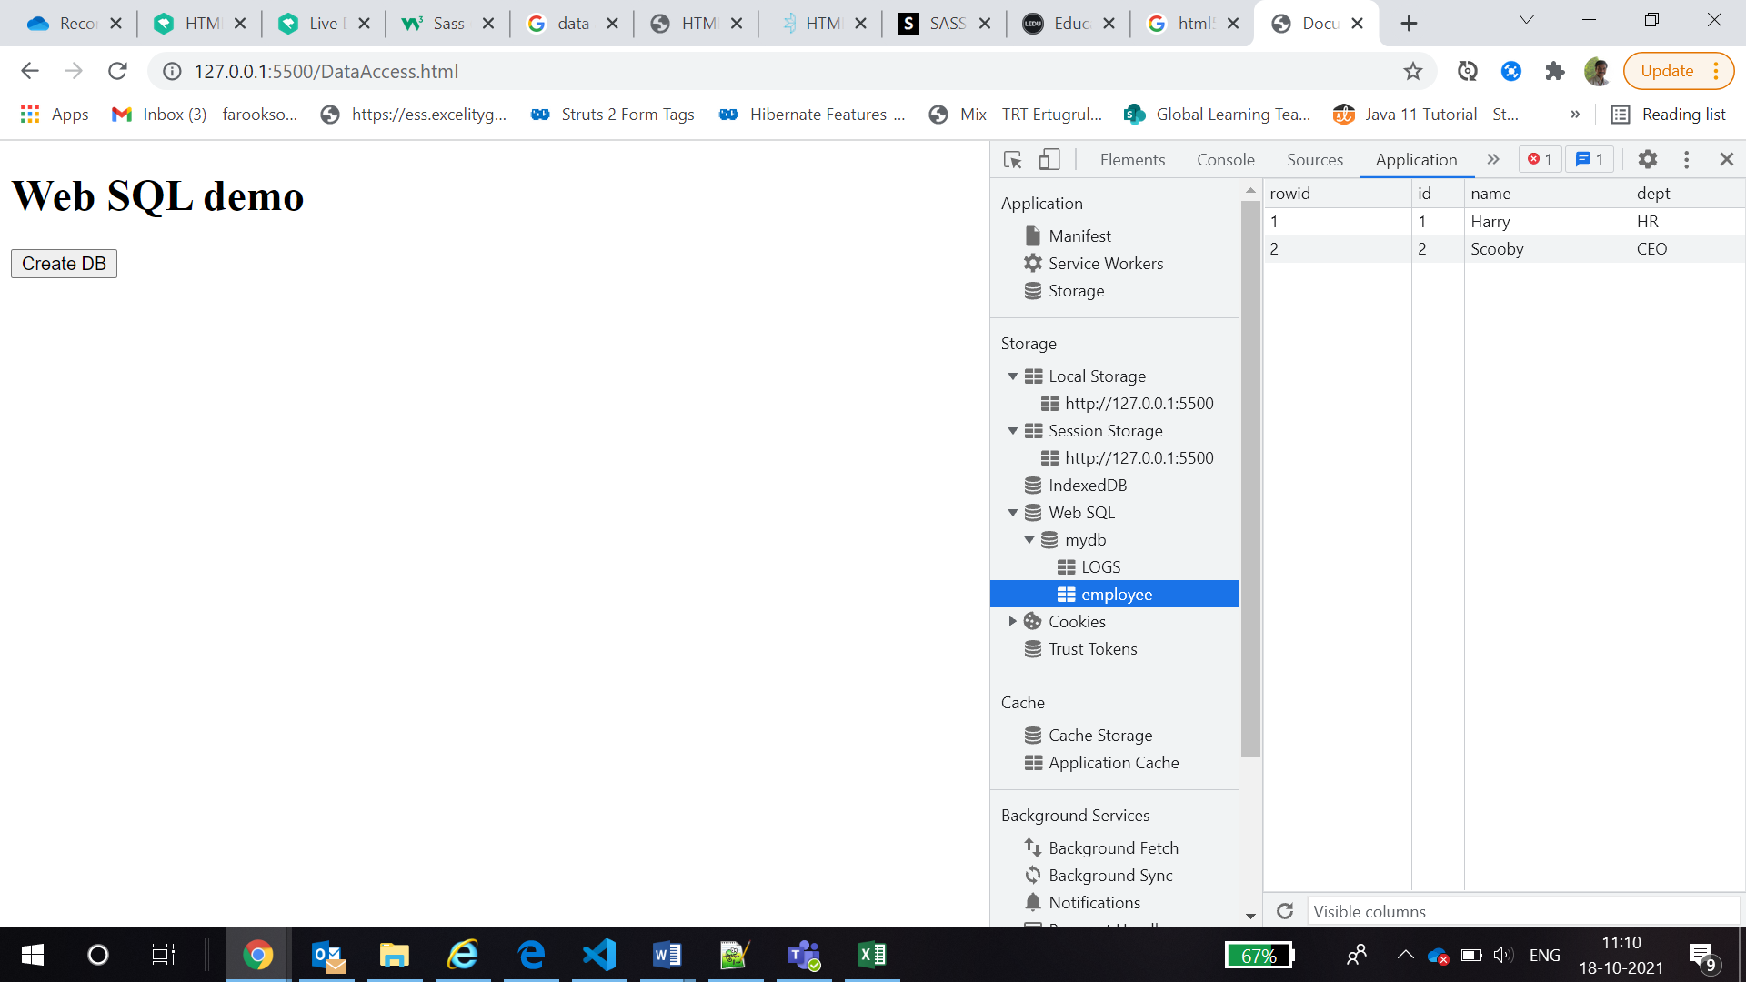
Web SQL DB

Slide 23
AJAX

Slide 24
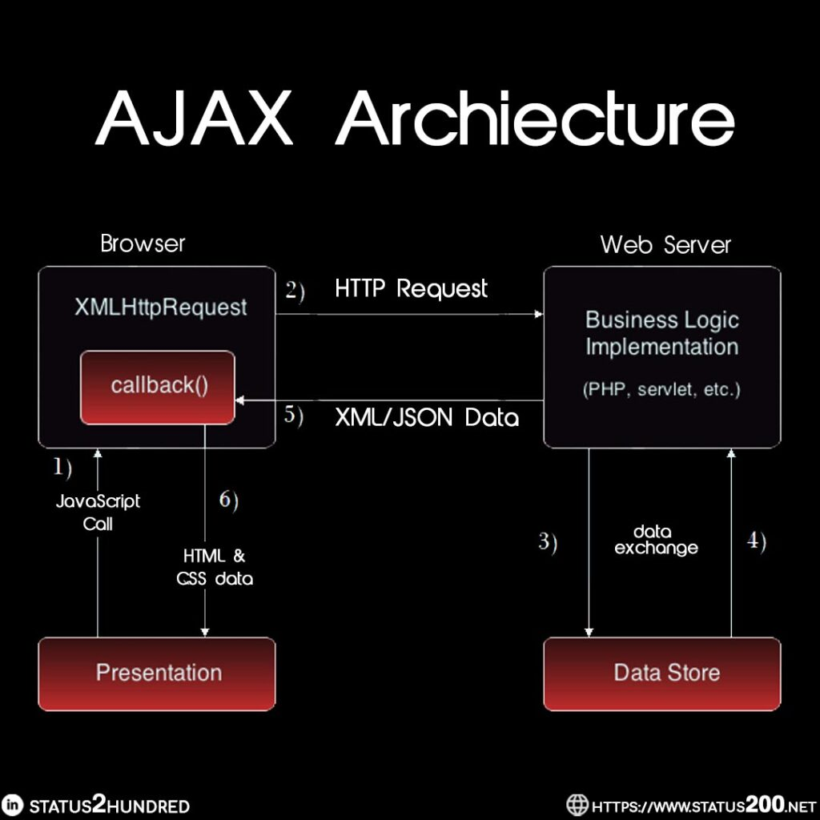

Slide 25
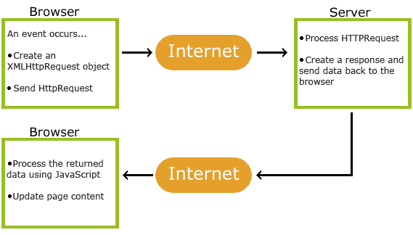

Slide 26
Application Cache in HTML5

Slide 27
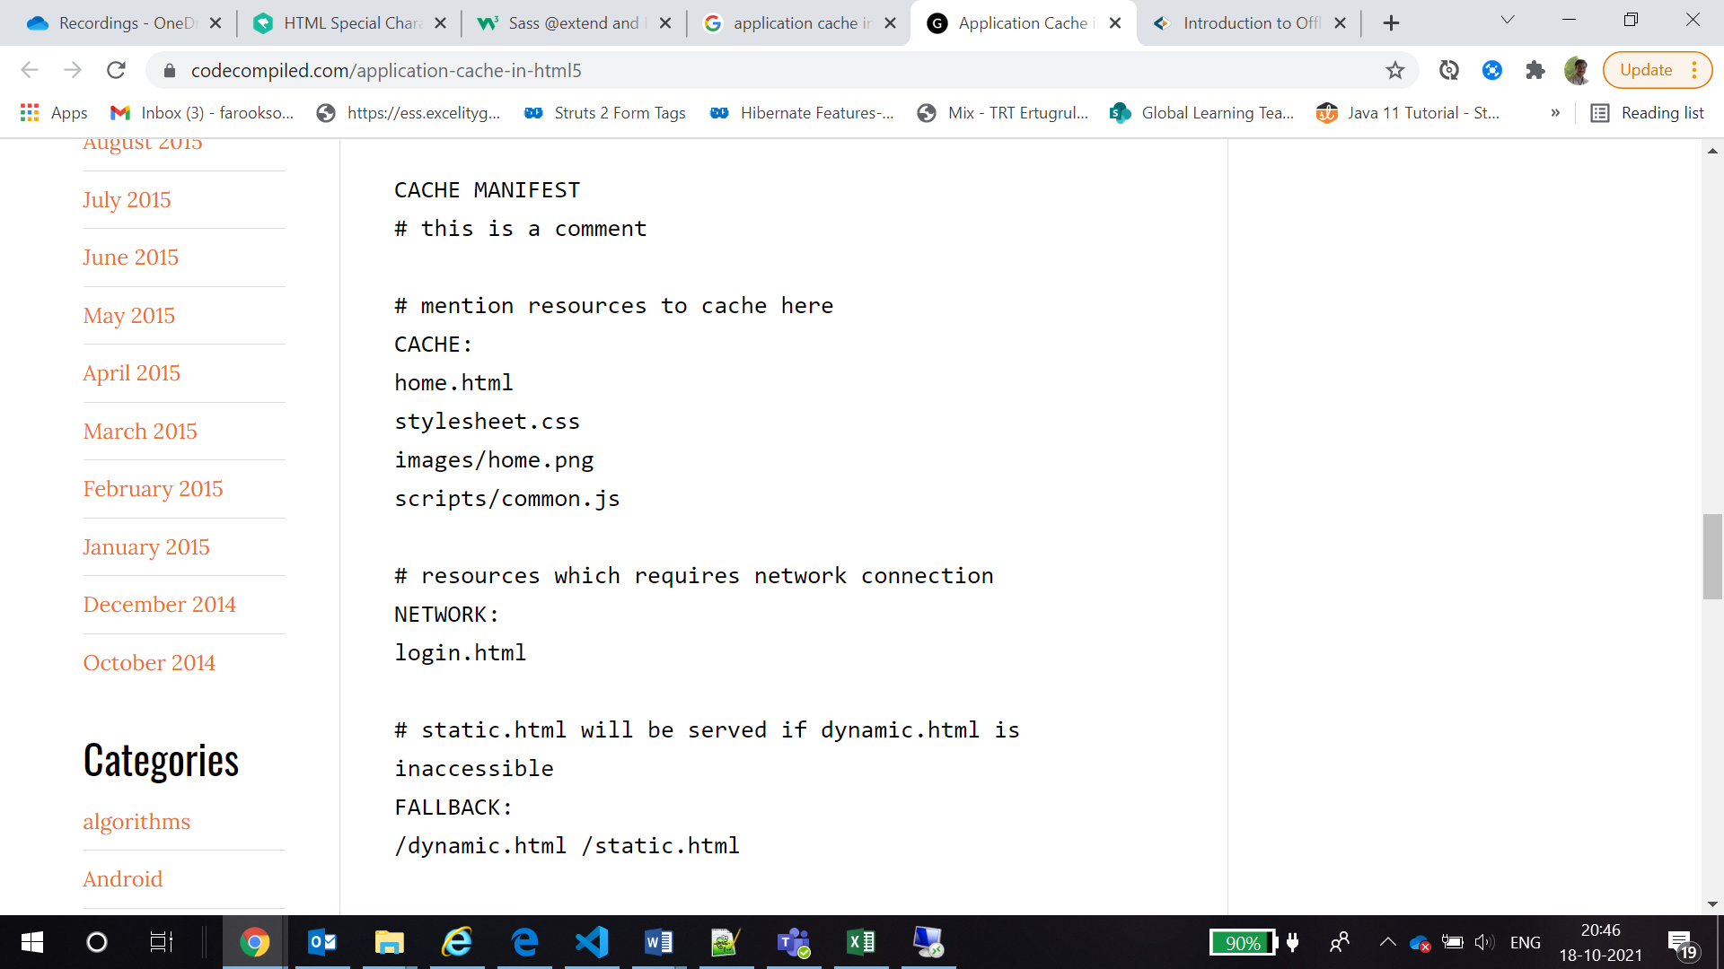
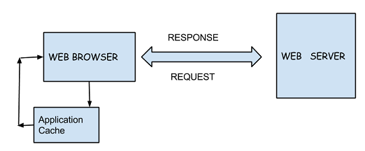

Slide 28
ALTERNATIVE RESOURCES

Slide 29
RESOURCES
Ajax: https://www.ibm.com/docs/en/rational-soft-arch/9.6.1?topic=page-asynchronous-javascript-xml-ajax-overview
CSS Animations: https://developer.mozilla.org/en-US/docs/Web/CSS/CSS_Animations/Using_CSS_animations
SASS: https://sass-lang.com/

Slide 30

THANKS!

