Slide 1

Module 3 UI
Day 3

Slide 2
Agenda
Web Workers
CORS
Web Messaging

Slide 3
Web Workers

Slide 4
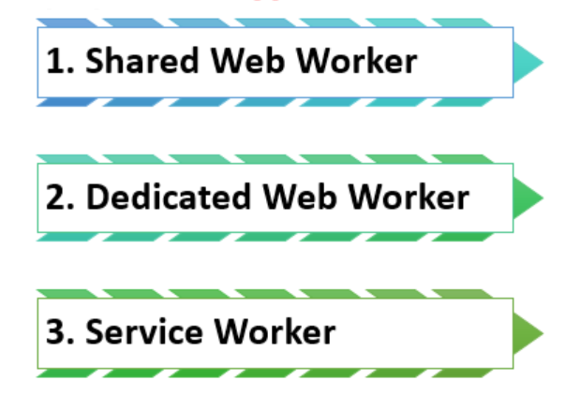
Create a Web Workers File
var worker = new Worker(sample.js);
worker. postMessage();
worker. onmessage = function(event)
worker.terminate()
Worker.onerror();

Slide 5
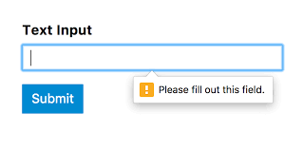
Form Validation

Slide 6
CORS

Slide 7
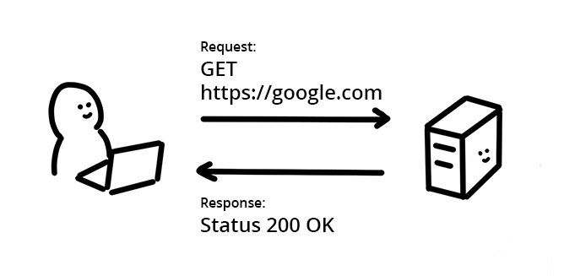
How does a resource request work on the web?
Sample Request header
Accept: text/html
Cookie: Version=1
Sample Response header
Content-Encoding: gzip
Cache-Control: no-store

Slide 8
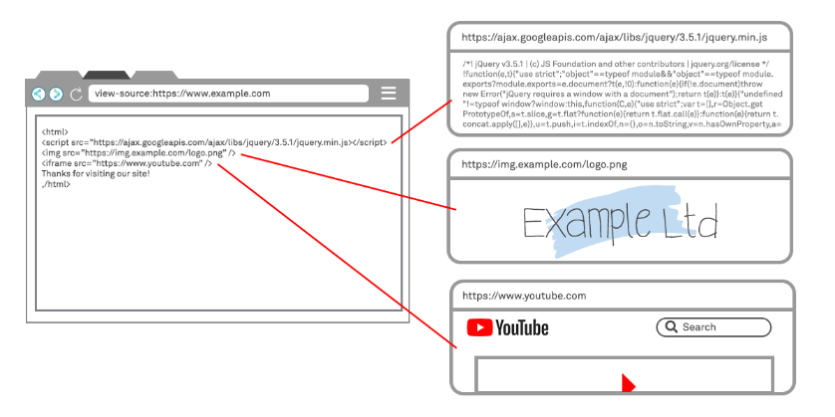

Slide 9
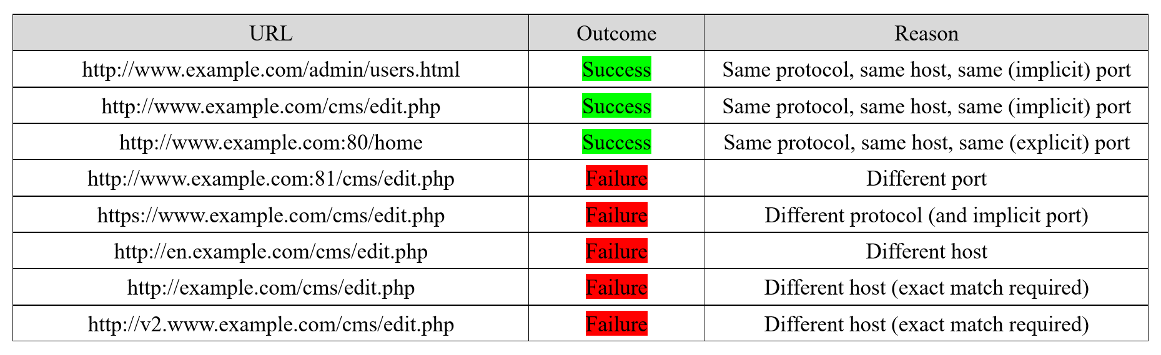
DOM cross-origin protection – The Same Origin Policy (SOP)

Slide 10
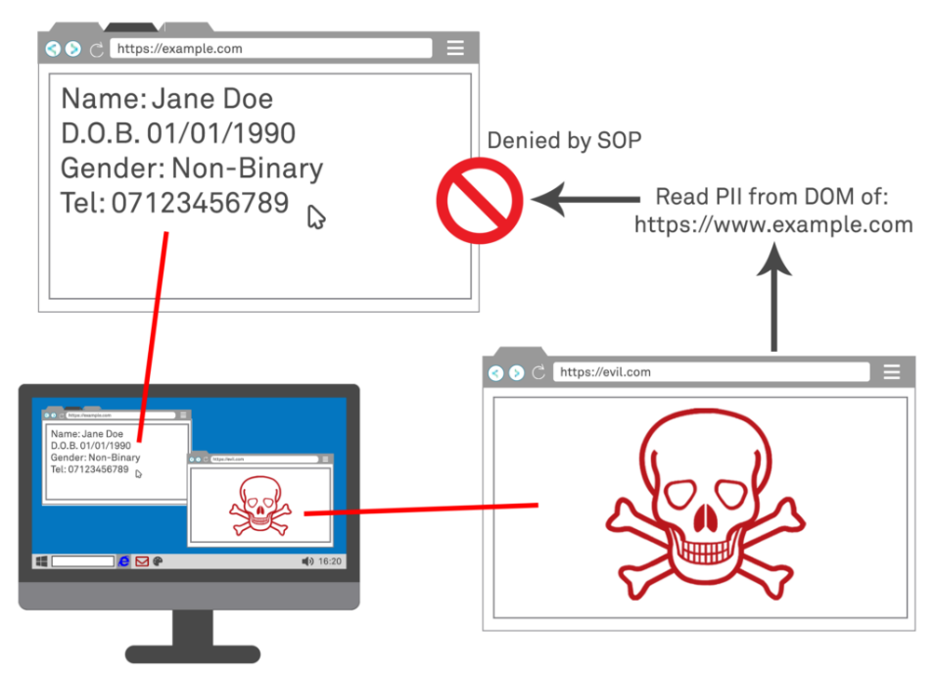

Slide 11
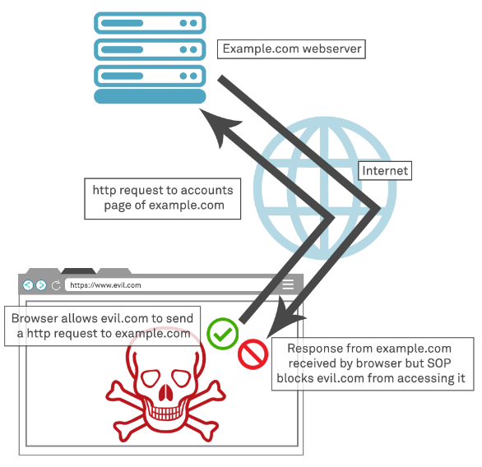

Slide 12
HTML5 Web Messaging

Slide 13
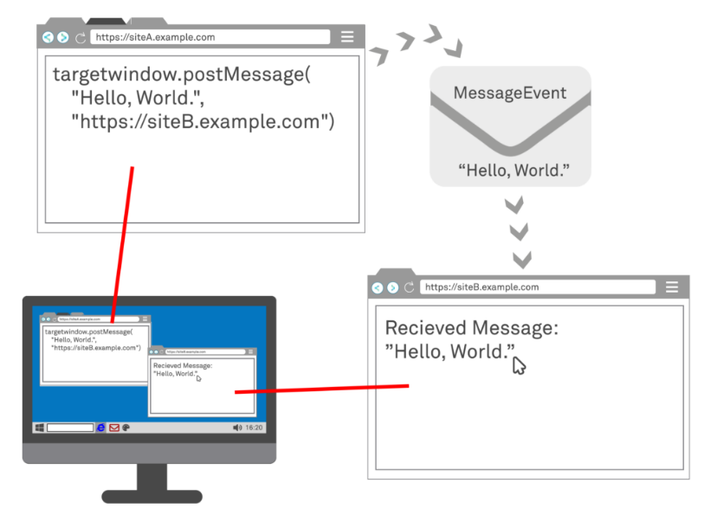
Web messaging Events
Data
Origin
Source
Ports
lastEventId

Slide 14
Domain Trust & Origin Restriction
Receiving A Message
Sending a message
Input Validation
Prevention & Mitigation

Slide 15
ALTERNATIVE RESOURCES

Slide 16

THANKS!

