Slide 1
Module 3 UI
Day 1

Slide 2
Agenda
HTML5 Intro
Page Semantics
CSS3
Forms

Slide 3
HTML5 Intro

Slide 4

HTML5 Intro
HTML5 is the new HTML standard that includes most of the features and capabilities of HTML4 along with new semantic markup plus a number of new JavaScript APIs.
HTML5 is a series of new elements, updates to existing elements and new JavaScript APIs available through contemporary web browsers.

Slide 5
Evolution of HTML 5 The Specification
HTML5 is a markup language that was founded in 2004 by the Web Hypertext Application Technology Working Group (WHATWG) whose members include Apple, Mozilla Foundation and Opera Software.
In March 2011, a big news revealed that "Disney buys HTML5 gaming start-up".
in July 2011, Pandora begins to make a HTML5 based audio player.
April 2012, Flicker include a new HTML5 uploader

Slide 6
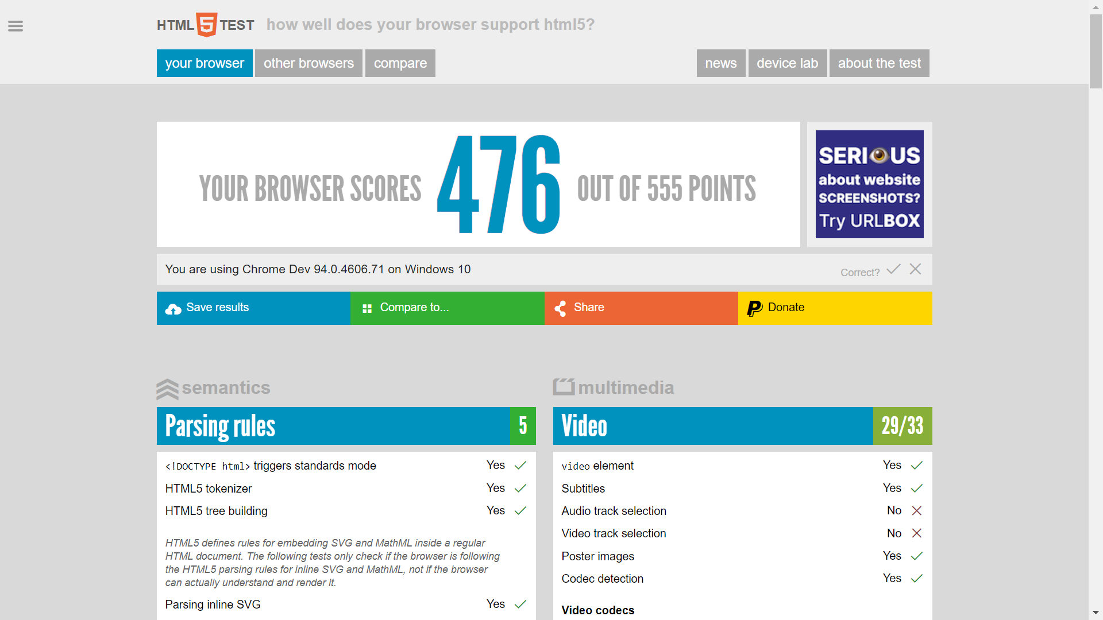

Browser Support http://html5test.com/

Slide 7
HTML5 advantages
Cleaner markup/ Improved code
Elegant forms
Consistency
Supports rich media elements
Offline Application Cache

Slide 8
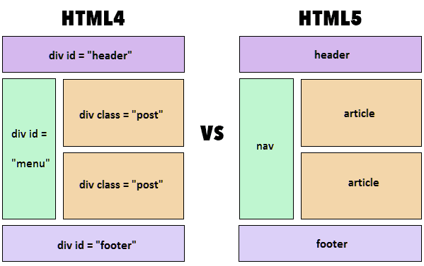
HTML5 Features

Slide 9
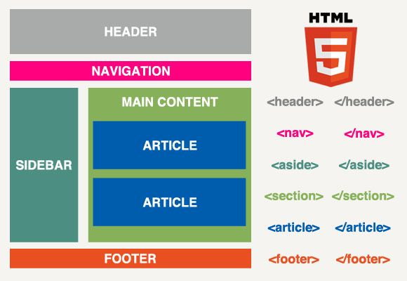
HTML5 Page Structure
header section with a logo and title
navigation bar
body content divided into three columns
articles and ad blocks within the columns
footer containing some author and copyright information

Slide 10
Formatting using CSS3

Slide 11

What You Can Do with CSS
apply same style rules on multiple elements
control the presentation of multiple pages
present the same page differently on different devices
alter the display of existing HTML elements

Slide 12
Advantages of Using CSS
CSS Save Lots of Time
Easy Maintenance
Pages Load Faster
Superior Styles to HTML
Multiple Device Compatibility

Slide 13
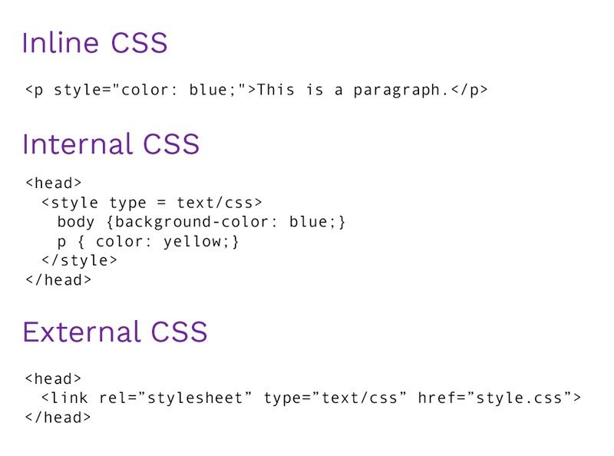
Including CSS in HTML Documents

Slide 14
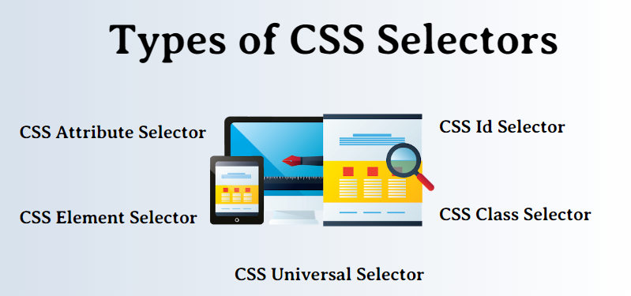
Selector

Slide 15
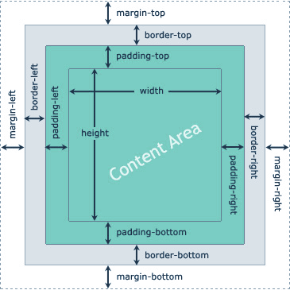
Box Model

Slide 16
Width and Height of the Elements
Box Size | CSS Properties
Total Width | width + padding-left + padding-right + border-left + border-right + margin-left + margin-right
Total Height | height + padding-top + padding-bottom + border-top + border-bottom + margin-top + margin-bottom

Slide 17
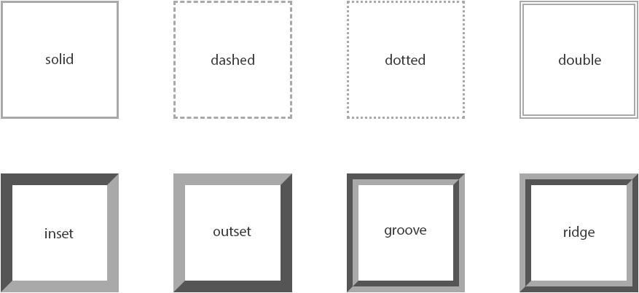
CSS Border Properties

Slide 18
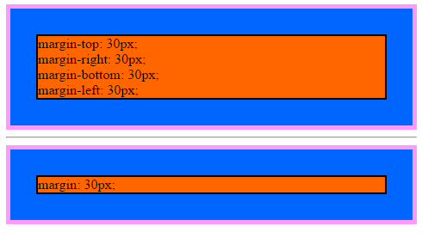
CSS Margin
The CSS margin properties allow you to set the spacing around the border of an element's box (or the edge of the element's box, if it has no defined border).

Slide 19
CSS Background
<div style="height: 200px; width: 500px; color: #ffffff;
background-color: #ff6600;
background-image: url(Images/block.gif);
background-repeat: repeat-x">
background-color: #ff6600;
background-image: url(Images/block.gif);
background-repeat: repeat-x;
</div>

Slide 20
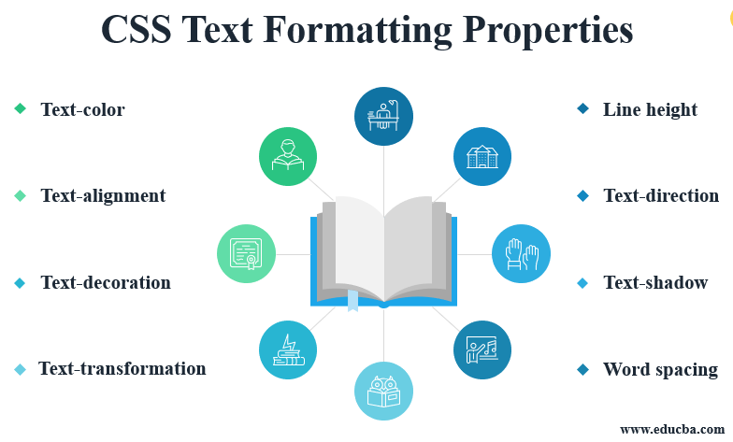
CSS Text

Slide 21
CSS Multi-column Layout
CSS Multi-column Properties
column-count
column-gap
column-rule-style
column-rule-width
column-rule-color
column-rule
column-span
column-width

Slide 22
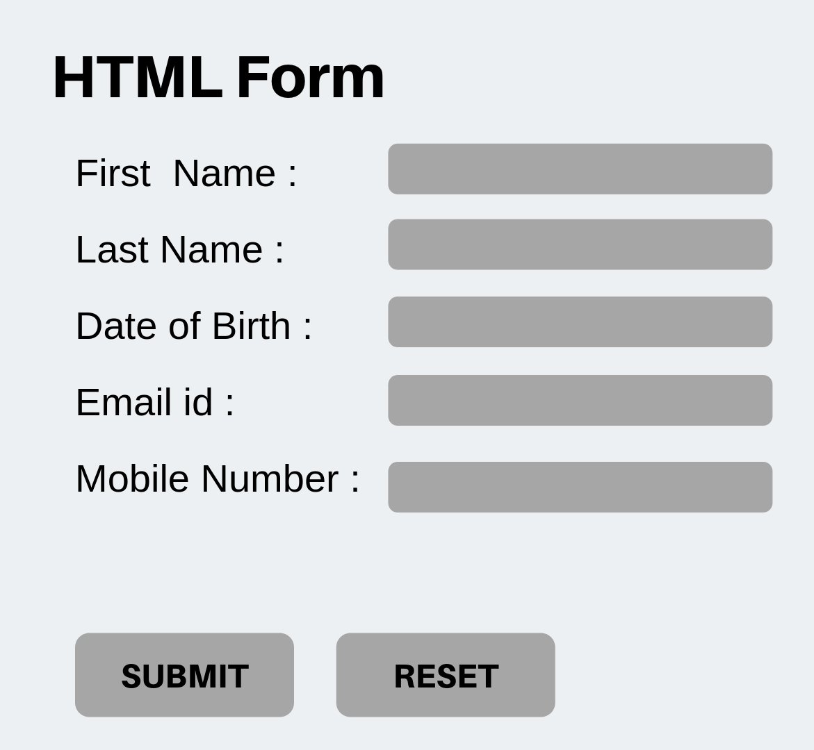
HTML Form

Slide 23
Form Attributes
Attribute | Description
name | Specifies the name of the form.
action | Specifies the URL of the program or script on the web server that will be used for processing the information submitted via form.
method | Specifies the HTTP method used for sending the data to the web server by the browser. The value can be either get (the default) and post.
target | Specifies where to display the response that is received after submitting the form. Possible values are _blank, _self, _parent and _top.
enctype | Specifies how the form data should be encoded when submitting the form to the server. Applicable only when the value of the method attribute is post.

Slide 24
ALTERNATIVE RESOURCES

Slide 25
RESOURCES
https://dev.w3.org/html5/html-author/
https://www.w3.org/TR/2001/WD-css3-roadmap-20010523/

Slide 26

THANKS!

