Slide 1
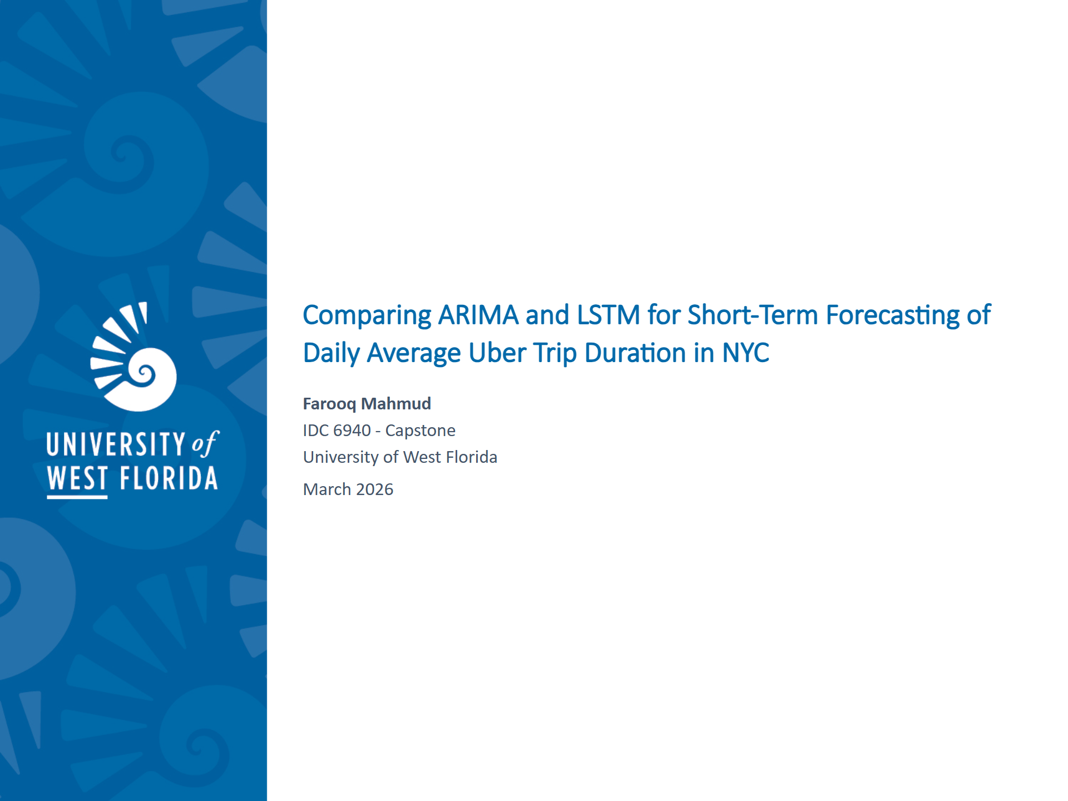
Notes:
SLIDE 1 SCRIPT (~30 seconds): "Good [morning/afternoon/evening] everyone. My name is Farooq Mahmud, and my capstone is longly titled 'Comparing ARIMA and LSTM for Short-Term Forecasting of Daily Average Uber Trip Duration in New York City.' Over the next 20 minutes I'll walk you through the motivation, the methods, the implementation, the results, and what I learned from this project. Let's get into it."

Slide 2

Notes:
SLIDE 2 SCRIPT (~30 seconds): "Here's a quick roadmap of the presentation. We'll start with the problem and why it matters, then move through the data, the two models, the implementation experience, the results, and close with the conclusions and future directions. I'll try to be as concrete as possible so you can see exactly what was done at each stage."

Slide 3
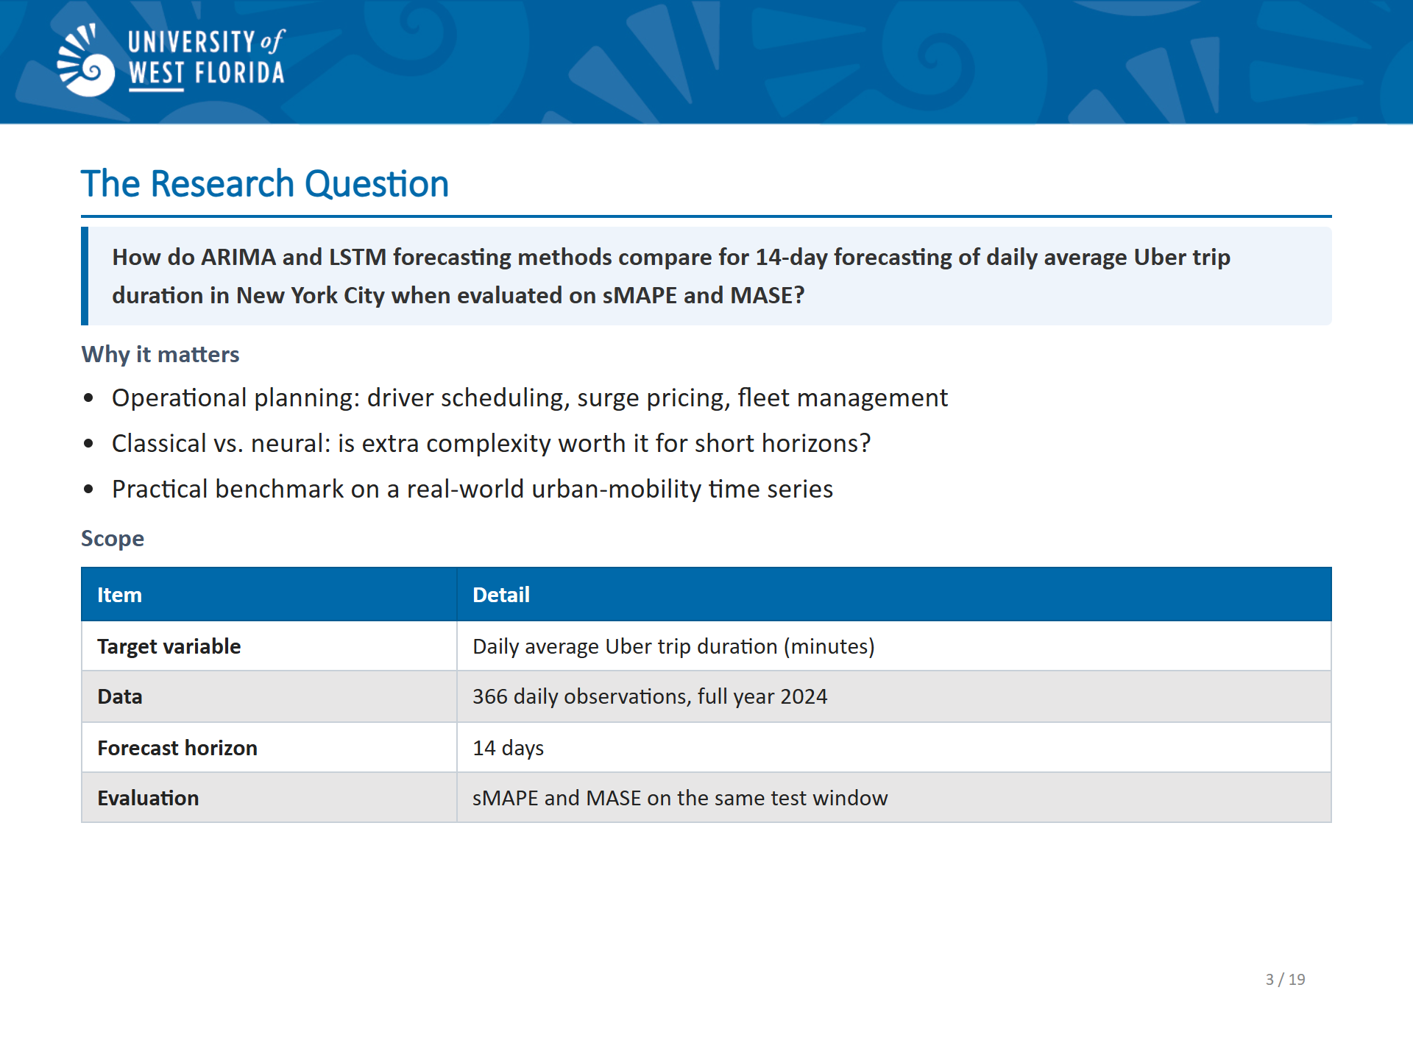
Notes:
SLIDE 3 SCRIPT (~1 minute): "The central question driving this capstone is straightforward: for a short-horizon, univariate time series, does a classical statistical model-ARIMA-outperform a neural sequence model-LSTM? This question matters in practice. If you work for Uber and are trying to predict driver utilization two weeks out, you need a reliable forecast. You also need to know whether it's worth the additional complexity of a deep learning model, or whether a simpler classical approach gives you equally good-or even better-results.
The specific target variable is the daily average Uber trip duration in minutes in New York City. We have 366 daily observations for the full year 2024 – 366 observations because 2024 was a leap year - and we produce a 14-day forecast with both methods, evaluated on the same test window using two well-established metrics: sMAPE which stands for “Symmetric Mean Absolute Percentage Error” and MASE which stands for Mean Absolute Scaled Error
"

Slide 4
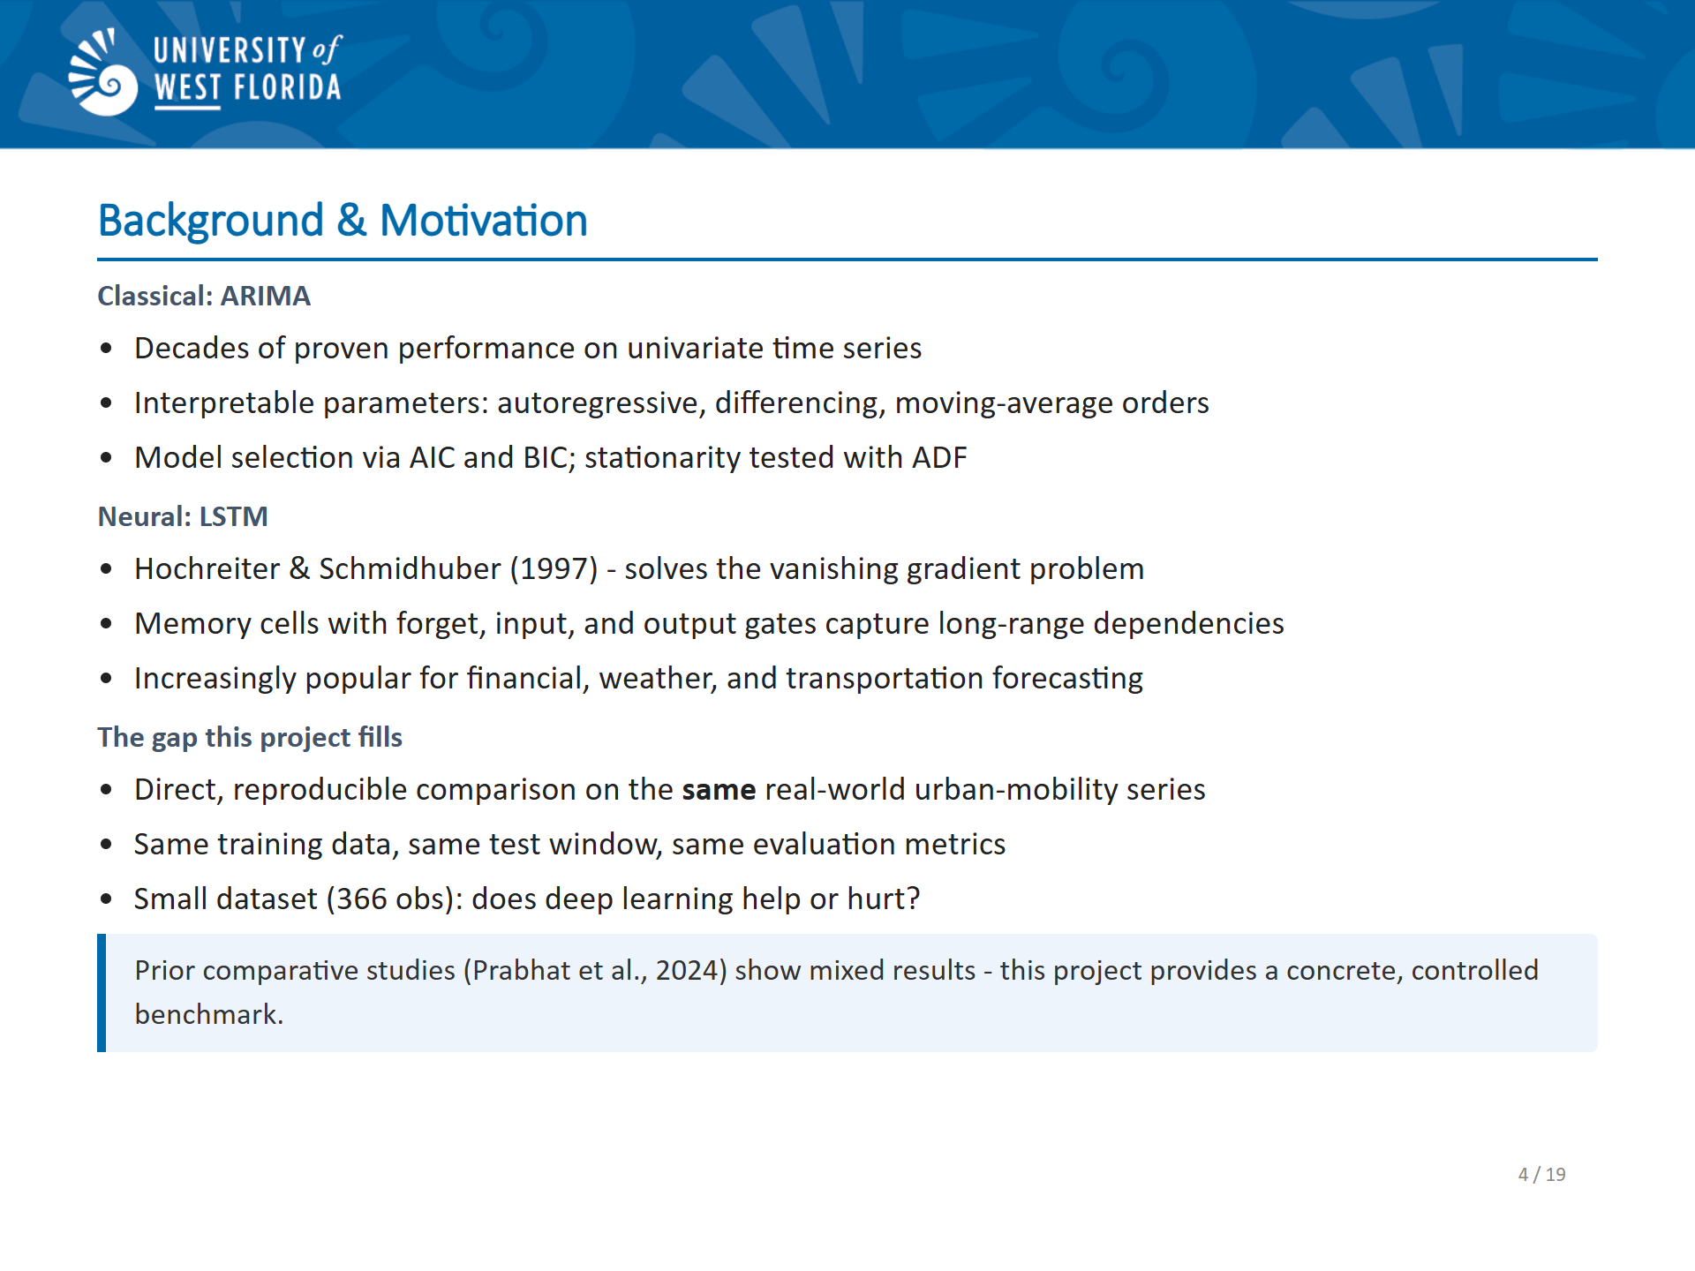
Notes:
SLIDE 4 SCRIPT (~1.5 minutes): "Let me give a bit more background, especially for those who haven’t taken a time-series course.
ARIMA which stands for AutoRegressive Integrated Moving Average-has been the workhorse of univariate forecasting for decades. It's interpretable, well-understood, and performs surprisingly well on datasets where the underlying dynamics are relatively simple. LSTM networks LSTM - stands for Long Short-Term Memory, are a type of recurrent neural network designed by Hochreiter and Schmidhuber in 1997, built specifically to capture long-range temporal dependencies that vanilla RNNs struggle with because of the vanishing gradient problem. They have become extremely popular for time-series tasks ranging from financial forecasting to natural language processing. The open question this project addresses is whether LSTM's added modeling power is actually beneficial when you have a relatively small dataset-366 observations in this case-and a univariate setting – the daily average trip duration being the sole variable. Comparative studies in the literature, like the one cited by Prabhat et al. 2024, show mixed results and motivate exactly this kind of direct, reproducible comparison."

Slide 5
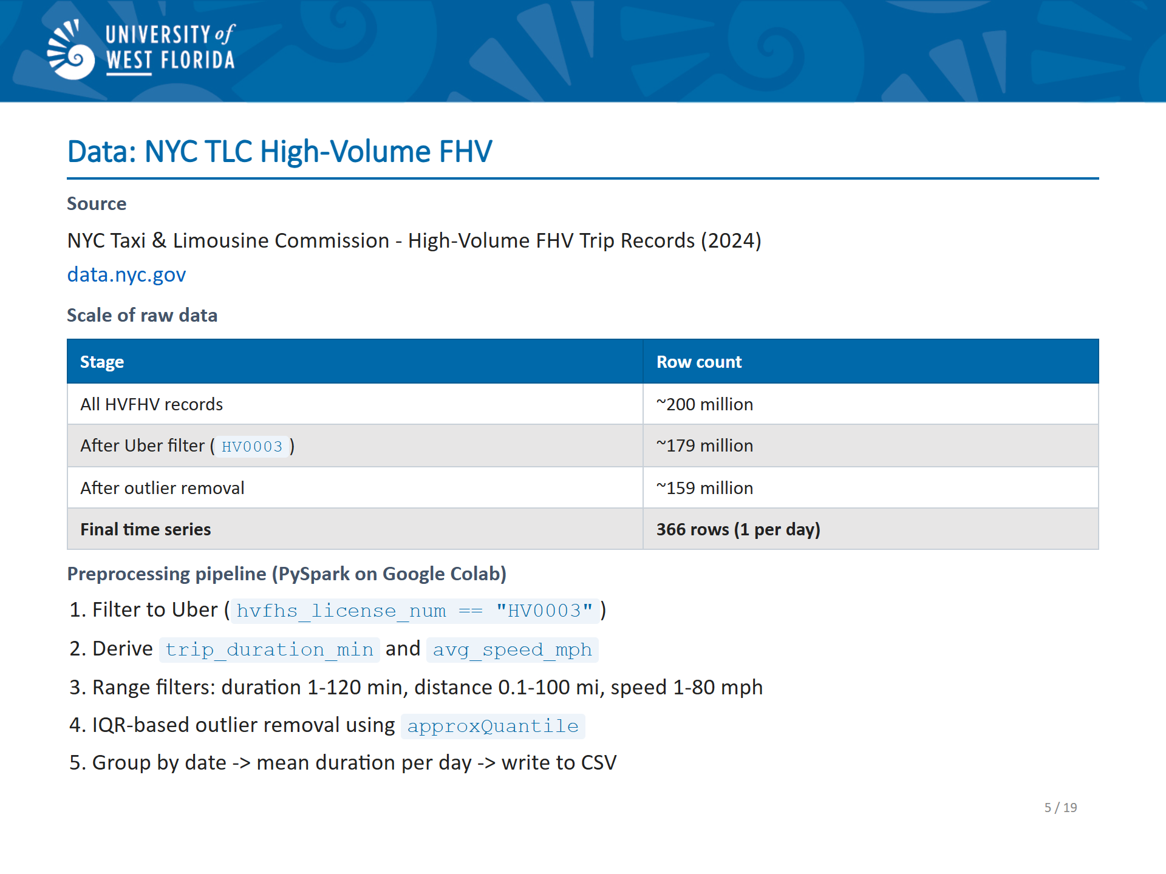
Notes:
SLIDE 5 SCRIPT (~1.5 minutes): "The data come from the New York City Taxi and Limousine Commission, which publishes monthly parquet files of every High-Volume For-Hire Vehicle trip in New York City. The raw dataset for 2024 contains over 200 million trip records. Of those, about 179 million belong to Uber, identified by the license code HV0003. The preprocessing was done in PySpark running on Google Colab, because the raw files are simply too large for me to process locally. After filtering to Uber trips, I derived two new columns-trip duration in minutes and average speed in miles per hour. I then applied a two-step outlier removal: first basic range filters to remove physically impossible trips such as a zero-minute duration or a 200-mile ride, and then an IQR-based filter to remove statistical outliers. After all of that, about 159 million rows remained, which were aggregated to a single CSV file with 366 rows-one row per day-containing the date and the mean trip duration for that day."

Slide 6
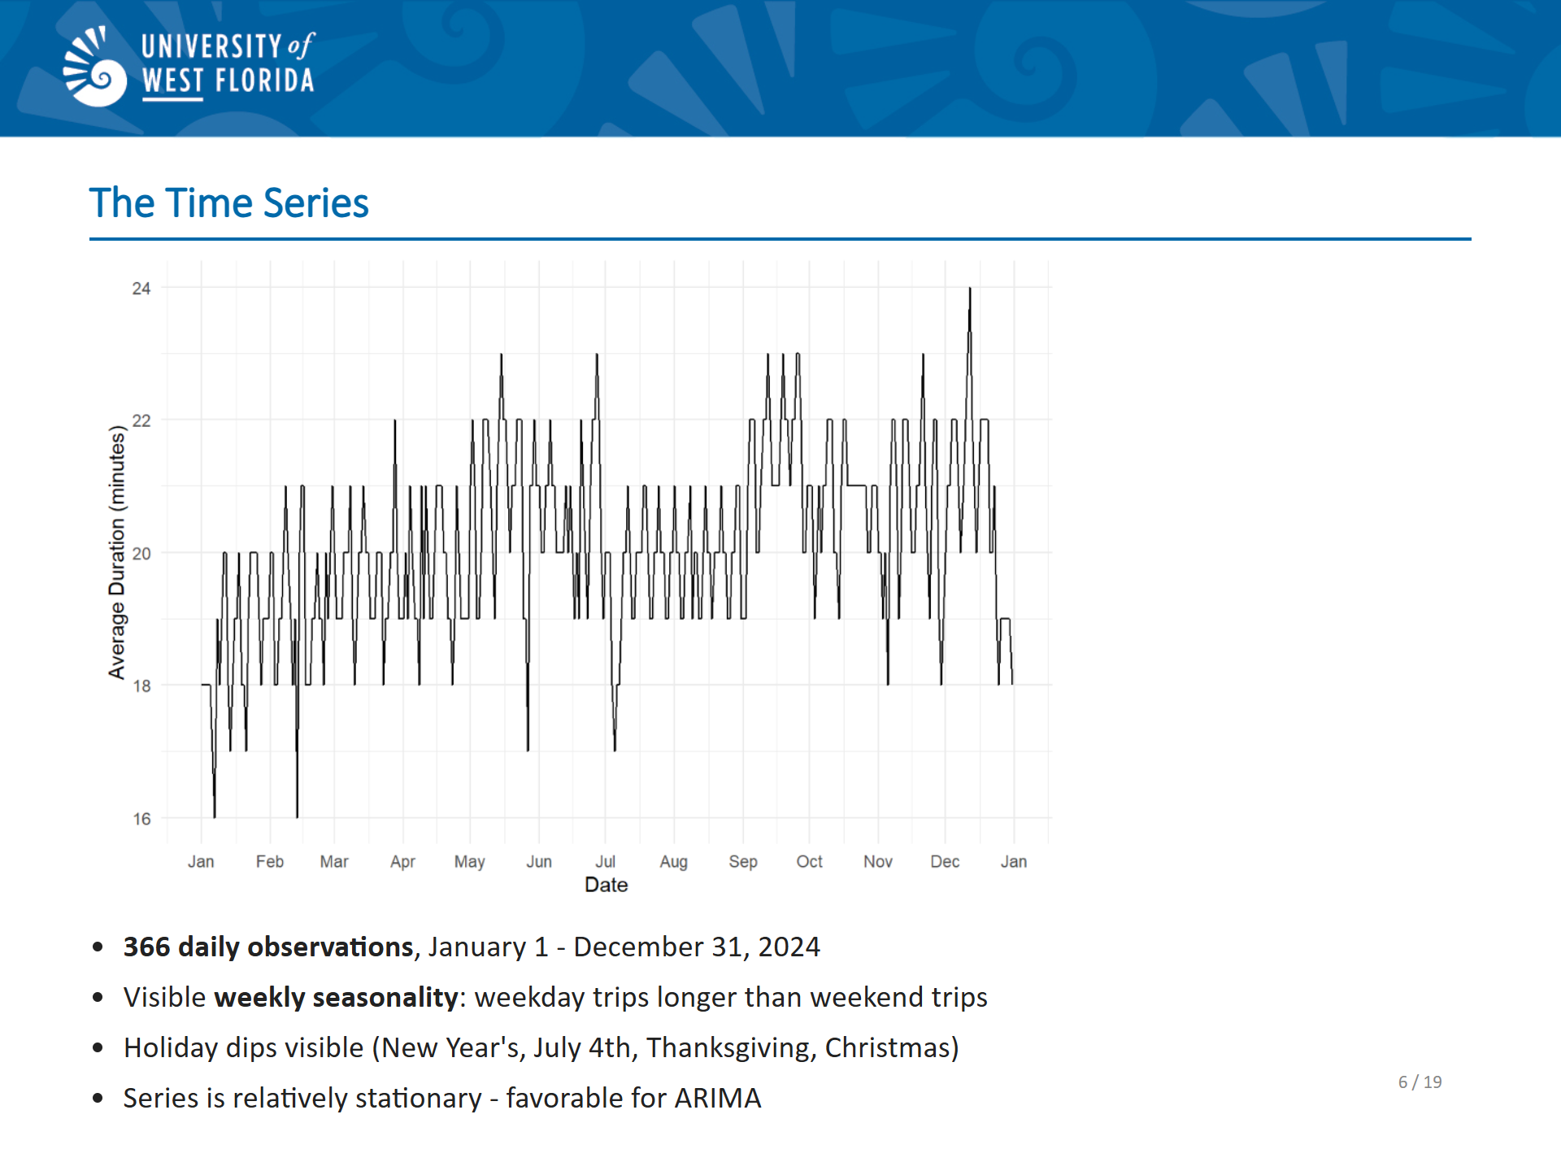
Notes:
SLIDE 6 SCRIPT (~1 minute): "Here's what the final time series looks like. You can see 366 points running from January through December 2024. The series looks stationary at first glance, at least to me. Stationarity is necessary property for ARIMA.
However, your intuition might tell you that trip durations should exhibit a pattern – trips are longer on the weekdays than on weekends. This is truly the case. This is called
A seasonal pattern. What’s more, there are obvious dips on major holidays. The December 25 dip is particularly visible. This seasonal component is reflected in the chosen ARIMA model. For LSTM, the weekly oscillation gives the model a repeating pattern to learn."

Slide 7
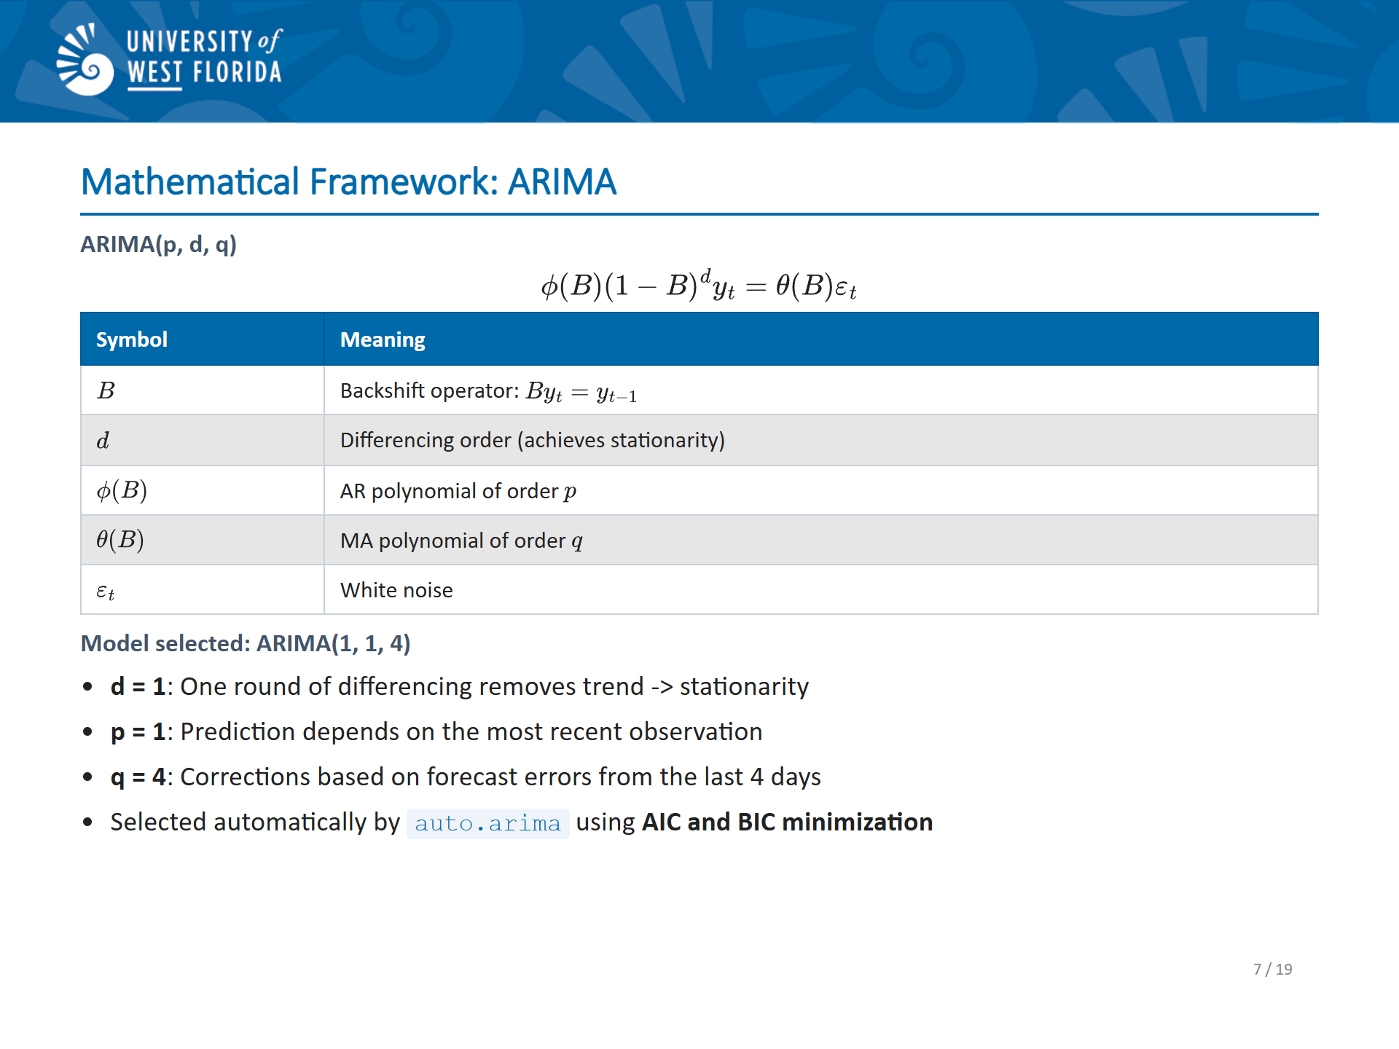
Notes:
SLIDE 7 SCRIPT (~2 minutes): "Now let me try to walk through the math. ARIMA stands for AutoRegressive Integrated Moving Average. The general form is ARIMA(p, d, q). After d rounds of differencing to achieve stationarity, the model expresses the current value as a linear combination of the p most recent past values-that's the autoregressive part-plus a linear combination of the q most recent forecast errors-that's the moving average part-plus white noise. The R forecast package's auto.arima function automates model selection. It first runs the Augmented Dickey-Fuller test to determine how many rounds of differencing are needed, then searches over combinations of p and q, selecting the one that minimizes AIC and BIC. In this project, auto.arima selected ARIMA(1, 1, 4). That means: one differencing step to remove the trend and achieve stationarity, an autoregressive term that depends on the most recent observation, p=1, and four moving-average terms that incorporate forecast errors from the last four time steps. Intuitively, the MA(4) terms help the model recover quickly from “shocks” in the system, like an unusual traffic event."

Slide 8
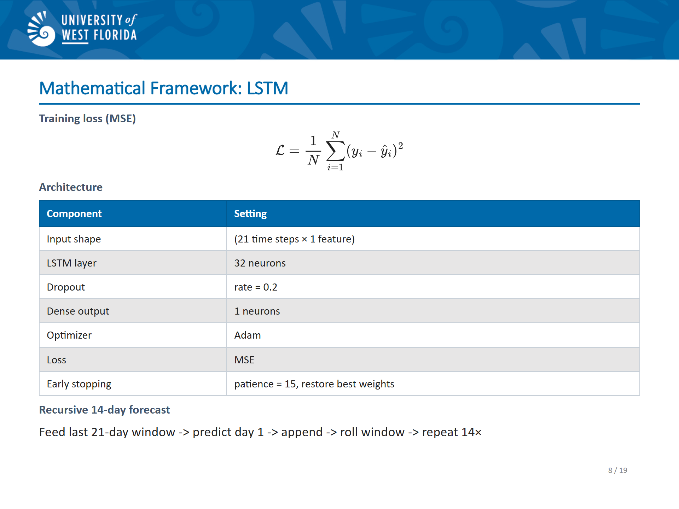
Notes:
SLIDE 8 SCRIPT (~2 minutes): "The second model is an LSTM network implemented in R using the Keras package. I’ll describe the architecture.
The input to the model is a 3-dimensional array: samples, time steps, and features. Here, features is just 1 since this is a univariate series. The time steps dimension is the sequence length, which I set to 21 days. I chose 21 because the series shows weekly cycles-weekdays and weekends behave differently. With three weeks of context, the LSTM sees three full repetitions of the weekly pattern, giving it enough information, in my view, to recognize and extrapolate the cycle. The model has a single LSTM layer with 32 hidden neurons. After the LSTM layer there's a dropout layer with a rate of 0.2, which randomly zeros out 20% of the neurons during each training step to reduce overfitting. Finally, a dense output layer with a single neuron produces the predicted value for the next day. The model is trained to minimize mean squared error using the Adam optimizer. Early stopping monitors the validation loss with a patience of 15 epochs and restores the best weights found during training. The term Patience is how long the training will wait
Before giving up on improvement. This is important because training too long can result in overfitting. Forecasting is done recursively: I feed the last 21-day window before the test period to the model, predict day 1, append that prediction to the window, drop the oldest value, and repeat 14 times to get the full 14-day forecast."

Slide 9
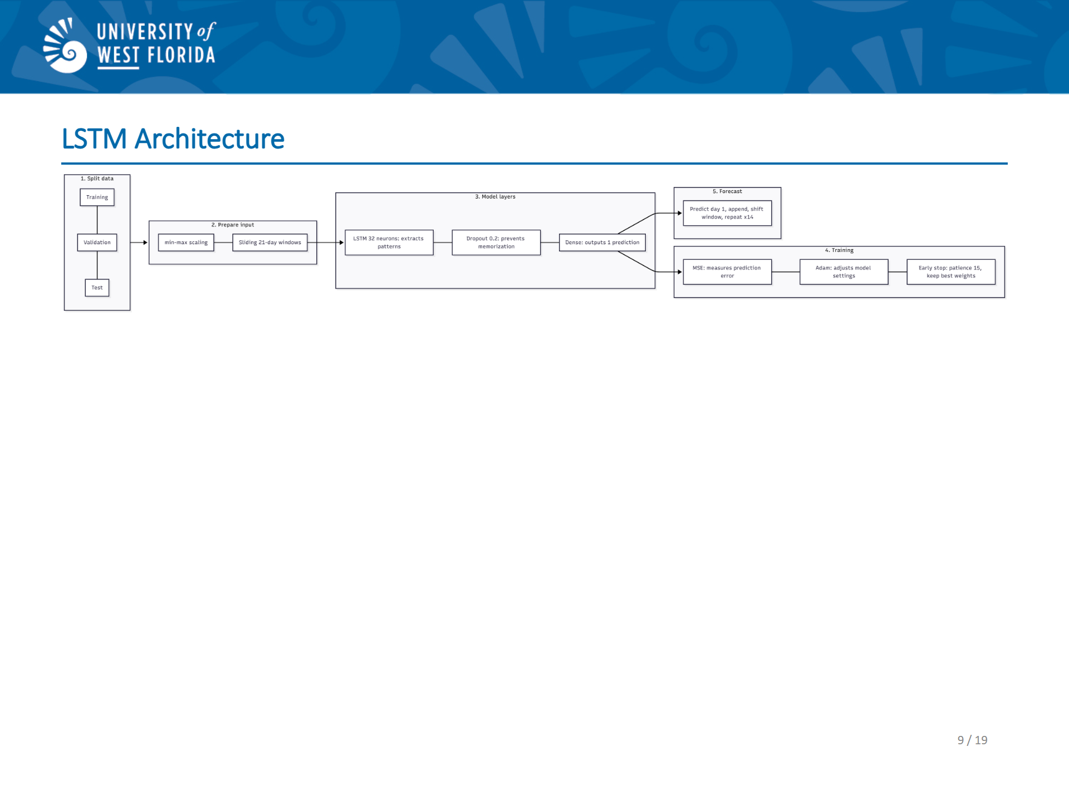
Notes:
SLIDE 9 SCRIPT (~30 seconds): "Here's a visual of the LSTM architecture showing how data flows from the input sequence through the LSTM layer, dropout, and into the single output neuron.“ Apologies for the scaling. It looks better
In the paper.

Slide 10
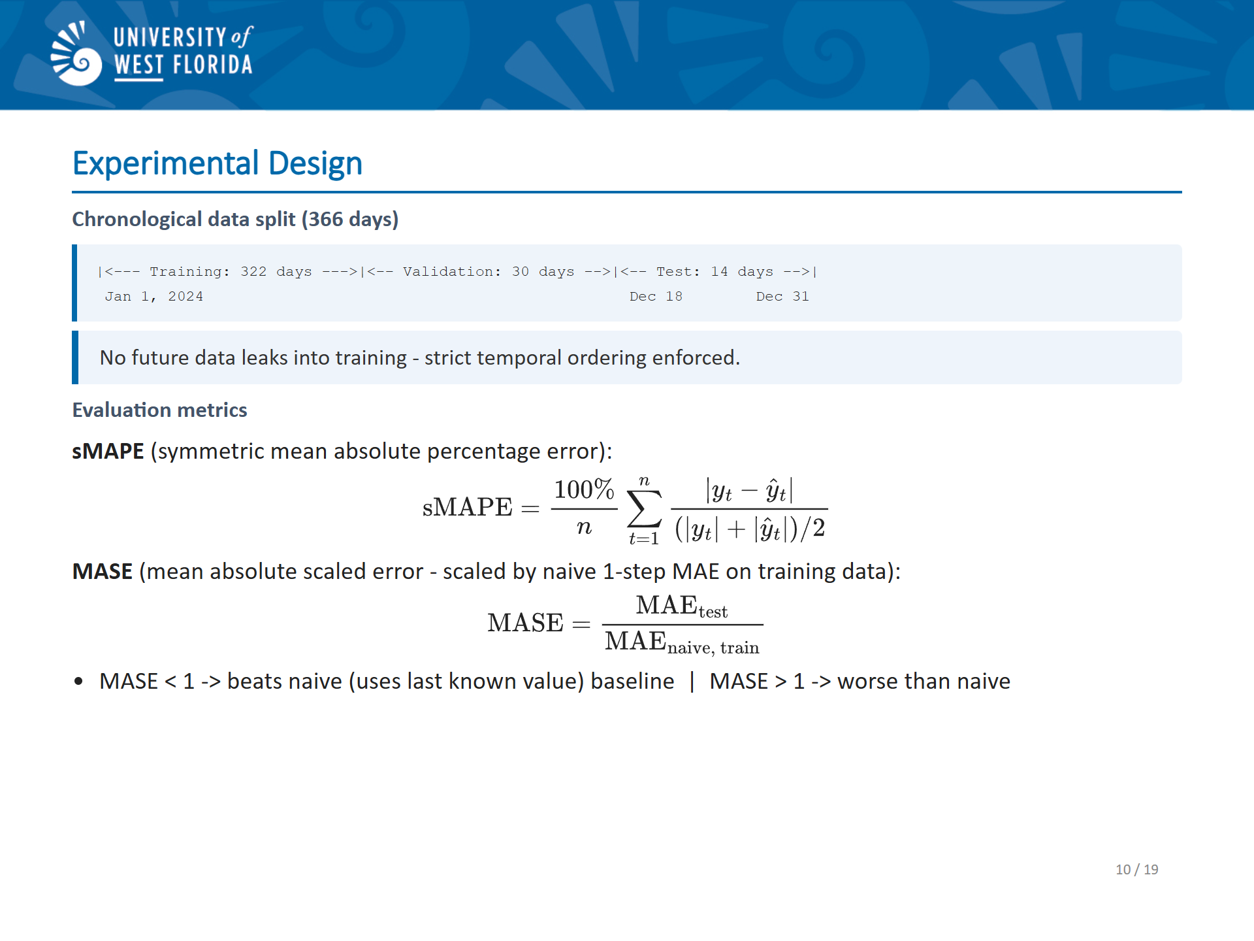
Notes:
SLIDE 10 SCRIPT (~1.5 minutes): "For the experimental design, both models use the same chronological split. The last 14 days of 2024-December 18 through the 31st-are held out as the test set. The preceding 30 days form the validation set, and all remaining data is training. This strict chronological split is essential. You must never train on future data when evaluating a time series model, because that would leak future information and produce artificially optimistic results. Both models are evaluated on the exact same 14 test days using two metrics. sMAPE- symmetric mean absolute percentage error-which is scale-independent and symmetric, treating over- and under-forecasting equally. MASE-mean absolute scaled error-benchmarks the forecast against a naive forecast on the training data. A naive foreacast meaning the last known value is used. A MASE below 1 means the model beats the naive forecast; above 1 means it doesn't. Since sMAPE is returned as a proportion by the R Metrics package, I multiply by 100 to express it as a percentage."

Slide 11
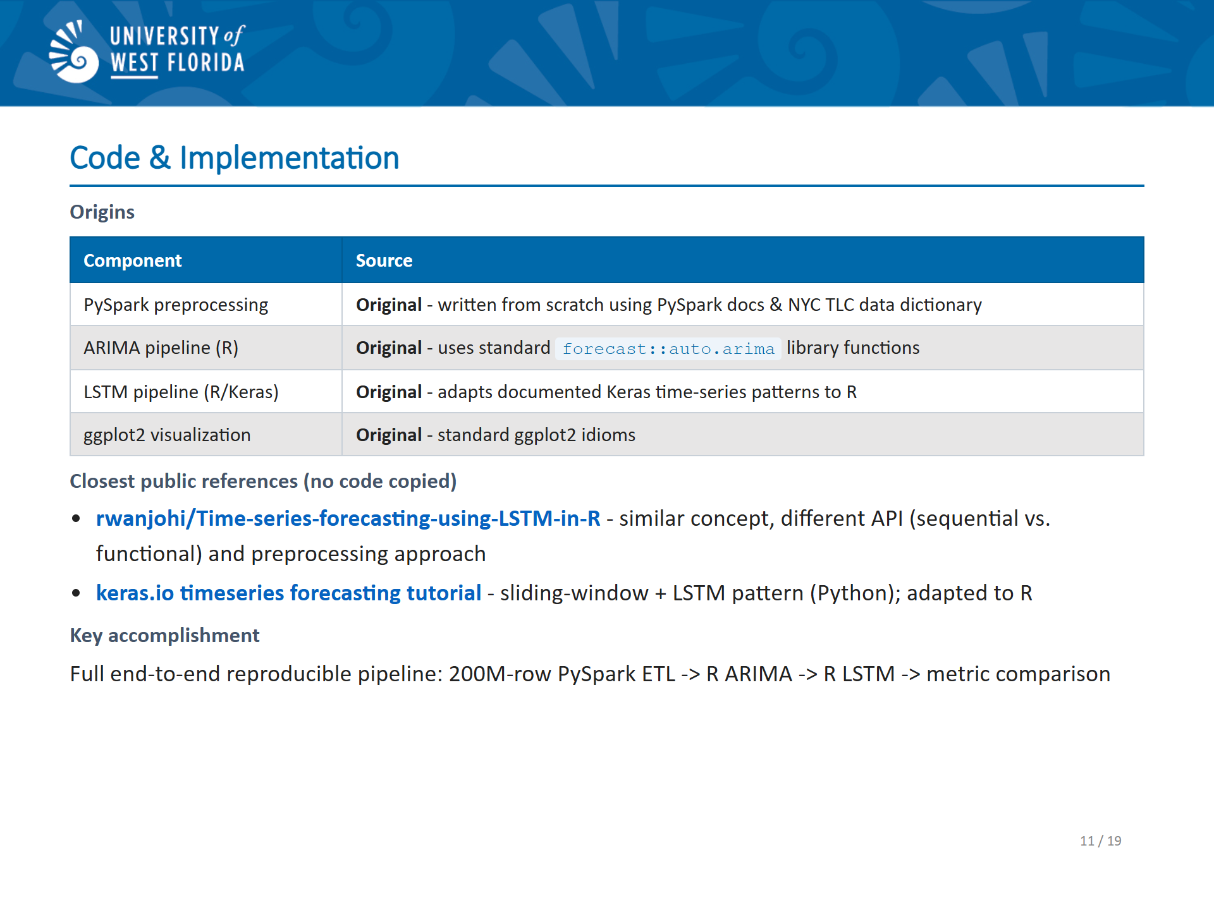
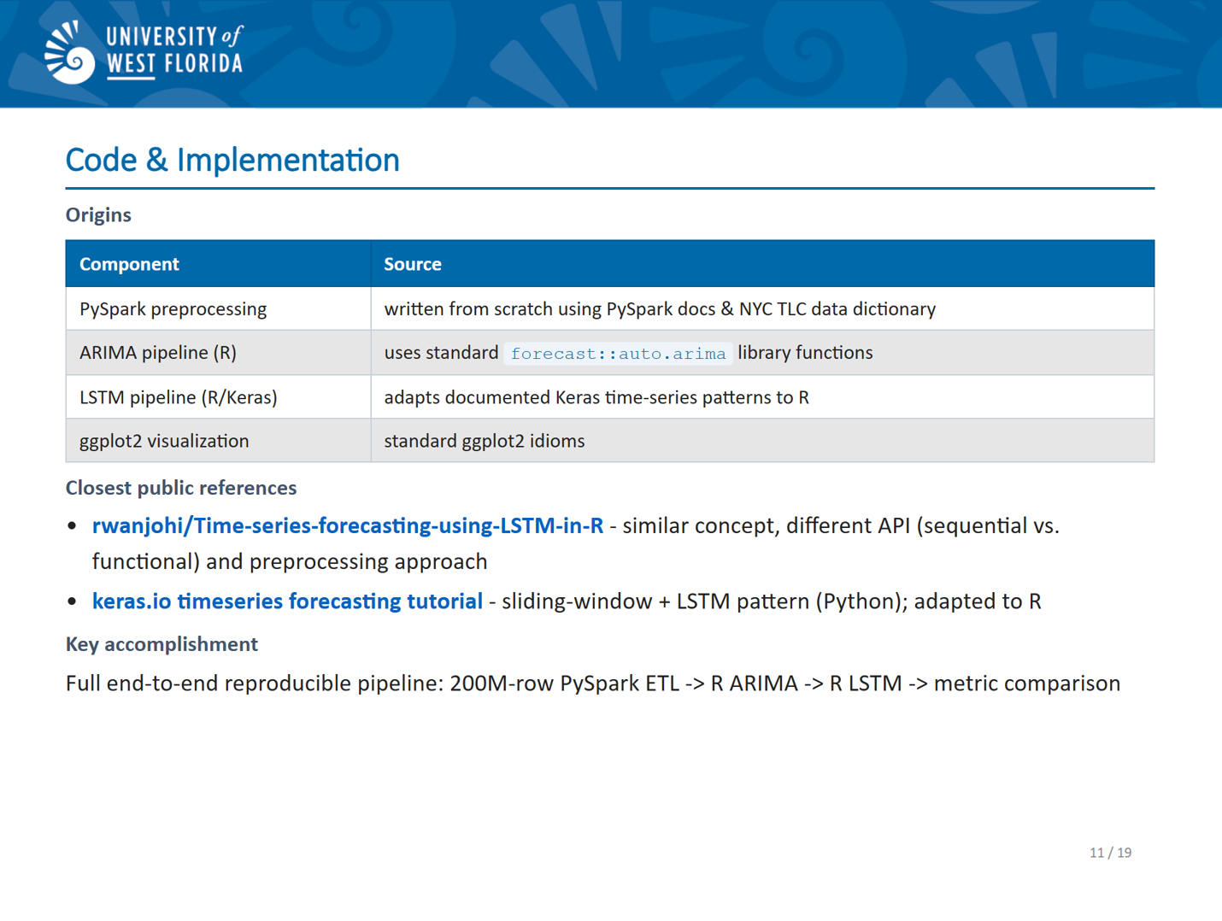
Notes:
SLIDE 11 SCRIPT (~2 minutes): "Now let me talk about the code and implementation, because this is where a lot of the real work happened. All the code is in my public github repo. The link will be on the next to the last slide. I had to write a lot of code. The code is dense. Instead of showing it here, I recommend those who are interested in the details, go to Github.
Coding was difficult mainly because of my lack of familiarity with Keras and R when it comes to LSTM’s. The PySpark preprocessing pipeline-all the filtering, cleaning, and aggregation-I wrote from scratch for this project, guided by the PySpark documentation and the structure of the NYC TLC data dictionary. The R LSTM pipeline follows well-known patterns documented in the Keras time series tutorial and the rwanjohi LSTM-in-R repository. However, the specific combination of the functional Keras API, and recursive forecasting loop is original code I wrote for this project. Aside from the code, the biggest implementation challenge was LSTM reproducibility, which I'll talk about on the next slide."

Slide 12
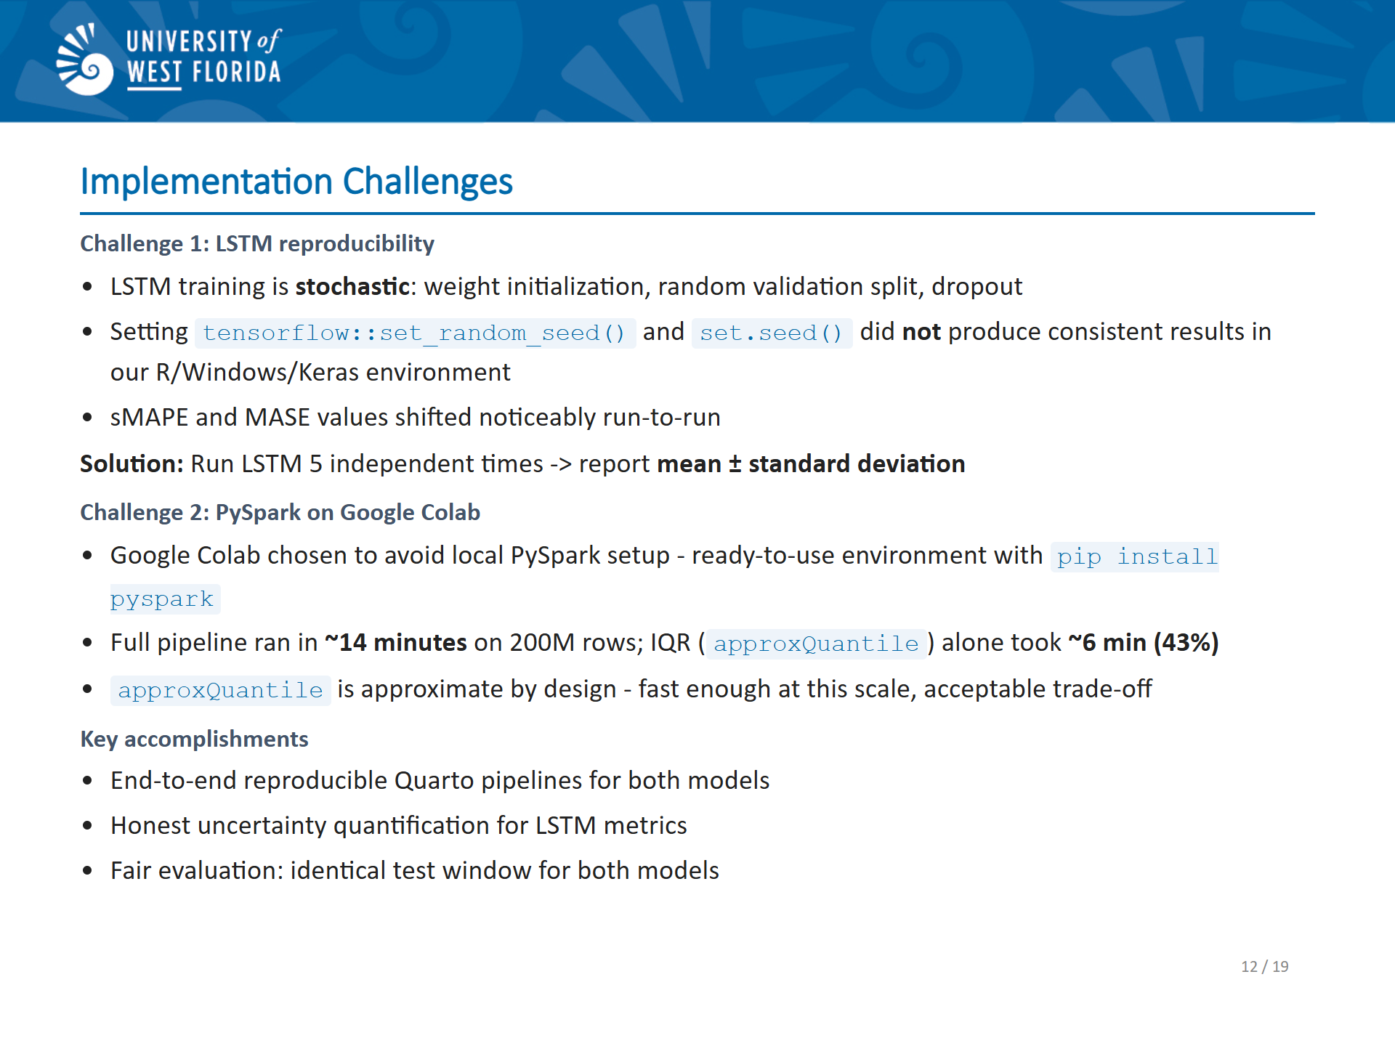
Notes:
SLIDE 12 SCRIPT (~2 minutes): "Unlike ARIMA, which is a deterministic algorithm given the same data, LSTM training is stochastic. The randomness comes from three sources: weight initialization, the random validation split during training, and dropout during each forward pass. I attempted to fix the random seed using TensorFlow's set_random_seed function and R's set.seed function, but in my environment-R with Keras on Windows-seed fixing did not produce consistent results across runs. I did not try 42 for the seed however.
As a result of this randomness, the sMAPE and MASE values shifted noticeably between different LSTM runs.
The solution I adopted was to run the LSTM pipeline five independent times and report the mean and standard deviation of the metrics across those five runs. This gives a statistically honest summary: you can see both the central tendency and the variability of the LSTM's performance, which makes the comparison with the deterministic ARIMA result much more meaningful. A second challenge was infrastructure. I chose to run the preprocessing in Google Colab to avoid the hassle of setting up PySpark locally-Colab provides a ready-to-use environment with just a pip install. The full pipeline ran in about 14 minutes on 200 million rows. Looking at the cell-level timings, three steps dominated: the IQR calculation took about 6 minutes-that's over 40% of the total runtime-because the approxQuantile function has to scan the full dataset for each column. The Uber filter plus count action took another 2.6 minutes, and the descriptive statistics call took 1.7 minutes. Everything else was negligible. I used PySpark's approxQuantile function, which is approximate by design but fast enough at this scale, and accurate enough for outlier detection."

Slide 13
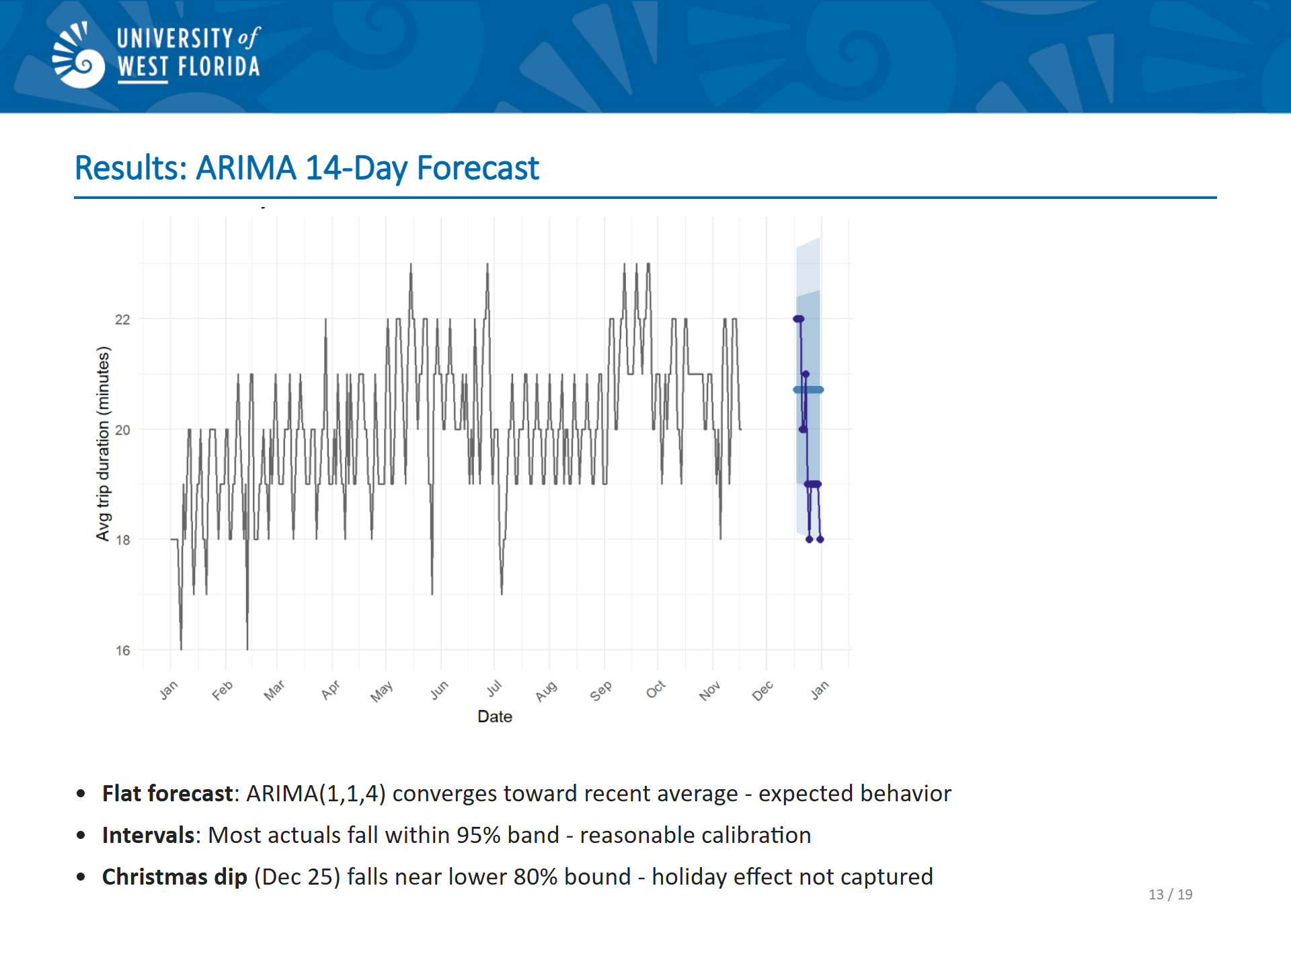
Notes:
SLIDE 13 SCRIPT (~1.5 minutes): "Let's look at the results. This plot shows the ARIMA 14-day point forecast together with the 80% and 95% prediction intervals, compared against the actual values.
Notice that the ARIMA forecast is flat. This is expected behavior because the ARIMA model converges toward the recent average – that’s the MA in ARIMA. Most of the actual values fall within the 95% prediction interval, this light blue band which is good. A couple of points-particularly around Christmas-fall outside the interval, reflecting the holiday-driven deviation that neither model anticipated."

Slide 14
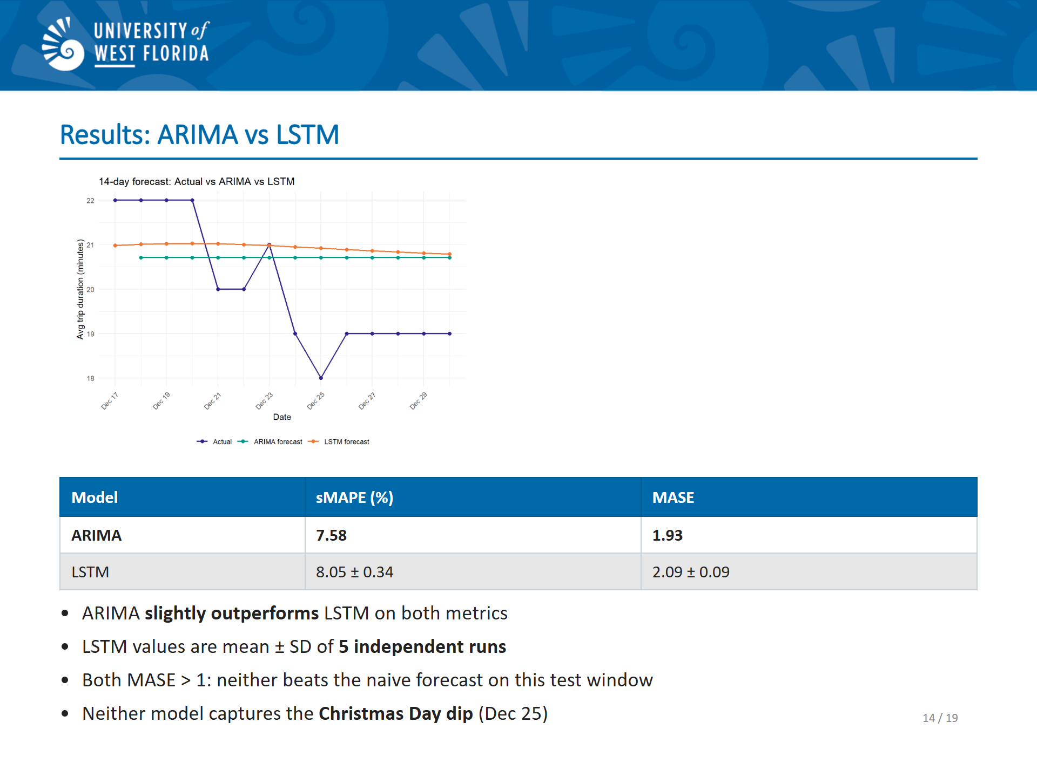
Notes:
SLIDE 14 SCRIPT (~2 minutes): "Now let's add LSTM to the picture. Overlaying the two forecasts, LSTM has a gentle downward trend, reflecting that the network is averaging toward the historical mean and picking up a slight downward signal in the recent data. But like ARIMA, it missed the Christmas dip entirely. The metric table tells the bottom line. ARIMA achieved an sMAPE of 7.58% and a MASE of 1.93. The LSTM averaged an sMAPE of 8.05% plus or minus 0.34 percentage points, and a MASE of 2.09 plus or minus 0.09, across five independent runs.
On both metrics, ARIMA edged out LSTM. The gap is significant. It’s worth noting that both models have MASE above 1, which means neither beats a naive forecast on this test window. That's an honest result because the 14-day holiday period is simply hard to forecast with a univariate model."

Slide 15
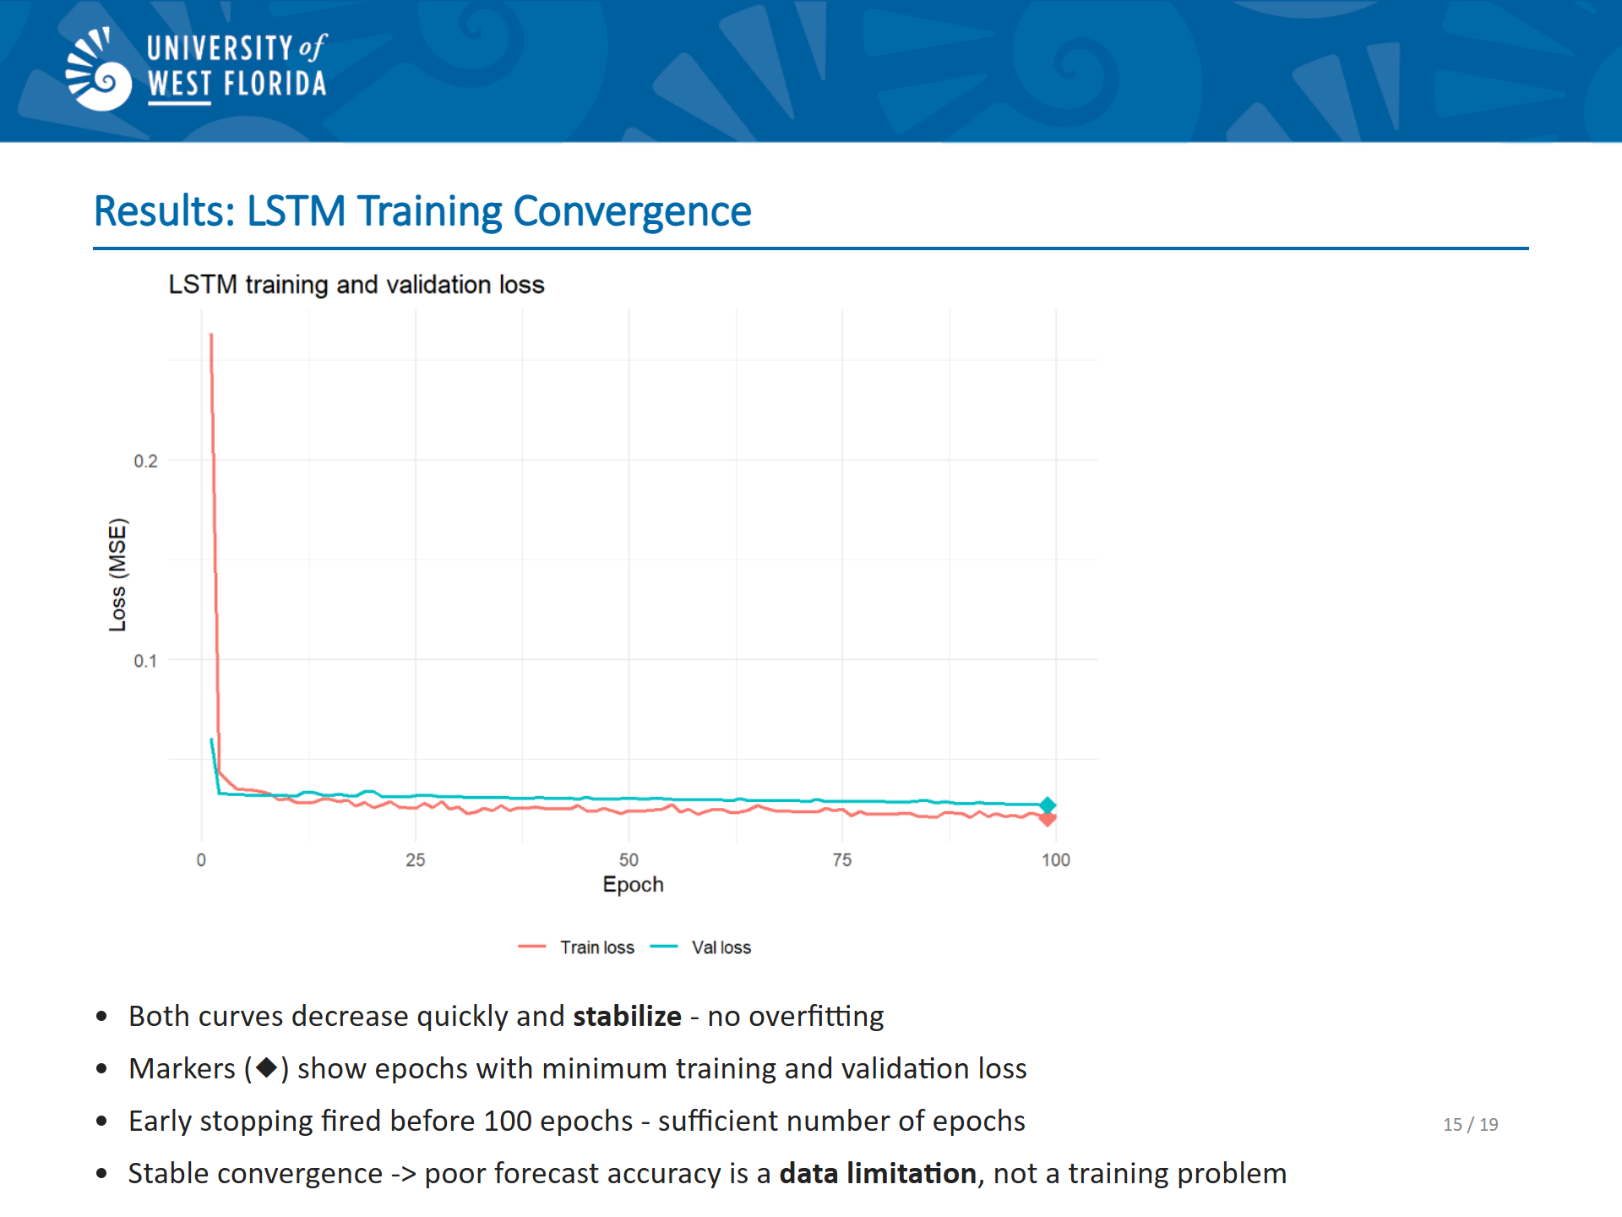
Notes:
SLIDE 15 SCRIPT (~1.5 minutes): "The LSTM training and validation loss curves both decrease quickly in early epochs and then flatten. The diamond markers indicate the epochs where the minimum training loss and minimum validation loss occurred. There is no sign of overfitting: the validation loss doesn't rise while the training loss continues to fall. Both curves stabilize well within the 100-epochs, confirming that early stopping fired appropriately and that additional epochs would not have improved the forecast."

Slide 16
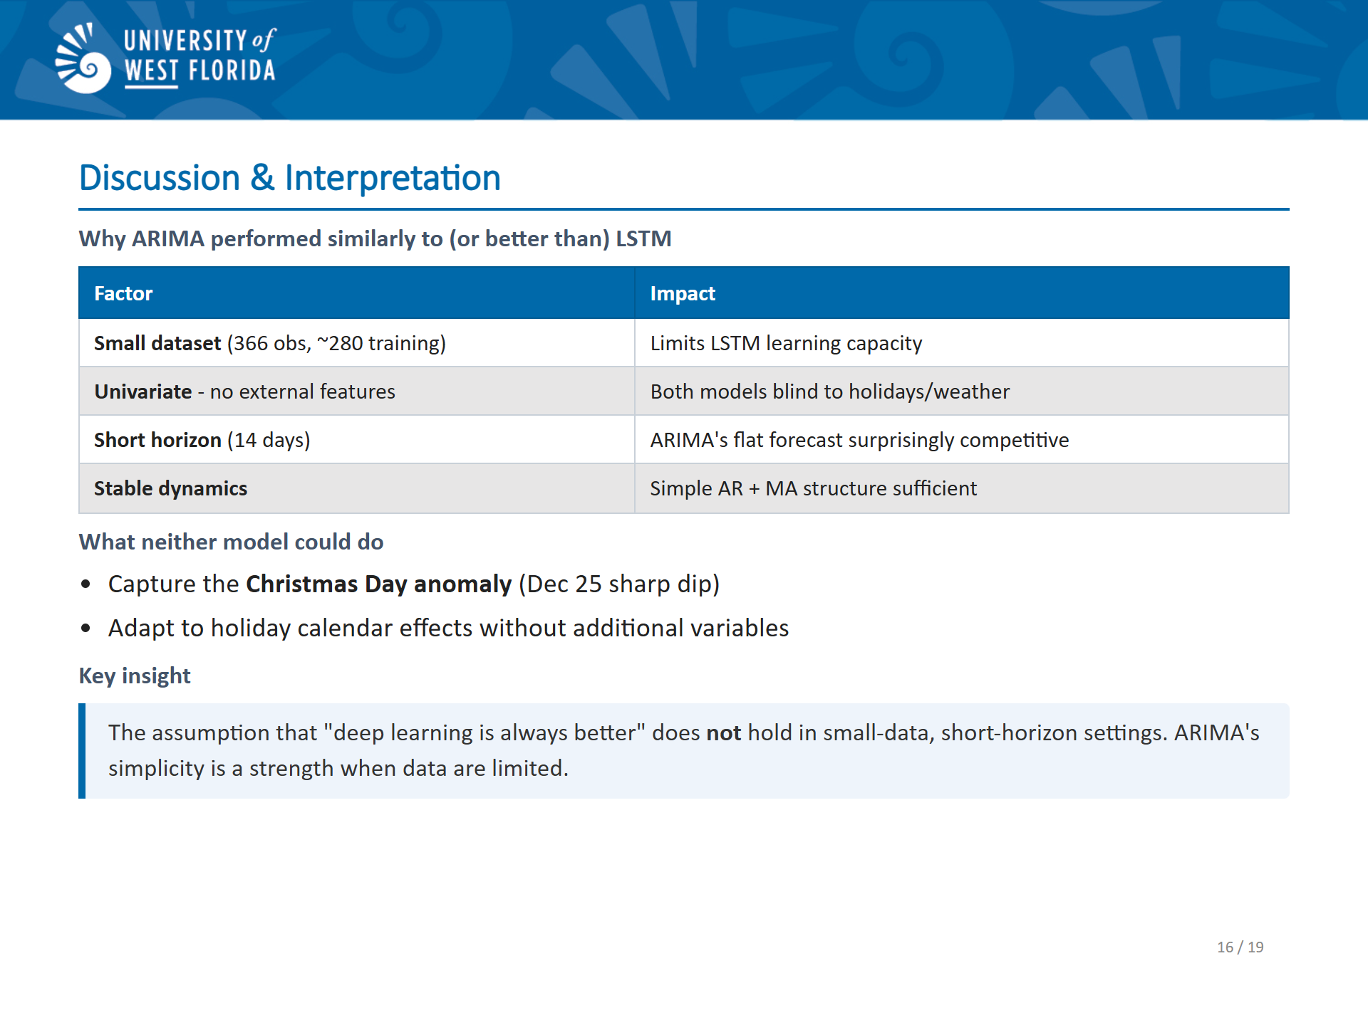
Notes:
SLIDE 16 SCRIPT (~1.5 minutes): "So what do these results mean? A few key interpretations. First, for a short-horizon univariate forecasting problem with only around 280 training observations, ARIMA is a strong baseline. It is deterministic, interpretable, and runs in seconds. The LSTM, by contrast, requires careful hyperparameter tuning, careful handling of scaling, early stopping, and multiple runs to get a stable metric estimate. All that extra complexity yielded a slightly worse result. Second, both models struggled with holiday effects. December 25 saw a sharp drop in average trip duration, likely because fewer riders take longer trips on Christmas Day. A univariate model with no calendar features simply cannot anticipate this. Third, the LSTM's run-to-run variability-roughly ±0.34 sMAPE points-is not insignificant. That variability matters and reporting a single LSTM run would be misleading. The broader takeaway is that the assumption 'deep learning is always better' does not hold in small-data, short-horizon settings. ARIMA's simplicity is a strength when data are limited."

Slide 17
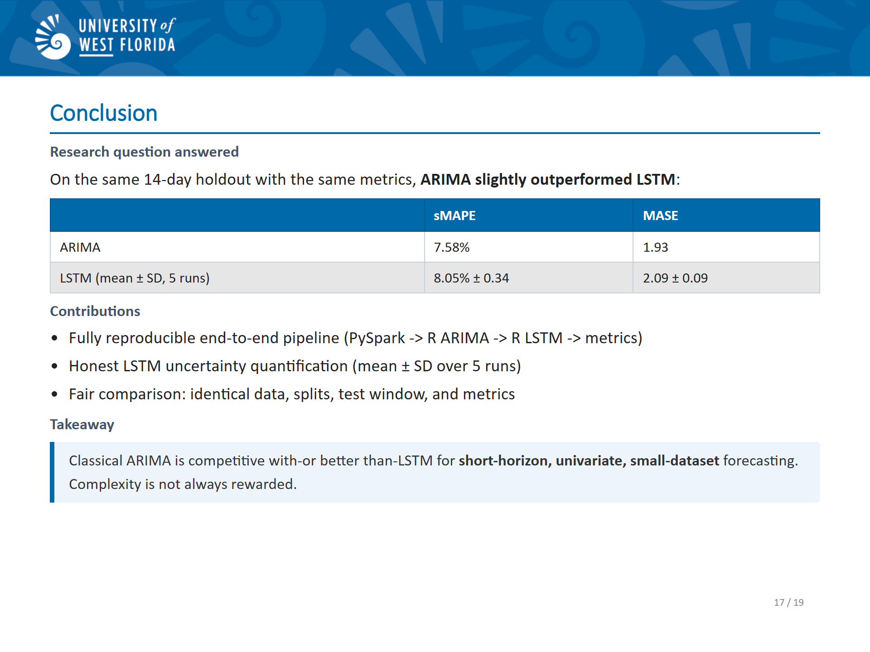
Notes:
SLIDE 17 SCRIPT (~1 minute): "Let me summarize the conclusions. The capstone set out to answer a concrete question: Shous you choose ARIMA or LSTM for 14-day forecasting of daily Uber trip duration? The answer is that ARIMA performed slightly better on sMAPE and MASE metrics in this controlled experiment. The capstone contributes a fully reproducible pipeline-from a 200-million-row PySpark ETL all the way through to metric evaluation-that others can replicate and extend. The honest reporting of LSTM variability across five runs adds statistical rigor that a single reported run would lack. The result is not a blanket endorsement of ARIMA over neural networks. It's a concrete, data-driven demonstration that in the right conditions-small sample, univariate, and short horizon-classical methods remain competitive. Choosing the right tool requires understanding both the data and the limitations of each method."

Slide 18
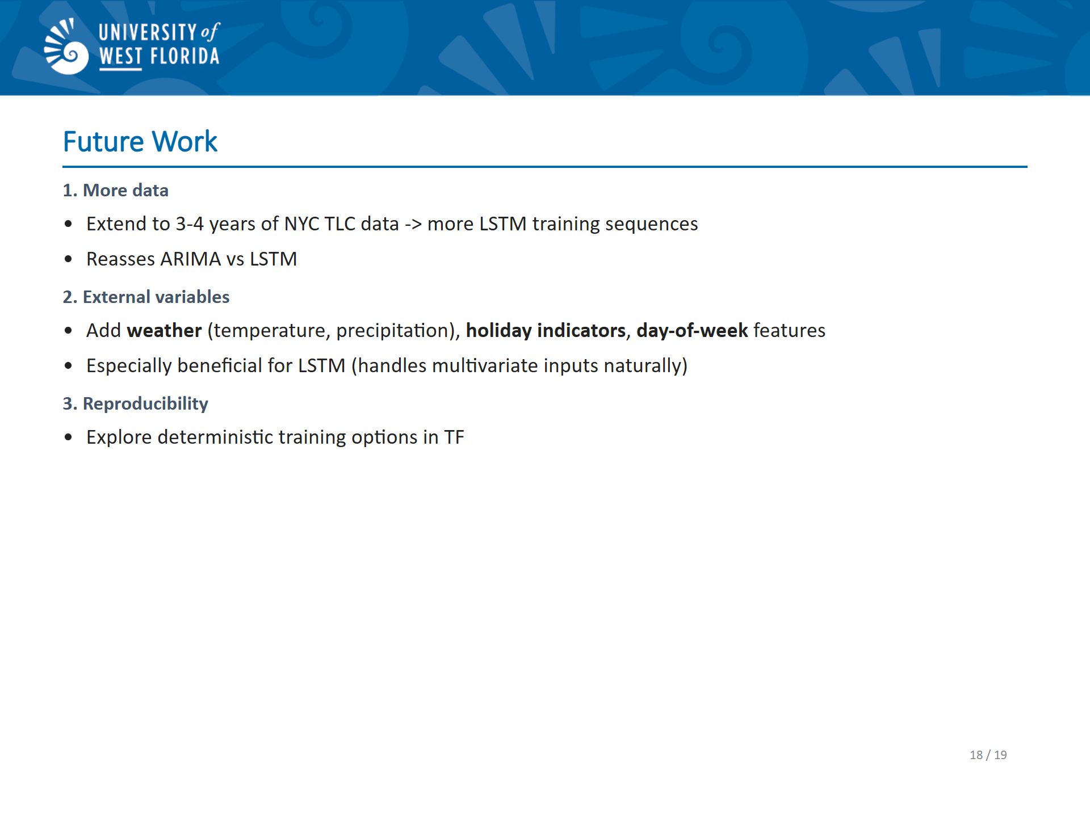
Notes:
SLIDE 18 SCRIPT (~45 seconds): "Looking forward, there are three concrete directions to extend this work. First and most impactful: extend the dataset. More years of NYC TLC data would give the LSTM far more training sequences and might change the comparison result. A model trained on three or four years of data versus one year is a fundamentally different experiment, and would let us reassess whether ARIMA's advantage holds. Second, add external variables. Weather data, holiday indicators, and day-of-week features are readily available and would likely help both models-but especially LSTM, which can incorporate multivariate inputs naturally. Third, improve reproducibility. Exploring deterministic training options in TensorFlow could resolve the seed-fixing issue and eliminate the need for averaging across multiple runs to get stable metrics."

Slide 19
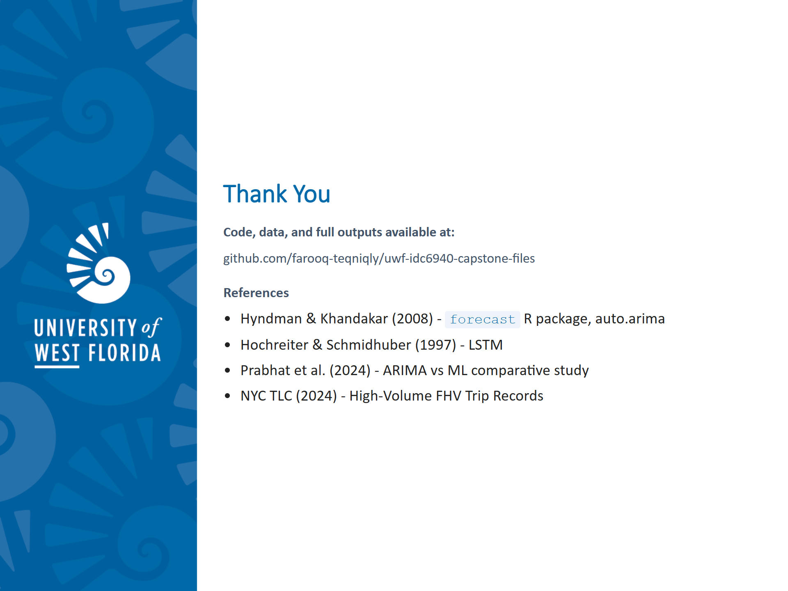
Notes:
SLIDE 19 SCRIPT (~30 seconds): "The code, data, and outputs for this project are all publicly available via the GitHub release shown here.
Thank you for your time.

