Slide 1
Image Interpolation for Multi-Directional Scaling using
FRQI & NEQR for Gray Images and MCQI for Color Images
By
A:dfasdfasdfasdfas
B:asdfasdfasdfasd
C:asdfasdfasdf
D:asdfasfasdfsdf
Dr.U.S.N.Raju, Associate Professor, NIT Warangal

Slide 2
ABSTRACT
Quantum image processing is much efficient and faster than classical image processing. We proposed methods for Image Interpolation using quantum circuits and gates.
The work focuses on low-resolution images and upscales the image, which is then implemented through quantum circuits using gray and color images by using methods such as FRQI, NEQR for gray images, and MCQI for color images.
After upscaling the image, we apply quantum gates on position qubits, and these are rearranged with the previous position qubits, which leads to the rearrangement of pixel locations and creates different images like image replication, horizontal stretching, and vertical stretching.

Slide 3
INTRODUCTION
Quantum Computing
Quantum computers mainly use quantum superposition and entanglement to handle data.
From this Quantum computing ,we are using the methods such as NEQR, FRQI and MCQI for the scaling of images.
Image Processing
Image Processing is nothing but processing of arrays i.e., giving array as input and getting array as output.
In this, we take image and perform multi-directional scaling that can show the image in different types such as vertical stretching, horizontal stretching, zooming and replication of images.
Quantum Image Processing
It is the combination of Quantum computing and Image processing.
we are processing images using NEQR and FRQI for gray images and MCQI for color images.

Slide 4

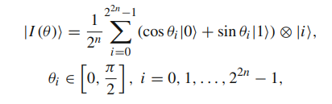

In this for the same input image, we get the same output for all the three methods but we can process the image in different types such as Horizontal Stretching, Vertical Stretching, zooming and Replication of images.
NEQR:
FRQI:
MCQI:

Slide 5
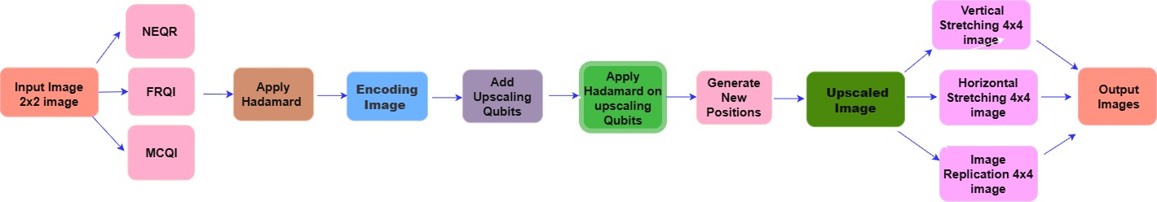
METHODOLOGY
Fig:1 Block diagram of NEQR and FRQI for gray images and MCQI for color images

Slide 6
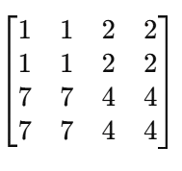
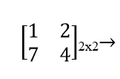
NEQR(Novel Enhanced Quantum Representation):
Input Image Upscaled image
In the quantum circuit of NEQR, initially convert the 2x2 input image into NEQR .
we will have 2 position Qubits the (row, col) and 3 gray value qubits (g0, g1, g2) taken based on the highest pixel in the input image.
Hadamard gate is applied on the position qubits to obtain superposition.
Later new position qubits (e_row, e_col) are added and hadamard gate is applied.
X-gates and CNOT gates are applied on gray value qubits.
The obtained upscaled image is Zoomed image.
By rearranging the new position qubits we get different images with Vertical Stretching, Horizontal Stretching and Image replication.

Slide 7
FRQI(Flexible Representation of Quantum Images) :
In the quantum circuit of FRQI, convert the input image into FRQI.
Hadamard gate is applied on the position qubits to obtain superposition.
The process is same as NEQR for obtaining the output images ,except
The FRQI will be encoded using angle(theta values).
1 gray value qubits (g) taken instead of multiple gray value qubits.
Rotation gates are applied on the gray value qubits and X-gates are applied on the position qubits and the image is upscaled.
The obtained upscaled image is Zoomed image.
By rearranging the new position qubits, we get different images with Vertical Stretching, Horizontal Stretching and Image replication.

Slide 8
MCQI(Multi-Channel Quantum Image):
This is the extension to the FRQI.
Hadamard gate is applied on the position qubits to obtain superposition.
This is also same as the FRQI but, here instead of single qubit three color channels are used.
They are R, G, B channels and rotation gates are applied on the color channel qubits.
X-gates are applied on the position qubits and the image is Upscaled.
The obtained upscaled image is Zoomed image.
By rearranging the new position qubits we get different images with Vertical Stretching, Horizontal Stretching and Image replication.

Slide 9
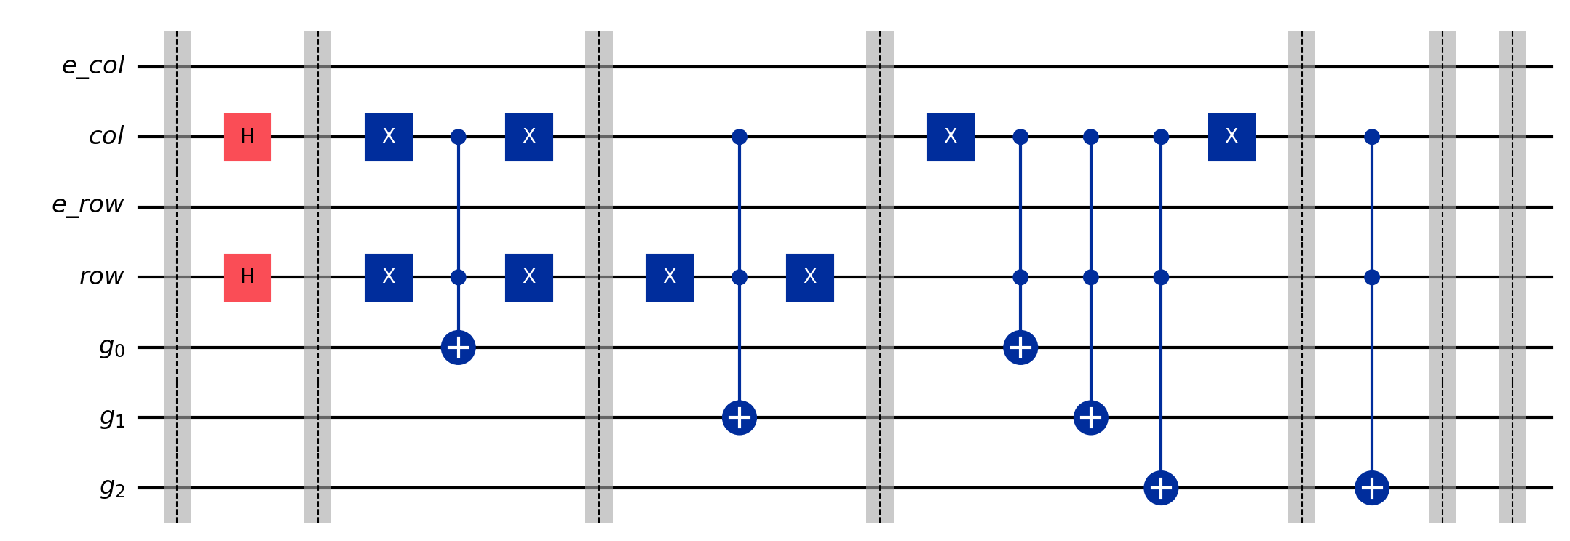
RESULTS
NEQR :
The Nearest Neighbor interpolation method was implemented using FRQI and NEQR for grayscale images and MCQI for color images
It is represented as |g2 g1 g0 ⟩ ⊗ ∣row⟩ ⊗ ∣col⟩
The output of 2x2 input image is shown in fig 5.
Fig:2 Quantum Circuit diagram of NEQR for 2x2 image

Slide 10
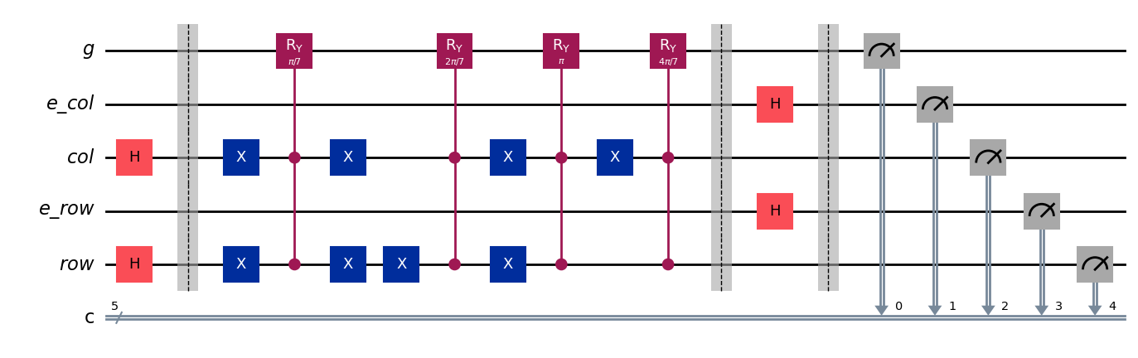
FRQI:
Fig:3 Quantum circuit diagram of FRQI for 2x2 image
It is represented as |g> ⊗ ∣row⟩ ⊗ ∣col⟩
The Outputs obtain are same as the NEQR. The output is shown in fig 5.

Slide 11
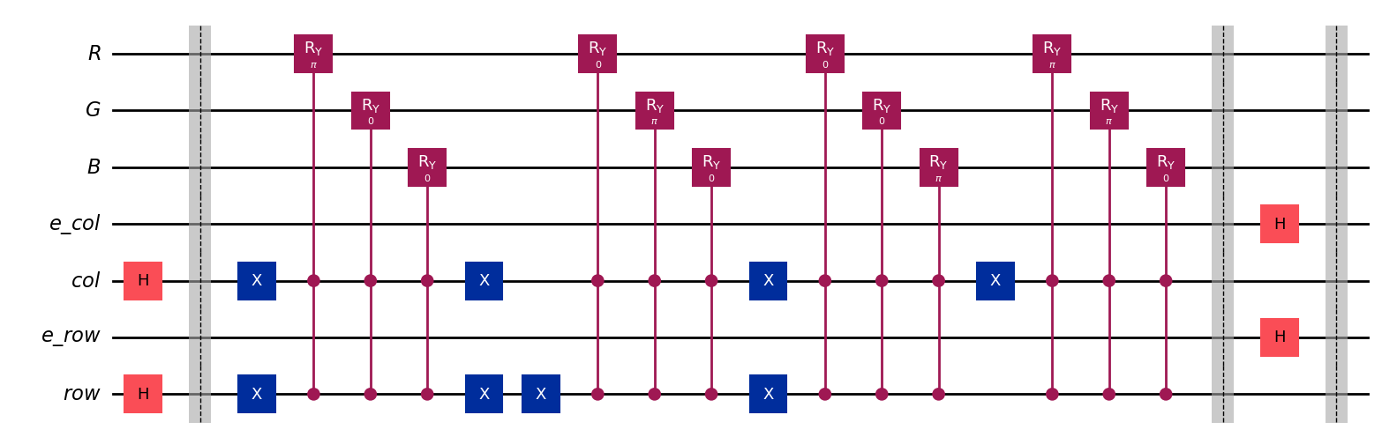
MCQI :
Fig 4 Quantum Circuit diagram of MCQI for 2x2 image
It is represented as ∣R⟩∣G⟩∣B⟩ ⊗ ∣row⟩ ⊗ ∣col⟩
The outputs obtained are same as the NEQR and FRQI. The output image is shown in fig 5.

Slide 12
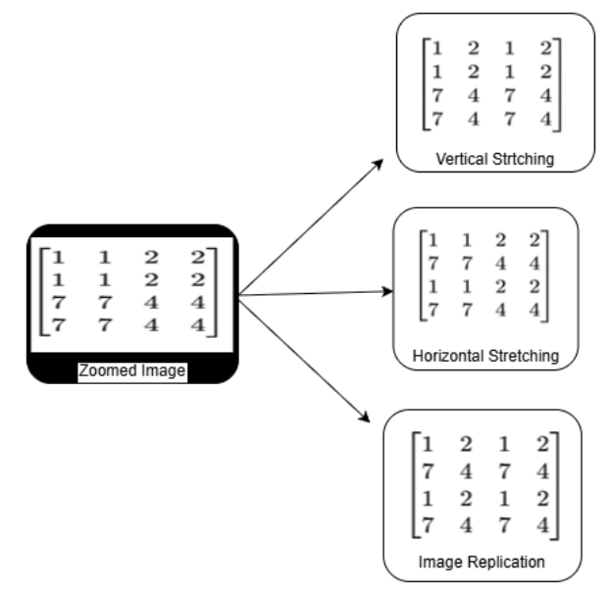
OUTPUT :
Fig:5 Output Images for Zoomed, Horizontal Stretching, Vertical Stretching and image replication
The output images are same for all the methods such as NEQR, FRQI, AND MCQI.
The experimental results demonstrate that quantum image representations can efficiently perform image enlargement and spatial transformations while maintaining image quality.

Slide 13
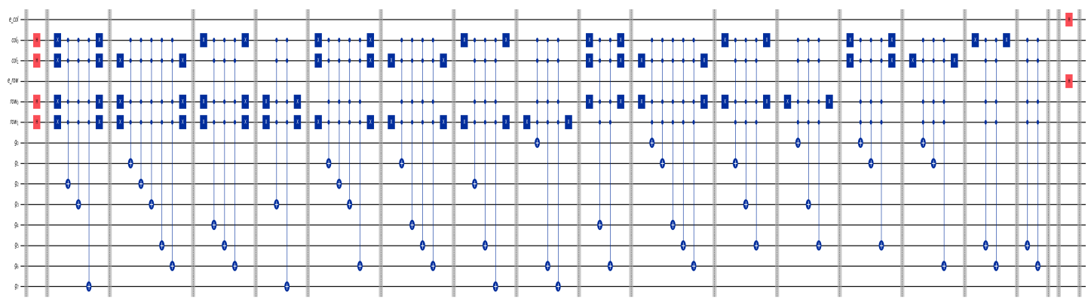
USING .tif image
NEQR :
Fig 6: Quantum Circuit diagram of NEQR
The input image is of size 64x64. So, the gray value qubits considered are 8 i.e., {g0, g1, g2, g3, g4, g5, g6, g7}.
Position qubits considered are {row1, row2, e_row} and {col1, col2, e_col}.
It is represented as |g7 g6 g5 g4 g3 g2 g1 g0⟩⊗∣row⟩⊗∣col⟩
The output image is shown in fig 9.

Slide 14
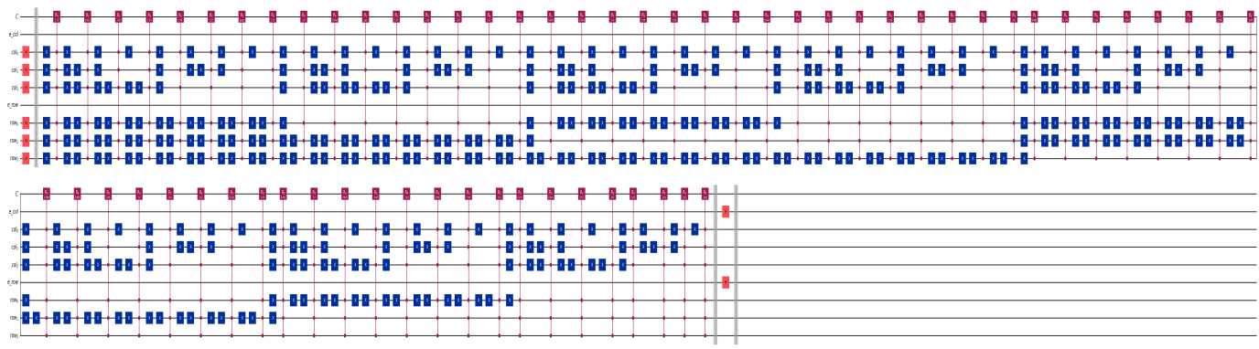
FRQI :
Fig:7 Qunatum Circuit diagram of FRQI
It is represented as ∣g⟩ ⊗ ∣row⟩ ⊗ ∣col⟩ .
The output image is same as NEQR i.e., shown in fig 9.

Slide 15
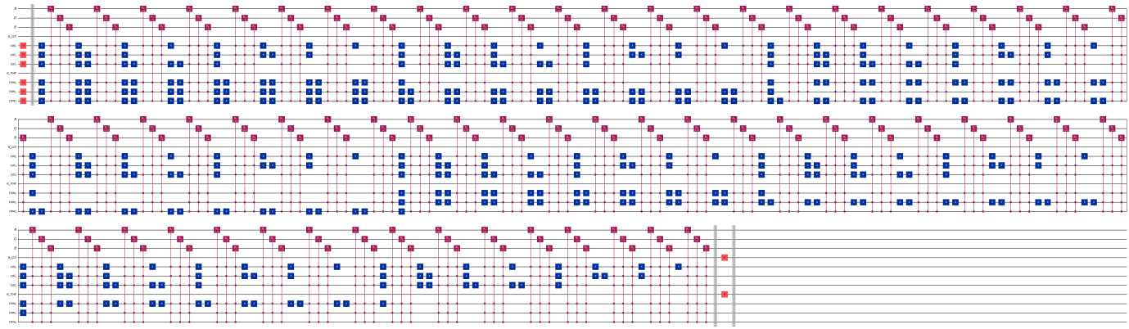
MCQI :
Fig:8 Quantum circuit diagram of MCQI
It is represented as ∣R⟩∣G⟩∣B⟩ ⊗ ∣row⟩ ⊗ ∣col⟩ .
The output image is same as NEQR and FRQI i.e., shown in fig 9.

Slide 16
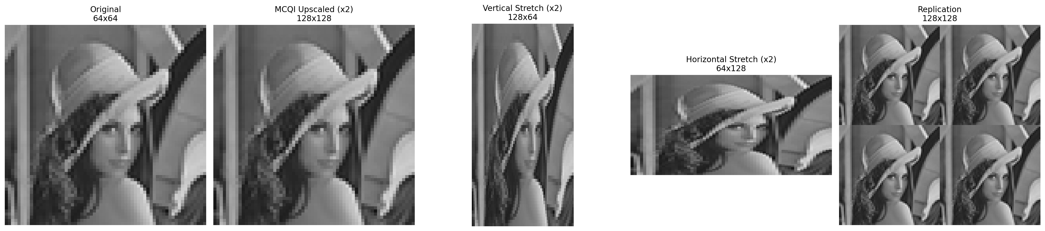
Output of .tif image :
Fig: 9 Output Images for Zoomed, Horizontal Stretching, Vertical Stretching and image replication
This Output of .tif image obtained is same for NEQR, FRQI and MCQI.

Slide 17
CONCLUSION
This work proposed a quantum image interpolation method for scaling low-resolution grayscale and color images using FRQI, NEQR, and MCQI representations.
The results shows that quantum circuits can effectively upscale images while preserving image quality.
By applying quantum gates to position qubits, various image transformations such as image replication, horizontal stretching, image zooming, and vertical stretching were successfully achieved.
The study demonstrates the potential of quantum image processing for efficient image enhancement and geometric transformations.

Slide 18
REFERENCES
1. M. A. Nielsen and I. L. Chuang, Quantum Computation and Quantum In-formation, 10th Anniversary ed. Cambridge, U.K.: Cambridge University Press, 2010.
2. P. Kaye, R. Laflamme, and M. Mosca, An Introduction to Quantum Compu-ting. Oxford, U.K.: Oxford University Press, 2007.
3. F. Yan and S. E. Venegas-Andraca, Quantum Image Processing. Singapore: Springer Nature Singapore Pte Ltd., 2020.
4. A. I. Mihovska and S. E. Venegas-Andraca, Quantum Image Processing in Practice. Hoboken, NJ, USA: John Wiley & Sons, 2024.
5. R. C. Gonzalez and R. E. Woods, Digital Image Processing, 3rd ed. Upper Saddle River, NJ, USA: Pearson Prentice Hall, 2008.
6. M. Sonka, V. Hlavac, and R. Boyle, Digital Image Processing and Comput-er Vision. Clifton Park, NY, USA: Cengage Learning, 2008.

Slide 19
7. A. Pathak, Elements of Quantum Computation and Quantum Communica-tion. Boca Raton, FL, USA: CRC Press, 2013.
8. N. S. Yanofsky and M. A. Mannucci, Quantum Computing for Computer Scientists. Cambridge, U.K.: Cambridge University Press, 2008.
9. C. Bernhardt, Quantum Computing for Everyone. Cambridge, MA, USA: MIT Press, 2019.
10. S. E. Venegas-Andraca, Quantum Walks for Computer Scientists. San Rafael, CA, USA: Morgan & Claypool Publishers, 2008.
11. D. A. Forsyth and J. Ponce, Computer Vision: A Modern Approach. Upper Saddle River, NJ, USA: Prentice Hall, 2003.
12. A. M. Tekalp, Digital Video Processing. Upper Saddle River, NJ, USA: Prentice Hall, 1995.
13. I. J. Cox, M. L. Miller, J. A. Bloom, J. Fridrich, and T. Kalker, Digital Wa-termarking and Steganography, 2nd ed. Burlington, MA, USA: Morgan Kauf-mann Publishers, 2008.

Slide 20
THANK YOU

