Slide 3
Kitchen
TV Lounge
Dining Space

Slide 5
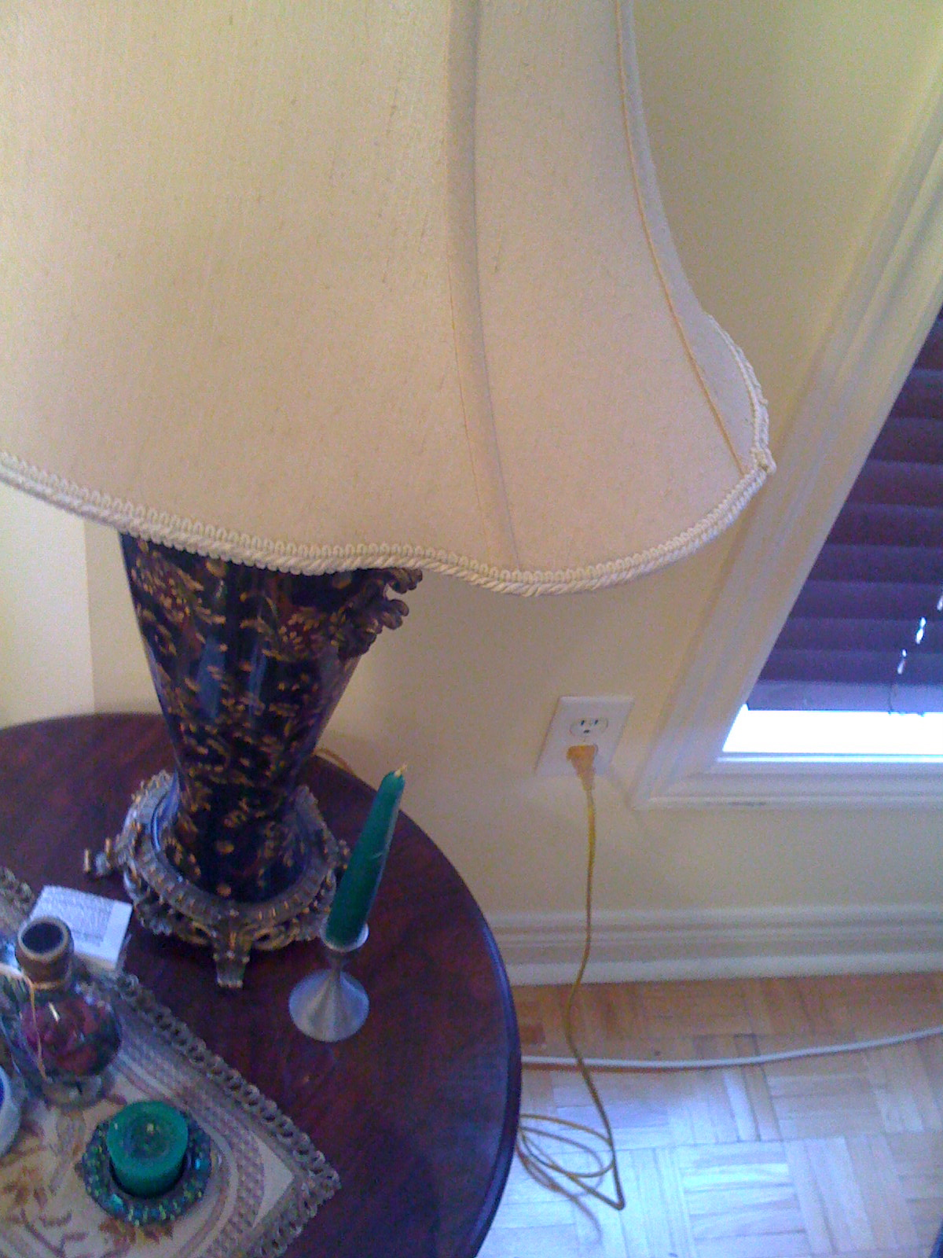
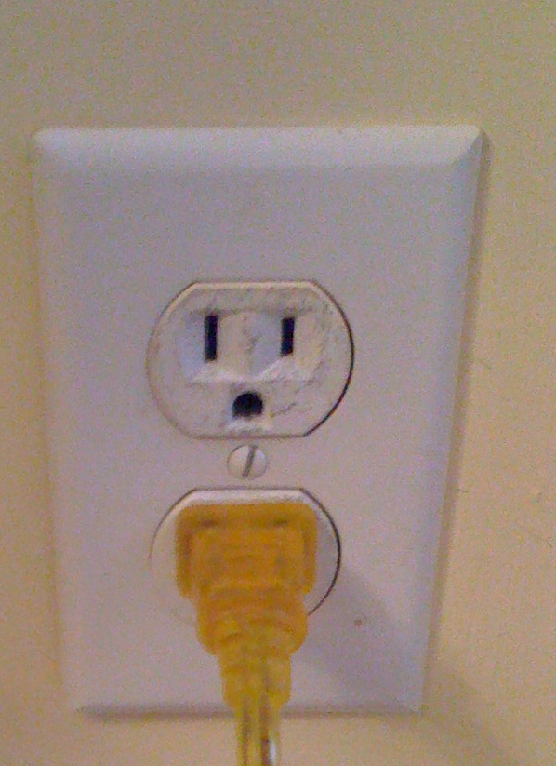
2 x NEMA 5 3-pin sockets
50% sockets usually available
Mouse over

Slide 6
®®

