Slide 1
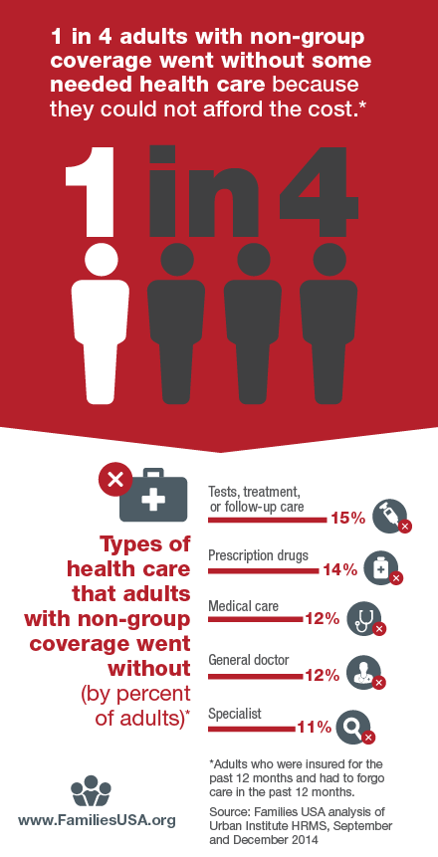
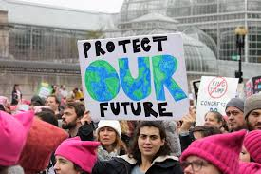


Have you seen the news lately?

Slide 2
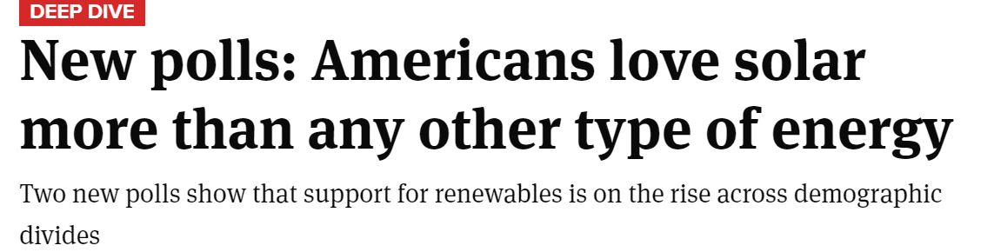
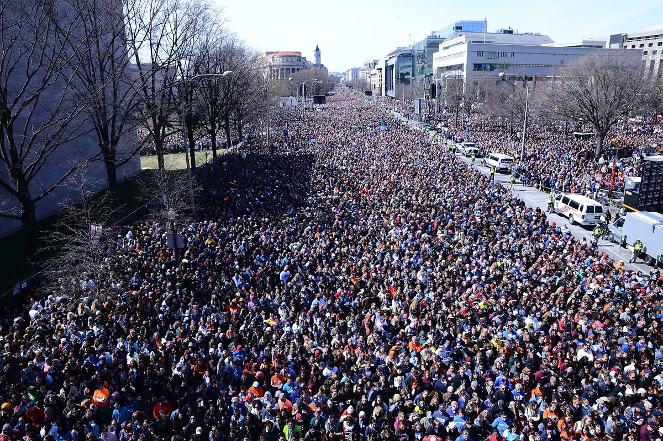
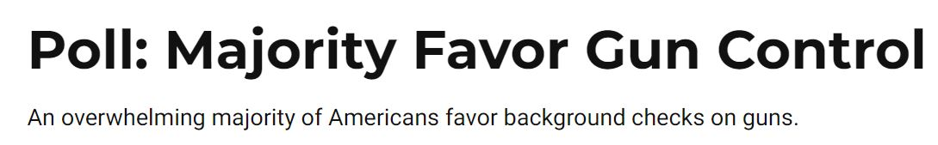
What The People Want Is Action
Thousands turned out for rallies in Washington, DC, and hundreds of cities across the United States.

Slide 3
Why Are The People Being Ignored?
For the people, of the people, by the people
Why?

Slide 4

Answer: Corporate Lobbyists
Corporate Lobbyists
For every $1 spent on lobbying by labor unions and public-interest groups together, large corporations and their associations now spend $34.
Of the 100 organizations that spend the most on lobbying, 95 consistently represent business.
Public Interest & Labor Unions

Slide 5
Answer: Corporate Lobbyists
Corporate Lobbyists
Follow The Money
Pharmaceuticals/Health Products | $3,937,356,877
Insurance | $2,704,636,807
Electric Utilities | $2,353,570,360
Source: www.opensecrets.org; Cumulative political contributions and lobbying spending from 1998-2018
Public Interest & Labor Unions

Slide 6
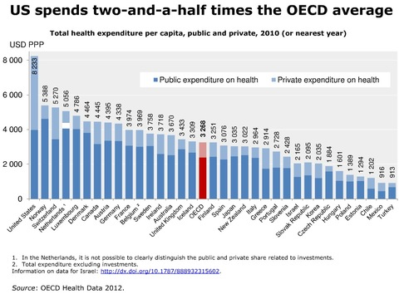
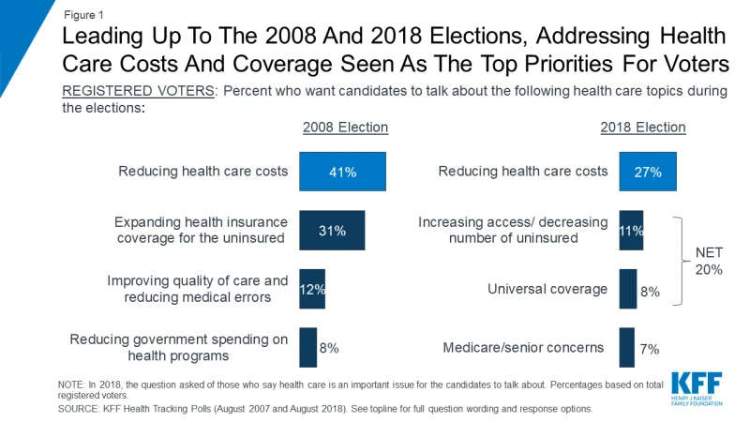
Health Care Concerns and UnHealthy Spending
Images of problems in news like gun violence
Why are the policy makers failing to address the health care concerns in spite of outspending every other nation?

Slide 7
This Is Where Our Solution Comes In

Slide 8
Our solution
We are bringing the power back to people. Our solution enables the public to express its opinion in the language that is used in capital Hill
We provide a platform to raise capital and direct that capital in a transparent, accountable manner such that the efforts can lead to positive policy outcomes.
Our platform combines political crowdfunding with Blockchain technology.

