Slide 1
Hyperledger Fabric Policy Hierarchy
System Channel
Application Channel
Access Control Lists (ACLs) and smart contracts

Slide 2
Hyperledger Fabric Policy Hierarchy
System Channel
Consortium Membership and blockchain structure
Transaction networks, business logic
Transactions, data, and events
Application Channel
ACLs and smart contracts

Slide 3
Hyperledger Fabric Policy Hierarchy
System Channel
What Orderer organizations govern
Consortium Membership and blockchain structure
 |  |  |  | Transaction networks, business logic
What
Consortium organizations govern
Application Channel
ACLs and smart contracts
Transactions, data, and events

Slide 4
Hyperledger Fabric Policy Hierarchy
System Channel
What
Consortium organizations govern
What Orderer organizations govern
Blockchain Structure Consensus Consortium membership Consortium Member Policies policies (Readers, Writers, Admins) |  |  |  |  |  | Channel modification
Consensus |  |  |  | Channel Membership Organization policies (Readers, Writers, Admins)
Smart Contracts Ledger data Events
Application Channel
ACLs and smart contracts

Slide 5
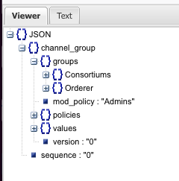
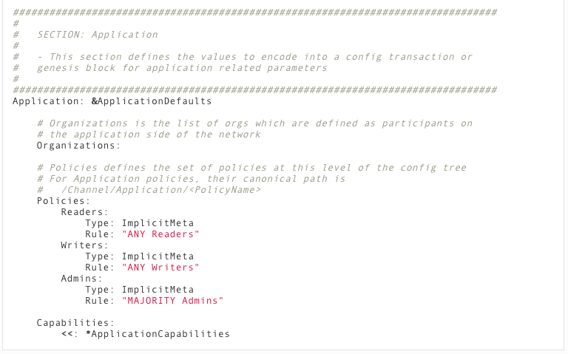

configtx.yaml
configtxgen tool
genesis.block

Slide 6

System Channel
Channel/Admins
MAJORITY sub policy: “Admins” Type = 3
Channel/Consortium/Admins
Channel/Orderer/Admins
n=0 (ANY) Type = 1
MAJORITY sub policy: “Admins” Type = 3
Channel/Consortium/SampleConsortium/Org1MSP/Admins
Channel/Consortium/SampleConsortium/Org2MSP/Admins
n=1 Role = “ADMIN” member of Org1MSP Type = 1
n=1 Role = “ADMIN” member of Org2MSP Type = 1
Channel/Orderer/OrdererOrg/Admins
Type 1 = Signature
Type 3 = ImplicitMeta
n=1 Role = “ADMIN” member of OrdererMSP Type =1
In order for the Channel/Admins policy to be satisfied, every sub-policy under it in the configuration hierarchy must
also be satisfied.

Slide 7
Application Channel
Channel/Admins
MAJORITY sub policy: “Admins” Type =3
Channel/Application/Admins
Channel/Orderer/Admins
n=0 (ANY) Type =1
MAJORITY sub policy: “Admins” Type =3
Channel/Consortium/SampleConsortium/Org1MSP/Admins
Channel/Consortium/SampleConsortium/Org2MSP/Admins
n=1 Role = “ADMIN” member of Org1MSP Type=1
n=1 Role = “ADMIN” member of Org2MSP Type=1
Channel/Orderer/OrdererOrg/Admins
n=1 Role = “ADMIN” member of OrdererMSP Type=1
In order for the Channel/Admins policy to be satisfied, every sub-policy under it in the configuration hierarchy must
be satisfied.

