Slide 1
PROG1440 - NBD
Initial Client Meeting

Slide 2
Staff Intros
Joshua Kaluba
Technical support, grading, and learning moments
Availability
TBD
Dave K.
Project Oversight, Team management, Interface design concerns, grading
Availability
TBD
Or, by appointment
Please email for scheduling if you have issues outside these times
We will most likely use Teams for these meetings.

Slide 3
Tracking Docs available
The WBS, individual tracking, and AI tracking docs are available.
Same as last term.
Must be submitted before presentation.

Slide 4
Overview – Basic App Requirements
Natural By design requires an application with the abilities to track/create/edit :
Clients
Related projects (a client can have many projects)
Related bids (a project can have many bids)
Related designers assigned to projects/bids
The financials
We will focus only on the bid process for this term.

Slide 5
Overview - Stakeholders
Stakeholders
Cheryl
Admin
Needs ability to approve before submitting to client for approval
Kerri/Stan
Management
Needs ability to review and approve before going to client
Designers
Need ability to complete multiple bids for a single project
Client/Project maintenance

Slide 6
Current System
Sales finds the client.
Designer meets with client.
Designer enters client/project info.
Designer creates a bid(s).
Cheryl/Kerri approve the bid.
Or sent back for revision
Client approves the bid.
Or sent back for revision
Bid moved to production stage.

Slide 7
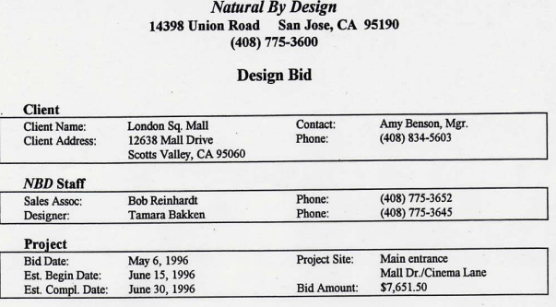
Design Bid - Sections
Top Section
Header
Client
Assigned staff
Project Info.
Bid Amount – Sum of materials chosen total plus labour requirements total (calculated)
Simplification: only 1 contact person per client.

Slide 8
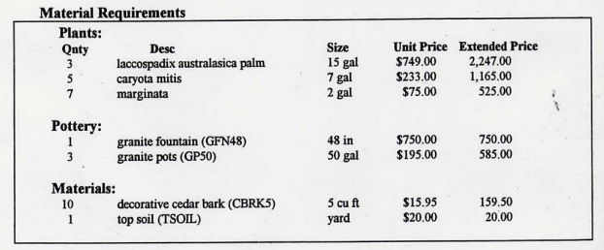
Design Bid Sections - Materials
Inventory list of items chosen for bid.
Sorted by type (Plant/Pottery/Materials)
Unit Price
What NBD charges client for that item
Matches the List$ on inventory report (see next slide)
Extended Price – Unit Price times Quantity

Slide 9
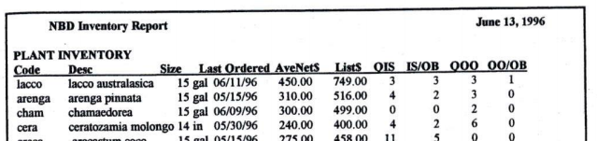
Design Bid – Materials Continued
Inventory
Ability to sort by Type (plant, material, pottery)
Simplification – Inventory will be lookup only. You will need to provide an initial list/tables with data, but no ability to add/edit/delete items. Do not worry about in-stock/out-of-stock/maintaining.
Use only the following fields from the inventory report image (pg 11 Case doc):
Code, Description, Size, List$
List$ is the cost that appears in the Bid’s Unit Price column

Slide 10
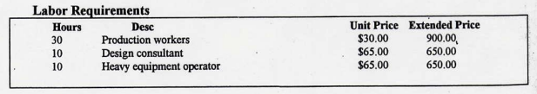
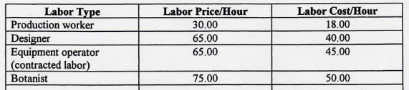
Design Bid Sections - Labour
Expected Labour requirements (see image above):
Unit price comes from the Labour Table (Labour Price/Hour).
Extended price is Unit price * Hours
Labour Table (see image below):
Labour Cost/Hour – what NBD pays employees.
Labour Price/Hour – what NBD charges client.
Simplification: The labour report will be a lookup table and you do not need to provide tools for managing it.

Slide 11
Additional Notes
No designer daily work report
Only used after the bid moves to production
No design budget
Completed only after bid has been approved
Consider approval process
Make sure to think about this as you model/design/build
Your app will go from finding client to approved bid (both management and client)
Consider stages as well
What stage is the bid at?

Slide 12
Prototype 1 - Expectations
Data model
Model the necessary relationships.
Expect a well-formed and detailed model including:
Client/Project/Bid/Staff and all related lookup tables.
All necessary relationships.
All necessary fields.
Keep the simplification notes on previous slides in mind

Slide 13
Prototype 1 – Expectations Continued
Begin an MVC progressive web app using SQLite database hosted on Azure:
Implement the following:
A landing page/dashboard (leave blank for now)
Menu system to move between the pages you will build
Build the client/project portion of your data model
Add seed data (minimum 5 clients with 2 projects each)
A client maintenance system:
Add/edit/review (search/filter)
A project maintenance system:
Add/edit/review (search/filter)
Ability to link a client to a project

Slide 14
Prototype 1 – Expectations
Begin implementing interface design concepts
Look, feel flow.
WCAG expectations as well.

Slide 15
Key Dates – Week of Jan 21st
Continue working on the app.
Instructors will be available during scheduled times
Watch Brightspace announcements for times
Not required to attend
But expected to be working on project

Slide 16
Key Dates – Week of Jan 28th
Progress meeting, method TBD
See Schedule for times.
Expectations:
Complete, well formed data model for review (not coded).
Posted to Azure:
Client/project portion of DM coded with seed data
Menu/Landing Page
Client: add/edit complete (roughly working).

Slide 17
Key Dates – Week of Feb 4th
All Prototype 1 expectations met and functioning.
Posted to Azure by required date and time.
9:30am Wednesday, Feb. 7th (all teams regardless of presentation time).
Send both instructors an email with Azure link by 9:30am Wednesday, Feb. 7th .
Do not make changes after it is posted! This is a recipe for disaster!
Client Meeting
You will lead the meeting.
Be prepared, early, and ready.
We will join the meeting at the appointed time.
Through telecom system, a session will be prepared for your team only.

Slide 18
Any Questions?
Please ask if you have any right now.
If not, simply meet the instructors during their scheduled times
Or have the comms specialist reach out to the staff via email.

Slide 19
Let’s get to work!!!
Remember:
We need the team email with assigned roles.
Start with the data model.

