Slide 1

Basic Details of the Team and Problem Statement
Preliminary Round- College Level
Institution Name: SNGIST Group of Institutions
Institute Code(AISHE): C-11585
Team Name: CodeGear
Team No: 2
Problem Statement: Language translator tool to convert English to Hindi which can be used by all the government organizations websites officially. (Software)
Team Leader Name: HASHIM AYOOB
Theme Name: BHASHA SAHAYAK
Date: 26-09-2023

Slide 2
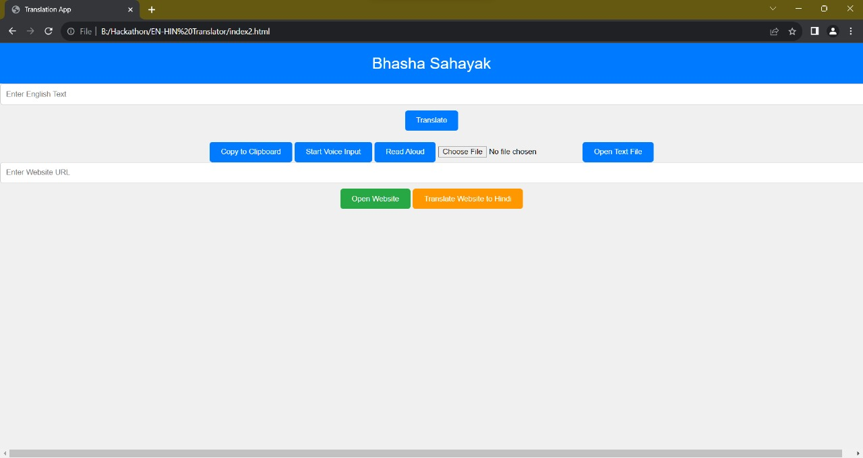
Idea/Approach Details
Simulated Image Of Prototype
Idea/Solution/Prototype :
The goal of the project is to create a tool that translates English into Hindi,catering to government organizations for their official websites.
It aims to ensure that government information is accessible and inclusive for a diverse population.
The project uses HTML, CSS, and JavaScript for development.
This approach ensures that users can easily input English text, audio, pdf, url request translations, and receive immediate results in a seamless and responsive manner.
Technologies used :
•HTML
•JavaScript
•CSS
•Fetch API
•LibreTranslate API

Slide 3
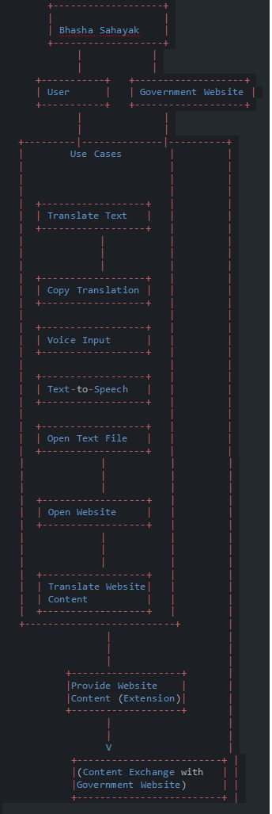
Idea/Approach Details
Use Cases
Dependencies
LibreTranslate API
Web Speech API
HTML, CSS, Java Script
File Reader API
iframe
Text-to-speech Voices
External Resources
Responsive Design
Internet Connection

Slide 4
Team Member Details
Team Leader Name: Hashim Ayoob
Branch (Btech/Mtech/PhD etc.): BTech | Stream (ECE, CSE etc.):CSE | Year (I,II,III,IV):IV
Team Member 1 Name: Farooq Jaleel Branch (Btech/Mtech/PhD etc.):Btech | Stream (ECE, CSE etc.):CSE | Year (I,II,III,IV):IV
Team Member 2 Name: Anulakshmi Shibu Branch (Btech/Mtech/PhD etc.):Btech | Stream (ECE, CSE etc.):CSE | Year (I,II,III,IV):IV
Team Member 3 Name: Samson TA
Branch (Btech/Mtech/PhD etc.):Btech Team Member 4 Name: Shilpa Shivanadan | Stream (ECE, CSE etc.):CSE | Year (I,II,III,IV):IV
Branch (Btech/Mtech/PhD etc.):Btech | Stream (ECE, CSE etc.):CSE | Year (I,II,III,IV):IV
Team Member 5 Name: S Sambu Branch (Btech/Mtech/PhD etc.):Btech | Stream (ECE, CSE etc.):CSE | Year (I,II,III,IV):IV

