Slide 1
MURSHID HOSPITAL

Slide 2
Group members:
MIRZA MUHAMMAD FAROOQ BAIG
ABDUL BASIT
SAMIULLAH KHAN

Slide 3
WHAT IS a HOSPITAL ?
A hospital is a health care institution providing patient treatment with specialized medical and nursing staff and medical equipment.

Slide 4
TYPES OF HOSPITALS
General and acute care
District
Specialized
Teaching
Clinics

Slide 5
How hospitals work
Hospitals are usually funded by the public sector, health organisations (for profit or nonprofit), health insurance companies, or charities, including direct charitable donations. Historically, hospitals were often founded and funded by religious orders, or by charitable individuals and leaders.
Currently, hospitals are largely staffed by professional physicians, surgeons, nurses, and allied health practitioners, whereas in the past, this work was usually performed by the members of founding religious orders or by volunteers.

Slide 6
OBJECTIVES
Provide optimum health services.
Provide care, cure, preventive service.
Protect the human rights of clients.
Provide training for professionals.
Provide in-service/continuing education in all discipline professional technical personnel.
Participate/conduct research.

Slide 7
CLASSIFICATION OF HOSPITALS
General
Government
Specialty

Slide 8
GENERAL HOSPITALS
General hospitals has an emergency department to treat urgent health problems ranging from fire and accident victims to a sudden illness.
Some of the general hospitals in Karachi are:
Hill park general hospital
Atia general hospital
Creek general hospital

Slide 9
GOVERNMENT HOSPITALS
A public hospital, or government hospital, is a hospital which is owned by a government and receives government funding. In some countries, this type of hospital provides medical care free of charge to patients, covering expenses and wages by government reimbursement.
Some of government hospitals in Karachi are:
Jinnah Postgraduate Medical Centre (JPMC)
National Institute of Cardiovascular Diseases (NICVD)
National Institute of Child Health (NICH)
Sindh Institute of Urology and Transplantation (SIUT)
Civil Hospital
Services Hospital

Slide 10
PRIVATE HOSPITALS
A private hospital is a hospital owned and operated by an organisation other than the state (which may include for-profit and non-profit companies) and/or which provides care funded other than by the state, for example funded by patients themselves ("self-pay"), by insurers, or by foreign embassies. Private hospitals are a common part of the majority of healthcare systems around the world (for example including the United States of America, Chile, France, Germany, and Australia).
Some of the private hospitals in Karachi are:
Ibn-e-Sina Medical Center:
Ibrahim Eye Hospital.
Imam Clinic.
Indus Hospital.
Karachi Institute of Heart Diseases.

Slide 11
Departments in OUR hospital
Department of heart
Department of OPD
Department of Dental
Department of ENT
Department of General surgery
Department of Radiology

Slide 12
HOSPITAL STAFF
Doctors (medical staff)
Nurses
Allied health professionals
Support staff

Slide 13
DOCTORS
You may be treated by a number of doctors during your hospital stay – the consultant (specialist), the registrar and the resident. Together they assess and manage your medical care. Depending on which hospital you are in, you may also be treated by interns and student doctors who work under the supervision of the senior doctors.
Doctors have different roles and responsibilities based on their level of experience and their medical specialty. These roles include:
senior consultants – specialist doctors who see patients at specific times
registrars – senior doctors who supervise residents, interns and students
residents – look after patients on the ward and are in training for specialization
interns – have completed their studies and are now finishing their final year in hospital
student doctors – undergraduate medical students.

Slide 14
DOCTORS IN OUR HOSPITAL
Dr. Saad
Dr. Sami
Dr. Farooq
Dr. Basit
Dr. Amir Liaquat
Dr. Rimsha

Slide 15
EQUIPMENT USED IN HOSPITALS
Anesthesia machine
Aspiration/Suction Pump
Autoclave / Sterilizer
Diagnostic Ultrasound with probes
ECG/EKG
Hospital Bed – med/surgery, birthing
Nebulizer
Oxygen Cylinder and Regulator
Patient Scale – adult and infant
Surgical Table – surgical and delivery
Thermometer
Ventilator
Vital Sign Monitor
Wheelchair
X-Ray equipment – portable, dental, mammography etc..

Slide 16
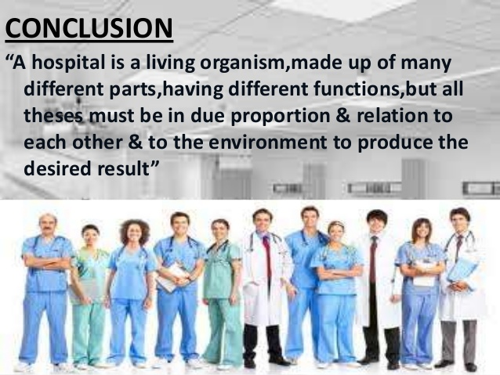
CONCLUSION

Slide 17
THANKYOU !

