Slide 1
Reactive programming
Overview http://reactivex.io/languages.html
ECMAScript Proposal

Slide 2
ReactiveX for javascript
ReactiveX combines the Observer pattern with the Iterator pattern and functional programming with collections to fill the need for an ideal way of managing sequences of events.
RXjs – think lodash for events
Purity, flow, values

Slide 3
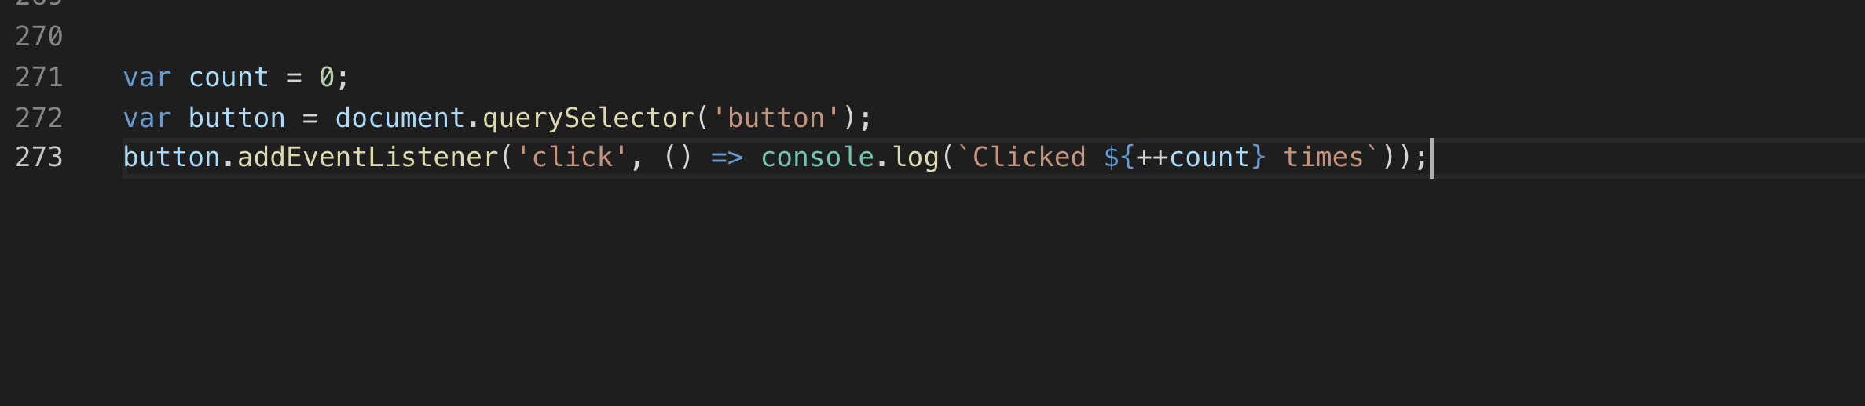
Purity
What makes RxJS powerful is its ability to produce values using pure functions. That means your code is less prone to errors.

Slide 4
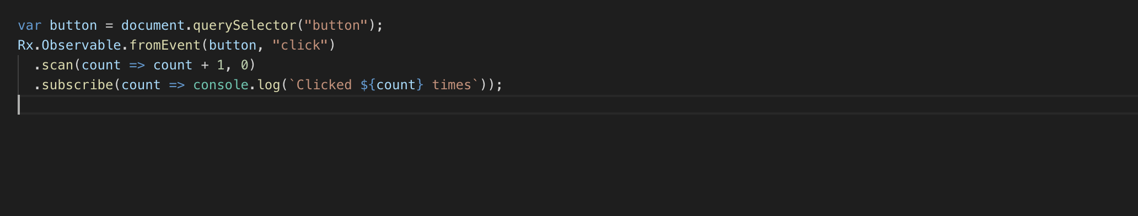
Using RxJS you isolate the state.

Slide 5
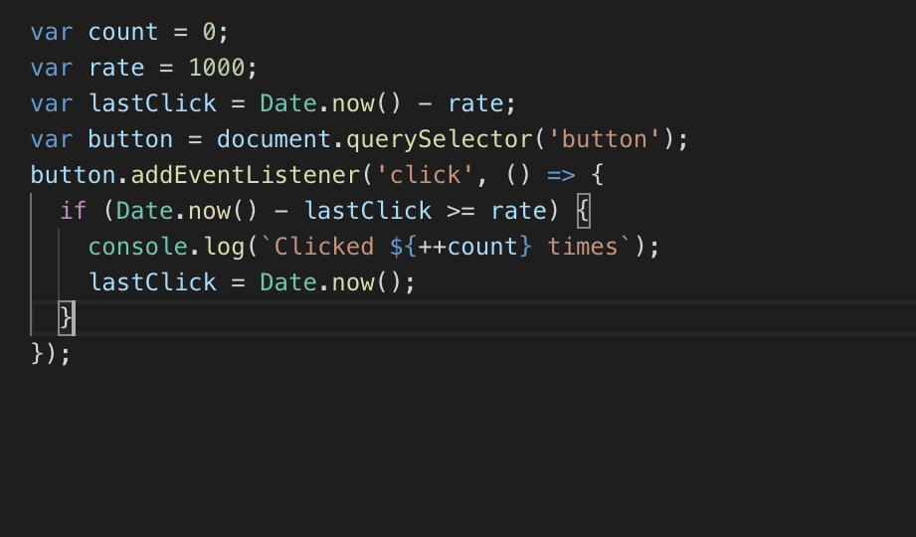
Flow
RxJS has a whole range of operators that helps you control how the events flow through your observables.

Slide 6
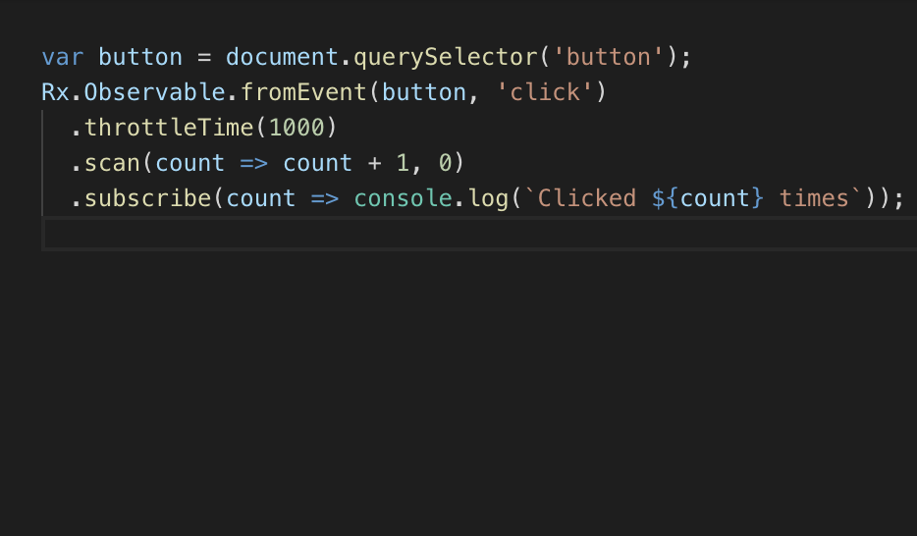
With RxJs
Other flow control operators are filter, delay, debounceTime, take, takeUntil, distinct, distinctUntilChanged etc.

Slide 7
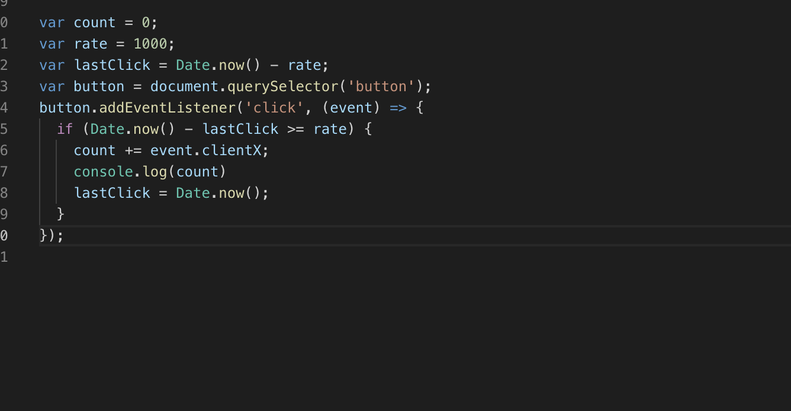
Values
you can transform the values passed through your observables.

Slide 8
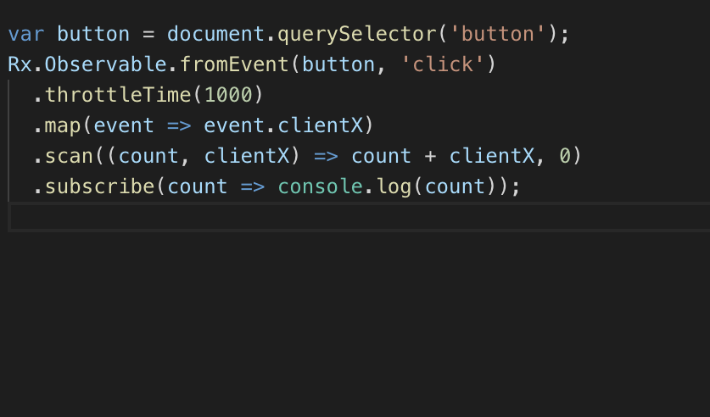
Rxjs
Other value producing operators are pluck, pairwise, sample etc.

Slide 9
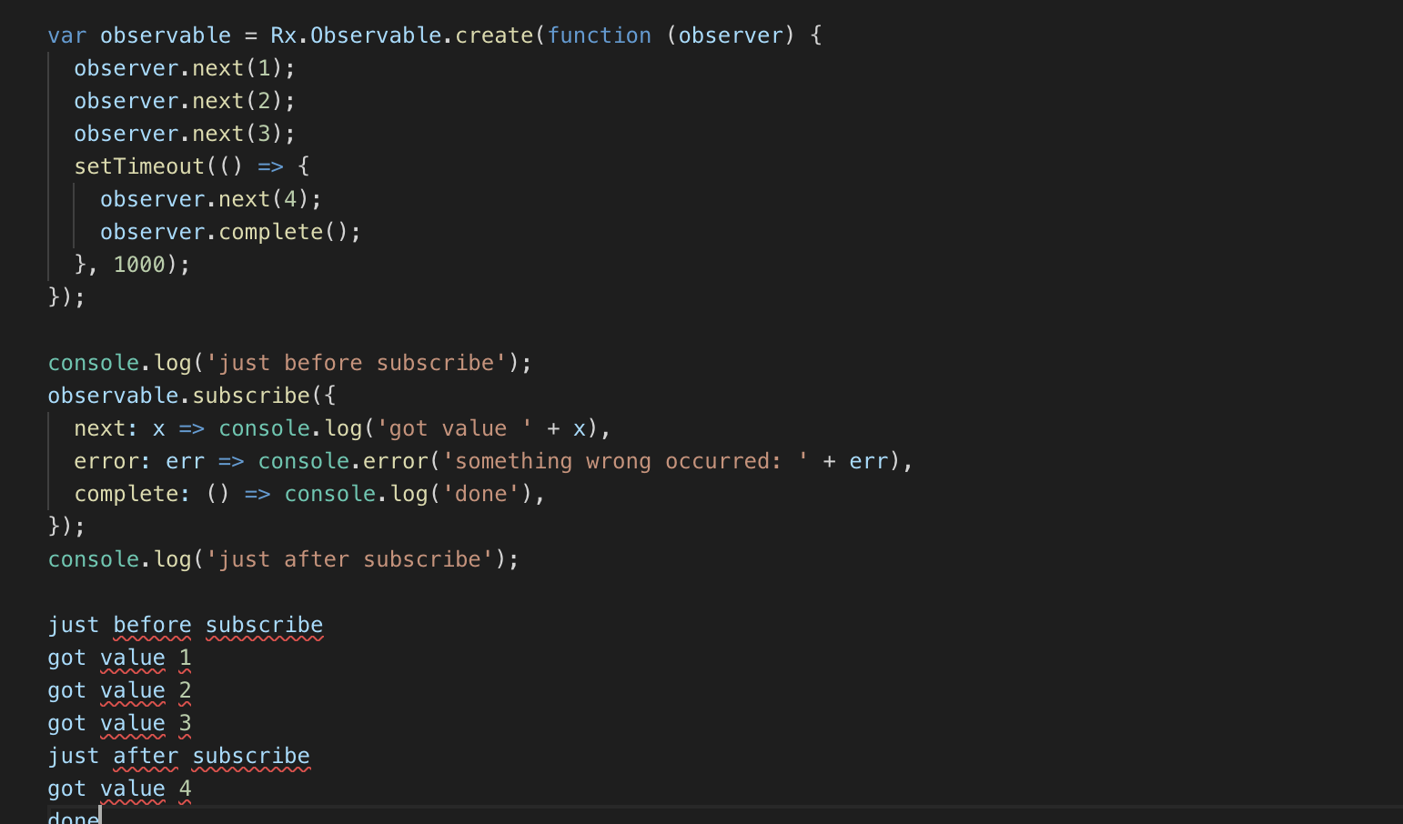
Observable
Observables are lazy Push collections of multiple values.
Unlike function they can produce multiple results.
To invoke the Observable and see these values, we need to subscribe to it
Pull(js func) and Push(promise) are two different protocols that describe how a data Producer can communicate with a data Consumer

Slide 10
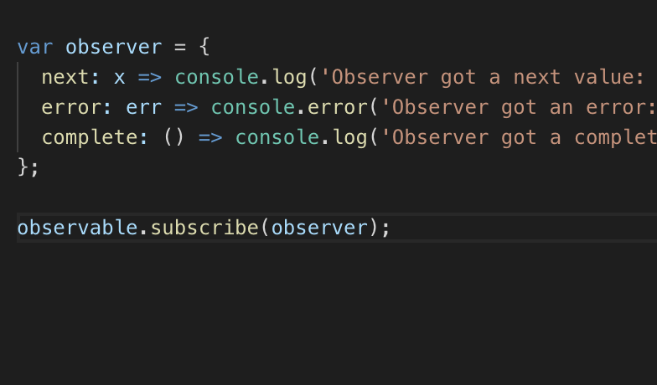
Observer
An Observer is a consumer of values delivered by an Observable.
Observers are just objects with three callbacks, one for each type of notification that an Observable may deliver.
One for each type of notification delivered by the Observable: next, error, and complete

Slide 11
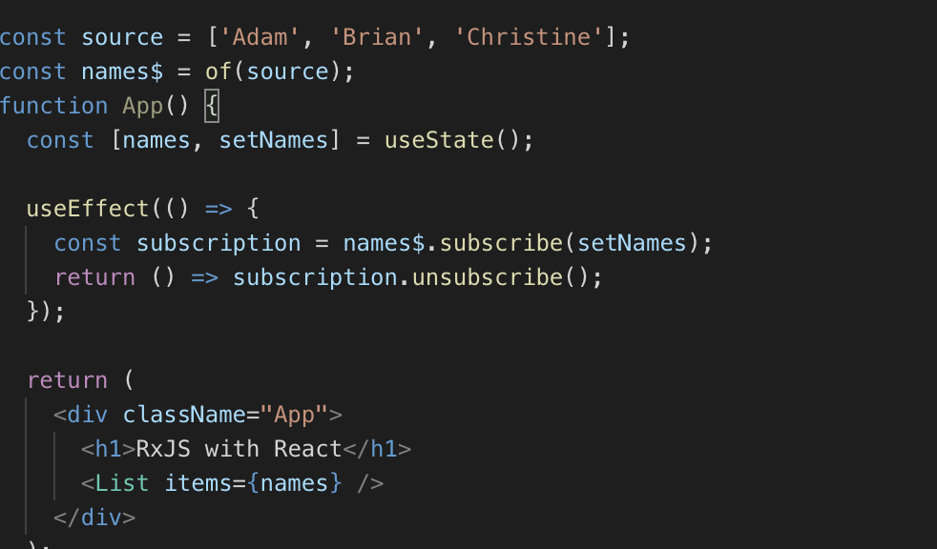
Subscription
A Subscription is an object that represents a disposable resource.
A Subscription essentially just has an unsubscribe() function to release resources or cancel Observable executions.

Slide 12
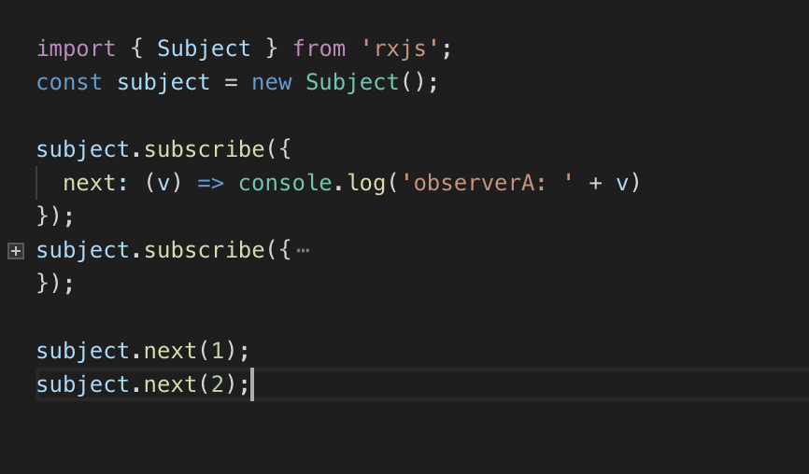
Subject
A Subject is like an Observable, but can multicast to many Observers. Subjects are like EventEmitters: they maintain a registry of many listeners.

Slide 13
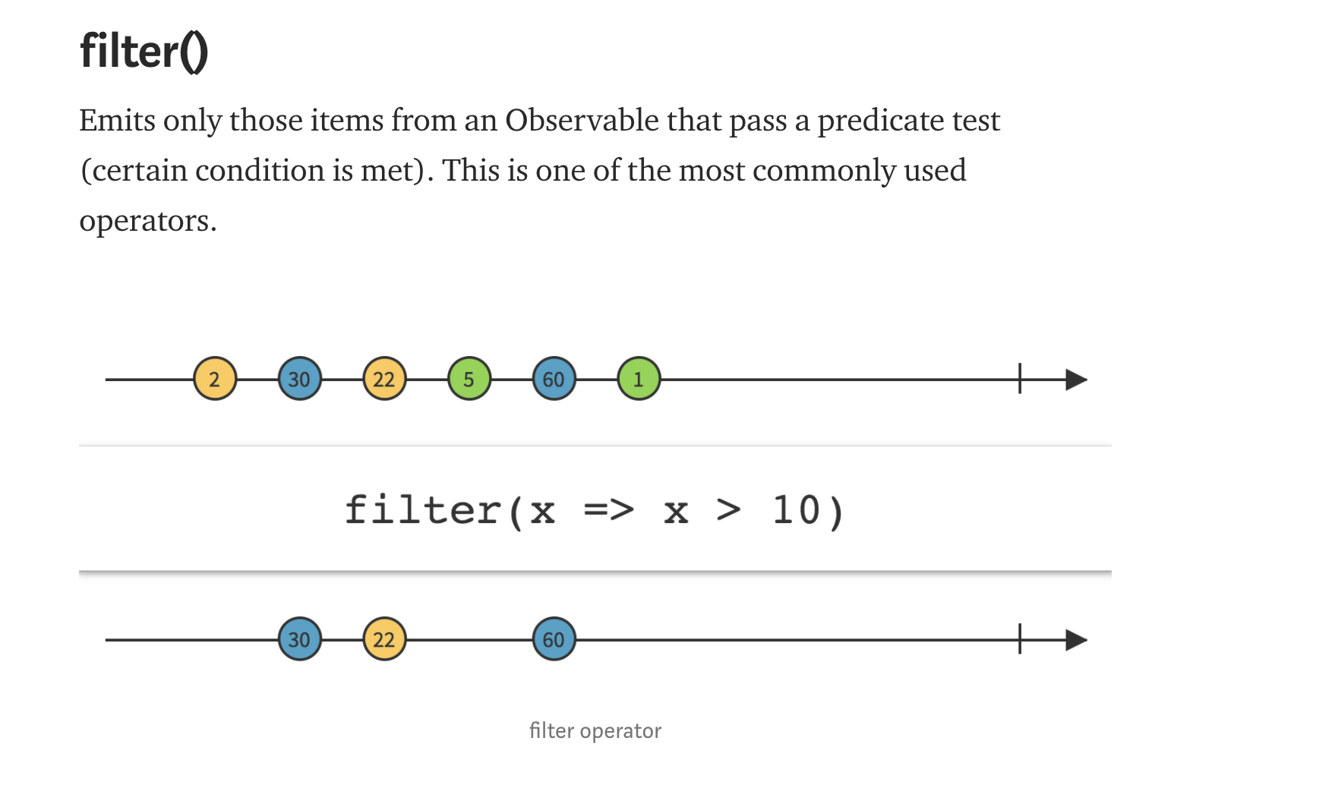
Operators https://medium.com/@jshvarts/read-marble-diagrams-like-a-pro-3d72934d3ef5
Marble Diagrams for Reactive Streams.
Common Operators: filter(), map() etc

Slide 14
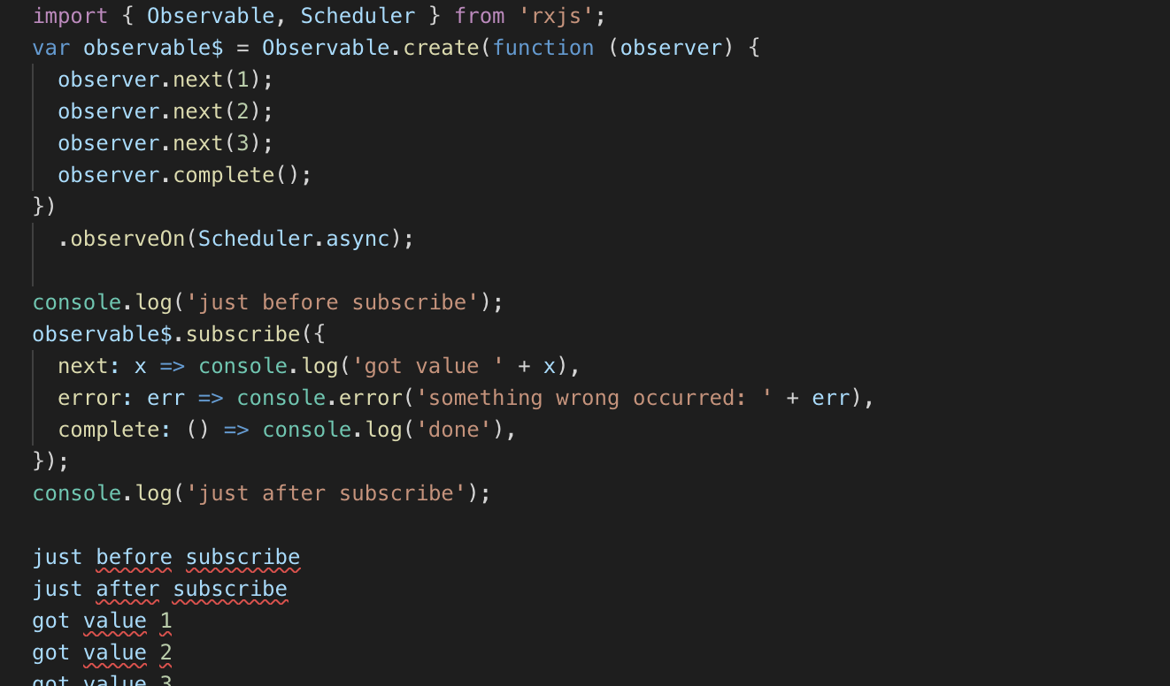
Scheduler
A Scheduler lets you define in what execution context will an Observable deliver notifications to its Observer.
Scheduler Types : null, queue, asap, async

Slide 15

End!
Questions ??????

Slide 16
Usefull Links
http://reactivex.io/rxjs/manual/overview.html
React app :https://github.com/farooqsah/rxjs_react_chat
Marble diagram : https://medium.com/@jshvarts/read-marble-diagrams-like-a-pro-3d72934d3ef5

