Slide 1
MACHINE LEARNING GRADUATION PROJECT
AutoWorth AI
Used Car Price Estimator & Smart Deal Advisor
Student: Mohamed Ahmed Farouk
Supervisor: Eng. Fayrouz Ahmed
Telecom Egypt (WE) — Artificial Intelligence Course
October 2026
0.968
£1,071
97k
Test R²
Test MAE
Cleaned listings

Slide 2
THE PROBLEM & SOLUTION
Is this asking price actually fair?
The Challenge
The Dual-Engine Solution
Used-car prices in the UK vary widely for near-identical cars.
Age, mileage, brand, engine and transmission all interact.
Buyers and sellers lack a quick, objective benchmark.
1
Fair-price prediction
Tuned XGBoost regressor estimates the market price.
2
Smart Deal classification
Compares the seller's price with the prediction and rates the deal.
AutoWorth AI | Mohamed Ahmed Farouk
2 / 10

Slide 3
DATA
Data Integration & Cleaning Pipeline
Source: Kaggle 100k UK Used Cars — 9 manufacturer files combined with a `make` column
99,187
97,050
2,137 rows removed
(1,475 exact duplicates)
→
Raw listings (9 files)
Clean listings
Issue | Action | Rows
Exact duplicate rows | Dropped | 1,475
Anomalous years (e.g. 2060, 1970); kept 1995–2020 | Dropped | 3
Engine size = 0.0 (missing data encoded as zero) | Dropped | 267
Price outside £1k–£80k · rare fuel/transmission · mileage outliers | Dropped | 122 · 257 · 13
MPG > 120 (optimistic hybrid figures) | Capped at 120 | 503
AutoWorth AI | Mohamed Ahmed Farouk
3 / 10

Slide 4
EDA
Exploratory Data Analysis — Key Insights
Right-skewed prices
Non-linear mileage decay
Most cars sit below £25k; a long tail of premium cars would distort non-robust metrics.
Price drops steeply in the first miles, then flattens. Correlation with mileage: −0.43.
German luxury premium
Automatic premium
Mercedes, BMW and Audi top the median price by make — brand acts as a price tier.
Automatic and semi-auto listings sit well above manual in price.
AutoWorth AI | Mohamed Ahmed Farouk
4 / 10

Slide 5
METHODOLOGY
Leakage Prevention & Feature Engineering
Split BEFORE any preprocessing — scalers and encoders are fit on the training set only.
70%
15%
15%
Train · 67,935
Validation · 14,557
Test · 14,558 (untouched)
4 domain features
car_age
mileage_per_year
2020 − year
mileage / max(car_age, 1)
is_premium
engine_efficiency
1 if Audi, BMW or Mercedes
mpg / engineSize
AutoWorth AI | Mohamed Ahmed Farouk
5 / 10

Slide 6
MODELLING
Model Benchmarking (Validation Set)
Model | Val R² | Val MAE | Val RMSE | Overfit gap (R²)
Random Forest | 0.9611 | £1,174.90 | £1,847.52 | 0.0209
Baseline XGBoost | 0.9540 | £1,345.04 | £2,008.98 | 0.0081
Decision Tree | 0.9401 | £1,404.99 | £2,291.93 | 0.0235
Gradient Boosting | 0.8951 | £2,124.89 | £3,032.69 | 0.0062
Linear Regression | 0.8870 | £2,099.08 | £3,147.67 | 0.0069
Tree ensembles beat linear models because price depends on interactions (e.g. mileage hurts an old premium car more). Random Forest led before tuning; boosted trees were chosen for tuning.
AutoWorth AI | Mohamed Ahmed Farouk
6 / 10

Slide 7
MODELLING
Model Optimization & Tuning
Stage | R² | MAE | RMSE
Baseline (Val) | 0.9540 | £1,345 | £2,009
Tuned (Val) | 0.9669 | £1,083 | £1,703
Tuned (Test) | 0.968 | £1,071 | £1,654
RandomizedSearchCV — XGBoost
n_estimators = 300
max_depth = 10
learning_rate = 0.1
subsample = 0.9
colsample_bytree = 0.8
min_child_weight = 5
10 candidates × 3-fold CV (30 fits)
Tuning cut validation MAE by about £262.
Final held-out Test: R² 0.968 · MAE £1,070.87 · RMSE £1,654.05
Train–test gap is small, so the model generalises.
AutoWorth AI | Mohamed Ahmed Farouk
7 / 10

Slide 8
INTERPRETATION
Explainability & Residual Diagnostics
Top feature importances
Residual trend
1. Transmission (manual)
2. is_premium
3. Engine size
4. Engine efficiency
5. Car age / year
Specific models (e.g. X7, i8) and brands follow — matching the EDA.
Actual-vs-predicted points hug the diagonal. Errors fan out at high prices — expensive cars are harder to price.
Largest misses: high-performance trims
BMW M4 (2016): actual £76,990 vs predicted £36,079
Audi A8 (2020): actual £78,990 vs predicted £53,467
The `model` column cannot capture trims such as AMG or M Sport.
AutoWorth AI | Mohamed Ahmed Farouk
8 / 10

Slide 9
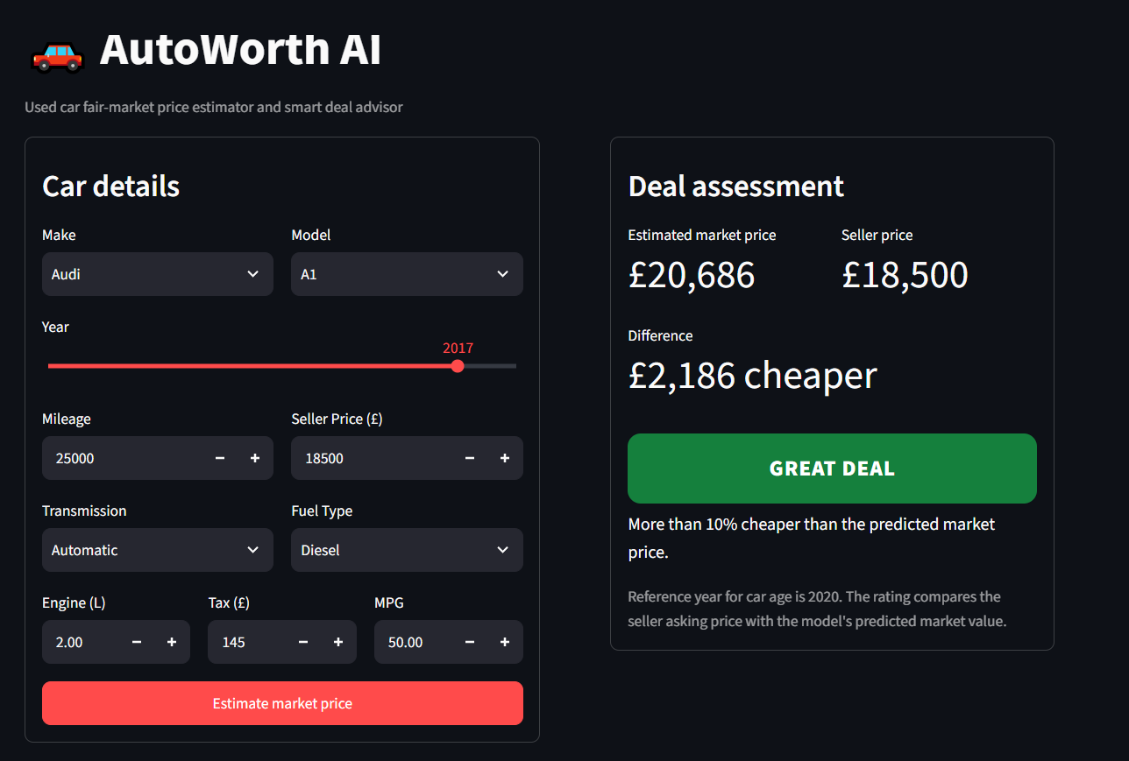
DEPLOYMENT
Productization & Smart Deal Advisor
Streamlit web app: enter car details + seller price, get instant verdict
Rating | Rule (seller vs predicted)
Great Deal | More than 10% cheaper
Good Deal | 5–10% cheaper
Fair Price | Within ±5%
Slightly Overpriced | 5–10% more expensive
Overpriced | More than 10% above
Live app: Audi A1 (2017) at £18,500 vs £20,686 estimated → Great Deal
LIVE DEMO
https://autoworth-ml.streamlit.app/
AutoWorth AI | Mohamed Ahmed Farouk
9 / 10

Slide 10
WRAP-UP
Conclusion, Business Impact & Next Steps
Robust pipeline
Business impact
Next steps
Leakage-safe split
Documented cleaning
Test R² 0.968, MAE £1,070.87
Small train–test gap
Buyers: spot bargains and avoid overpaying
Sellers: price listings competitively
Instant, objective verdicts
Parse trims (AMG, M Sport) to fix high-end misses
Add location data
Retrain on fresh listings
AutoWorth AI | Mohamed Ahmed Farouk
10 / 10

