Slide 1

Project Proposal Helping the environment
Prepared For :Nayef Abu-Ageel
Prepared by :Farouq Hassan

Slide 2

Table of Contents
The Problem
The Solution
Goals and Benefits
Deliverables and Success Criteria
Project Management Strategy
Budget
Requirements
Timeline
Conclusion

Slide 3

The Problem
"Our organization's carbon footprint is significantly contributing to environmental degradation, and it increases waste and costs, This problem affects all stakeholders, including employees, customers, and the planet, and if left unaddressed, it could lead to increased regulatory penalties, reputational damage, and higher expenses."

Slide 4

The Solution
implementing a recycling program and inventory system for recycled devices and including increasing employee participation in recycling programs, by providing training sessions for employees on recycling and reducing carbon footprint.

Slide 5

Goals and Benefits
The Goals
Reduce carbon footprint
Increase recycling of devices
Implement a inventory system for recycle program and tracking recycled devices and parts
Provide training sessions for employees on recycling and reducing the carbon footprint
The Benefits
Decrease environmental impact and meet sustainability goals
Save cost by purchasing refurbishment devices
Promote environmental consciousness among employees

Slide 6
Deliverables and Success Criteria
Carbon Footprint Reduction Plan: Due date: Month / Criteria for acceptance: Reduction in overall carbon footprint by a specified percentage.
Recycling Program Implementation: Due date: Month 2 / Criteria for acceptance: Increase in the percentage of devices recycled or repaired, and percentage of employees participating in a recycling program.
Inventory System for Recycled Devices and Parts: Due date: Month 3 / Criteria for acceptance: Accuracy and completeness of inventory data.
Employee Training Sessions: Due date: Month 4 / Criteria for acceptance: Number of employees trained, and satisfaction survey results.
Recycling Program Evaluation: Due date: Month 6 / Criteria for acceptance: Metrics meeting or exceeding established targets.

Slide 7
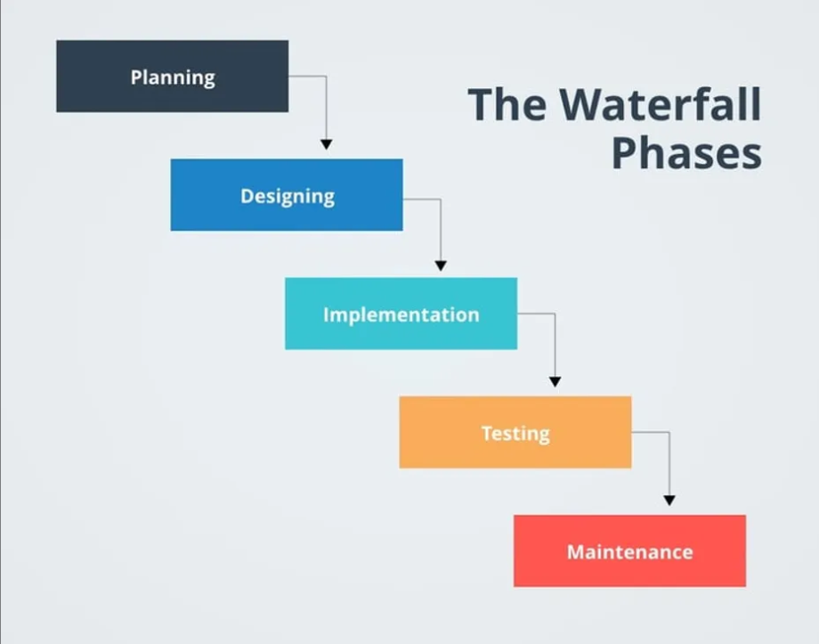
Project Management Strategy (Waterfall)
This method is well-suited for projects with well-defined, fixed requirements and clear deliverables.
This approach will allow us to clearly define and plan each step of the project, ensuring it stays on schedule and within budget
It will provide clear acceptance criteria and allow us to effectively track and measure progress throughout the project.

Slide 8
Budget
Project Management 36250/24%
Software Development 48660/32%
Environmental Project Development 16770/11%
Testing and Quality Assurance 0 7560/5%
Training and Support
12520/8%
Reserves
30000/20%
Total Project Cost Estimate 151760

Slide 9
Requirements
Human resources
Software
Equipment
Special location
Additional resources

Slide 10
Timeline
25 Jan.
Design 25/1 Milestone 1
3 Mar.
Coding
Milestone 2
20 Mar.
Testing (piloting)
12 Apr.
Licensed software
19 Apr.
Deployment (all employees) Milestone 3
30 May
Develop a system for tracking devices and parts for recycling
Milestone 4
1 June
Implementation of the recycling program and tracking system
Milestone 5
8 June
Develop training materials
19 June
Trainees' and preparation Milestone 6

Slide 11

Conclusion

Slide 12

Thank you for paying attention

